Slide 1
What you need to design a detector: Principle of Field Calculation and Pulse Shape Simulation
Jing Liu
Kavli IPMU, University of Tokyo
8 Apr. 2013, Tuebingen
Notes:
The working principle of a germanium detector system is well known and formulated. It can be fully simulated. No need to consider how to cool it down. Zero background, electronic noise and infinite band width can be easily achieved. Don’t do real experiment, just simulation. You will be very happy. Guaranteed!

Slide 2
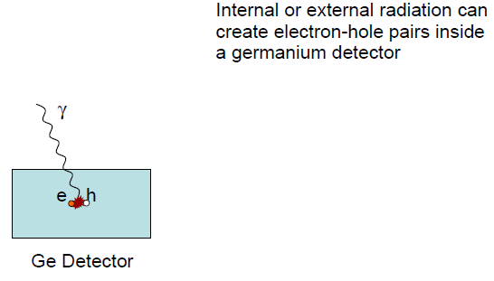
Geant4
Please refer to Xiang’s talk

Slide 3
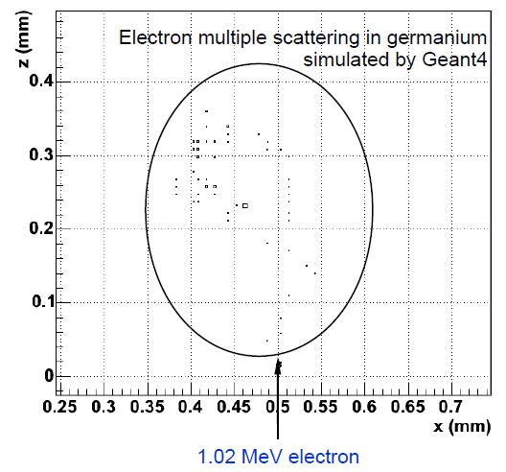
Spatial resolution

Slide 4
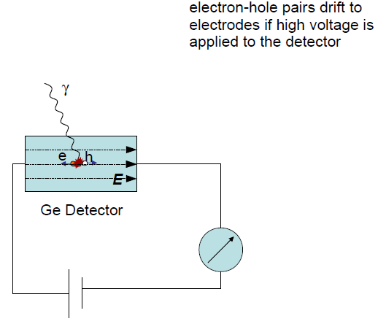
Static electric field

Slide 5
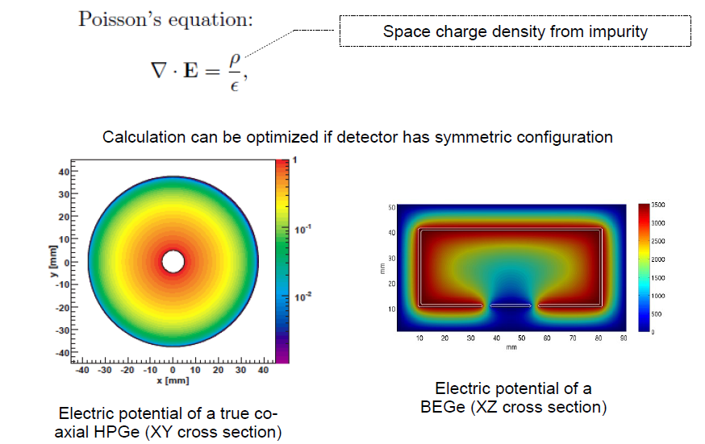
Poisson’s equation
Please refer to Burcin’ talk

Slide 6
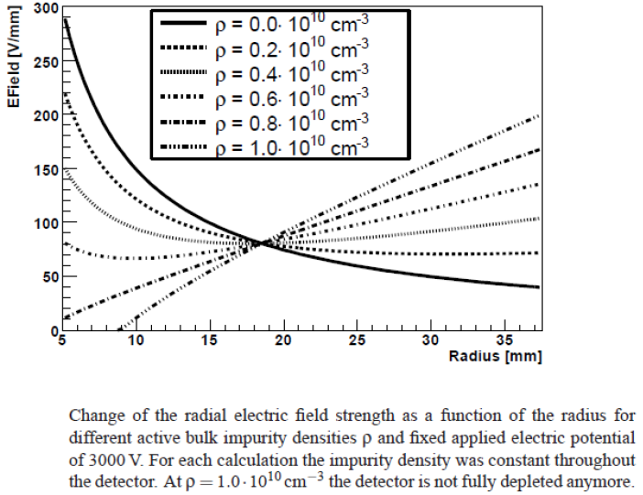
Impurity
Please refer to Iris’s talk

Slide 7
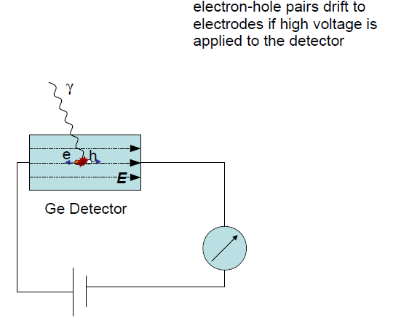
Drift of charge carriers

Slide 8
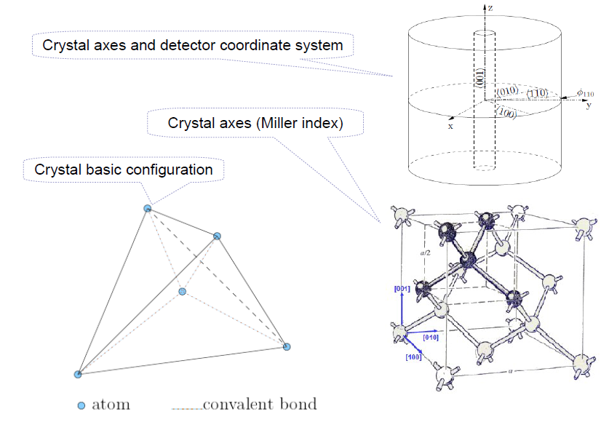
Crystal structure

Slide 9
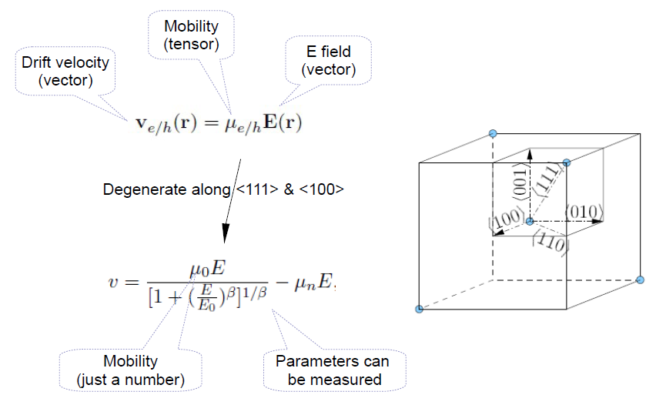
Drift velocity

Slide 10
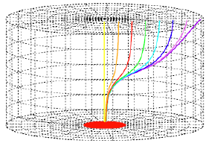
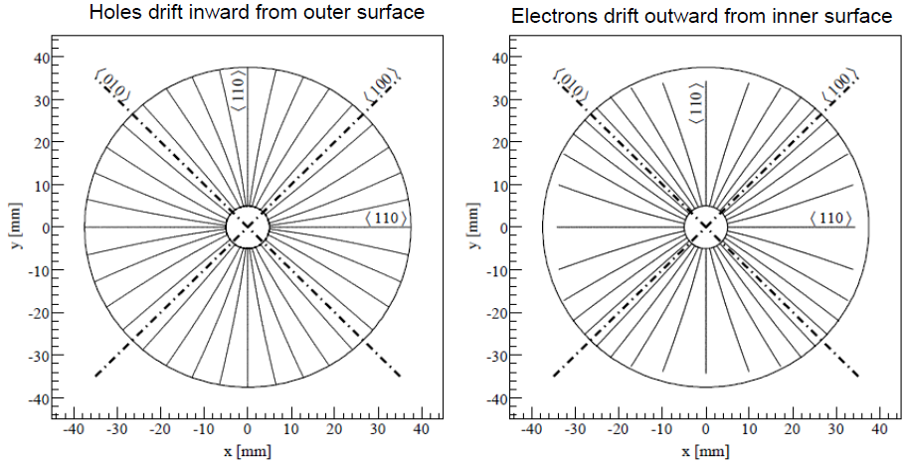
Drift trajectory

Slide 11
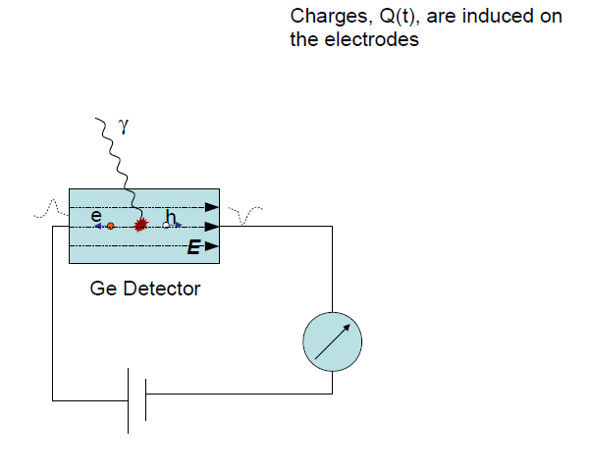
Pulses

Slide 12
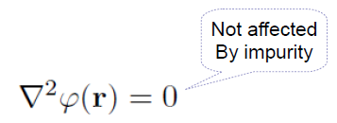
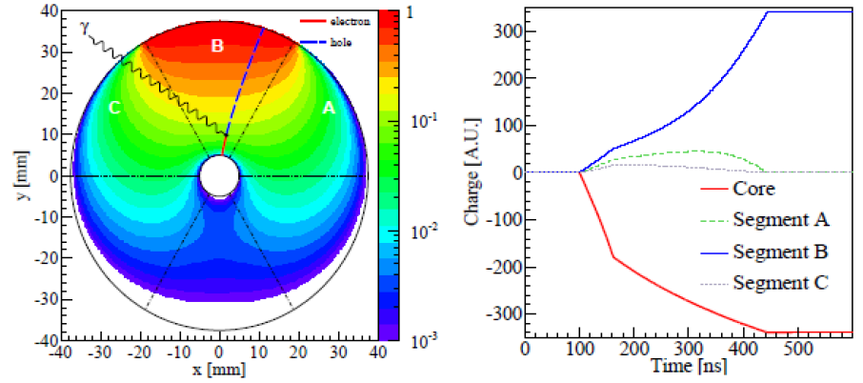
Ramo’s theory
Induced charge is proportional to the Weighting Potential seen by charge carriers along their trajectories
Weighting potential equals unity on the considered electrode and zero on all other electrodes

Slide 13
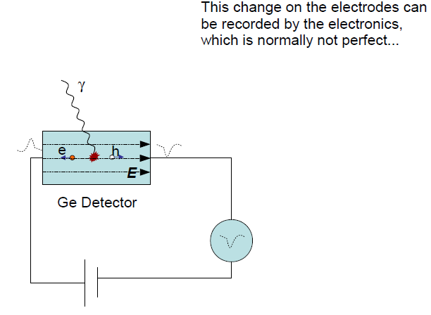
Electronic effects

Slide 14
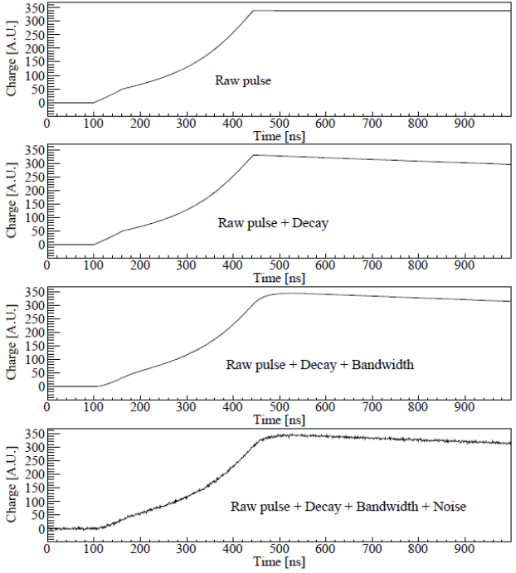

Slide 15
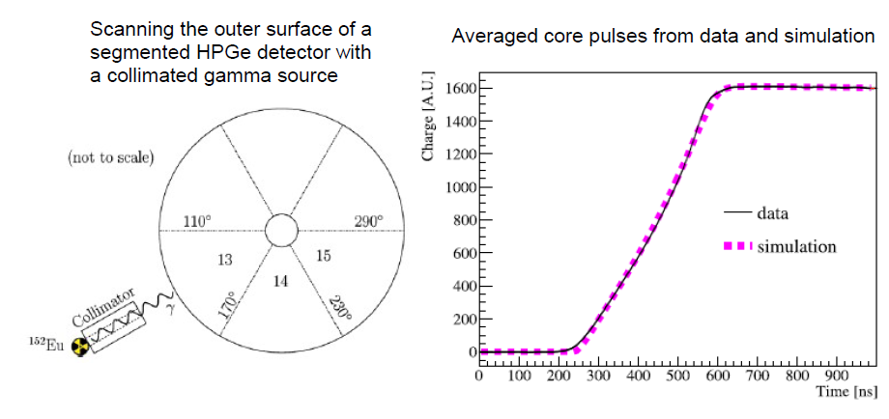
Verification

Slide 16
Input parameters
Discrepancy between data and simulation is mainly caused by input parameters
Geometry and material
Impurity
Mobility along 100 and 111
Modeling of electronics
It is possible to establish a good simulation package, but it takes time

Slide 17
applications

Slide 18
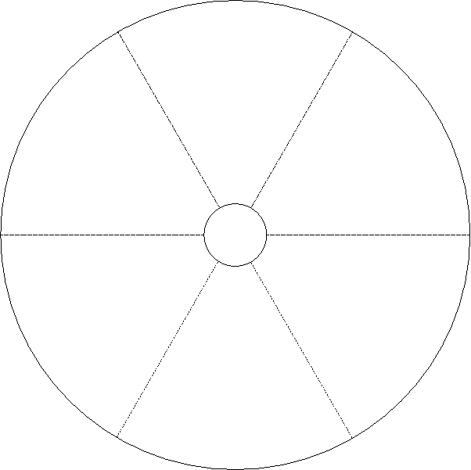
Determine crystal orientation
Number of pulses recorded in segments should be different even if hits are homogeneously distributed:

Slide 19
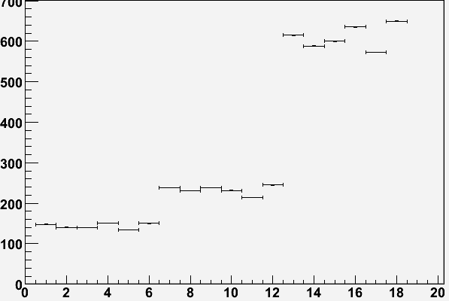
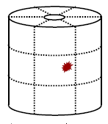
Experiment
⁶⁰Co
10cm
Vacuum can
Top layer
Ge
Number of recorded pulses
Middle layer
Bottom layer
Segment ID

Slide 20
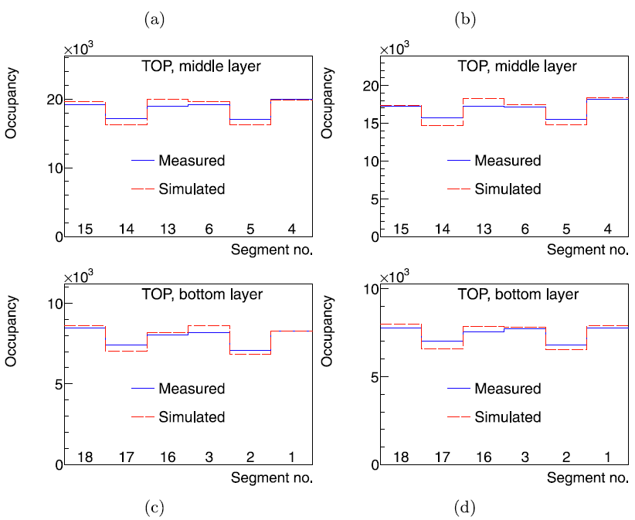
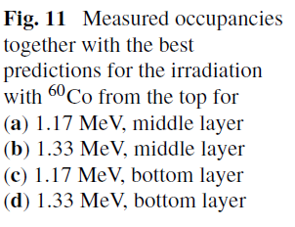
Result

Slide 21
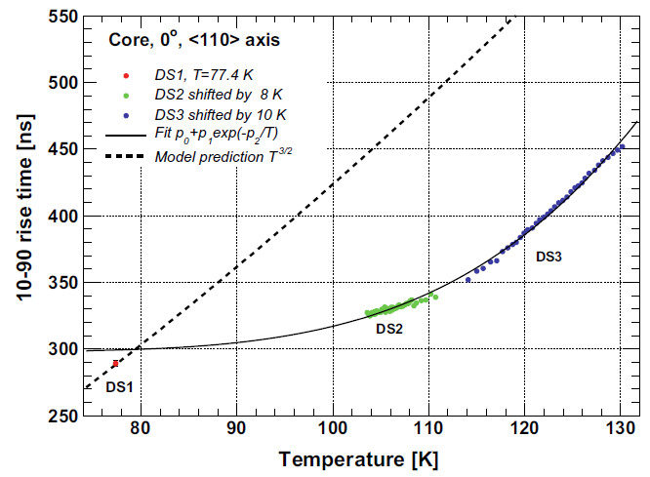
Determine rise time
Noise of a real pulse prevent precise measurement of the rise time.
This can be overcome if a simulated pulse is fitted to a real one with its time scale as a free parameter, since all information is used:
Good fit
Bad fit

Slide 22
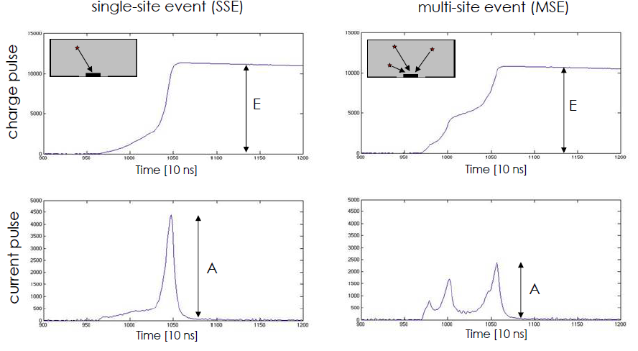
Develop event selection method

Slide 23
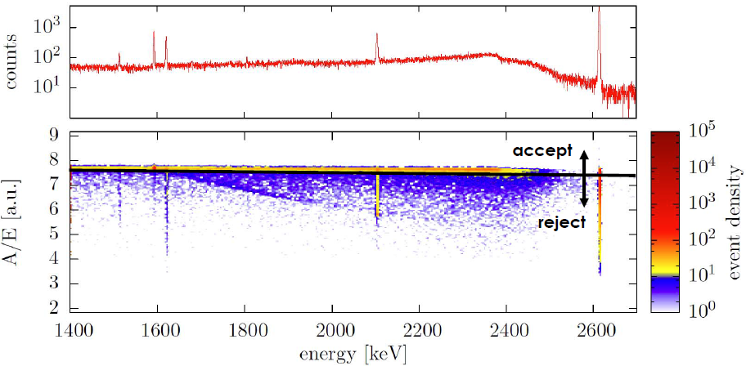
Estimate efficiency
²²⁸Th with BEGe

Slide 24
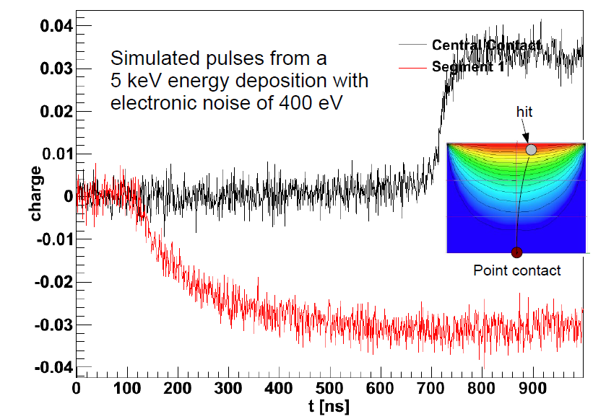
New design
Please refer to David and Burcin’s talks

Slide 25
Summary
Simulation processes
Geant4 simulation
Field calculation
Drift calculation
Weighting field
Electronics effect
Verification
Compare to dedicated measurement
Tune input parameters
Applications
Determine crystal orientation
Determine rise time
Investigate event selection method and estimate its efficiency
Design new detectors
Many more…

