Slide 1
The Liquid Argon Test Facility in THU
Development of High Purity Germanium Detector Techniques
for Applications in Fundamental Research
Qinghao Chen
Tsinghua Univ.
CDEX collaboration
@Universitaet Tuebingen
April 9, 2013

Slide 2
Outline
1
Liquid Argon Detector in CDEX
2
Liquid Argon Test Facility
3
Preliminary experimental results
4
Future Work

Slide 3
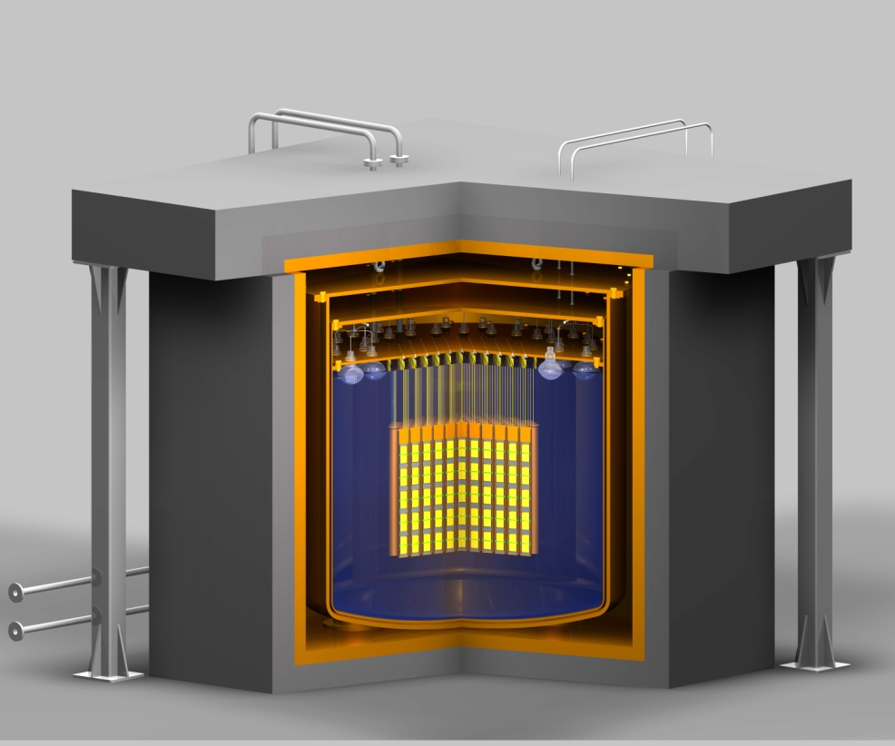
CDEX
CDEX（China Dark matter EXperiment）
ton-scale LAr as anti-Compton detector of ULE HPGe array in WIMPs direct detection @ CJPL

Slide 4
The function of liquid argon
Keep Ge in a low temperature
Anti-Compton
Passive shielding

Slide 5
Advantages of LAr Detector
Good stopping power
High scintillation yield (40000photons/MeV)
Excellent particle identification capability
transparent to their own scintillation light

Slide 6
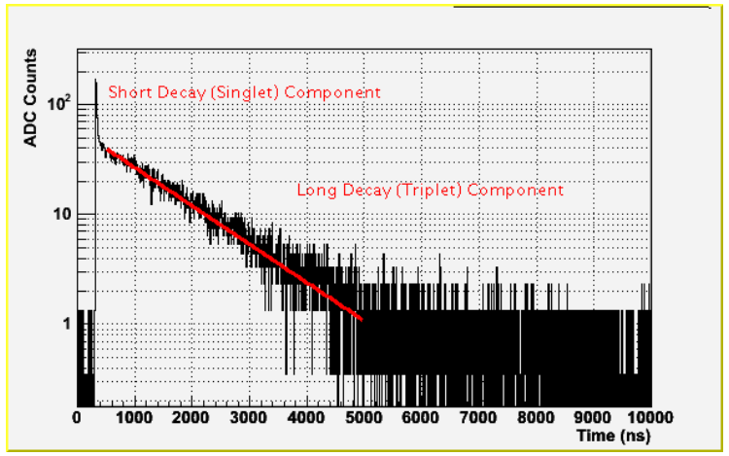
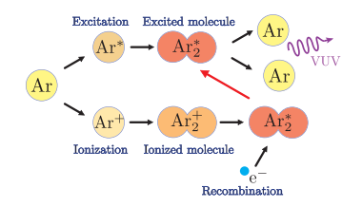




scintillation light of Ar
three nearly degenerate spin states
Fast component: 4ns ~ 7ns
（1）Excitation -> decay
（2）Ionization
-> neutralized by
thermalized electrons
-> decay
Slow component:
1100ns ~ 1600ns

Slide 7
What’s more
Purification of Ar
The detection of EUV photons
  Wavelength shifter(WLS):TPB(tetraphenyl butadiene)

Slide 8
Outline
1
Liquid Argon Detector in CDEX
2
Liquid Argon Test Facility
3
Preliminary experimental results
4
Future Work

Slide 9
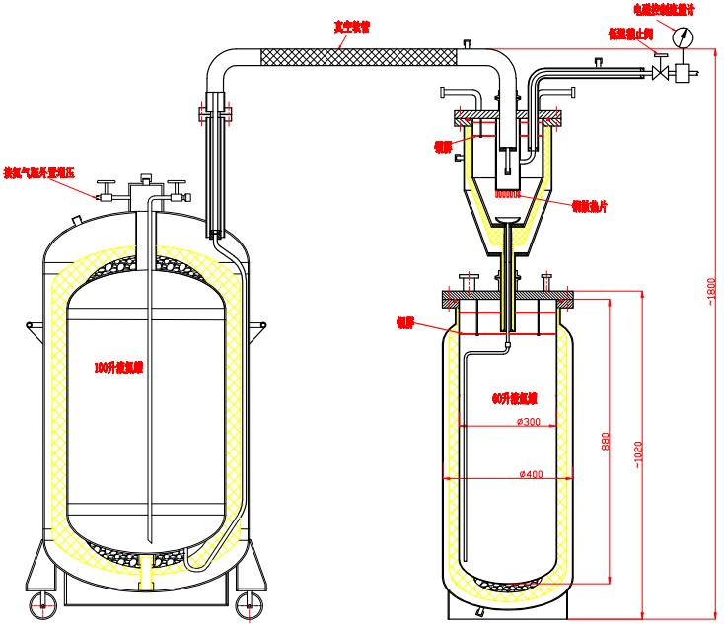
The Liquid Nitrogen Cooling System
Liquid Nitrogen
LAr & GAr

Slide 10
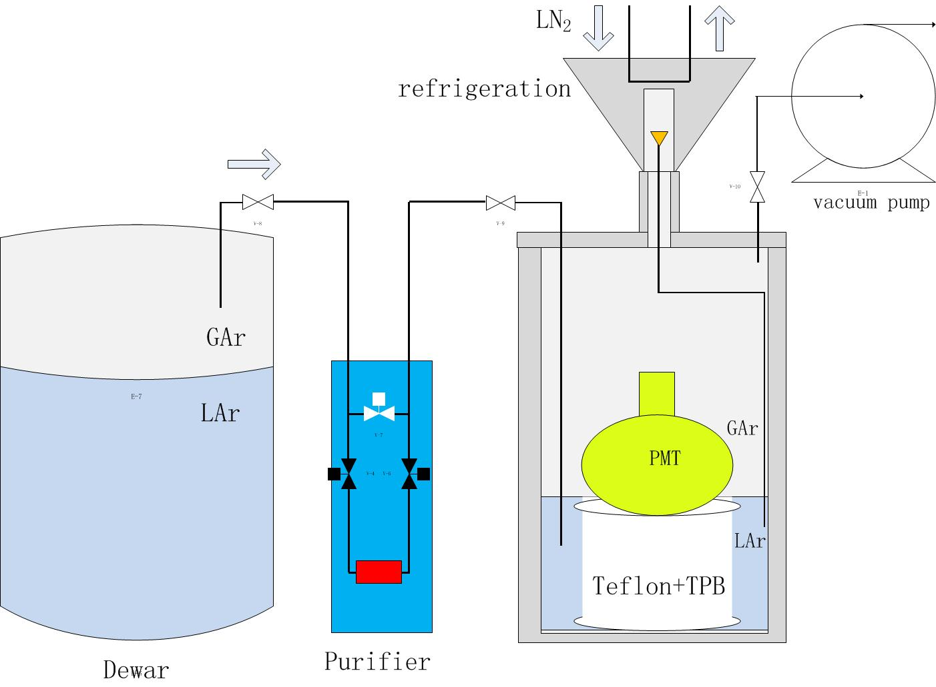
LAr System

Slide 11
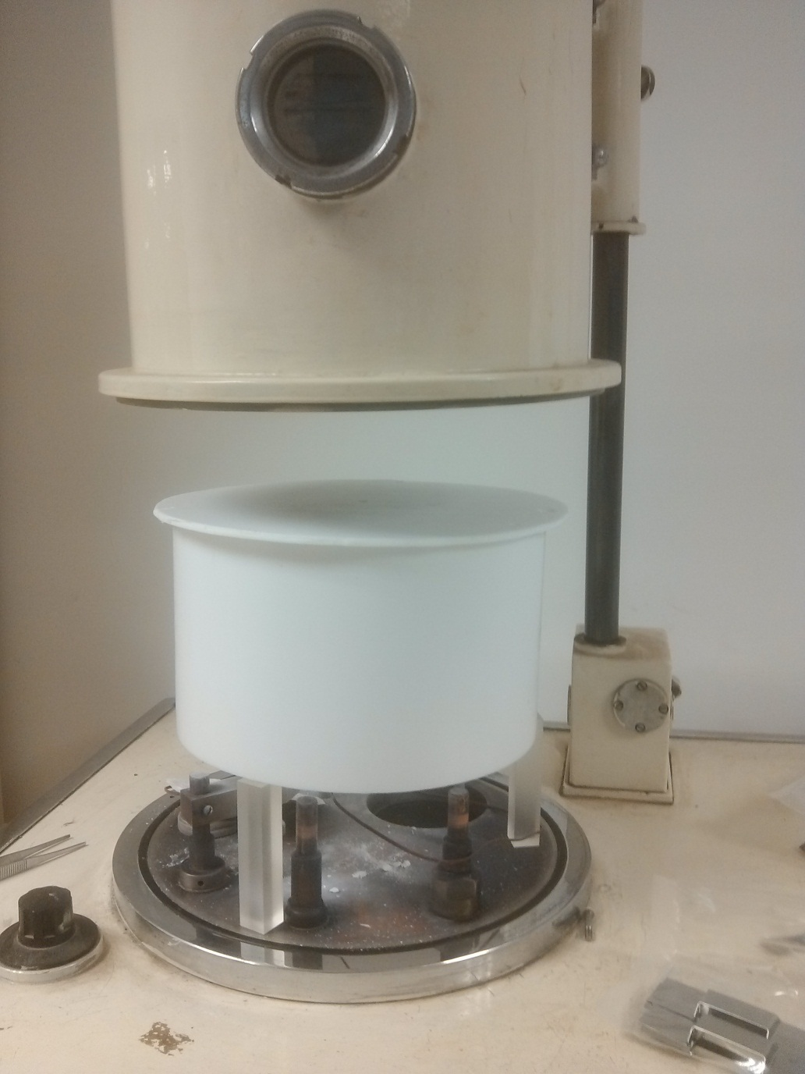
TPB evaporation system
Teflon
Teflon cylinder

Slide 12
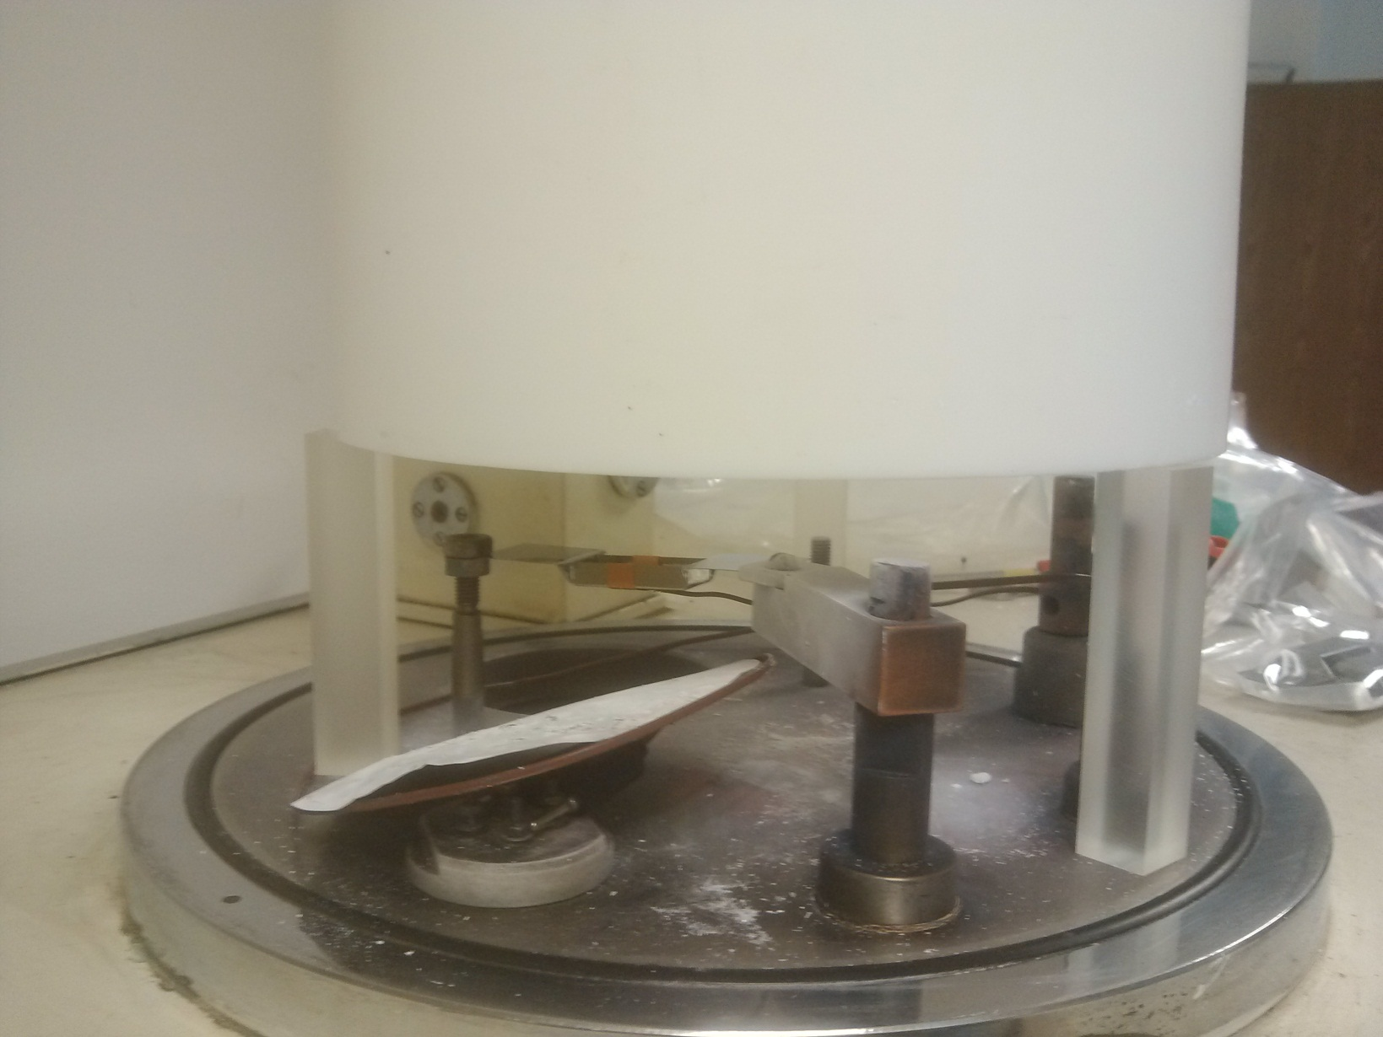
TPB evaporation system
TPB

Slide 13
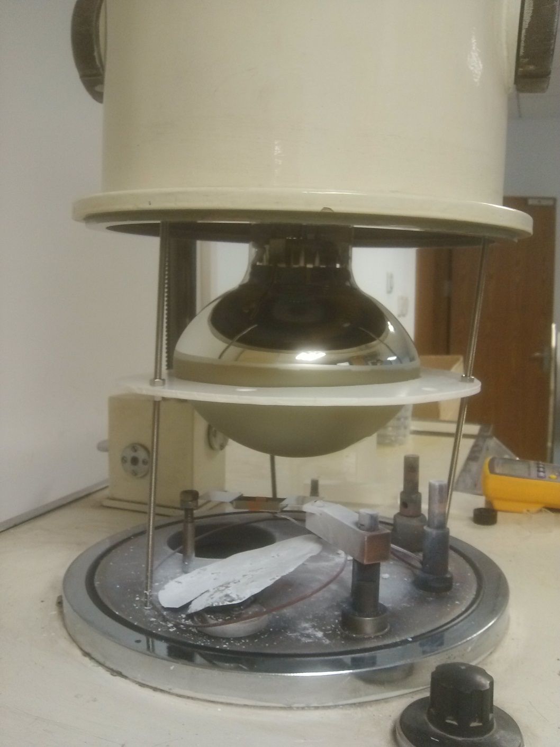
TPB evaporation system
PMT
Teflon

Slide 14
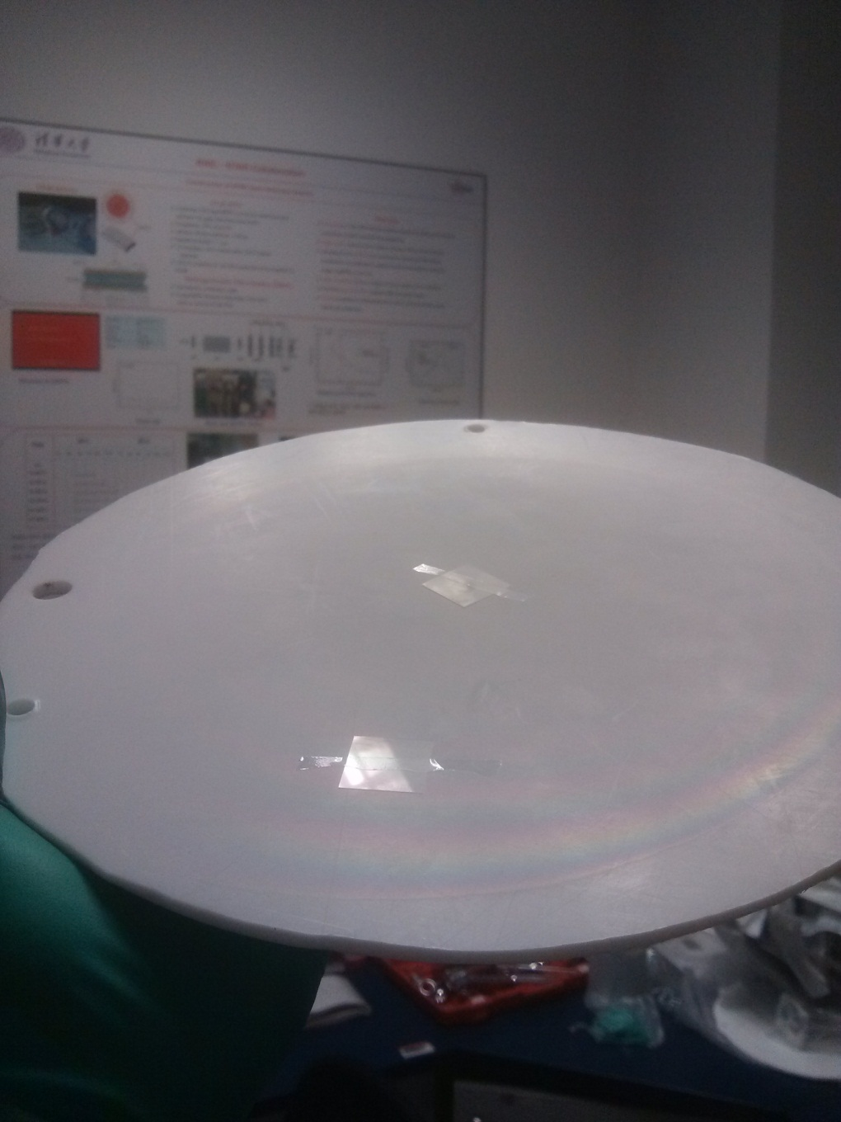
TPB Coating
Small glass pieces

Slide 15
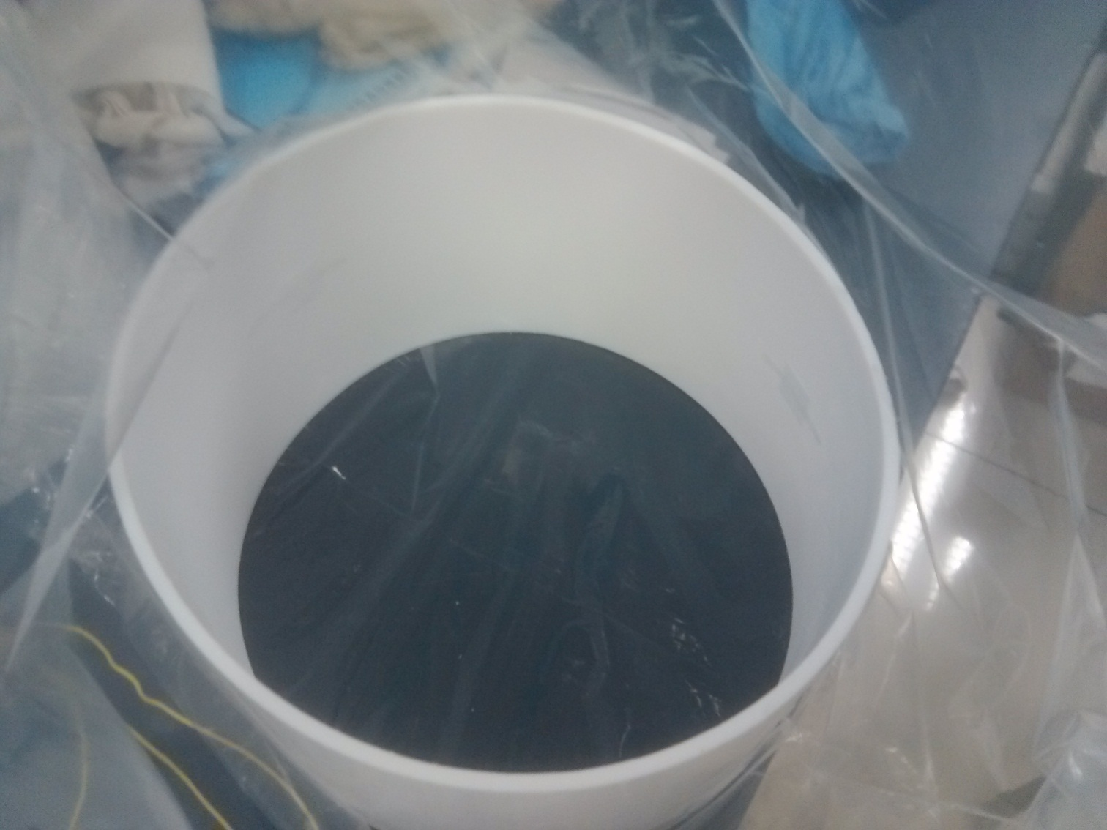
TPB Coating
Small glass pieces

Slide 16
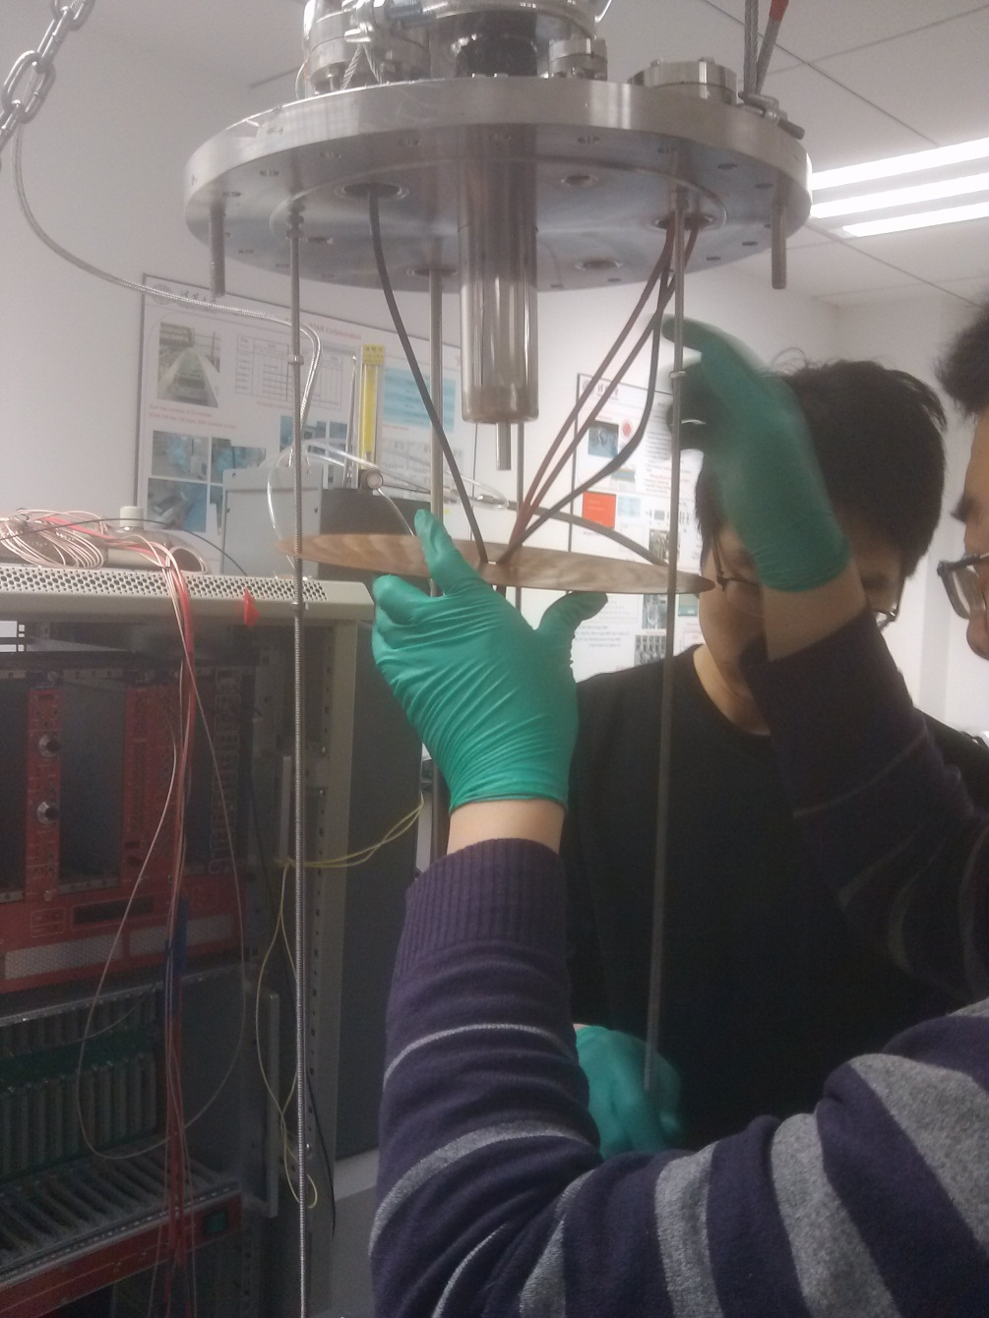
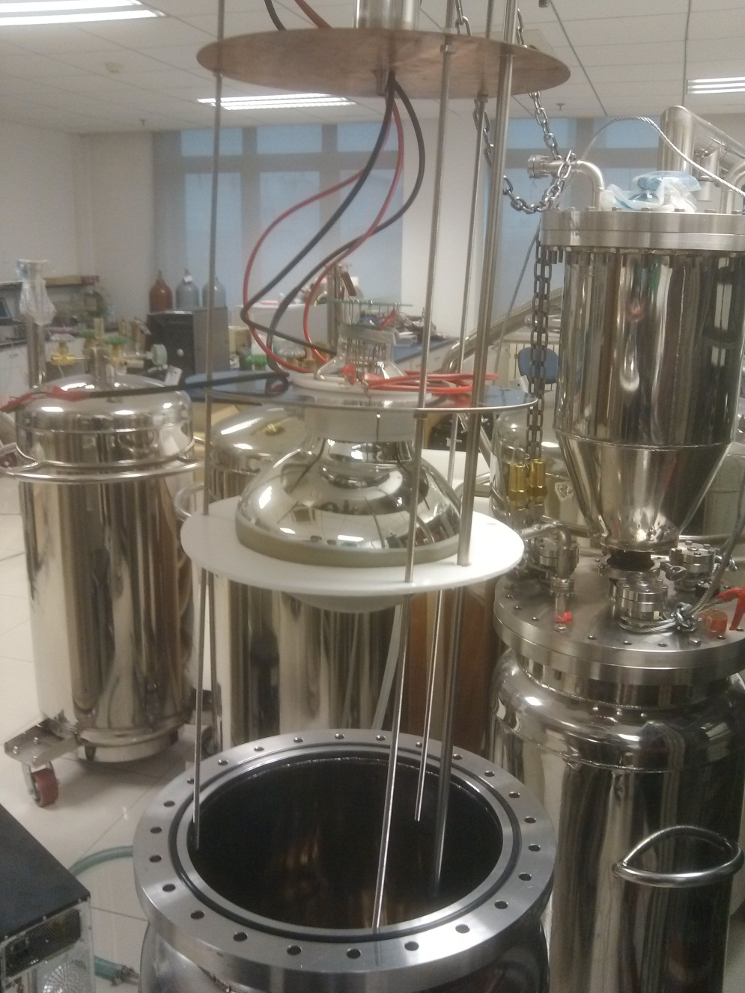
System Installation

Slide 17
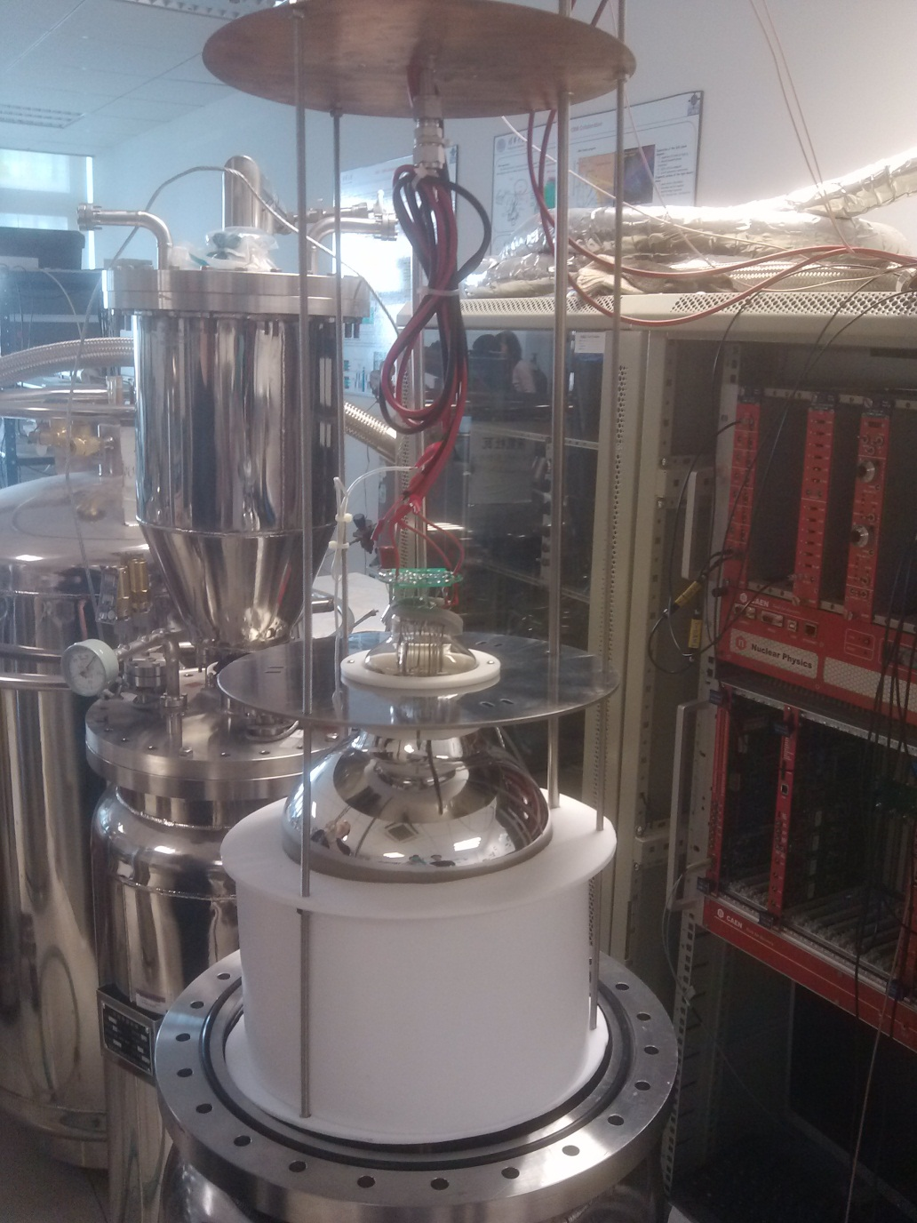
System Installation

Slide 18
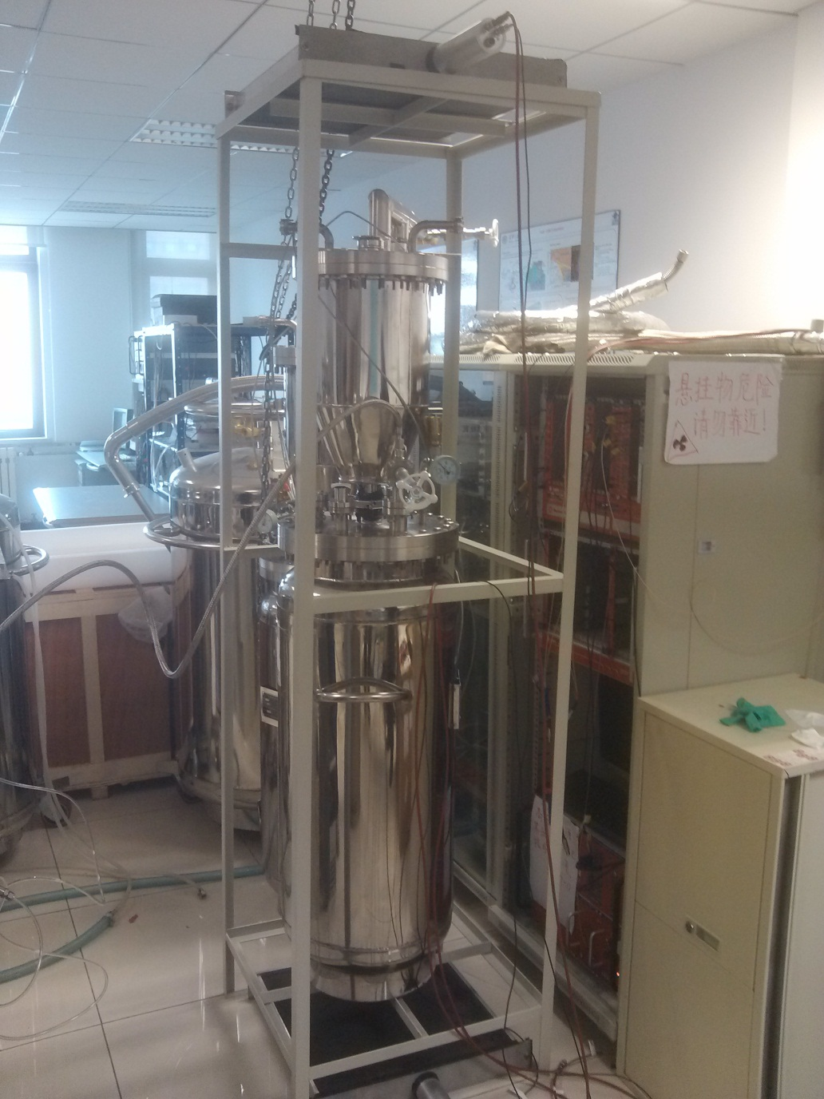
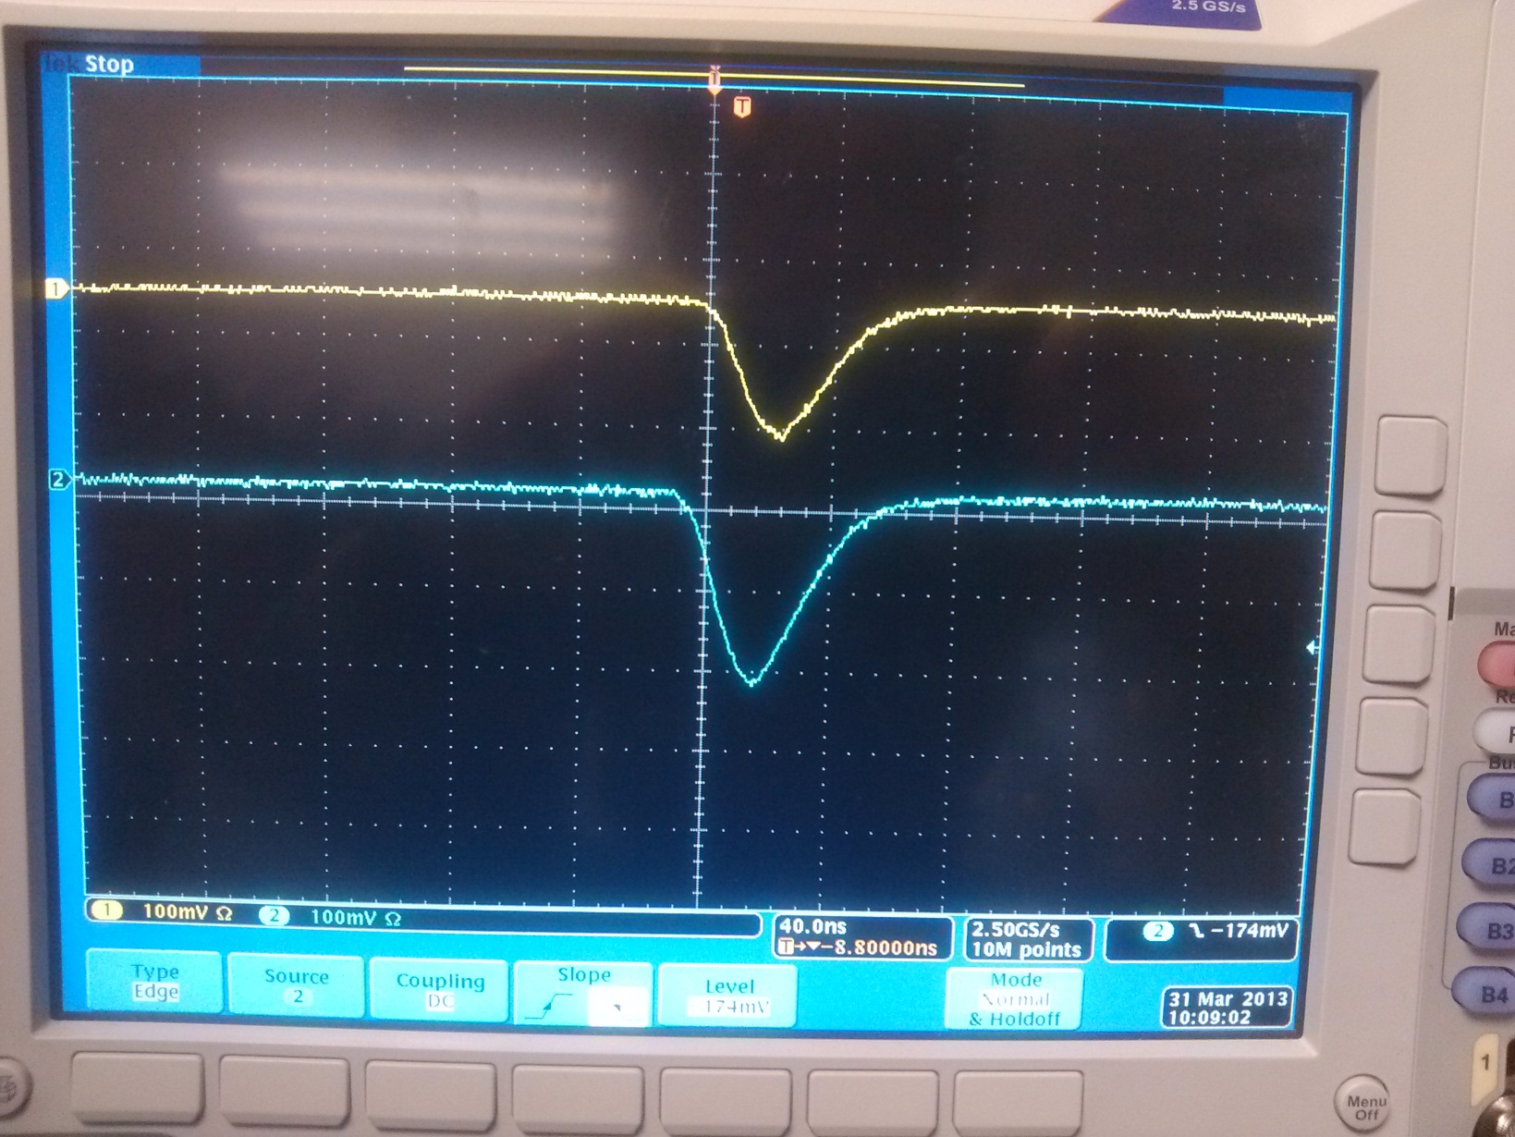
System Installation
Plastic scintillator ：
to tag cosmic rays

Slide 19
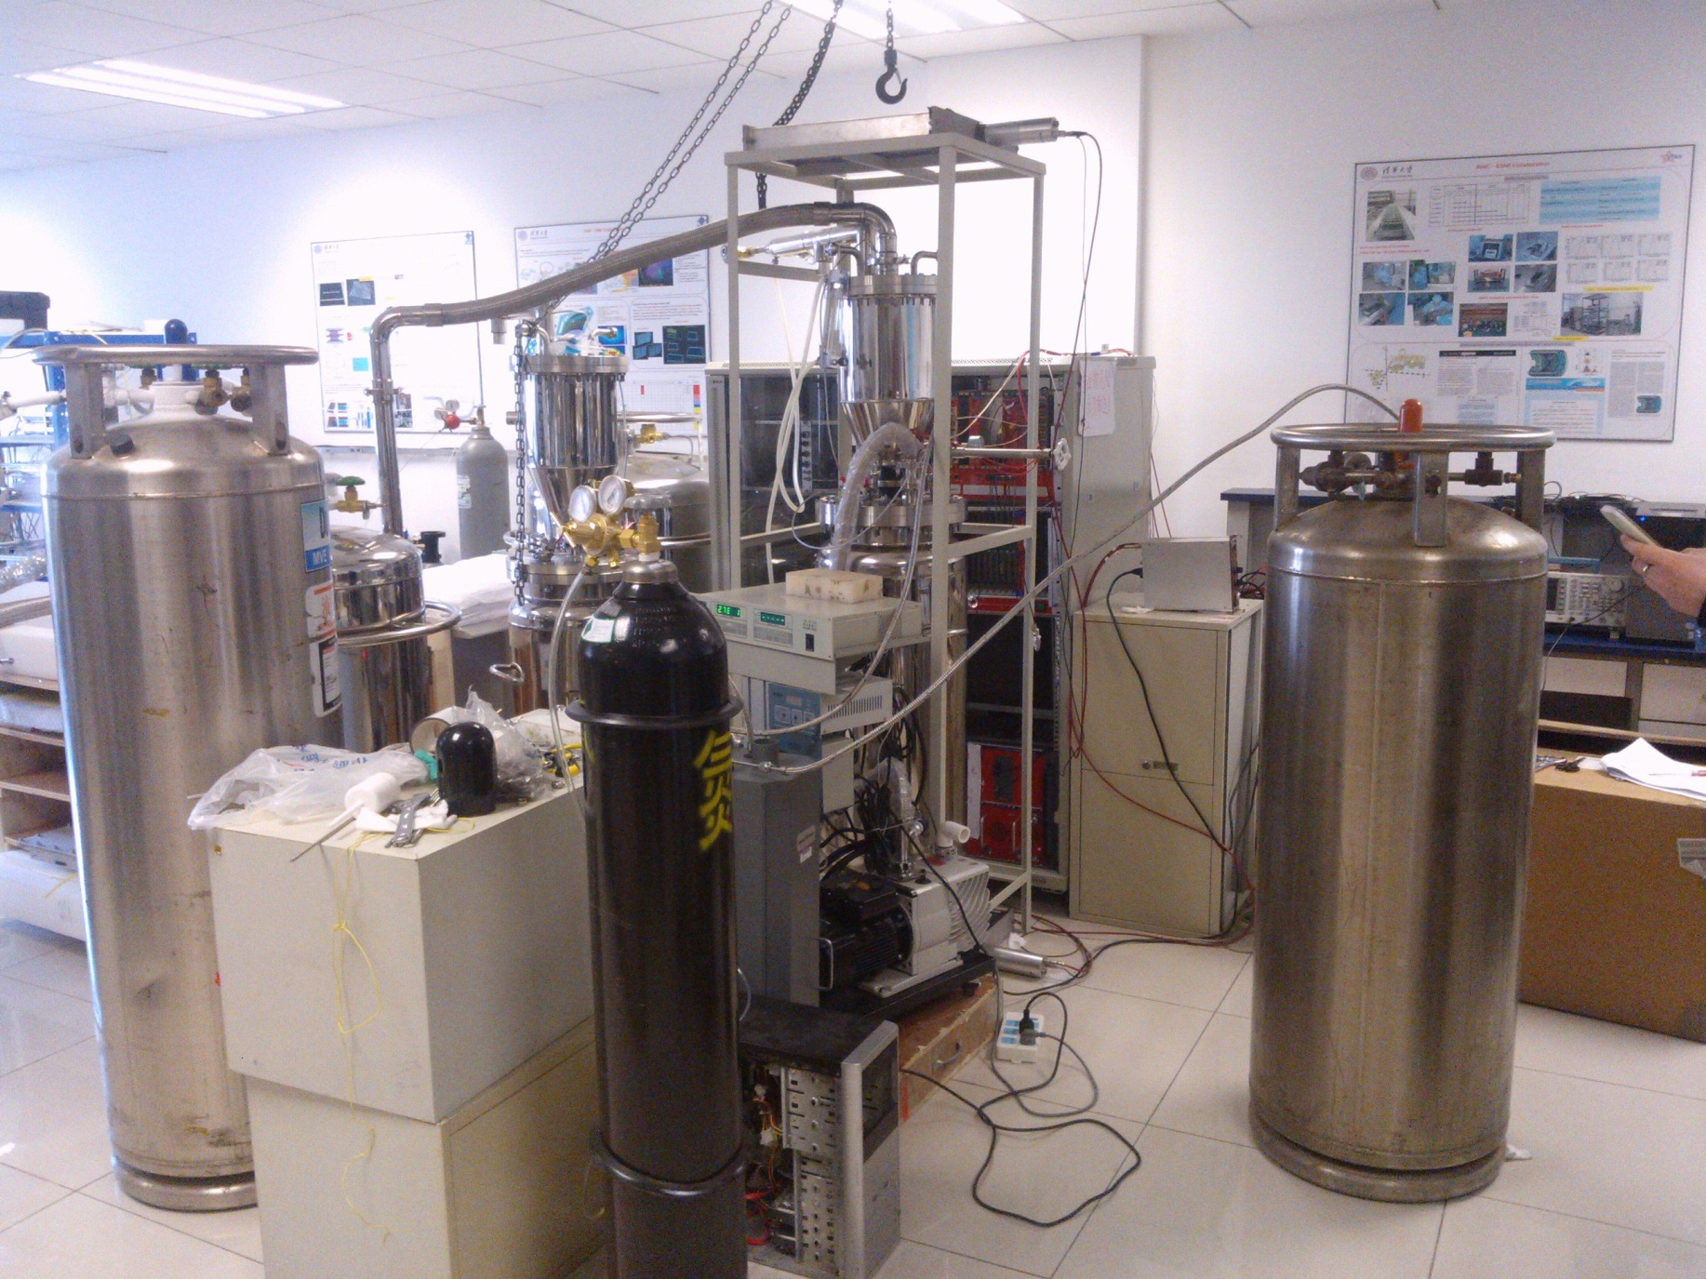
System Installation

Slide 20
Outline
1
Liquid Argon Detector in CDEX
2
Liquid Argon Test Facility
3
Preliminary experimental results
4
Future Work

Slide 21
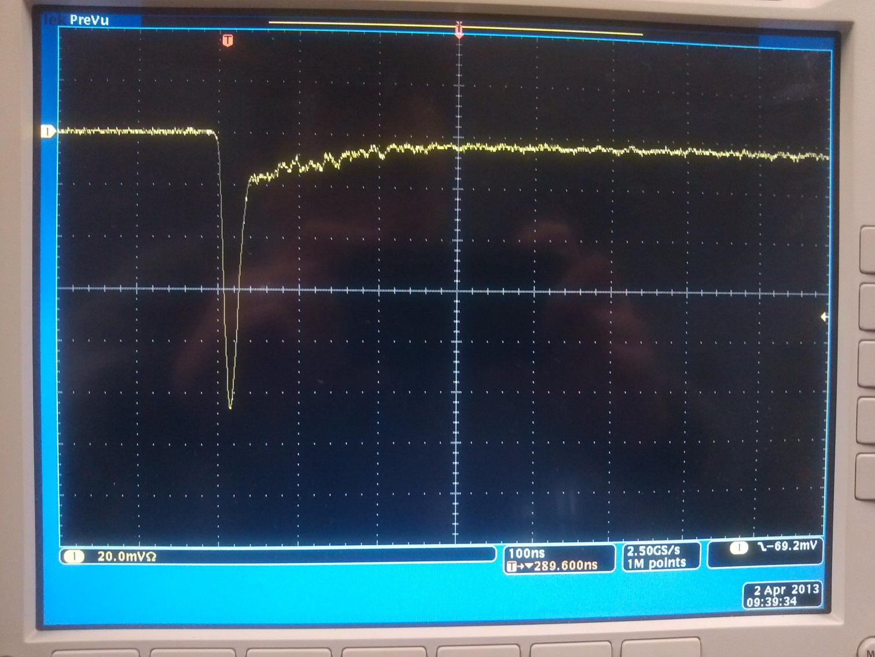
The Pulse Shape in GAr
快慢成分较为明显！

Slide 22
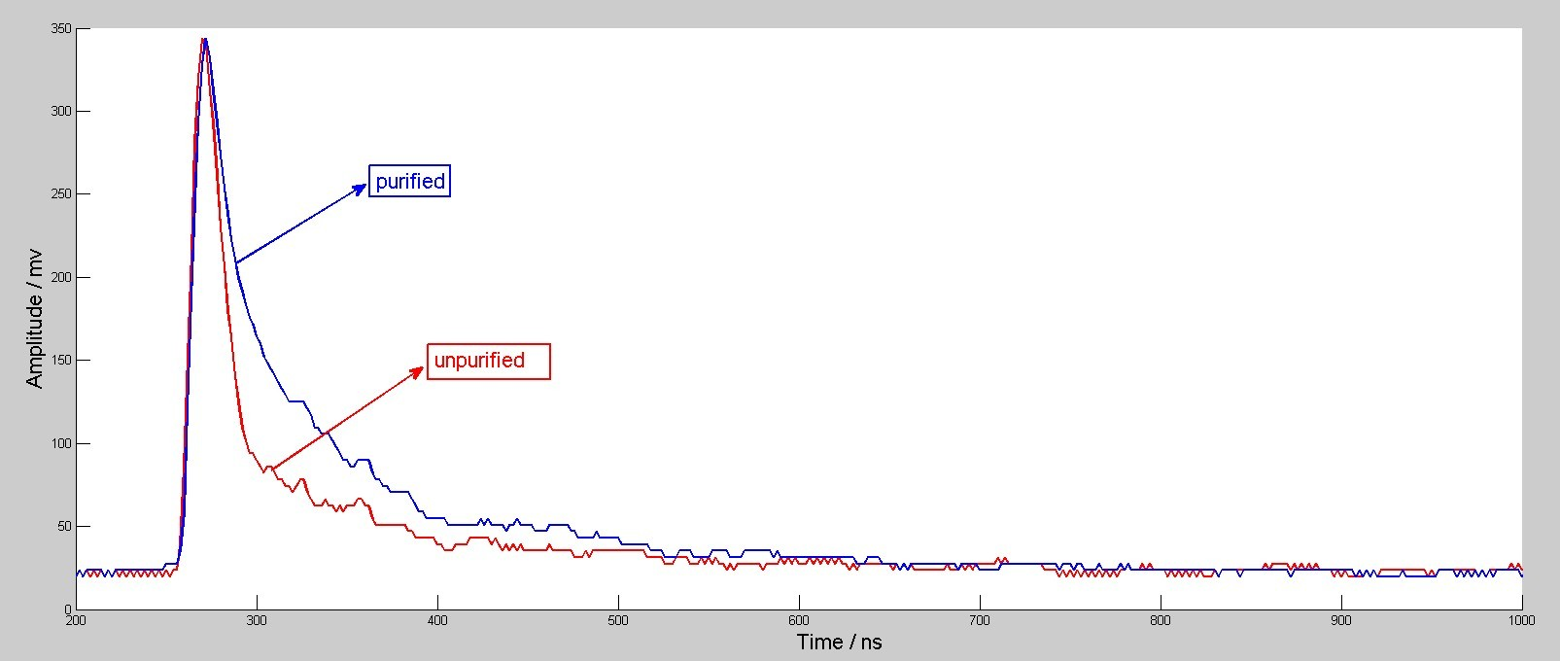
The Pulse Shape before/after Purified

Slide 23
Outline
1
Liquid Argon Detector in CDEX
2
Liquid Argon Test Facility
3
Preliminary experimental results
4
Future Work

Slide 24
Future Work
Get the pulse shapes in:
  Unpurified GAr
  Purified GAr
  Unpurified LAr
  Purified LAr

Slide 25
THANK YOU!!!

