Slide 1
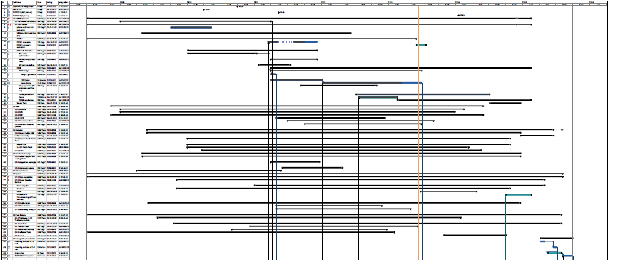
Schedule
So far: academic exercise to check if all makes sense
Now: have to convert to a real production schedule with realistic delivery time
Need your input!
Don‘t forget details! (cables & connectors & assembly & testing & labelling)

Slide 2
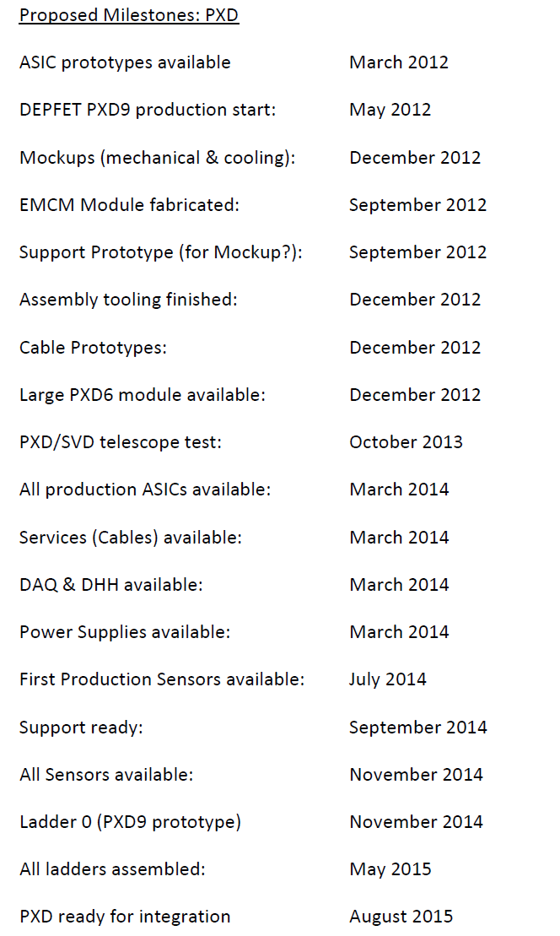
Milestones
Extracted from schedule
Given to
Technical coordinator
BPAC
Some delays
mech. And therm mockup
EMCM
PXD6 module
Especially the EMCM has an impact on the overall schedule
2013

Slide 3
Milestones
Many more milestones extracted from the MS project schedule
Blue:
Official milestones

Slide 4
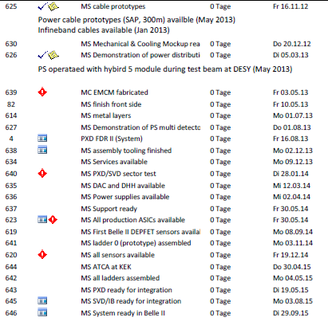
Milestones

Slide 5
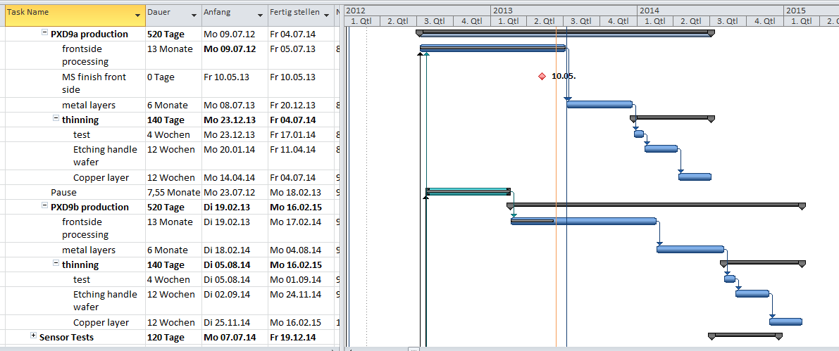
PXD9 Production
PXD9 batch one production faster than planned (300d/360, actually 250/360)
Wait for EMCM test befor start of metal layer processing: 8.7.2013
However: EMCM will not be ready till then + time to test!
Hope: production will also be faster
First modules ready July 2014

Slide 6
PXD9 Production
Calender
Days
Batch 2: first phase could be finished till December 2013

Slide 7
Conclusions
Progress:
Test beam: complete readout chain (DCD-DHP-DHH-Onsen)
DESY: RVC works!
Things to worry:
EMCM: already delays the sensor production (though, we learned a lot)
=> speedy testing!
DCD: submission of a new chip, which is of course much better
Do we have time for sufficient testing and a 2nd iteration?
Alternative installation procedure: very tight schedule!
Thermal Mockup: stalled due to work on RVC, MARCO still unreliable

