Slide 1

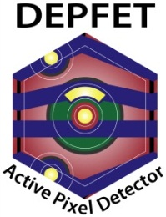

Test beam preparations
Florian Lütticke, Mikhail Lemarenko, Carlos Marinas
University of Bonn (Prof. Norbert Wermes)
DEPFET workshop Ringberg (June 12-15, 2013, Ringberg)

Slide 2
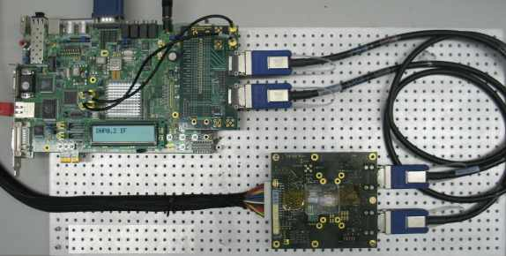
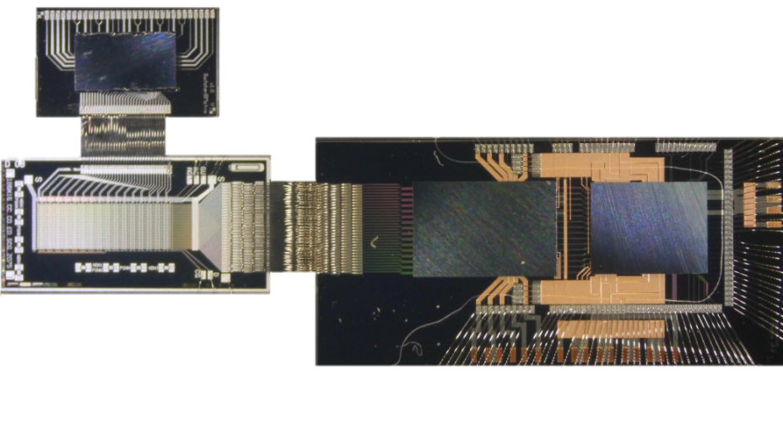
Goal: Test beam in May at DESY
System Integration test
Primary goal:
  Complete data flow:
  DEPFET -> DCD -> DHP -> DHH -> ONSEN -> PC
  Slow Control over DHH
  Task force: Gießen, TUM, Bonn
Backup plan:
  Zero suppressed readout:
  DEPFET -> DCD -> DHP -> DHHe(mulator) -> PC
  Slow control over DHHe
  Lab test system
PC means:
  Producer -> Bonn-EVB -> Bonn-EUDAQ-Producer -> EUDAQ-EVB
  Producer -> Bonn-EVB -> Online Monitor
  Producer -> Bonn-EVB -> Bonn-EUDAQ-Producer -> EUDAQ-EVB -> EUDAQ-Monitor

Slide 3
Tasks: get that system working!
Develop Hardware platform and get the DHP working
Testing
Develop Software necessary
Testing.
Update existing DAQ Software
Testing..
Correct mapping from matrix to DHP
Testing…
Optimize System components, including the DEPFET and DCD
Implement additional features (for testing)
Testing….

Slide 4
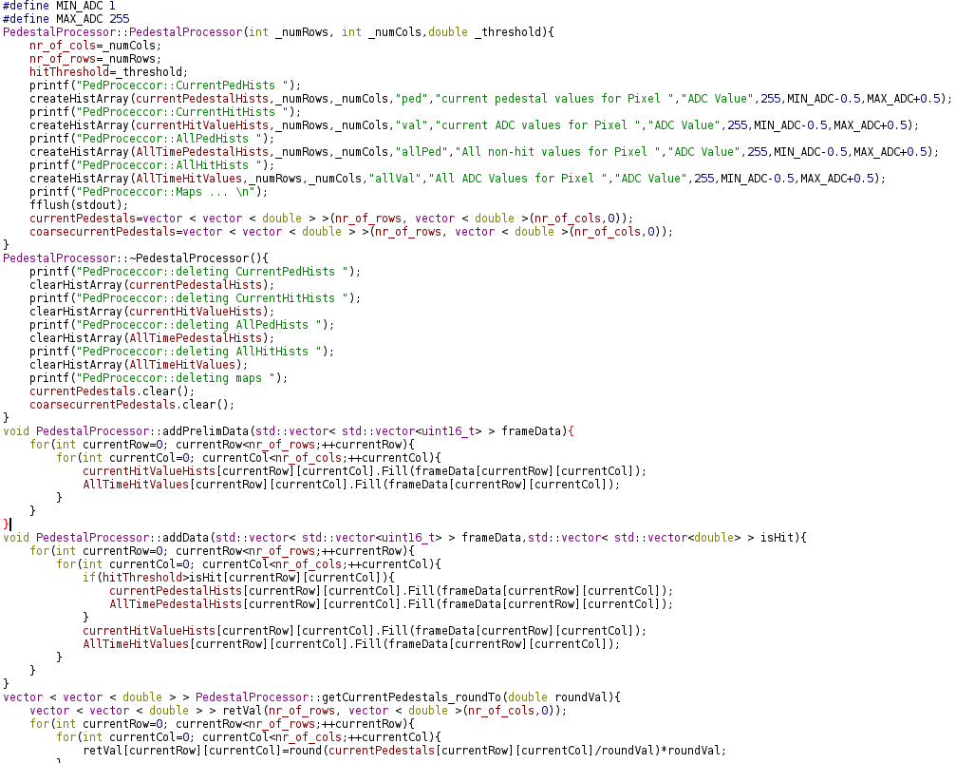
DHHe Control, MATLAB scripts & DHHe
Development of Config_GUI software to configure DCD and DHP over JTAG, configure DHHe, upload Pedestals, mask Pixels etc.
Development of MATLAB scripts to generate test frames and calculate pedestals
Development of fileReader class and MATLAB plugin for “easy” access to DEPFET data files
Development of automated routines for testing the DHP
  Using Softcore inside DHHe
  Fast upload of pedestals
  Fast scan of all DCD channels
Implemented and tested trigger engine for communication with EUDAQ TLU
  Variable Trigger length, settable delays

Slide 5
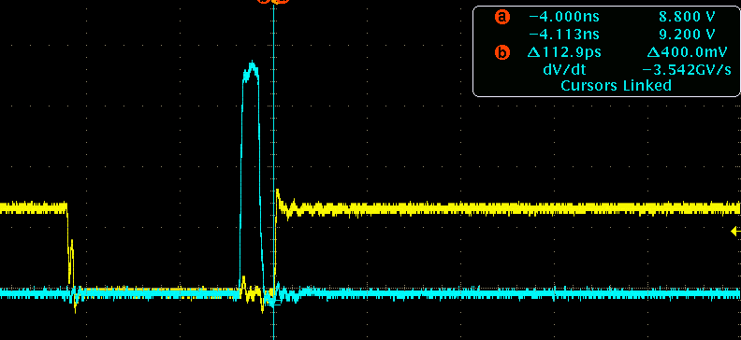
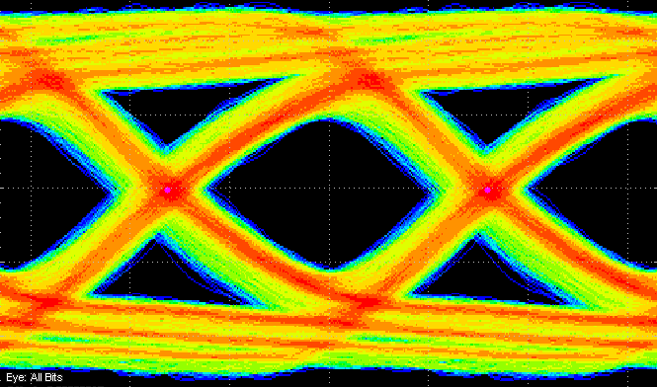
DHP Functionality tests & Optimizations
Functionality tests
  High speed link
  Communication with DCD @ different clock speeds
  Data processing (transmission losses with
  pre-programmed test frames)
  Configuration of DCD via JTAG
Switcher output sequences
Optimized timings for Signals between DHP and DCD, same for DHHe to DHP
Optimized timings to trigger the Systems with the TLU
  Triggered laser and readout at the same time
  Optimized timings to get all laser pulses
Data loss, %
Occupancy, %

Slide 6
Development of DAQ Software
Development of a new generic producer plugin for our DAQ software
  Multithreaded approach
  Control thread and connection to/from the DAQ are handled in generic way.
  Only data receiving thread needs to be rewritten for different devices
Development of DHHe producer plugin
Development of DHHe random generator plugin for testing the data flow
ONSEN producer and ONSEN generator (Gießen)
Implemented and tested DHHe and ONSEN data handling into the DAQ Software and into EUDAQ
DHHe Producer plugin and our DAQ are able to write about 100k frames/sec to disc, if frames are small (1-5 pix firing)
And much more, including incredible many bug fixes

Slide 7
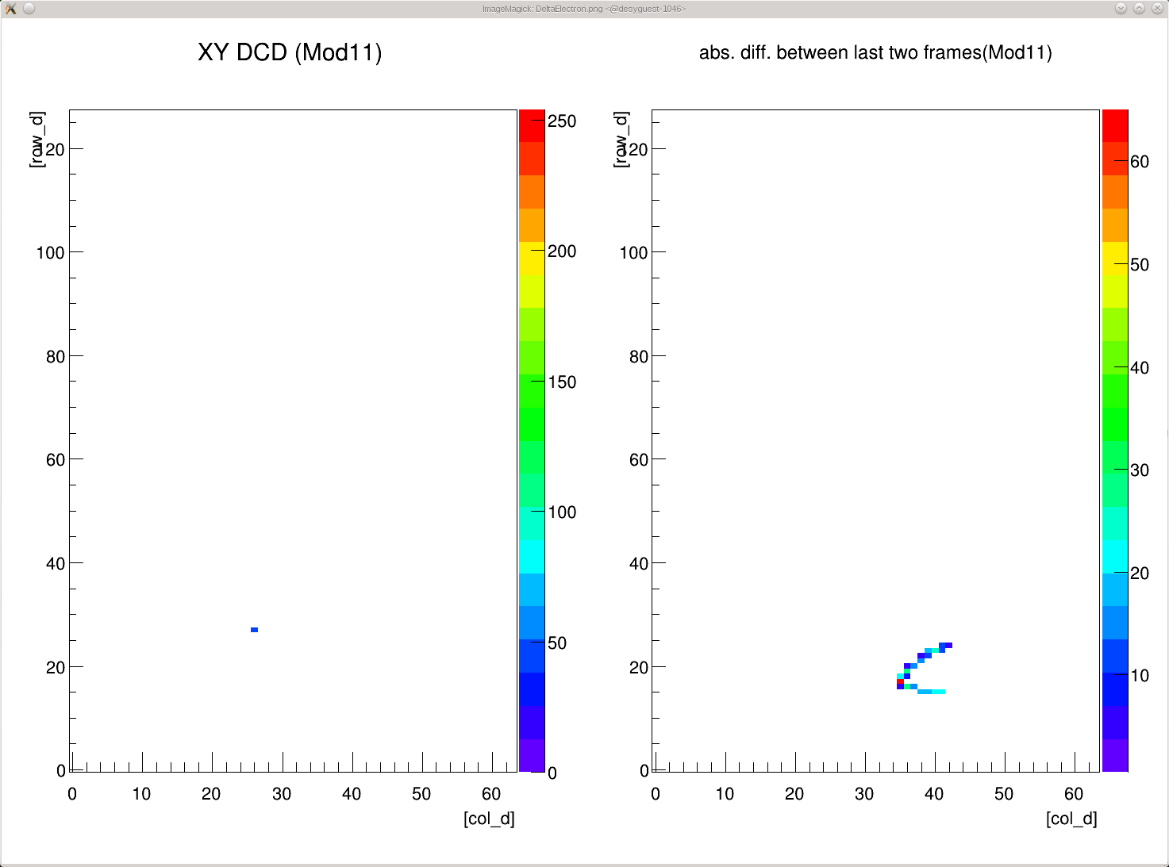
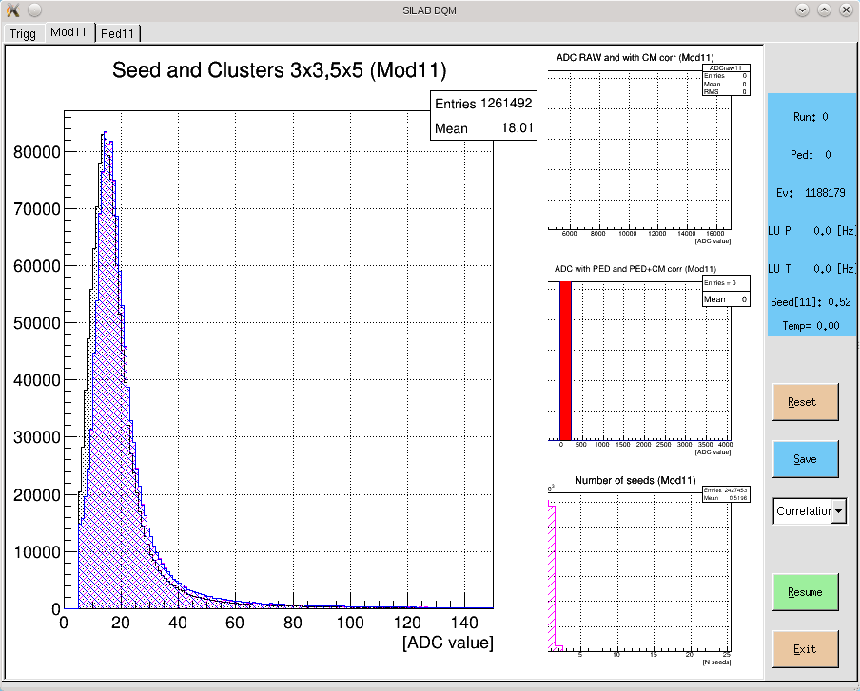
Development of Online Monitor
Implemented DHHe and ONSEN data interpreter into our OnlineMonitor
Implemented DHHe and ONSEN data interpreter into EUDAQ together with Benjamin

Slide 8
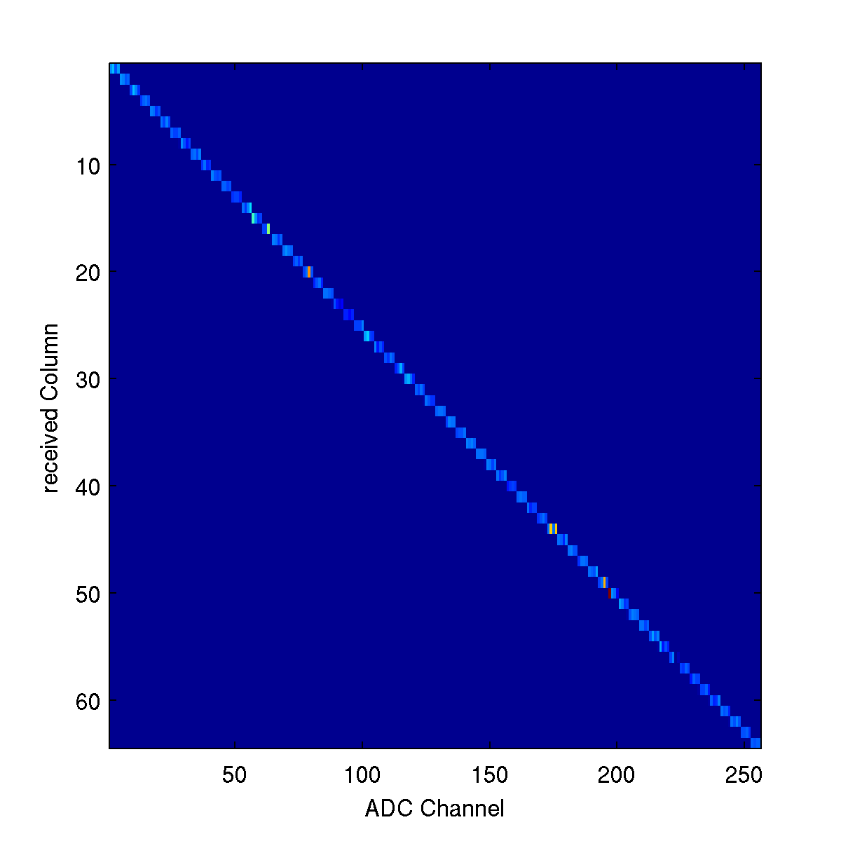
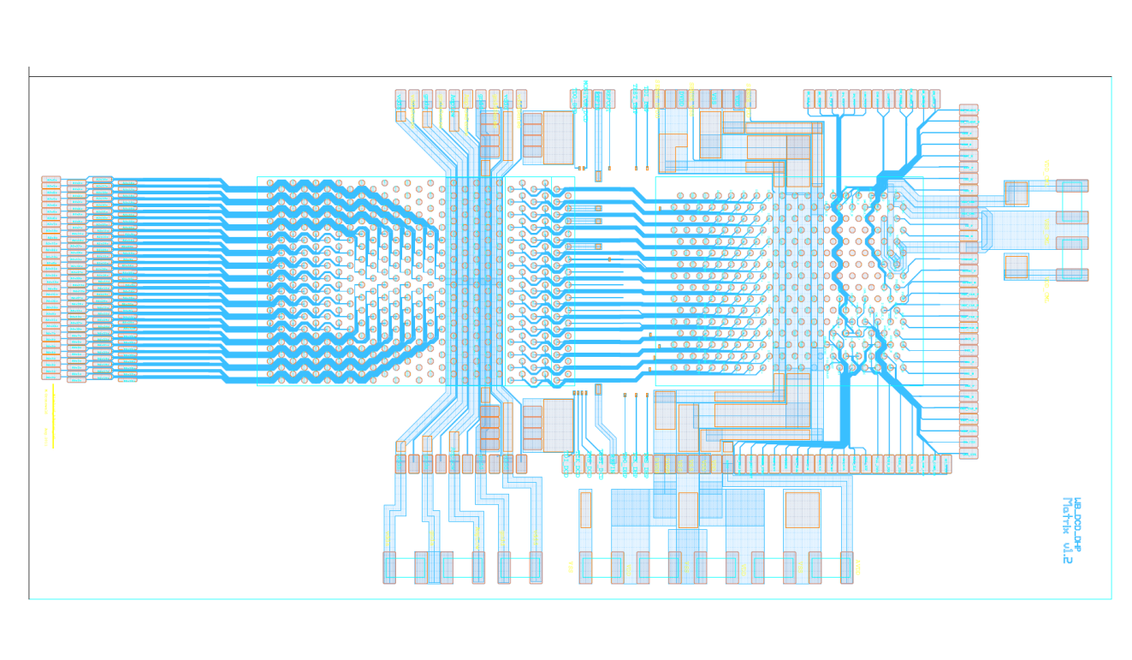
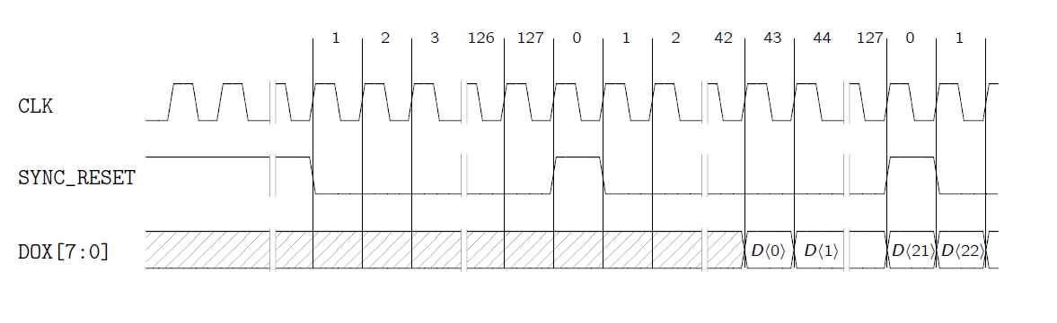
Mapping (I) – DCD-DHP Synchronization
DHP Coordinates received
Mapping DHP-> DCD (synchronize Data!)
Mapping DCD-> BondPads
BondPads->MatrixPads
MatrixPads->Drains->Pixel location
Delay Setting Row2_sync_DCD_Delay
  Steers point where DHP expects first byte
  from DCD Byte D<0> has to be at the beginning
Switcher
Points to direction of matrix, is located at the switcher side
DEPFET
DCD/DHP
Straight digital data path ->
no Mapping, only synchronization

Slide 9
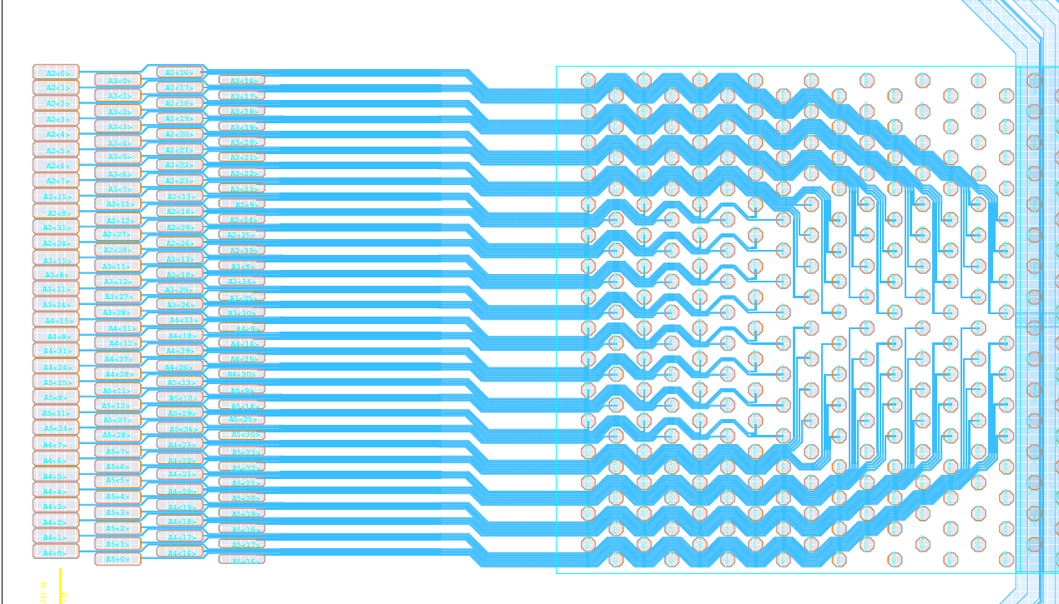
Mapping (II) – DCDB Adapter Fanout
Inner Mapping
Outer Mapping

Slide 10
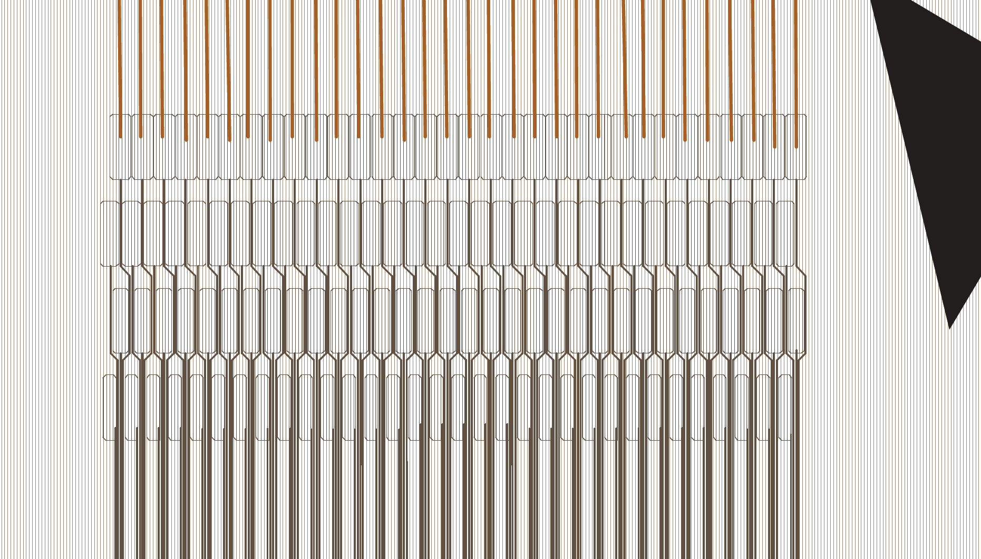
Mapping (III) – Mapping at wirebonds
Wirebonds to the DEPFET Matrix
A4
7
A4
6
A4
1
A4
0
A5
24
A5
31
A5
8
A5
15
A4
24
A3
15
A2
24
A2
31
A2
8
A2
15
A2
7
A2
6
A2
3
A2
1
A2
0
P0
31
P0
30
P0
1
P0
0
A5
7
A5
6
A5
1
A5
0
A5
28
A5
27
A5
12
A5
11
A2
28
A2
27
A2
12
A2
11
A3
7
A3
6
A3
3
A3
1
A3
0
P1
31
P1
30
P1
1
P1
0
A4
23
A4
22
A4
17
A4
16
A5
26
A5
29
A5
10
A5
13
A2
26
A2
29
A2
10
A2
13
A2
23
A2
22
A2
19
A2
17
A2
16
P2
31
P2
30
P2
1
P2
0
A5
23
A5
22
A5 17
A5
16
A5
30
A5
25
A5
14
A5
9
A2
30
A2
25
A2
14
A2
9
A3
23
A3
22
A3
19
A3
17
A3
16
P3
31
P3
30
P3
1
P3
0
Lines to DCD

Slide 11
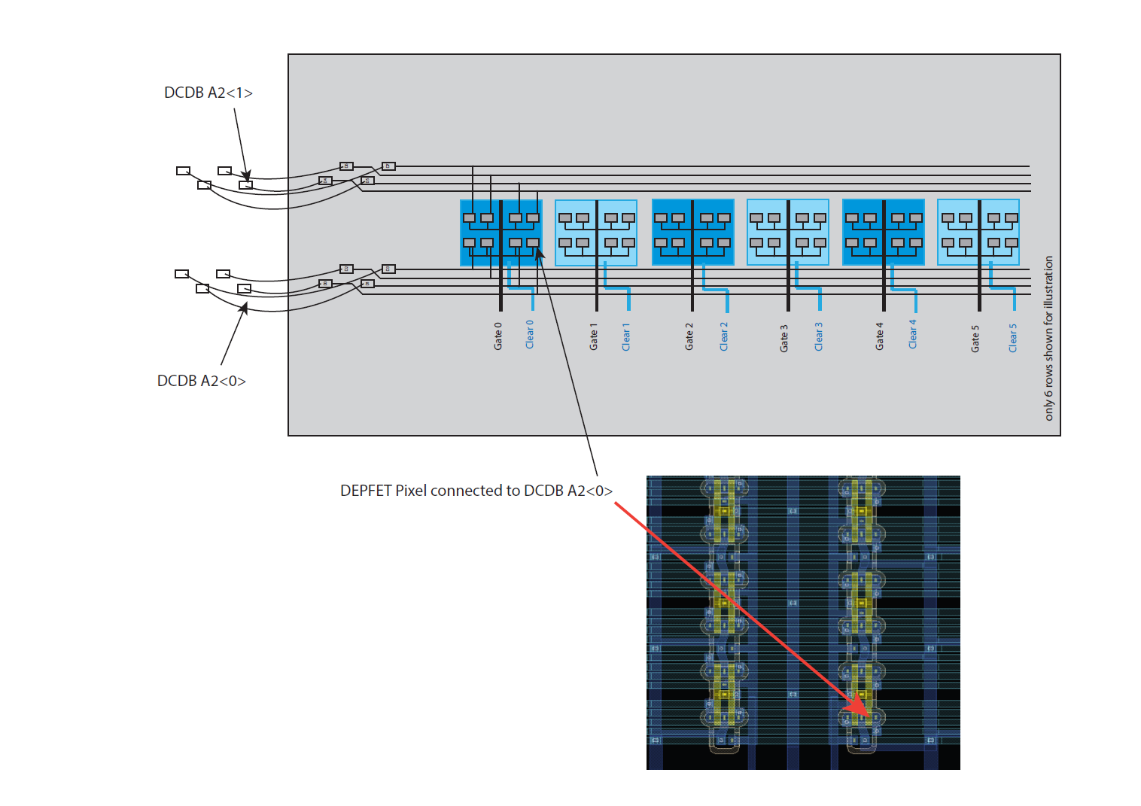
Mapping (IV) – Drain lines to Pixels
Wirebond adaptor

Slide 12
Mapping (V) – Results
DHP |  | DCD |  |  | BondPad |  | Matrix
Col | Row | Total | Bl | Ch. | Row | Col | Drain | Col | Row
16 | 0 | 64 | 2 | 0 | 0 | 0 | 0 | 0 | 3
16 | 1 | 65 | 2 | 1 | 0 | 1 | 4 | 1 | 3
16 | 2 | 66 | 2 | 2 | 0 | 2 | 8 | 2 | 3
16 | 3 | 67 | 2 | 3 | 0 | 3 | 12 | 3 | 3
17 | 0 | 68 | 2 | 4 | 0 | 4 | 16 | 4 | 3
17 | 1 | 69 | 2 | 5 | 0 | 5 | 20 | 5 | 3
17 | 2 | 70 | 2 | 6 | 0 | 6 | 24 | 6 | 3
17 | 3 | 71 | 2 | 7 | 0 | 7 | 28 | 7 | 3
18 | 0 | 72 | 2 | 8 | 0 | 9 | 36 | 9 | 3
18 | 1 | 73 | 2 | 9 | 3 | 8 | 35 | 8 | 0
18 | 2 | 74 | 2 | 10 | 2 | 9 | 37 | 9 | 1
18 | 3 | 75 | 2 | 11 | 1 | 8 | 34 | 8 | 2
19 | 0 | 76 | 2 | 12 | 1 | 9 | 38 | 9 | 2
19 | 1 | 77 | 2 | 13 | 2 | 8 | 33 | 8 | 1
19 | 2 | 78 | 2 | 14 | 3 | 9 | 39 | 9 | 0
19 | 3 | 79 | 2 | 15 | 0 | 8 | 32 | 8 | 3
20 | 0 | 80 | 2 | 16 | 2 | 0 | 1 | 0 | 1
20 | 1 | 81 | 2 | 17 | 2 | 1 | 5 | 1 | 1
20 | 2 | 82 | 2 | 18 | 2 | 2 | 9 | 2 | 1
20 | 3 | 83 | 2 | 19 | 2 | 3 | 13 | 3 | 1
21 | 0 | 84 | 2 | 20 | 2 | 4 | 17 | 4 | 1
21 | 1 | 85 | 2 | 21 | 2 | 5 | 21 | 5 | 1
21 | 2 | 86 | 2 | 22 | 2 | 6 | 25 | 6 | 1
21 | 3 | 87 | 2 | 23 | 2 | 7 | 29 | 7 | 1
22 | 0 | 88 | 2 | 24 | 0 | 11 | 44 | 11 | 3
22 | 1 | 89 | 2 | 25 | 3 | 10 | 43 | 10 | 0
22 | 2 | 90 | 2 | 26 | 2 | 11 | 45 | 11 | 1
22 | 3 | 91 | 2 | 27 | 1 | 10 | 42 | 10 | 2
23 | 0 | 92 | 2 | 28 | 1 | 11 | 46 | 11 | 2
23 | 1 | 93 | 2 | 29 | 2 | 10 | 41 | 10 | 1
23 | 2 | 94 | 2 | 30 | 3 | 11 | 47 | 11 | 0
23 | 3 | 95 | 2 | 31 | 0 | 10 | 40 | 10 | 3
DHP |  | DCD |  |  | BondPad |  | Matrix
Col | Row | Total | Bl | Ch. | Row | Col | Drain | Col | Row
24 | 0 | 96 | 3 | 0 | 1 | 0 | 2 | 0 | 2
24 | 1 | 97 | 3 | 1 | 1 | 1 | 6 | 1 | 2
24 | 2 | 98 | 3 | 2 | 1 | 2 | 10 | 2 | 2
24 | 3 | 99 | 3 | 3 | 1 | 3 | 14 | 3 | 2
25 | 0 | 100 | 3 | 4 | 1 | 4 | 18 | 4 | 2
25 | 1 | 101 | 3 | 5 | 1 | 5 | 22 | 5 | 2
25 | 2 | 102 | 3 | 6 | 1 | 6 | 26 | 6 | 2
25 | 3 | 103 | 3 | 7 | 1 | 7 | 30 | 7 | 2
26 | 0 | 104 | 3 | 8 | 0 | 13 | 52 | 13 | 3
26 | 1 | 105 | 3 | 9 | 3 | 12 | 51 | 12 | 0
26 | 2 | 106 | 3 | 10 | 2 | 13 | 53 | 13 | 1
26 | 3 | 107 | 3 | 11 | 1 | 12 | 50 | 12 | 2
27 | 0 | 108 | 3 | 12 | 1 | 13 | 54 | 13 | 2
27 | 1 | 109 | 3 | 13 | 2 | 12 | 49 | 12 | 1
27 | 2 | 110 | 3 | 14 | 3 | 13 | 55 | 13 | 0
27 | 3 | 111 | 3 | 15 | 0 | 12 | 48 | 12 | 3
28 | 0 | 112 | 3 | 16 | 3 | 0 | 3 | 0 | 0
28 | 1 | 113 | 3 | 17 | 3 | 1 | 7 | 1 | 0
28 | 2 | 114 | 3 | 18 | 3 | 2 | 11 | 2 | 0
28 | 3 | 115 | 3 | 19 | 3 | 3 | 15 | 3 | 0
29 | 0 | 116 | 3 | 20 | 3 | 4 | 19 | 4 | 0
29 | 1 | 117 | 3 | 21 | 3 | 5 | 23 | 5 | 0
29 | 2 | 118 | 3 | 22 | 3 | 6 | 27 | 6 | 0
29 | 3 | 119 | 3 | 23 | 3 | 7 | 31 | 7 | 0
30 | 0 | 120 | 3 | 24 | 0 | 15 | 60 | 15 | 3
30 | 1 | 121 | 3 | 25 | 3 | 14 | 59 | 14 | 0
30 | 2 | 122 | 3 | 26 | 2 | 15 | 61 | 15 | 1
30 | 3 | 123 | 3 | 27 | 1 | 14 | 58 | 14 | 2
31 | 0 | 124 | 3 | 28 | 1 | 15 | 62 | 15 | 2
31 | 1 | 125 | 3 | 29 | 2 | 14 | 57 | 14 | 1
31 | 2 | 126 | 3 | 30 | 3 | 15 | 63 | 15 | 0
31 | 3 | 127 | 3 | 31 | 0 | 14 | 56 | 14 | 3
DHP |  | DCD |  |  | BondPad |  | Matrix
Col | Row | Total | Bl | Ch. | Row | Col | Drain | Col | Row
32 | 0 | 128 | 4 | 0 | 0 | 31 | 124 | 31 | 3
32 | 1 | 129 | 4 | 1 | 0 | 30 | 120 | 30 | 3
32 | 2 | 130 | 4 | 2 | 0 | 29 | 116 | 29 | 3
32 | 3 | 131 | 4 | 3 | 0 | 28 | 112 | 28 | 3
33 | 0 | 132 | 4 | 4 | 0 | 27 | 108 | 27 | 3
33 | 1 | 133 | 4 | 5 | 0 | 26 | 104 | 26 | 3
33 | 2 | 134 | 4 | 6 | 0 | 25 | 100 | 25 | 3
33 | 3 | 135 | 4 | 7 | 0 | 24 | 96 | 24 | 3
34 | 0 | 136 | 4 | 8 | 0 | 17 | 68 | 17 | 3
34 | 1 | 137 | 4 | 9 | 3 | 16 | 67 | 16 | 0
34 | 2 | 138 | 4 | 10 | 2 | 17 | 69 | 17 | 1
34 | 3 | 139 | 4 | 11 | 1 | 16 | 66 | 16 | 2
35 | 0 | 140 | 4 | 12 | 1 | 17 | 70 | 17 | 2
35 | 1 | 141 | 4 | 13 | 2 | 16 | 65 | 16 | 1
35 | 2 | 142 | 4 | 14 | 3 | 17 | 71 | 17 | 0
35 | 3 | 143 | 4 | 15 | 0 | 16 | 64 | 16 | 3
36 | 0 | 144 | 4 | 16 | 2 | 31 | 125 | 31 | 1
36 | 1 | 145 | 4 | 17 | 2 | 30 | 121 | 30 | 1
36 | 2 | 146 | 4 | 18 | 2 | 29 | 117 | 29 | 1
36 | 3 | 147 | 4 | 19 | 2 | 28 | 113 | 28 | 1
37 | 0 | 148 | 4 | 20 | 2 | 27 | 109 | 27 | 1
37 | 1 | 149 | 4 | 21 | 2 | 26 | 105 | 26 | 1
37 | 2 | 150 | 4 | 22 | 2 | 25 | 101 | 25 | 1
37 | 3 | 151 | 4 | 23 | 2 | 24 | 97 | 24 | 1
38 | 0 | 152 | 4 | 24 | 0 | 19 | 76 | 19 | 3
38 | 1 | 153 | 4 | 25 | 3 | 18 | 75 | 18 | 0
38 | 2 | 154 | 4 | 26 | 2 | 19 | 77 | 19 | 1
38 | 3 | 155 | 4 | 27 | 1 | 18 | 74 | 18 | 2
39 | 0 | 156 | 4 | 28 | 1 | 19 | 78 | 19 | 2
39 | 1 | 157 | 4 | 29 | 2 | 18 | 73 | 18 | 1
39 | 2 | 158 | 4 | 30 | 3 | 19 | 79 | 19 | 0
39 | 3 | 159 | 4 | 31 | 0 | 18 | 72 | 18 | 3
DHP |  | DCD |  |  | BondPad |  | Matrix
Col | Row | Total | Bl | Ch. | Row | Col | Drain | Col | Row
40 | 0 | 160 | 5 | 0 | 1 | 31 | 126 | 31 | 2
40 | 1 | 161 | 5 | 1 | 1 | 30 | 122 | 30 | 2
40 | 2 | 162 | 5 | 2 | 1 | 29 | 118 | 29 | 2
40 | 3 | 163 | 5 | 3 | 1 | 28 | 114 | 28 | 2
41 | 0 | 164 | 5 | 4 | 1 | 27 | 110 | 27 | 2
41 | 1 | 165 | 5 | 5 | 1 | 26 | 106 | 26 | 2
41 | 2 | 166 | 5 | 6 | 1 | 25 | 102 | 25 | 2
41 | 3 | 167 | 5 | 7 | 1 | 24 | 98 | 24 | 2
42 | 0 | 168 | 5 | 8 | 0 | 21 | 84 | 21 | 3
42 | 1 | 169 | 5 | 9 | 3 | 20 | 83 | 20 | 0
42 | 2 | 170 | 5 | 10 | 2 | 21 | 85 | 21 | 1
42 | 3 | 171 | 5 | 11 | 1 | 20 | 82 | 20 | 2
43 | 0 | 172 | 5 | 12 | 1 | 21 | 86 | 21 | 2
43 | 1 | 173 | 5 | 13 | 2 | 20 | 81 | 20 | 1
43 | 2 | 174 | 5 | 14 | 3 | 21 | 87 | 21 | 0
43 | 3 | 175 | 5 | 15 | 0 | 20 | 80 | 20 | 3
44 | 0 | 176 | 5 | 16 | 3 | 31 | 127 | 31 | 0
44 | 1 | 177 | 5 | 17 | 3 | 30 | 123 | 30 | 0
44 | 2 | 178 | 5 | 18 | 3 | 29 | 119 | 29 | 0
44 | 3 | 179 | 5 | 19 | 3 | 28 | 115 | 28 | 0
45 | 0 | 180 | 5 | 20 | 3 | 27 | 111 | 27 | 0
45 | 1 | 181 | 5 | 21 | 3 | 26 | 107 | 26 | 0
45 | 2 | 182 | 5 | 22 | 3 | 25 | 103 | 25 | 0
45 | 3 | 183 | 5 | 23 | 3 | 24 | 99 | 24 | 0
46 | 0 | 184 | 5 | 24 | 0 | 23 | 92 | 23 | 3
46 | 1 | 185 | 5 | 25 | 3 | 22 | 91 | 22 | 0
46 | 2 | 186 | 5 | 26 | 2 | 23 | 93 | 23 | 1
46 | 3 | 187 | 5 | 27 | 1 | 22 | 90 | 22 | 2
47 | 0 | 188 | 5 | 28 | 1 | 23 | 94 | 23 | 2
47 | 1 | 189 | 5 | 29 | 2 | 22 | 89 | 22 | 1
47 | 2 | 190 | 5 | 30 | 3 | 23 | 95 | 23 | 0
47 | 3 | 191 | 5 | 31 | 0 | 22 | 88 | 22 | 3
You got 30 seconds to remember everything. There will be a test!

Slide 13
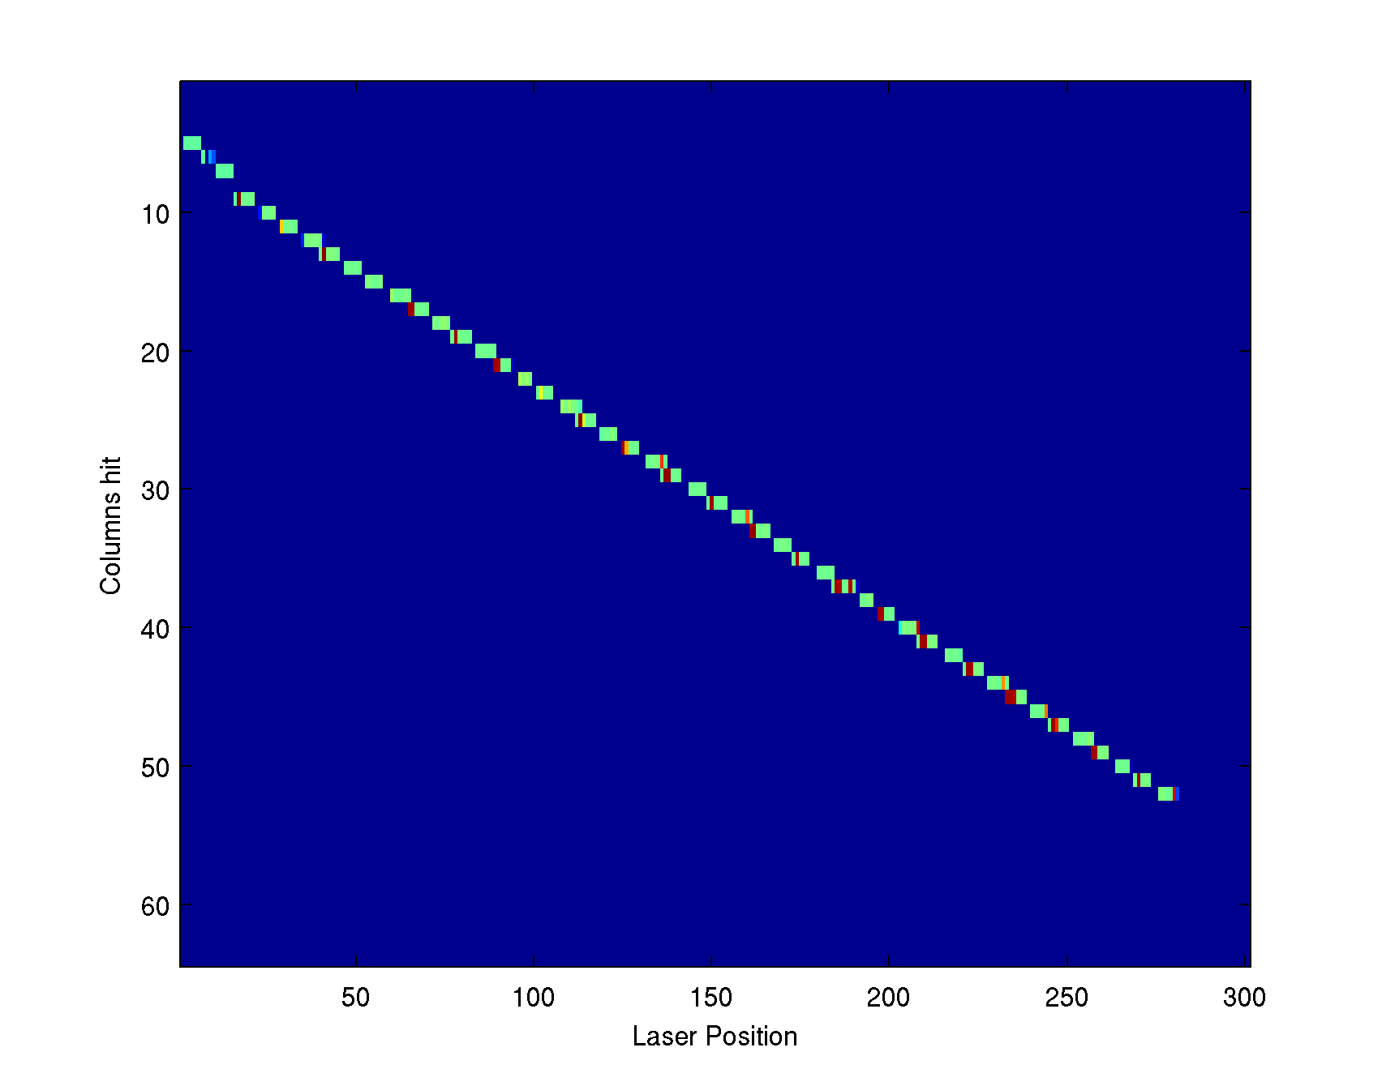
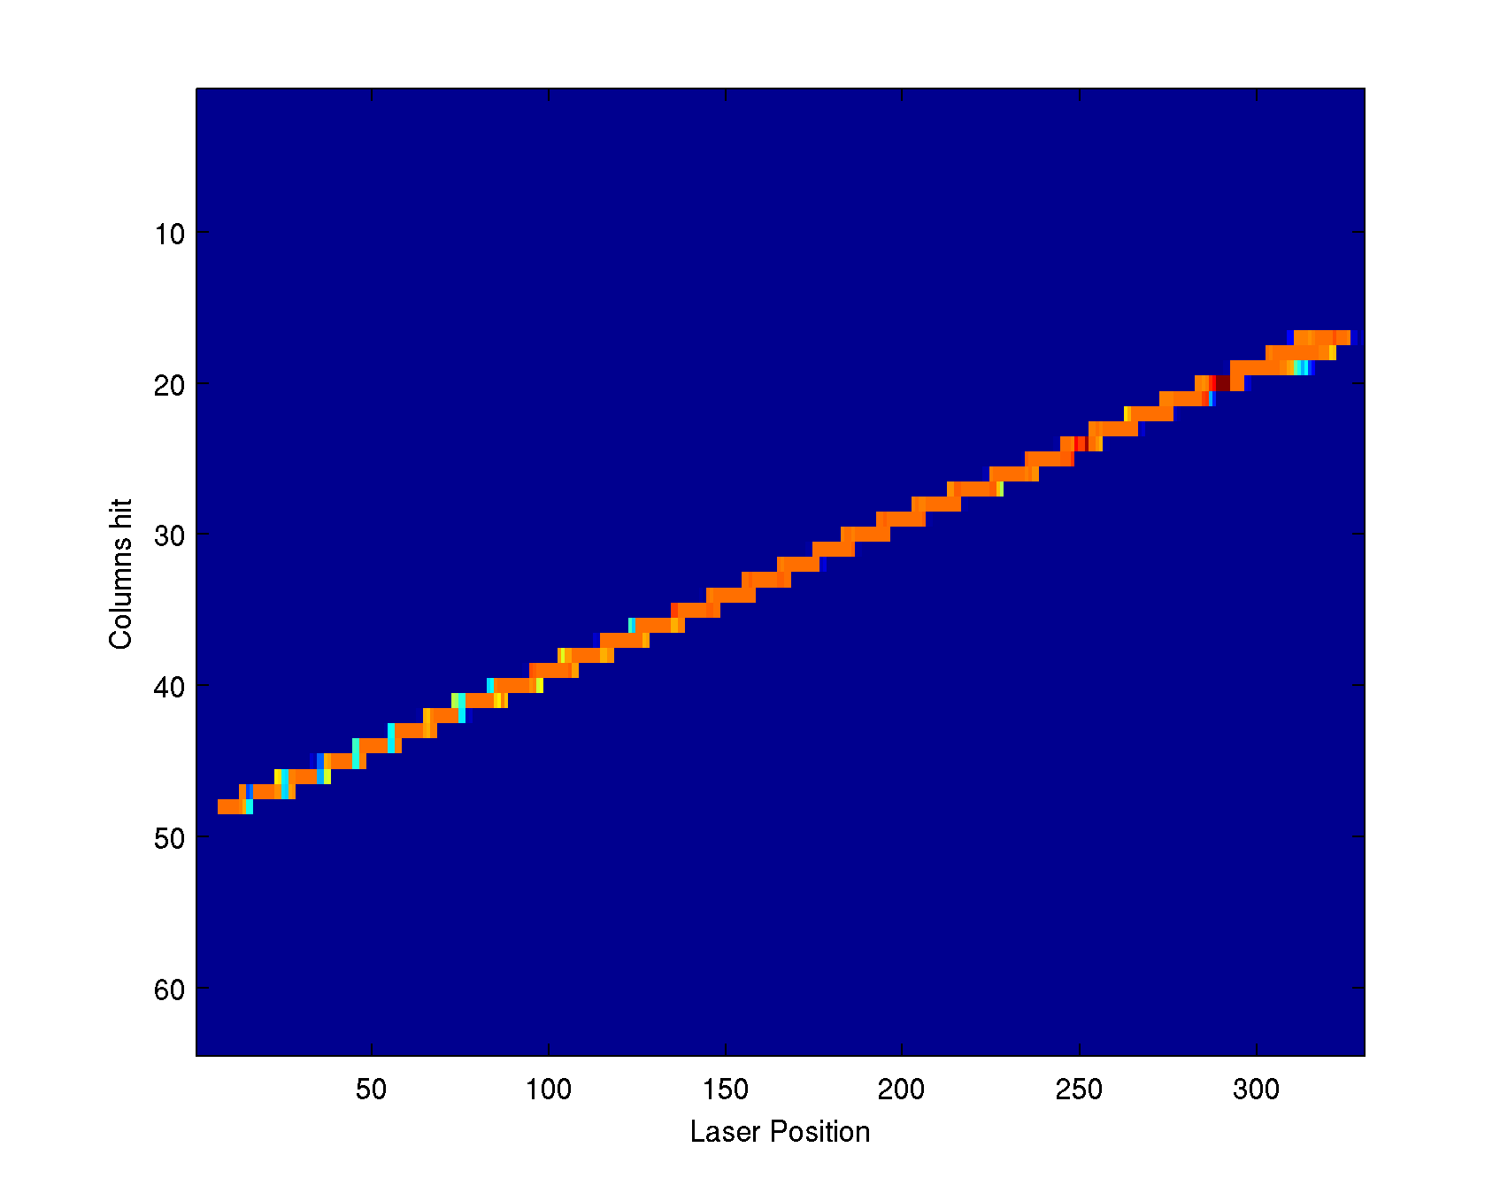
Mapping (VI) – Test with Laser
Move Laser spot over Matrix. At every position take measurements, which pixel was hit. Plot reconstructed position vs. real laser Position.
Laser position vs. row
Laser position vs. column

Slide 14
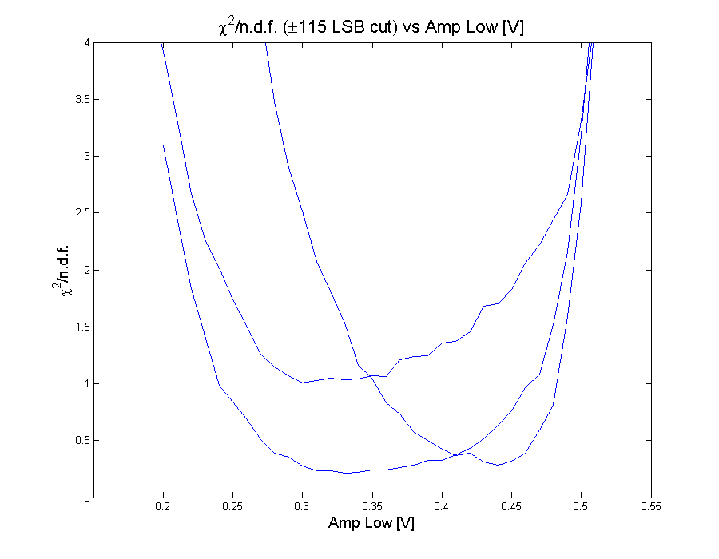
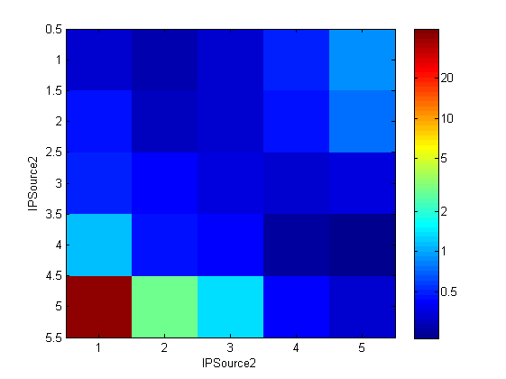
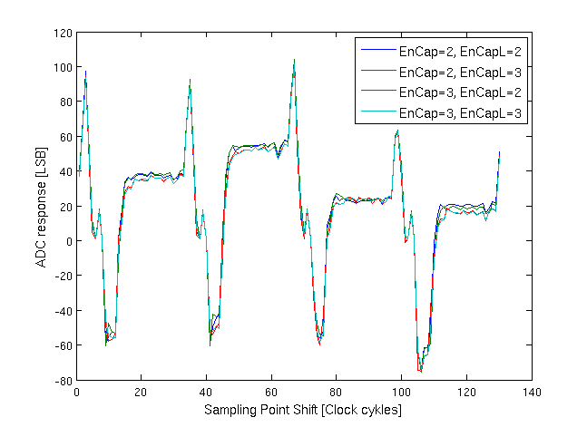
DCD Optimization
Bias Voltages + DACs
Timing between DHP and DCD
Optimal sampling point
  Same procedure as every year.

Slide 15
Dry test and DHP hands on Session
DHP Hands on Session in Bonn
  Two weeks before test beam, 2-3 days
  Topics:
    Setup of Bonn DAQ Software & important commands
    Data Formats & how to read them
    Powering Hybrid 5 & configuring it
    Running Hybrid 5
  Participants: Benjamin, Paola, Felix, Tadeas, Marca, Ulf
Dry test
  One week before test beam, 2-3 days, 2 other dry runs even before that.
  Topics:
    Connection between ONSEN and DHH
    Connection between ONSEN and readout PC
    Data flow from ONSEN data generator to Bonn DAQ and to EUDAQ
    Connection between DHP and DHH
    Configuring DHP over DHH JTAG.
  Participants: Sören, David, Thomas, Björn, Dima, Igor

Slide 16
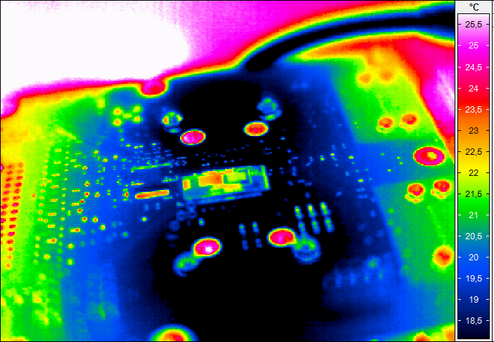
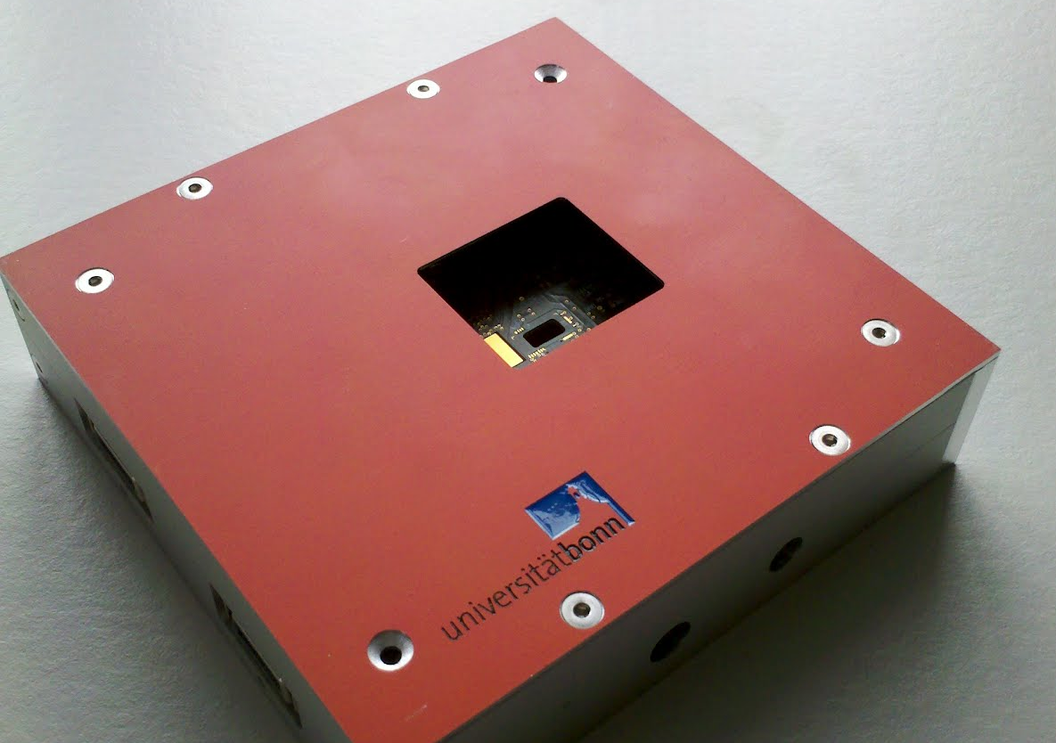
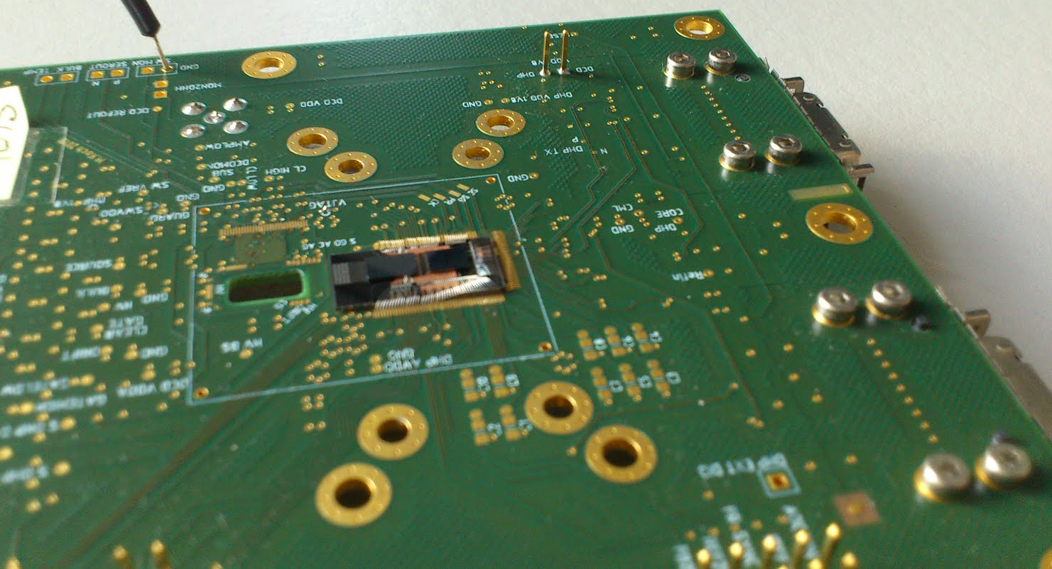
And much more…
Mechanics
Hybrid Design
Cooling
Logistics
  Planning
  Packing
  Setup
Checked pedestal stability
  Result: Stable on hour scale
Sensor Characterization
DHP0.2
DCDBv2
Cooling block on the back side of the PCB and thermal vias

Slide 17
Thank you for your attention

