Slide 1
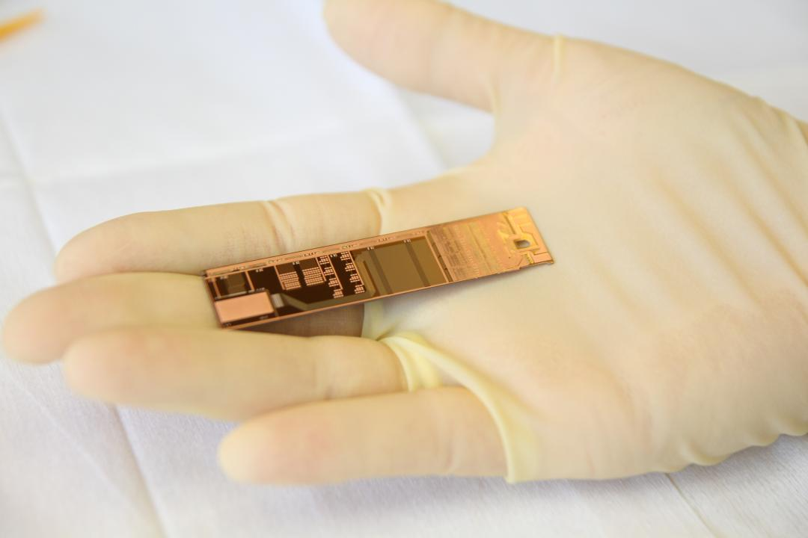
Lessons learned from EMCMs
assembly status - next steps

Slide 2
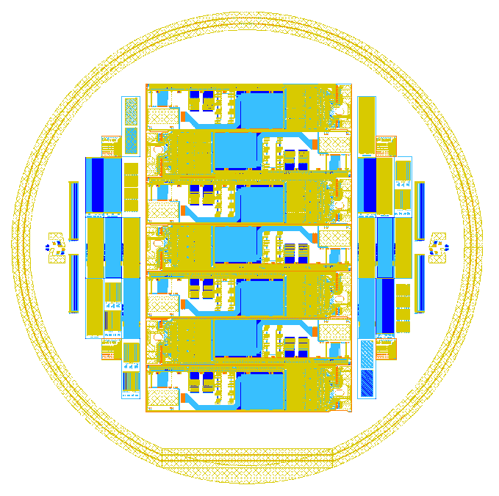
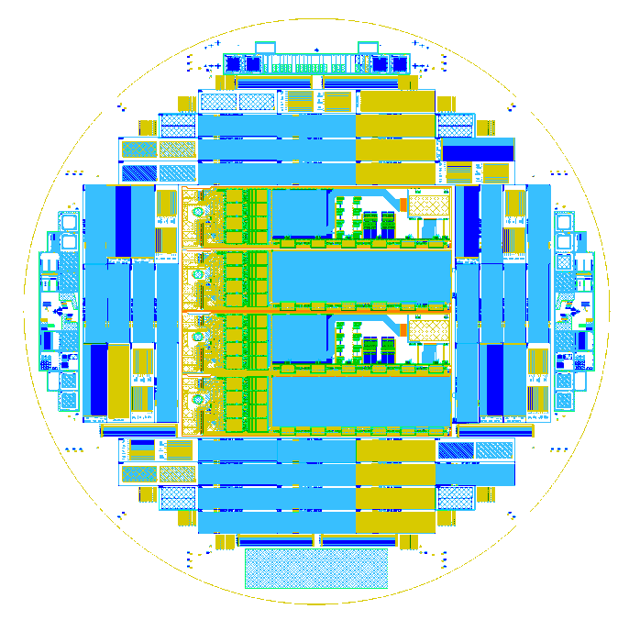
A bit of history
Two test projects
“test-EMCM-1”
Produce first electrically active modules for system tests
Use “standard” double-Alu system, 5 wafers 1st batch
ILD: thick LTO, 2µm
Plan to make it on SOI
Less test structures, but 7 EMCMs per wafer
Production on “fast” track on R&D line
Full triple metal (2 Al+1 Cu) immediately
Finished Sept. 2012
“test-ZMI-5”
Optimize double-Alu system
6 wafers with various inter-level dielectrics
low temp. oxide with different thicknesses
new Al₂O₃ Isolation
…
Many test structures, 2 EMCMs per Wafer
Production on main process line
After double-Alu qualification add Cu layer
Finished double metal (including many tests) Feb. 2013

Slide 3
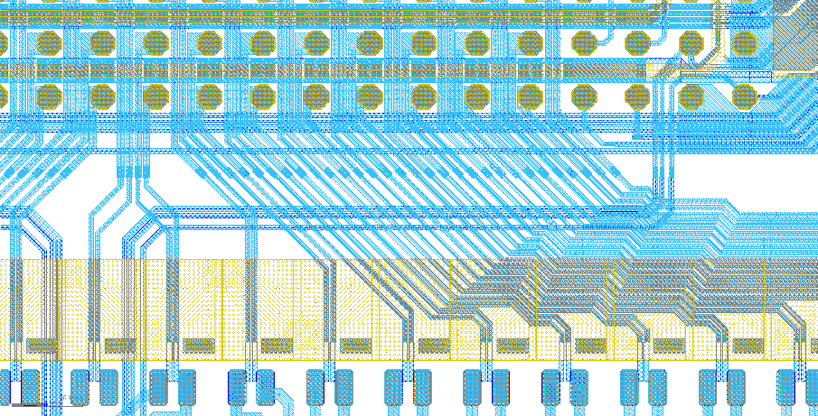
EMCM-1 results – test structures → 1st lesson
Visual inspection:
:- 2 wafers show breaks in al1 and obvious problems with co2n etching (2µm ILD!!!) → process dummies
:- 3 wafers visually okay
Measurements on test structures on these 3 wafers:
Cu layer:
:- ILD2 integrity (BCB) okay
:- contacts to al2 good down 10µm diameter
:- comb structures good down to 10 µm gap
Al2 layer:
:- contact to al1 good down to 5µm diameter, problems start at 3 µm
:- test structures show issues with climbing capability al2 over al1 → possible discontinuities
Al1 layer :- narrow gaps for drain lines → possible shorts
EMCM Wafer with 7 modules/wafer
Drain lines, al1-al2, narrow gap in al1 → shorts

Slide 4
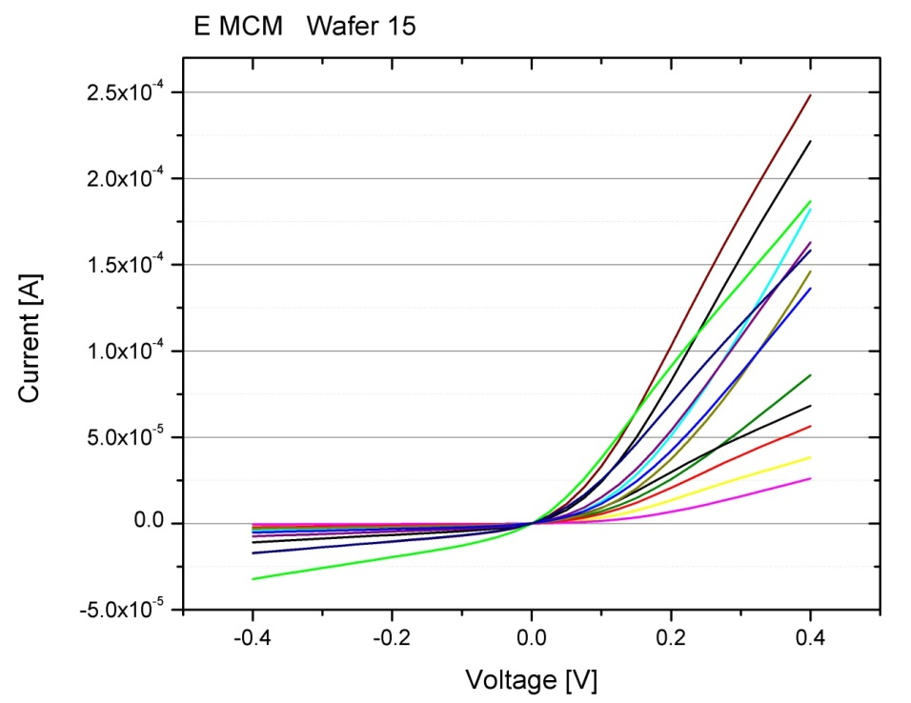
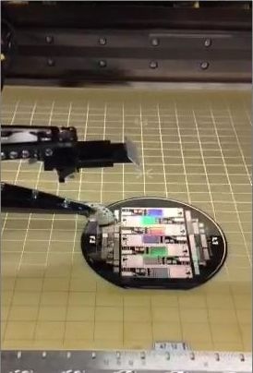
EMCM results – testing in the device → 2nd Lesson
Complex schematic and complex task:
:- 14 bump bonded ASICs – power, clock, JTAG, I/O… about different 2000 nets
:- test for shorts and breaks → ~100k measurements
:- define nets, extract coordinates, layout ←→ schematic, generate test file
:- find the right equipment manufacturer (“gray area” between PCB and ASIC testing)
:- ….
Finally, Feb. 2013:
:- ATG, a test equipment manufacturer succeeded to perform the first full tests on the EMCM
:- two “flying needles”
:- continuity checks: ~10% of the lines have breaks, mostly on not used signal and switcher lines
:- shorts between nets: almost all of the nets are shorted via the silicon bulk → diode characteristics
EMCM Wafer with 7 modules/wafer

Slide 5
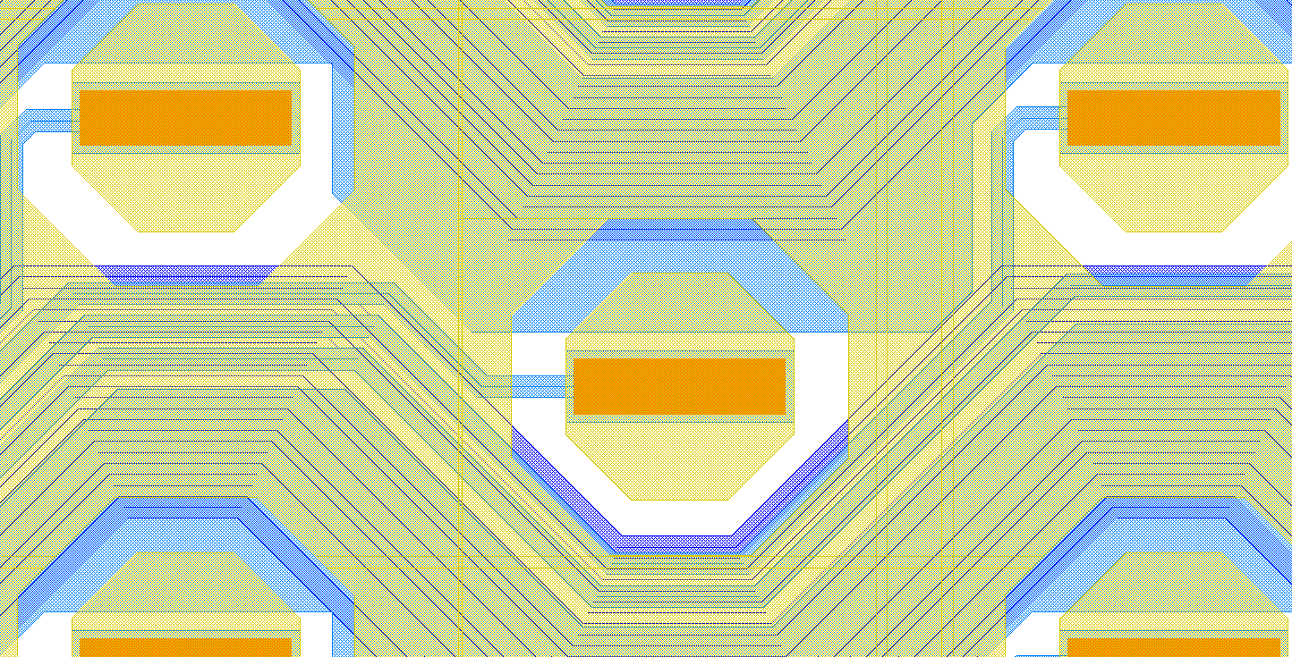
EMCM results – shorts to substrate
EMCM Wafer with 7 modules/wafer

Slide 6
Summarizing the issue – 3rd Lesson
:- problematic step is the contact etching to 1st Al
:- 1st ILD is too thick, contact holes too narrow
:- while etching the contact holes in 1st ILD, the base oxide is removed at the edges (only at edges ..!!!)
:- → short Alu to bulk after 2nd Al deposition → Schottky contact → diode characteristics
EMCM Wafer with 7 modules/wafer
3 µm is to little for 2 µm of ILD thickness
(~okay for 1 µm, but should be made safer)

Slide 7
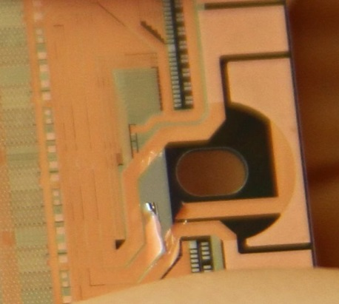
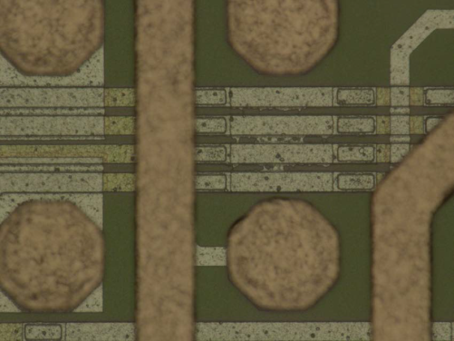
test-ZMI-5 … and more lessons
:- there are no dedicated test structures for this problem!!
:- after spotting the problem in test-EMCM-1, spot checks done on all wafers from test-ZMI-5
:- all 6 wafers are good, no shorts to bulk!!
:- What is different?
:- thinner ILD2 (1µm instead of 2µm) → less over-etching
:- base oxide is thicker: 200nm thermal + 400nm low temp. oxide
:- lithography on better equipment, better alignment …
:- finished, cut, ready for FC … but: … see Christian’s talk
:- 4th lesson: al2 residues when Al2 directly on al1
:- 5th lesson: possible BCB residues in al2/cu contact, if al1 below
:- 6th lesson: wider BCB frame at laser dicing line
:- 7th lesson: don’t use co1n for the EMCM … ;-)
EMCM Wafer with 7 modules/wafer

Slide 8
EMCM-1 + ZMI-5 + lessons learned = EMCM-2
:- 8 wafers, 7 EMCM each
:- thick field oxide
:- metal 1 (alu)
:- interdielectric (1µm oxide)
:- via 1
:- metal 2 (alu) ← this week
:- interdielectric (3 µm BCB)
:- via 2
:- metal 3 (4 µm copper)
:- solder stop - (3 µm BCB) ← 2nd week July
EMCM-1 stack

Slide 9
EMCM-2 layout changes I – al2 support lines
Old: switcher control lines
4µm Al2 gap
New: switcher control lines
8µm Al2 gap

Slide 10
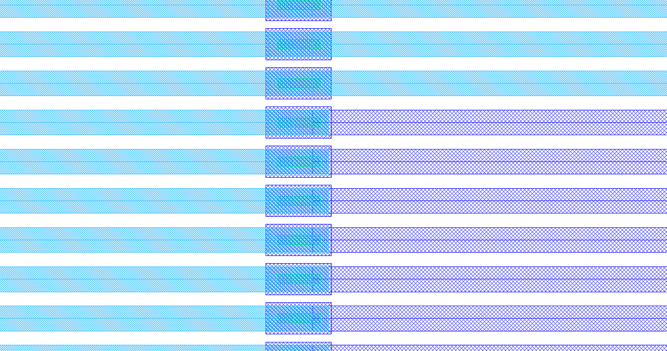
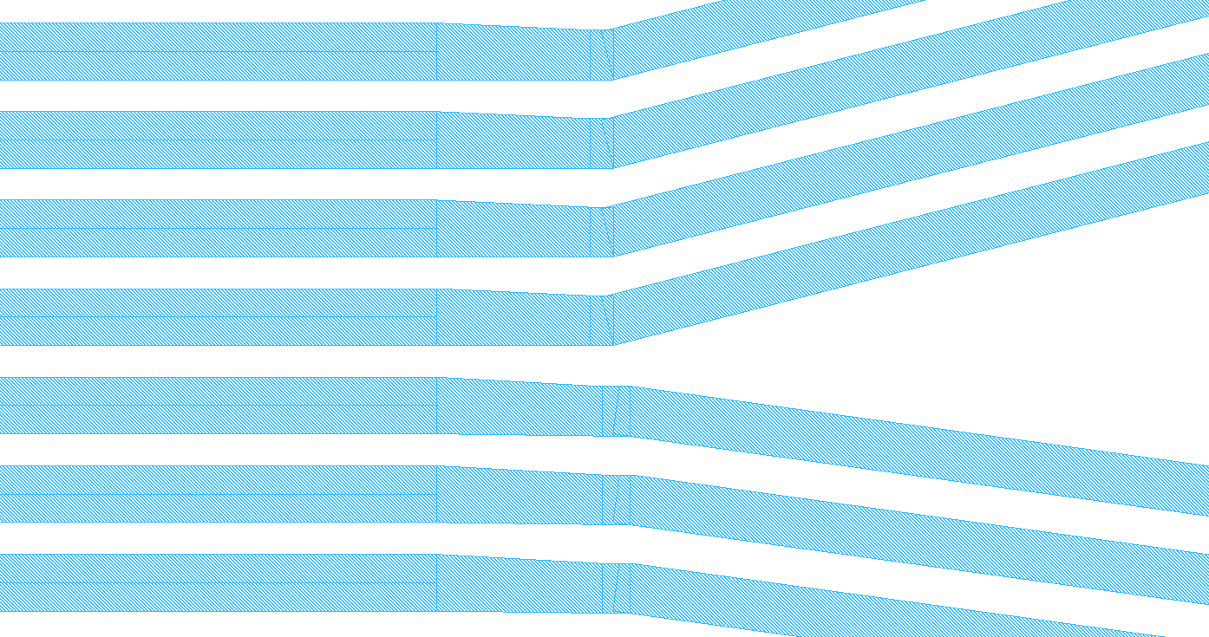
EMCM-2 layout changes II – DCD fan-in
Old: interleaved Al1/Al2 fanin
New DCD fan-in: only al2n lines
On top of punch-through
Bias structure (-80V)
→ thicker insulator to Al2
- less crossings
- slightly smaller pitch

Slide 11
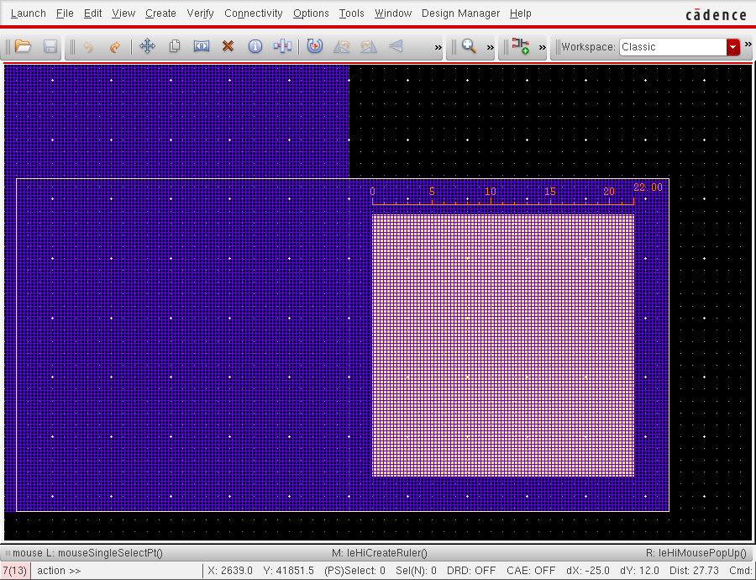
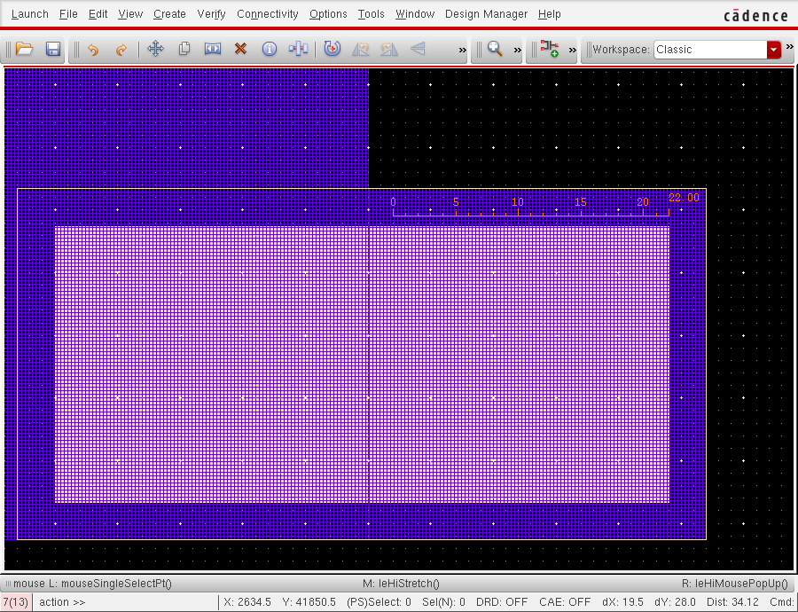
EMCM-2 layout changes III
:- al1/al2/Cu contact yield issues
:- 20µm seems to be to small for this topo.
Reasons:
:- non-optimal BCB lithography
:- co2n on top of co3n →stray light possible
Changes:
:- bigger co3n contacts
:- no direct overlay of co3n and co2n
:- optimized BCB exp./dev. time for this topo.

Slide 12
EMCM status in summary
:- two productions, many technological issues already found and understood
:- testing on bare substrate level was real challenge, now under control
:- from 10 EMCMs of the ZMI-5 test, 3 are usable and ready for FC
:- EMCM-2 batch started, now already at Al2 deposition
:- expect to be ready for probe needle testing in ~4 weeks
What are the next steps for the 3 EMCMs from ZMI-5?
EMCM Wafer with 7 modules/wafer

Slide 13
EMCM next steps – Flip chip
:- FC of DCDs/DHPs/SWB
:- original intention was to assemble 3 EMCMs only with one DCD/DHP/SWB branch
:- looking at the probe needle results one fully populated EMCM would be possible
:- should we go for it??
:- IZM Berlin is prepared to do the FC, as soon as we are ready …
:- processing time at IZM 2 weeks
:- IZM uses flux and reflow in separate oven, have experience with “our” copper from
Bonn DHP/DCD bump adapter assembly
EMCM Wafer with 7 modules/wafer

Slide 14
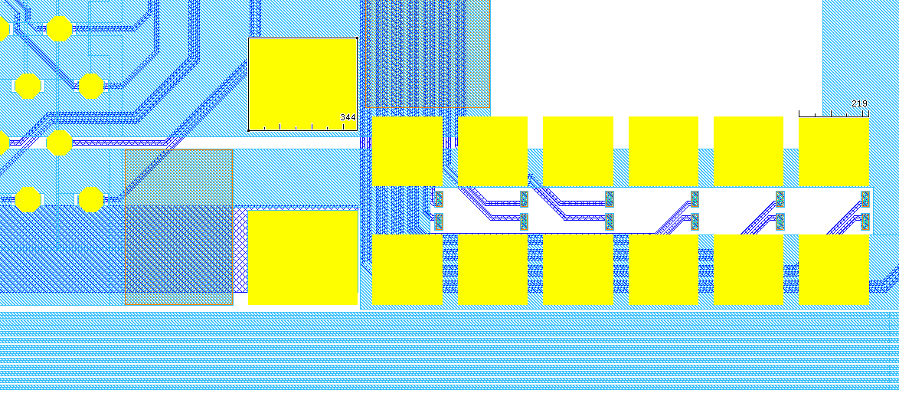
EMCM next steps – passives, R and C
:- ~50 0201 decoupling caps, ~20 01005 termination resistors
:- very small footprint of components (~220µm◻)!!
:- need for accurate dispensing of very fine solder paste
:- placement and soldering of passives
:- IZM does not have the equipment for this (dispenser with fine needles)
:- can be and will be done at Finetech in Berlin after FC
:- actual processing time hard to estimate, first trials to start in parallel to FC
EMCM Wafer with 7 modules/wafer

Slide 15
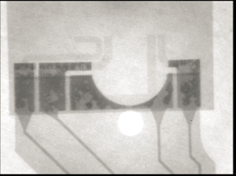
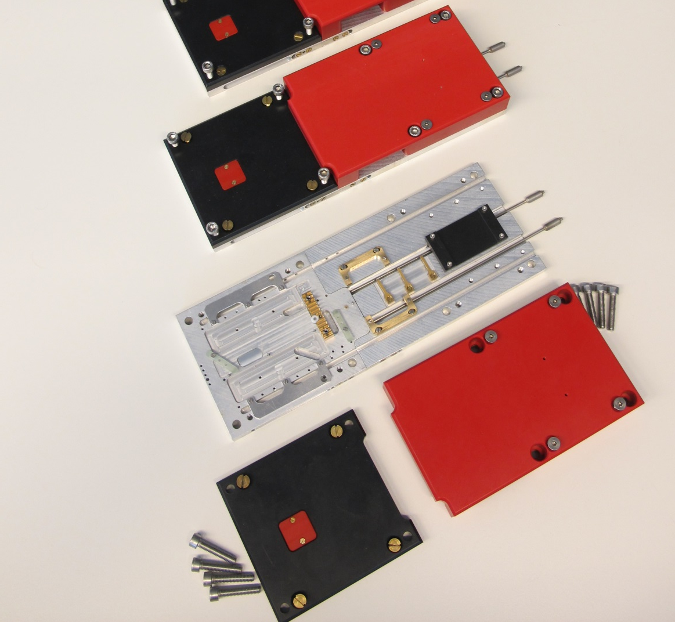
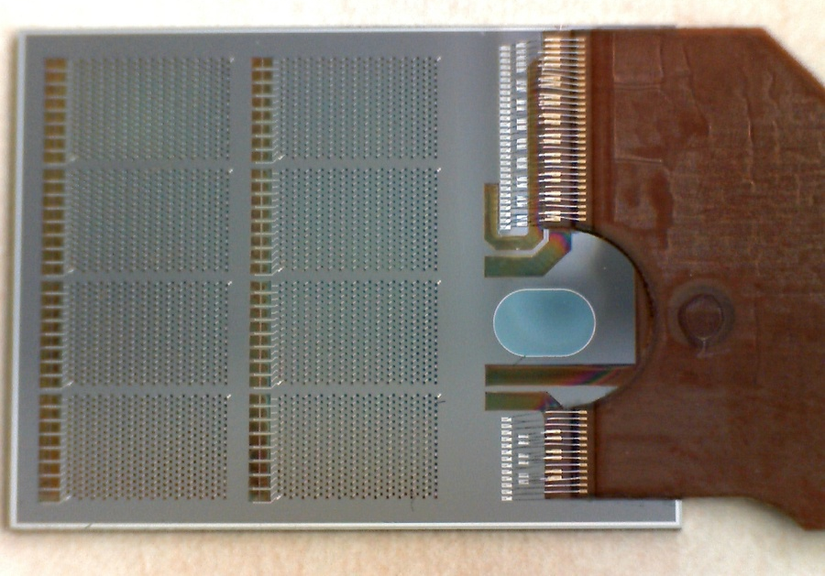
After the Flip Chip…
:- Assembly and test jig (MPI)
:- system test and evaluation
EMCM Wafer with 7 modules/wafer
DGND
AGND
DCD Amplow
DCD AVDD
:- Kapton attachment (soldering)
:- Wire Bonding at MPI

Slide 16
In Summary
already the production and first needle testing of the EMCMs lead to some changes and improvements
→ EMCM-2
FC and passives attachment scheduled at IZM and Finetech
FC at CNM/VLC still in optimization phase → Daniel’s talk
placement of the passives is critical
Finetech said, they can do it, remains to be shown
Kapton attachment at MPI
prepared, ready to start
we are bit short on kapton cables, new production is running ..

Slide 17
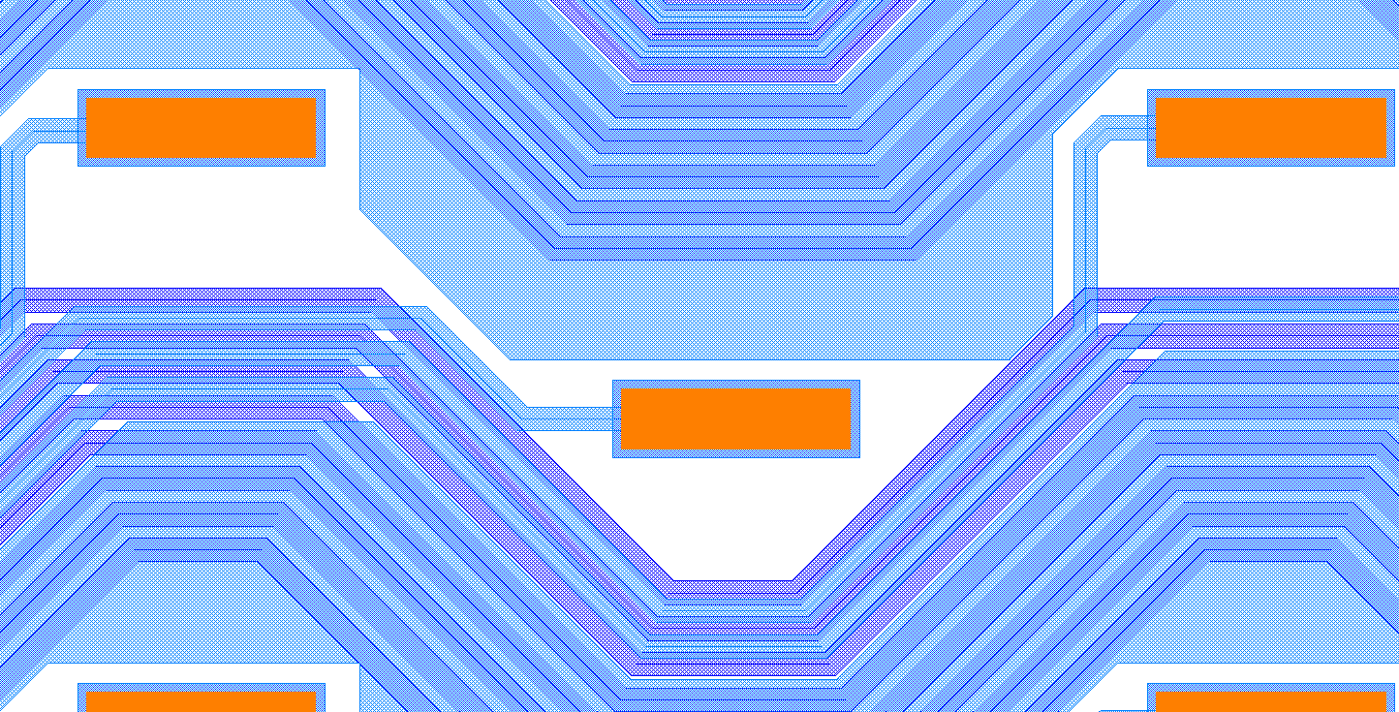
EMCM results – shorts to substrate
Oxidize substrate
Sputter 1µm 1st Al

Slide 18
EMCM results – shorts to substrate
Deposited 2 µm ILD
Etch contact to 1st Al

Slide 19
EMCM results – shorts to substrate
EMCM Wafer with 7 modules/wafer
Sputter 1µm 2nd Al
Deposit 3µm ILD2
Contact to 2nd

Slide 20
EMCM results – shorts to substrate
EMCM Wafer with 7 modules/wafer
Deposit Cu

