Slide 1
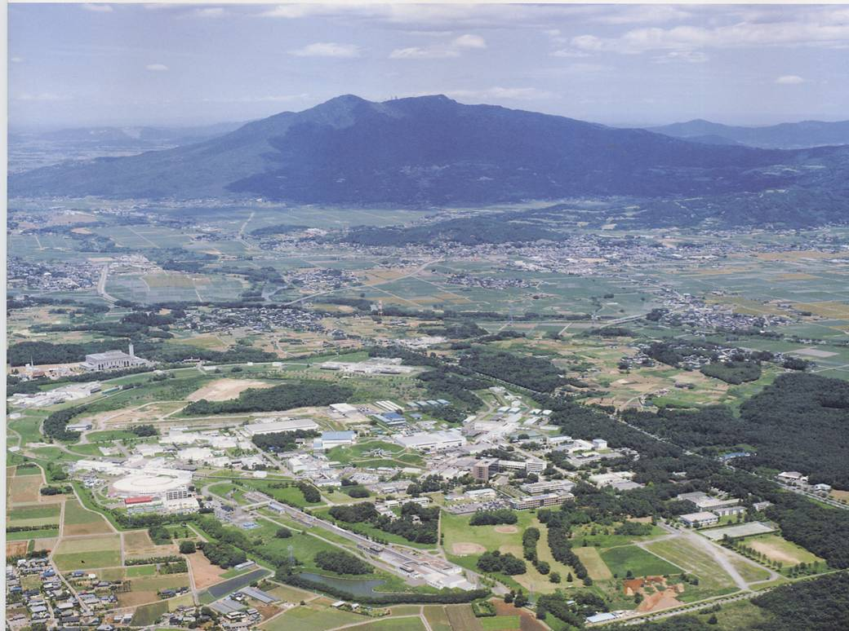


13th International Workshop on DEPFET Detectors and Applications
Ringberg, June 12, 2013
DEPFET as X-ray detector for synchrotron protein X-ray crystallography & SAXS experiments
Super KEK-B
Soichi Wakatsuki IMSS, KEK
Photon Science, SLAC
School of Medicine, Stanford
3GeV ERL (proposed)
cERL
6.5GeV PF-AR
2.5 GeV PF

Slide 2
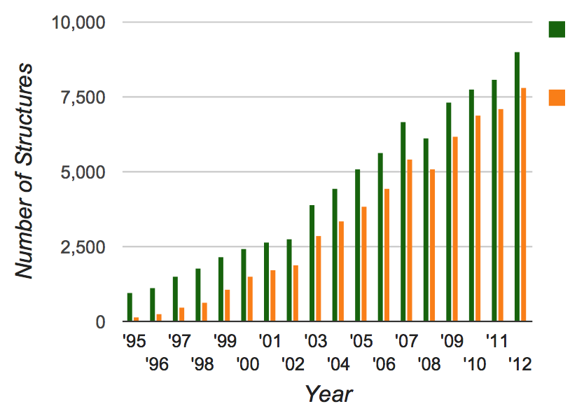
Protein Data Bank structure depositions determined by X-ray methods: total vs. synchrotron (130 beamlines)
Total
X-ray
http://biosync.sbkb.org/index.jsp
SR
Grand total as of June 5, 2013: 90196
Monthly downloads: 30 to 40 M

Slide 3
DEPFET Pixel Detector Project
High Energy Accelerator Research Organization
Institute of Materials Structure Science
Soichi Wakatsuki, Naohiro Matsugaki, Nobutaka Shimizu
Institute of Particle and Nuclear Science
Yutaka Ushiroda, Shuji Tanaka, Takeo Higuchi, Hideki Miyake
Toru Tsuboyama
Max Planck Institute for Physics, Munich
Hans-Günther Moser, Christian Kiesling, Jelena Ninkovic
Christian Koffmane, Felix Müller, Martin Ritter

Slide 4


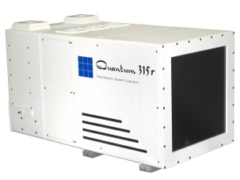
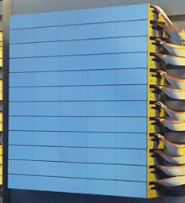
Needs of new detectors for protein xtallography/solution scattering experiments
Protein Crystallography
Solution scattering
Now Efficient data collection
Issue How to measure intensities of very small spots from micro beam/micro xtals
Now Protin folding & solution dynamics of protein-protein interactions
Issue fastest dynamics: ~msec
Targets: structure and dynamics of large complexes and membrane proteins
Required properties of X-ray detectors
High spatial resolution
High sensitivity
Large # of pixels
Fast readout
Large dynamics range
Detector | Effective pixel size | Readout speed | Dynamic range | Readout scheme
ＣＣＤ | 90 μm | 300 msec | 10⁴ | Integration
Hybrid PAD | 170 μm | 3 msec | 10⁶ | Streamlined
CCD（Quantum315r）
Hybrid PAD（Pilatus 6M）
Needs for fast & high spatial resolution 2D detector for micro/nano beam
Notes:
タンパク質結晶構造解析のターゲットは、生命活動に重要な働きをもつ膜タンパク質や、リボソームに代表される超分子複合体へ移ってきている。これらのタンパク質は本質的に構造が不安定であるため結晶からの回折強度が微弱であり、分子量が巨大であるため回折点の間隔が非常に密となる。構造を高い分解能で正確に決定するためには、微弱な反射を測定可能な空間分解能の高い二次元検出器が必須である。一方、タンパク質溶液の小角散乱による時分割構造解析においては、試料の高速混合技術によりサブミリ秒オーダーの時間変化を追いかけることが可能となってきている。この時間領域には、酵素反応に伴う構造変化やタンパク質のフォールディングなど興味深い対象があり、より詳細な空間的・時間的構造を解明するためには、広いダイナミックレンジかつ高い位置分解能を持つ画像をマイクロ秒オーダーで読み出す検出器が求められる。
現在、タンパク質の結晶構造解析や溶液小角散乱に用いられている検出器としては、CCD検出器(Charge Coupled Device Image Sensor) が多用されている。しかし、CCD検出器を用いる場合は、広い受光面積を実現するために回折X線を薄い蛍光体層で可視光に変換し、光ファイバーを束ねて絞り込んだ光学系を経由してCCDチップに導く。そのため回折X線を直接観測できる検出器と比較して感度、位置分解能の上で不利である。また、電荷を溜め込む蓄積型のセンサーであるため、微弱な信号はノイズの影響を受けやすい。そこで最近ではPILATUS(参考文献[1])に代表される、回折X線の直接観測が可能なフォトンカウンティング型の2次元イメージシリコン検出器が実用化され、実験に用いられ始めている。

Slide 5
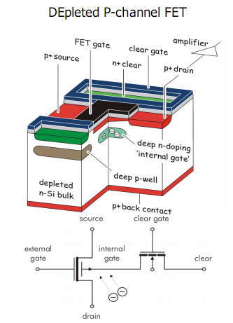
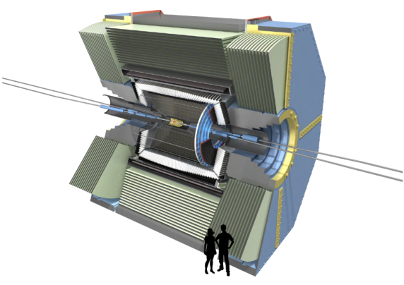
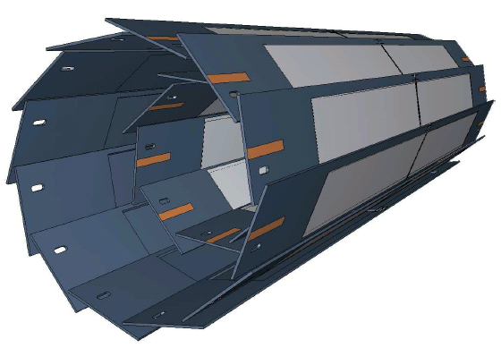
DEPFET （DEpleted P-channel FET）
Detector type | # of piexels | Eff. resolution | Readout speed | Dynamic range | Readout
ＣＣＤ | 16 M | 90 μm | 300 msec | 10⁴ | Integration
Hybrid PAD | 6 M | 170 μm | 3 msec | 10⁶ | Continuous
DEPFET | 8 M | 50 μm x 55μm (25 μm) | 20 μsec (Continuous) | 10⁷ (Integration mode) | Switchable between integration / continuous
（Up by 4~7）
（Up by 150）
Super KEK B-factory
μm
e⁻ (7GeV)
e⁺ (4GeV)
X-ray
Major development for structural biology appl.
① smaller pixels large area
② Fast readout: 20μs
Upgrade of KEK-B, Nobel Physics Award to Kobayashi & Masukawa (Expected to start operation in 2014)
Sensor chip development by Max Plank Institute, Munchen

Slide 6
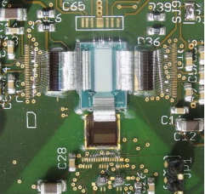
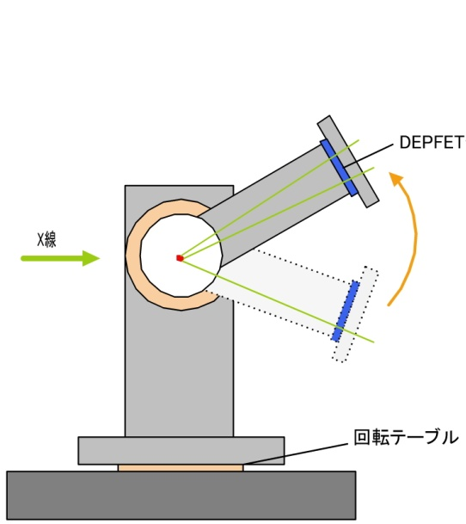
① Prep for developing the DEPFET detector
Preliminary experiments to characterize DEPFET sensors for structural biology applications
① － Ⅰ High spatial resolution images of diffraction patterns
  Check of spatial resolution and peak shape with small beam matched for small xtals
① －Ⅱ Fast readout data acquisition for solution scatterin gexperiments
  Protein folding and photo excitation dyanmics followed by time-resolved SAXS with 20 μsec time resolution
Small DEPFET sensor
256×64 pixels
DEPFET
X-ray
Design optimization of for large-are DEPFET detector system
Spatial resolution, sensitivity, non-uniformity, dynamic range etc.
Comparison with commercially available detectors
Rotation table
Pseudo large solid angle data collection using a rotation stage

Slide 7
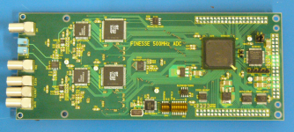
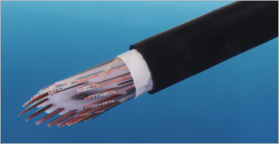
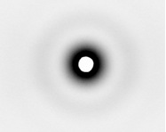
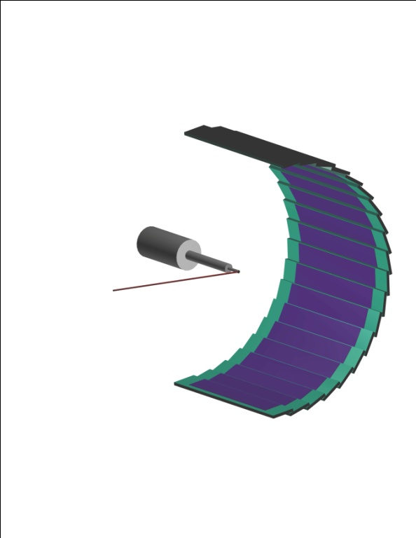
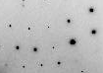
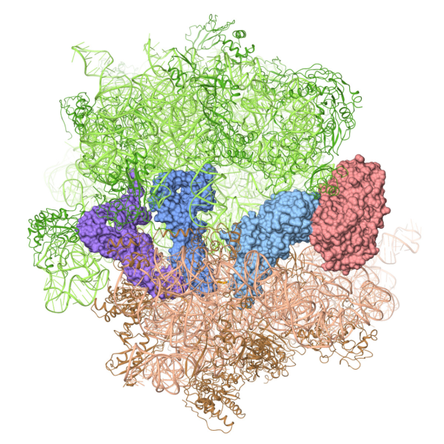
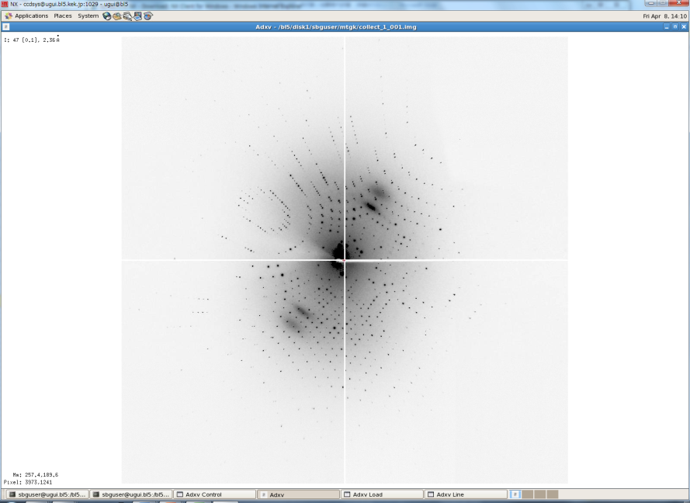
② Development of large area DEPFET detector
②－Ⅰ Ultrafast readout system
Crystallo-graphic analysis
8 bit/pixel
On-the-fly integration of max 50,000 images (24 bit/pixel)
Integration mode
⇒
Software for noise reduction
Large area censor
1536×256 pixels
ADC
Fast noise reduction
Max 1 Gbytes/sec
Fiber optics
Fast continuous mode
Protein dynamics
…
…
②－Ⅱ 8M pixel DEPFET detector based structural/dynamics analysis system
8M pixels with 20 DEPFET sensors
X線
Xtal
Data acquisition and analysis

Slide 8
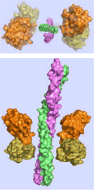
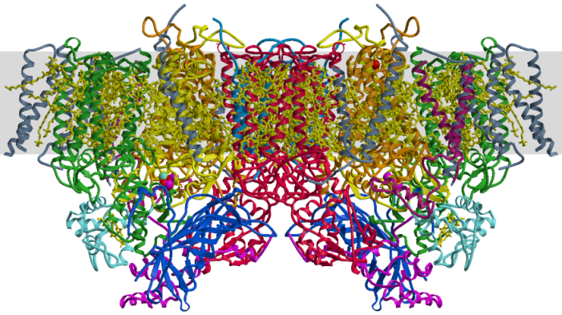
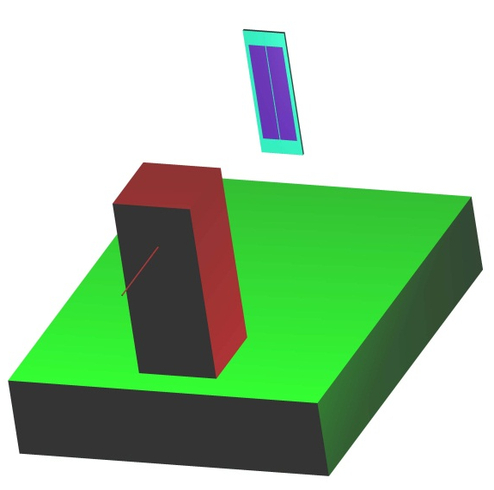
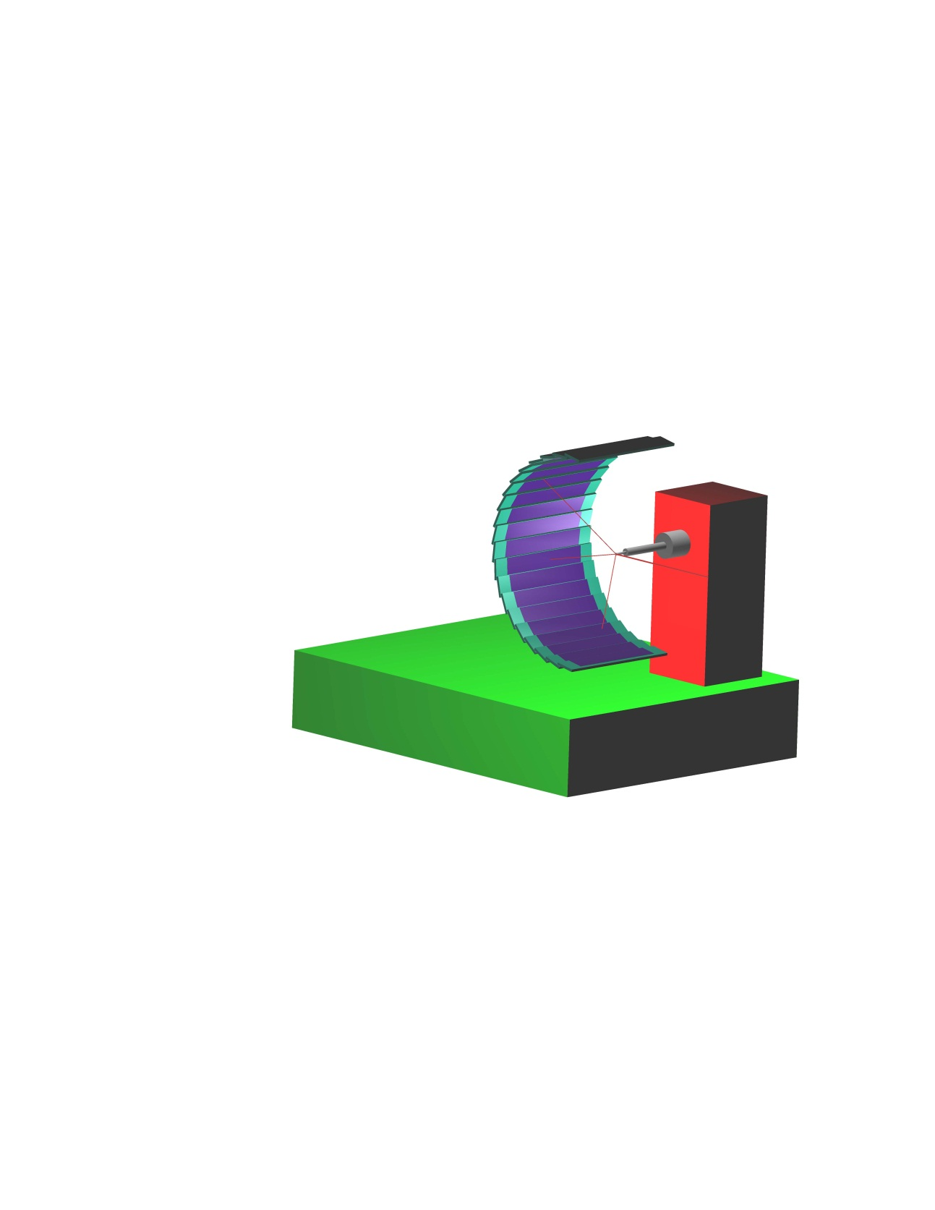
③ Applications to challenging targets
③－Ⅰ Structural analysis and dynamics of membrane protein complexes & large complexes
③－Ⅱ Solution studies of domain association-dissociation dynamics and kinetics of signalosomes
Structure dynamics of complexes involved in photo synthesis and respiratory chain： photo excitation dynamics
Structural changes of NEMO in complex with linear ubiquitin chains: NF-ｋB signal tranduction pathway involved in inflammation, apoptosis, and cancer
Photo excitation
Rahighi et al. Cell, 2009
Liq jet rapid mixing
IKKα・IKKβ・NEMO complex
Linearly ubiquitylated protein substrate
…
…
hν
20 μsec time resolution dynamics solution scattering experiments
Ring
Notes:
タンパク質結晶構造解析用に半円筒型に配列するためのDEPFETセンサーを20枚生産し、完成した新型DEPFET検出器を用いた高難度タンパク質の結晶構造解析および20μsの時分割溶液散乱の観測技術の方法を確立する。

Slide 9
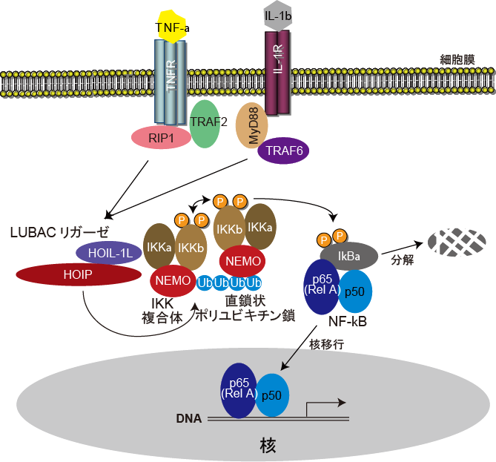
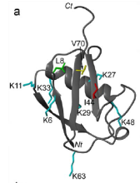
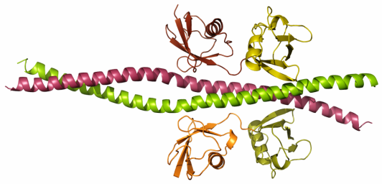
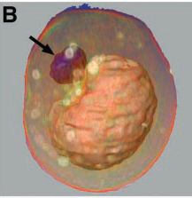
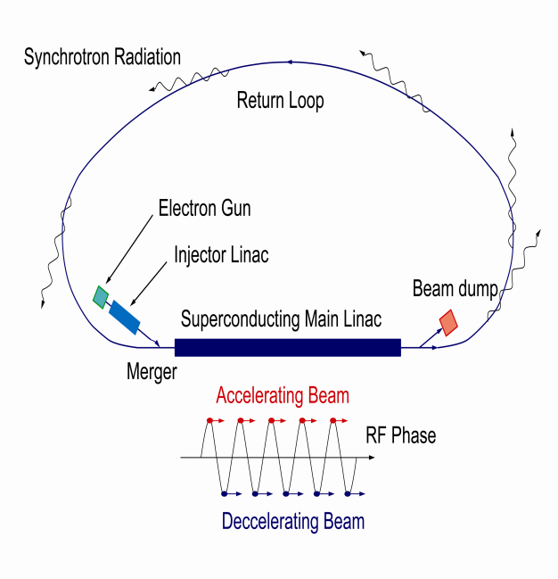
Dynamics of hierarchical structures: polyUb recognition
Membrane dynamics: GI-SAXS& GI-SANS
NF-kB pathway
Macroscopic structural changes ⇔ function
Hierarchical structure of ubiquitin recognition
Dynamics: NMR & SAXS
Protein Crystallography
Rahighi et al., Cell 2009
Figure by Carolyn Larabell
3 GeV ERL + XFEL-O
EM & SR X-ray tomography
Structural studies of polyubiquitin synthesis & recognition
In vivo analysis of drug delivery and signal transduction

Slide 10
Integrated Biology: correlated structural biology
O. Nureki
S. Iwata
J. Takagi
S. Wakatsuki
Dynamic
SAXS/SANS
MRI/cell imaging
Dynamics
Degree of in vivo nature
in situ
NMR
Cryo-tomography
Fluorescnece (optical) microscopy
Static
in vitro
Single particle analysis
PX
High
Theory & Computation
Spatial resolution
Mass Spec
Low
Organic synthesis
☆ Seamless connections of different structural methods

Slide 11
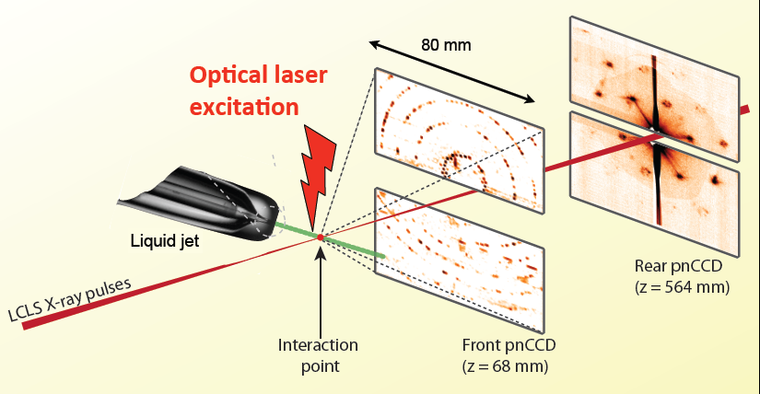
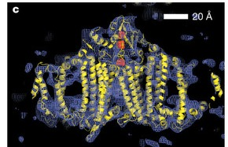
Femtosecond nano-crystallolgraphy using XFEL
Structure determination of submicron crystals have been impossible due to the limitation in brightness of X-ray beams from storage rings and radiation damages. XFEL solves both problems by providing 10¹⁰ times higher peak brightness and 1 to 100 fsec X-ray pulses which allow “DIFFRACT BEFORE DESTRUCTION (diffract and destroy)”
Chapman et al., Nature, vol 470, 73-78, February 3, 2011
Photosystem I structure

Slide 12
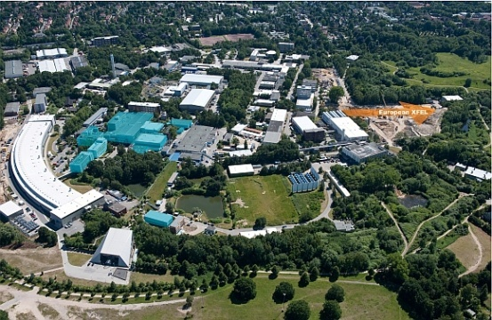
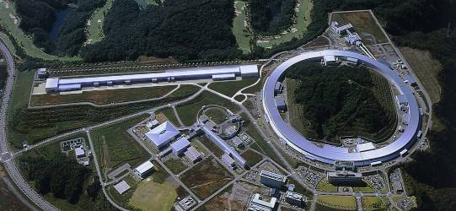
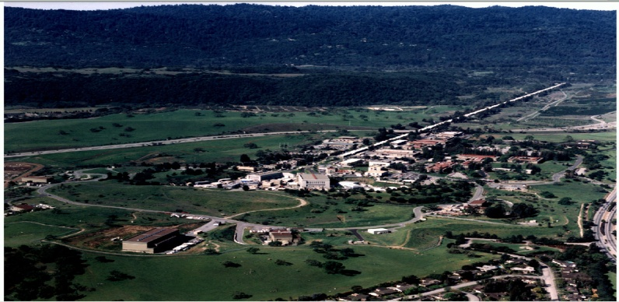
XFEL Developments: 3 large facilities
 | Europe DESY：Deutsches Elektronen-Synchrotron European X-ray Free Electron Laser | Japan RIKEN & JASRI SACLA：SPring-8 Angstrom Compact Free Electron Laser | US SLAC National Accelerator Laboratory：Stanford Linear Accelerator Center LCLS: Liniac Coherent Light Source
Total length | ca. 3.3km | 0.7 km | 4 km
Electron energy | 10～20 GeV | 8 GeV | 14 GeV
Photon wave-length | 0.85 A | 0.6 A | April 2009, 1.5 A December 2009, 1.2 A
Operation | 2015 | 2011 | 2009
Hamburg, Germany
Harima, Japan
Stanford, USA

Slide 13
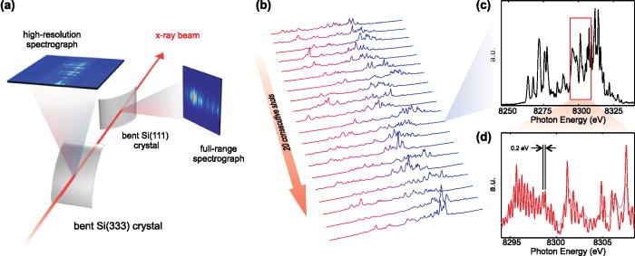
FIG. 2. (a) Schematics of the experimental setup. (b) Example of SASE spectra for 20 consecutive pulses recorded using the full-range Si(111) spectrometer. (c) The full-range Si(111) spectrum and (d) the high-resolution Si(333) spectrum of the same individual pul...
D. Zhu et al., Appl. Appl. Phys. Lett. 101, 034103 (2012)
© 2012 American Institute of Physics

Slide 14
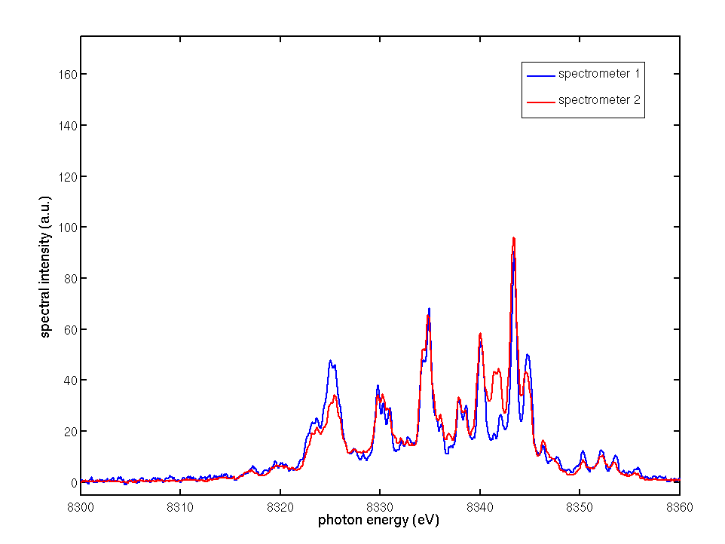
Measuring spectra of each XFEL pulse
the Si(111) spectrometer resolution of 0.49±0.02 eV
Si(333) spectrometer, the resolution lower bound 0.13 eV
D. Zhu et al., Appl. Phys Lett. 101, 034103 (2012)
Courtesy of David Fritz

Slide 15
Data Collection (William Weis)
~ monochromatic
- all partially recorded reflections
detector
X-ray beam
X-ray beam
Maximum λ λ
Minimum λ λ
Small energy spread
- some fully recorded reflections

Slide 16
KEK-PF beam test status report
2013/02/16 Belle II PXD/SVD Workshop and 12th International Workshop on DEPFET Detectors and Applications
Wetzlar, Germany
Hideki MIYAKE (KEK)

Slide 17
KEK-Photon Factory Test Beams
High Energy Accelerator Research Organization
Institute of Materials Structure Science
Soichi Wakatsuki, Naohiro Matsugaki, Nobutaka Shimizu
Institute of Particle and Nuclear Science
Yutaka Ushiroda, Shuji Tanaka, Takeo Higuchi ^{(*)}, Toru Tsuboyama, Hideki Miyake
(*)IPMU
Max Planck Institute for Physics, Munich
Hans-Günther Moser, Christian Kiesling, Jelena Ninkovic, Christian Koffmane, Felix Müller, Martin Ritter

Slide 18
Overview
Application of DEPFET sensor for material science (X-ray diffraction of protein crystal)
Employ almost same setup as previous series of experiments (‘11 Nov. and ’12 Mar.)
  KEK Photon Factory 12KeV beam (BL-5A)
  S3B system (ILC type)
  XYZ rotational stage (this time 2D only)
NEW feature
  Combination of PF beam line system with DEPFET DAQ
  Concatenation of multiple images (virtual large surface detector up to 8 Mega pixel)
  This time perform 100x100 mm² scan

Slide 19
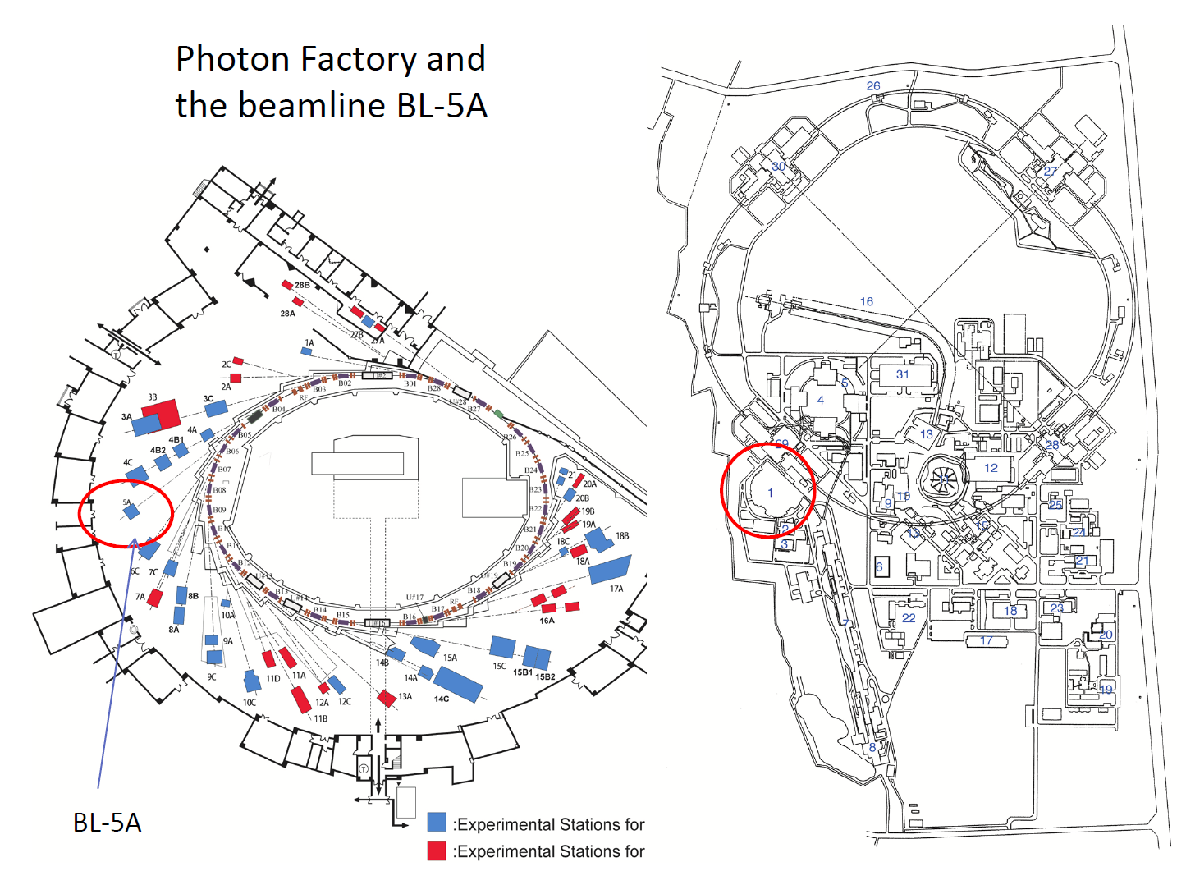
Experimental apparatus
BL1A
BL10C

Slide 20
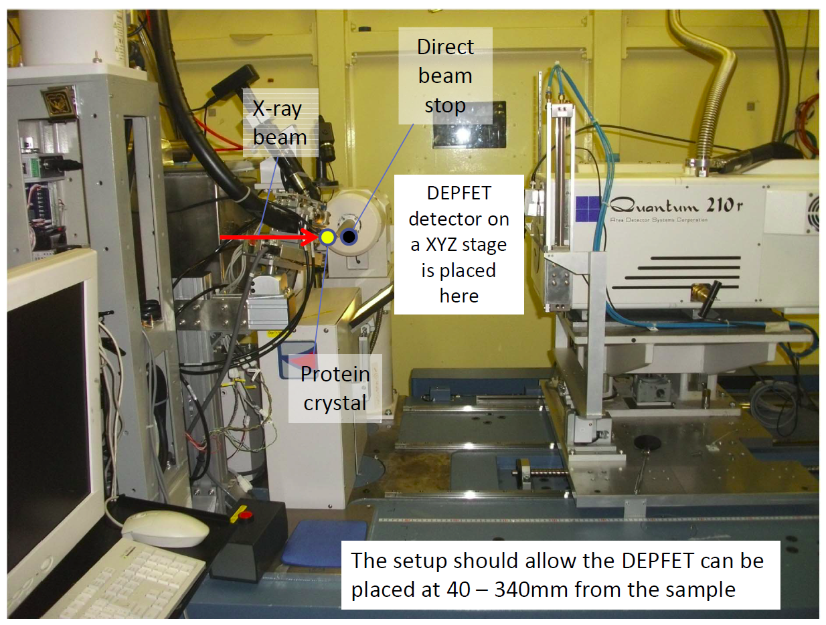
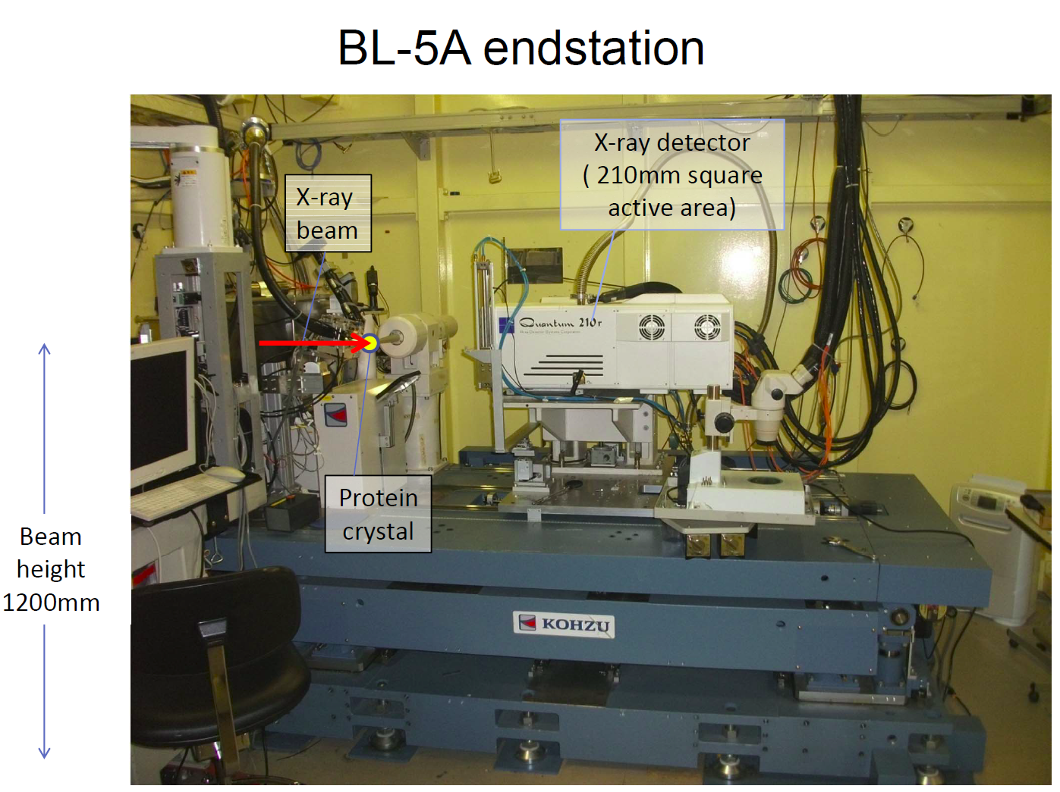

Slide 21
Experiment outline
Preparation of S3B system at MPI
Preparation of XYZ rotational stage at KEK
Experiment at KEK-PF (last Nov.)
Offline image concatenation
  ROOT histogram (useful for HEP guys)
  Visible PNG file
  PILATUS compatible image (based on 32 bit TIFF), necessary for various X-ray diffraction analysis tools

Slide 22
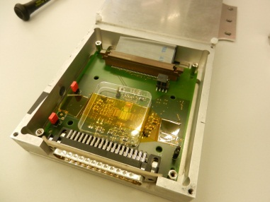
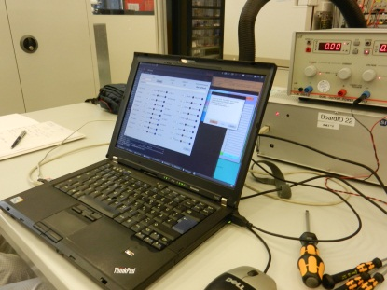
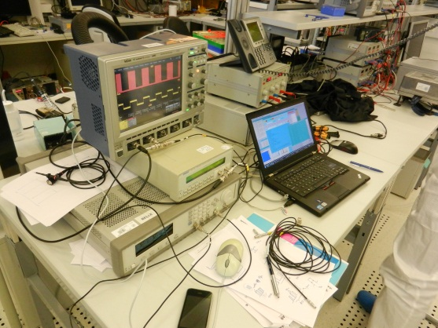
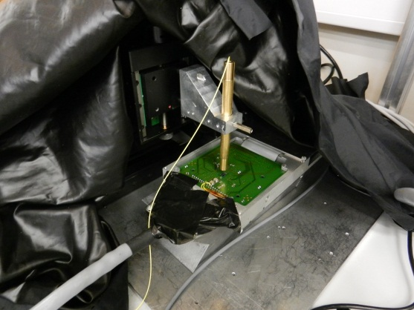
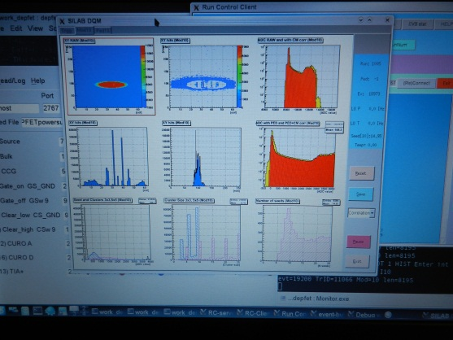
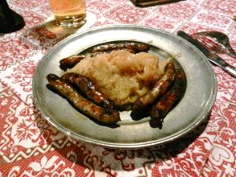
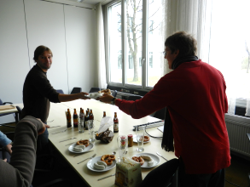
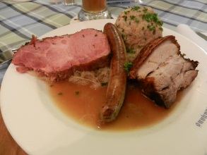

Miyake: MPI days at a glance
Learning of system operation
Test of burst mode trigger
  Finally employ random mode
Confirmation by laser spot
Thank you for warm hosting!
  Especially Christian, Felix, and Paola

Slide 23
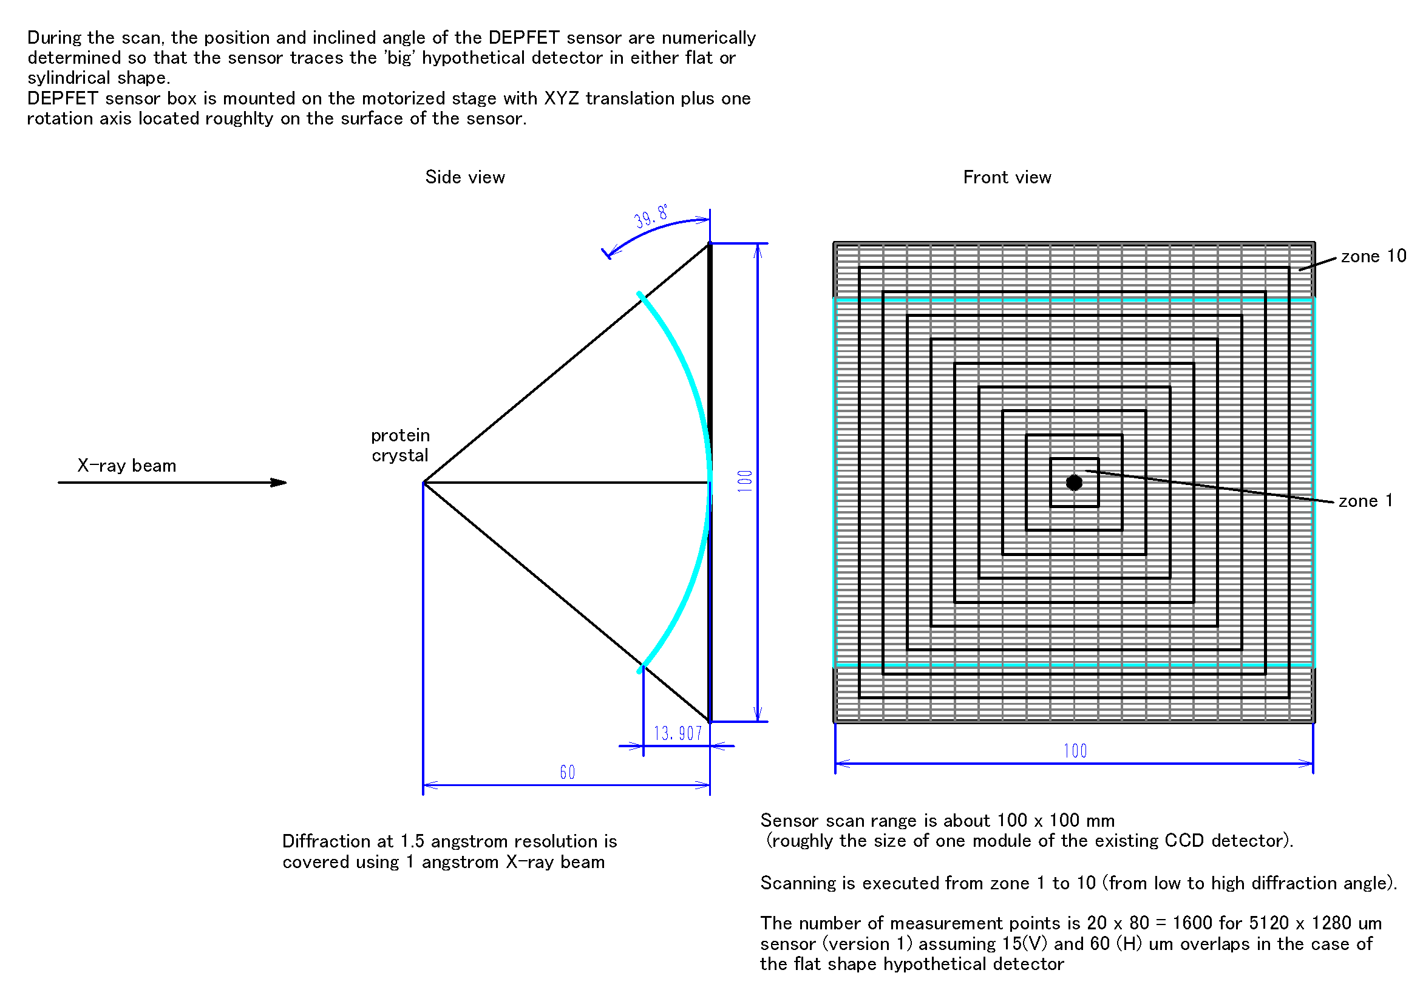
Stage control
This time, only 2D movement is performed

Slide 24
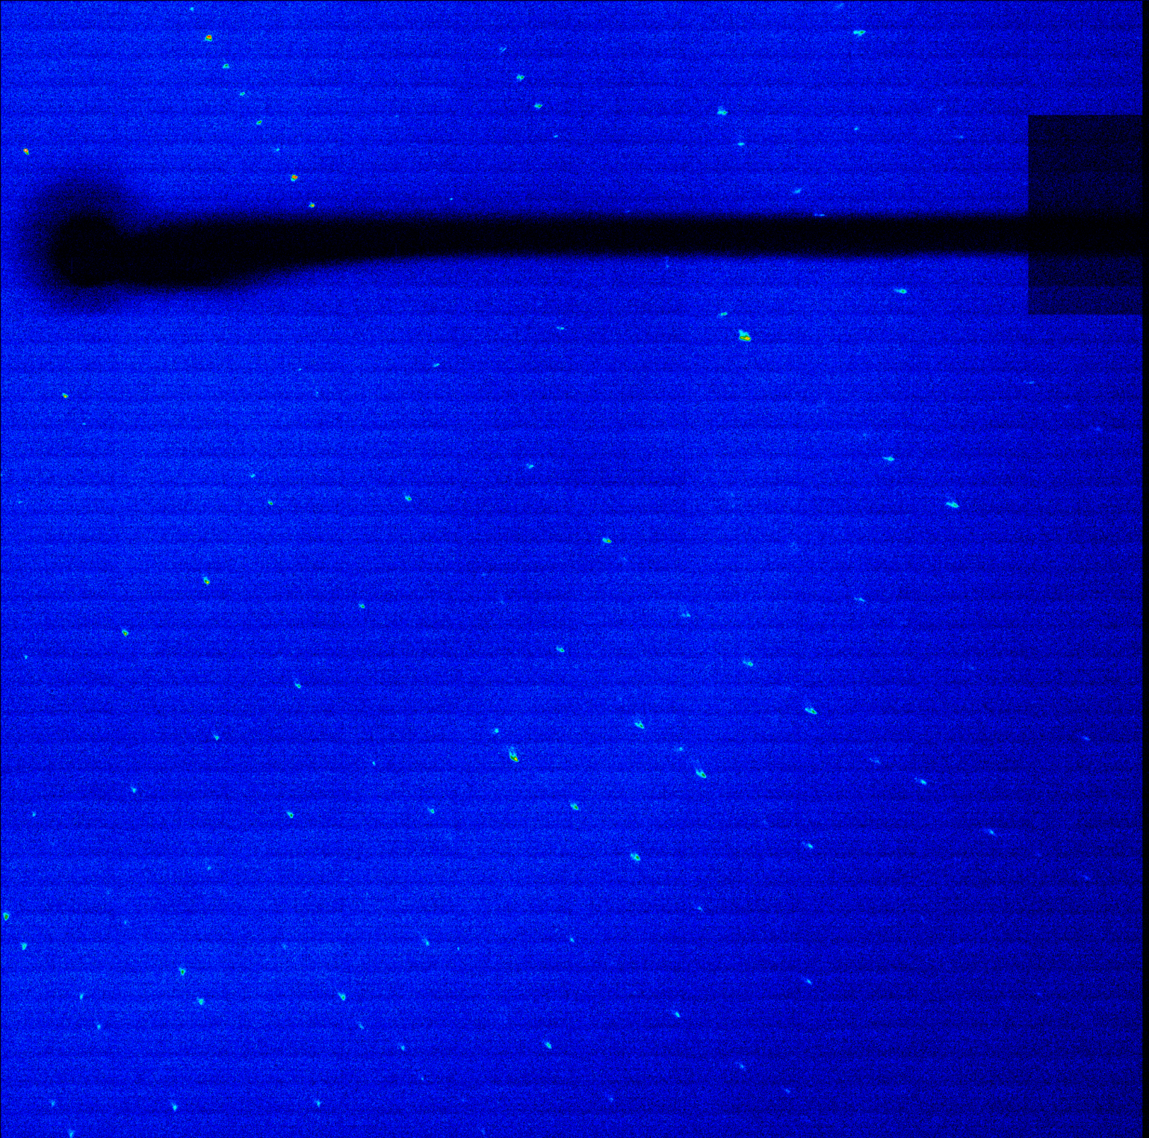
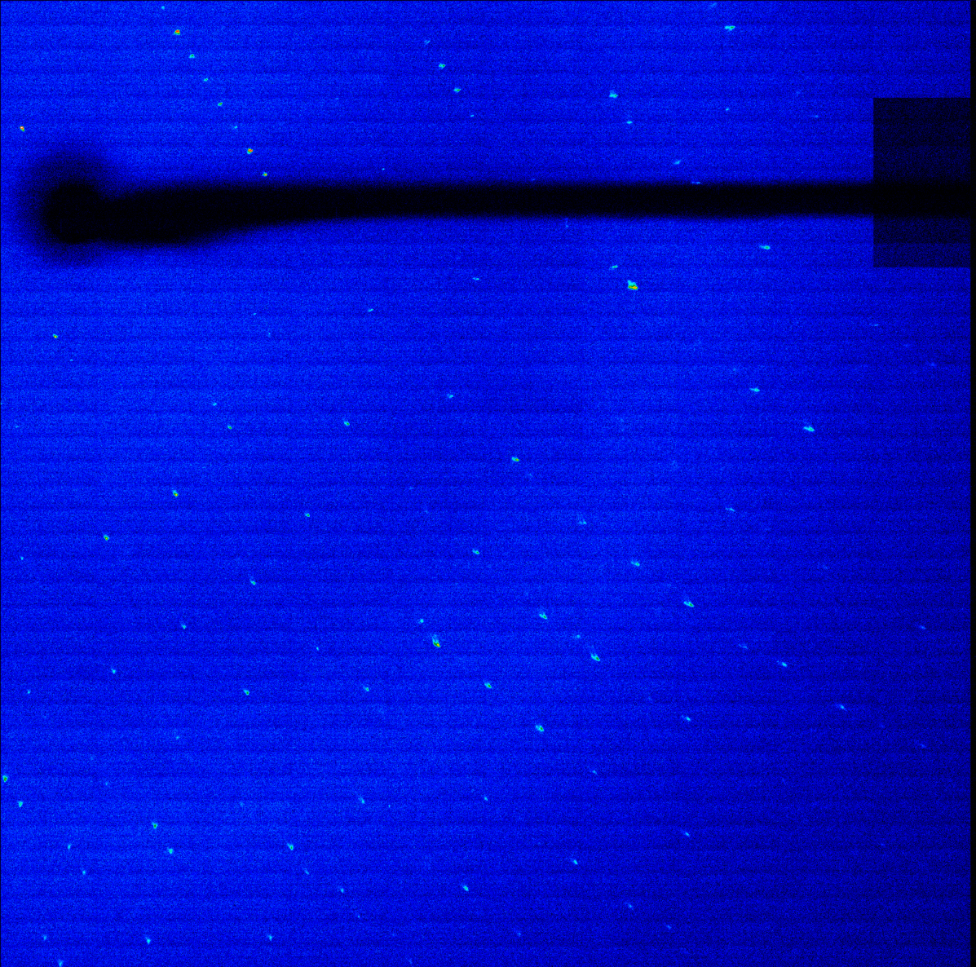
2D hitmap
- Employ DEPFET software library for Belle II (Many thanks to Martin Ritter!)
- Not cover all of available zone (due to accidental beam loss)

Slide 25
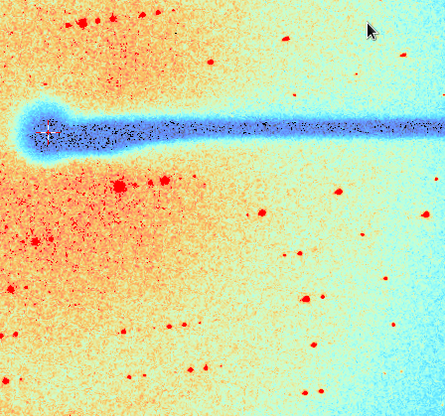
2D hitmap
- Employ DEPFET software library for Belle II (Many thanks to Martin Ritter!)
- Not cover all of available zone (due to accidental beam loss)
Clear advantage!
CCD
(different sample)

Slide 26
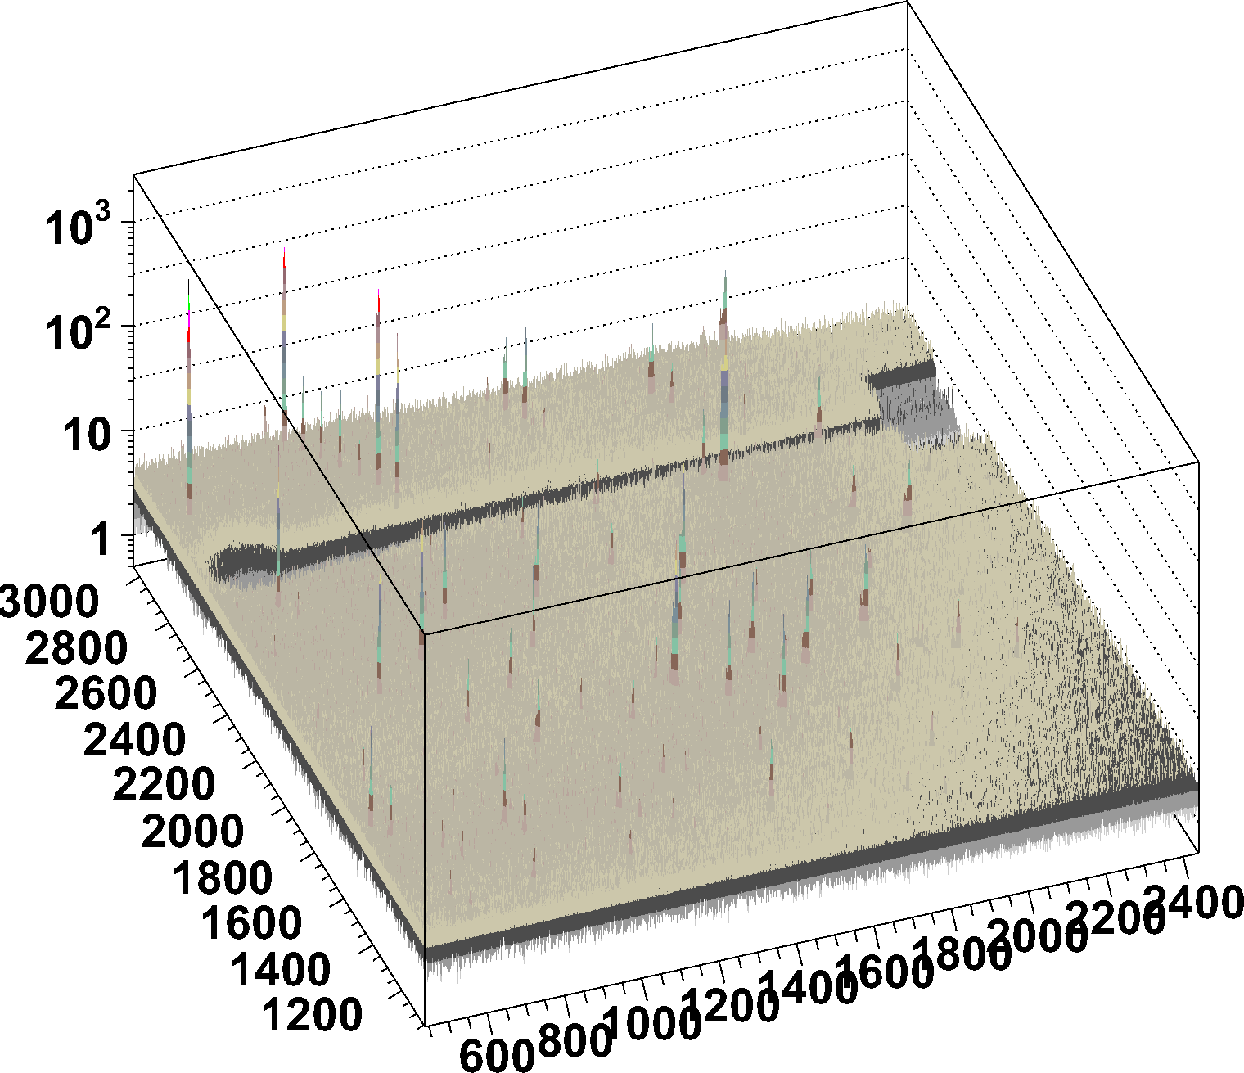
3D distribution (log scale)
Pixel-by-pixel ADC distribution is shown
ADC/ped
Y
X

Slide 27
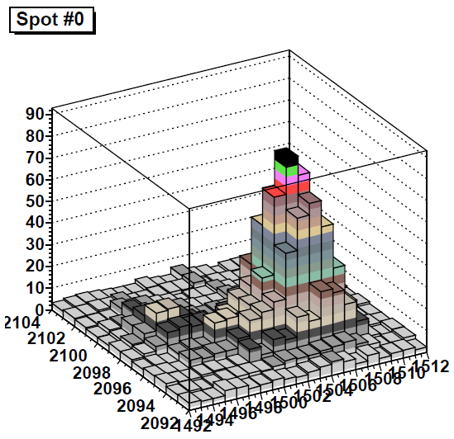
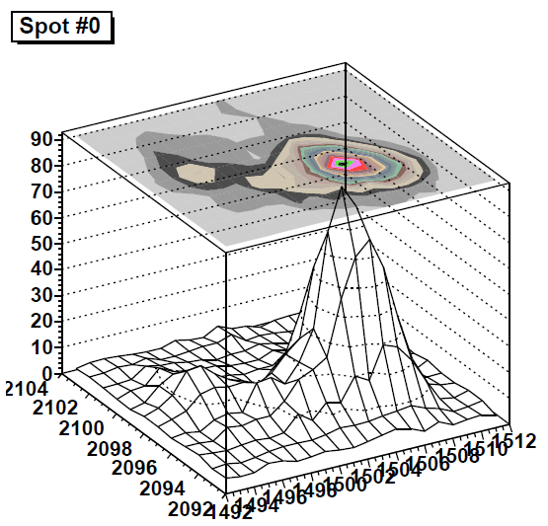
ADC profile@spot
Normalized by pedestal
Shown by linear scale
ADC/ped
ADC/ped
y
y
x
x

Slide 28
Plan: data analysis
Finalize offline analysis (e.g. frame by frame)
Precise comparison with PILATUS data
3D rotation to avoid image distortion
Switch to PXD system (large surface, fast DAQ)
  Time dependent analysis of protein dynamics

Slide 29




Uniformity test (May 7, June. 6)
X-ray ( ) generator
$$\tilde{>}$$
17keV
Intensity (arbitrary unit)
X-ray wave length / Å
Generate (near) flat and characteristic energy X-ray using Molybdenum target
Assure flatness of the source by individual measurements around the center (five points)
Intensity is controlled by Aluminum plates so that each cluster is not overlapped
Analysis of the result is ongoing

Slide 30



Upcoming SAXS experiment using DEPFET on PF-BL10C, June 13-15, 2013
DEPFET to be mounted on this stage
Sample: collagen fibre
Future SAXS experiments: time-resolved SAXS on structural changes

Slide 31
DEPFET system for PF applications
DEPFET system: (tentative idea)
DEPFET sensor: by MPI
KEK should define sensor size thickness, pixel size, # of sensors
ASIC chips: DHP, Switcher, DCD*
same as Belle-II PXD (by DEPFET collaboration)
KEK group should define readout scheme by consulting by MPI
Kapton flex
Similar with PXD but could be shorter (Shuji)
DHH
same as Belle-II PXD (by DEPFET collaboration)
Readout PC system
preparation by Higuchi-san
Module assembly: @MPI
System test: @MPI?
Mechanics
Prepared in Japan
Cooling: water cooling
Prepared in Japan

Slide 32
Schedule
FY2011-FY2013 (fiscal year: April 1 to March 31)
  R&D (beam test@PF)
  Design to be finalized
FY2014-FY2015 (March 31, 2016)
  Sensor system production
  Final beam test with DEPFET system

Slide 33
Summary and future prospects
DEPFET: hybrid of detector developments in high energy physics and structural biology. Half cylindrical shape for lower energy data collection
  FY2013: critical decision on (1) the large production and (2) half cylindrical or flat design.
  Application to future protein crystallography, small angle X-ray scattering, XPCS (X-ray photon correlation spectroscopy)
  Possible future applications to XFEL nanocrystallography for two-color modes: need for smaller pixels.

