Slide 1

PXD – DEPFET
PS noise emission tests
Mateo Iglesias
Fernando Arteche

Slide 2
Outline
1.Introduction
2. Conducted emission test
  Test set-up
  Test results
  Filtering
3.Radiated noise emission test
  Test set-up
  Test results
4.Conclusions

Slide 3
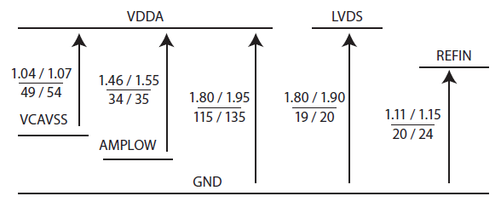
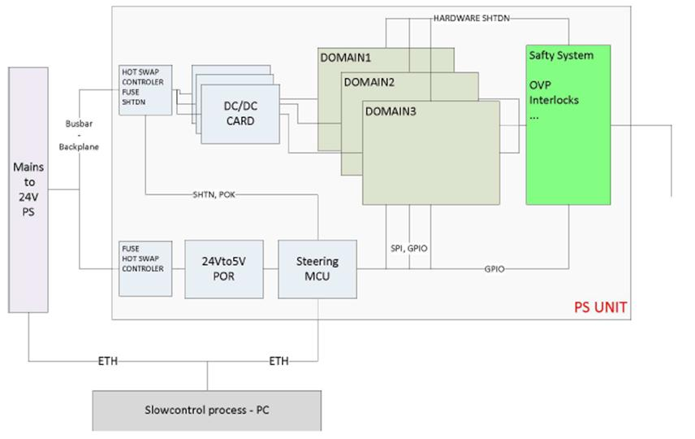
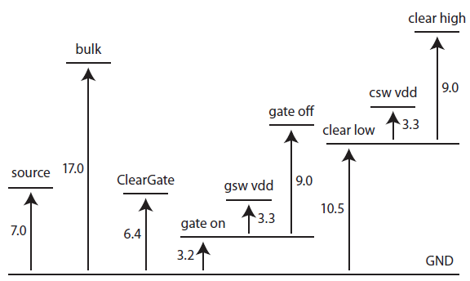
1.Introduction
PS system of PXD is very complex – (Many voltages)
It has three main components
  DC-DC converters
  Regulators
  Master controller unit
DCD VOLT
DEPFET VOLT

Slide 4
2. Conducted noise emission test
A prototype of the PS unit has been tested at ITA
PS characteristics :
  Input characteristic : 24V / 2.49 A input
  5 DC-DC converters & 16 output lines
Test procedure is based on MIL-STD/ EMC test at ESA
  It has been already performed in HEP – CMS-LHC
The test layout should represent the worst case in terms of current emissions following a topology as close as possible to the final PS system
  The PS and load are connected in such a way that creates a very low impedance path for CM & DM currents
  Measured values are equal or higher than the real ones – Safety margin.

Slide 5
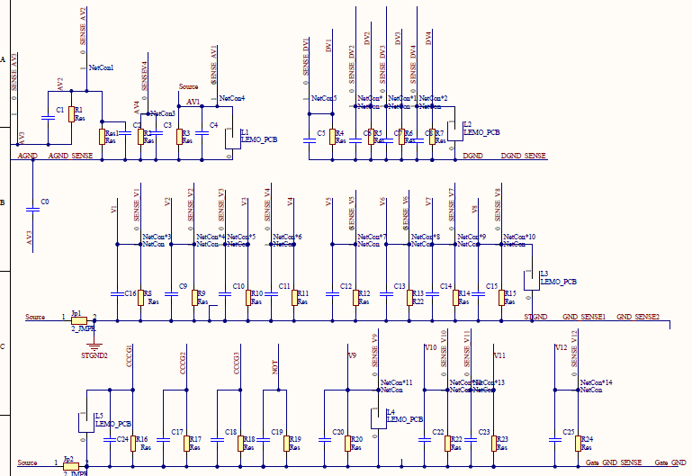
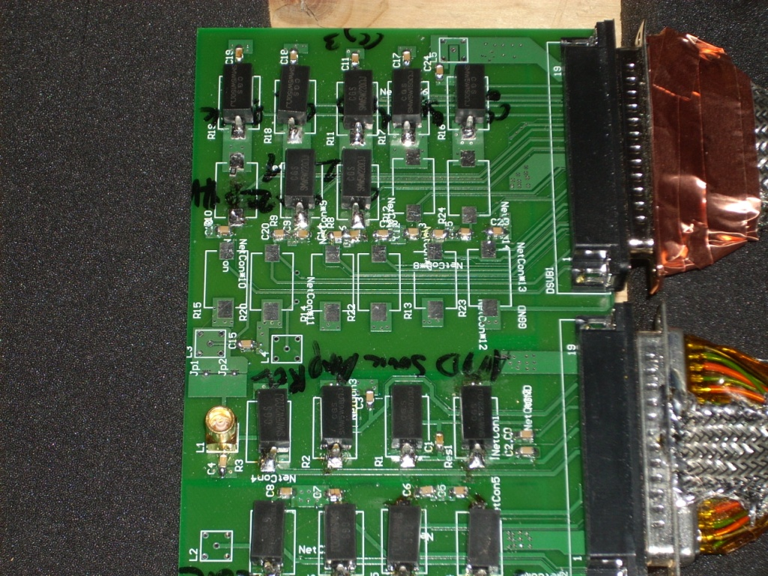
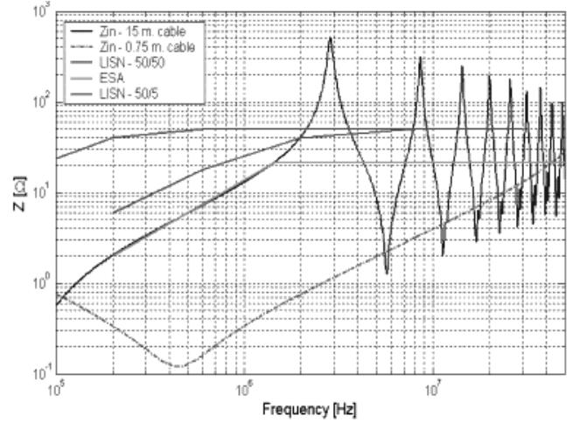
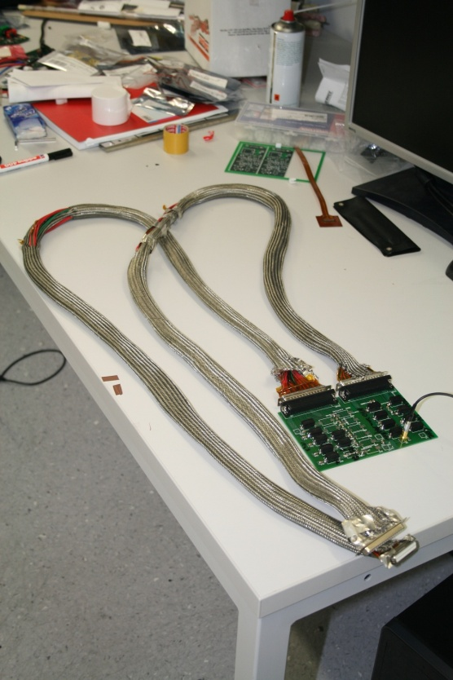
2.1 Conducted noise: Test set-up
LOAD : A set of resistances
  It does not generate noise:
CABLE : Short cable
  It minimizes cable resonance and normalizes impedance

Slide 6
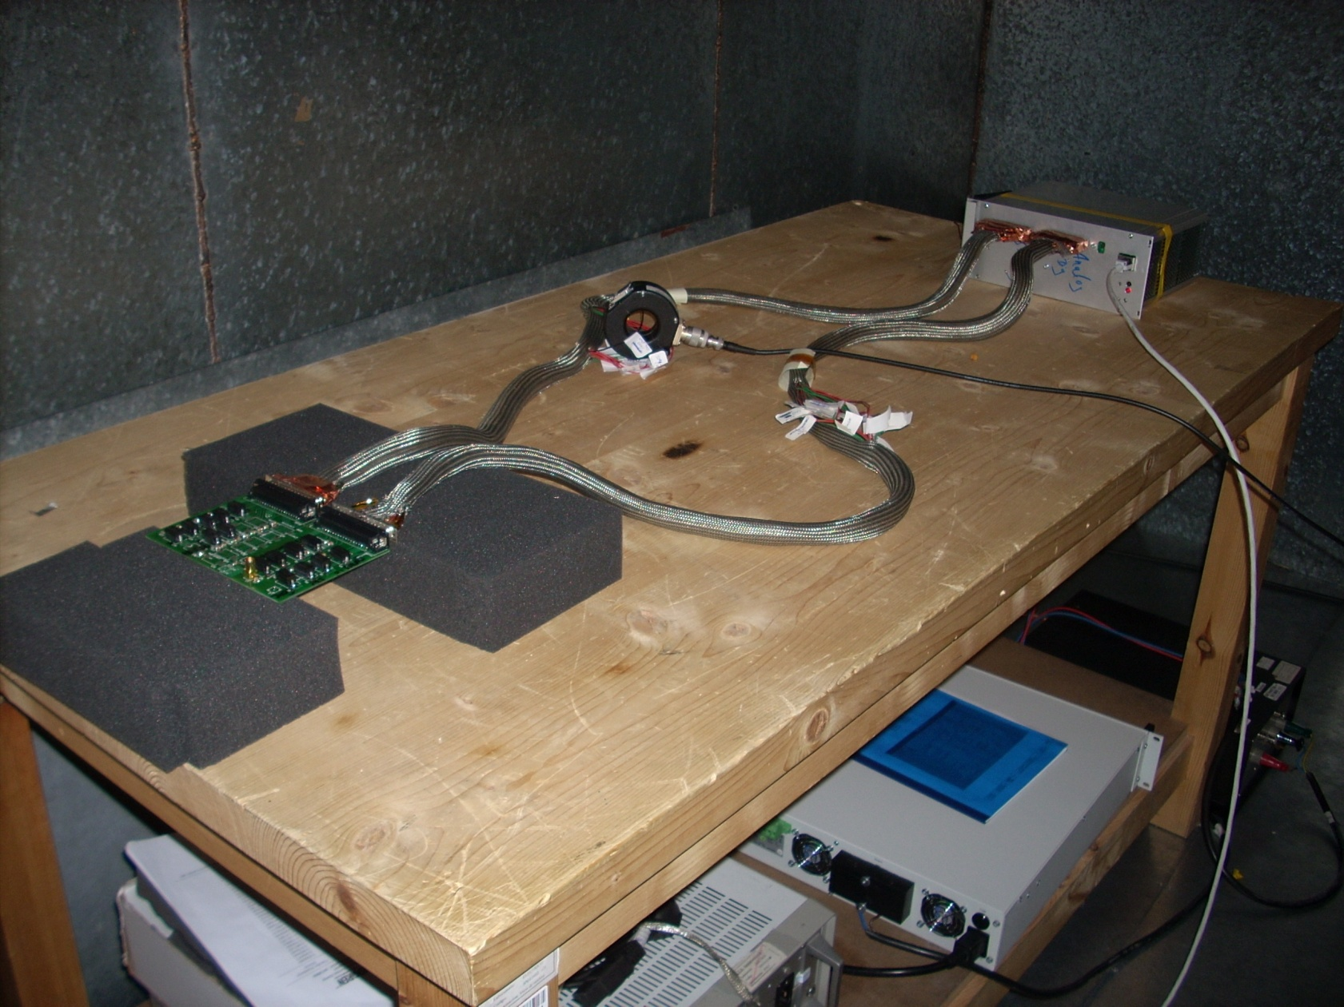
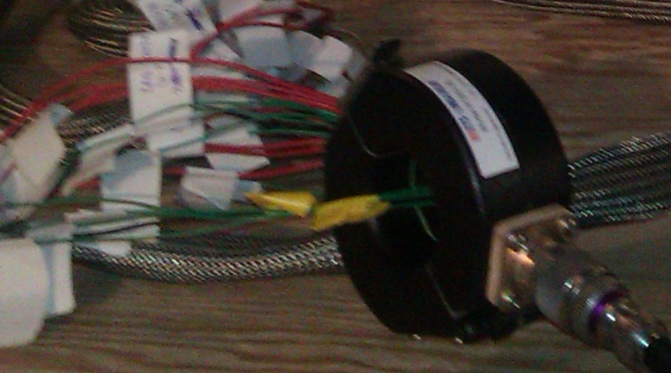
2.1 Conducted noise: Test set-up
PS unit
Cable
LISN
Load
Auxiliary PS (24 V)

Slide 7
2.1 Conducted noise: Test set-up
The conducted noise emissions have been measured in a Faraday chamber with:
    Spectrum Analyzer
    Current probe
  Frequency range : 10 kHz – 50 MHz
  Several operation modes have been measured
    Off, Standby and Reg. On
  Noise identification
    1 CM per converter - 5 CM noise
    Line noise - CM + DM
  It will help to fix corrective actions in case they are necessary.
  Two working conditions – Standby / Reg on

Slide 8
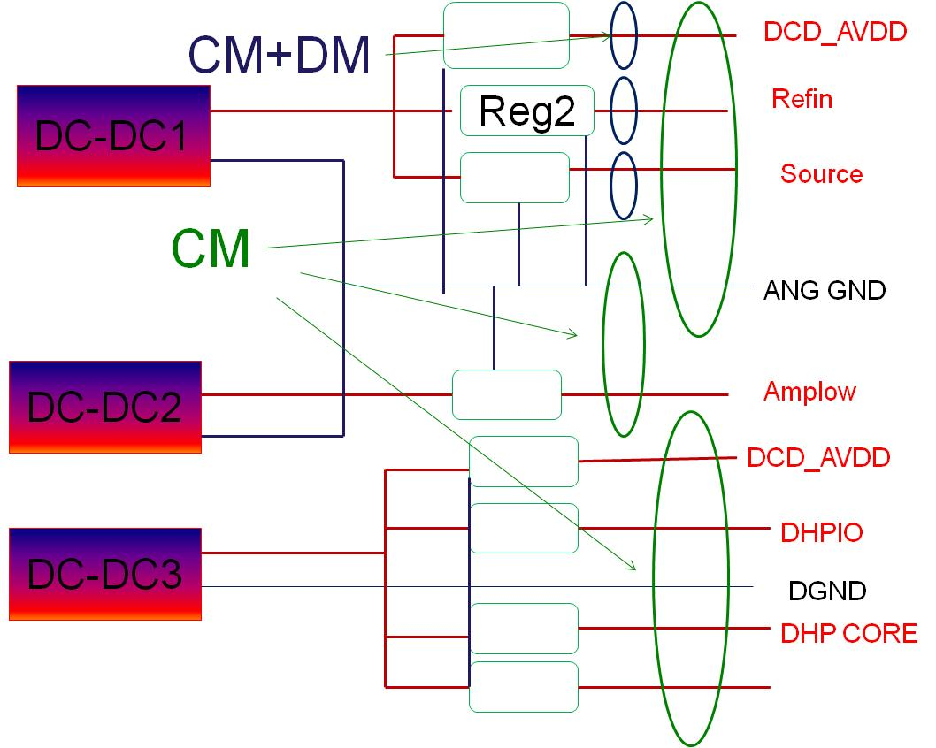
2.1 Conducted noise: Test set-up
ANALOG | DCD_AVDD | DC-DC 1
 | Refin | DC-DC 1
 | Source | DC-DC 1
 | Amplow | DC-DC 2
DIGITAL | DCD_DVDD | DC-DC 3
 | DHP_IO | DC-DC 3
 | DHP_CORE | DC-DC 3
 | SW_DVDD | DC-DC 3
STEERING | BP - HV | DC-DC 4
 | CLEAR ON | DC-DC 5
 | CLEAR_OFF | DC-DC 5
 | Bulk | DC-DC 5
 | Guard | DC-DC 5
 | ccg2 | DC-DC 5
 | ccg3 | DC-DC 5
 | NOT_USED_2 | DC-DC 5

Slide 9
2.2 Conducted noise: Test results
(CM+DM) – Noise channel spectrum

Slide 10
2.2 Conducted noise: Test results
The noise emissions spectra profile is very similar in all channels
  Both cables : ANG-DIG / STEERING
PS noise emissions are higher in normal operation conditions than standby condition
  More clear at the steering cables

Slide 11
2.2 Conducted noise: Test results
CM nosie – DC-DC

Slide 12
2.2 Conducted noise: Test results
CM noise emissions are very similar in all DC-DC converters
DC-DC converters noise emissions are higher in normal operation conditions than standby condition

Slide 13
2.2 Conducted noise: Test results
CM & CM+DM noise emissions are compared
  It helps to identify the nature of noise emission
CM noise is the dominant mode of noise propagation above hundreds KHz
CM vs CM+DM

Slide 14
2.3 Conducted noise: Filtering
Noise emissions seem not to be high
  Some frequencies areas are very low
  Some peaks – around 1 MHz
But … FEE immunity will define that
A CM filter has been prepared as a possible backup solution in case noise level is not compatible with FEE.
PS1
PXD
PS2

Slide 15
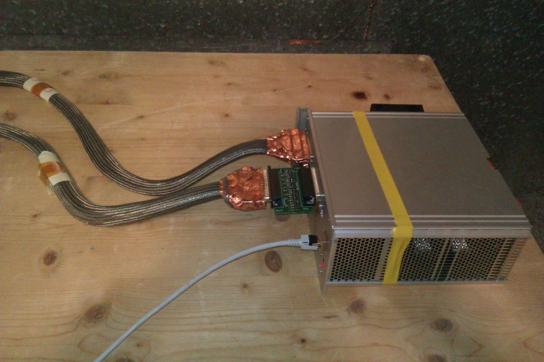
2.3 Conducted noise: Filtering
Filter performance not very good.
  It attenuates a few dB above 5 or 10 MHz.
It was prepared without any knowledge about noise profile

Slide 16
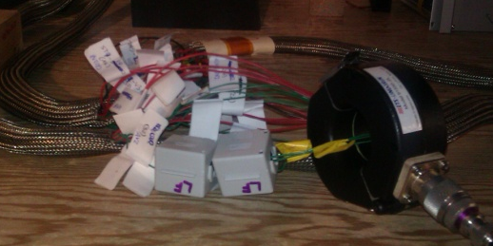
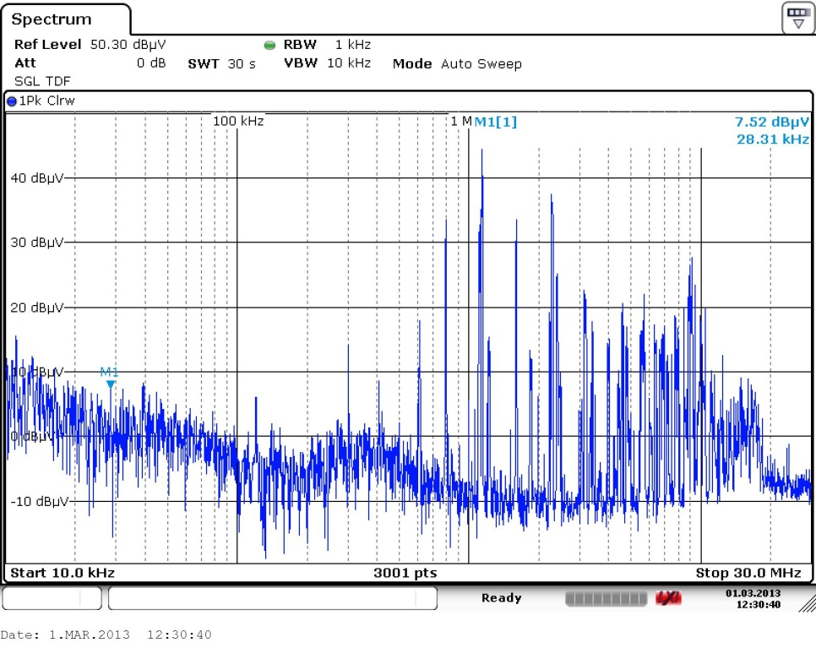
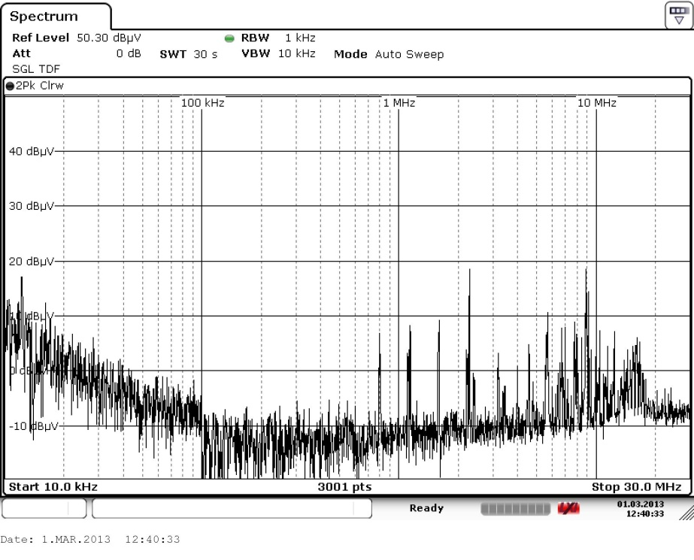
2.3 Conducted noise: Filtering
After the test, a filter improvement was implemented
  Some ferrites were added
  Specific working area
Nosie decreases more than 30 dB

Slide 17
3. Radiated noise emission test
A similar test set-up has been prepared to measure the radiated noise emitted by PS
The PS operation conditions are identical to conducted noise tests
Two types of field have been measured :
  Electromagnetic field (30 MHZ – 1 GHz)
  Magnetic field (10 kHz – 30 MHz)
The test has been performed in a semi-anechoic chamber
The antennas have been placed between 1m and 3m far from the PS unit.

Slide 18
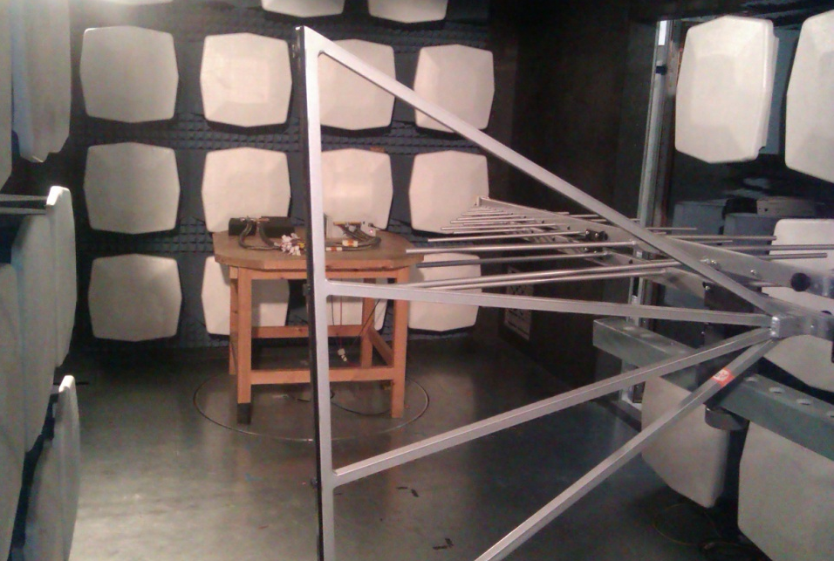
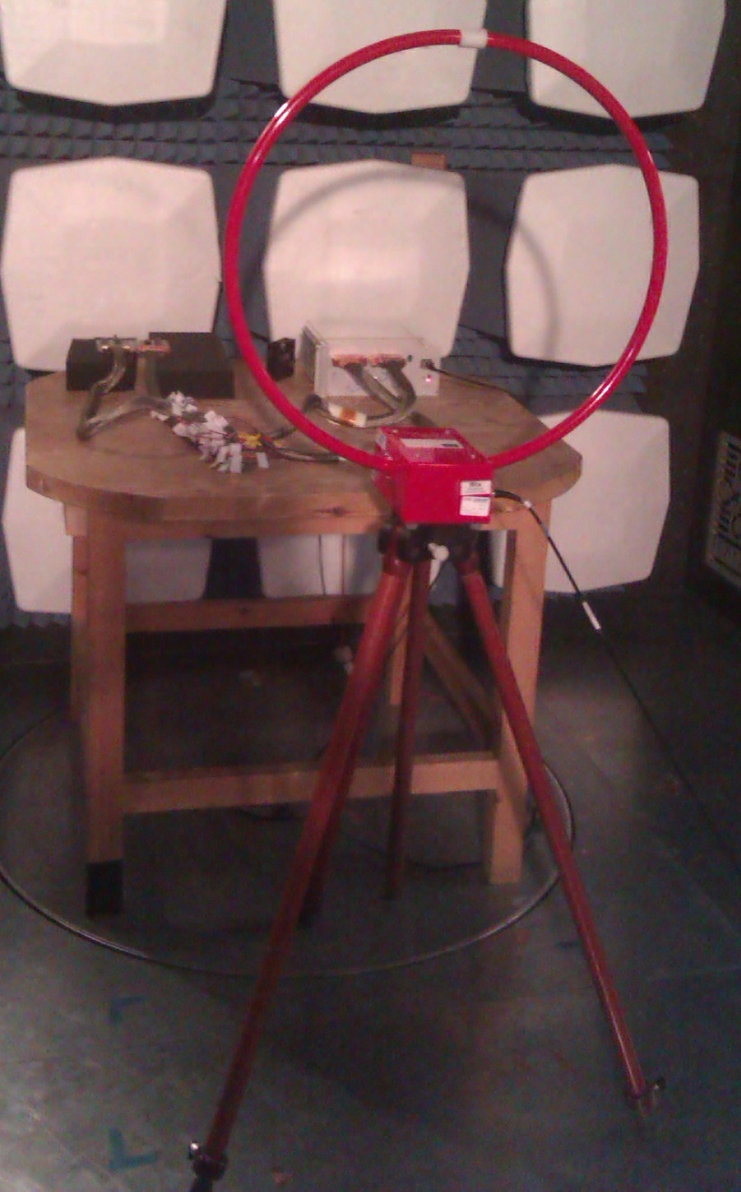
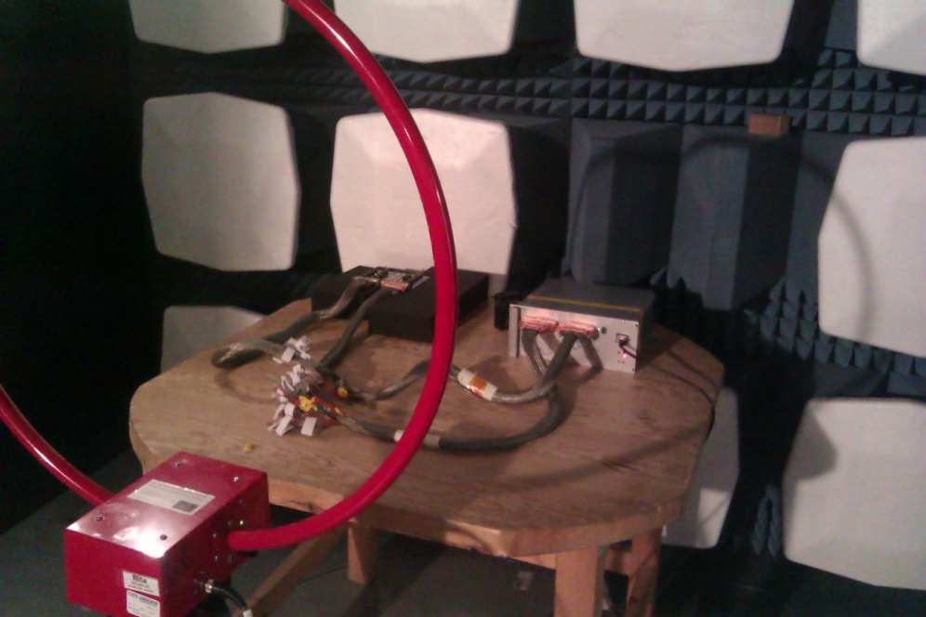
3.1 Radiated noise : Test set-up
E
H
H

Slide 19
3.2 Radiated noise : Test results
H field
It seems the radiated emissions are very low
H-field emissions closely related to CM emissions
  Cable - No shield connection increases radiation

Slide 20
3.2 Radiated noise : Test results
E field
Electric radiated emissions are low
    Big peak (E) is FM radio - Coupled via power lines (AUX PS )
    Small differences between standby / on condition

Slide 21
4. Conclusions
Noise emission test on PXD power supplies has been finished
Two kinds of test have been carried out
  Conducted
  Radiated
Test results:
  Most of the noise is emitted between few hundreds of kHz and 10/20 MHz.
  CM noise is the dominant mode of propagation
  There are no big differences from one channel to another or DC-DC.
  Radiated emissions are low.
Noise analysis has required an analysis of 117 Files
  Filtering improvements & shielding effects

Slide 22
BACKUP SLIDES

Slide 23
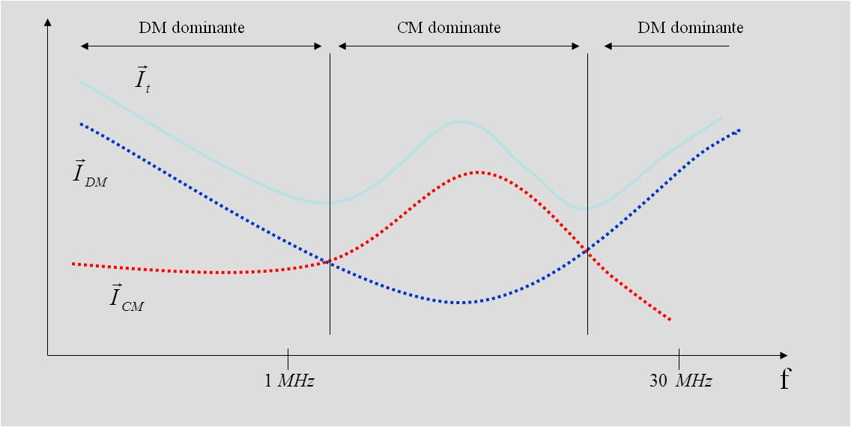
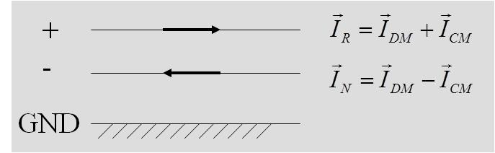
1. Introduction
DC-DC converter is the main noise source of the PS unit (large bibliography – More than 25 years)
  Control units too – But they are smaller
  LV regulators – It behaves like short-circuit at HF
DC-DC has two kinds of EMI emission
  Radiated Emissions
    Electric , Magnetic or Electromagnetic field
  Conducted Emissions
    Common mode
    Differential mode

Slide 24
2.1 Conducted noise: Test set-up
Low noise - set-up

Slide 25
2. Test set-up
DCD_AVDD
DC-DC1
Reg2
Refin
Source
ANG GND
DC-DC2
Amplow
DCD_AVDD
DHPIO
DC-DC3
DGND
DHP CORE

Slide 26
2. Test set-up
Clear on
DC-DC5
Reg2
Clear off
Bulk
Guard
ccg2
ccg3
NoT
STER GND
DC-DC4
HV (Back plane)

Slide 27
2.1 Conducted noise: Test set-up

Slide 28
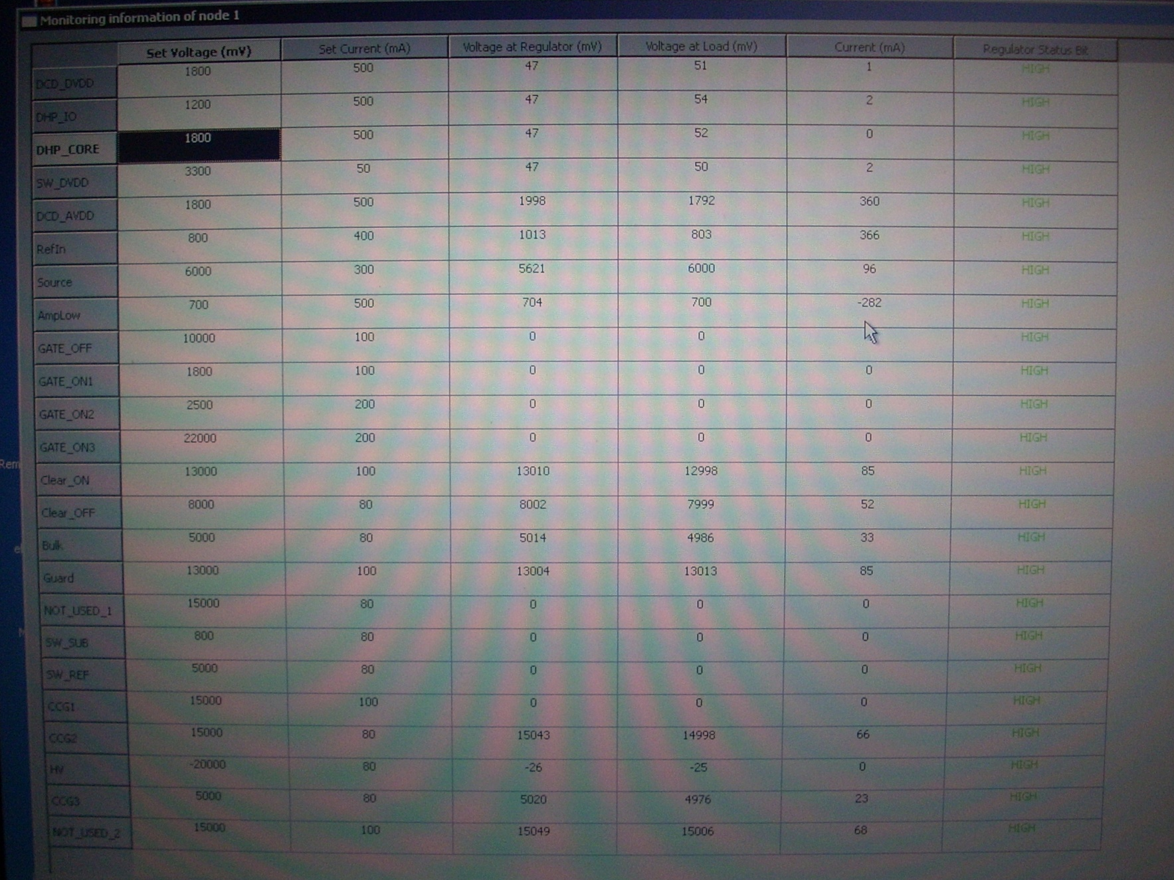

Slide 30
