Slide 1
New DCD Chips
Ivan Perić

Slide 2
Introduction
Two chips submitted – DCDBv4 and DCDBPip(eline)
DCDBv4 based on the old design
DCDBPipeline uses pipeline ADCs (already tested for another project) and has a new digital part
DCDPipeline: two times faster than the present DCD: 10 µs readout time for DEPFET module possible
Motivation for DCDPipeline: extension of safety margin

Slide 3
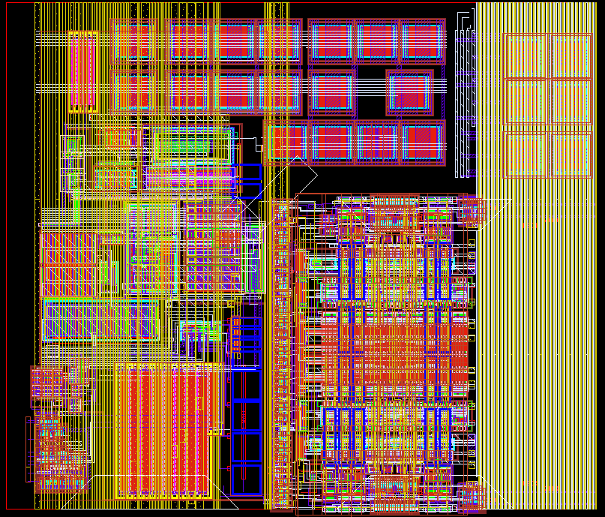
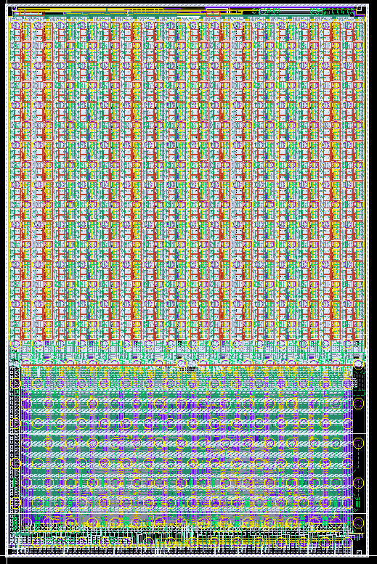
DCDBv4
TIA
ADC
200 µm
5 mm

Slide 4
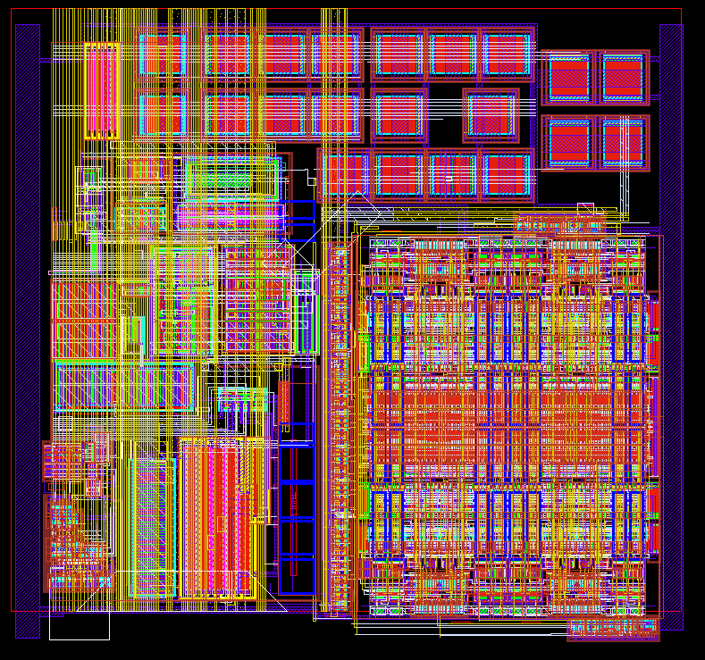
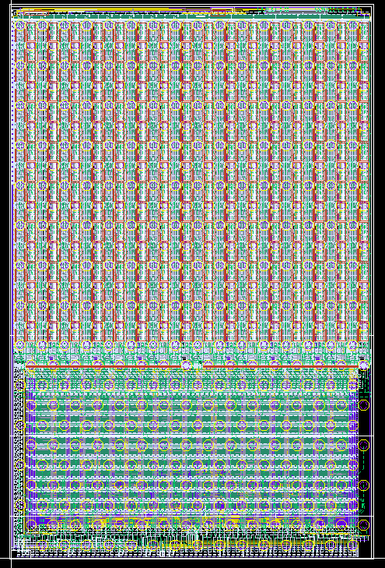
DCDBPip
TIA
ADC
200 µm
5 mm

Slide 5
Pipelined vs. Cyclic ADC
Algorithm:
Copy here copy there
Compare with threshold add reference
Subtract two outputs (duplicate)
Pipeline ADC
Memory cell
ADC1
ADC2
MSB cell
LSB cells
1
1
1
1
2
1
1
1
1
1
1
1
1
1
1
1
1
1
1
1
1
1
1
Hi
Lo
Cyclic ADC approach
- Algorithm performed cyclically (ping pong wise)
by two memory cell pairs
- Two ADCs per channel
- 200ns sampling rate/ADC
- ADC clocked with 100MHz
- Pipeline ADC approach
- Algorithm performed as in production line by 8 memory cell pairs
- One ADC per channel
- 100ns sampling rate when clocked with 50MHz
- Designed for 50 ns sampling rate

Slide 6
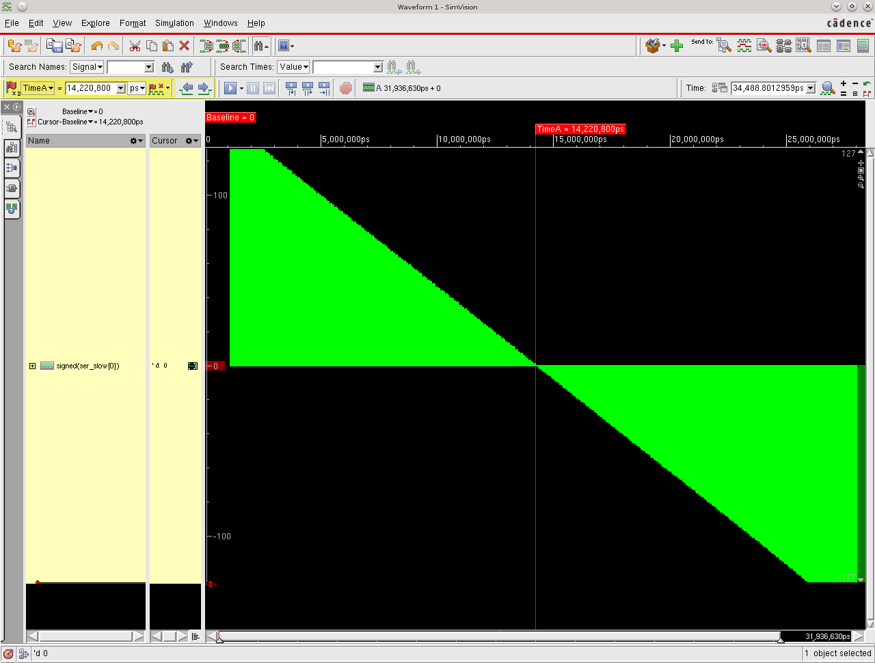
Analog Simulation (T=1.6ns)
ADC simulated in mixed mode (digital VERILOG, analog transistor-level) at 51ns sampling rate

Slide 7
Overview of Changes
ADC robustness (in both chips)
VPMOS voltage added
Better distribution of the digital lines in the ADC
Shield for x-talk protection in the ADC
Better layout: many contacts are doubled, protection diodes added
Pipeline ADC
Based on the ADC used in SPADIC chip (multi channel CBM TRD readout chip) with several changes

Slide 8
Overview of Changes
Global circuits (in both chips)
Two temperature stable reference circuits added, the old reference is still there
One of three references can be selected for use, by writing a code into the shift register
Global DAC layout improved for better (7-bit) accuracy (for all DACs)
Precise programmable current source added and connected to the monitor line – allows better ADC characteristics measurements without external generators – should speed up the probe station tests
Idea: do probe station tests only with JTAG!
All analog NMOS transistors (e.g. in switches and mirrors) are now circular

Slide 9
Temperature-stable Current Reference
Temperature stable reference
Working principle: generate a voltage with small negative temperature coefficient
Buffer the voltage and generate a temperature stable current using a poly resistor with negative temperature dependence
We have implemented two temperature stabile designs
For safety we keep the present reference as well
Ref1
Ref2
9

Slide 10
Overview of Changes
Transimpedance-Amplifier
CMC On/Off switches changed – channels can be excluded from CMC (both DCDs)
DCD Pipeline – AmpLow switch added - CMC and normal operation possible on the same chip
DCD4 – no changes in TIA vs. present design - CMC operation possible only if AmpLowAmp pads are floating – requires special footprint or removal of bumps
Output current range of the TIA can be programmed (DCD Pipeline)
IO Pads
LVDS clock input added, CMOS input still present, both can be used (control bit in global register)
Improved layout of output drivers for better yield – current increased by 25%.
Capacitance of digital lines on the module – 2.5 - 5pF! The transitions a bit slow, but still acceptable

Slide 11
TIA for DCD4
TIA Design in DCDBv4: excluding of individual channels from CMC network possible
The excluded channel “feels” the CMC changes in AmpLowAmp node – Measurement of average DEPFET current possible (requires calibration)
ADC
UseCMC
UseCMC
Bias
UseCMC
AmpLowAmp
AmpLowADC
CMCOff
11

Slide 12
TIA for DCD Pipeline
TIA Design in DCDBPip: CMC and standard operation possible on the same chip
Extra transistor added to the most sensitive node – for safety implemented only in DCDPipeline
ADC
UseCMC
UseCMC
Bias
UseCMC
On/Off
AmpLowADC
AmpLowAmp
CMCOff
12

Slide 13
Overview of Changes
New digital block for pipeline ADC designed
According to simulation: Two times faster and two times less current consumption than the present block for cyclic ADC
New
204 mW at 320 MHz
330 mW at 500 MHz
389 mW at 640 MHz
Old
394 mW at 320 MHz
521 mW at 400 MHz (doesn’t work)
New serializer and deserializer schemes
Changed test bit pattern to allow synchronization
The pipeline DCD works in simulation at 50ns sampling rate!

Slide 14
Digital Block – Top Schematics
New digital block for pipeline ADC designed
Pedestal DAC inputs
8x
Deserializer
ADC outputs
32
Hi/Lo
ADC RO-Block
32x
CkSlow
Derandomizer
CkSlow
CkSlow
Clock Generator
CkSlow
+
CkFast
Sorted
Compressed
Serializer
CkSlow
CkFast
CkGen
SerFast cnt
CkSlow
CkFast
Res50Slow
Res400
0-7
Res
Res50
LdPedestal
LdSerFast
LdSerFast
CkSlow
Data cnt
CkFast
Res50Slow
0-7
Res
Res400
DI
Collumn RO-Block
DO
JTAG

Slide 15
Overview of Changes
JTAG allows boundary scan
Fast sampling of ADC outputs possible using JTAG
Probe station test of all ADCs at full speed possible using only JTAG and CLK pads
Advantage: very simple needle card: only JTAG (5 pads), clock, reset and power should be connected
Disadvantage: output drivers not tested.
  The new DCD has robust scheme/layout of output drivers
  Loopback from output pads to JTAG can be implemented in the final design
  Probably higher possibility of damaging the solder balls during tests than of non working output drivers
Alternative – JTAG use
Few needle contacts
Drivers not tested
Present tests
Many needle contacts
Not supported yet – loopback
Drivers tested
Digital block

Slide 16
Overview of Changes
Still not implemented: SEU tolerant memory cells and read-back of memory cells ☹
Possibly not necessary – see DHP SEU tests, 180nm technology should be even less sensitive to SEU due to higher capacitances of storage nodes and higher supply voltage

Slide 17
Review in Mannheim
Participants: P. Avella, T. Hemperek, C. Kiesling, I Konorov, C. Koffmane, C Kreidl, H Krüger, F. Lütticke, C. Marinas, H-G Moser, R. Richter, A. Wassatsch and I Peric
Measurement results presented – some concerns arose:
1) Noise at 320MHz higher than at 100MHz (noise source still unclear – maybe x-talk from outside)
Noise excess manifest as CM noise
2) Noise vs. DCD channel position dependence observed in the measurements with DEPFET matrix – edge channels more noisy, measurements without matrix do not show this effect
3) Different channels have different optimal AmpLow settings – difficult optimization
4) Pedestal correction procedure does not work always properly – possible cause: limited response speed of the amplifier
5) Pixel and global registers capture input at falling CLK edge and release output at rising CLK edge (Recommendation: change the polarities according to JTAG standard)
The use of small fixes (DCDBv4), pipelined ADC (DCDBPip) and CMC scheme should fix issues 1-3
Optimized bias settings should fix issue 4
I have tried fix issue 5. Unfortunately the solution I followed showed to be unsafe I had to abandon it – the new DCDs implements the old scheme. New analysis of the concern 5: Not a problem if DHP TDO changes after CLK falling edge (normal case). SWITCHER can be programmed using bypass mode in JTAG that is according to JTAG standard
6) Recommendation: implement chip ID using fuse

Slide 18
Potential Problem
We are relying on UMC 180nm technology with “aluminum redistribution layer” AL RDL (original technology has 6 metal layers) and solder bumps for several projects, among others PET
The production of our last PET design took 1 year due to problems with bumping
UMC and Europractice are considering another bumping process (plating) as the standard. “UMC is pushing Europractice to use such bumping process even for this MPW!”
The DCD design as it is now wouldn’t be possible in this process: 1) due to a large bump pitch (400 µm) and 2) due to the fact that we do not have M6 pads and rely on ALRDL with certain geometry
Europractice has been informed that the bumping issue is endangering 4 years our chip development and the whole project and they will (try to) convince UMC (my feeling is that it will work for this run)
Europractice offered gold stud bumping – not suitable for DCD as it is designed now
Al RDL
Power, MIMCAP
Power, MIMCAP
M6
M6
M6 used for pads (DCD2, SWITCHER)
RDL used for pads (DCDB)

Slide 19
Potential Problem
Possible backup solution – transfer of the DCD design in 180nm AMS/IBM (HV) technology (the SWITCHER’s technology)
Common engineering run with SWITCHERs, DCDs and maybe our third project. The run costs 160 k€ (AMS price) can be shared (realistic 80 k€ for DEPFET). Bumping by IBM or by PacTech
Transfer of DCD design from UMC to AMS would be possible within 3 months
Al RDL
Power, MIMCAP
Power, MIMCAP
M6
M6
M6 used for pads (DCD2, SWITCHER)
RDL used for pads (DCDB)

Slide 20
Conclusion
Two chips submitted – DCD4 and DCDPipeline
DCD4 based on the old design
DCDPipeline uses the pipeline ADCs and has a new digital part
The chips implement all the features necessary for the PXD production
Future of the UMC bumping technology unclear – this run is most probably not affected
Possible alternative: engineering run with DCD and SWITCHER in 180nm AMS/IBM bumping by IBM or PacTech

Slide 21
Backup: new ADC scheme

Slide 22
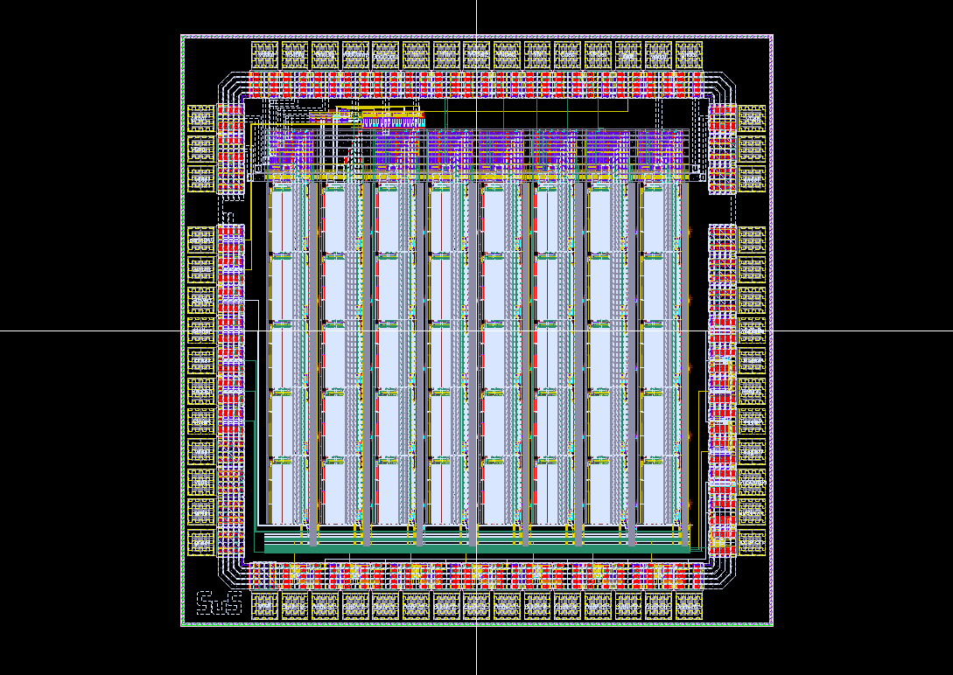
Test Chip
Forty ADCs based on successive approximation principle with asynchronous logic (UMC 180nm) on a test chip

Slide 23
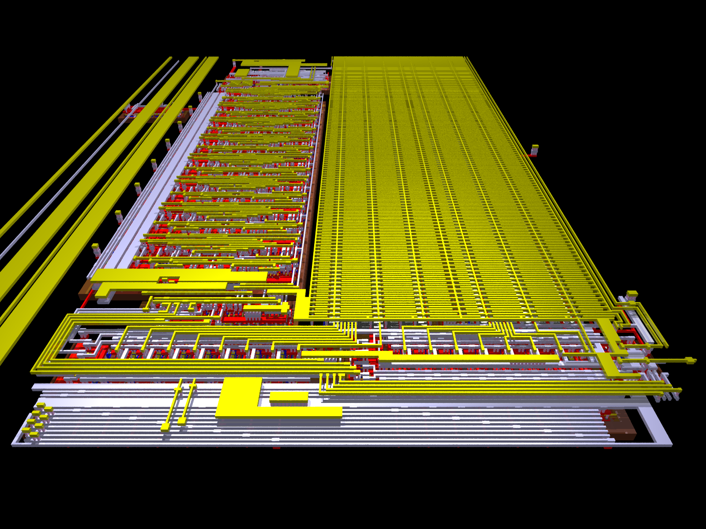
ADC-Channel layout
Two ADCs fit in the present DCD channel

Slide 24
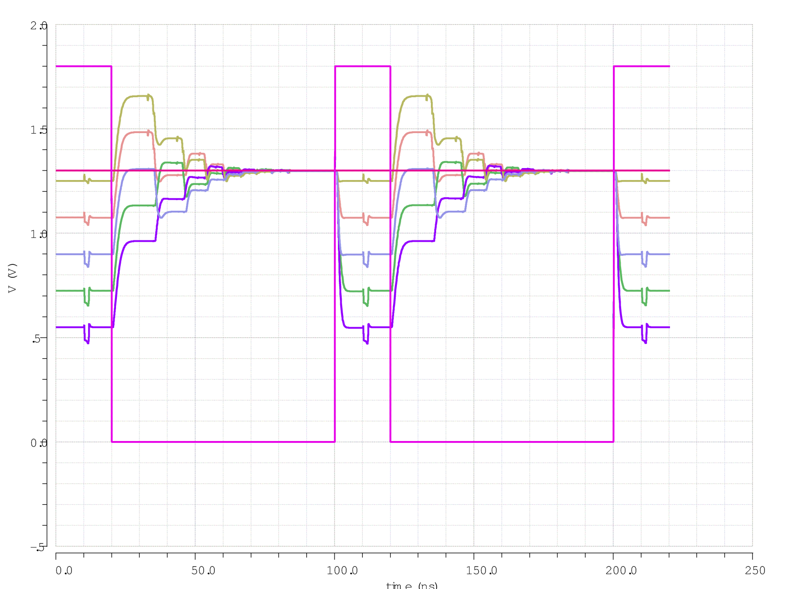
Simulation
Sampling period 100ns possible according to simulation

Slide 25
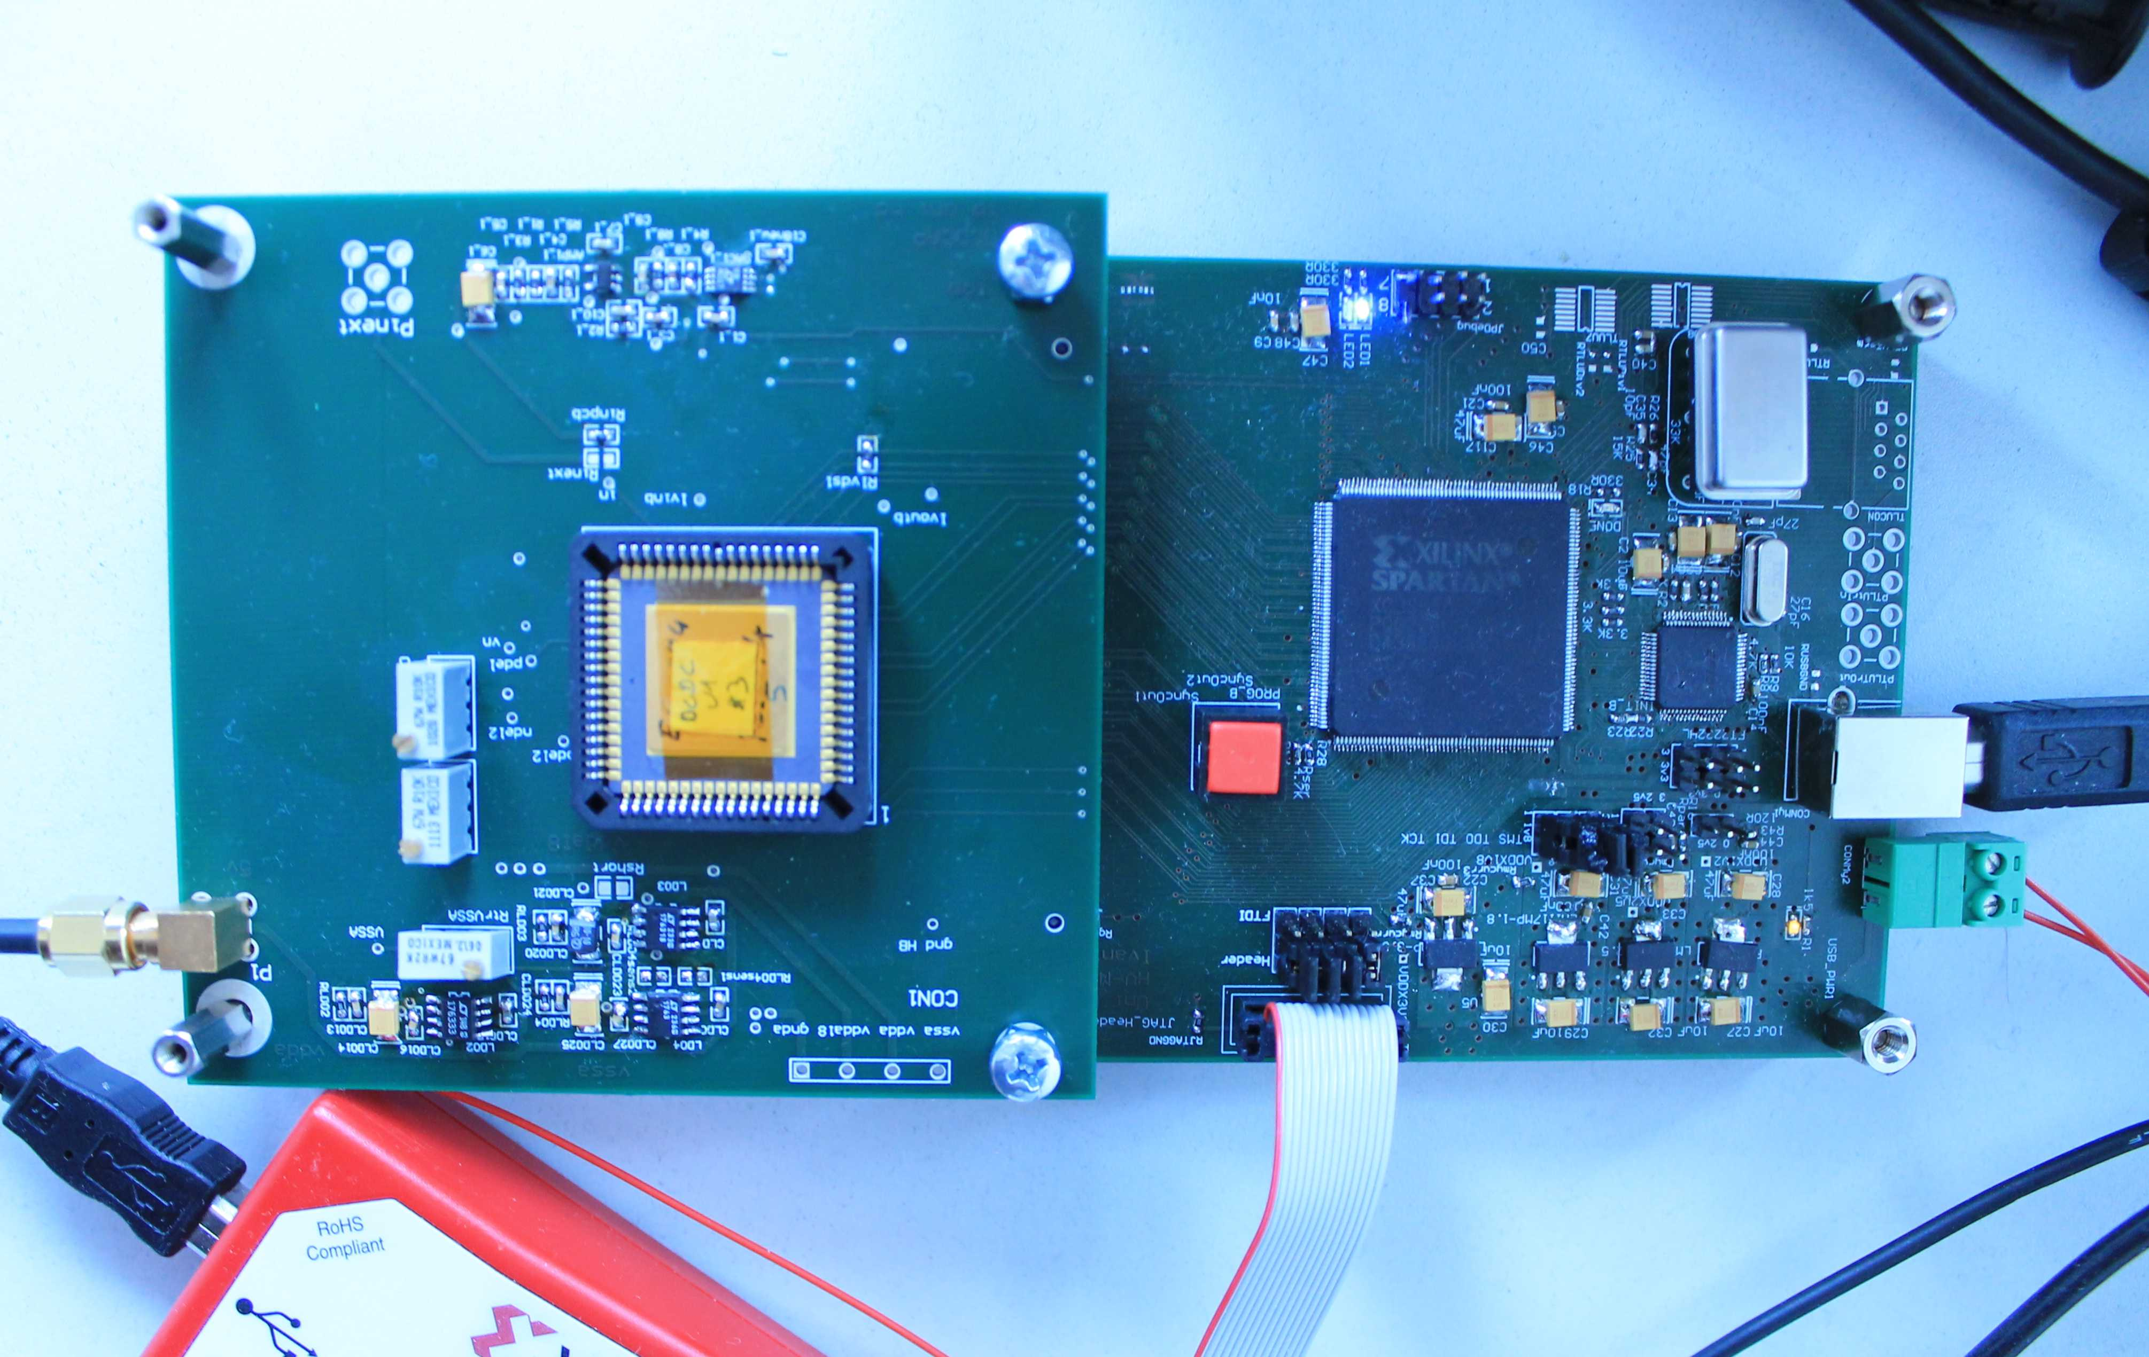
Measurements

Slide 26
Measurements
Measurement: 200ns sampling possible – requires two ADCs per channel
Improved design will be tested soon

Slide 27
Measurements
Excellent (=low) noise

