Slide 1
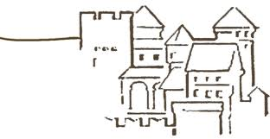
FOS for VXD testbeam @ DESY Ringberg Castle, 13th DEPFET Workshop
E. Currás, D. Moya, I. Vila, A. L. Virto.,J.González
Instituto de Física de Cantabria (CSIC-UC)
G. Carrión, M. Frövel.
Instituto Nacional de Técnica Aeronautica (INTA)

Slide 2
FOS baseline
During DESY’s test beam up to twelve readout channels (four of them for vibrations)
We can safely readout up to 70 sensors
Integration with HEPIX (via TCPIP)
L-shapes for monitoring of longitudinal position along the beam.

Slide 3
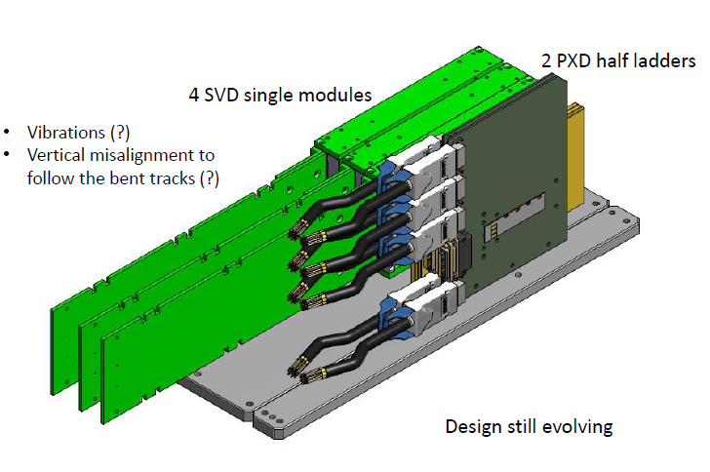
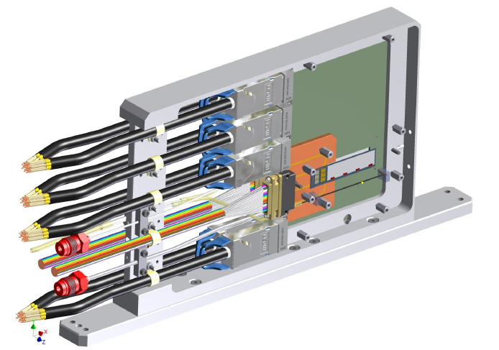
Discussion (1) from C. Mariñas talk
L –shapes
Sensors inside the PXD box
on the cooling block
Nearby the CF tube

Slide 4
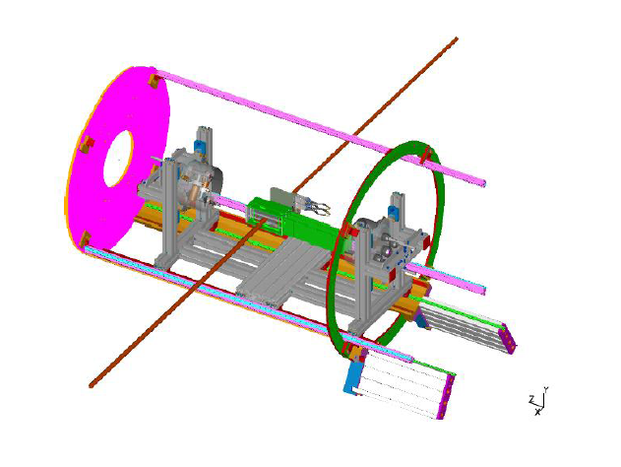
Discussion (2) from C. Mariñas talk
Input needed

