Slide 1
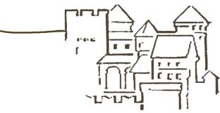


Update on FOS monitor
Ringberg Castle, 13th DEPFET Workshop
E. Currás, D. Moya, I. Vila, A. L. Virto.,J.González
Instituto de Física de Cantabria (CSIC-UC)
G. Carrión, M. Frövel.
Instituto Nacional de Técnica Aeronautica (INTA)

Slide 2
Outline
FOS-based L-shape
Calibration of L-shapes
  Temperature calibration
  Displacement calibration: Stability, Reproducibility, linearity.
  Other issues: fixation and improved contact.
Outlook

Slide 3
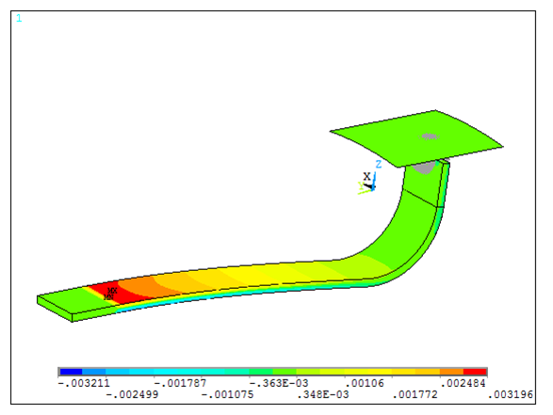
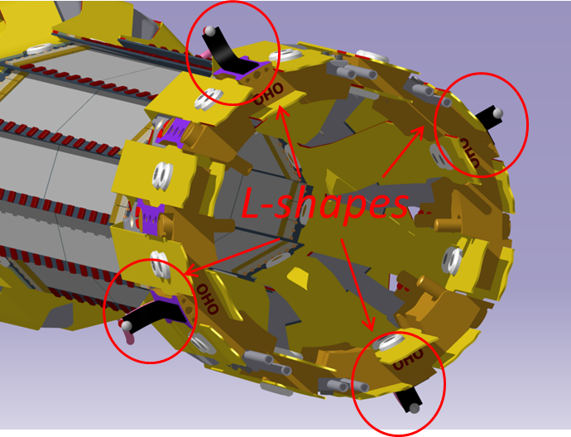
L-shape basics
Temperature & strain to displacement transducer with custom geometry for integration in PXD
Readout speed from zero to 1KHz (vibrations)
Currently three demonstrators manufactured
Contact surface
Locked part
FBG sensors
Contact ball

Slide 4
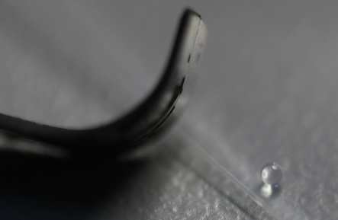
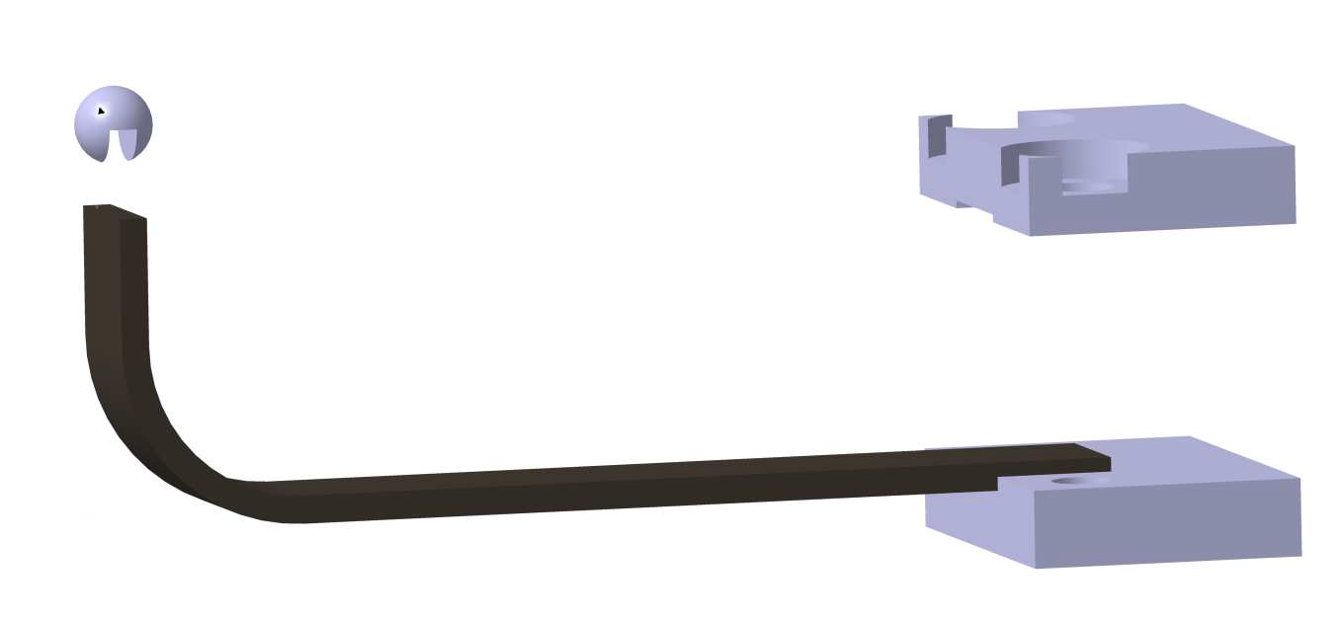
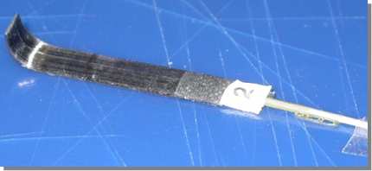
L-Shape Demostrators
One millimiter Diameter Quartz contact ball
Clamping system
ball glued
L-shape tip

Slide 5
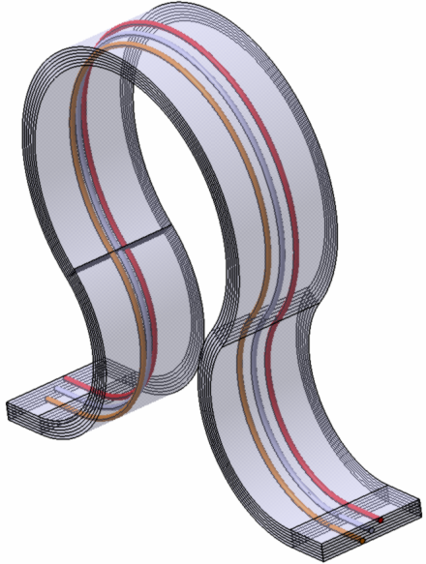
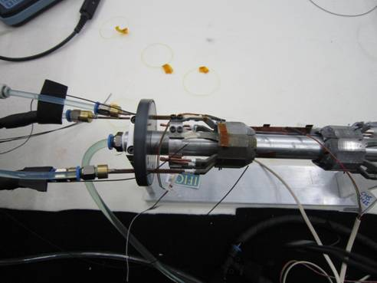
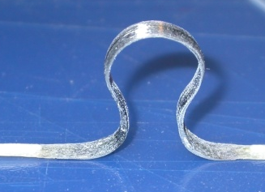
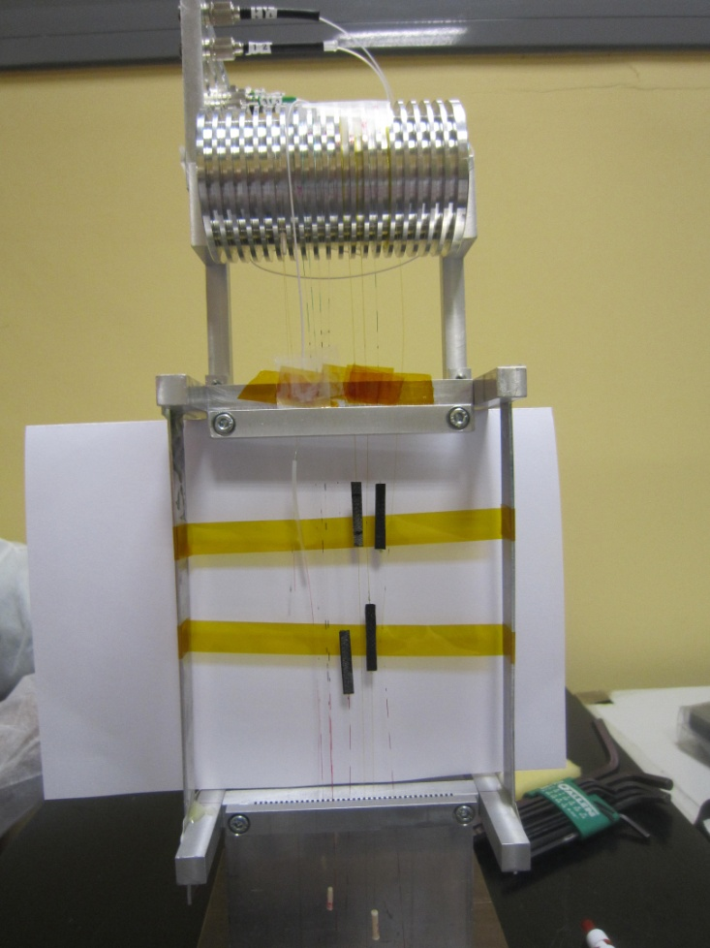
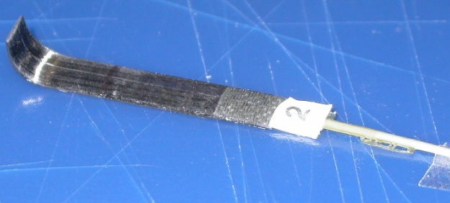
FOS Monitor Timeline
,
2009 Oct FOS Monitor proposal
2010 Jan Omega-shape proposal
2010 Oct. FOS radiation hardness study (1.5 GRads ,3.3 10¹⁵ p/cm2)
2011 January First omega mechanical dummies
2011 Sept. FOS radiation hardness study ( 10 Mrads )
2011 Dec Proof-of-concept-prototype omega
2012 Feb Omega calibration.
2012 March New transducer design L-shape
2012 May Test in depfet mock-up at IFIC
2012 October L –shape calibration
(resolution less 1 um ,accuracy≈10 um )
2013 May Test in mock-up at IFIC (N₂ atmosphere)
2013 June-July Omegas and L-s irradiation ELSA
2014 January commissioning at PXD-SVD common test beam
Notes:
Poner primero el año
Poner omega-shape
Test in first Depfet mock-up
Poner punto de la calibración

Slide 6
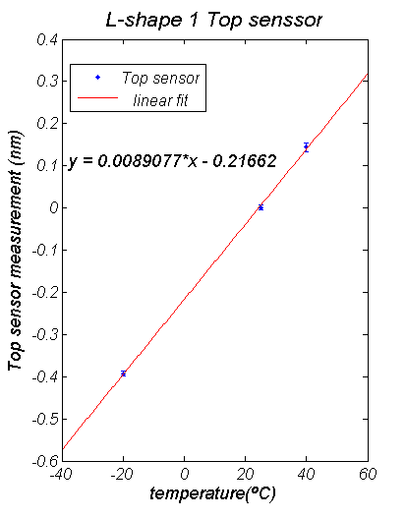
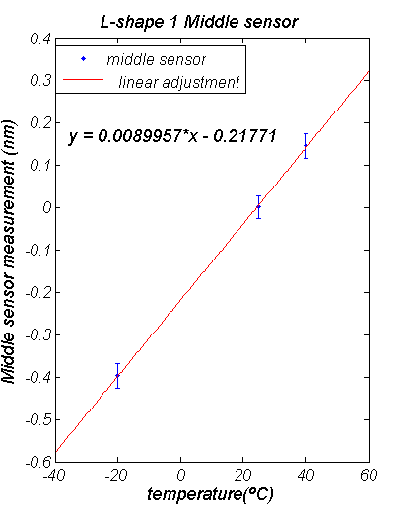
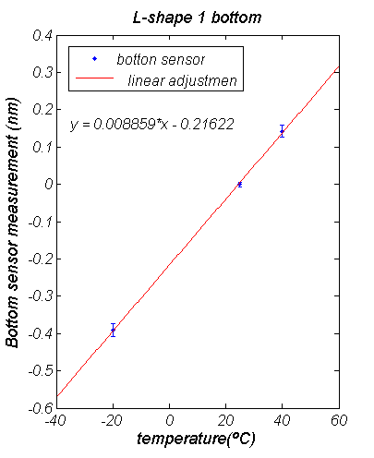
Thermal calibrations & temperature compensation
Calibration using a SIKA thermocouples calibrator.
The sensitivity of three sensors was constant and near the same (difference<0.6%)
Maximum deviation < 3 pm (0.3 ºC)
Error X 10
Error X 10
Error X 10
Trivial approach to temperature compensation

Slide 7
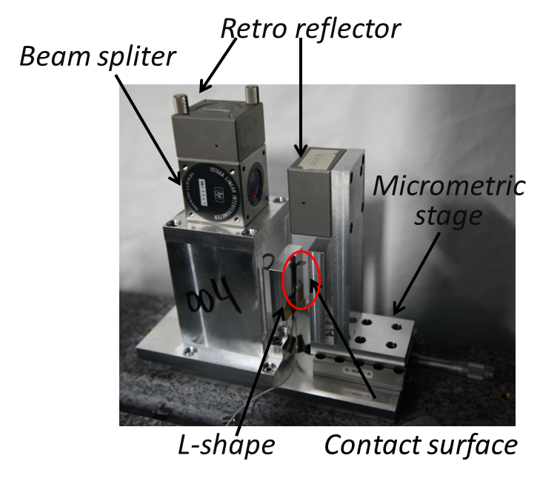
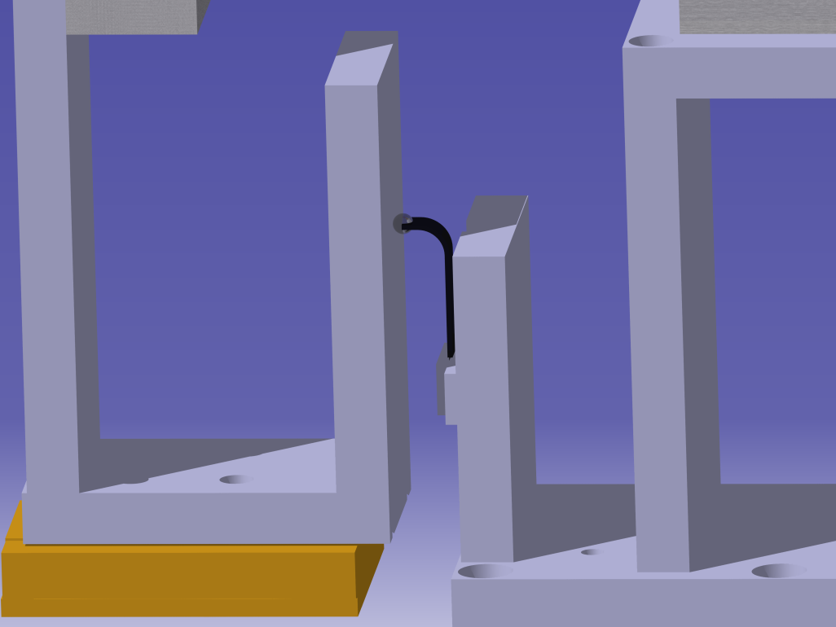
Displacement Calibration
Displacement measured with Michelson interferometer for high precision calibration (tenth of a micron)
Readout of L-shape compared with true position (interferometer)
Contact ball
Micrometric stage
Contact
surface
L-shape
D.Moya, LC2013 Tracking-Vertex session, Desy May. 30th 2013

Slide 8
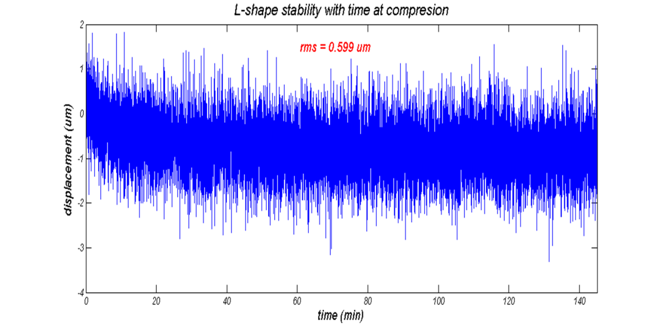
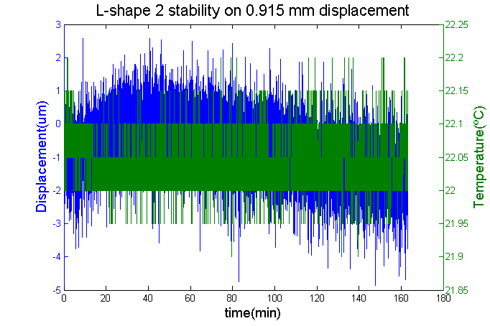
L-shape Output Stability
Short term studies (temperature constant ± 0.1° )
Continuous readout of the sensor output.
Stabilities below or about 1um (convolution with mechanics stability)
RMS ≈ 1.1 um
RMS ≈ 0.6 um

Slide 9
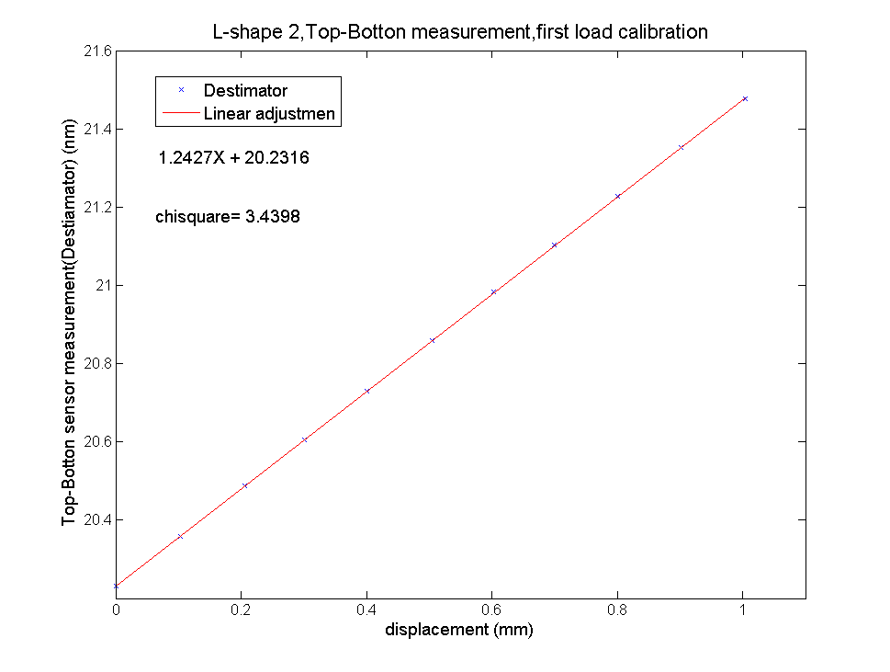
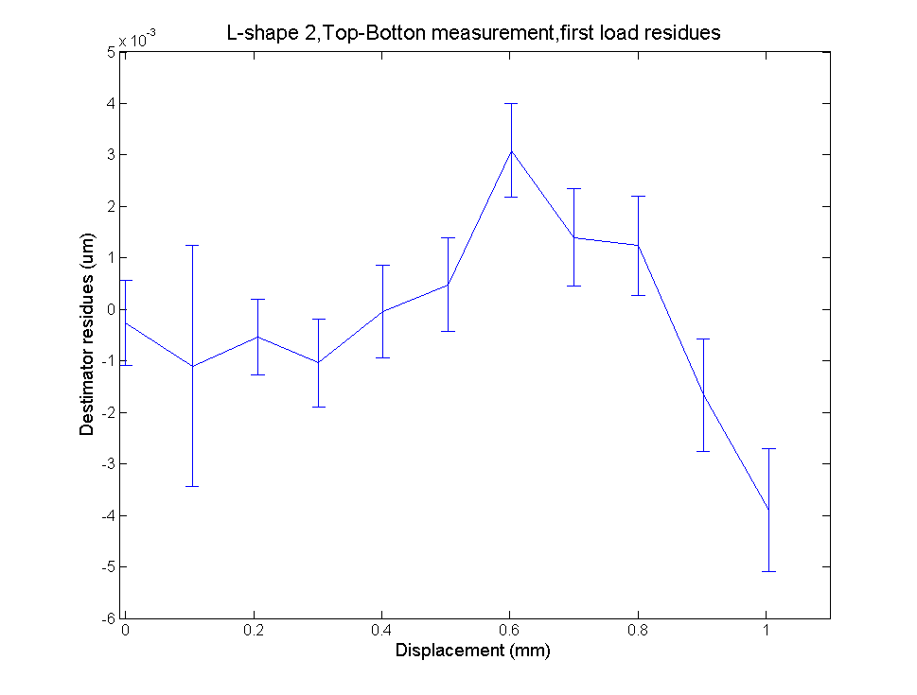
L-shape Linearity vs. Displacement
Calibration over a range of 1mm
Resolution (readout resolution) 0.5 um.
Accuracy (diff. Between inter & L-shape) ≈ 2 um
Sensitivity 1.2 pm/um

Slide 10
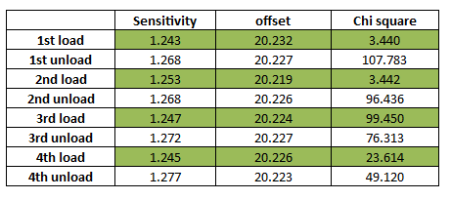
L-shape Linearity (2)
L-shape sensibility presents a small dependence depending of the direction of movement (L-shape specific effect due to its shape)
Sensitivity reproducibility
0.4 %
Difference load-unload cycle
2 %

Slide 11
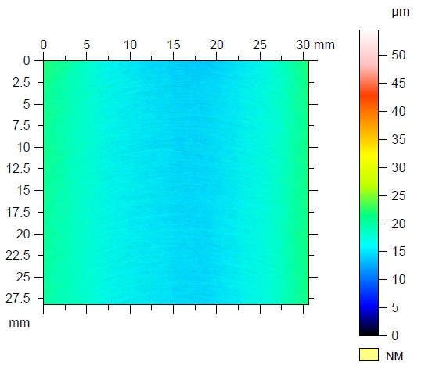
L-Shape Linearity (3)
Investigate the effect of the roughness of the contact surface on the asymmetric load-unload behavior.
POLISHING
OF CONTACT SURFACE
Still sensitivity asymmetry 2 %
More studies in progress
(harder materials than Al)
Still sensitivity asymmetry 2 %
More studies in progress
(harder materials than Al)

Slide 12
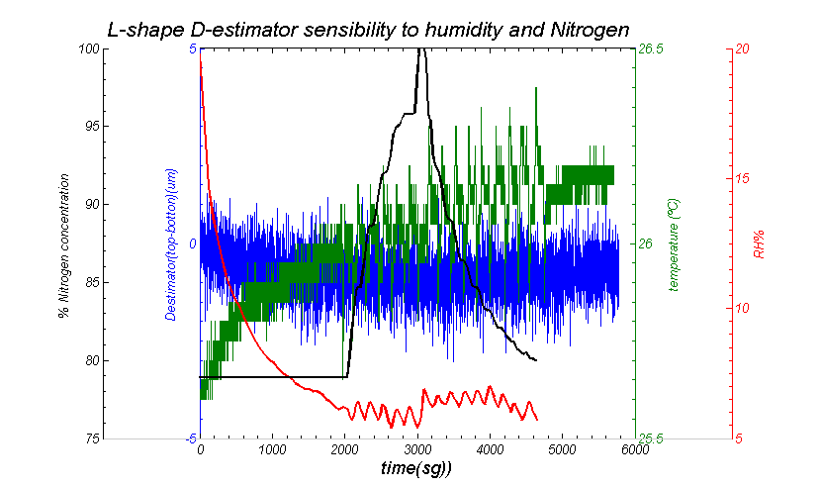
L-Shape sensitivity to enviromental conditions: HR%, T, N₂
No sensitivity to environmental conditions

Slide 13
Outlook
In-depth calibration of L-shapes
Accuracy of few tenths of degree and few microns demonstrated
Short term and in progress activities:
  Asymmetric linearity (2%) for loading and unloading movements (improve the ball-surface contact).
  Radiation tolerance of the L-shape as a whole (ESLA irradiation).

Slide 14
BACK UP

