Slide 1
Probe Card prototyping status

Slide 2
Introduction
The idea is to pre-test the modules before attaching the cable interconnect, otherwise reworking may be impossible (well, at least difficult…)
  A probe-card for the EMCM is to be built in order to proof that testing with and probe-card is feasible
  The pad layout is similar, but not equal to the final module. So this probe-card would just be a demonstration proof of testing concept
The probe-card needles will be assembled by HTT (Munich)
  The iteration process is taking long, but I’m partially responsible of it
  But we’re coming now to an end
The PCB:
  Design and routing by me
  Manufacturing company to be decided, but already got some confident options

Slide 3
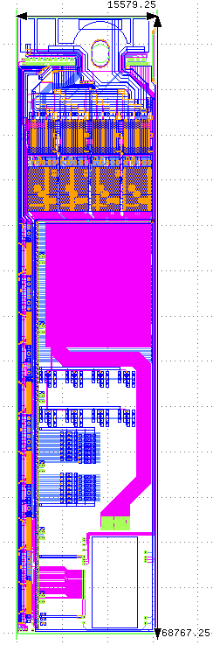
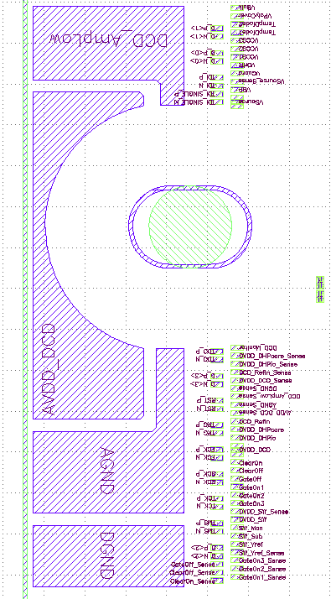
EMCM module
~5 mm
Module to be tested
(Dimensions in um)
Here is where the pads are!!
~16 mm

Slide 4
Dimensions (effective area for the needles)
~3.7 mm
Pad size:
In this two areas we have single Al pads:
~130 um
~300 um
In this areas we have big copper lands.
We will put 2 or 3 needles in each land since these are GND and power/bias lines .
~16 mm

Slide 5
Opening (PCB cut-out) dimensions
~22.5 mm
We want this area of the PCB open, nothing above it !!
~17 mm
~45 mm
~13 mm
For the 3 needles that go in each of these 4 big land copper pads we have freedom to place them anywhere within the pads.
This means that the needles can be brought closer to the other pads

Slide 6
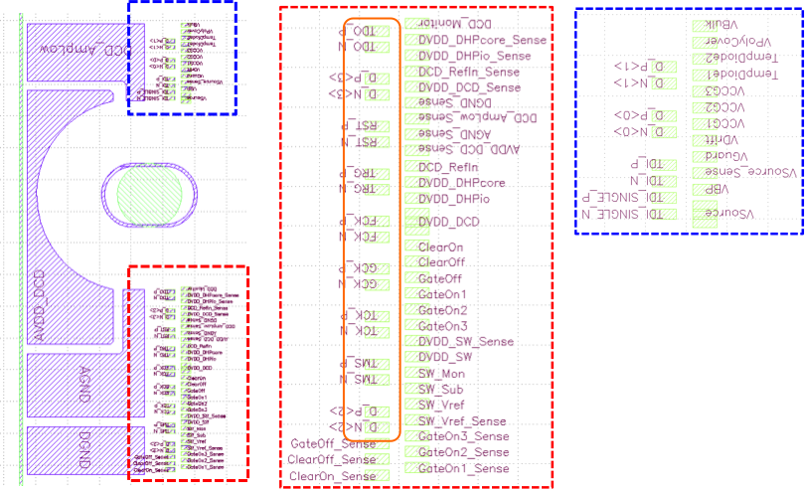
Current consumptions and Nr of needles needed per power pad
4
1
6
7
2
-
8
This one has a triple size pad
3
Pad size according to GDS design file
9
5
130 um
10
300 um
 |  | 1 chip | 1 module | 1 module + 20% | Nr needles |  |  |  | 1 chip | 1 module | 1 module + 20% | Nr needles
1 | DCD_RefIn | 50 | 200 | 240 | 2 |  | 6 | DHP1.2 | 100 | 400 | 480 | 3
2 | Vsource | 10 | 40 | 48 | 1 |  | 7 | DHP1.8 | 25 | 100 | 120 | 1
 | AVDD_DCD (AGND) | 280 | 1120 | 1344 | 7 |  | 8 | DVDD_DCD | 220 | 880 | 1056 | 6
 | AVDD_DCD (Amplow) | 180 | 720 | 864 | 5 |  | 9 | DVDD_SW | 25 | 150 | 180 | 1
3 | AVDD_DCD (TOTAL) | 460 | 1840 | 2208 | 12
4 | DCD_Amplow | 180 | 720 | 864 | 5
5 | AGND | 340 | 1360 | 1632 | 9 |  | 10 | DGND | 370 | 1530 | 1836 | 10
 | Max current / needle | 200 |  |  |  |  |  | All currents in mA

Slide 7
HTT V2

Slide 8
Placement of needles

Slide 9
Summary
About the needles… almost done. Two open questions:
  I’d like to place an edge detection needle and I’m trying to figure what the best place shall be
  After that I should get a land pattern layout
With the land pattern layout I can continue with the PCB design:
  Schematic done since very long
  All footprints also made
  Just the needles land-pattern missing
It may be very helpful to have a kind of mini-review before submitting anything, to avoid wasting money and precious time…

