Slide 1

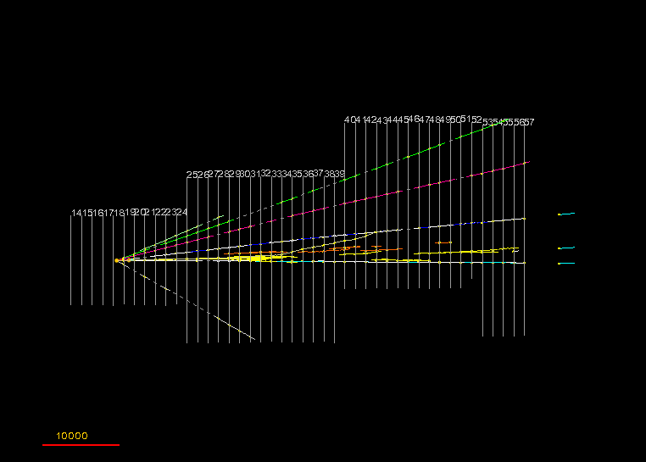

Recent results from OPERA
Pablo del Amo Sánchez
(LAPP-IN2P3-CNRS / Université de Savoie)
µm

Slide 2
Overview
A bit of context about neutrino oscillations
OPERA detector and CNGS beam
ν_{µ} → ν_{e} appearance search
ν_{µ} → ν_{τ} appearance search
Conclusions

Slide 3
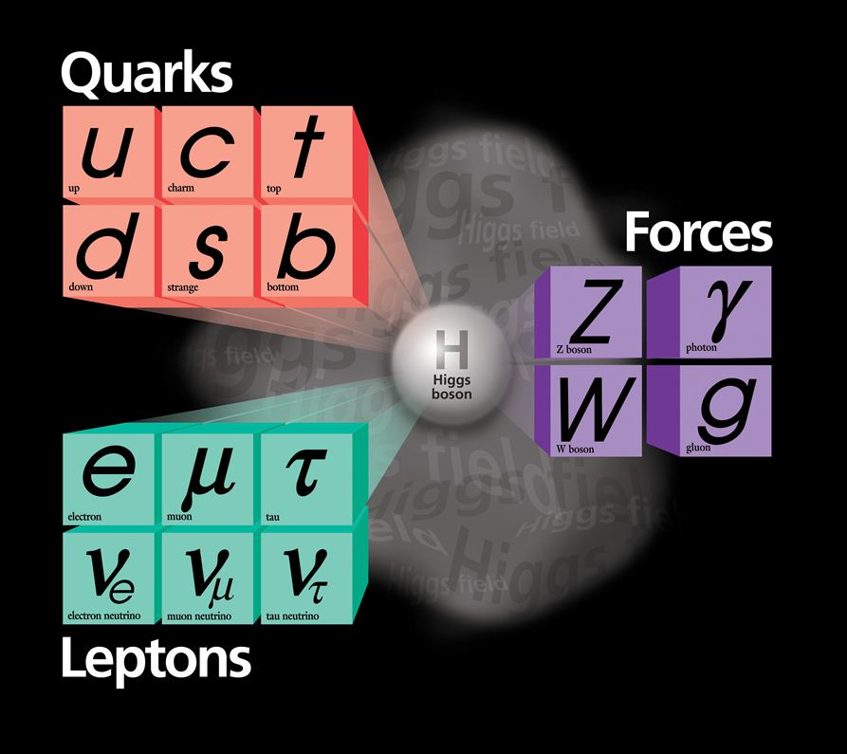
Neutrinos in Standard Model
Generations differ only in flavour quantum numbers
Neutrinos poorly known due to tiny interaction xsections
Only upper bounds on ν masses

Slide 4
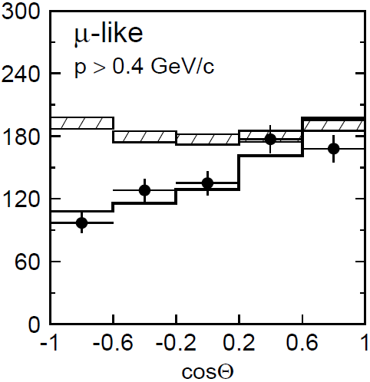
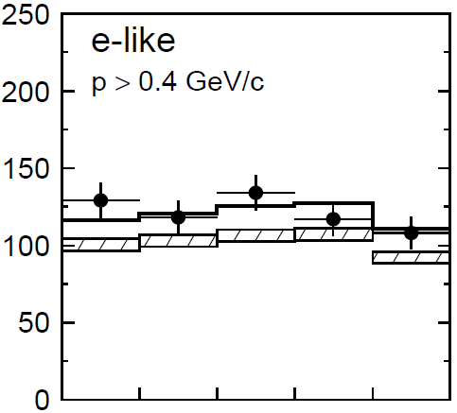
Neutrino oscillations
But flavour numbers not conserved by weak force…
Particle-antiparticle (K⁰ – K⁰) oscillations (Gell-Mann & Pais, 1954)
Pontecorvo (1957): ν - ν oscillations
Maki, Nakagawa, Sakata (1962): ν mixing among different ν flavours
Pontecorvo & Gribov (1967): 1st computation of oscillation probability
Solar neutrinos: ν_{e} deficit (1968, Ray Davis), oscillation (SNO, 2001)
Atmospheric neutrinos: Super-Kamiokande (1998) and many others
ν_{μ} disappearance
P(ν_{μ}→ν_{τ}) ~ sin²2θ₂₃cos⁴θ₁₃sin²(Δm²₂₃L/4E)

Slide 5
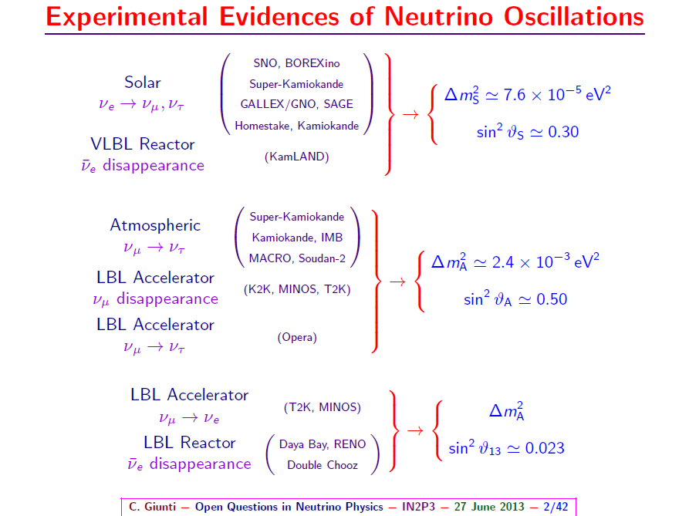
Neutrino oscillations
ν oscillation picture well established, but only by dissapearance measurements!

Slide 6
OPERA Physics case
SK(1998): atmospheric ν_{µ} disappearance, Chooz, SK: ν_{µ} → ν_{e} => ν_{µ} → ν_{τ} ?
ν oscillation picture prediction of appearance of different ν flavour not tested directly. Most experimental results on disappearance.
OPERA’s goal: observe ν_{τ} appearance in ν_{µ} beam
(confirms oscillation framework and atmospheric ν_{µ} → ν_{τ} oscillation)
ν_{μ}
μ ⁻
ν_{μ}
Neutrino Oscillation
ν_{μ} CC int
ν_{τ}
ν_{τ}
decay kink
τ ⁻
μ⁻, h⁻ ,e⁻
ν_{τ} CC int

Slide 7

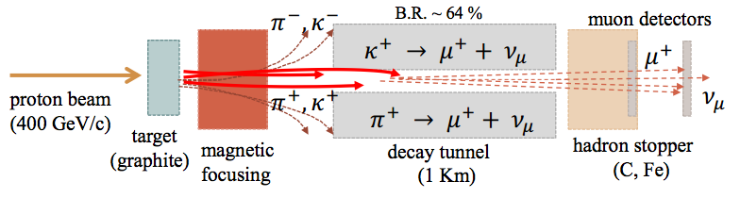
CERN ν_{μ} beam
SPS 400 GeV protons on graphite target.
Negligible ν_{τ} beam pollution, small ν_{e} and ν_{µ} pollutions (<3% of interactions)
Relatively big systematic uncertainties on ν interactions on OPERA target (systematic on νμ + systematic on νs cross sections → uncertainty ~10%)
(ν_{e} CC + ν_{e} CC)/ ν_{µ} CC | 0.89%
ν_{µ} CC/ν_{µ} CC | 2.1%
prompt ν_{τ} | negligible

Slide 8
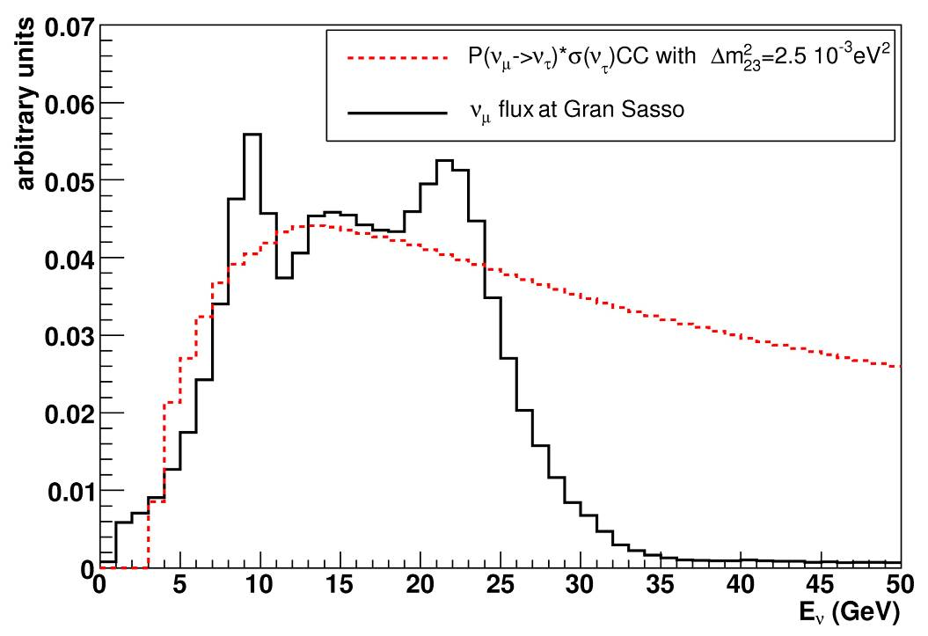
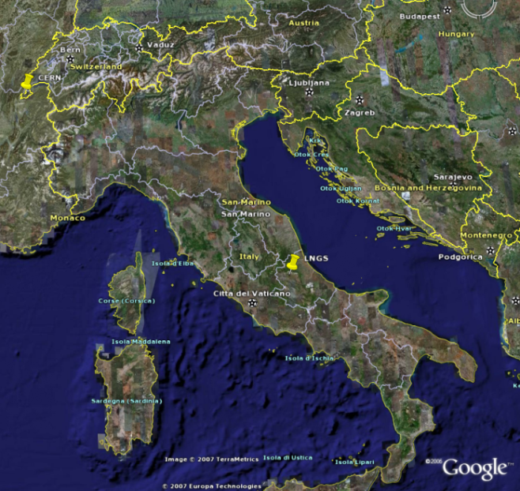
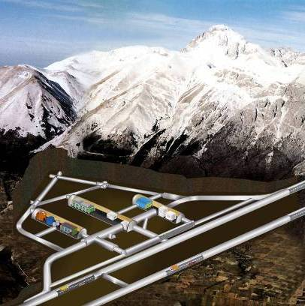
CERN Neutrinos to Gran Sasso
CERN ν_{µ} beam to INFN Gran Sasso underground lab
High <Eν> to boost σ(ν_{τ} ChargedCurrent)
OPERA not on oscillation maximum:
~20000 ν_{µ} events vs ~100 ν_{τ} events
CERN
Under 1400 m of rock
(3400 m water equiv)
730 km
LNGS
<E_{ν}> | 17 GeV
L | 730 km
P(ν_{µ} → ν_{τ}) ≈ 1.7%
(ν_{e} CC + ν_{e} CC)/ ν_{µ} CC | 0.89%
ν_{µ} CC/ν_{µ} CC | 2.1%
prompt ν_{τ} | negligible
10⁶ cosmic ray
attenuation wrt surface

Slide 9
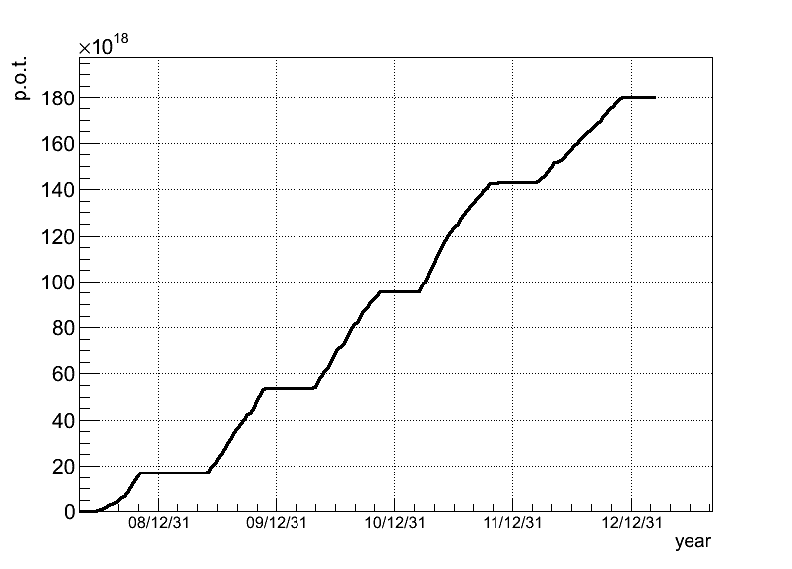
CNGS performance
Beam exposure from 2008 to 2012, record performance in 2011
Total integrated pots ~ 20% less than proposal value (22.5 x 10¹⁹ pot)
Year | Beam days | P.O.T. (10¹⁹)
2008 | 123 | 1.74
2009 | 155 | 3.53
2010 | 187 | 4.09
2011 | 243 | 4.75
2012 | 257 | 3.86
Total | 965 | 17.97
p.o.t. (10¹⁸)
2012
2011
2010
2009
2008
date

Slide 10
Backgrounds
ν_{μ,e}
μ⁻,e⁻
μ⁺
e⁺
h⁺
Backgrounds to kink topology:
  ν_{µ} CC charm production (4% of CC), with µ mis-id’d
  (similar lifetime, missing E_{T} decays)
  large angle coulomb scattering of µ
  nuclear interactions of hadrons (0.2% of NC)
Detector requirements:
  kink topology -> excellent position resolution
  charm bkg -> very good muon ID and charge reconstruction
  charm, hadronic bkgs -> some kinematical discrimination, e.g. φ variable
Kinematical variables to reduce background:
  Flight length
  Total p_{T} of τ daughters wrt τ direction
  Missing p_{T} at 1ary vertex
  φ = angle of τ wrt hadronic shower in transverse plane to beam
D⁺
ν_{μ}
μ⁻
ν_{μ}
ν_{μ}
h±
h±
Signal :
φ =180º
X (hadron shower)
BG:
small φ
x
φ
kink
ν_{τ}N τ⁻X
π⁻
τ⁻
τ-decay
π⁻
ν_{τ}
π⁻
ν_{μ}N ν_{μ}π⁻X
ν_{μ}

Slide 11
Detection principle
ECC brick
1 mm
electronic
trackers
τ
ν_{τ}
Pb
emulsion layers
Cleanest signature: kink topology
Hybrid detector: nuclear emulsions (“ECC”) & electronic detectors
Micrometric resolution: σ(position) < 1 µm, σ(angle) ≈ 2 mrad
Emulsions & Pb plates grouped in “bricks” (8.3 kg, 10 X₀)
Electronic detectors trigger, select brick, measure muon momentum & charge
interface films (CS)

Slide 12
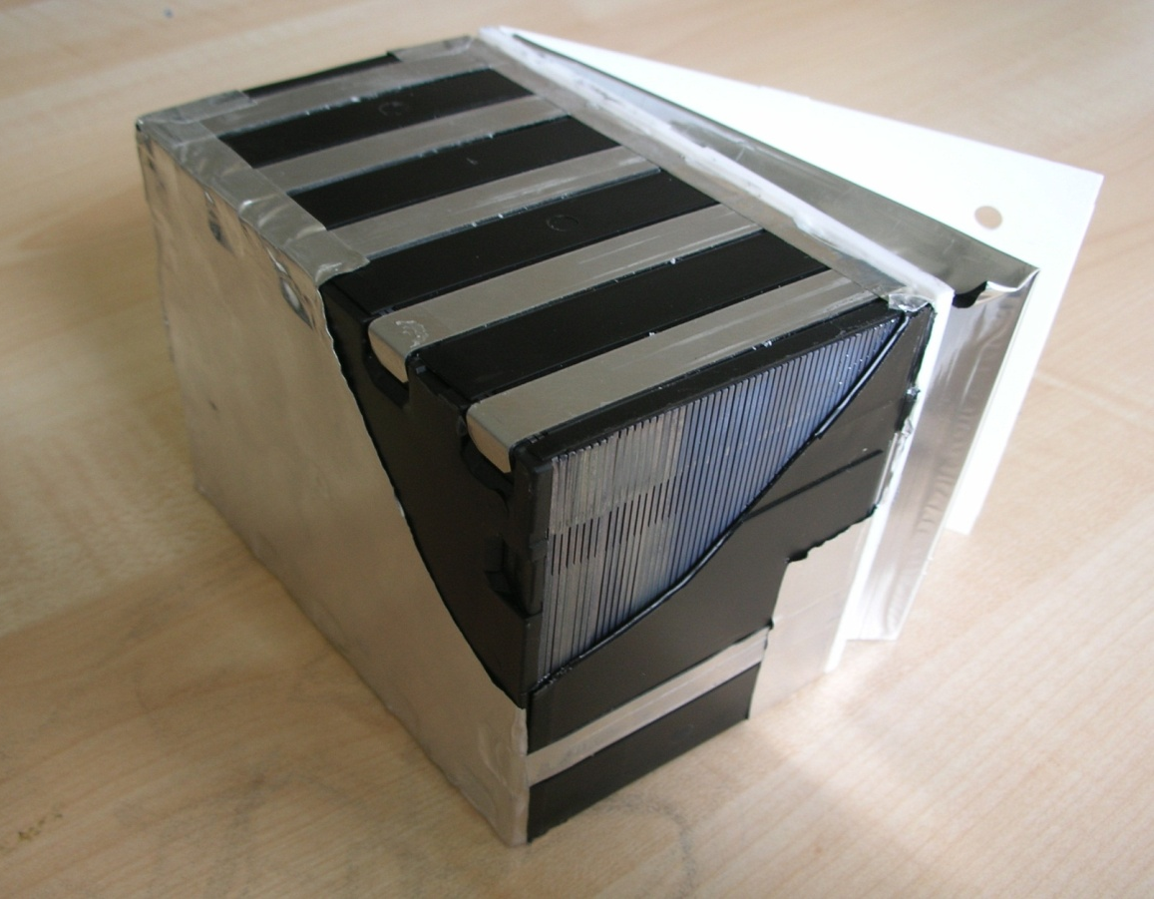
Detection principle
7.5 cm
ECC brick
12.5 cm
1 mm
electronic
trackers
τ
ν_{τ}
10 cm
Pb
emulsion layers
Cleanest signature: kink topology
Hybrid detector: nuclear emulsions (“ECC”) & electronic detectors
Micrometric resolution: σ(position) < 1 µm, σ(angle) ≈ 2 mrad
Emulsions & Pb plates grouped in “bricks” (8.3 kg, 10 X₀)
Electronic detectors trigger, select brick, measure muon momentum & charge
interface films (CS)

Slide 13

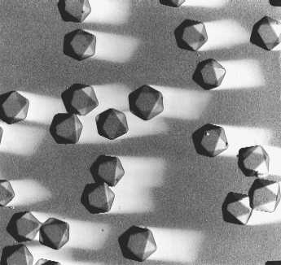
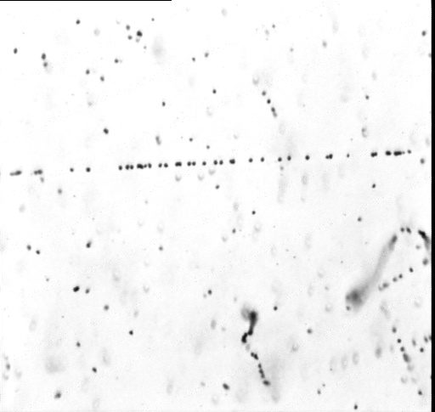
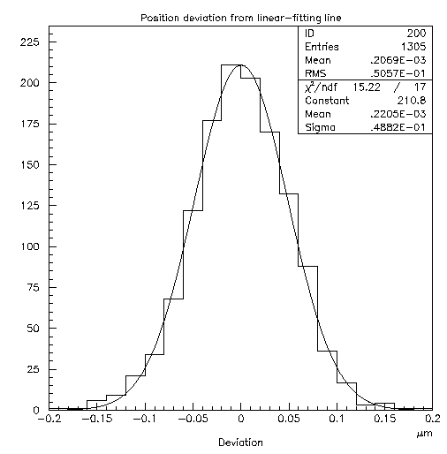
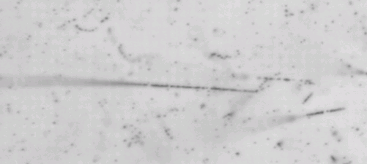
Emulsion films
Emulsion Layer (44 microns)
basic detector: AgBr crystal,
size = 0.2 micron
detection eff.= 0.16/crystal
10¹³ “detectors” per film
Plastic Base (205 microns)
Emulsion Layer
grain density ~15 grains/44 microns for mips
intrinsic resolution: 50 nm
mip
deviation from linear-fit line. (2D)
electron ～100 keV
20 μm
high dE/dx tracks
from nuclear evaporation

Slide 14
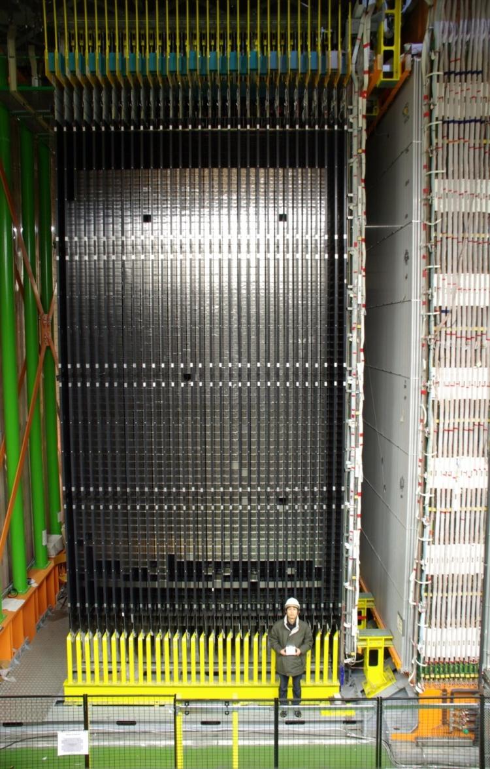
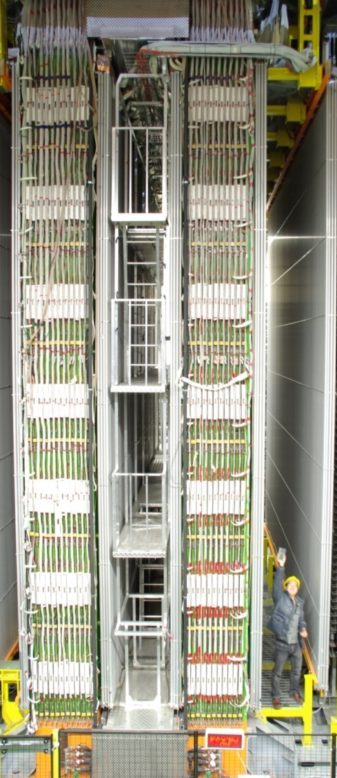
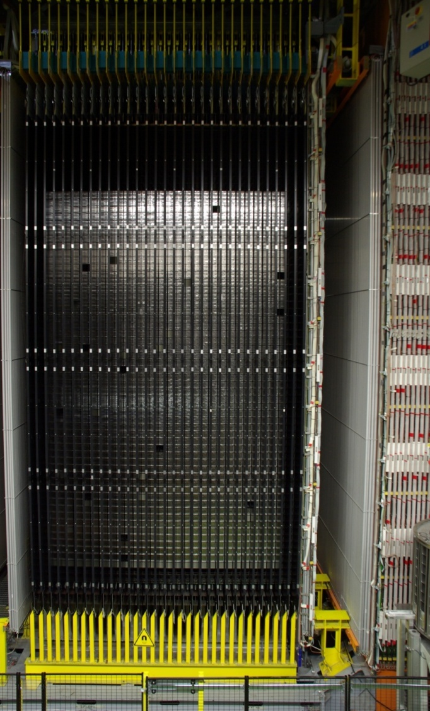
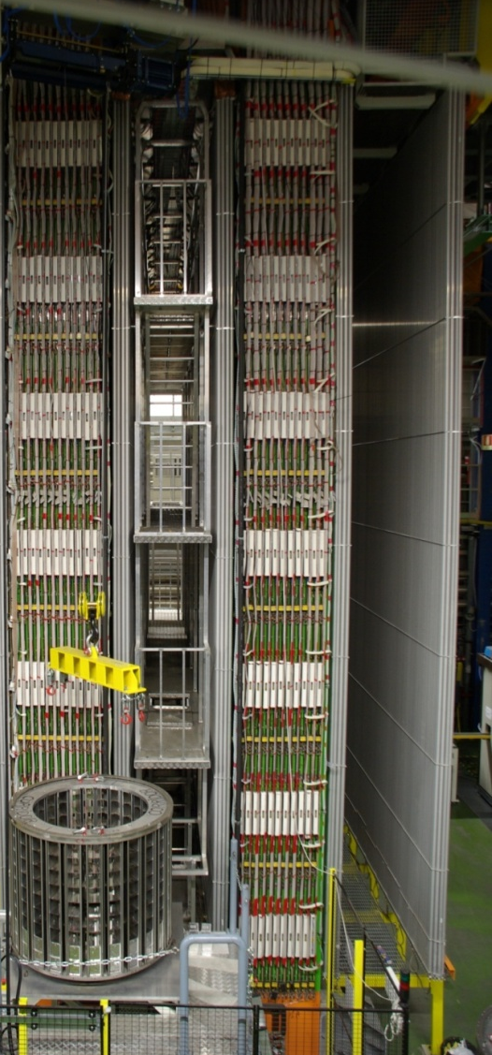
Detector
Muon veto
Muon spectrometer Δp/p ~ 20%
JINST 4 (2009) 04018
ν
Target area
B = 1.55 T
Target area
~150000 bricks = 1,25 kton in total
31 Target Tracker planes
Brick Manipulating System

Slide 15
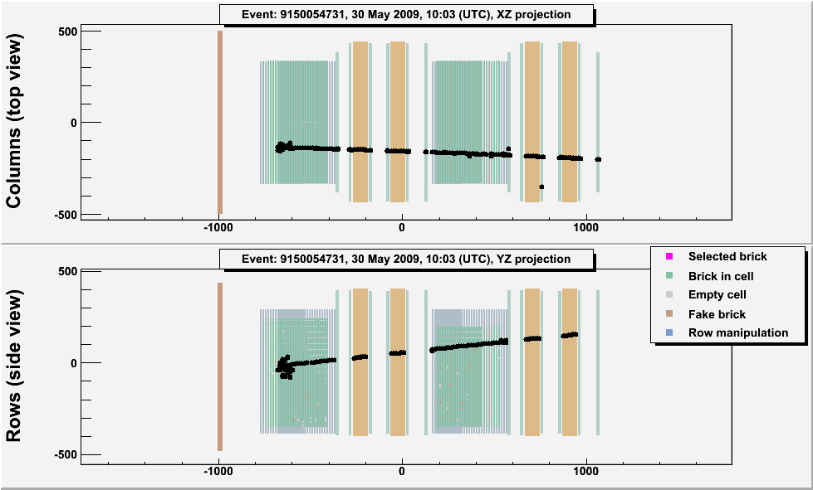
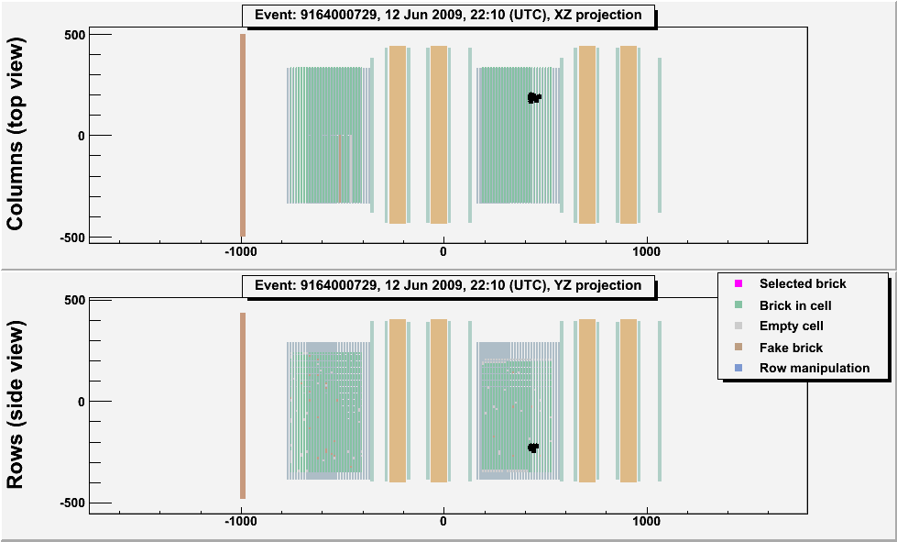
ED
Typical ν_{μ} CC and
NC-like events
20 m

Slide 16
Muon ID and ν_{μ} CC ID
3D tracks reconstructed with Kalman filter
Muons ID’ed by range (left plot):
95% eff for ν_{μ} CC events → (Track length)x(density) > 660 g/cm2
~5% NC events misID’ed as muons
muon ID → momentum estimate by range-momentum correlation
CC events also ID’ed by # of walls touched (right plot): CC if N_{ED} > 14

Slide 17
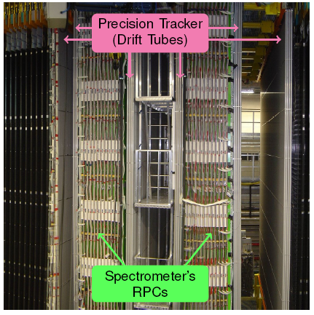
Muon charge and momentum
1.55 T magnetic field
24 RPC planes + 6 drift tubes
Momentum resolution
20 % below 20 GeV/c
Muon charge misID < 2%

Slide 18
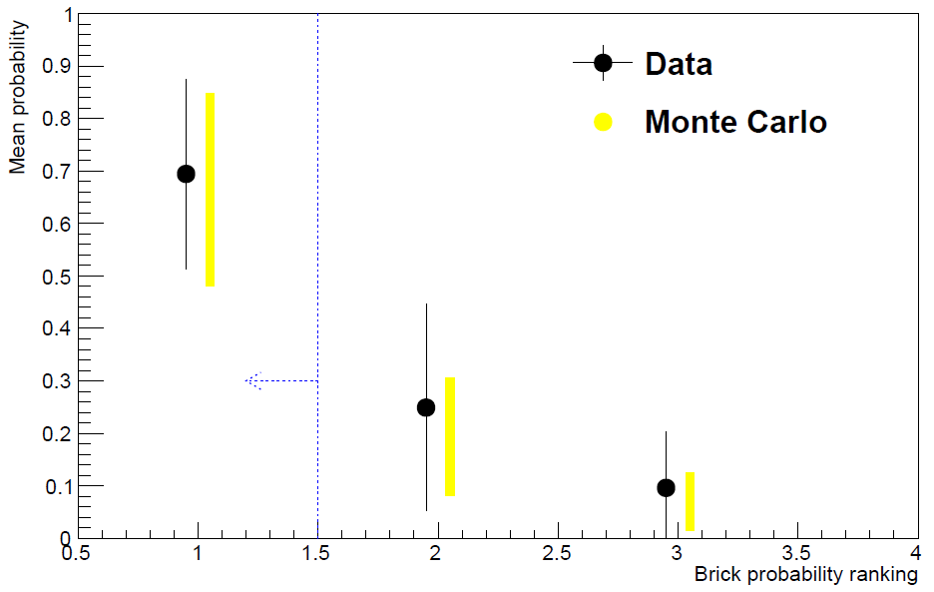
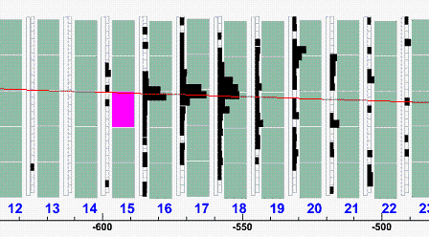
Brick Finding
Use TT tracks + energy deposits to select brick most probably containing ν int.
Average of 1.6 iterations / event
Extract this brick

Slide 19
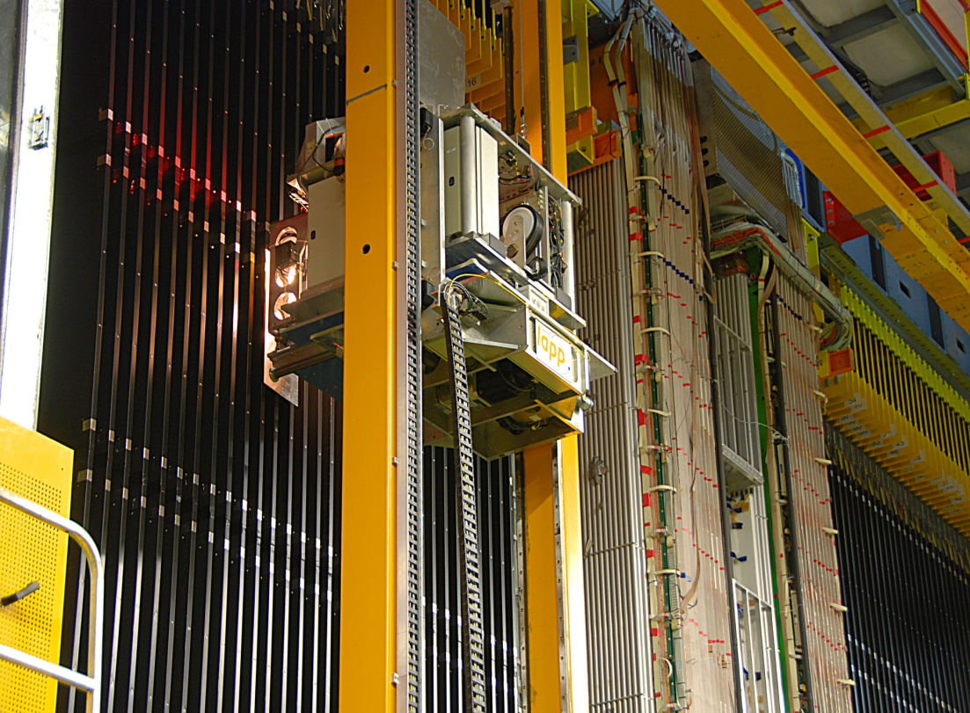
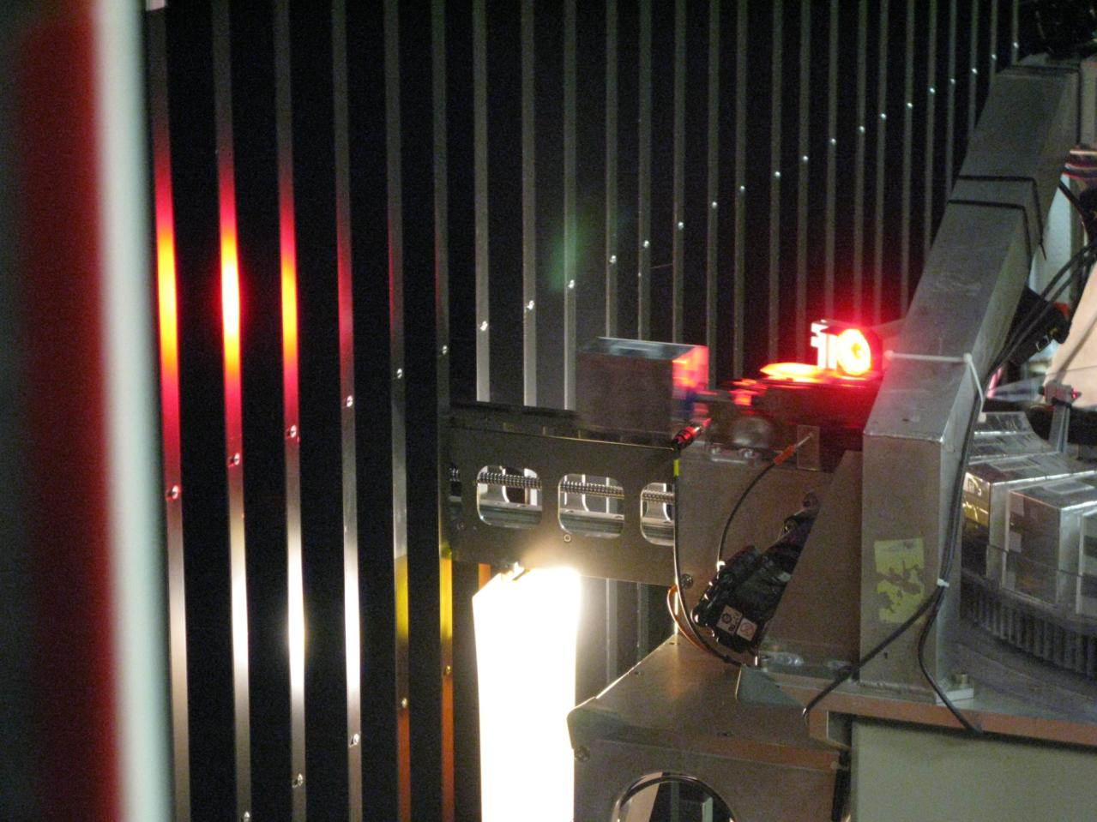
Brick extraction
Fully automated Brick Manipulating System (LAPP)
Up to 50 bricks/day
Quasi on-line neutrino event extraction
~9% target mass loss during data-taking

Slide 20
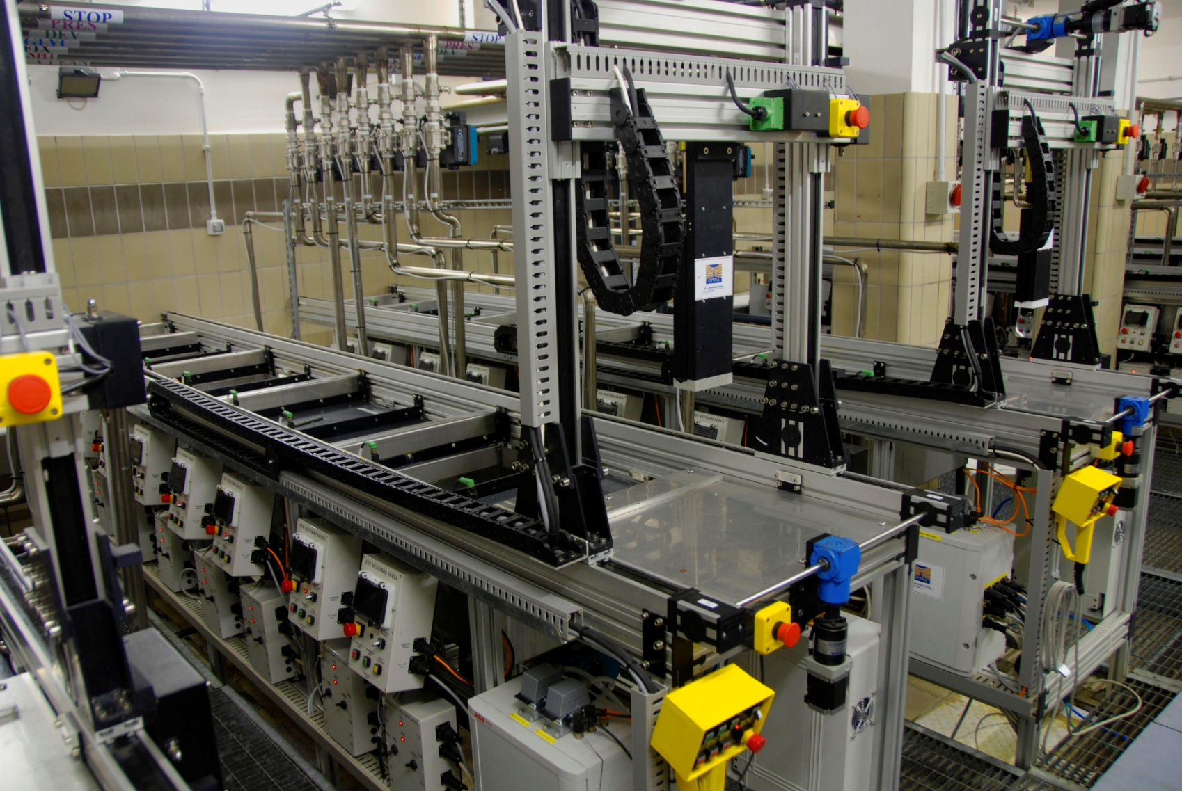
Emulsion Film Development
5 automated film development lines running in parallel, in a dark room
Up to 150 bricks/week
Additional underground development facility for CS doublets

Slide 21
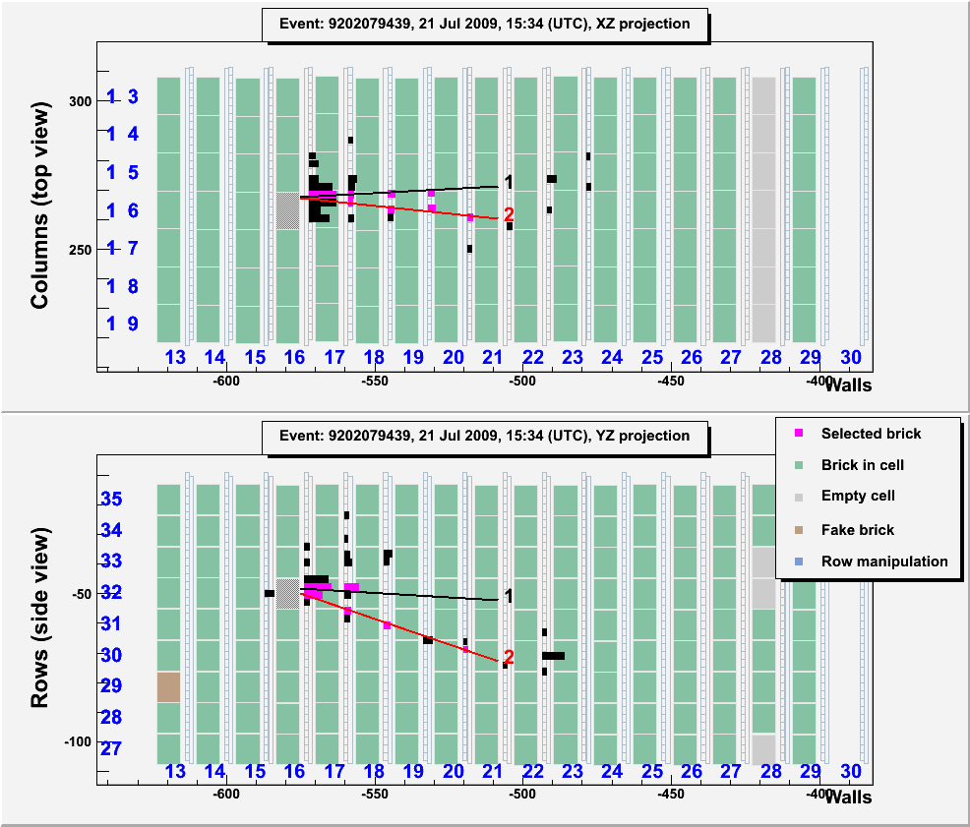
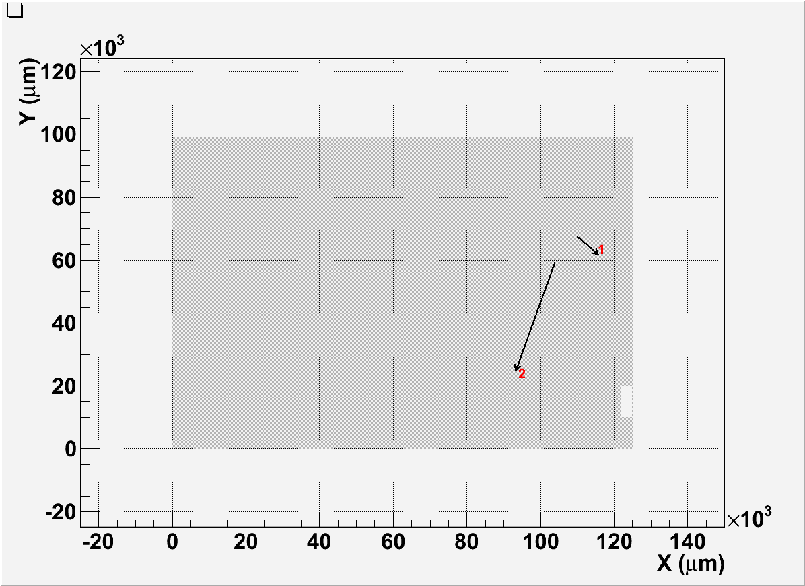
CS doublet
Check extracted brick contains ν interaction with Changeable Sheet (CS) doublet
Scan large area around ED prediction (20 -35 cm²) and match found tracks with
EleDet tracks within resolution (15 mrad, 60 mrad cut)
If no match found return brick to target,
extract following most probable brick
CS tracks: the arrow length is
proportional to its slope

Slide 22
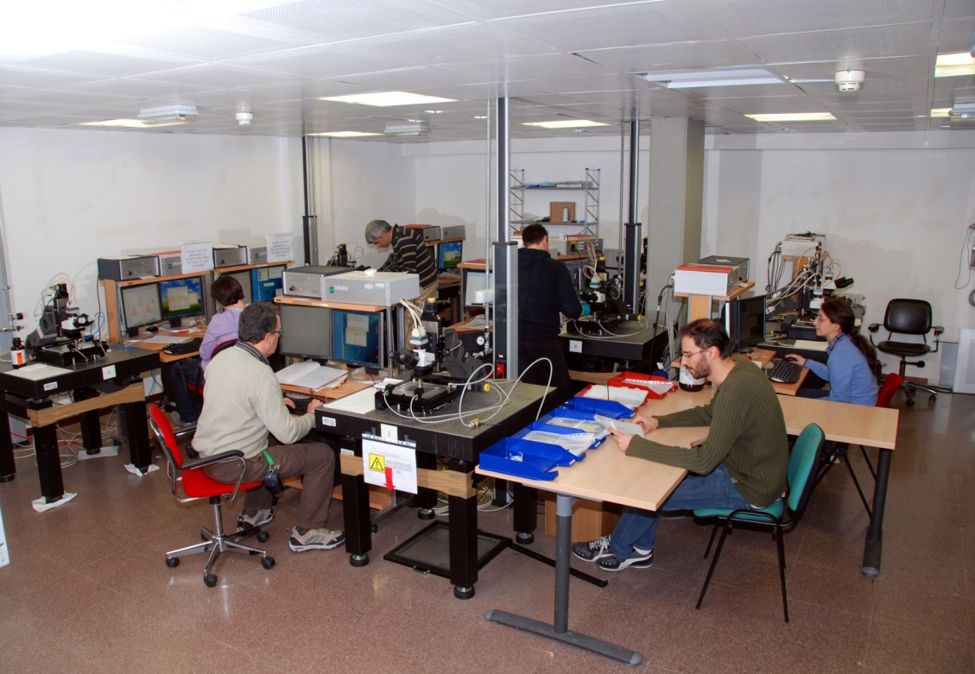
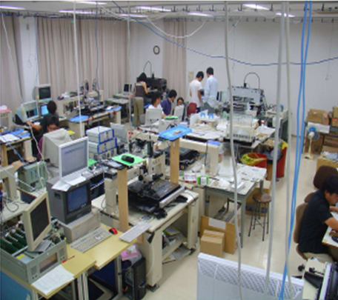
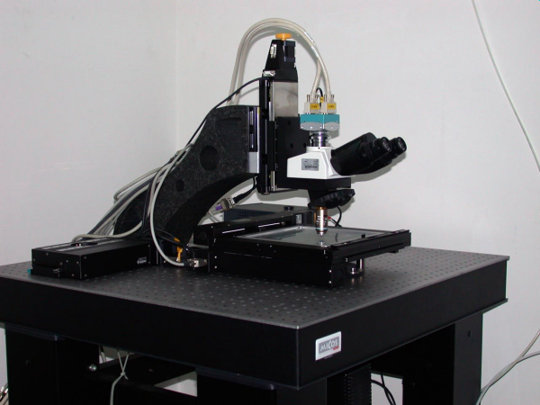
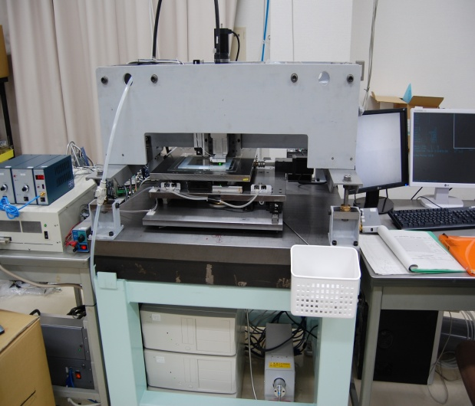
Scanning systems
LNGS
Nagoya
V
High speed automatic microscopes:
~ 200 cm² emulsion film surface/hour/facility
State of the art technologies
European Scanning System
Super-UltraTrack Selector (Japan)

Slide 23
Event Location in the ECC
Changeable
Sheet
ECC
Large Area Scanning
~5cm x 5cm
ν
Lead
film
Lead
film
Lead
film
Lead
film
Lead
film
Lead
film
Lead
film
Lead
film
film
film

Slide 24
Event Location in the ECC
Changeable
Sheet
ECC
Small area scan
~0.1mm*0.1mm
ν
Read-out films around the stopping point
Lead
film
Lead
film
Lead
film
Lead
film
Lead
film
Lead
film
Lead
film
Lead
film
film
film

Slide 25
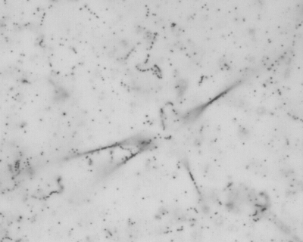
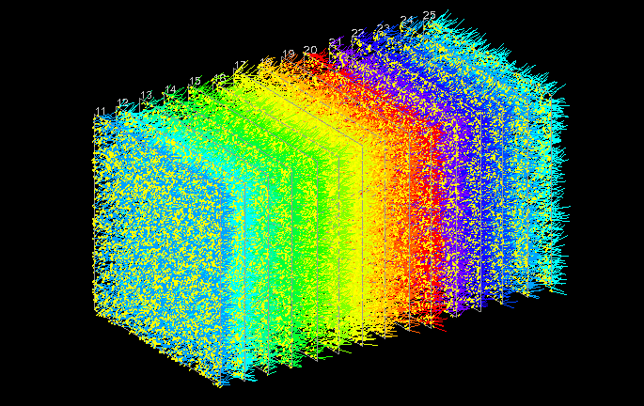
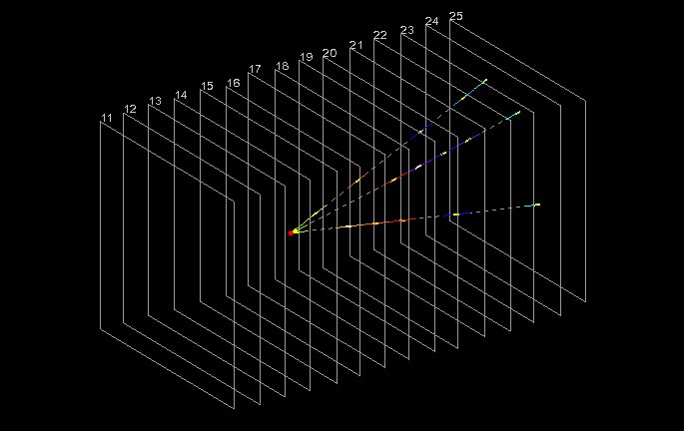
Scanning
Developed emulsion
Automated microscope
European Scanning System
1 cm
1 cm
Low energy & random tracks
High energy tracks connecting across the lead

Slide 26
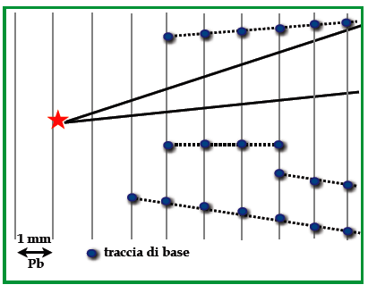
Decay Search
Topological selection after volume scan around located vertex = “Decay Search”
Track segment

Slide 27
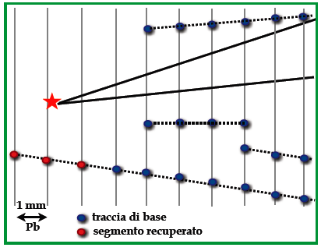
Decay Search
Extra track search, not connected to 1ary vertex: |Δz| < 3 mm and IP < 500 μm
Track segment
micro-track segment

Slide 28
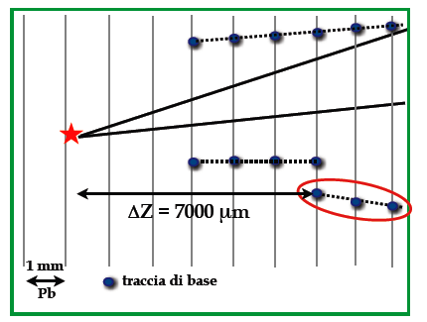
Decay Search
Remove tracks far from vertex
Track segment

Slide 29
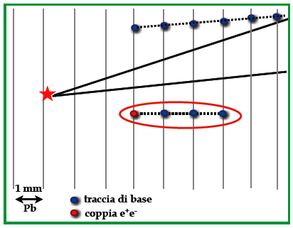
Decay Search
Remove e+e- pairs and other particles with high scattering
Track segment
e^{+/}e⁻ from an electron pair

Slide 30
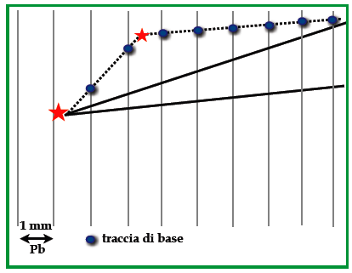
Decay Search
Search for short-lived parent tracks
Compute kink angle between track segments. Larger than 5x angular spread of base-tracks? Larger than 20 mrad? Yes, kink trigger.
Track segment

Slide 31
Kinematics and PID
Momentum measured via Multiple Coulomb Scattering of tracks in lead
MCS method developed with test beam bricks,
checked with soft muons & muon spectrometer
Some particle ID:
dE/dx (=grain density along track, nuclear fragments),
showering (electrons),
track following in emulsion (nuclear interaction,
hadrons), and Electronic Detector (range, muons)
New J.Phys. 14 (2012) 013026

Slide 32
ν_{µ} → ν_{e} appearance search

Slide 33
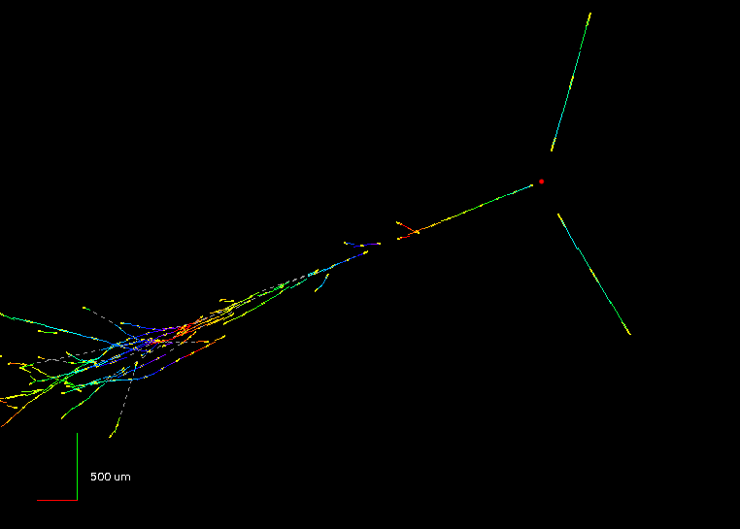
ν_{e} appearance search
ν_{µ} → ν_{e} appearance search in 2008+2009 sample (5.25 x 10¹⁹ PoT)
μ-less events with EM shower attached to 1ary vertex, no visible kink
E_{ν} = 16 GeV

Slide 34
ν_{e} appearance search
Dedicated “trigger”: EM showers in CS of NC-like events.
19 ν_{e} candidates found in 505 0μ events
Interface
films

Slide 35
ν_{e} appearance search
Background from mis-id’d π⁰ from NC 0.2 ± 0.2 events
Gamma-ray
1micron
A close-up of an electron pair

Slide 36
ν_{e} appearance search
Expected ν_{e} events :
ν_{e} beam contamination 19.3 ± 2.8
Background τ → e + mis-id’d π⁰ 0.5 ± 0.2
→ Observed 19 events sin²(2θ₁₃) < 0.44 @ 90% CL
ν_{µ} → ν_{e} 1.4 evts (sin²(2θ₁₃) = 0.098)

Slide 37
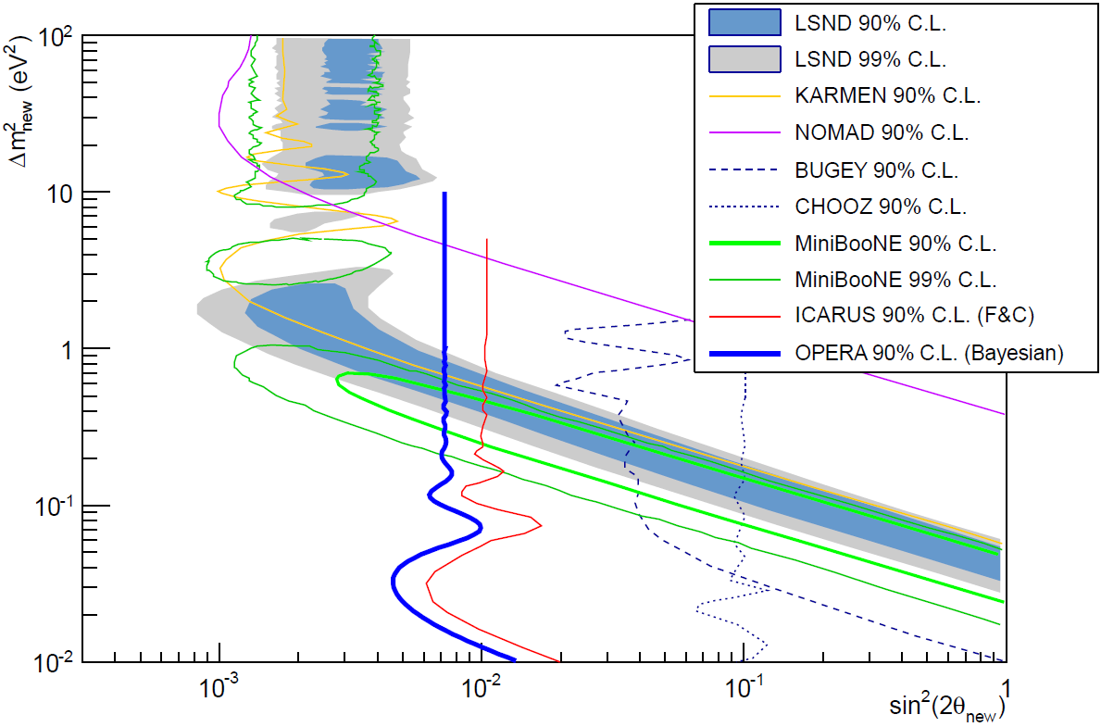
ν_{e} appearance search
Expected ν_{e} events :
ν_{e} beam contamination 19.3 ± 2.8
Background τ → e + mis-id’d π⁰ 0.5 ± 0.2
→ Observed 19 events sin²(2θ₁₃) < 0.44 @ 90% CL
ν_{µ} → ν_{e} 1.4 evts (sin²(2θ₁₃) = 0.098)
→ Upper limit on non standard ν oscillations sin²(2θ_{new}) < 7.2 x 10⁻³ 90% CL where
P = sin²(2θ_{new}) sin2(1.27 Δm²_{new} L/E)

Slide 38
ν_{µ} → ν_{τ} appearance search

Slide 39
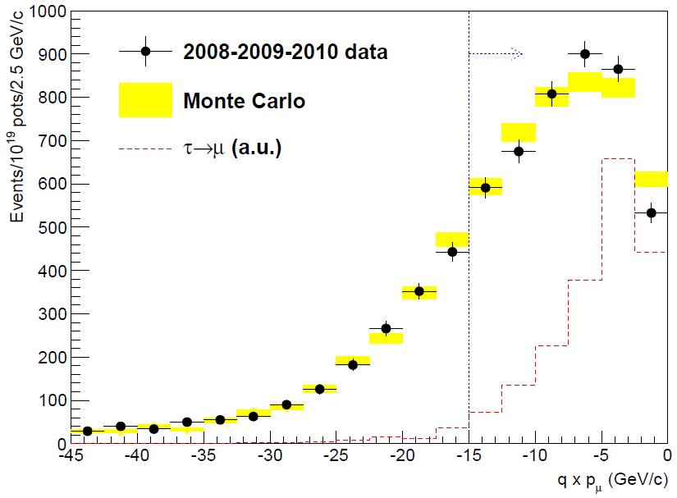
Event analysis strategy
Status of scanning:
2008+2009: “minimum” bias sample, no preselection
2010, prioritise highest probable brick and 1μ with p_{μ} < 15 GeV/c
2011, prioritise highest probable brick for 0μ events
Years | PoT (x10¹⁹) | Status | # of Decay Searched events
2008-2009 | 5.27 | Completed | 2783
2010-2011-2012 | 12.7 | In progress | 1942
Total | 18.0 |  | 4725

Slide 40
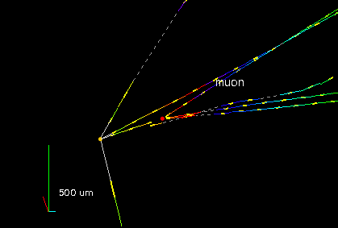
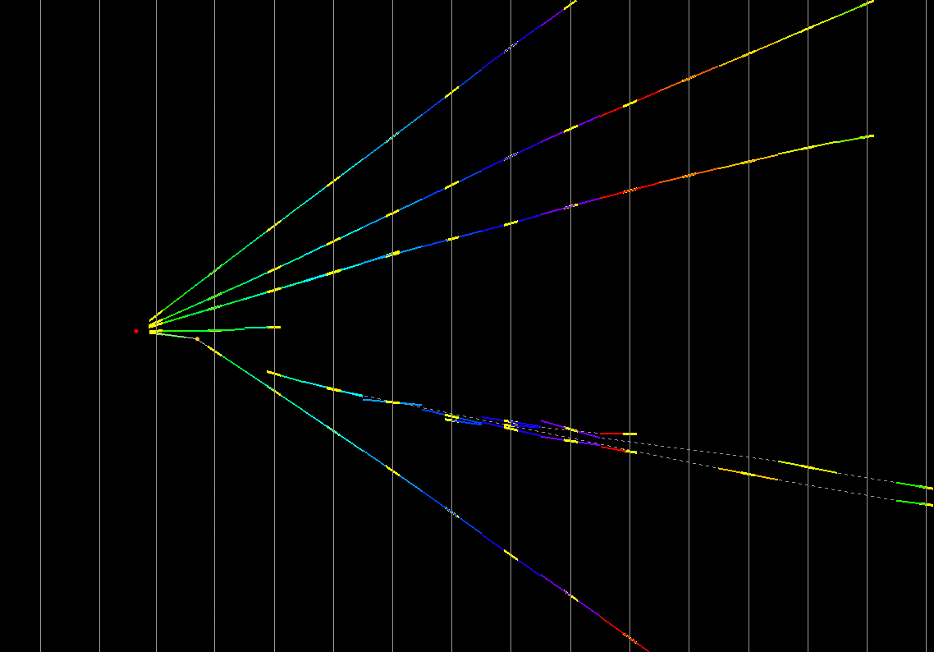
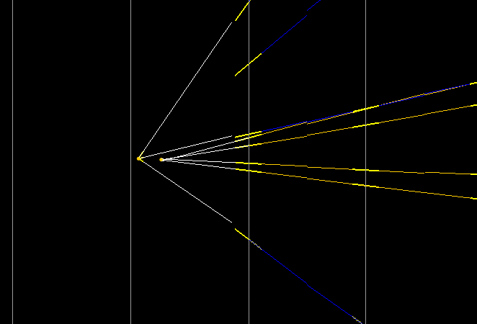
Control sample: charm
Same decay topologies & lifetimes as τ signal
A few examples of charm candidates
(muon at 1ry vertex, phi value or both):
x-view
1ry muon
3-prong
1ry
vertex
Flight length = 4350 µm
di-muon
kink
4 mm
1.3 mm
1-prong
daughter muon
Flight length = 1330 µm
D⁰ 4-prong
φ = 173°
Flight length = 313 µm

Slide 41
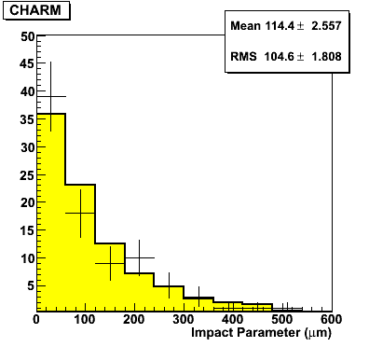
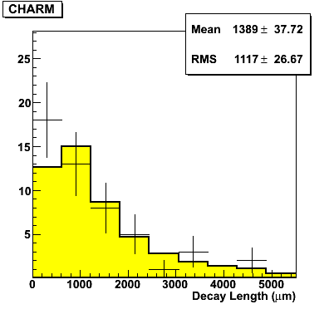
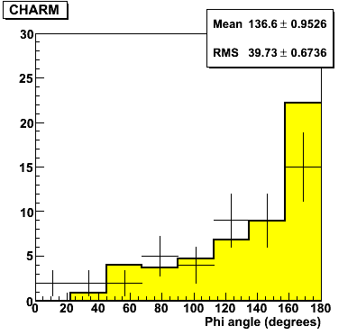

Control sample: charm
Topology | Expected from MC | Observed in Data
1-prong | 29.5 | 19
2-prong | 18.7 | 22
3-prong | 5.6 | 5
4-prong | 0.8 | 4
Total | 55 ± 10 | 50

Slide 42
Expected ν_{τ} candidates
Status of scanning:
Expected number of signal and background events in analysed sample
Years | PoT (x10¹⁹) | Status | # of Decay Searched events
2008-2009 | 5.27 | Completed | 2783
2010-2011-2012 | 12.7 | In progress | 1942
Total | 18.0 |  | 4725
Signature | BR (%) | Observed candidates | Signal | Background | Charm | Mu scattering | Hadrons
τ– → µ– | 17.7 | 1 | 0.56 | 0.026 | 0.0084 | 0.018
τ– → e– | 17.8 |  | 0.49 | 0.065 | 0.065
τ– → h– | 49.3 | 1 | 0.66 | 0.045 | 0.029 |  | 0.016
τ– → h–h⁺h– | 15.2 | 1 | 0.61 | 0.090 | 0.087 |  | 0.003
Total |  | 3 | 2.32 | 0.23 | 0.19 | 0.02 | 0.02

Slide 43

Backgrounds: had int
Hadronic interactions a major background to channels τ– → h– and τ– → h– h⁺ h–
Data
1 cm

Slide 44






Hadronic interactions
Compare Fluka MC with data from OPERA brick exposed to π beam. 10% systematics
Multiplicity
2GeV/c
4GeV/c
10GeV/c
10 GeV/c
Error bars : Experimental data
Histogram : Simulated data
Kink angle (1-prong)

Slide 45






Hadronic interactions
Cuts on daughter p_{T} and daughter p efficient at reducing hadronic background
Data
2GeV/c
4GeV/c
10GeV/c
0/12 tracks
0/7 tracks
1/10 tracks
Signal region
1-prong
MC
1/388 tracks
9/132 tracks
13/95 tracks

Slide 46


Hadronic interactions
Nuclear fragments: Reduce hadronic background for free! - 40%
Nuclear
Fragments
τ
h
h
h
ντ
ν
NC
Highly ionizing fragments
Black : experimental data
Red : simulated data (β = p/E = 0.7)

Slide 47




Backgrounds: μ scatt
Simulations predict ~10⁻⁶ rates. Only upper limit measured (<10⁻⁵ @ 95% C.L. NIM A423 (1986) 518). Measure it with μ beam on OPERA brick!
Kink angle (mrad)
Pt (MeV/c)
Kink angle (>20 mrad)
Pt (> 250 MeV/c)

Slide 48


1st ν_{τ} candidate
φ
τ– → ρ– ν_{τ} , ρ– → π– π⁰ , π⁰ → γγ
Selection criteria | Measurements
Kink > 20 mrad | 41 ± 2
Flight length < 2600 µm | 1335 ± 35
p daughter > 2 GeV/c | 12 ⁺⁶₋₃
p_{T} daughter > 300 MeV/c | 470 ⁺²³⁰₋₁₂₀
missing p_{T} < 1 GeV/c | 570 ⁺³²⁰₋₁₇₀
ϕ > 90° | 173 ± 2
m(π⁰) = 120 ± 20(stat.) ± 35(syst.)
Phys.Lett. B691 (2010) 138-145

Slide 49


Track Follow Down
Further reduce ID inefficiencies by following tracks till they exit the detector, interact hadronically, decay (muon) or use range again
L = track length
R_{lead} = µ range
ρ_{average} = average density
ρ_{lead} = lead density
p = momentum in emulsion

Slide 50



2nd ν_{τ} candidate
τ⁻→h⁻h⁺h⁻ν_{τ}
Interaction Vertex in lead plate
1 nuclear fragment
Primary Track
φ = (167.8 ± 1.1)°
µm
Flight length 1.54 mm
d2
τ
φ
Decay point
In Plastic Base
No nuclear fragment
d3
d1
Kink angle
(rad)
Secondary Interaction
In Emulsion
4 nuclear fragments
degrees

Slide 51



3rd ν_{τ} candidate
NEW!!
τ⁻ → μ⁻ ν_{μ} ν_{τ}
µm
μm
Muon kink in emulsion – 10 to 100 times
less likely than in Pb
τ⁻ → μ⁻ ν_{μ} ν_{τ}
τ
Decay point
In Plastic Base

Slide 52


3rd ν_{τ} candidate
NEW!!
τ⁻ → μ⁻ ν_{μ} ν_{τ}
Primary track is hadron
(range, 14 cm)
Muon charge measured
by spectrometer
2.8 ± 0.2 GeV μ

Slide 53

3rd ν_{τ} candidate
NEW!!
Negative charge measured at > 5 σ
Target Tracker hits
X
P2<0 → negative charge
5.6 σ significance
R ~ 85 cm
B
RPC hits

Slide 54



3rd ν_{τ} candidate
NEW!!
τ→μ MC
τ→μ candidate
excluded region
Kink angle
(mrad)
φ
Flight length
(μm)
degrees
φ = (154.5 ± 1.5)° Kink angle 245 ± 5 mrad Flight length 376 ± 10 μm
τ⁻ → μ⁻ ν_{μ} ν_{τ}
3 ν_{µ} → ν_{τ} candidates: appearance at 3.2 σ

Slide 55
Summary and conclusions
OPERA has recorded events corresponding to 18.0 x 10¹⁹ PoT delivered by the CNGS beam from 2008 to 2012
Scanning (“second data-taking”) and analysis ongoing. ~50% completed!
ν_{µ} → ν_{e} oscillation search:
non standard ν oscillations sin²(2θ_{new}) < 7.2 x 10⁻³ @ 90% CL
ν_{µ} → ν_{τ} appearance search, > 3 σ significance
3 candidates obs’d, 2.3 signal + 0.2 bkg expected
More events in the pipeline... Stay tuned!

Slide 56











The OPERA collaboration
140 physicists, 28 institutions in 11 countries
Belgium
IIHE-ULB Brussels
Russia
INR RAS Moscow
LPI RAS Moscow
ITEP Moscow
SINP MSU Moscow
JINR Dubna
Italy
Bari
Bologna
Frascati
L’Aquila,
LNGS
Naples
Padova
Rome
Salerno
Croatia
IRB Zagreb
France
LAPP Annecy
IPHC Strasbourg
Switzerland
Bern
Japan
Aichi
Toho
Kobe
Nagoya
Utsunomiya
Germany
Hamburg
Turkey
METU, Ankara
Israel
Technion Haifa
Korea
Jinju

Slide 57
BACK UP SLIDES

Slide 58






Hadronic interactions
2GeV/c
4GeV/c
10GeV/c
Multiplicity
MC: β < 0.7
Error bars : experiment
Histogram : simulation
Emission angle(cos θ)
Backward
Forward
Backward
Forward
Backward
Forward

Slide 59


Tqrget ;qss evolution
date bricks
16/07/08 146398
24/06/09 147292
31/05/12 135606
13/03/13 133425
Target loss ∼ 112 tons

Slide 60
Event analysis flow
Flow diagram (with pictures?), with key resolution figures and measurements and particle ID

