Slide 1
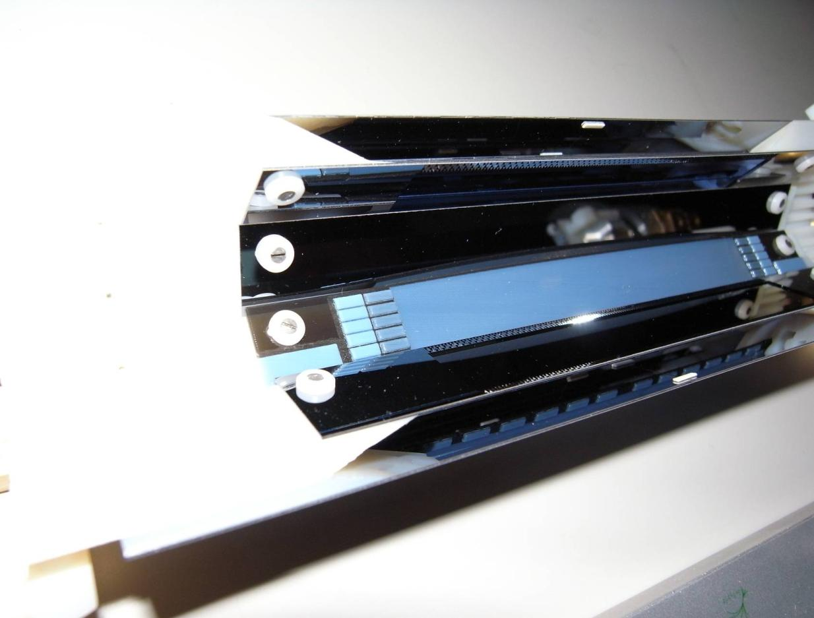
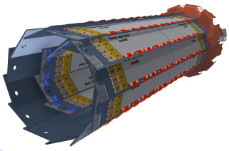
The Belle II Vertex Pixel Detector
IMPRS Young
Scientist Workshop
July 16 - 19, 2014
Ringberg Castle
Kreuth, Germany
Felix Mueller
fmu@mpp.mpg.de

Slide 2
Outline
SuperKEKB and Belle II
Vertex Detector (VXD)
Pixel Detector (PXD) and its characteristics
DEPFET technology and working principle
The readout electronics
Gated Mode Operation
Production / Technology Issues
Lab Measurements and TestBeam with PXD6
Summary and future plans

Slide 3
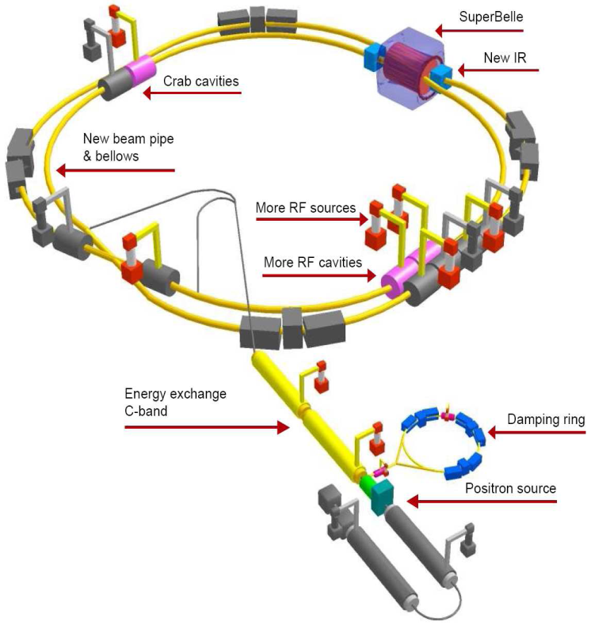
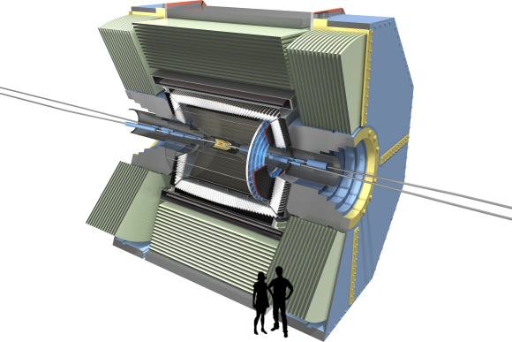
SuperKEKB upgrade
Belle II
electron (7 GeV)
5.0 m
positron (4 GeV)
7.4 m
see Martin‘s talk
Nano beam scheme → smaller beam size (~nm) & increased beam currents (x2)
L = 8 x 10³⁵ cm⁻² s⁻¹ (40 times larger than in KEKB)
E_{e-} = 7 (8) GeV & E_{e+} = 4 (3.5) GeV
(βγ = 0.42 (KEK) → 0.28 (SuperKEK))
E_{cm} = 10.58 GeV - Y(4S)
Changes involving the Vertex Detector (VXD):
Four layers of Double Sided Si-Strip Detector (DSSD) with a larger radius
Two layers of DEPFET pixel detector (PXD)

Slide 4
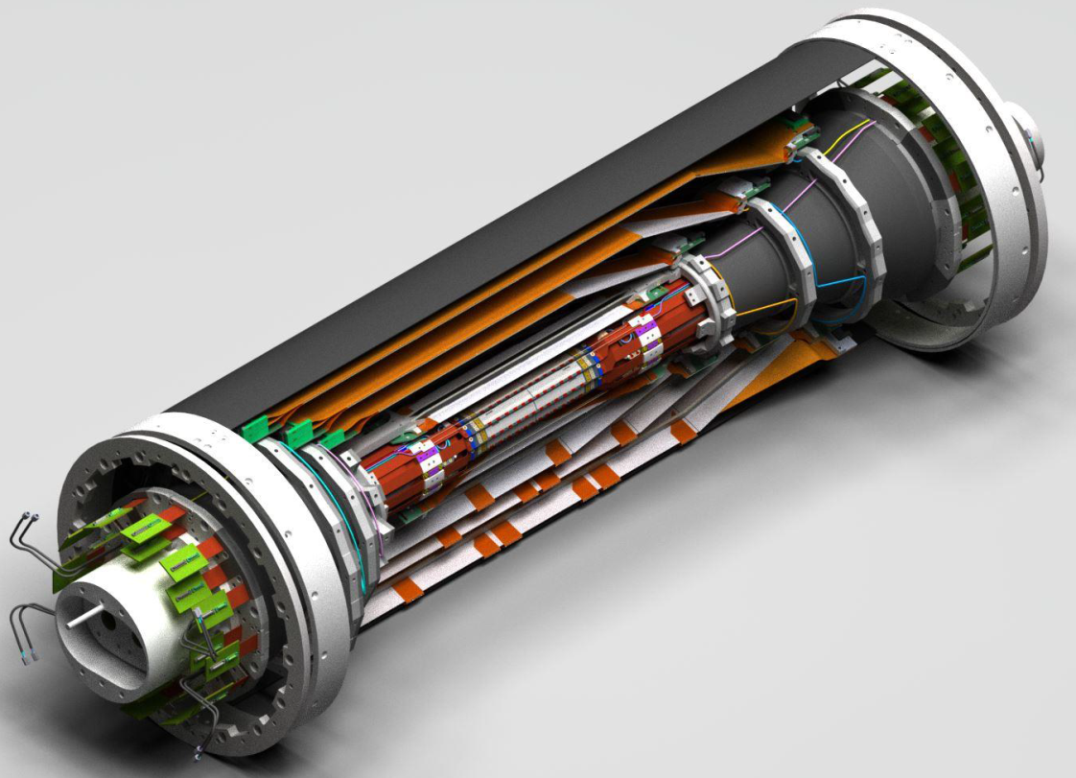
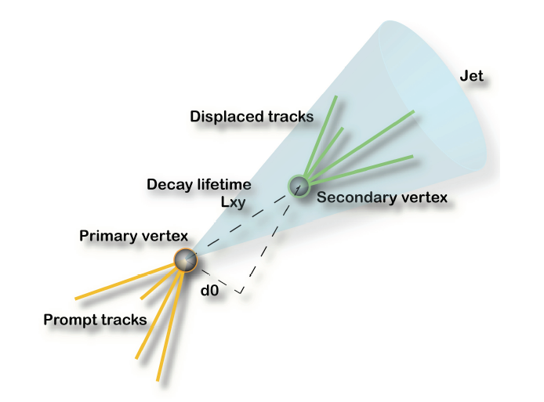
Vertex Detector (VXD)
Tasks of the vertex detector:
reconstruction of primary, secondary, … vertices of short-lived particles
decay of particles is typical in the order of 100 µm from the IP
detect tracks of low momentum particles (in high B field) which cannot make it to the main tracker
Innermost detector system as close as possible to IP
highly granular pixel sensors; provide most accurate 2D position information
should be massless and still provide a large enough S/N
Design and specifications to a larger extent driven by machine/beam characteristics
Beam background, radiation
damage, occupancy …

Slide 5
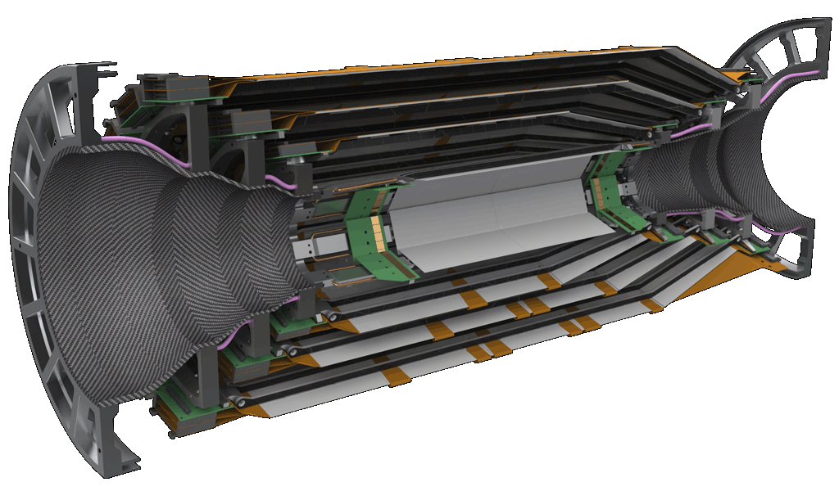
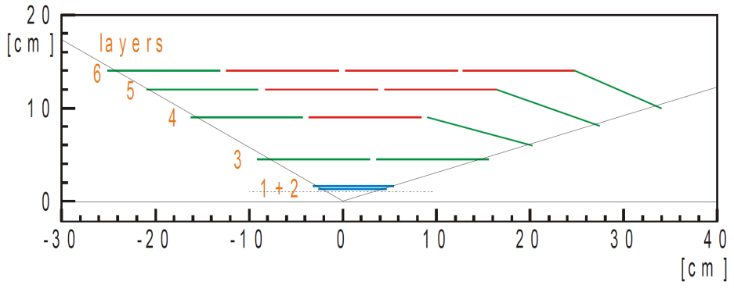
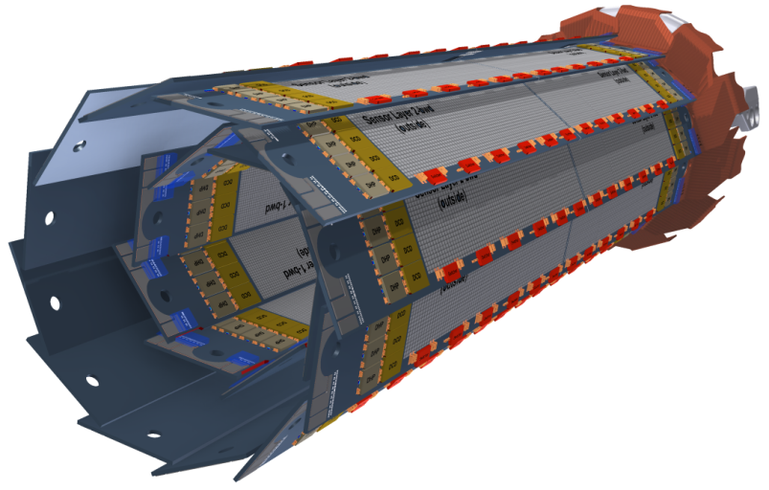
Vertex Detector (VXD)
Silicon Vertex Detector (SVD)
4 layers of double sided silicon strip detector
R= 3.8 cm, 8.0 cm, 11.5 cm, 14 cm
Beam pipe: R=10mm
Pixel Detector (PXD)
2 layers of DEPFET pixels
R = 1.4 cm, 2.2 cm

Slide 6
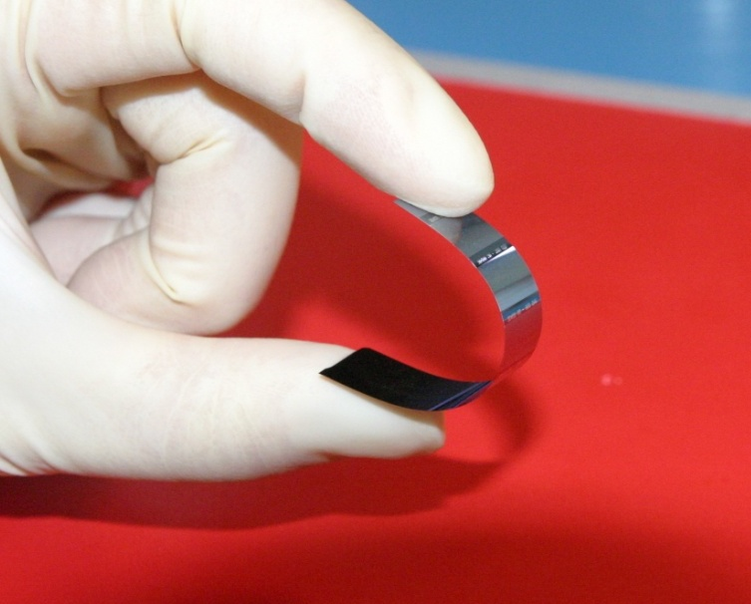
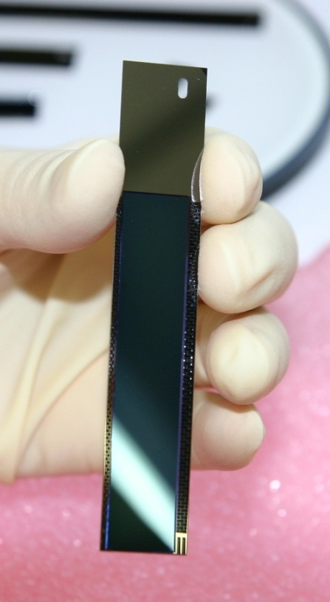
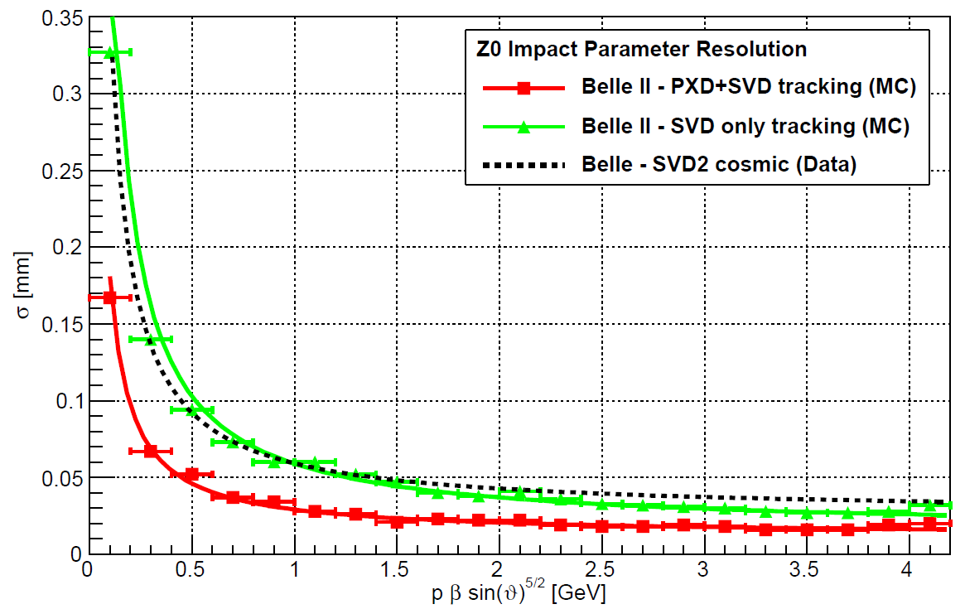
PXD detector requirements
Occupancy | 0.1 hits/µm²/s
Frame time | 20 µs (rolling shutter mode)
Momentum range | Low momentum (<1GeV)
Acceptance | 17°-150°
Radiation | ~20 kGy/year, 1⋅10¹⁰ n/ab⁻¹cm²
Belle II is dominated by low momentum tracks
Modest intrinsic resolution (15 μm), dominated by multiple scattering → Moderate pixel size (50 x 75 μm²)
Lowest possible material budget (0.2% X₀/layer) [including ASICs]
due to higher background (20x-40x): Radiation damage and occupancy, fake hits and pile-up noise
10x higher event rate => higher trigger rate
Replace inner layers of SVD with PXD

Slide 7
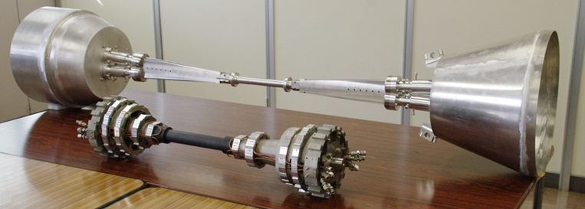
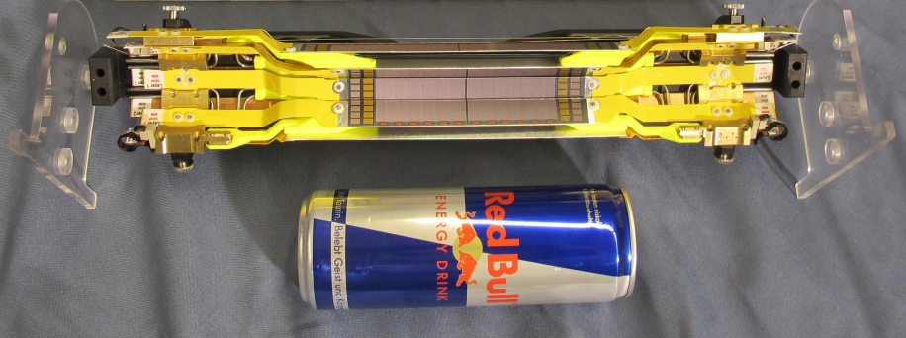
Mockup of the Belle II PXD Detector
Beam pipe radius:
10 mm (inner), 12.5 mm (outer)
Half Ladder

Slide 8
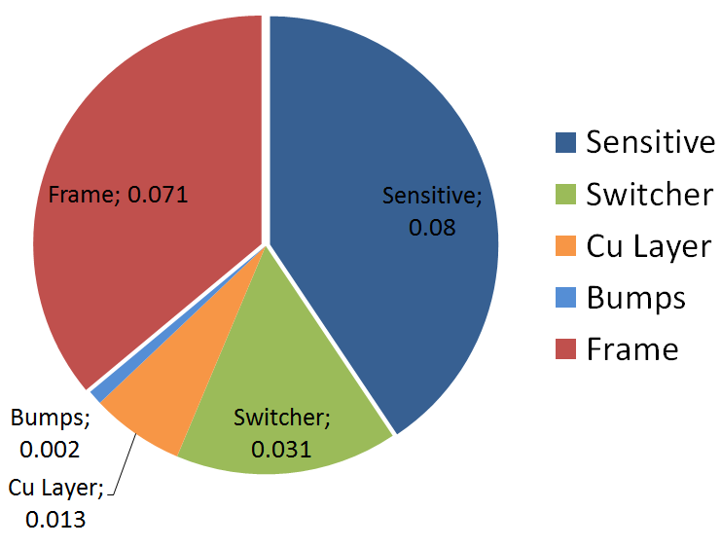
Half Ladder of DEPFET PXD
 | Inner layer (L1) | Outer layer (L2)
# modules | 8 | 12
Distance from IP (cm) | 1.4 | 2.2
Thickness (µm) | 75 | 75
Total # pixels | 3.072 x 10⁶ | 4.608 x 10⁶
Pixel size (µm²) | 55, 60 x 50 | 70, 85 x 50
Sensitive area (mm²) | 44.8 x 12.5 | 61.44 x 12.5
Sensor length (mm) | 90 | 123
Frame/Row rate | 50 kHz / 10 MHz | 50 kHz / 10 MHz
~0.2%X₀ per layer
256 x 250 pixels
55 x 50 µm² (L1)
70 x 50 µm² (L2)
512 x 250 pixels
60 x 50 µm² (L1)
85 x 50 µm² (L2)

Slide 9
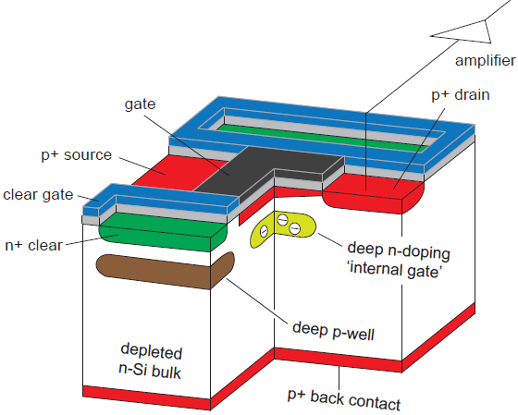
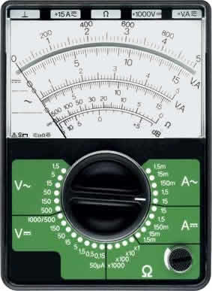
DEPFET (DEPleted p-channel Field Effect Transistor)
Turn on DEPFET
impinging
particle
Gate
source
Clear

Slide 10
DEPFET (DEPleted p-channel Field Effect Transistor)
Cross-section of a DEPFET
internal amplification:
g_{q}≈0.5 nA/e⁻
A DEPFET is a MOSFET onto a sideward depleted silicon bulk
90 steps fabrication process
9 Implantations
19 Lithographies
2 Polysilicon layers
2 Aluminum layers
1 Copper layer
Back side processing
Impinging
particle
→ Low noise
→ Low power
→ High signal/noise-ratio
→ Non-destructive readout

Slide 11
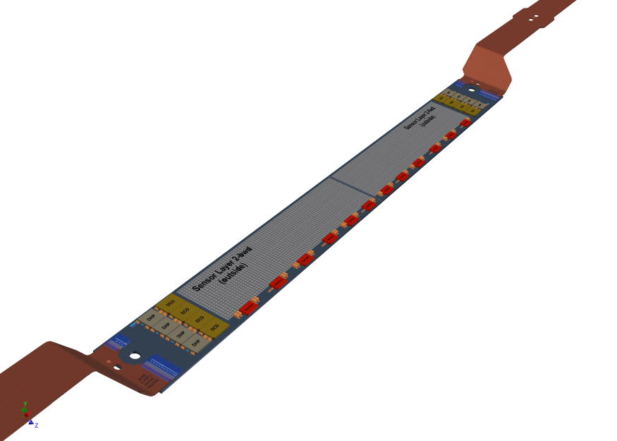
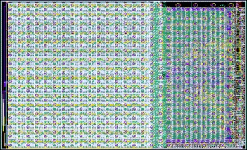
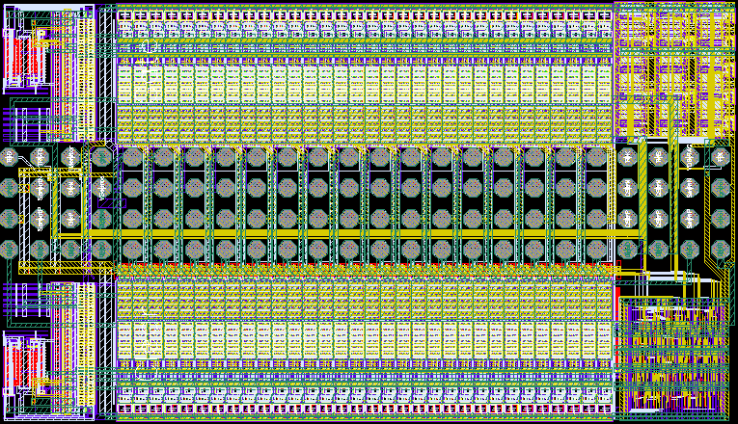
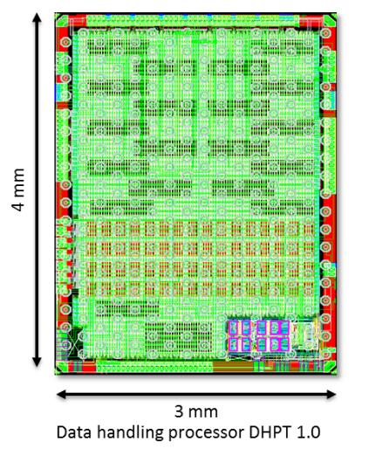
Control and readout electronics
Drain Current Digitizer (DCD)
Keeps the columns line potential constant
8 bit ADCs
Compensates for pedestal current variation (2bit DAC)
Programmable gain and BW
256 input channels (4 per module)
DEPFET
SWITCHER
Fast voltage pulses up to 20 V to activate gate rows and to clear the internal gate
JTAG for interconnectivity tests
64 output drivers for both gate and clear channels → address 32 matrix segments
768 rows → 192 electrical rows → 6 ASICs needed per module
Data Handling Processor (DHP)
Pedestal correction
Common mode correction
Data reduction using the zero suppression
Triggered readout scheme introduces
further data reduction
Controls the Switcher sequence
Kapton Flex cable
Power Supply via soldered contacts and bond wires
Data transmission via bond wires
4 layers, 48 cm

Slide 12
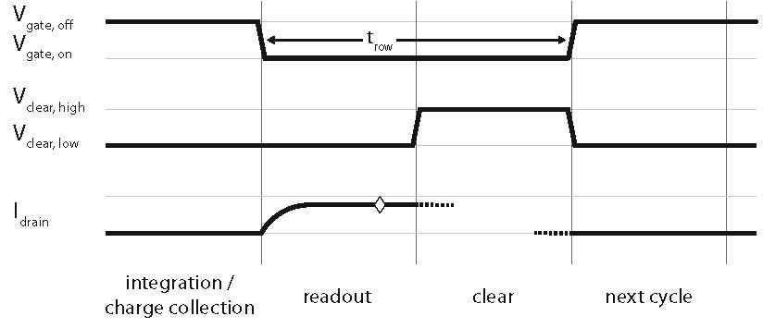
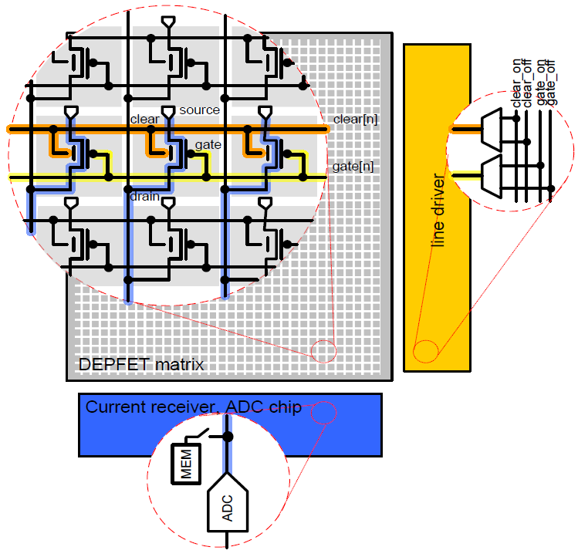
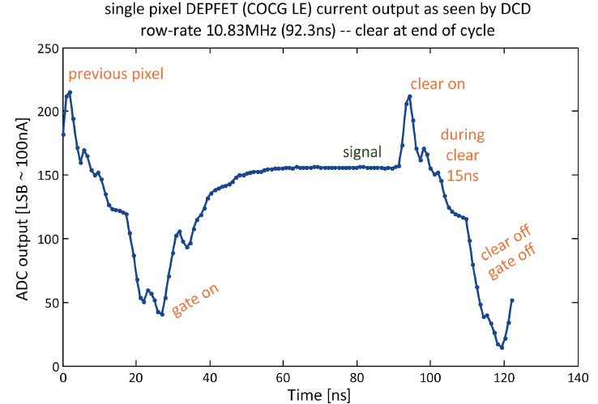
Rolling Shutter Mode - Readout
Rolling Shutter Mode
Low power consumption; only one row is active; all are sensitive
Single Sampling (pedestal subtraction and common mode correction)
Readout time: 20 µs for entire frame (50 kHz)
Read-Clear cycle: 100 ns
one ADC per column

Slide 13
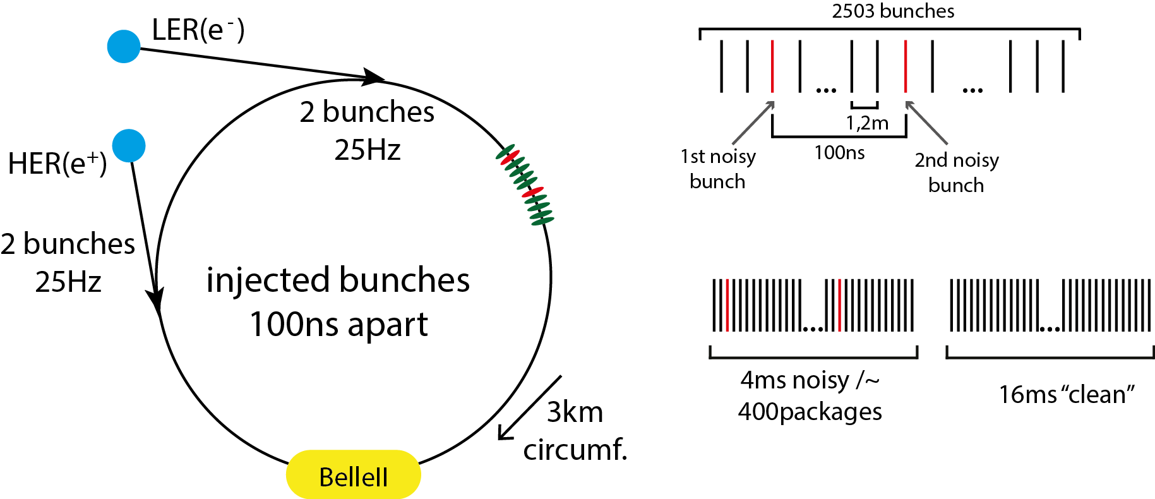
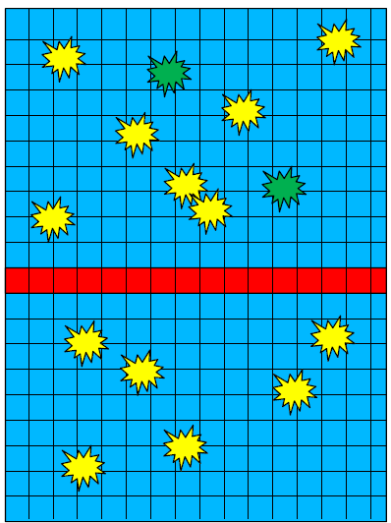
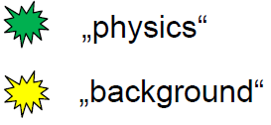
Gated-Mode Operation
Continuous injection scheme; total rate: 50 Hz
Due to Liouville theorem injected bunches need to cool (4ms); results in „noisy“ particles
Very large occupancy („junk charge“)
If similar damping is assumed for SuperKEKB => 20% deadtime for PXD

Slide 14
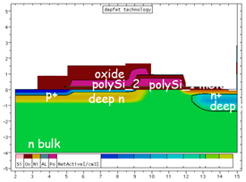
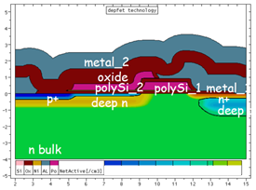
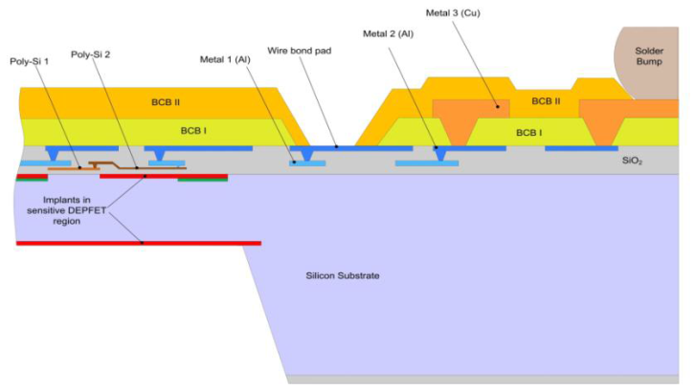
Processing
Phase I – before metal
Implantations
Polysilicon
Dielectric depositions
Phase II – Aluminum
Metal 1
Isolation
Metal 2
Phase III – Thinning & Copper
Handle Wafer Removal
Dielectric deposition
Metal 3
Passivation
front end of line
back end of line

Slide 15
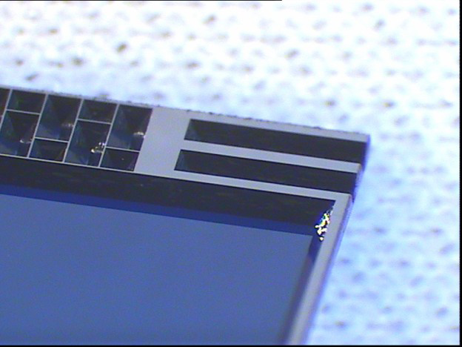
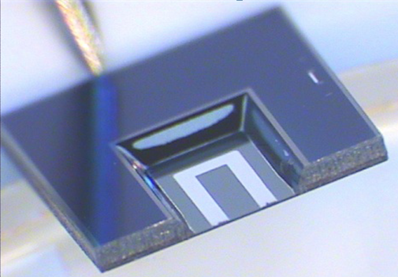
Thinning Technology
Perforated frame
450 μm
Etched grooves
50 μm

Slide 16
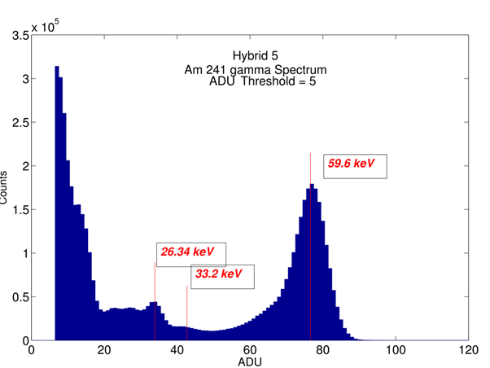
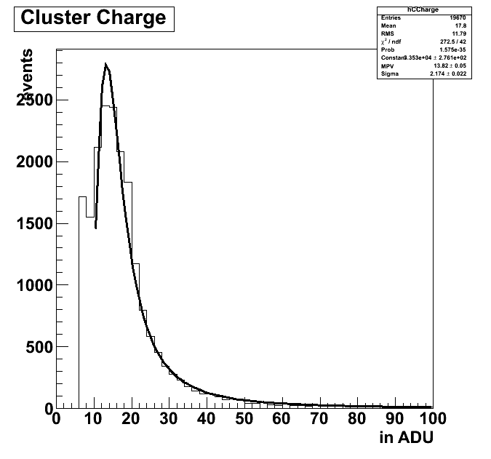
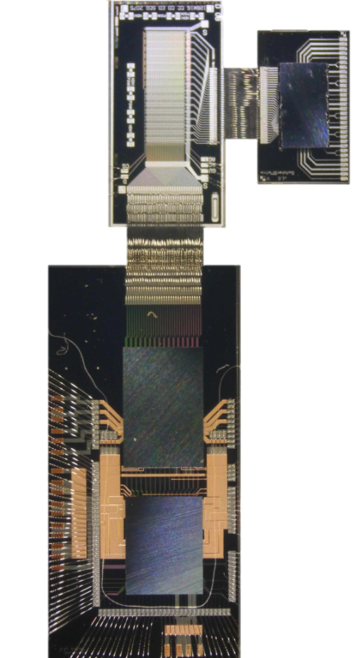
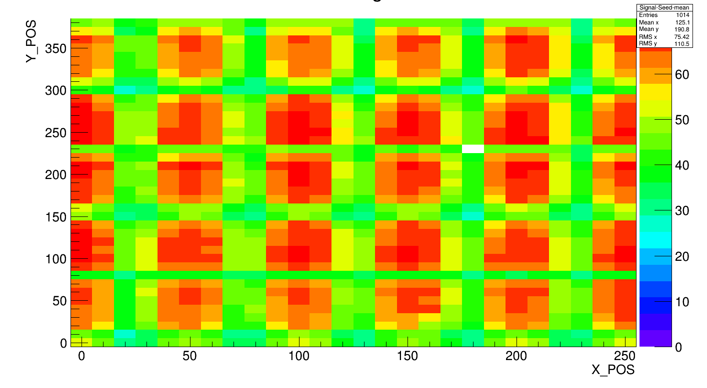
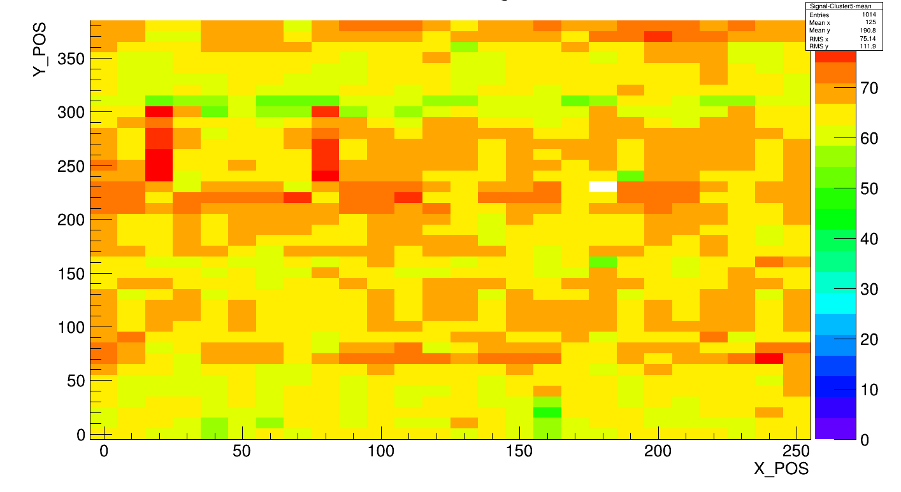
Lab measurements and Beam Test
PXD6
50x75µm²
50µm
Switcher
B-18v1.0
g_{q} ~ 450 pA/e⁻
Test Beam,
2013
DCDBv2
DHP0.2
seed charge
Laser scan 5x6 pixels
cluster charge
Laser scan 5x6 pixels
Homogeneous charge collection

Slide 17
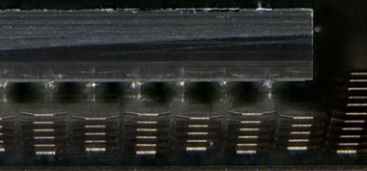
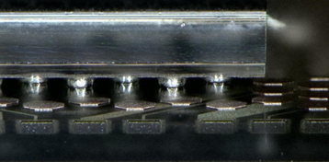
Large PXD6 Prototype Matrix – fully populated module
Switcher-B18v2.0
DCD-Bv2
SW
DCD
DHP
16 mm
DEPFET
66 mm
Belle II pixel cell design
640x192 pixels matrix
50x75x50 µm³ pixel cells

Slide 18
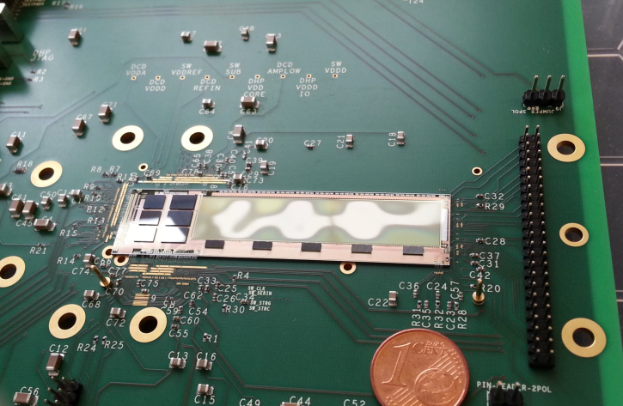
Testbeam 2014 at DESY (Hamburg, GER)
Glue (between PCB and PXD6 module): Epotek 920 EL, cure at 120°C
Due to different coefficients of thermal expansion
⇒ Bowing of matrix (crest & valley: 80 µm at a distance of 1 cm)

Slide 19
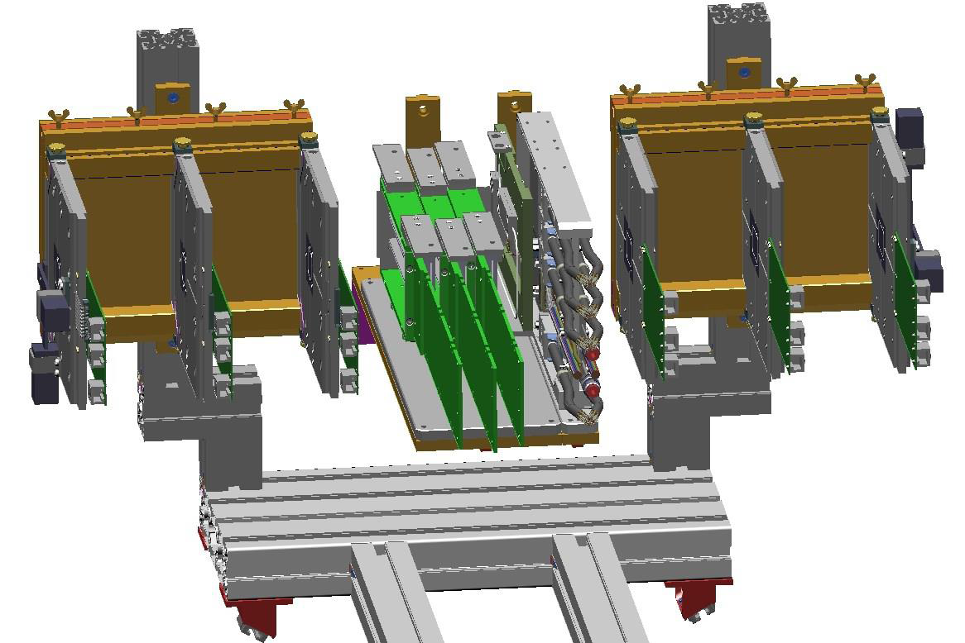
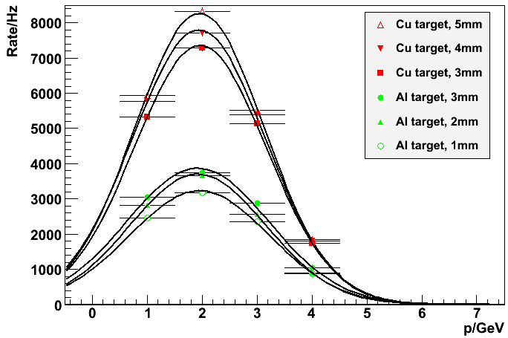
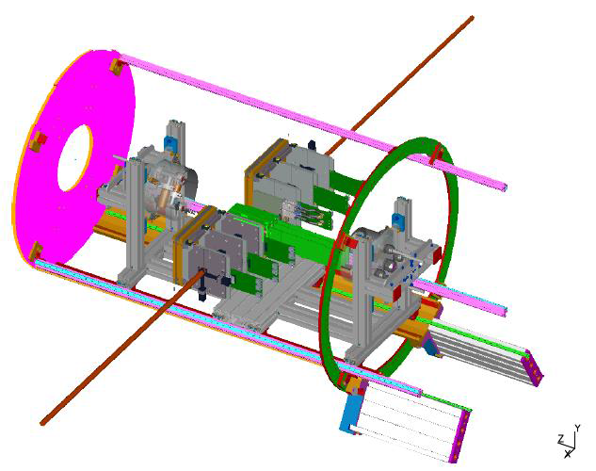
Vertex Detector and AIDA Telescope – Testbeam 2014
PXD
beam
Telescope
Telescope
SVD
1 Tesla Solenoid Field

Slide 20
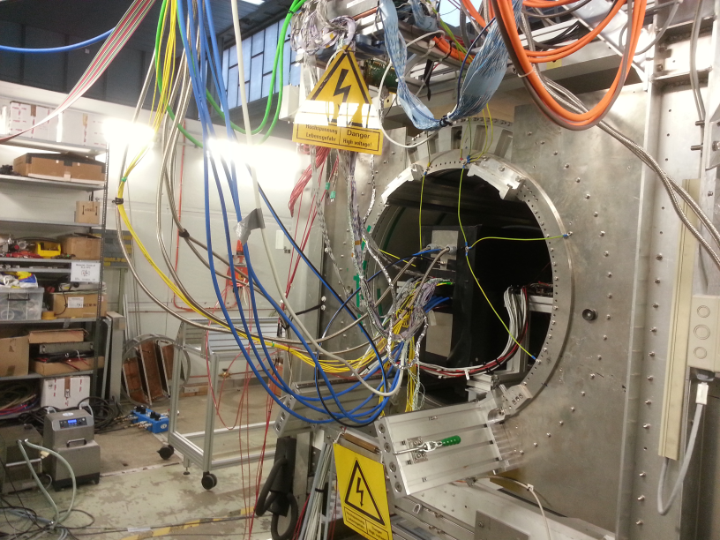
Setup – Testeam 2014 – DESY
Telescope
BlackBox
PXD, SVD
BEAM
Fibres
Power, Data cables, cooling pipe
Solenoid

Slide 21
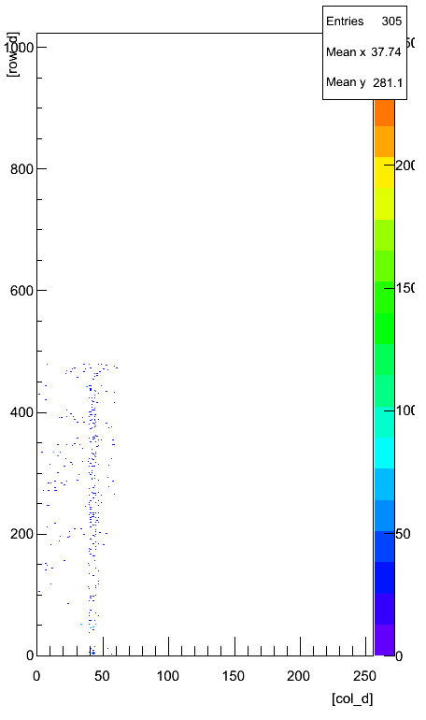
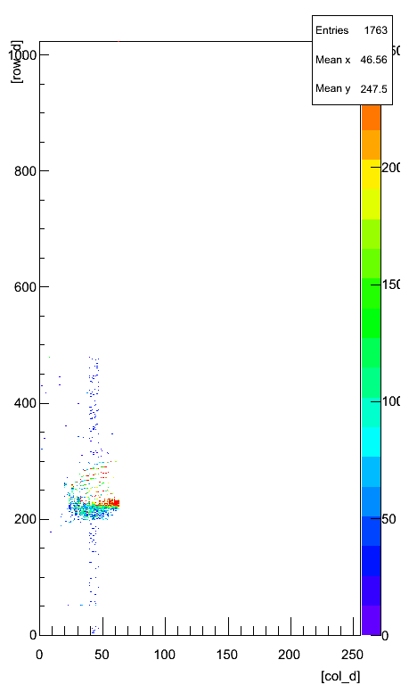
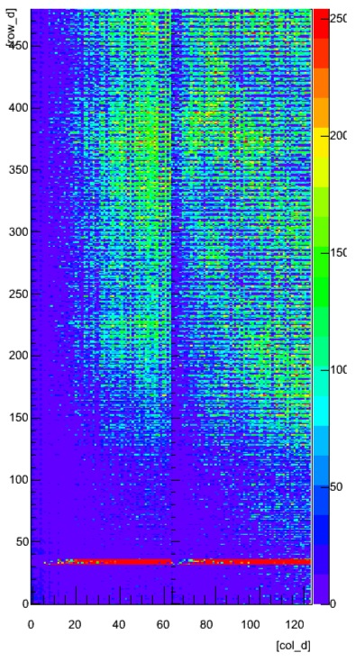
Results – Testbeam 2014 - DESY
alignment
laser
Pedestal distribution
(dominated by induced stress)
non irradiated devices
Zero suppressed
frame
Zero suppressed
frame – laser spot

Slide 22
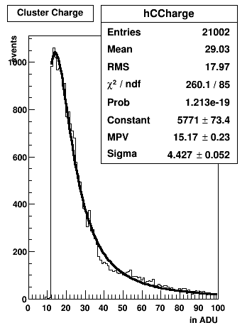
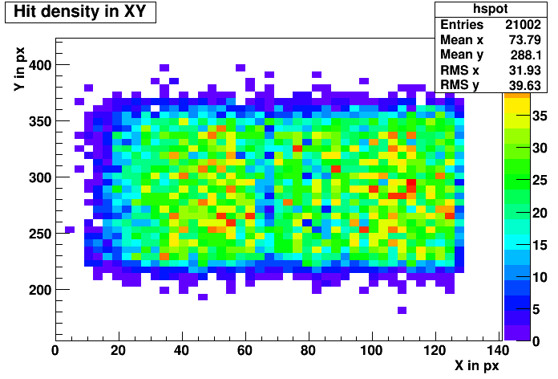
Results – Testbeam 2014 - DESY
DEPFET PXD6 HitMap
Beam Spot: 11 x 6 mm²
Cluster Signal
MPV ~ 15ADU

Slide 23
DEPFET Collaboration
CNM/IFAE, Barcelona
Charles University, Prague
DESY, Hamburg
HLL, Munich
IFCA, Santander
IFIC, Valencia
IFJ PAN, Krakow
IHEP, Beijing
KEK-PF, Tsukuba
KIT, Karlsruhe
LMU Munich
MPI for Physics, Munich
TU, Munich
University of Barcelona
University of Bonn
University of Heidelberg
University of Giessen
University of Göttingen

Slide 24
Summary
To fully exploit the high luminosity (increase by factor 40), the detector is currently upgraded
Excellent spatial resolution of ~ 15 μm; occupancy ~ 1%, fast readout (50 kHz frame rate), huge number of pixels (~ 8 Mpix) => fits all the requirements for Belle II
Complex DEPFET technology; fully functional; successful demonstration in lab and beam tests
Thinning of sensitive area down to 50µm / 75 μm (0.2% X₀), minimizing multiple scattering;
Low power consumption ~ 18 W per ladder
ASICs and Sensors close to final version
Signal to Noise: ~ 40 (including noise from ASICs)
Many aspects not covered in this talk; though in development by the Collaboration

Slide 25
Backup

Slide 26
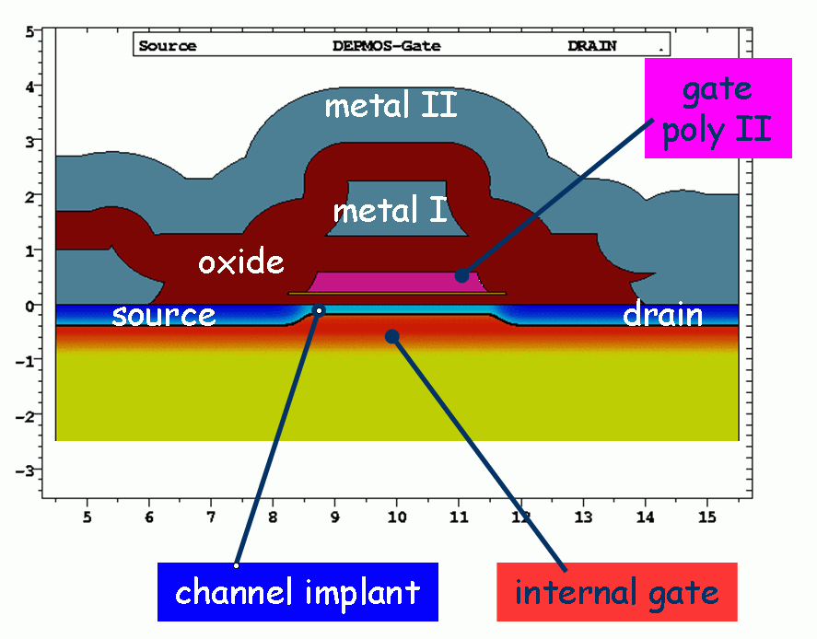
Radiation Tolerance
Gate Dielectrics: ~ 200nm
Radiation field at Belle II dominated by ~MeV electrons/positrons from QED beam background
Ionizing Radiation - Total Ionizing Dose (TID)
(~2Mrad/a at Belle II)
Positive fixed oxide positive charge → ∆V_{T}
interface trap density →
reduced mobility (g_{m})
higher 1/f noise
Non Ionizing Energy Loss (NIEL)
(10¹² n_{eq}/cm²/year at Belle II)
leakage current increase → shot noise
trapping not considered to be critical
Type inversion expected after 10¹⁴ n_{eq}/cm²

Slide 27
Radiation Tolerance
R&D since 2008:
Reduce t_{ox}
Optimize gate dielectric layer
ΔVt(10Mrad): ~15V → 3 V
The remaining small threshold
voltage shift can easily be
compensated by a shift of
the operating voltages
of the DEPFET!
→ Safe operation for about 10 years in Belle II

Slide 28
Belle II – Pixel Detector – Inner Layer
Inner layer
Kapton cables
Inner layer close to the IP (14mm)
Additional carbon fibers capillaries to cool the Switchers, if needed (not tested yet)

Slide 29
Belle II – Pixel Detector – OuterLayer
Outer layer
PXD fully armored
Low material budget cooling
Massive structures outside the acceptance to cool down the readout chips
The center of the ladder rely on cold air

Slide 30
Gated Mode – Simulations – trajectories of electrons
Collection Mode
Blind Mode
Clear
Internal Gate
V_{Clear} = 3V
V_{Clear} = 18V

Slide 31
GM: Generation of Junk Charge – CCG dependance
Generated charge:
185 000 e/h pairs
<1‰ of the generated charge accumulate in the internal gate
for ClearHigh ≥ 12V
1ADU
=
2.61 electrons

Slide 32
Generation of Junk Charge-Laser intensity dependence
Generated charge
185 000,
370 000
555 000
e/h pairs
1ADU
=
2.61 electrons

Slide 33
Four Fold Readout
column 1
column 2
column 3
row 1
row 1
row 1
row 2
Gate
row 1
row 1
row 3
row 1
row 4
geometrically speaking
electrically speaking
column 1 2 3 4 5 6 7 8 9 10 11 12
Drain

Slide 34
Cooling Issues

Slide 35
Telescope HitMap – Testbeam 2014 - DESY
Beam: 5GeV, 1T Magnetic Field

Slide 36
Further Talks related to Belle & Belle II
“The Belle/Belle II Experiment“
by Martin Ritter
“The Neutral Z-Vertex Trigger for Belle II”
by Fernando Abudinen

Slide 37
Abbreviations
DCD = Drain Current Digitizer
DHP = Data Handling Processor
DEPFET = DEPleted p-channel Field Effect Transistor
IP = Interaction Point
MIP = Minimum Ionizing Particle
MPV = Most probable value
PXD = Pixel Detector
S/N = Signal to Noise Ratio
SVD = Silicon Vertex Detector (historivally based, meaning: silicon strip detector)
X0 = Radiation length = electron loses all but 1/e of itsenergy
VXD = Vertex Detector

