Slide 1


NLO Calculations with GoSam
Hans van Deurzen

Slide 2
NLO Calculations with GoSam
Hans van Deurzen

Slide 3
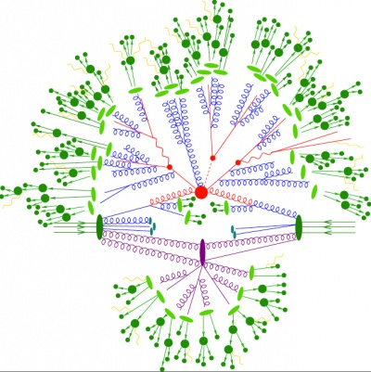
LHC

Slide 4
Motivation
Higgs found, need properties
  Spin
  CP properties
  Couplings to other particles
BSM physics?

Slide 5
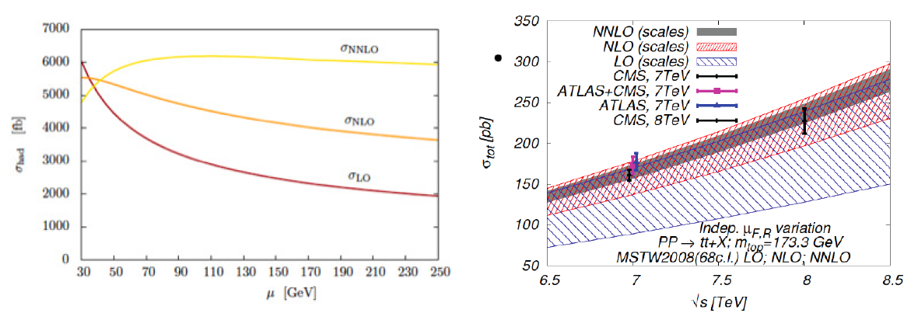
Motivation for NLO
Reduce theoretical error
Strong dependence on factorization and renormalization scale

Slide 6
NLO Calculations
NLO calculations consists of:
  Leading Order (LO): Born diagrams
  Virtual corrections: Loop diagrams
  Real corrections: Additional radiation
  Subtraction terms to regulate infinities
⬅ GoSam

Slide 7
GoSam
Collaboration
Cullen, HvD, Greiner, Heinrich, Luisoni, Mastrolia, Mirabella, Ossola, Peraro, Schlenk,
von Soden-Fraunhofen, Tramontano
Reduction algorithms
  Samurai, Xsamurai
  d-dimensional integrand-level reduction
  current default
  [Mastrolia, Ossola, Reiter, Tramontano]; [HvD (2013)]
  Golem95, Golem95 higherrank extension
  Tensorial reduction
  Numerically stable ➔ rescue system
  [Binoth, Guillet, Heinrich, Pilon, Reiter]; [Guillet, Heinrich, von Soden-Fraunhofen]
  Ninja
  Integrand-level+Laurent expansion
  Stable and fast
  [Mastrolia, Mirabella, Peraro]; [HvD, Luisoni, Mastrolia, Mirabella, Ossola, Peraro]; [Peraro]

Slide 8

Amplitudes at one loop

Slide 9
Amplitudes at one loop
Residues multivariate polynomials
Need rank to determine generic form
Renormalizability requires rank ≤ propagators

Slide 10
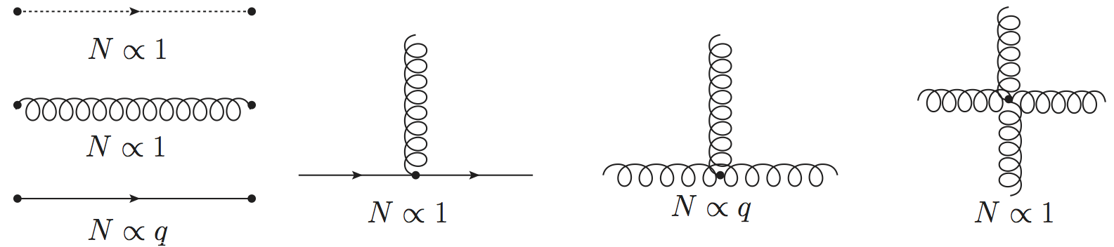
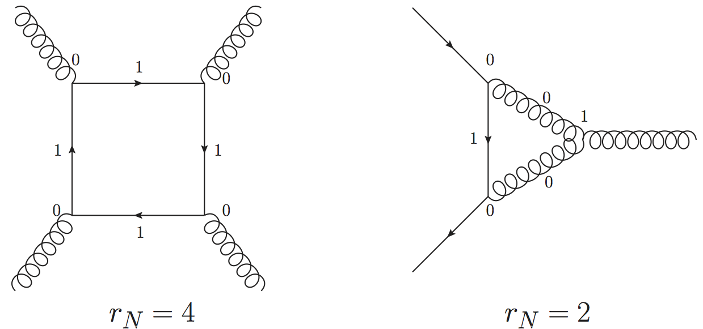
Rank of the numerator

Slide 11
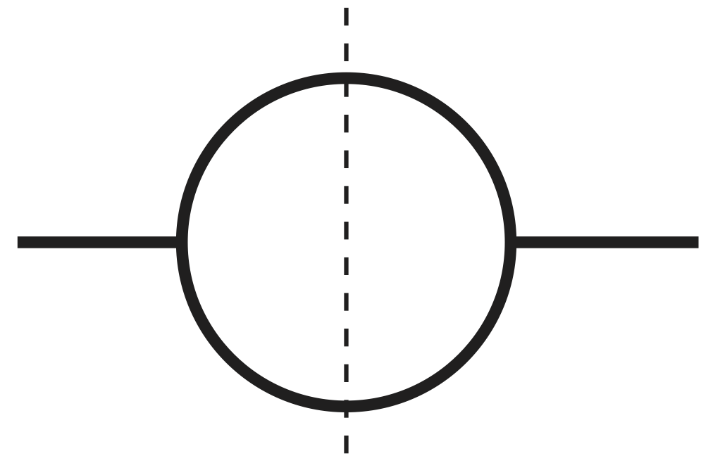
Integrand decomposition

Slide 12
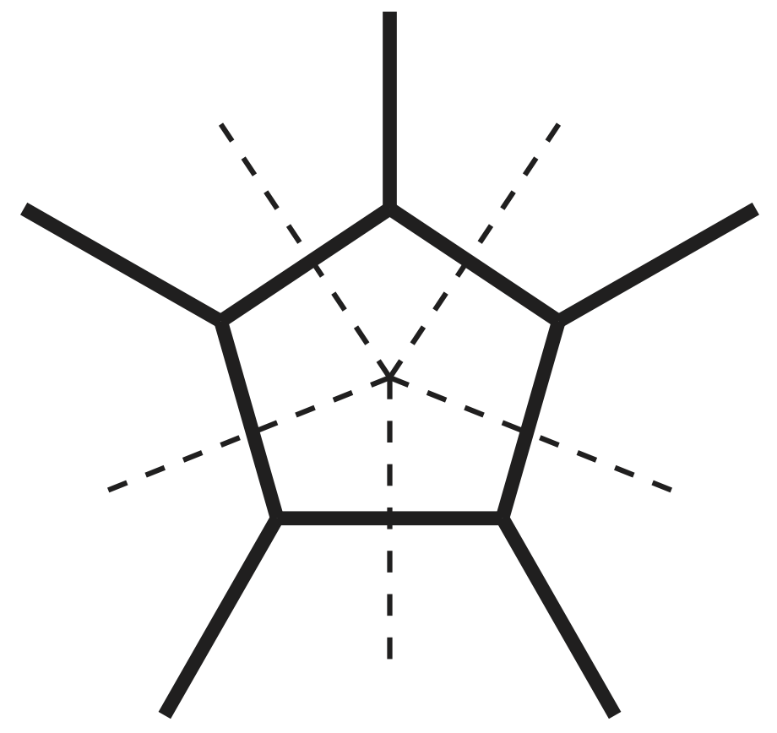
Integrand decomposition
Quintuple cut

Slide 13
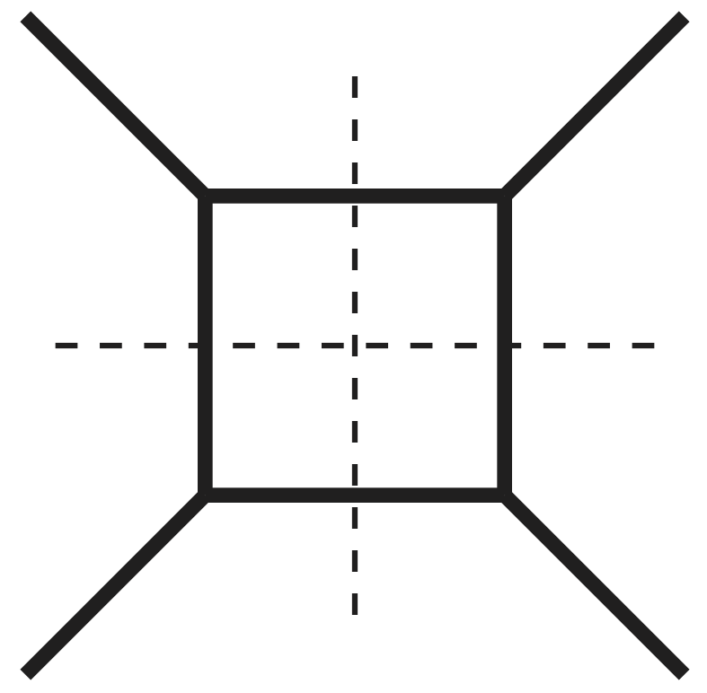
Integrand decomposition
1 coefficient
Quadruple cut

Slide 14
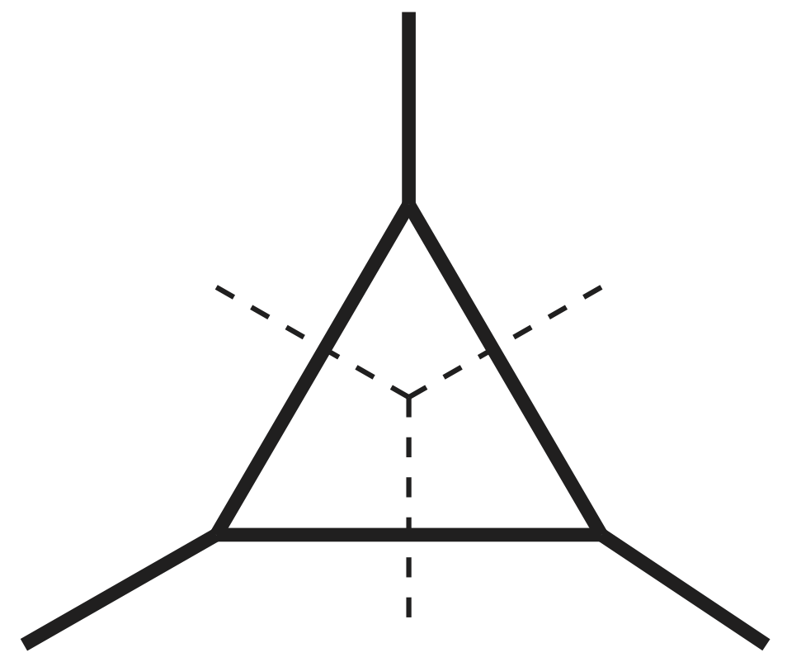
Integrand decomposition
1 coefficient
5 coefficients
Triple cut

Slide 15
Integrand decomposition
1 coefficient
5 coefficients
10 coefficients
Double cut

Slide 16
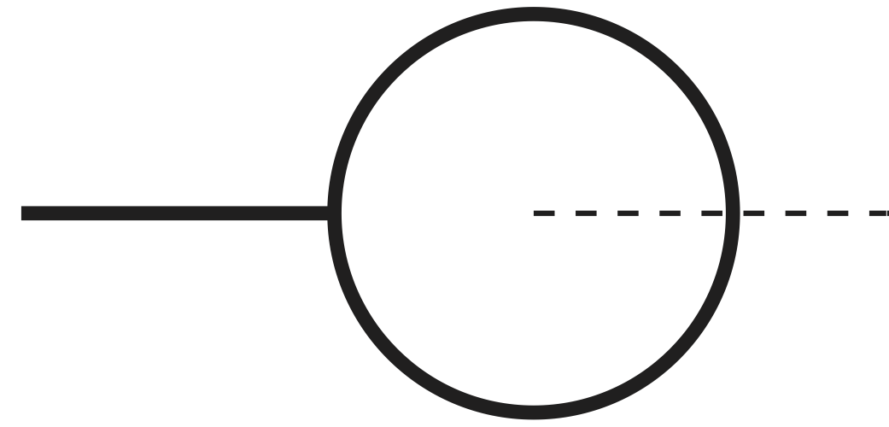
Integrand decomposition
1 coefficient
5 coefficients
10 coefficients
10 coefficients
Single cut

Slide 17
Integrand decomposition
1 coefficient
5 coefficients
10 coefficients
10 coefficients
5 coefficients
Hexagon:

Slide 18
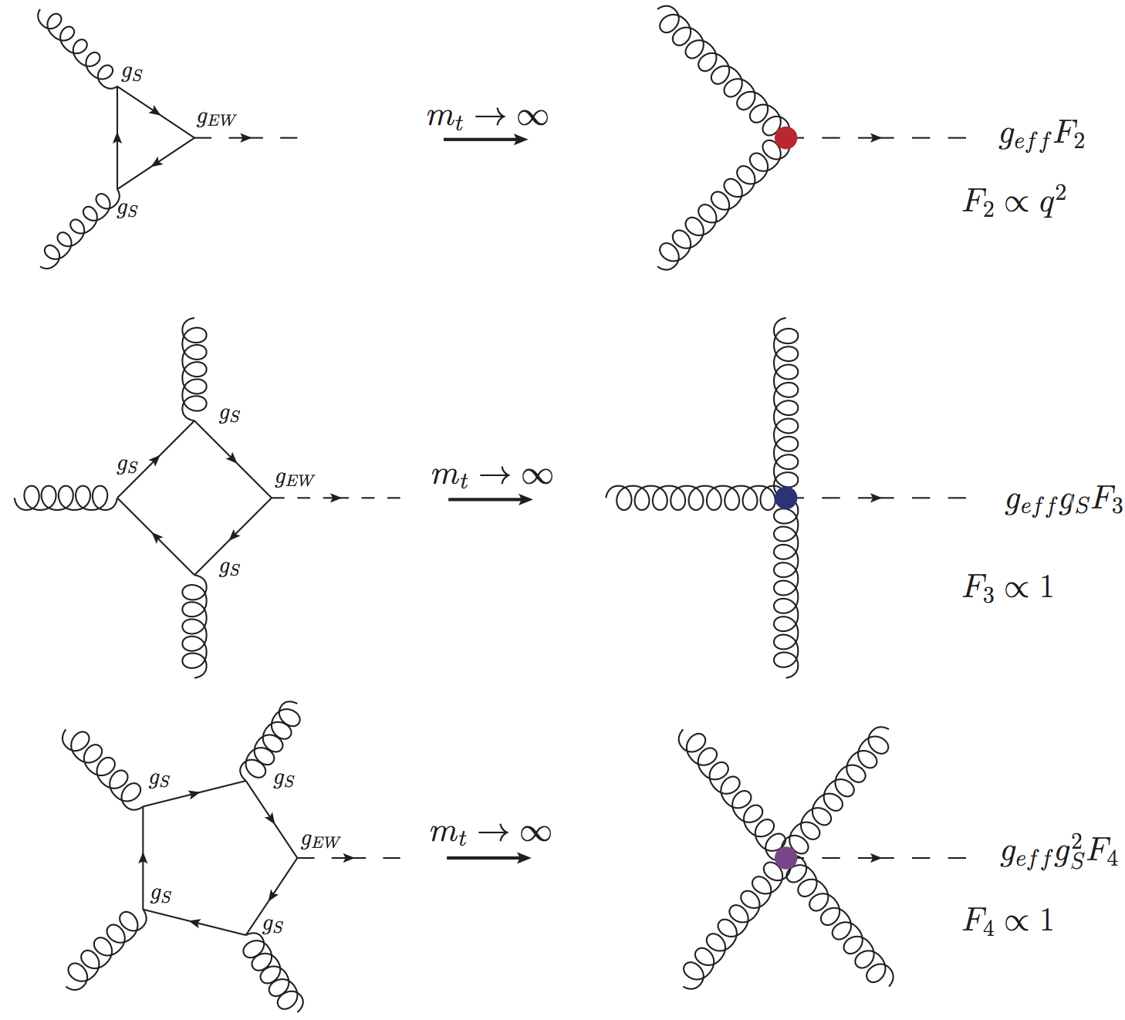
Higher rank

Slide 19
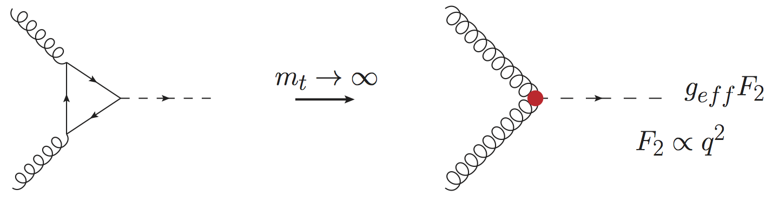
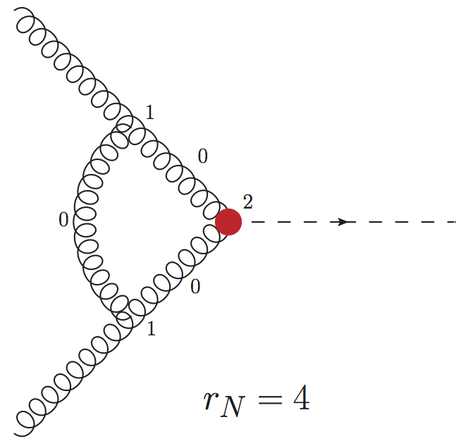
Higher rank
Effective vertex in loop adds two powers of q
New rule: rank ≤ propagators + 1

Slide 20
Integrand decomposition
1➔1 coefficient
5➔6 coefficients
10➔15 coefficients
10➔20 coefficients
5➔15 coefficients
Hexagon:
[Mastrolia, Mirabella, Peraro (2012)]; [HvD (2013)]

Slide 21
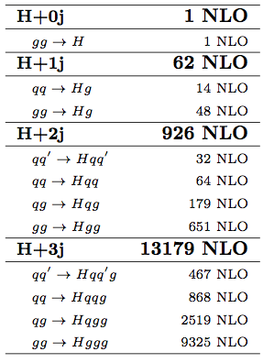
Applications
p p > h j j at NLO in Gluon Fusion
p p > h j j j at NLO in Gluon Fusion
[HvD, Greiner, Luisoni, Mastrolia, Mirabella, Ossola,
Peraro, von Soden-Fraunhofen, Tramontano (2013)]
[Cullen, HvD, Greiner, Luisoni, Mastrolia, Mirabella,
Ossola, Peraro, Tramontano (2013)]

Slide 22
NLO Calculations
NLO calculations consists of:
  Leading Order (LO): Born diagrams
  Virtual corrections: Loop diagrams
  Real corrections: Additional radiation
  Subtraction terms to regulate infinities
⬅ GoSam

Slide 23
NLO Calculations
NLO calculations consists of:
  Leading Order (LO): Born diagrams
  Virtual corrections: Loop diagrams
  Real corrections: Additional radiation
  Subtraction terms to regulate infinities
⬅ MC
⬅ GoSam
⬅ MC
⬅ MC

Slide 24
Interface with aMC@NLO
Recent release: MadGraph5_aMC@NLO (MG5aMC)
Uses Binoth Les Houches Accord interface (BLHA)
See next talk by Johann Felix
Interface tested on several non-trivial processes
Compared GoSam vs. MadLoop
Runs smoothly parallelized with Condor

Slide 25
Summary
GoSam is a framework for the automated computation of one loop diagrams
Samurai has been extended to deal with higher rank numerators, f.e. effective Higgs couplings: Xsamurai
Xsamurai has been used to calculate Higgs plus 2 and 3 jets in Gluon Fusion at NLO
GoSam is being interfaced to MG5aMC for the calculation of even more complicated processes

