Slide 1
Young scientist workshop, Ringberg castle 19-07-14
Impact of sterile neutrinos on
long baseline experiments
Niki Klop
Ludwig-Maximilians University Munich Max Planck Institute for Physics Munich
Supervisor: Antonio Palazzo
Notes:
Naam van antonio erbij en kennelijk raffelt

Slide 2
Outline
ν oscillations in the standard framework
Motivations for a sterile neutrino
What I am doing

Slide 3
Introduction
In the Standard Model, neutrinos are massless
Experiments have shown that neutrinos can change flavour
Spectrum of 3 neutrino mass eigenstates
Flavour states can be written as a superposition of mass eigenstates (and vice versa)
Notes:
Solar, atmospheric, accelerator and reactor Experiments have shown that neutrinos can change flavour

Slide 4
Introduction
Transition probability
Only dependent of ∆m², not of the absolute mass.
The sensitivity to ∆m² of an experiment is maximal for the values of ∆m² such that
~ 1
Notes:
Matrix elements determine the amplitudes of the oscillation

Slide 5
Introduction
The PMNS matrix
Mixing angles are measured
CP-violating phase still has to be determined
LBL experiments (T2K)
Notes:
Mixing angles all different than zero

Slide 6
The T2K experiment
Notes:
Wagner-> gebruik hier: Pmu e= P atm + P sol + P

Slide 7
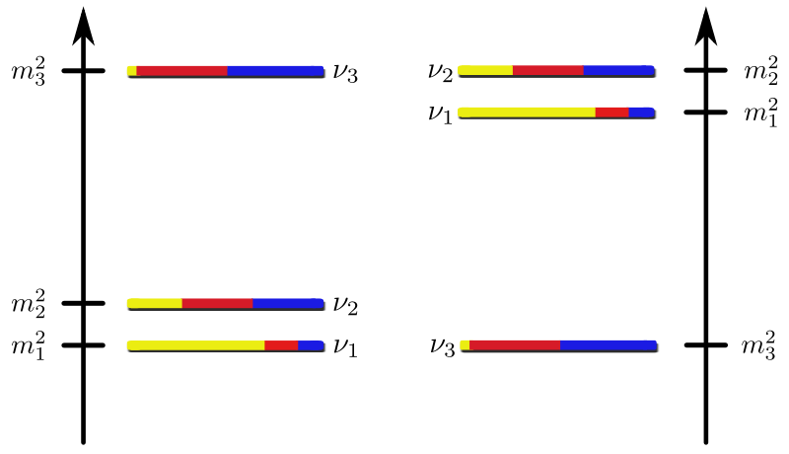
Introduction
The neutrino mass spectrum:
normal hierarchy
inverted hierarchy
Δm²_{atm}
Δm²_{sol}
Δm²_{atm} = Δm²₂₃ = 2.4 • 10⁻³ eV²
Δm²_{sol} = Δm²₁₂ = 7.6 • 10⁻⁵ eV²

Slide 8
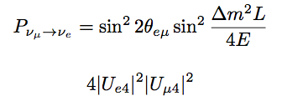
Motivation
Anomalies in short baseline (SBL) experiments:
experiments for which L/E ~ 1 km/GeV ( ∆m²~ 1 eV² )
ν_{e} appearance:
LSND measured ν_{e} appearance
from ν_{μ} beam consistent with
mixing with ∆m²~ 1 eV²
MiniBoone: rules out part
of the LSND region
_
_
Notes:
Anomalies inkorten misschien om binnen de tijd te blijven.

Slide 9
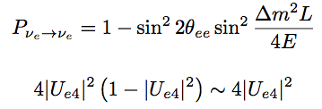
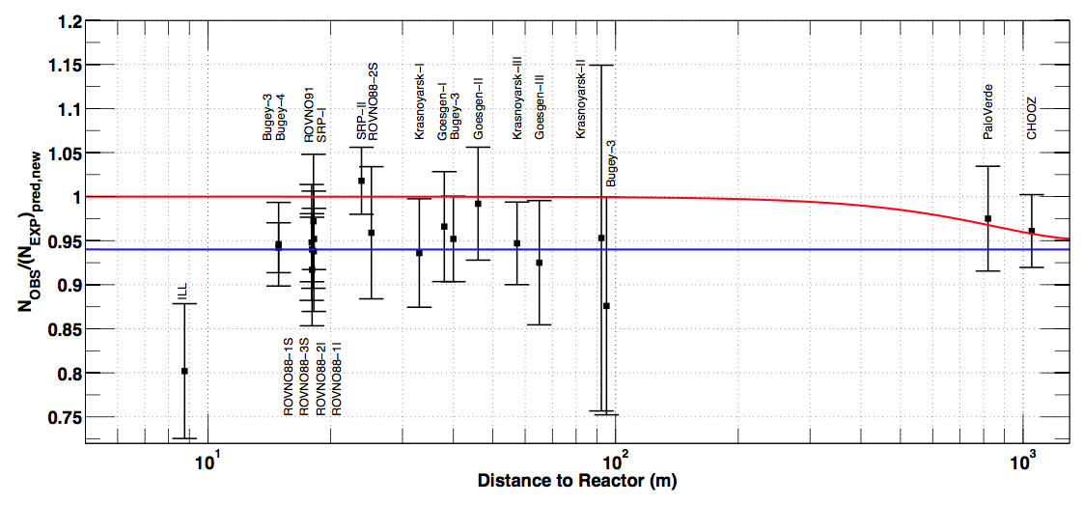
Motivation
ν_{e} disappearance L/E ~ 1 m/MeV
Reactor anomaly
Mention et al. arXiv:1101:2755
Notes:
L/E~ 10 m/MeV voor reactor, maar wat voor Gallium?
Hier die andere plaatjes uit A zijn talk
Kansen voor SBL alleen reactor hier en zeggen dat gallium similar is.. Notice there is no dependence on cp violating phases.

Slide 10
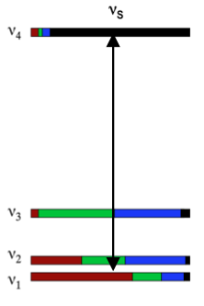
Motivation
Introduction of a 4th neutrino with ∆m²~ 1 eV²
4th neutrino should be sterile
(must not couple to the standard electroweak current)
Success of 3ν should be preserved
4x4 mixing matrix
6 mixing angles, 3 CP-violating phases

Slide 11
What I am doing
If sterile neutrinos indeed exist, this will have both positive and negative effects on the efficiency of the LBL experiments
Simulation of 3+1 neutrino oscillation
in a LBL experiment (T2K)
Goal: put LBL-experiments in a wider perspective. 3+1 case
Notes:
Motivatie voor mijn onderzoek: de LBL experimenten zijn/ worden gemaakt om de cp-violating phase te onderzoeken. Zijn veel duurder dan SBL experimenten. Daarom van belang de efficiency te bepalen mocht die sterile neutrino gevonden worden. Kijken wat de effecten zijn van zo’n sterile neutrino op de mixing parameters etc.
We expect to get degeneracies. Will not be able to determine all these parameters because they will be equivalent because the difference can be small

Slide 12
3ν probability
P
Sin(2ϑ₁₃)
Notes:
Matrix elements determine the amplitudes of the oscillation

Slide 13
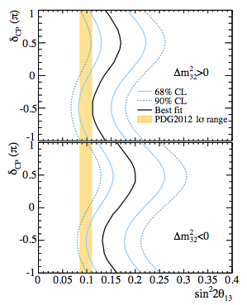
NH
Best fit
90% CL
68% CL
3ν (matter)
δ_{cp} (π)
IH
Best fit
90% CL
68% CL
Sin²(2ϑ₁₃)

Slide 14
3ν (vacuum)
δ_{cp} (π)
Best fit
90% CL
68% CL
DB I I
Sin²(2ϑ₁₃)

Slide 15
4ν probability
P
Sin(2ϑ_{eμ})

Slide 16
4ν “results” (vacuum)
Best fit
90% CL
68% CL
Best fit
90% CL
68% CL
DB I I
DB I I
δ₁₄ = π/2
δ₁₃ (π)
Best fit
90% CL
68% CL
Best fit
90% CL
68% CL
DB I I
DB I I
δ₁₄ = - π/2
δ₁₄ = π
Sin²(2ϑ₁₃)

Slide 17
Summary
The standard 3 ν framework may be not complete
Intriguing indications in the favour of light sterile neutrinos ~ 1 eV
Large experimental activity on sterile ν
Large theoretical activity on sterile ν
I focus on impact of these sterile neutrinos in LBL experiments
Notes:
first to do this
expensive experiments, important to know there potential

Slide 18
The T2K experiment
Notes:
Wagner-> gebruik hier: Pmu e= P atm + P sol + P

