Slide 1
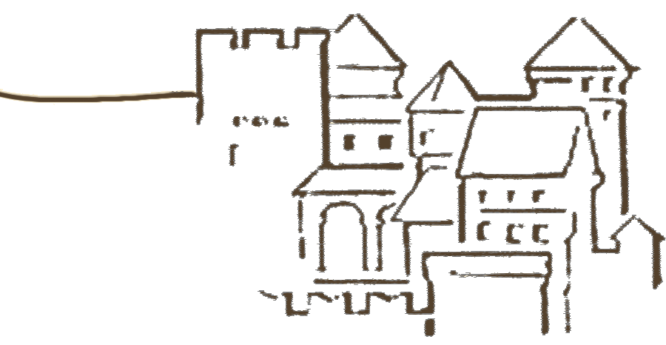
Matter versus antimatter
the grand battle
Alexander Kartavtsev
23 July 2013
Notes:
Good morning.
First of all, thank you for waking up so early. I know by my own experience, how difficult it is to get up before nine.
The title of this talk is "Matter versus antimatter - the grand battle". What is it really about ? Here is the answer.

Slide 2
Angels and demons
Notes:
This talk is about matter, antimatter and how the former won against the latter. The artist impression of matter-antimatter explosionis certainly not hundred percent realistic, but it conveys the message - when matter and antimatter particles collide they annihilate producing a bunch of other particles, in particular photons.
All in all, we should be happy that there is no antimatter in this room.

Slide 3
Outline
Experimental observations
Theoretical advancements
Electroweak baryogenesis
Baryogenesis via leptogenesis
Current status
Summary
Notes:
Usually when I give a talk on the generation of the baryon asymmetry of the universe I start with the Sakharov conditions, briefly review how baryogenesis via leptogenesis works and then switch to the Boltzmann or Kadanoff-Baym equations.
Today I will do it differently and try to present this information from the historical prospective. After the talk you will know which experimental observations lead to the now widely accepted conclusion that the Universe is baryonically asymmetric. You will learn about theoretical advances that lead in the eighties to the two most popular scenarios of the baryon asymmetry generation - electroweak baryogenesis and baryogenesis via leptogenesis. You will also know how these scenarios work and what is their experimental status nowadays.
Finally, I will summarize my talk.

Slide 5
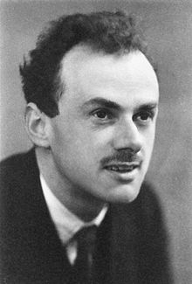
Antimatter predicted (1928)
… during his postgraduate years he concentrated solely on his research, and stopped only on Sunday, when he took long strolls alone …
Paul Dirac
Notes:
The history of antimatter started in 1928 when Paul Dirac has formulated his famous Dirac equation. He realized, that in addition to electrons, his equation also predicted particles with the same mass and spin, but opposite charge. In other words, he predicted the existence of antimatter.

Slide 7
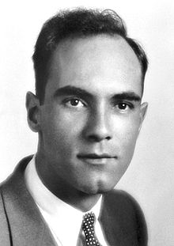
Antimatter discovered (1932)
Carl Anderson
Notes:
Just four years later, positrons have been discovered by Carl Anderson. He used cloud chamber and, as Dirac predicted, observe particles that had the same mass as electron but were bent in the opposite direction.

Slide 8
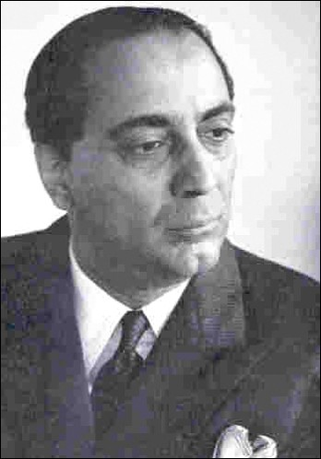
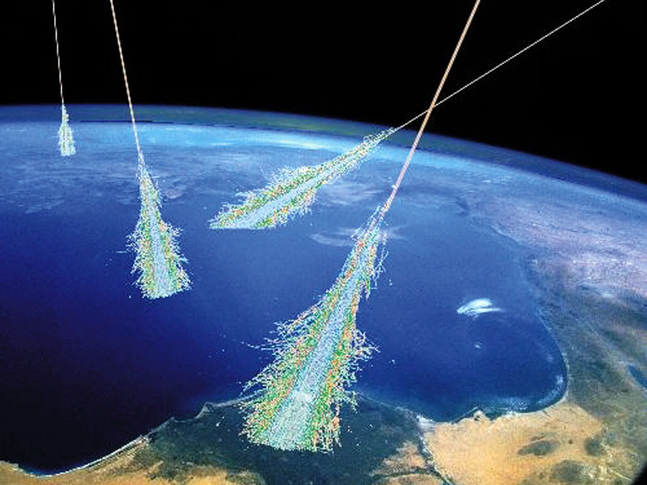
Cosmic rays (1936)
Homi Bhabha
Notes:
Just four years later the Dirac theory of electron was already widely accepted and used by Homi Bhaba to model comic ray air showers. In particular he has calculated the cross-section of electron-positron scattering and used it to describe the cosmic ray showers.

Slide 9
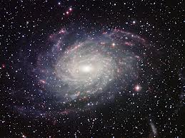
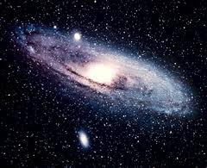
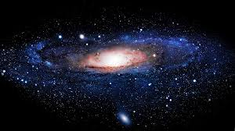
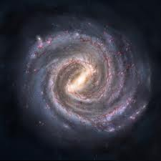
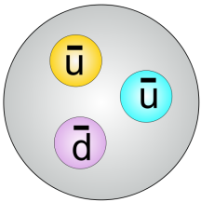
Cosmic rays contain
positrons and antiprotons
Notes:
As we now know, cosmic rays consist of matter. They contain a small fraction of antiparticles, but these are secondaries produced in the collisions of cosmic rays with the interstellar medium.
May be at this moment you are asking yourself this question: "How one can distinguish between the antimatter produced in the collisions and the antimatter potentially coming from the distant antimatter galaxies". The answer is … complexity.
If the nearby galaxies are made of matter, then they also emit only matter particles. As these travel through the space, they interact with the interstellar medium and produce the simplest building blocks of antimatter - positrons and antiprotons.

Slide 10
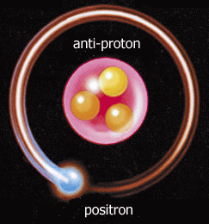
Cosmic rays would contain
complex antiatoms
Notes:
On the other hand, if galaxies made of antimatter existed, we would instead find anti-hydrogen, anti-helium or even more complex anti-atoms in the cosmic rays.
Combined with the fact that we don't see the characteristic matter-antimatter annihilation lines this observation allows us to conclude that the part of the Universe that we can see is made of matter.

Slide 11
Notes:
You can now say: "Well, may be there is no antimatter in the part of the Universe that we can see, but how do we know what is beyond it ? May be the Universe is made of huge patches, patches of the size of the observable Universe, that consists almost entirely of matter or antimatter and are separated by gigantic voids."

Slide 13
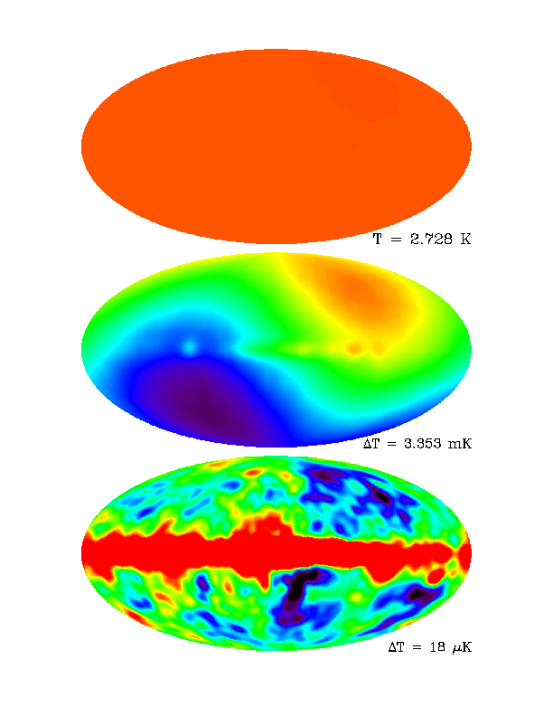
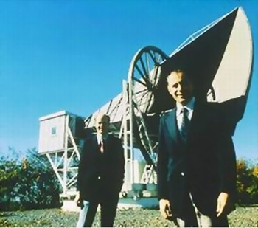
CMB (1965)
Robert Woodrow Wilson
Arno Allan Penzias
Notes:
Looks OK at first sight, but … There is one problem with this picture.
In 1965 Wilson and Penzias have experimentally discovered cosmic microwave background, that is, thermal radiation left over after the Big Bang. After protons and electrons recombined and formed hydrogen atoms, the Universe became transparent for the photons and after that they propagate freely. Any sizable inhomogeneity would leave an imprint on the CMB.
This extreme homogeneity of the cosmic microwave background therefore implies that just before the last scattering surface there were no sizable voids. In other words, matter and antimatter were in close contact before and immediately after the recombination.
Now, after the recombination structure formation began. Structure formation is a highly non-linear process, which is driven by gravity. And gravity does not care about the charges. So, why should it separate matter from antimatter ?
Furthermore, the annihilation of the particles antiparticles would again produce characteristic gamma lines. Although redshifted, they would still be present today in the CMB spectrum and clearly indicate the existence of antimatter after recombination.

Slide 14
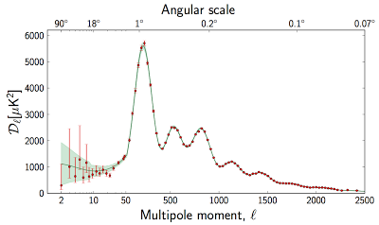
Baryon to photon ratio
= 6.1x10⁻¹⁰
Notes:
Speaking about CMB. CMB provides an invaluable peephole into the early Universe and can actually be used to measure the value of the baryon asymmetry.
The baryon asymmetry is often characterized by the baryon to photon ratio. This definition is convenient for two reasons. First, in this ratio the trivial effects like the Universe expansion conveniently cancel out. In other words, if there are no processes violating baryon number, then this ratio remains constant. Second, the baryon to photon ratio determines the equation of states of the plasma before decoupling. And the equation of state, in turn, manifests itself in the relative height of odd and even peaks in the power spectrum. Using, for instance, the WMAP7 data one finds a tiny number, η=6.1x10⁻¹⁰.

Slide 15
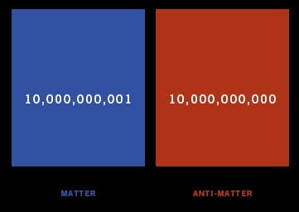
Notes:
Just to stress how tiny this number is, here is the balance of matter and antimatter. For every ten billion antiparticles there have been ten billion and one particle in the early Universe.

Slide 16
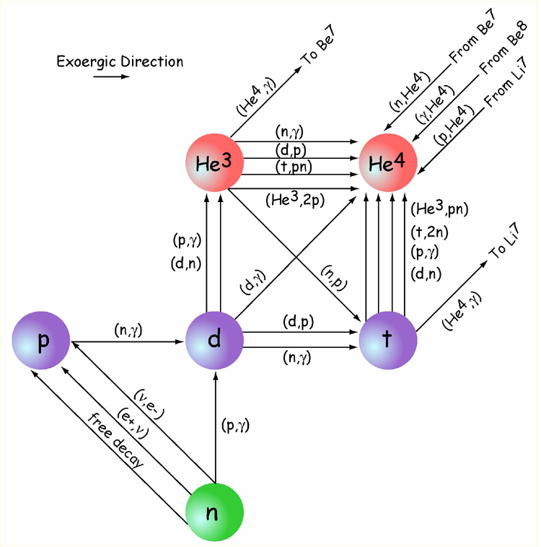
BBN
η = 5.8x10⁻¹⁰
Notes:
Another peephole to the early Universe is provided by the Big Bang Nucleosynthesis, which was an established theory by approximately 1970.
The processes relevant for BBN start when temperature drops to about 2 MeV. The temperature is then already low enough for the nuclei to exist and still high enough for thermonuclear reactions to occur. The physics at those temperatures is very well understood theoretically and has also been tested in the laboratory experiments. Given that, the abundance of Deuterium, Helium and Lithium depends on a single unknown parameter - the baryon-to-photon ratio. The abundance of Deuterium is especially sensitive to the baryon-to-photon ratio and this is good. It is good because there are no known astrophysical sources of Deuterium and therefore its observed abundance provides a reliable estimate of its primordial value. A comparison of theoretical predictions with the measured abundances gives us η=5.8x10⁻¹⁰ for the baryon to photon ratio.
This number is in a remarkable agreement with the one obtained using the CMB data. Given that the CMB and BBN calculations are pretty much independent this is an indication that: first, we very well understand the physics at the scale below a few MeV; and second, we can reliably estimate the magnitude of the baryon-to-photon ratio experimentally.

Slide 17
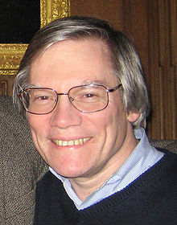
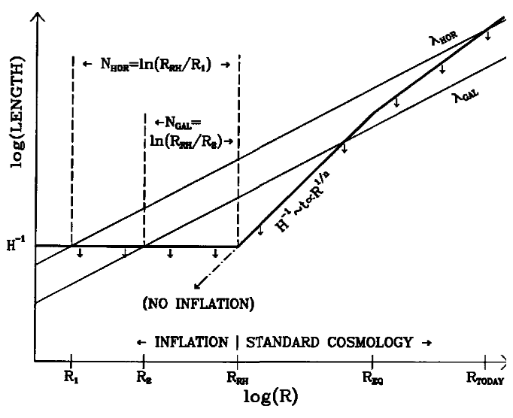
Inflation
Alan Guth
Notes:
The next important advancement was made in 1980 by Alan Guth, who proposed inflation, that is a short period in the history of the Universe when it was expanding exponentially fast. After inflation the scales were stretched by a huge factor, 10⁷⁸.
Now one can ask if the baryon asymmetry of the Universe could be an initial condition, that is if it existed before inflation began. This hypothesis seems extremely unlikely because inflation would dilute any preexisting asymmetry to an unobservably small value.

Slide 18
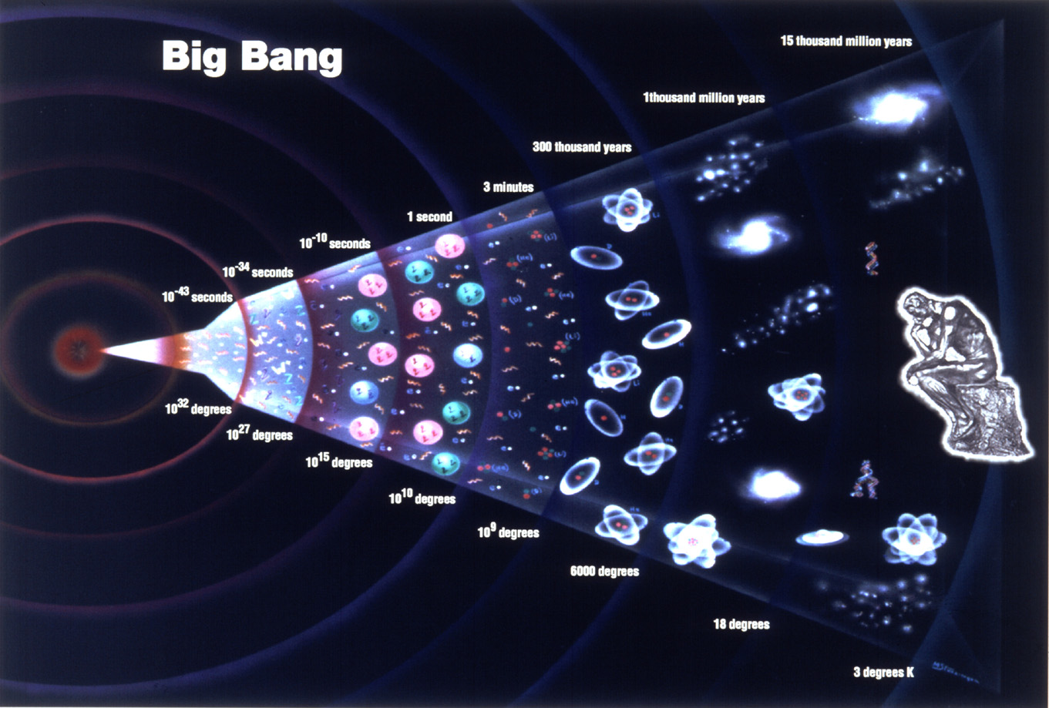
Generation of the baryon asymmetry
Notes:
This implies the baryon asymmetry of the Universe should have been produced dynamically, from an initially baryonically symmetric state. And this should have happened after inflation but before Big-Bang Nucleosynthesis, within this narrow range on this plot.

Slide 19
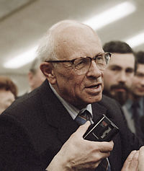
Sakharov conditions (1967)
Violation of baryon number
C- and CP-violation
Deviation from equilibrium
Andrei Sakharov
Notes:
Now let us leave the exciting eighties and go back to the groovy sixties. Already in the sixties the fact that there is almost no antimatter in the Universe was considered as one of the major puzzles that need explanation. In 1967 Andrei Sakharov has formulated the famous three conditions required for the generation of a nonzero lepton asymmetry. Here they are.
The first condition is baryon number violation.
The second is CP-violation.
And the third is deviation from thermal equilibrium.
The first condition is obvious. If the baryon number is conserved then, by definition, it cannot change with time. The second and the third are more complicated. So for now just keep in mind that one also needs CP-violation and a deviation from thermal equilibrium. In a few minutes we will consider some examples and see why these two conditions are important.

Slide 20
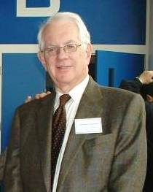
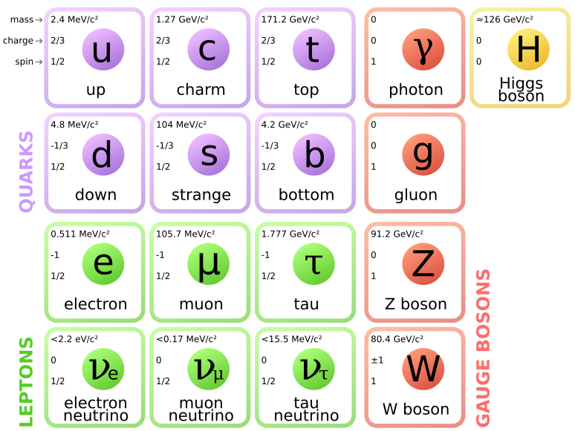
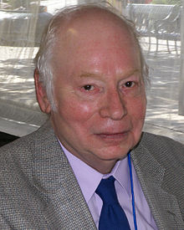
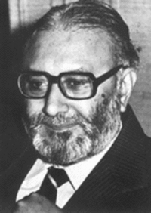
Standard model (1967)
Sheldon Glashow
Steven Weinberg
Abdus Salam
Notes:
In the same year Weinberg and Salam developed the ideas presented earlier by Glashow and came up with what is called the Standard Model today. As we now know, this model is almost perfect and describes with a great precisions results of the accelerator experiments performed so far. Can the baryon asymmetry of the Universe be also explained within this model.

Slide 21
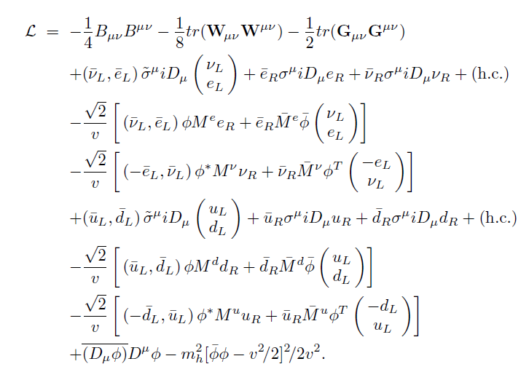
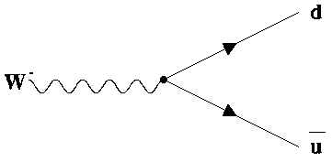
Baryon number violation ?
Notes:
First of all, Is the baryon number conserved in the Standard Model ? At first sight, yes, it is conserved. The Lagrangian of the Standard Model does not contain terms which could violate baryon number - in each decay a quark is created together with an antiquark and the total baryon number does not change. This is actually good, because if there was such a Lagrangian term, then the proton would be unstable. And as you can imagine, this would have terrible consequences for the human race.

Slide 23
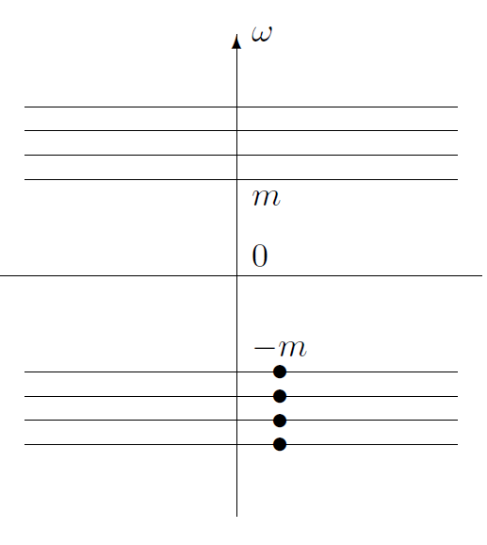
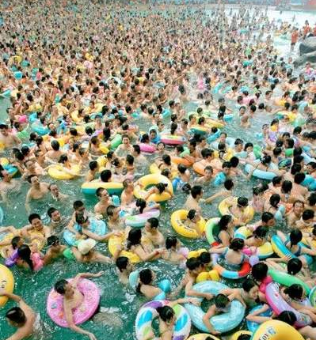
Dirac sea
Notes:
But the situation is more complicated than it might seem. Remember the Dirac see picture ? In vacuum all the positive energy levels are free and all the negative energy levels are occupied.

Slide 24
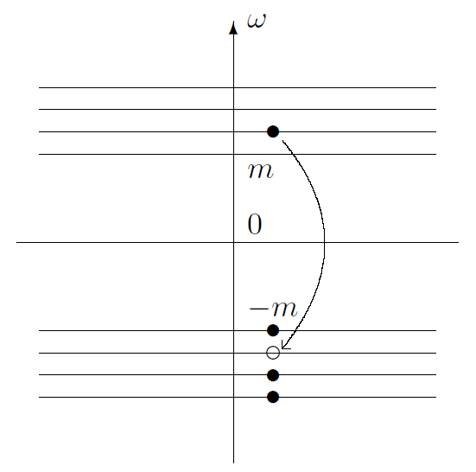
Dirac sea
Notes:
If we would move a "particle" with a negative energy and move it to a positive energy level, we would end up with particle and a hole, which is interpreted as the antiparticle. The sum of the baryon numbers of the particle and antiparticle is zero and the total baryon number does not change. This what happens in perturbative processes.

Slide 25
Notes:
Now imagine that the entire Dirac see is flooded and shifted one level up.

Slide 26
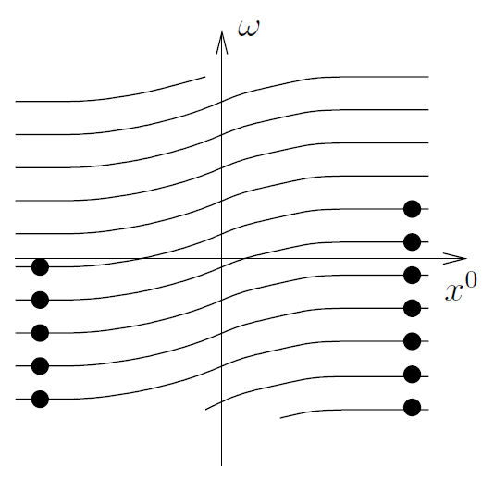
Sphalerons (1984)
Frans Klinkhamer
Nick Manton
Notes:
What we have is a non-perturbative particle creation process. No particles in the beginning and a few particles in the end.
Such floods do take place at very high temperatures when the SU(2)_{L} gauge fields move from one gauge vacuum to a gauge equivalent but topologically inequivalent another vacuum. The field configuration that corresponds to this process is called "sphaleron" and has been discovered in 1984 . You might have heard of it before.
As you see, the first Sakharov condition is indeed fulfilled in the Standard Model.

Slide 27
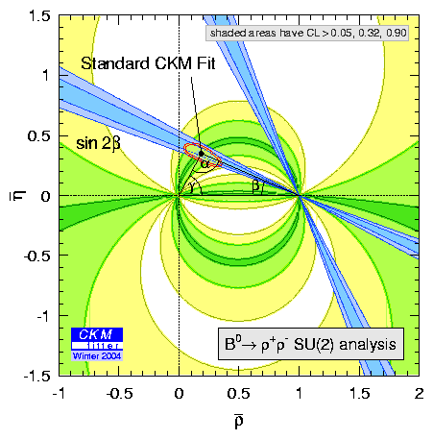
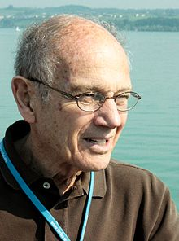
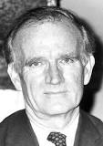
CP-violation
James Cronin
Val Fitch
Notes:
How about CP-violation. CP is violated in the Standard Model. In fact, CP-violation was discovered already in 1964 by Cronin and Fitch in the decay of neutral kaons. On the level Standard Model CP is violated in the quark sector and is parameterized by one CP-violating phase.

Slide 28
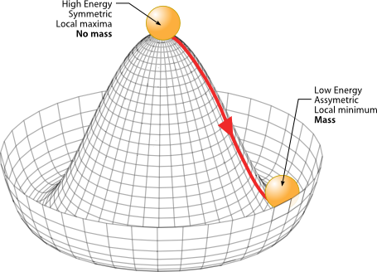
Deviation from equilibrium
Notes:
The last Sakharov condition is deviation from thermal is it fulfilled in the Standard Model. Yes. Moreover, there are two sources of deviation from equilibrium. First, it is expansion of the Universe. The Universe is slightly out of equilibrium just because it expands and cools down. Second, an even stronger deviation from equilibrium is achieved during electroweak phase transition.
As you surely remember, the Higgs potential has a form of the Mexican hat and its minimum is located in the rim of the hat. In vacuum the field is located in the minimum and has a non-zero expectation value.

Slide 29
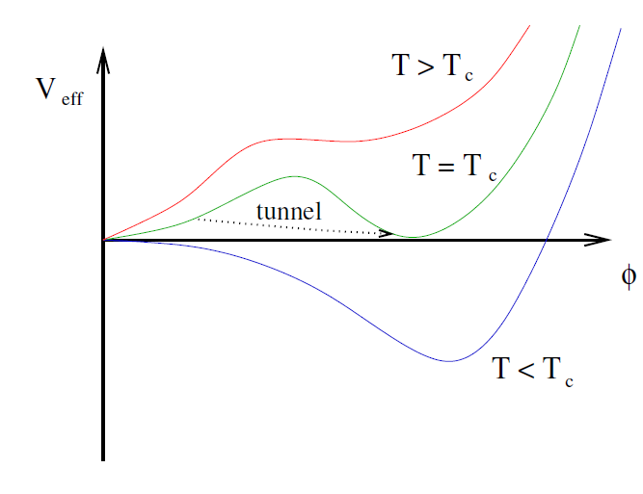
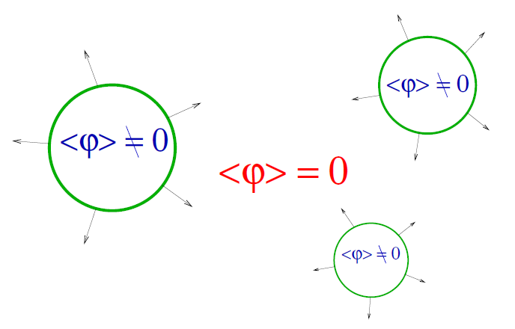
First order transition ?
Notes:
However, in the early Universe the situation was different and the Higgs field was not in the minimum of the potential. Why ? Because the interactions in the hot plasma of the early Universe effectively change the shape of the potential. Here is a sketch. Please keep in mind that in the Minimal Standard model this picture would be correct only if the Higgs mass was bellow approximately 70 GeV, which is of course now excluded experimentally. But it can still be correct in extensions of the Standard Model. A particularly popular extension is, of course, supersymmetry. According to this sketch at very high temperatures the thermal effects are so large that the minimum of the potential is located at the origin and the Higgs has no expectation value. As the temperature decreases, the thermal effects become smaller as well and at some point there are two degenerate minima. At this point tunneling between the minima begins. What we have now, are bubbles inside which the Higgs vev is already not zero. These bubbles are surrounded by the phase where the Higgs vacuum expectation value is still zero. As the temperature drops even further, the second minimum becomes the global one and the Higgs field rolls down to it.

Slide 30
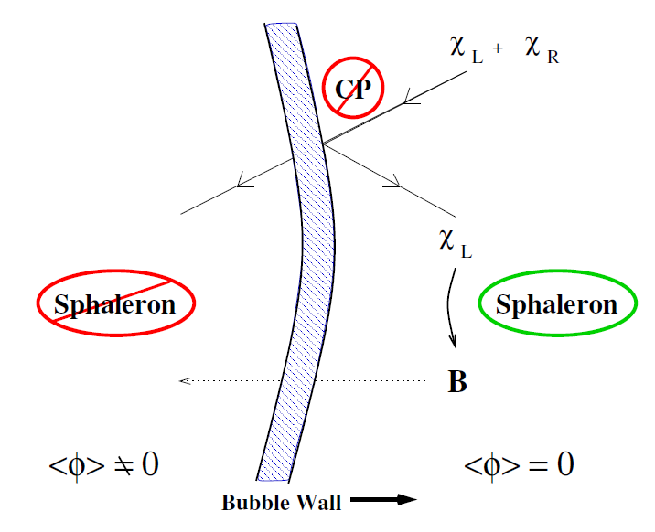
Electroweak baryogenesis (1985)
Valery Rubakov
Vadim Kuzmin
Mikhail Shaposhnikov
Notes:
Of course, the most interesting things happen when the tunneling between the two different phases takes place. Inside the bubble the baryon number violating processes are exponentially suppressed. Outside of the bubbles the baryon number violating processes are very fast. Now the following thing can happen. Fermions outside of the bubble collide with the bubble wall. Because of CP-violation the reflection probabilities for particles and antiparticles are different. As a result some a charge asymmetry is created just before the wall. The sphaleron processes convert this charge asymmetry into the baryon asymmetry. Meanwhile, the wall expands such that this baryon asymmetry is caught in the bubble. As I have already mentioned, inside the bubble the baryon number violating processes are frozen and therefore the generated baryon asymmetry can non be washed out.
This is the essence of the scenario of electroweak baryogenesis proposed in 1985 by Kuzmin, Rubakov and Shaposhnikov. A few years after this scenario was formulated it became clear that in the Standard Model the generated asymmetry would be orders of magnitude smaller than the observed one. The first problem is the smallness of CP-violation in the quark sector. The second problem is that the deviation from equilibrium during the phase transition would be sufficiently large only for light Higgs with the mass of the order of 30 to 50 GeV and this was already excluded. However, there was a big hope that new physics would introduce new sources of CP-violation and provide a stronger deviation from thermal equilibrium. Now, it is important that in order to do all that this new physics should reside at the electroweak scale. An easy task for the LHC to test it.

Slide 31
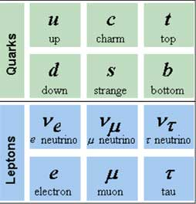
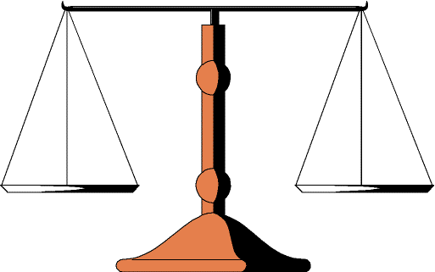
B-L = const.
sphaleron scales
ΔL
ΔB
B-L=const.
Notes:
You probably remember that quark and lepton doublets have the same properties with respect to the SU(2)_{L} transformations. Therefore, when new baryons are created, new leptons are created as well. In a sense, the sphaleron processes act as scales. If you put more baryon asymmetry on the scales, more lepton asymmetry will be created. And If you put more leptons on the scales, you also have to put more baryons to make sure that the scales remain balanced. As a result this process violates the baryon and lepton numbers but conserves their difference.

Slide 32
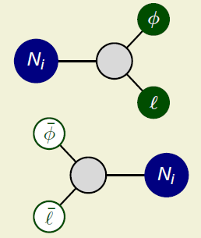
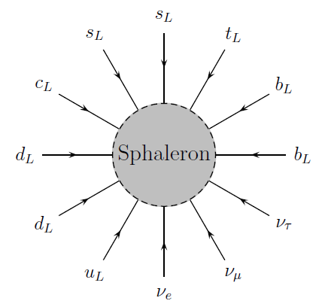
Leptogenesis (1986)
ΔL
Masataka Fukugita
ΔB
Tsutomu Yanagida
Notes:
This direct connection between the baryon and lepton numbers leads to a simple but exciting idea. If there was a source of lepton asymmetry in the early Universe, this lepton asymmetry would be converted to the observed baryon asymmetry by the sphaleron processes. This scenario is called "baryogenesis via leptogenesis" and was proposed just a year later, in 1986, by two Japanese physicists, Fukugita and Yanagida.
What they had in mind as source of the lepton number violation was a heavy Majorana neutrino that couples to the lepton doublet and the Higgs.

Slide 33
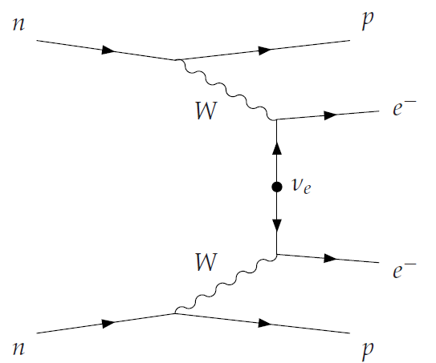
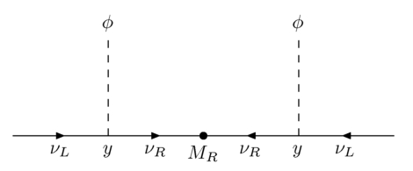
Lepton number violation
Notes:
If you have been at the GERDA talk exactly a week ago, you remember that neutrinoless double-beta decay is a process that violates lepton number by two units. No leptons in the initial state and two leptons of the same charge in the final state. Here is the Feynman diagram that describes this process.
Now if we zoom in into the light Majorana neutrino in the middle, we will see that in the heart of it there is a heavy Majorana neutrino. The same neutrino that Fukugita and Yanagida proposed to use as a lepton number generator. It is the Majorana mass term of this heavy neutrino, that violates lepton number in the neutrinoless double-beta decay. The remaining part of the Lagrangian, the Lagrangian of the Standard Model, is lepton number conserving, as we have just discussed.

Slide 34
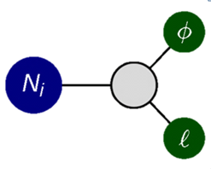
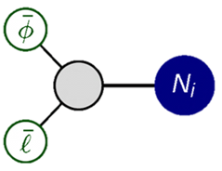
CP-violation
+
Notes:
Is adding the heavy Majorana neutrinos to the Standard Model a guarantee that the required amount of the baryon asymmetry is produced ? No, not really. The outcome strongly depends on the Yukawa couplings of these heavy neutrinos to leptons and the Higgs.
Imagine the following situation. The heavy neutrinos decay to leptons and antileptons with equal probability such that the total lepton number remains zero. These decays then slightly reheat the Universe and change its expansion history, but there is no lepton asymmetry to convert to the baryon asymmetry. This special case is realized if there is no CP-violation, or, put in a bit more formal way, if the Lagrangian is invariant under a transformation that consists of the charge-conjugation and parity-conjugation.
That is why the second Sakharov condition - CP-violation is so important.

Slide 35
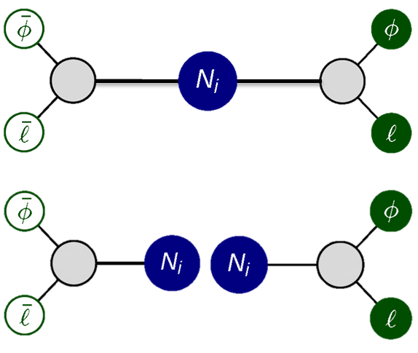
Deviation from equilibrium
forward
inverse
Notes:
How is the third Sakharov condition reflected in the baryogenesis via leptogenesis scenario ? Recall that the thermal equilibrium is achieved when the rates of the forward and inverse processes become equal. In other words, even if there is both lepton number violation and CP-violation, the asymmetry created in the Majorana decays is immediately washed out by the inverse decay and scattering processes.
Of course, the early Universe was rapidly expanding and was nether in a complete thermal equilibrium. But in physics everything is relative. Rapidly expanding means "fast compared to the expansion rate today". But if you compare this expansion rate to the typical time scale of the particles interactions back then, then this "rapidly" turns out to be "really slow". Therefore, even though the Universe was never in exact thermal equilibrium, the lepton number violating decays of the heavy neutrino could have been fast enough to actually bring them very very close to equilibrium.

Slide 37
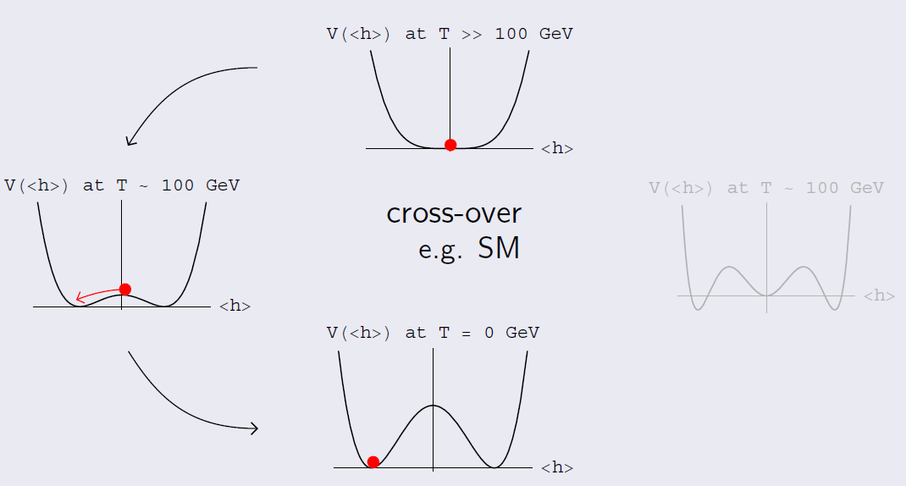
LHC (2012)
m_{H}=126 GeV
Notes:
What is the current status of these two very compelling scenarios. Within the past year there have been new experimental results relevant for this question.
First of all, the LHC has found the Higgs with the mass of 126 GeV. And no deviations from the predictions of the Standard Model. This implies that instead of a strong first-order phase transition we deal with so-called electroweak crossover. And it provides just way too small deviation from equilibrium.
Moreover, the updated measurements of CP-violation in the quark sector are also in agreement with the Standard Model predictions. No new sources of CP-violation have been found.
Does that mean that electroweak baryogenesis is excluded. Not really. If you take for instance supersymmetric extensions of the Standard Model, there are still corners of the parameter space which are compatible with all the experimental constraints and baryon asymmetry of the Universe. Will these corners survive the next LHC run - who knows.

Slide 38
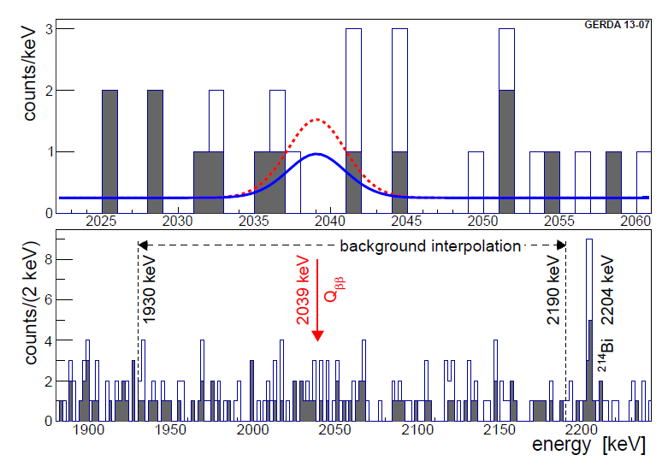
GERDA (2013)
Notes:
Another important experimental result has been presented exactly a weak ago by the GERDA collaboration. No sign for neutrinoless double-beta decay. If leptogenesis is the explanation for the baryon asymmetry of the Universe, then neutrino must be a Majorana particle. Of course, the absence of the signal does not mean that the active neutrinos are Dirac particles. Most likely, GERDA is just not sensitive enough. May GERDA -phase 2 will observe neutrinoless double beta decay. Until then the status of leptogenesis is also unclear.

Slide 39
Summary
The Universe is baryonically asymmetric
SM contains all ingredients but the generated asymmetry is way too small
An option are SUSY-like extensions combined with electroweak baryogenesis
Adding heavy Majorana neutrinos we can explain neutrino masses and the baryon asymmetry
Notes:
This brings me to the summary.
First of all, the Universe is baryonically asymmetric. There is practically no antimatter and the antimatter that is there is born in the collisions of the cosmic rays with interstellar medium.
Second, the minimal Standard Model in principle contains all the ingredients necessary for the asymmetry generation. Sphalerons violate baryon number, CP is violated in the quark sector, and there is a deviation from equilibrium as the Higgs acquires a non-zero vacuum expectation value. However, numerically the produced asymmetry is orders of magnitude smaller than the observed one.
Therefore, the Standard Model, despite its tremendous success, must be extended. A popular extension is to supplement the Standard Model by three heavy Majorana neutrino. This extension naturally explains the smallness of the active neutrino masses through the see-saw mechanism and the baryon asymmetry of the universe through baryogenesis via leptogenesis.
Another possibility, somewhat disfavored by not yet ruled out by the LHC is to add additional TeV-scale new particles to the theory, in particular new scalars. In such extensions we have new sources of CP-violation and a stronger phase transition. As a result the asymmetry can be generated by the electroweak baryogenesis mechanism.

Slide 41
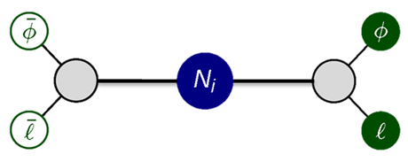
See-saw mechanism
Notes:
This reveals an exciting connection between the baryon asymmetry of the Universe and low-energy neutrino physics that arises in the scenario of baryogenesis via leptogenesis. Here is a Feynman diagram that describes neutrino-Higgs scattering mediated by the heavy Majorana neutrinos. After the electroweak symmetry breaking the Higgs develops a vacuum expectation value, such that the Higgs lines at this diagram is replaced by a cross. The scattering diagram turns into a mass term for the active neutrinos. And the smallness of the active neutrino masses is naturally explained by the largeness of the heavy Majorana neutrino masses. For this reason this mechanism of the mass generation is called "see-saw mechanism".

