Slide 1
GRB observation of The MAGIC telescopes and PMT for Next Generation Telescope
Particle Physics School Munich Colloquium
December 13th, 2013
Max-Planck-Institut für Physik
Föhringer Ring, Munich, Main Auditorium
Takeshi Toyama
Notes:
Thank you Chairman and thank you for attending this meeting
I would like to talk

Slide 2
Contents
3 Messages!
How MAGIC telescopes observe Gamma ray
Photo sensor for Next generation
Gamma Ray Burst observation by MAGIC
- Motivation, Way, Difficulty, Result

Slide 3
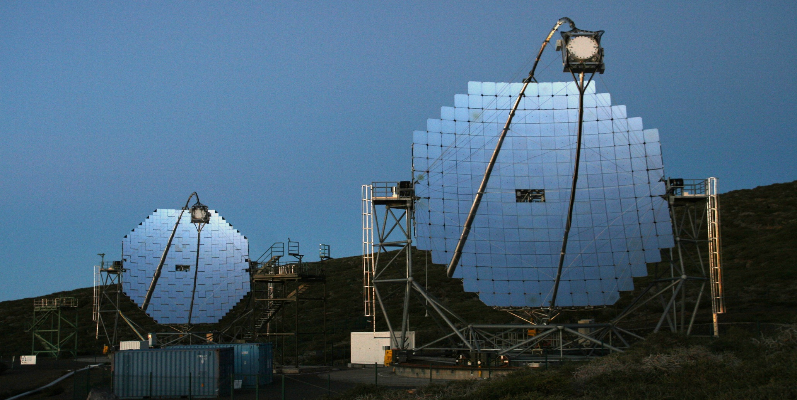
MAGIC telescope
17m
85m
Location
Energy range
Angular resolution
Sensitivity
Canary Island La Palma
50GeV - 50TeV
~0.06°(@1TeV)
~0.06%Crab (@500GeV with 50h observation )
2013/Jan/11
GRB observation of MAGIC telescopes and PMT for Next Generation telescope Takeshi Toyama
3

Slide 4
MAGIC telescope
17m
blah-blah-blah
85m
Location
Energy range
Angular resolution
Sensitivity
Canary Island La Palma
50GeV - 50TeV
~0.06°(@1TeV)
~0.06%Crab (@500GeV with 50h observation )
4

Slide 5
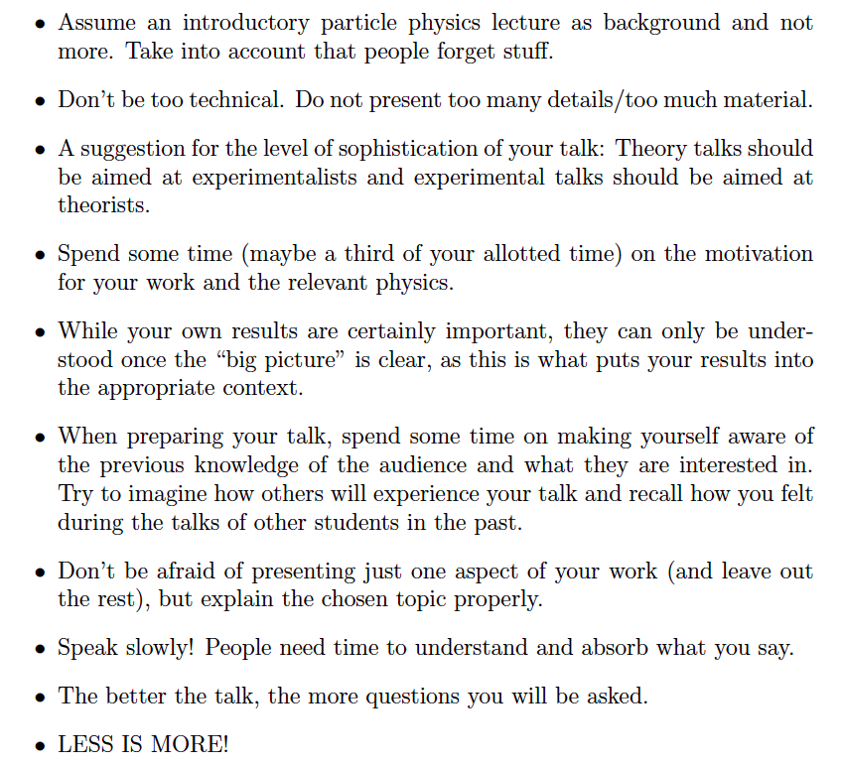
Before talk

Slide 6
A big glass cube
10km * 10km * 10Km

Slide 7
100GeV

Slide 9
These reactions continue until particles become enough low energy.
We measure gamma ray by using this phenomenon

Slide 10
Charged particle has velocity more than one of light in medium. The particle emits Cherenkov Light
Cherenkov Light is directional radiation, not isotropic

Slide 11

Replace a glass with just atmosphere
Angle of light emitting is narrow θ= 1°
n: index of refraction
β= vp/c
vp: velocity of particle
Atmosphere
n: 1.0003 β≒1
θ= 1°

Slide 12
~100m

Slide 13
If we put
fast (time resolution <~10nsec)
sensitive ( < ~10photon)
sensor
You can count particles
Investigate which particle

Slide 14
Then put many sensors
14

Slide 15
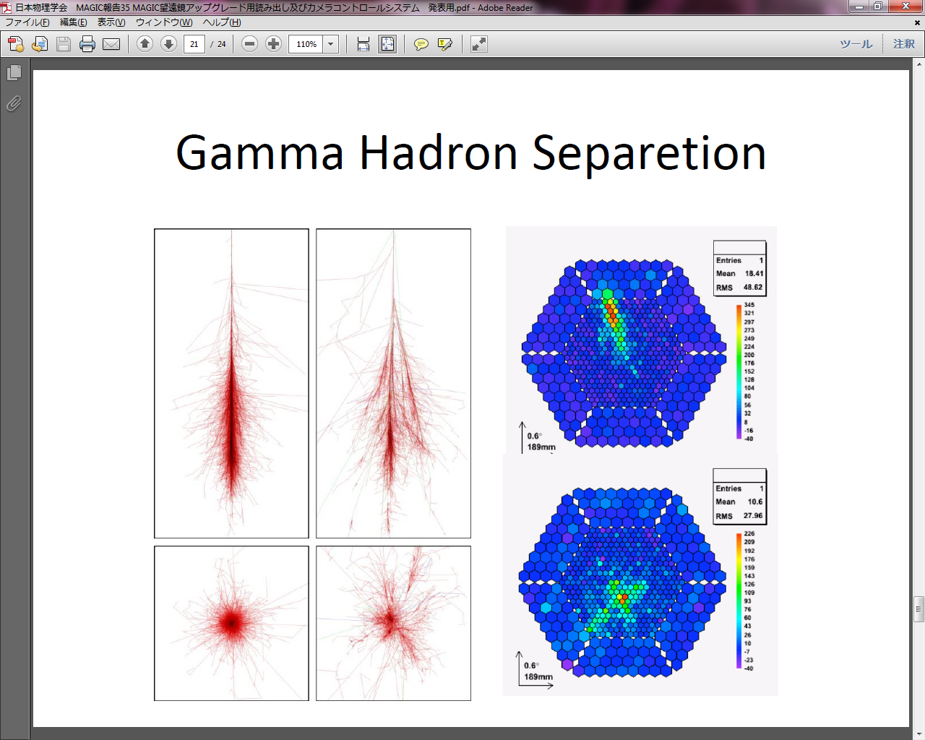
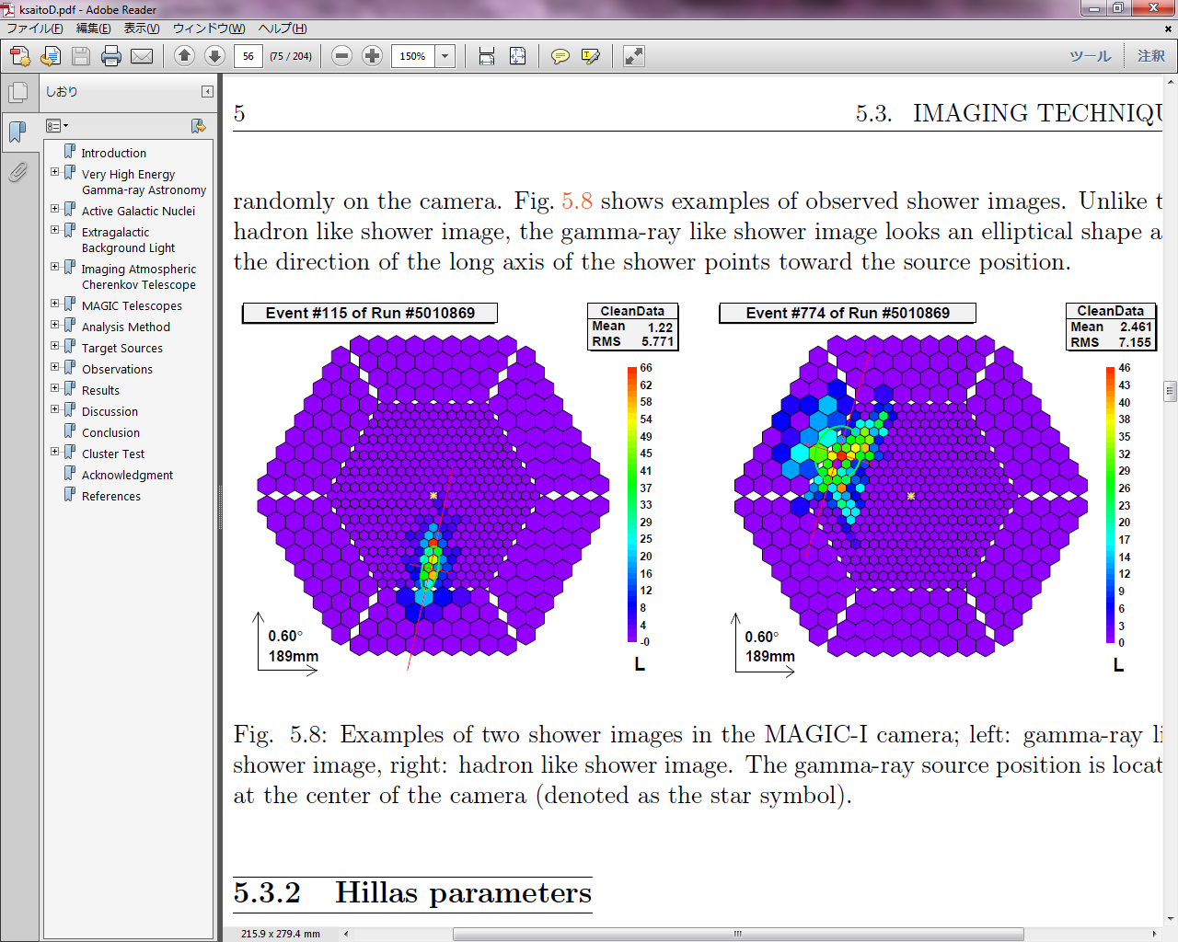
Air shower by gamma ray
Air shower by hadron
You can distinguish between gamma and the others
to some extent
15

Slide 16
I want to track a object in sky
You can distinguish between gamma and the others
to some extent
16

Slide 17
Tracking Device

Slide 18
Well, no significant signal…
Let`s collect more photon to get signal!
Tracking Device

Slide 19
Get significant signal from CrabNebula!
(the Whipple Observatory 1989)
Mirror
Tracking Device

Slide 20
Get significant signal from CrabNebula!
(the Whipple Observatory 1989)
Mirror
More sensitive!
Tracking Device

Slide 21
Better sensitivity & resolution

Slide 22
MAGIC telescope
17m
85m
Location
Energy range
Angular resolution
Field of View
Canary Island La Palma
50GeV - 50TeV
~0.06°(@1TeV)
3.5°
22

Slide 23
Photo sensor for Next generation

Slide 24
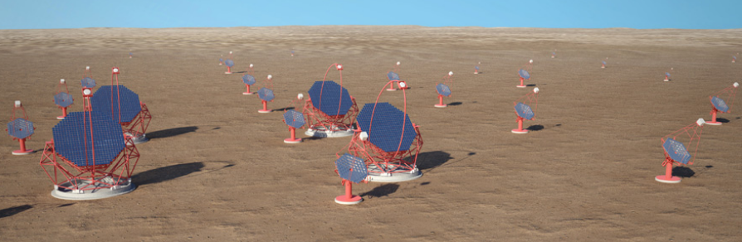
Next Generation Project
Cherenkov Telescope Array (CTA)
G. Perez, SMM, IAC from CTA web site https://portal.cta-observatory.org
Before several groups built Telescopes
In next generation, They all are going to build Telescopes in one project.
-> To achieve 10 time better sensitivity than current Telescopes
We need better photo sensor!

Slide 25
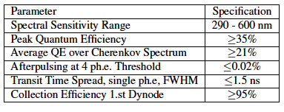
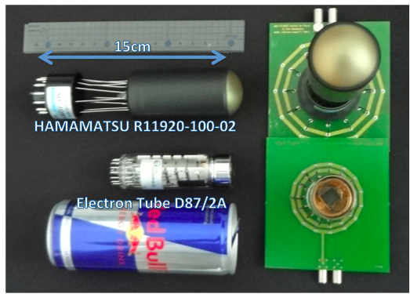
Photomultiplier Requirement
New PMTs are almost satisfied with requirement
Today I want to focus two parameter “Quantum Efficiency & Afterpulse”

Slide 26
PhotoMultiplier Tube (PMT)
Vacuum ~0.1Pa (10⁻⁷ atm)
Cathode
Anode
Dynodes

Slide 38
Quantum Efficiency(QE)
Ratio to convert from Photon to electron
If we got better QE
-> we can measure weak signal
-> It leads to lower threshold energy
Hamamastu and Electron Tube produce Good PMT having QE.
c.f. MAGIC current PMT is 〜32%

Slide 39
AfterPulse(AP)
Current
2us
Signal
Time
Afterpulse is dummy signal after signal.
-> We want to reduce this AP as much as possible

Slide 40
Cause of After Pulse 1

Slide 43
On 1st dynode, plus ION can be produced

Slide 46
These electrons will go 1 st dynode
-> it will be cause of After Pulse.

Slide 47
Cause of After Pulse 2

Slide 53
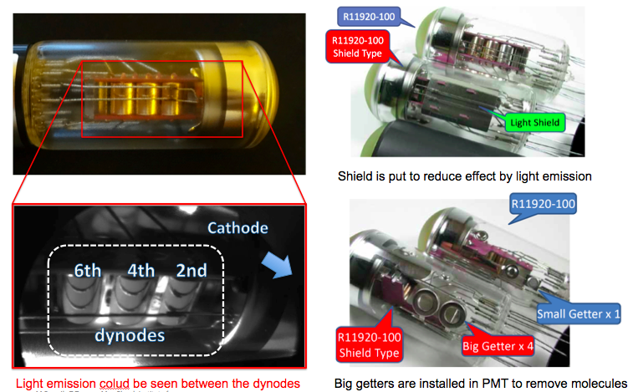

Slide 54
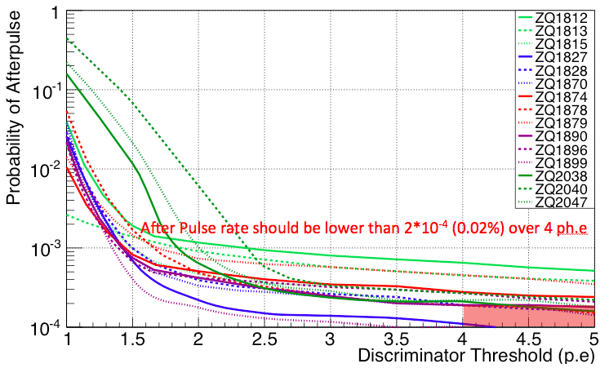
Results of After Pulse measurement

Slide 55
GRB observation of MAGIC telescope

Slide 56
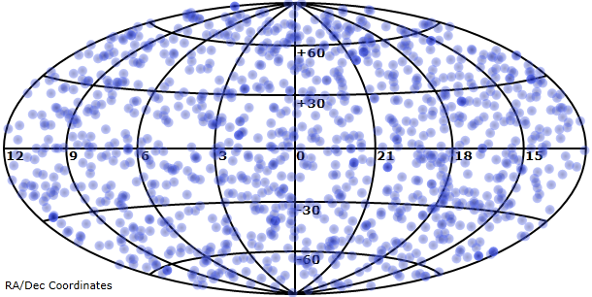
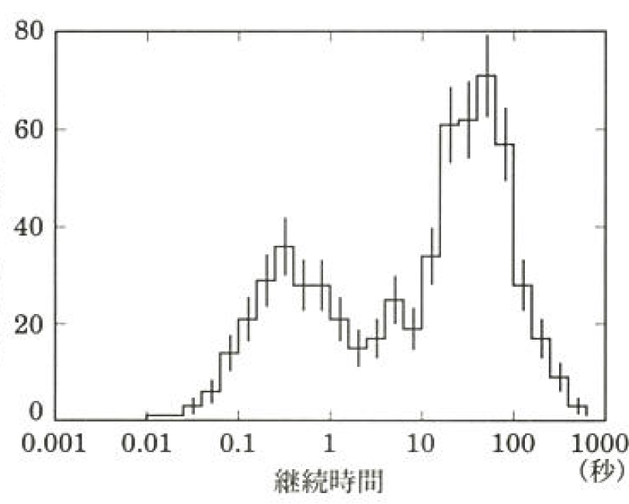
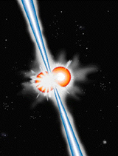
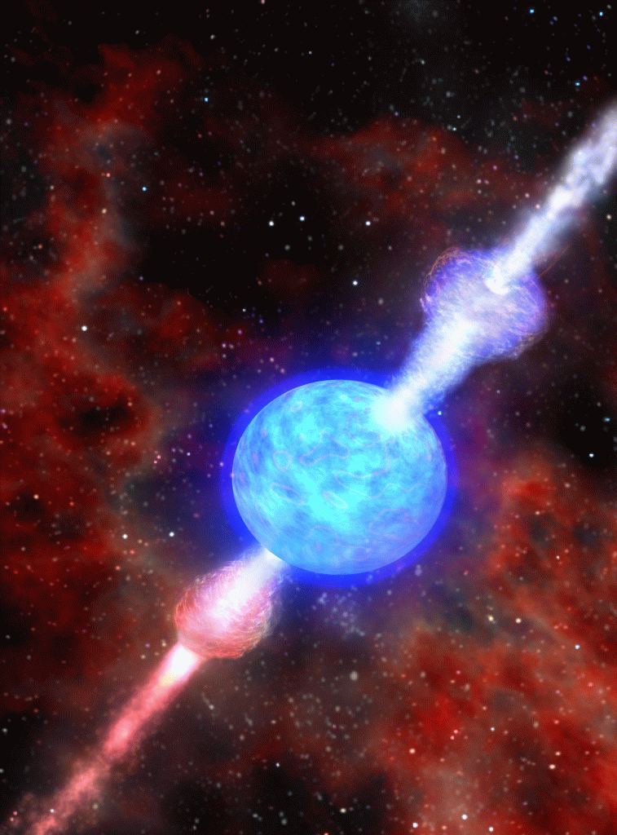
Gamma Ray Burst
Number of burst
http://grb.sonoma.edu/
No anisotropy
duration time
(sec)
1. It occurs at cosmological distances.
2. two different population of bursts
3. Some of the Long GRBs are related to hypernova.
4. Afterglow is observed in X ray band. However, GRB is not a well-understood phenomena yet.
Short GRB
Long GRB
Notes:
なぞ
エネルギー、等方的、天文学的な距離にあることが判明、2種類、Hノバと関連
未だに分かっていないこととして放射機構、（モデル）、10GeV以上のスペクトラム
No anisotropy
Total energy of GRB is around …

Slide 57
Motivation
No detection of GRB by this type of Telescope (Imaging Atmospheric Cherenkov Telescope) in history.
Nobody knows
- Energy spectrum more than 300GeV
-What is central engine?
ADVANTAGE of MAGIC for GRB obseration
1.MAGIC can measure more than 50GeV, effective area is over 1000times than Fermi LAT
2. MAGIC can track available source within 25sec at least

Slide 58
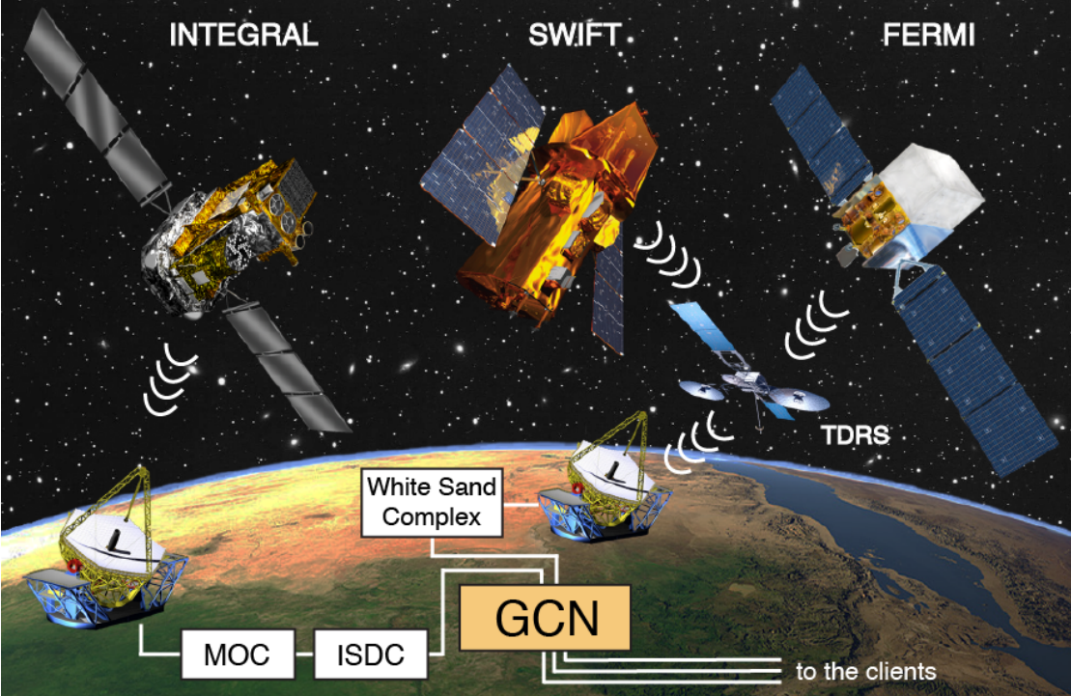
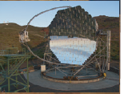
GRB observation in MAGIC
Notes:
衛星とMAGIC
MAGIC FoV is 6 times bigger than moon in angular diameter.
So it is very low probability that GRB happen in MAGIC FoV. ()
We need to repointing after GRB

Slide 59
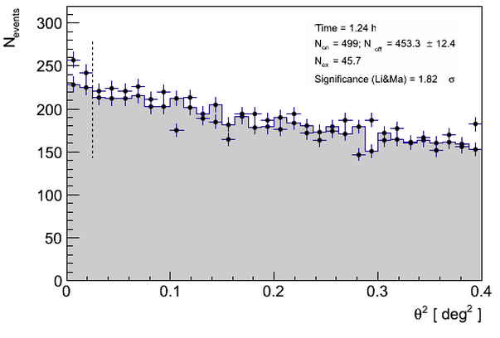
GRB13YYYY
Onset
Preliminary

Slide 60
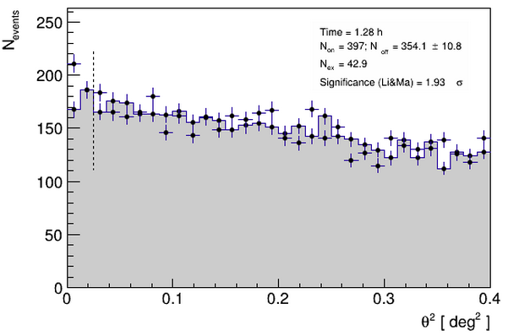
GRB13XXXX
Preliminary

Slide 61
Summary
PMT for Next generation telescope has good performance
GRB observation by MAGIC, unfortunately still no detection, But we have the biggest chance as long as CTA will start.

Slide 62
Thank you !!!

Slide 63
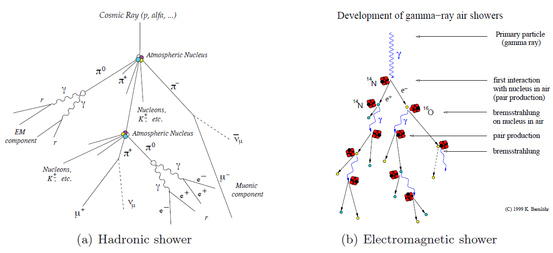

Slide 64
