Slide 1
Tracks Merging Status
A. Abdesselam
University of Tabuk
F2F Tracking Meeting, Prague 12/12/2013

Slide 2
Overview
Merging algorithm
Tracks merging purity
Future plan

Slide 3
Merging Module: siCDCTrackMerger
Get the CDC and Si tracks (outputs of MCfilter)
Loop on the CDC and Si tracks (2 separate loops)
Extrapolate tracks to the CDC inner wall and get θ and φ
Put the track in a (θ, φ) grid
θ
φ
Track shared between two cells
Track shared between 4 cells

Slide 4
Merging Module (Cont)
The number of cells and overlap are parameters to the code.
Loop on the (θ, φ) cells
Loop on the CDC tracks in a cell
ExtrapolateToPlane (plane generated by position on cylinder obtained in the previous step)
Get state and Covariance matrix on that plane
Loop on Si tracks in the same cell
ExtrapolateToPlane (same plane)
Get state and Covariance matrix
Calculate the chi-square:

Slide 5
Merging Algorithm (Cont)
The matching track is the one with the smallest .
There is no further cut on . (should be envisaged later).
Save the pair of matched tracks in a std::map(cdc_trk, si_trk).
Analysis part (produces an local ntuple)
Loop on the list of track pairs in the std::map
It’s necessary to do the analysis part in a new loop outside the matching loop because of the overlaps between cells and thus the possibility of counting a track more than once.
Calculate the residuals
Get the states and calculate …etc.

Slide 6
Analysis: Purity
Study the purity as function of two parameters: track momentum and tracks multiplicity.
Simulate 1000 muon/anti-muon event for each value for each these two parameters:
Simulated momenta: 0.5, 0.8, 1.1, 1.4, 1.7, 2, 5, 8, GeV (ntrack fixed at 10).
Simulated ntracks: 1, 3, 5, 7, 10, 15, 20 track (momentum fixed at 0.5 and 20 GeV).
Purity calculation:
CDC and SVD tracks are merged together to form pairs of tracks.
A matching is successful only when the MCParticle associated to the CDC track is the same MCParticle associated to the SVD track.
The merging purity, is the ratio of successfully matched pairs to the total number of matched pairs.

Slide 7
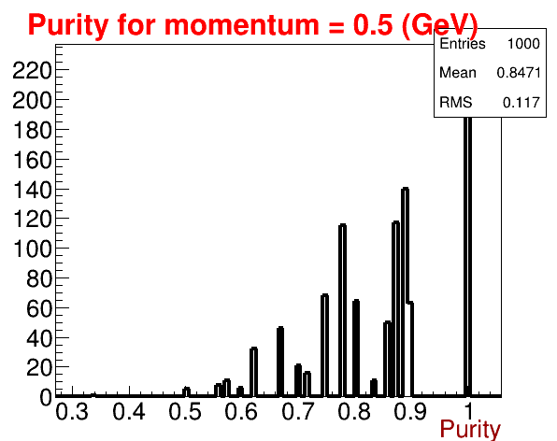
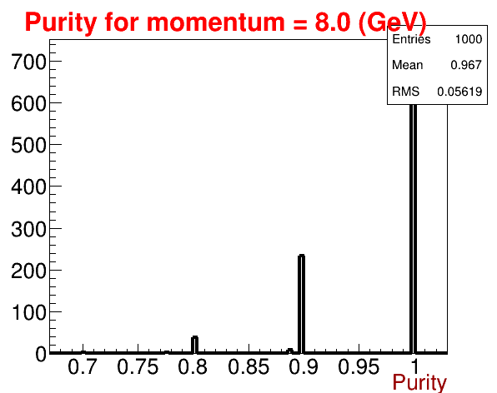
Purity per Event
85%
97%
Simulated 10 muon/anti-muon in each event: This allows us to calculate a merging purity per event and thus obtain a sort of purity distribution.
Since 10 tracks were generated per event, the purity could be 10/10, 9/10, 8,/10 ...etc. (i.e. Discontinuous as seen on the plots)
The merging purity per event is quite high at high momentum (mean=97%) and a bit low for small momentum (mean=75%)

Slide 8
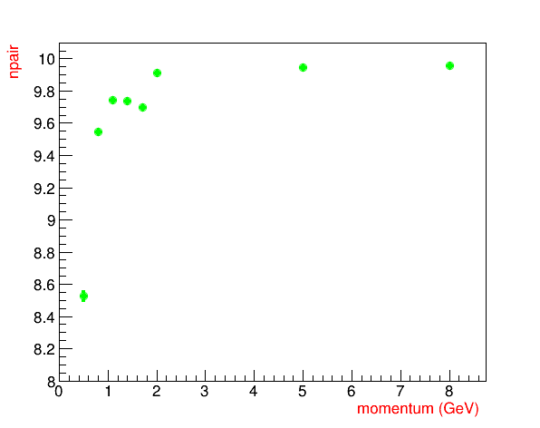
Purity versus Momentum
Purity vs momentum
Efficiency vs momentum
10 tracks per Event
10 tracks per Event
As would one would expect, both purity and efficiency do increase with increasing momentum. (the right plot represent, in a way, the efficiency: 10 pairs represents 100% efficiency since precisely 10 tracks were generated)

Slide 9
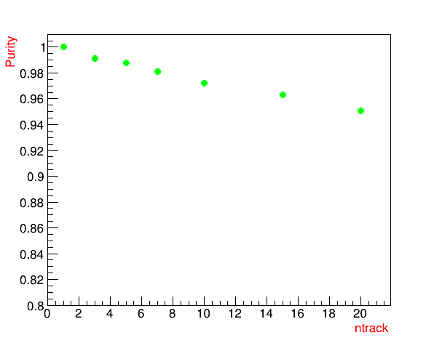
Purity versus ntrakcs
Purity vs ntrack
Purity vs ntrack
Momentum = 0.5 GeV
Momentum = 20 GeV
The purity decreases when the number of tracks in the event is increased, especially at low momentum.

Slide 10
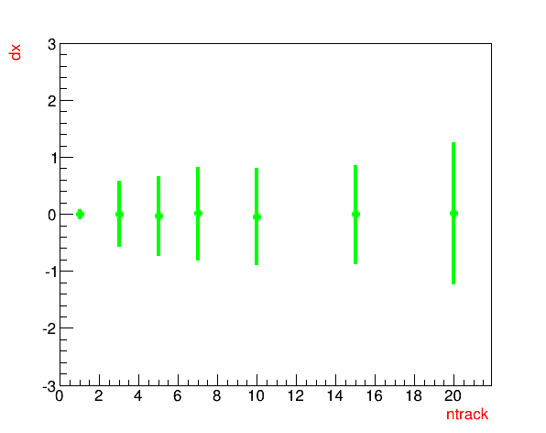
Residuals versus ntracks
X-residuals vs ntrack
X-residuals vs ntrack
Momentum = 0.5 GeV
Momentum = 20 GeV
The residuals increase when the number of tracks in the event is increased (plot on the left). The Y-axis is in centimetres.
They decreases when the momentum is increased (plot on the right).

Slide 11
Residuals versus momentum
10 tracks per Event
The residuals decrease when the momentum is increased.

Slide 12
Chi-Square
Chi-square mean values are too small!!.
An investigation is needed!

Slide 13
Future Plan
Code writing
Fit the Merged pair as a single track and store the new track in the data store (?).
Extrapolate non-matched tracks on either side.
Explore other matching algorithms.
Analysis
Continue studying the purity and efficiency…etc.

Slide 14
Backup Slides

Slide 15
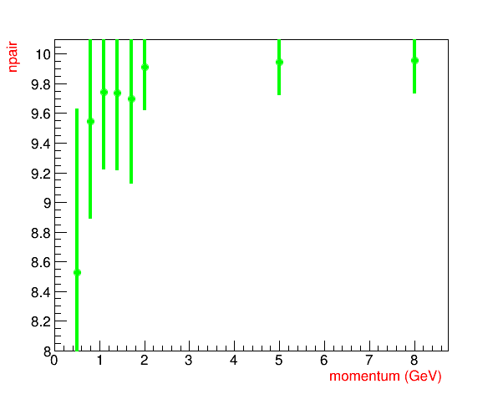
Purity vs Momentum
Mean of the Purity and its spread (sigma) are shown. This is the same plot presented on slide 8 but now the sigma of the distribution is shown.

Slide 16
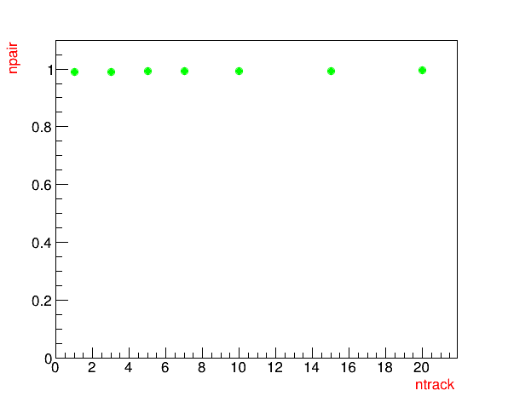
Number of track pairs vs number of tracks in the Event
Momentum = 0.5 GeV
Momentum = 20 GeV
These plots represent somehow the efficiency of tracks merging. Since 10 tracks per event were generated, one would expect , an average, 10 pair per event.

Slide 17
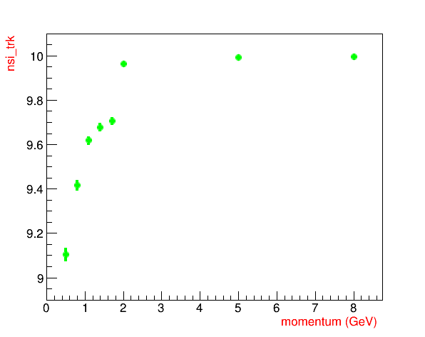
CDC and Si tracks vs Momentum
CDC sub-detector
Si sub-detector
These two plot show the track reconstruction efficiency of the CDC and Si sub-detectors. Since 10 tracks per event were generated, one would expect , an average, 10 reconstructed tracks per event.

