Slide 1
The MAGIC Telescopes in 2014
Razmik Mirzoyan
for the MPP MAGIC group

Slide 2
Eckart obtaining diplom in Polish Embassy

Slide 3
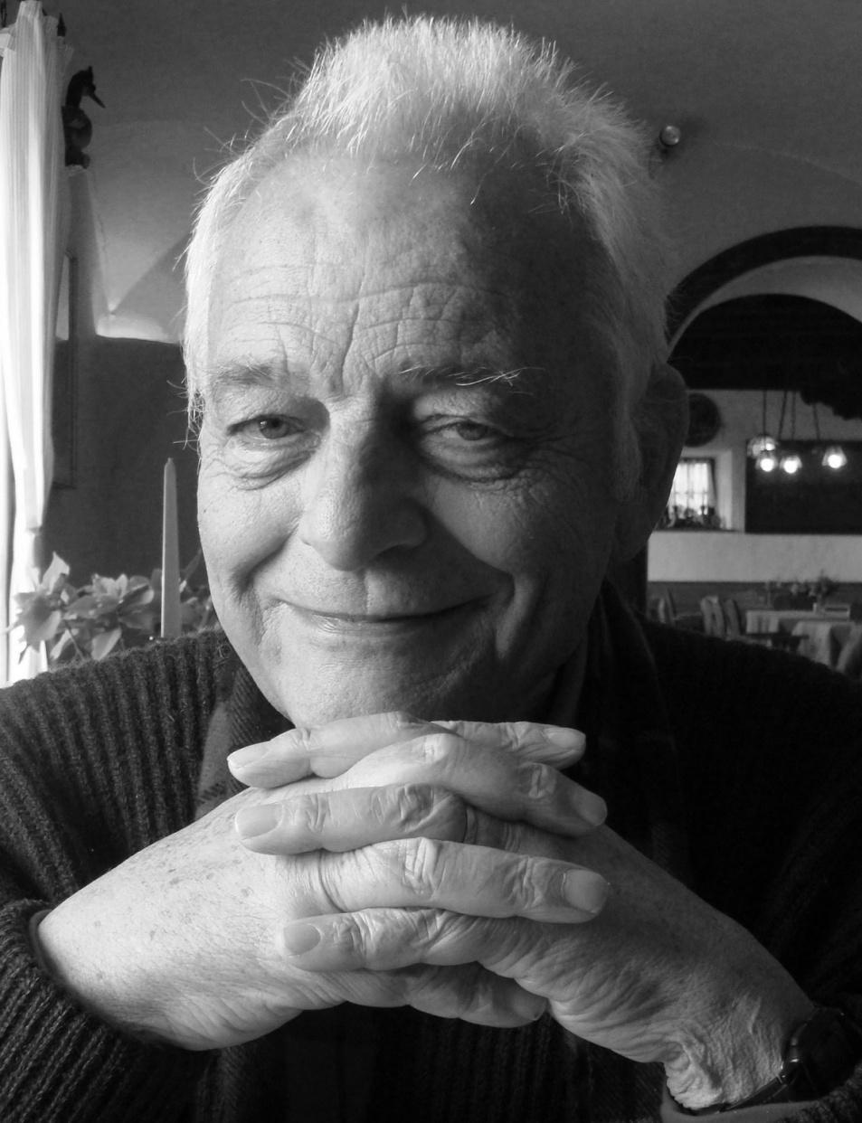
Eckart Lorenz: a life devoted to science
We are organizing a mini-
-symposium devoted to
Eckart Lorenz. It will take place
in MPI for Physics on 23rd
January 2015:
https://indico.mpp.mpg.de/
conferenceDisplay.py?ovw=
True&confId=3202

Slide 4
Trevor Weekes from CfA: VHE ground-based γ−ray astronomy pioneer passed away in May 2014

Slide 5
Daniel Kranich, long-term HEGRA & MAGIC member
Daniel Kranich, diploma student,
then PhD thesis in HEGRA, in MPP
After PhD working on MAGIC ,
real enthusiast, sharing his
experiences with newcomers
extended stays in MPP, University
of Davies (USA), ETH Zurich
passed away in Alps in August

Slide 6
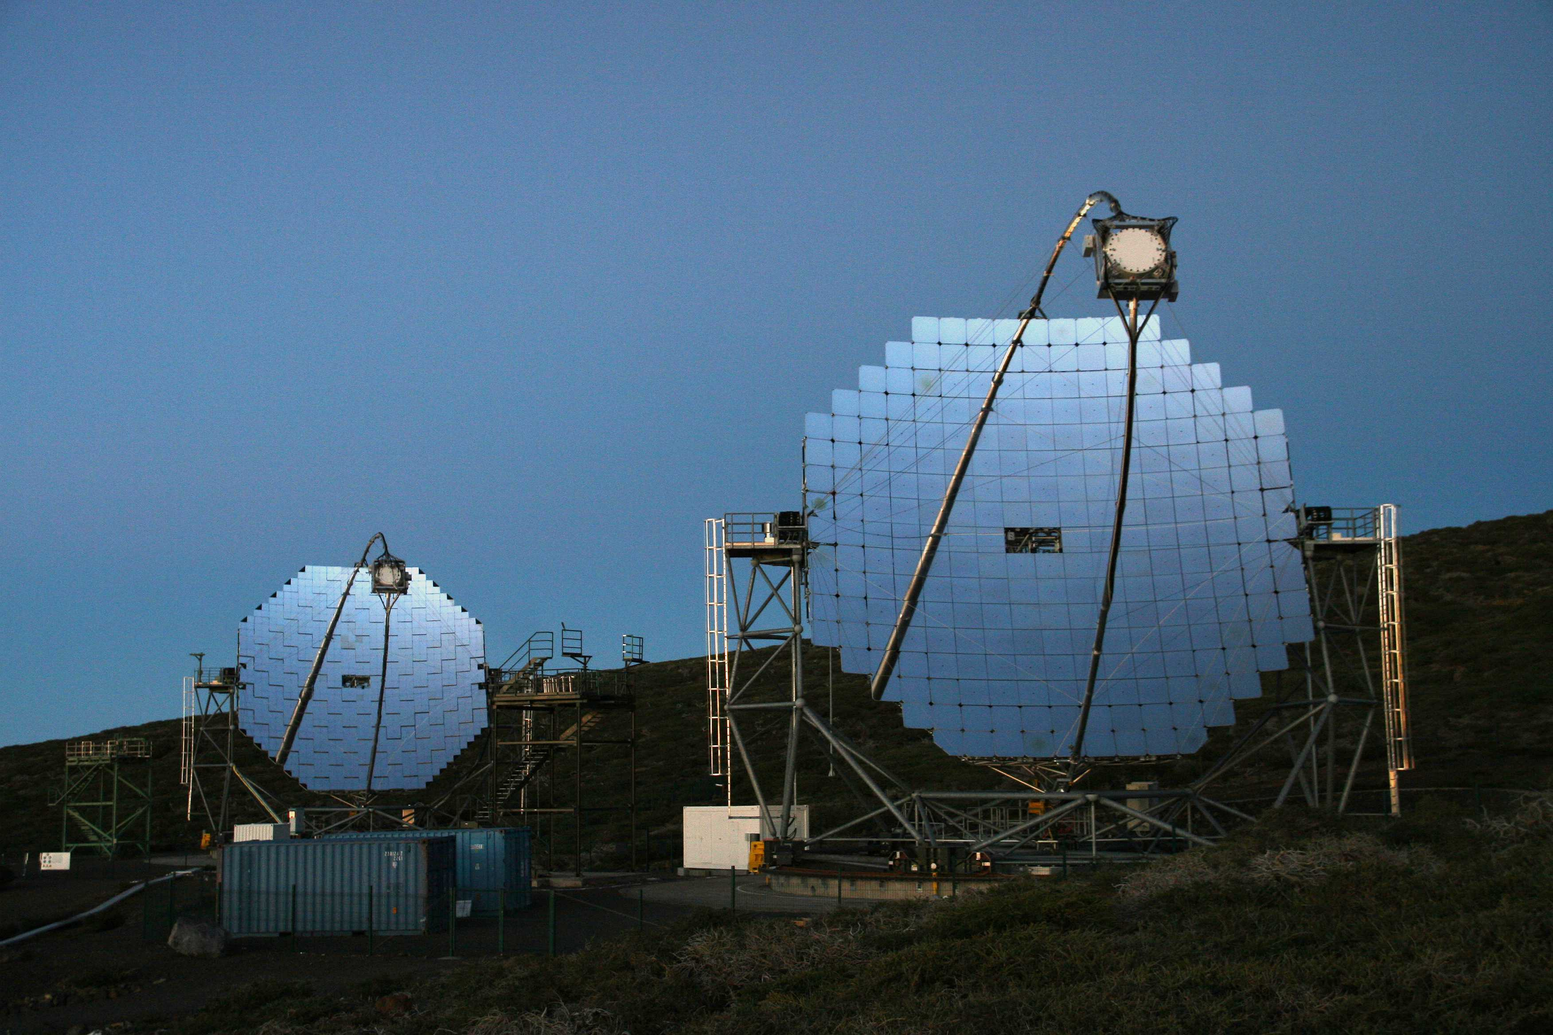
The Two 17m Ø MAGIC Telescopes

Slide 7
System of 2 MAGICs: the main parameters
Energy threshold (trigger): ~ 50 GeV
Current energy threshold in “Sum-Trigger” modus: ~35 GeV
Energy resolution: 20 % @ 100 GeV; < 15 % @ 1TeV
Angular resolution: 0.1° @ 100 GeV; 0.05° @ 1 TeV
Sensitivity: 5/1000 of Crab Nebula in 50h observations
Light-weight construction, only ~70 T
Fast re-positioning to any coordinates in the sky: ~25s/180°
Electro-optical design optimized and set to provide ~2.5ns FWHM pulses
Data digitized by using 2GSample/s DRS4 chips
Producing ~ 1 TB data per observation night

Slide 8
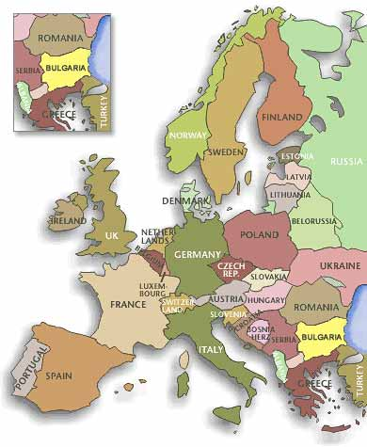
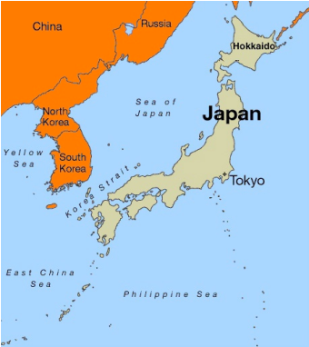
~170 Collaborating Astro-Physicists from 9 Countries
Bulgaria Sofia
Croatia Consortium (Zagreb, +…)
Finland Consortium (Tuorla, +…)
Germany DESY Zeuthen, U. Dortmund,
MPI Munich, U. Würzburg
Japan Consortium (Kyoto, +…)
Italy INFN & U. Padova, INFN Pisa & U. Siena, INFN Como/Milano Bicocca, INFN Udine/Trieste & U. Udine,
INAF (Consortium: Rome, +…)
Poland Lodz
Spain U. Barcelona, UAB Barcelona, IEEC- CSIC Barcelona, IFAE Barcelona, IAA Granada, IAC Tenerife, U. Complutense Madrid, CIEMAT Madrid
Switzerland ETH Zurich
India queuing to be accepted in 2015

Slide 9
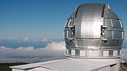
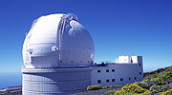
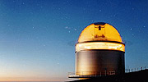
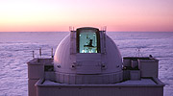
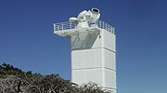
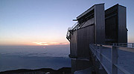
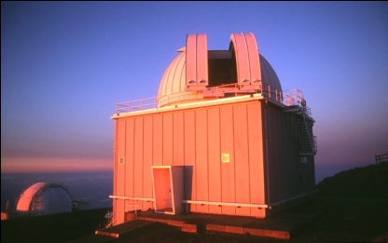
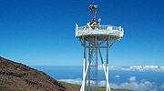
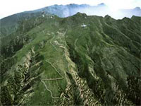
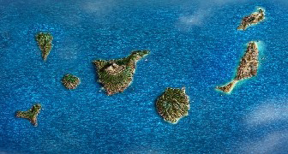
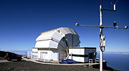
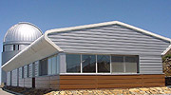
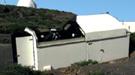
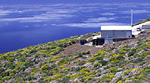
The Main Telescopes of the “Roque de los Muchachos” European Northern Observatory
ORM is located on the Canary island of
La Palma, at a height of
2200-2400 m a.s.l.

Slide 10
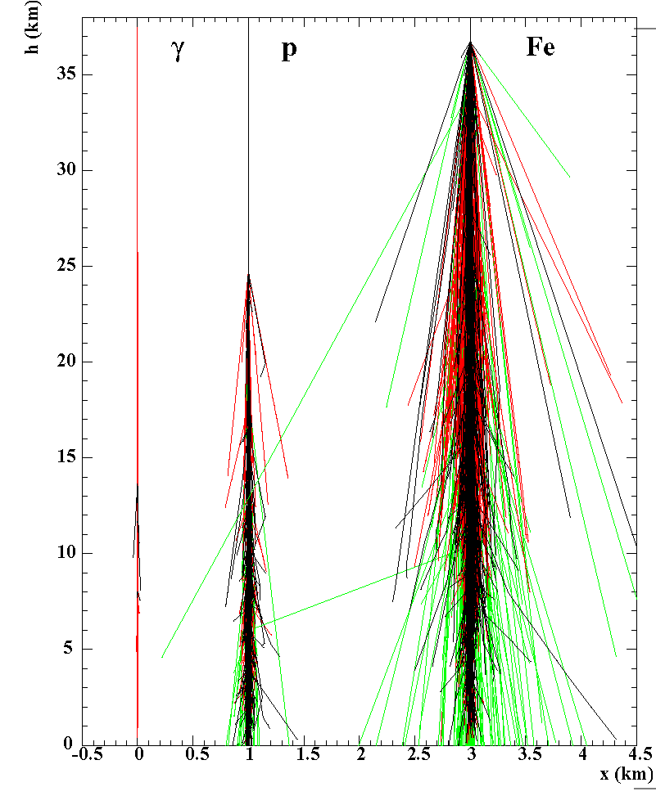
Images of Extensive Air Showers in Cherenkov Light

Slide 11
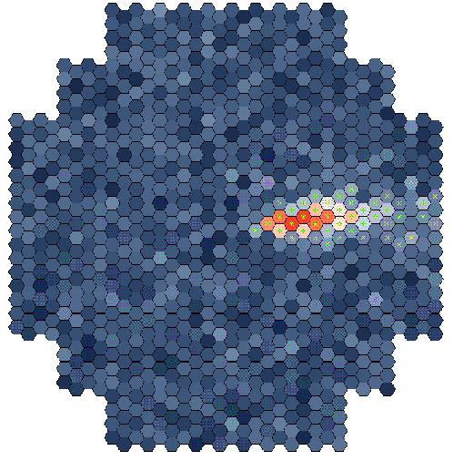
The IACT principle

Slide 12
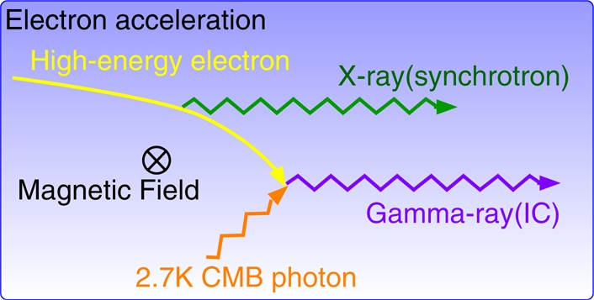
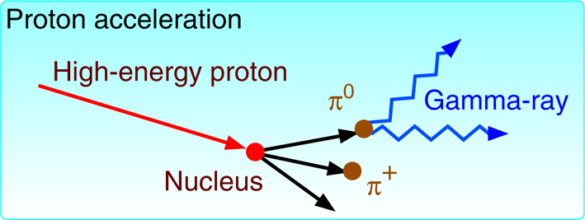
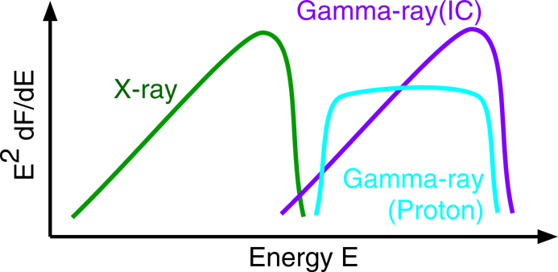
Gamma-Ray Emission Processes Astrophysical process

Slide 13
Fast Rotation of MAGIC to„catch“ GRB

Slide 14
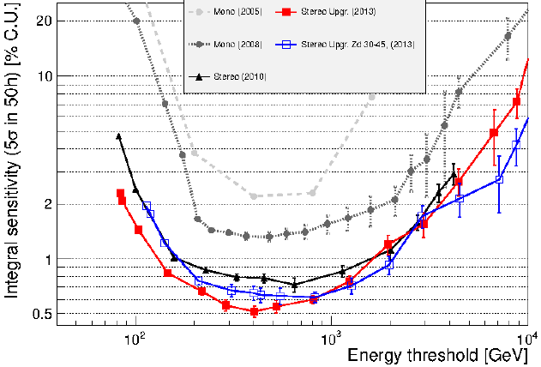
MAGIC Progress in 2014
The MAGIC project yieldid a remarkable scientific harvest in 2014. Current sensitivity: 50 mCrab in 50h for E_{γ} ≥ 400 GeV

Slide 15
Brief summary of the MAGIC publication pipeline in peer-reviewed journals in 2014
16 already published
2 accepted
9 submitted
In total : 27 papers
16 AGNs
7 Galactic
1 GRB
1 AstroParticle physics
2 Technical papers

Slide 16
Current MAGIC projects queuing to become publication in peer-reviewed journals
– Paper(s) now circulating through MAGIC collaboration: 1 (AGN)
– Under review by MAGIC internal referees: 2 (1 AGN + 1 Gal)
– Under review by the MAGIC science groups: 4 (3 AGNs + 1 AP)
– Other projects (not drafts, because include just-taken data) under preparation (49)
Split by topics
Astroparticle group: 2
Galactic group (incl. pulsars): 14 (11 from “old Galactic” +
+ 3 from “old Pulsars”)
AGN group: 33 (including 4 flares from 2014)

Slide 17
2004 – 2014: Celebrating the 10th anniversary of science operation of MAGIC:
100 publications, 5 in SCIENCE
Having “50+ pending projects” is not a problem, provided we keep moving projects to drafts and publications as good as we did in 2014.
And we are confident that we are going to continue in this line
David Paneque,
Publication Manager
of MAGIC

Slide 18
MPP‘s decisive role in MAGIC
Strongest and largest group in MAGIC
In the structure of the collaboration the MPP group provides
Spokesperson (myself)
Physics Coordinator (Masahiro Teshima)
Publication Manager (David Paneque)
Technical Coordinator (Daniel Mazin – until recently)
Providing 4 out of 9 positions in Executive Board (responsible for the day-to-day dicisions to run the experiment)
Co-convener AGN group (Daniel Mazin: until recently)
Convener Astroparticle and Fundamental physics: Pierre Colin

Slide 19
MPP´s decisive role in MAGIC
The group includes about 15-20 physicists
Director Masahiro Teshima
3 permanent positions: R. Mirzoyan, T. Schweizer, D. Paneque
Typically ~ 6 postdocs, 7-8 PhD students, few undergraduates
We acknowledge the very strong and cooperative support from the MPP workshops: O. Reimann, T. Hauboled, D. Fink,
H. Wetteskind, C. Jablonski, M. Fras, W. Haberer, S. Schmidl,
A. Dettlaff, S. Horn, J. Schlammer, …,
Providing 30-40 % of resources in the collaboration

Slide 20
SUM-Trigger
Novel design should allow MAGIC lowering the standard threshold from current ~55 GeV down to ~30 GeV
This design and its implementation in MAGIC telescopes in La Palma is lead by Thomas Schweizer with strong help of Francesco Dazzi and Jezabel Garcia (all from MPP)
Preliminary data taken in spring 2014 showed +70 % higher excess of gamma-rays from Crab pulsar; the estimated threshold is ~ 35 GeV.
Currently we are taking steps to lower the threshold to even lower values

Slide 21
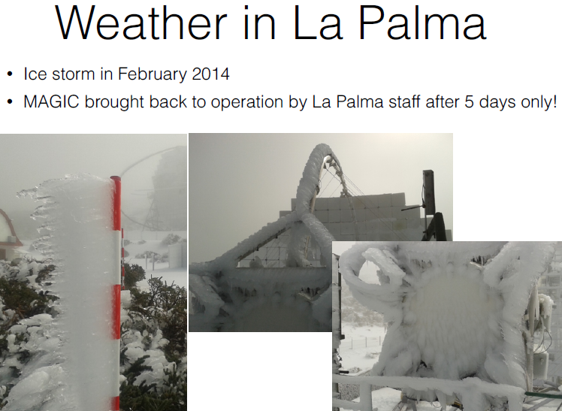
Extreme weather in La Palma; similar severe
weather happened in January 1994

Slide 22
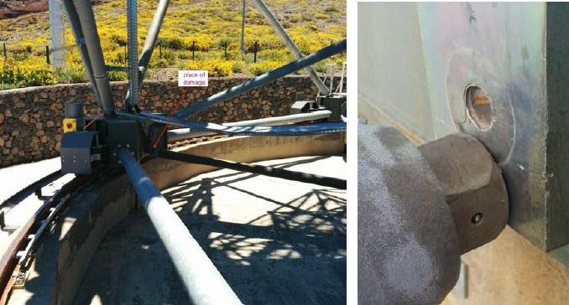
Repair of MAGIC-I azimuth structure
MAGIC-I is operating already for 11 years. The MPP workshop does service work on the telescope twice a year. When necessary, they do also an extra work.
A big screw of one of the big tubes in azimuth structure broke on June 18th. The MPP workshop repaired it professionally.

Slide 23
MAGIC-I all-Al mirror problems
Through microscopic holes water
can slowly penetrate into
honeycomb structure behind the
Al-plate
When freezing this water (ice) can
expand and deform the front
surface

Slide 24
MAGIC-I mirror exchange
The mirrors on MAGIC-I are 11 years old.
On most telescopes mirrors serve at most 3, rare 5 years
The al-Al mirror technology suggested by Eckart has long lifetime but some of the mirrors collect water inside and when it freezes in winter, can damages the surface.
Substituted 62 Al mirror panels on M-I and 10+3 glass and Al mirrors on M-II by the INAF team in August 2014
Substituted 24 (50x50cm²) Al mirrors on M-I by INAF team.
These reduced the M-I weight by ~1.5 tons. This allowed reducing the counterweight by ~150 kg
We shall profit in threshold from higher reflectivity

Slide 25
Reducing sampling speed of DRS4 readout from 2 Gsample/s to 1.64 Gsample/s
After long planned tests we decided to reduce the sampling speed of the DRS4 chips.
This allowed us closing small gaps in certain azimuth directions when observing sources under large zenith angle
For the time being we see a small instrumental increase of noise of ~5 % but we hope we can identify the reason and corret for it

Slide 26
Gravitational Waves & MAGIC & HAWC
LIGO - VIRGO – EGO (European Gravitational Observatory) Collaboration opened call for em-gw identification and follow-up observations of event candidates.
MoU between MAGIC and LV-collaboration was signed
We have signed up an MoU with the HAWC collaboration
(HAWC is a wide angle detector of gamma rays, based on dense array of large-size water tanks in Mexico)

Slide 27
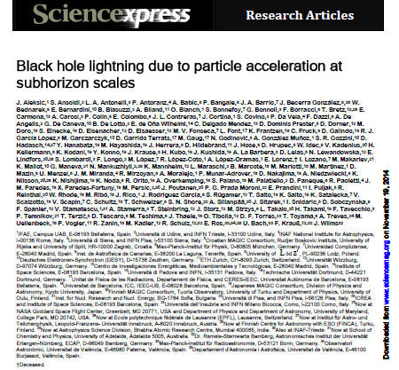
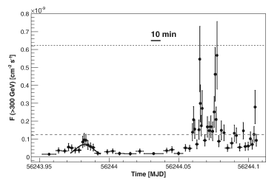
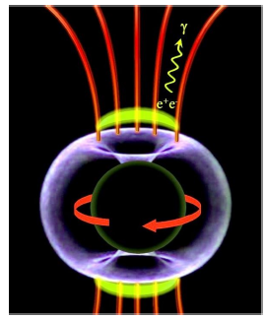

Slide 28
The possible scenarios
fall into three categories:
1. mini-jet structures within the jets;
2. jet-cloud interactions, where the clouds may originate from stellar winds; and
3. magnetospheric models, similar to those known from pulsar theory.
1‘. Is not possible because required jet power is two orders of magnitude higher than the one estimated from radio
2’. The emission would have to be confined to within an angle of 10⁻⁵ rad to explain the observed variability time scale, requiring a very stable direction of accelerated particle beams

Slide 29
The possible scenarios
3‘. The magnetosphere is anchored to the ergosphere of accreting black hole. As particles accelerate to ultrahigh energies, electromagnetic cascades develop, multiplying the number of charge carriers until their current shortcuts the gap. The excess particles are then swept away with the jet flow, until the gap reappears.
Radio galaxies and blazars with very low accretion rates allow us to obtain a glimpse of the jet formation process near super-massive black holes

Slide 30
Crab pulsar
Aliu et al. (MAGIC collab.)
Science 322 (2008) 1221
First detection of emission above 25GeV for a pulsar
Aliu et al. (VERITAS collab.)
Science 334 (2011) 69-72
First detection of emission above 100GeV
Aleksic et al (MAGIC collab.), ApJ, 742 (2011) 43,
First spectrum 25-100GeV
Aleksic et al (MAGIC collab.), A&A, 540 (2012) A69
First spectrum 50-400GeV
Aleksic et al (MAGIC collab.),
A&A, 565, L12 (2014)
Detection of Bridge Emission
≥ 50 GeV from the Crab pulsar

Slide 31
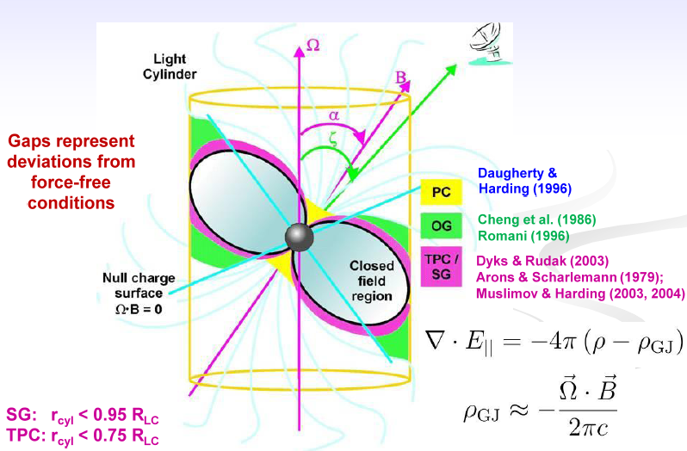
Cartoon of a pulsar

Slide 32
MAGIC discovery of the bridge emission & very narrow pulses
J. Aleksic, et al., arXiv:1402.4219
Fermi bridge emission becomes strong above few GeV
P1: 8σ
P2: 14σ
Bridge: 7σ
Nebula component
bridge
bridge hints on toroidal bending of magnetic lines near LC
This result set a quest for precision Crab pulsar theories

Slide 33
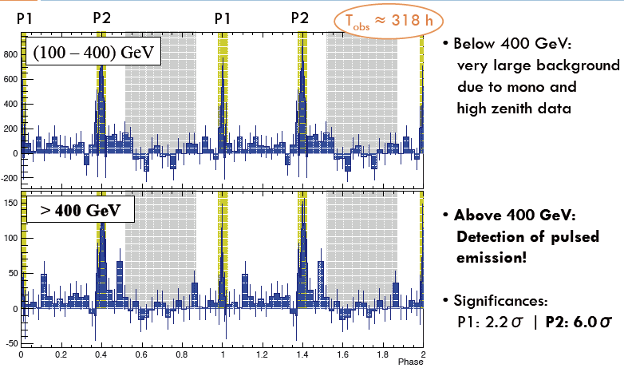
Pulsed emission measured for E ≥ 400 GeV

Slide 34
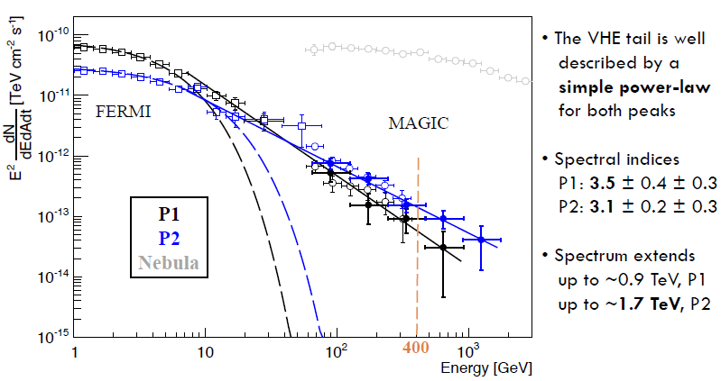
Spectral Energy Distribution

Slide 35
Submitted to SCIENCE magazine on October 30th, 2014; everyday waiting for a (positive) answer !

Slide 36
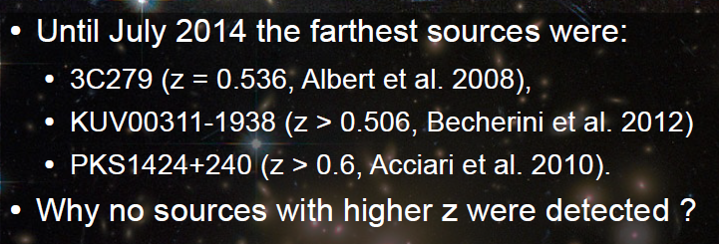
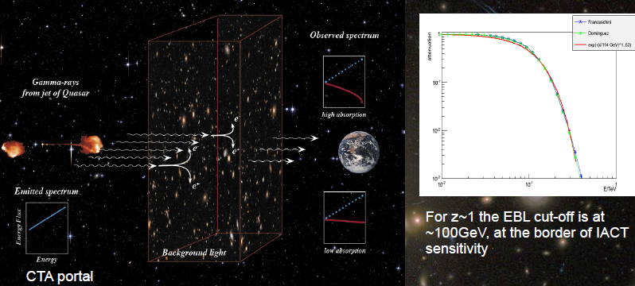
Furthest away sources in VHE: visibility limitation due to absorption on EBL

Slide 37
S3 0218+357

Slide 38
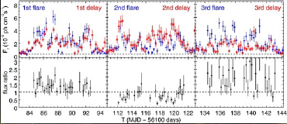
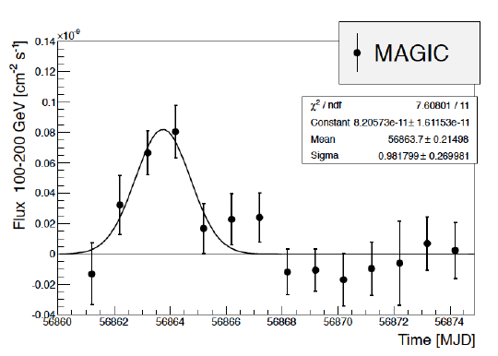
S3 0218+357
In 2012 Fermi observed high state, with many overlapping flares
Fermi claimed 11.46 ± 0.16 days delay for the lensed component
On July 13/14 2014 Fermi again observed a high state
Magic started observing 2 days before the predicted delayed signal and kept on-going till 5th of August

Slide 39
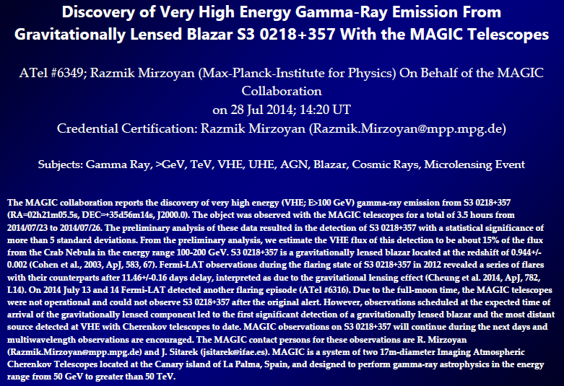

Slide 40
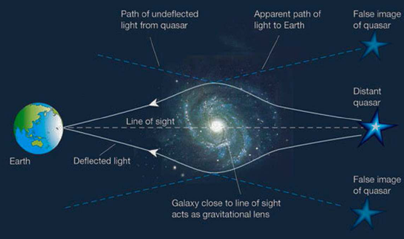
Next highlight result under preparation now
S3 0218 gravitationally lensed source @ the red shift 0.944

Slide 41
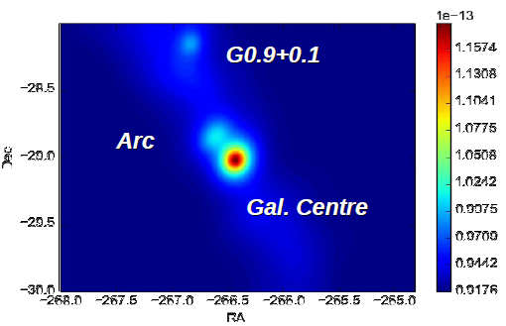
Next possible highlight result under consideration
Diffuse emission from the galactic ridge & arc ?

Slide 42
MAGIC Next Future
Never has been any better than now, keep on-going like this !
MAGIC sensitivity curve touches the 0.5 % Crab units
The topological trigger may help further increasing sensitivity
With the well-tuned Sum-Trigger, we are very competitive, at least for the next ~ 5 years
We plan be exploring the very large zenith angle observation technique (θ ≥ 70°), trying to have a fresh look into the Pevatrons
A model analysis is under development, anticipated to further boost the MAGIC analysis sensitivity
Moving towards 0.04 % Crab !

Slide 43
MAGIC Bright Future
The CTA prototype 23m Ø LST will be hosted by the MAGIC site; good for the LST but also for MAGIC (x2 improvement in sensitivity may be anticipated from common operation)
Political issues on MAGIC-CTA cooperation need to be settled
In future we may iterate on
a) higher QE PMTs of <42> % on average; this has the potential lowering the MAGIC threshold by ~ 30 % (~2100 PMTs, ~450.-k€)
b) novel mirror type, having much reduced specular-diffuse component; this has the potential of reducing dramatically the trigger threshold

