Slide 1
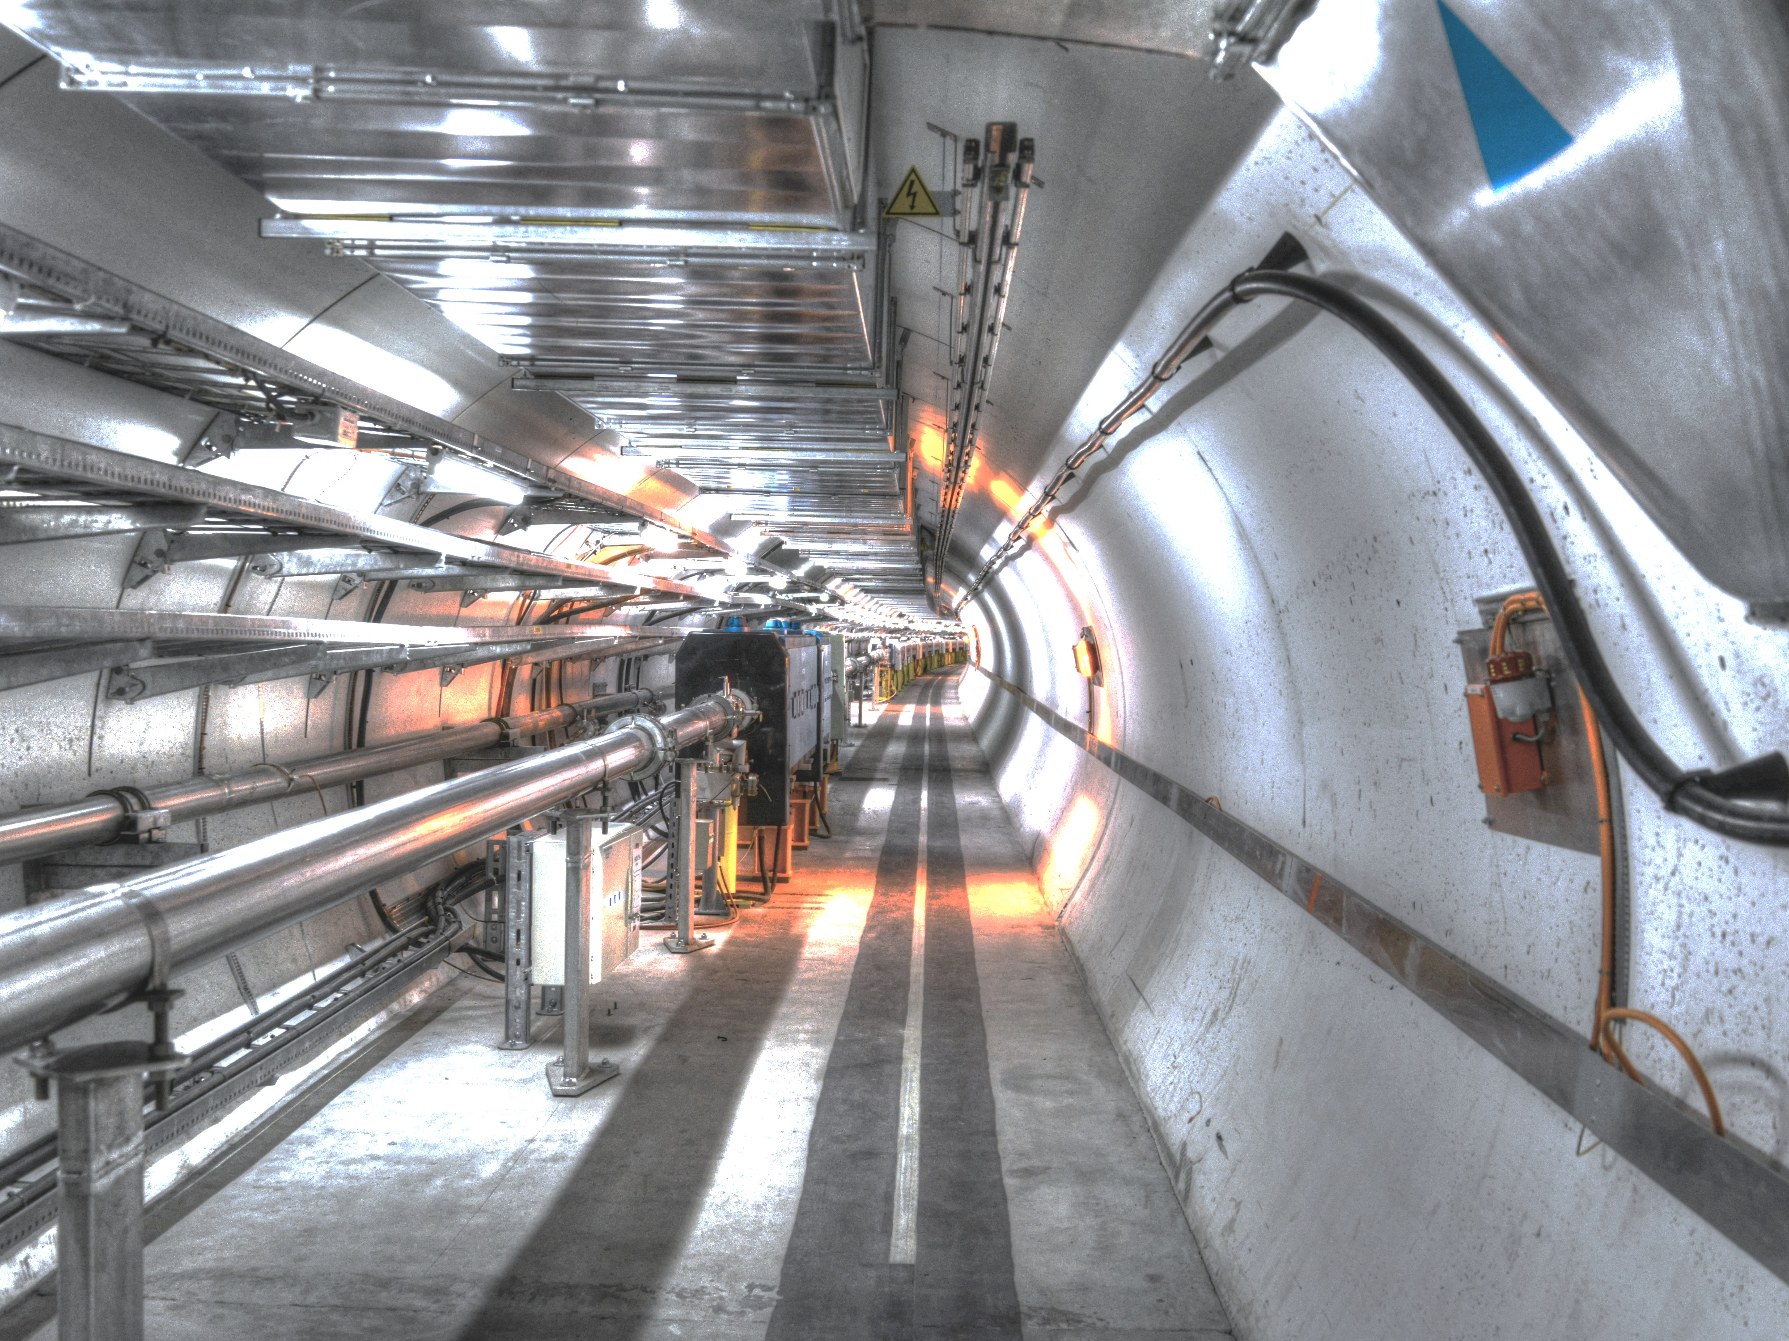
Progress report on p+ driven PWFA experiment @ CERN/SPS (AWAKE)
R.Tarkeshian
for AWAKE Team
Max-Planck Inst für Physik
16.Dec.2014
CERN, AWAKE beamline

Slide 2
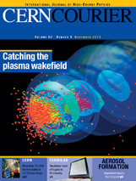
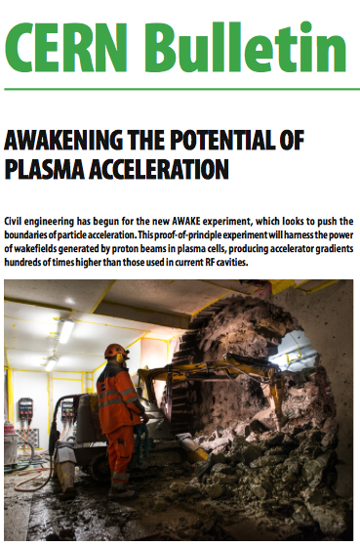
Outline
Motivation
AWAKE at MPP
  Plasma source
  Laser propagation
  SMI-Diagnostics
AWAKE at CERN
  First beam expected in 2016
  First proton-driven plasma wake-field
  experiment worldwide
Civil engineering works are currently ongoing at the AWAKE facility, 2014

Slide 3
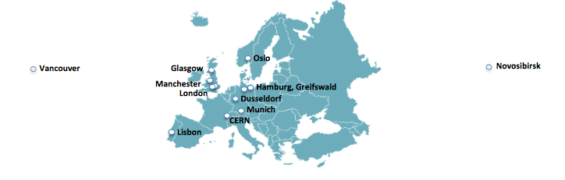
AWAKE collaboration
AWAKE at MPI
Project spoke person: Allen Caldwell
Group leader : Patric Muggli
Scientific Staff: Olaf Reimann
Research fellow: Erdem Oez, Joshua Moody, Roxana Tarkeshian
PhD students: Karl Rieger, Jasmine Israeli, Scott Mandry (UCL)
Master students: Fabian Batsch, Jan Machacek (graduated)
AWAKE collaboration: 14 Institutes world-wide:

Slide 4
Motivation
Limited acceleration field of RF cavities <100MV/m
Several tens of km for future linear collider
Plasma can sustain up to 3 orders of magnitude higher gradient
BNL, 2004, LWFA, GeV electron beam from cm scale plasma
SLAC 2007, Electron energy doubling from 42 GeV to 85 GeV over 0.85 m
staging problem exists to reach 1 TeV energy for LWFA and e-driven PWFA.

Slide 5
Plasma Wakefield Acceleration (PWFA)
Linear PWFA Theory
  Driving force: space charge of driver displaces plasma electrons.
  Restoring force: Plasma ions exert restoring force.
₋
₋
₋
₋
₋
₊
₊
₊
₊
Focusing (E_{r})
Accelerating
Decelerating
₋
₋
₋
₋
₋
-
-
-
-
-
-
-
-
-
-
-
-
-
-
-
-
-
-
-
-
-
-
-
-
-
-
-
-
-
-
-
-
-
-
-
-
-
-
-
-
-
-
-
₊
₊
₊
₊
₊
₊
-
-
-
-
-
₊
₊
₊
-
-
-
₊
₊
-
-
₊
₊
₊
₊
₊
-
-
-
-
-
₊
₊
₊
₊
₊
₊
-
₊
₊
₊
-
-
-
-
-
-
₊
₊
₊
₊
₊
-
-
-
-
-
-
₊
-
-
₊
-
₊
₊
-
-
-
-
-
₊
₊
₊
₊
₊
₊
₊
₊
₊
₊
₊
-
₊
₊
₊
₊
₊
₊
₊
₊
₊
₊
₊
₊
₊
₊
₊
₊
-
-
-
-
-
-
-
-
₊
₊
₊
₊
₊
-
-
-
-
₊
₊
₊
₊
₊
-
Direction of Travel (z)
-
-
-
-
-
-
-
-
-
-
-
-
-
-
-
-
-
-
-
-
-
-
-
-
-
-
-
-
-
-
-
-
-
-
-
-
Witness pulse
Drive pulse
E_{z}: accelerating field,
N: # e⁻/bunch
σ_{z}: gaussian bunch length,
Notes:
A single bunch from the linac drives a large amplitude plasma wave which focus and accelerates particles
For a single bunch the plasma works as an energy transformer and transfers energy from the head to the tail
In some respects the process of an electron gaining energy from a plasma wake is similar to surfing down an ocean wave. The short laser pulse shooting through the plasma disturbs the plasma electrons and sets up a wake that looks like a wave as I have already mentioned. This wake can be thought of as a periodic variation of plasma electron density.In this figure the red regions are where the electron density has increased above it’s background value and the blue regions are where the density is lower than the background value. Furthermore because the laser pulse that produced this disturbance is moving through the plasma at close to light speed the wake structure also moves at this speed.
This wave can be thought of as a series of microscopic capacitors.Near the crest of the wake there is an excess of electrons and therefore we can think of this as the negative plate.Near the trough of the wake there is a deficit of electrons which means an excess of ions.So this is the positive plate of the capacitor.The electric field in a parallel plate capacitor points from the positive plate to the negative plate.Now if one were to place a free electron near the crest of the wave it would be accelerated by this electric field .Th do this the electron has to somehow be preaccelerated to the speed of the wave in analogy with the surfer trying to catch the ocean wave.Of course the acceleration will stop once the electron reaches the trough.But because the wave is moving near c and so is the particle,it takes a long time for the electron to outrun the wave. The increase in electron energy is due to an increase in it’s mass according to the special theory of relativity.
The advantage of using a plasma is that the accelerating field can be a thousand times larger than that in a conventional accelerator bur the downside is that the whole plasma structure is microscopically small ephemeral.The typical size of the structure is 0.1mm and it lasts just a trillionth of a second.It is for this reason that many prominent scientists remained skeptical that this method of accelerating particles could ever be made to work.

Slide 6
Motivation
Why protons?
There are proton bunches available at CERN with TeV energy scale:
existing proton at CERN with TeV scale energy per particle.
  LHC p+ bunch ( 7 TeV, 1.2*10¹¹p⁺) carries 130kJ energy
  SPS p+ bunch ( 0.4 TeV, 1.2*10¹¹p⁺) carries 19kJ energy
  Using LHC beam as driver it is possible to obtain TeV-level in a single stage.

Slide 7
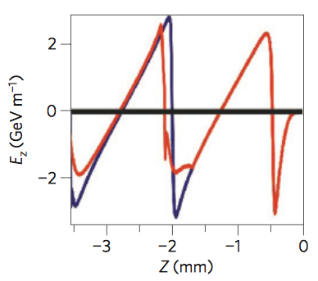
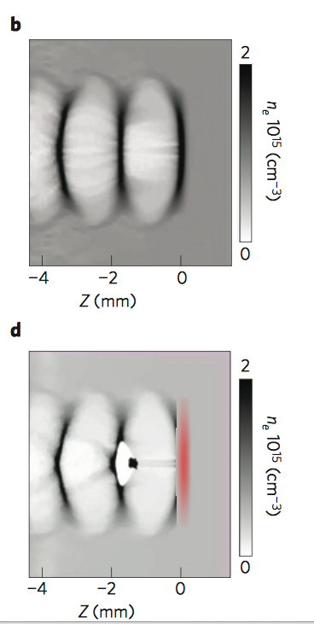
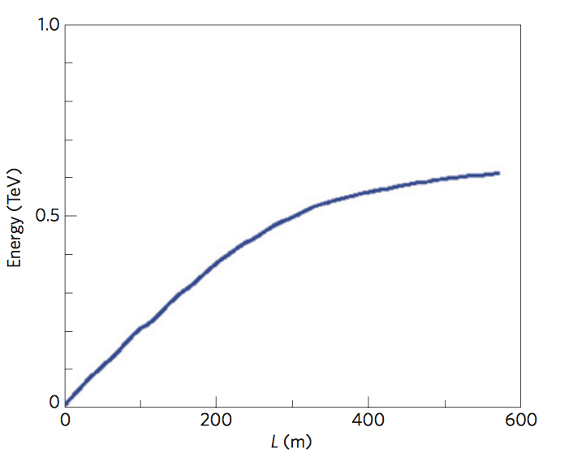
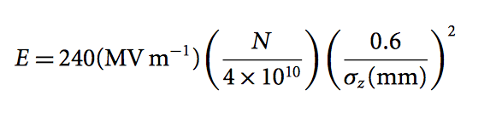
Motivation : Proton driven PWFA
Caldwell, Nature. Phys. 5, 363, (2009)
￼
Simulation results for field strength and electron density
E_{z ,} GeV
unloaded vs loaded
p+ bunch driver 1TeV, σ_{z}≈100µm
witness e⁻
drive p⁺
￼
Witness e⁻ bunch
0.6 TeV/ 500m
Challenge: LHC bunch is 12cm and σ_{z} ≈ 100µm does not exist!

Slide 8
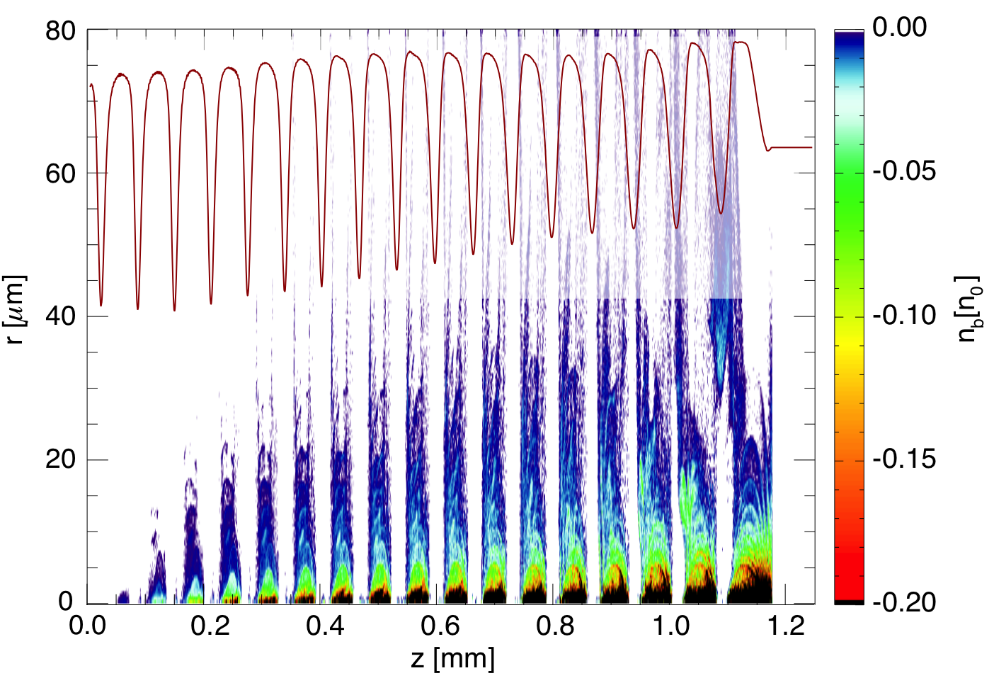

Motivation : Self-modulation instability
N. Kumar et al., Phys. Rev. Letters (2010)
Using plasma-beam instability for self-modulation of the beam!
z= 5cm, e⁻
z=0, e⁻
F
D
D
A
→ design an experiment …

Slide 9
AWAKE experimental layout : I
Phase I
plasma
gas
Laser
proton bunch
laser pulse
Ionizing
Laser
Pulse
Final
Focus
Plasma
p⁺ dump
Laser dump
Diagnostics
OTR/CTR
Diagnostics
p⁺ from SPS
SMI
SPS proton bunch experiences Self-Modulation Instability (SMI) in the plasma.
Laser ionizes the plasma and seeds the SMI in a controlled way.
10 m long plasma cell: Rubidium vapor source, ne = 7x10¹⁴cm⁻³.

Slide 10
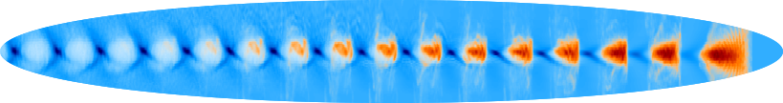
AWAKE experimental layout :II
Phase II
Plasma
gas
e⁻
p⁺ from SPS
Laser
RF gun
Laser
e⁻ spectrometer
Ionizing
Laser
Pulse
e⁻
Final
Focus
Plasma
p⁺ dump
Laser dump
Diagnostics
OTR/CTR
Diagnostics
p⁺ from SPS
SMI
Acceleration
Probe the accelerating wakefields with externally injected electrons, including energy spectrum measurements for different injection and plasma parameters.
Synchronization between laser and electron is in ps level.

Slide 11
AWAKE at MPP

Slide 12

Metal-vapor Plasma Source Development
E. Öz, P. Muggli,J. Moody,F. Batsch
Self modulation introduces a strict and CHALLENGING requirement on plasma uniformity for injected electrons to stay in accelerating focusing phase, namely the uniformity must be better than 0.2 %.
Field ionized rubidium vapor cell with custom oil heating and custom fast valves satisfies this condition
Rb ((4.177 eV) is chosen because:
The required laser intensity for tunnel ionization is low, I_{threshol}=1.7x10¹² Wcm⁻²
The required temperature for reaching optimum plasma density is also low, T=200 ºC
Field ionization is a threshold process therefore
Plasma density = Vapor Density (n)
FIELD-IONIZING
LASER
Rb vapor density as a function of temperature of cell

Slide 13
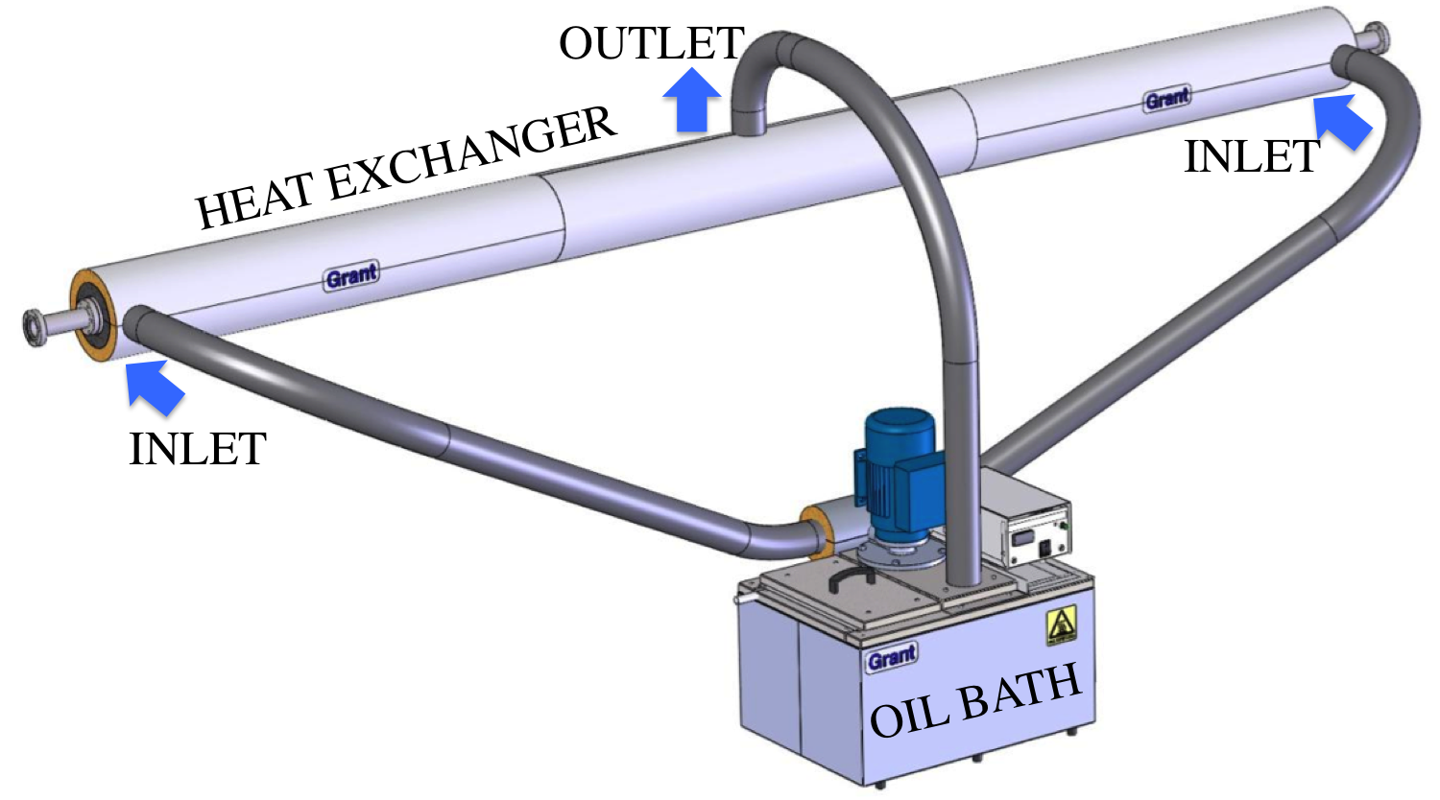
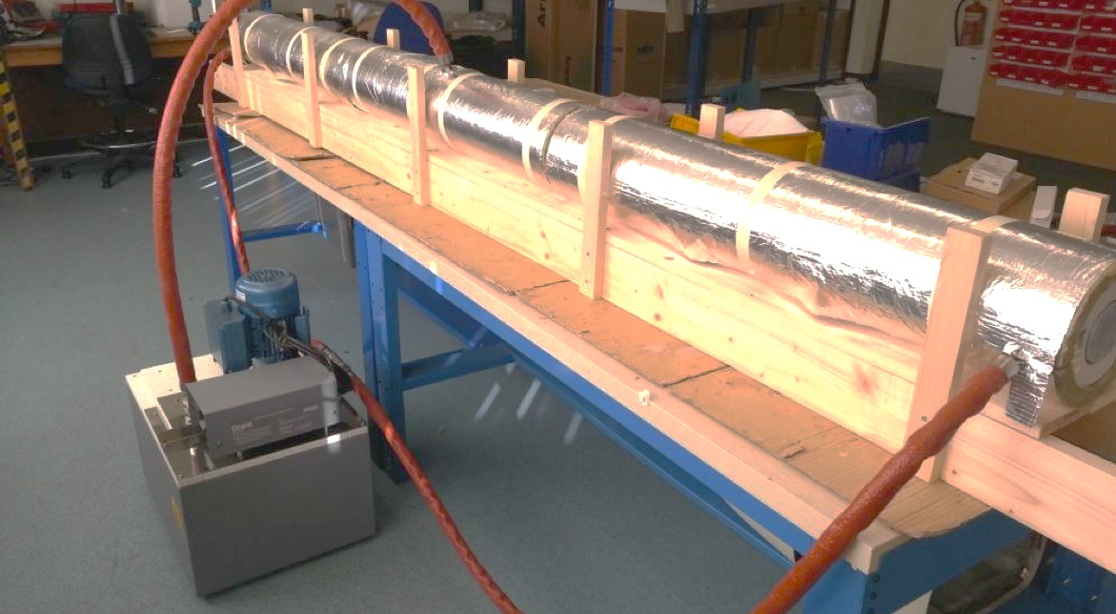
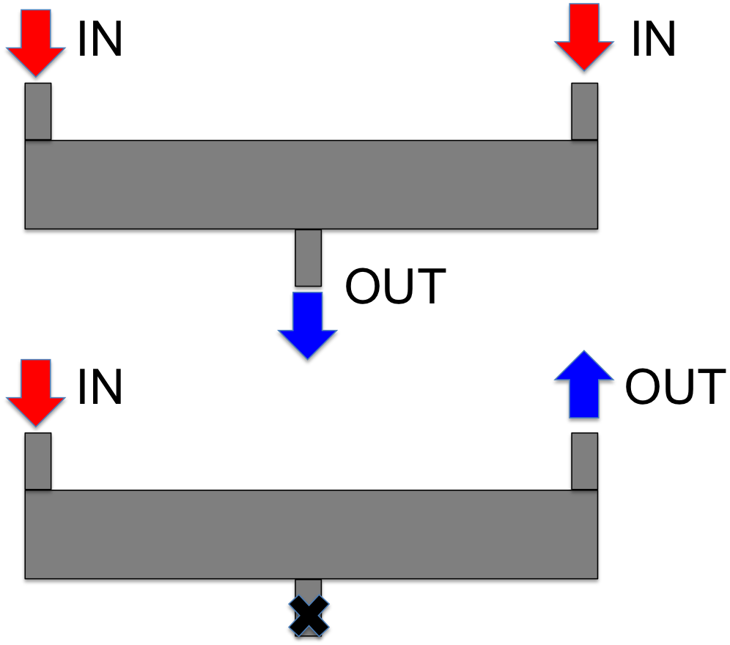

Uniform Density ~ uniform heating
E. Öz, EPS 2014
3 m Prototype Oil Heater built to test the Temperature Uniformity by GRANT INSTRUMENTS of UK
We measured the temperature profile at MPP
How does it perform?
No gradient is measured within accuracy!

Slide 14
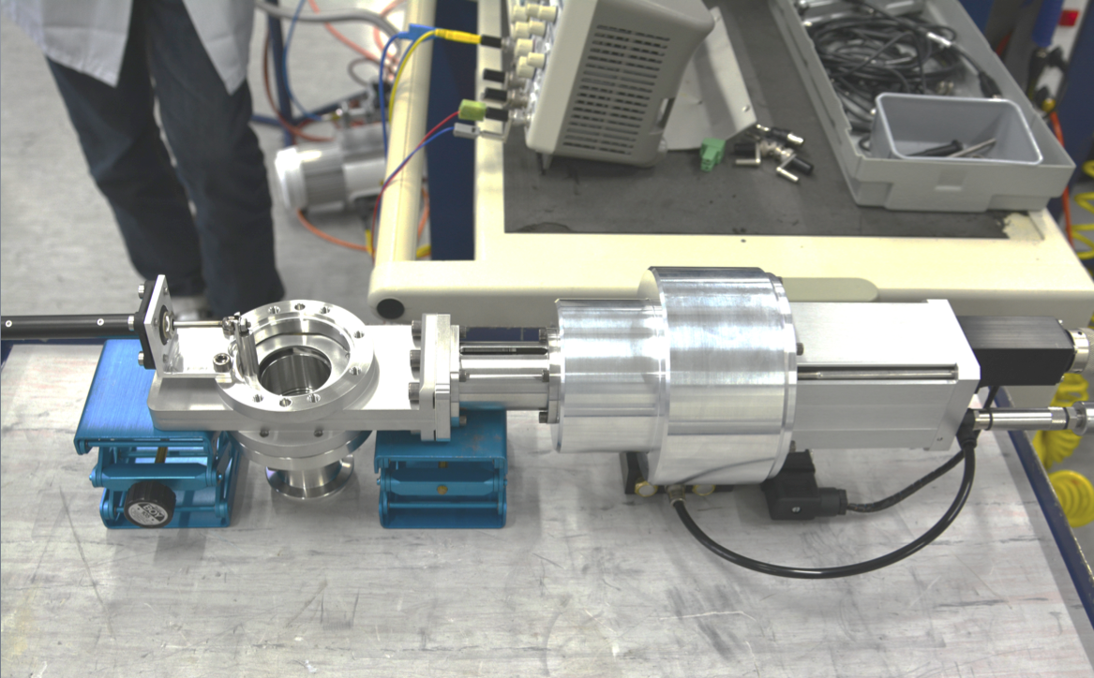
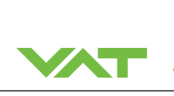
Custom built fast valves provide access to beams
Custom built ultra fast valves developed by VAT and recently delivered to CERN for test
Fast valves minimize density disturbance
FAST VALVE SPECIFICATIONS
Opening Time | ~10 ms
Closing Time | <1 s
Environment | Rubidium, radiation resistant
Temperature | 180 - 220 ºC
Aperture Size (D) | 4 cm
Number of Cycles | 43200

Slide 15
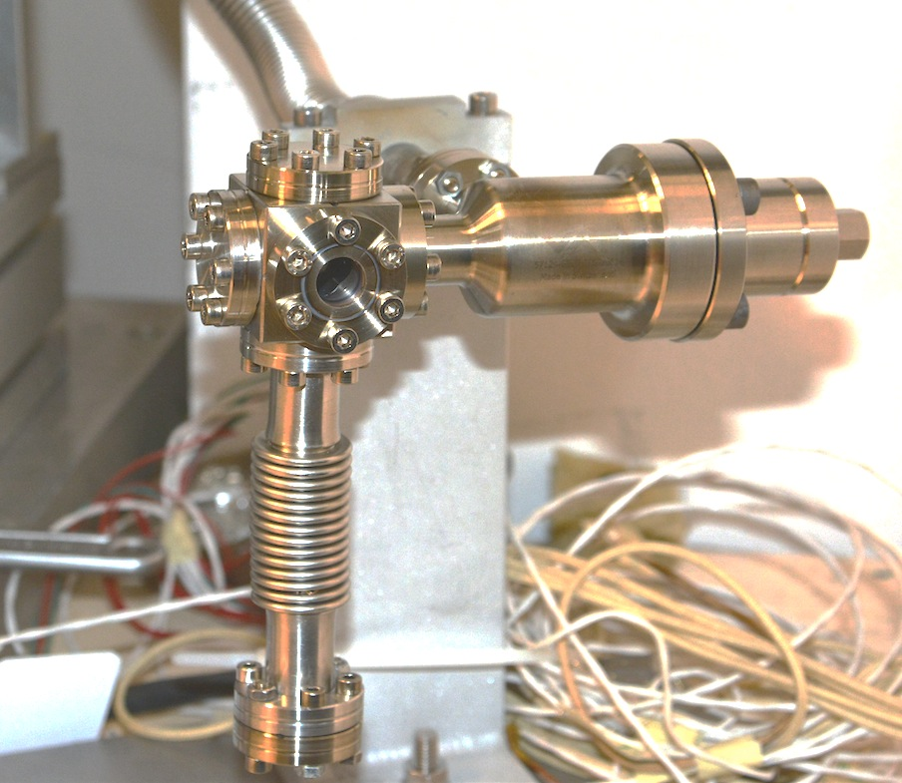
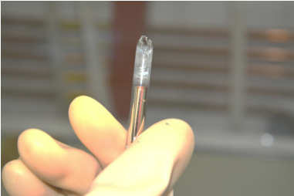
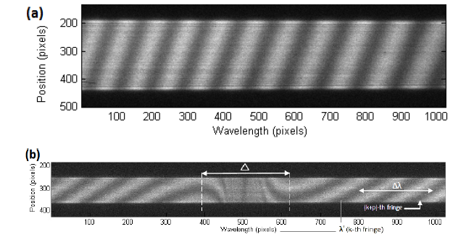
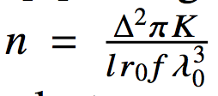
Hook interferometry
E. Oez, F. Batsch
Photo of the test Rb reservoir
  “Hook Method” white light
  interferometry measurement, gives
  density within 20%
Compensating windows
Plane mirror
Sapphire windows
Rb Cell
Beam splitter
Convex lens
CCD &
Spectrograph
Translation stage
Aperture
Halogen lamp
Photo of 1 g break-glass Rb
Spectrograph Image

Slide 16
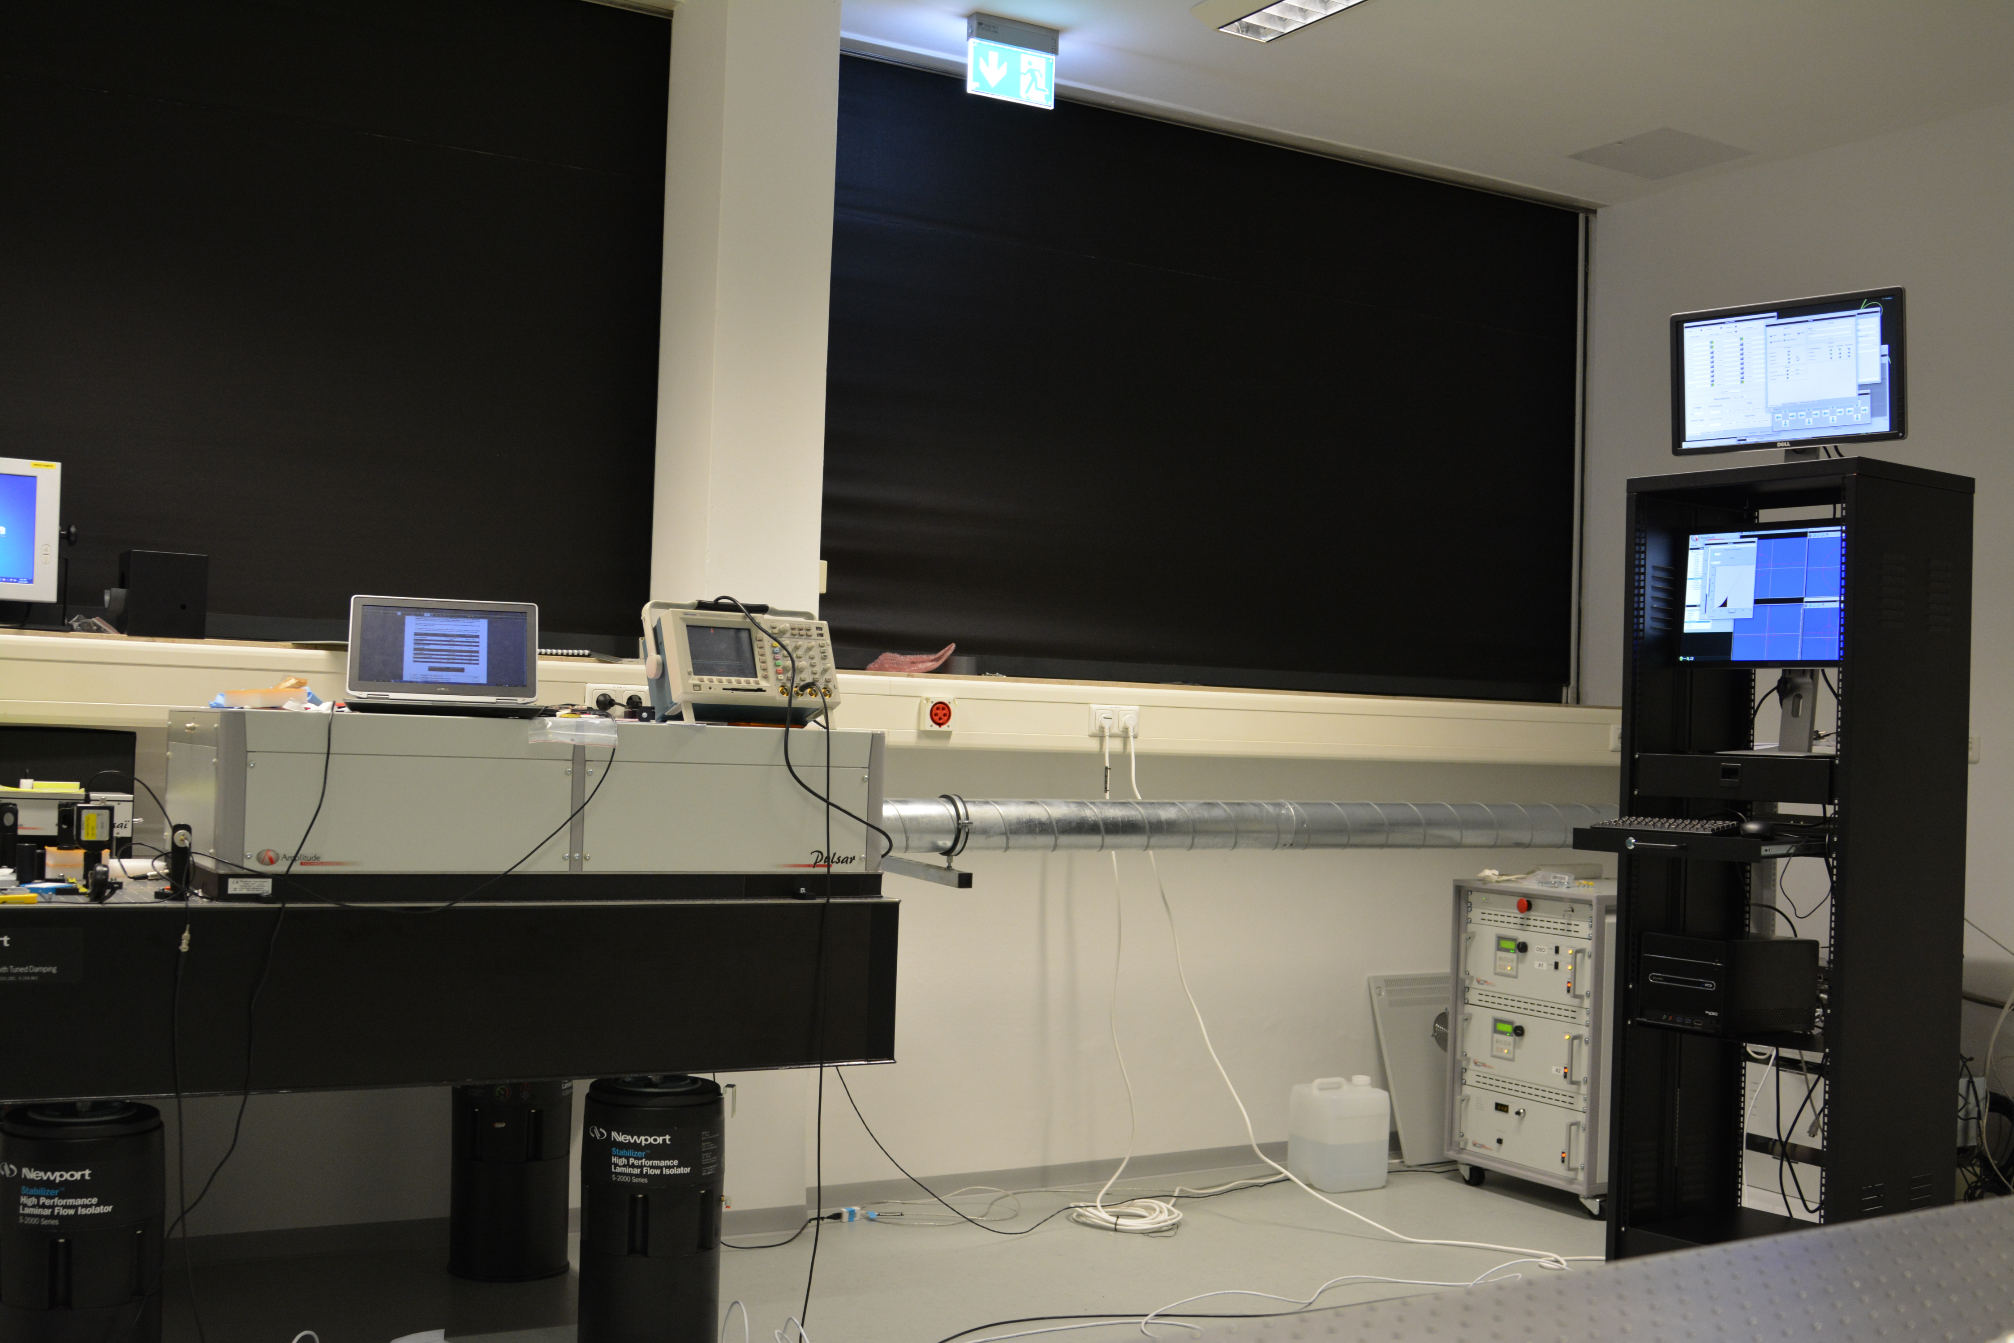
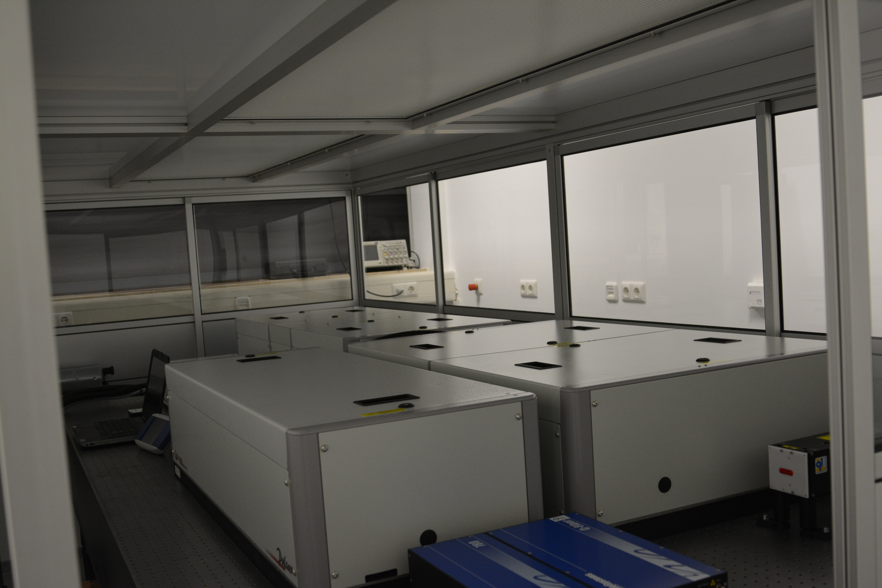
Laser room @ MPP
TW Laser system installation took place in October 2014
Since then the laser has been used to investigate
  propagation through rubidium cell
  to study ionization effects through heat pipe oven in first half of 2015
Laser will move to CERN in ~July 2015 to take part in AWAKE experiment
t =100 fs
rr=10 Hz
E=250 mJ (48% att)
λ =780 nm

Slide 17
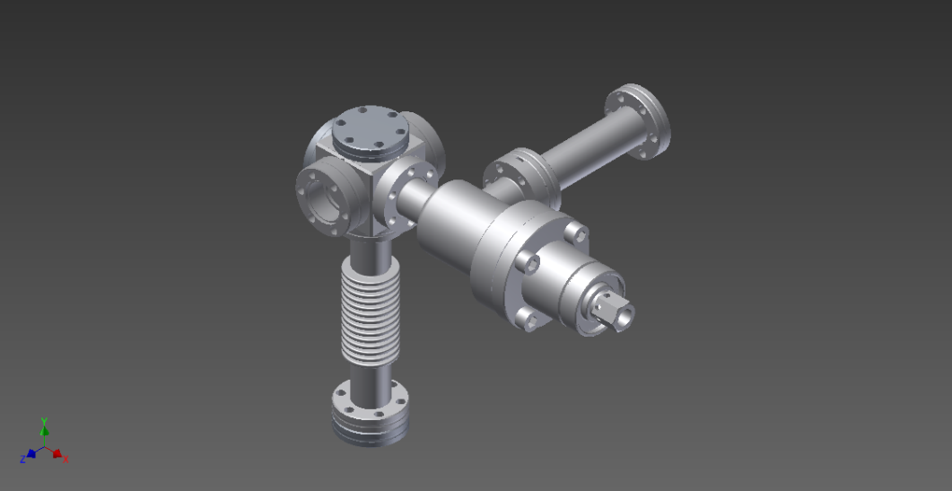
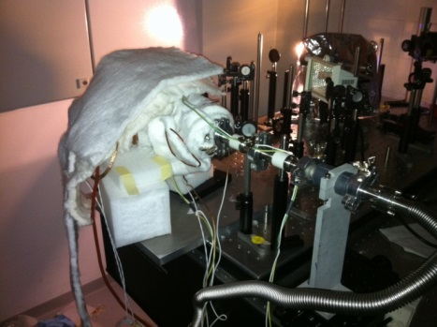
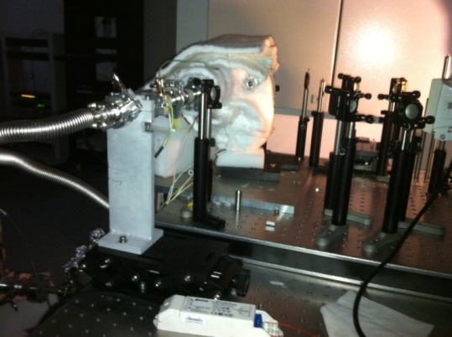
laser study: Phase I
Preliminary result 3.5 cm test Rubidium reservoir
Laser through here
To Pump
n<<10¹³cm⁻³
L = 3.5 cm
Valve
Rb piece
Cell at 200C
n~10¹⁵cm⁻³

Slide 18
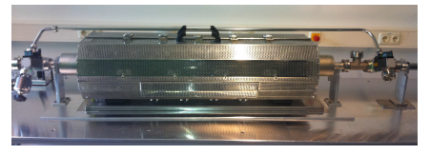
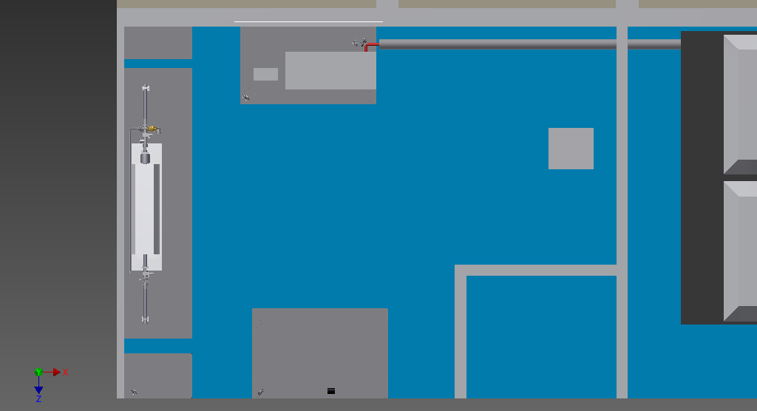
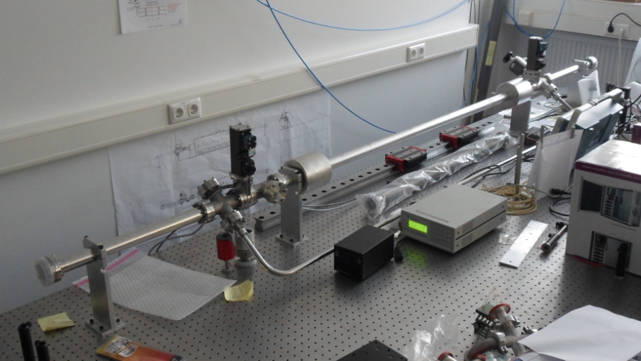
Laser study : Phase II
laser plasma ionization experiments
Because of space limitation experiment will be done in (1.4 m Heat-pipe oven) , built 2 years ago at MPP
Uses buffer gas to confine Rb vapor
Heat Pipe Oven
window
Laser Compressor
Heat Pipe Oven
End Diagnostics
window
top view laser+plasma room

Slide 19
SMI - Diagnostics
Proton bunch self-Modulation measurement
Clear understanding of the temporal and spatial modulation of the proton driver bunch after propagation through the plasma:
challenges :
single shot (possible large time jitter & shot-to-shot variation of bunch)
  high frequency (~ 237 GHz)
  broadband (500 GHz) detection scheme
  measurement window (1/4σ_{p} ~ 100 ps)
p⁺
σ_{p} ~ 400 ps
Foil
Transition radiation (TR)
Coherent TR ~ (λ_{p} < σ_{p})
Transverse CTR
Incoherent TR ~ (λ_{p} < σ_{p})
4 ps
λ_{p} = 1.3 mm ~ 4 ps @ n_{e}= 7 *10 ¹⁴ cm⁻³
f_{p} = 237.5 GHz

Slide 20

OTR measurement and streak camera
Optical Transition Radiation using streak camera?
  radial p⁺ bunch modulation (0.2 mm -1 mm)
  constant current per cross-section of the bunch
  selecting and imaging the right part of the radiation pattern
  dynamic range/resolution of streak camera
  space charge effect due to long bunch (σ :400 ps)
OTR
Filter
Lens
e.g.
fiber based
transport
Hamamatsu
Streak Unit
CCD

Slide 21
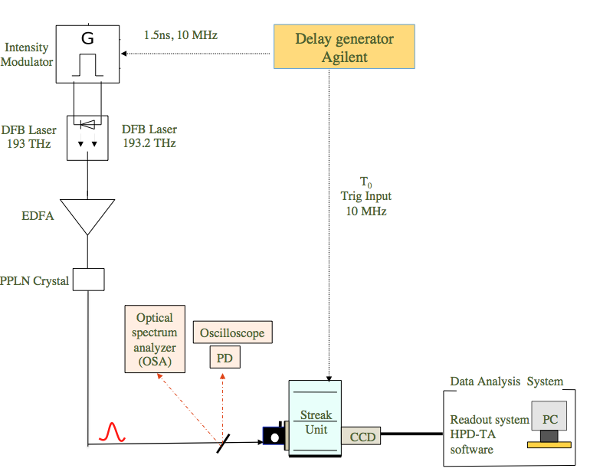
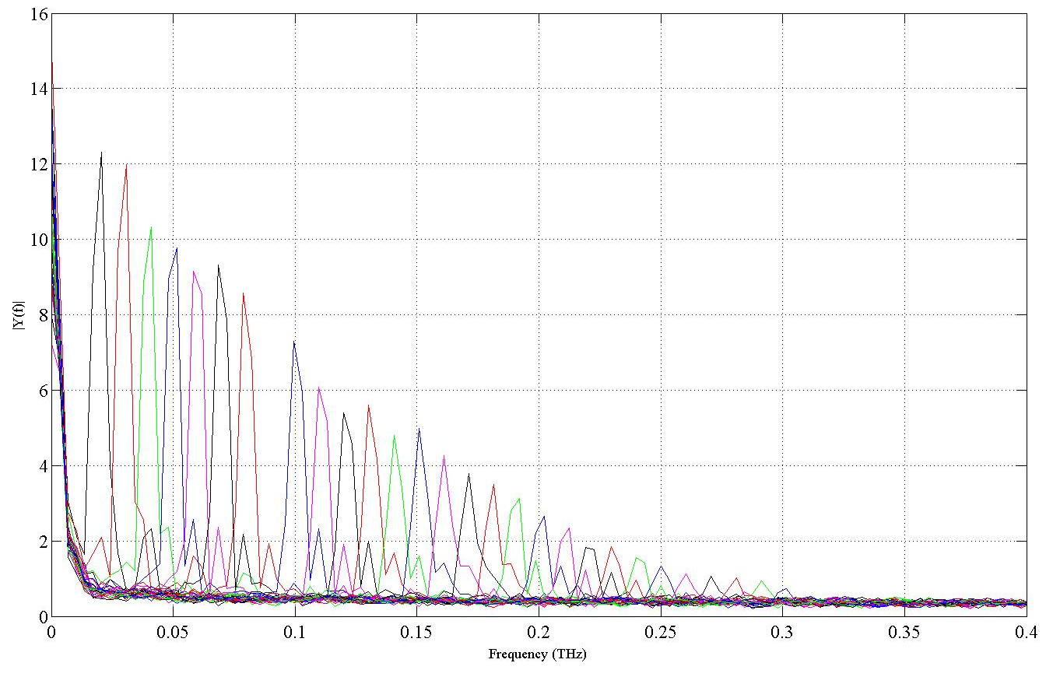
Streak camera test
First tests (average over 10 pulses ) with 2ps resolution streak camera
(OPTRONIS)
Decreasing measured amplitude at higher frequency due to space-charge effect?!
Single shot measurement at frequency of 250 GHz under good conditions maybe possible! ☺
Master thesis, K.Rieger

Slide 22
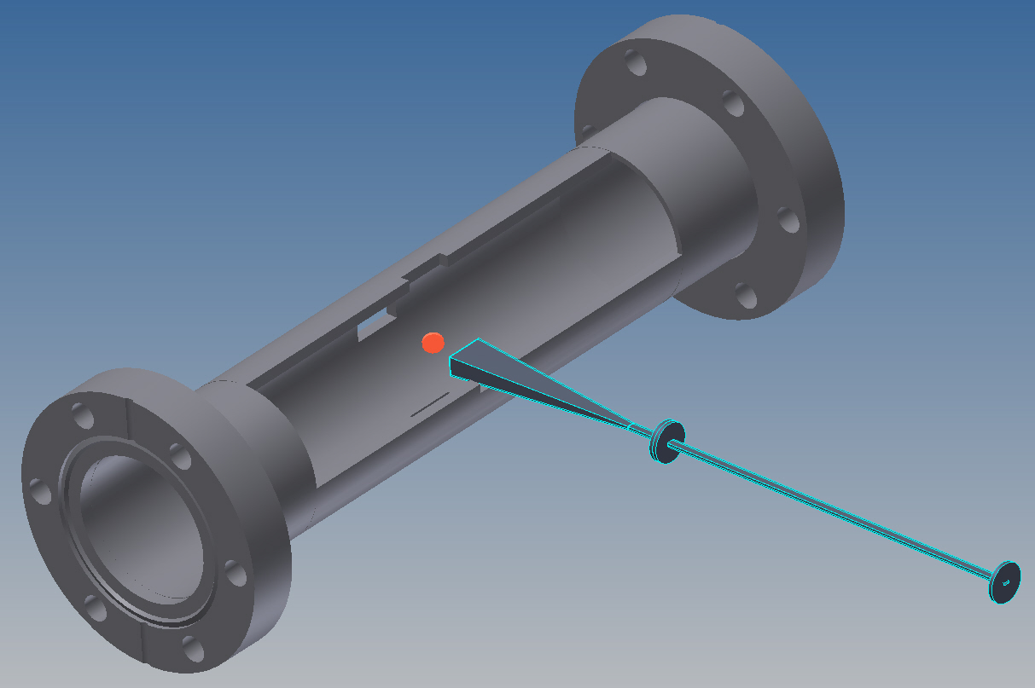
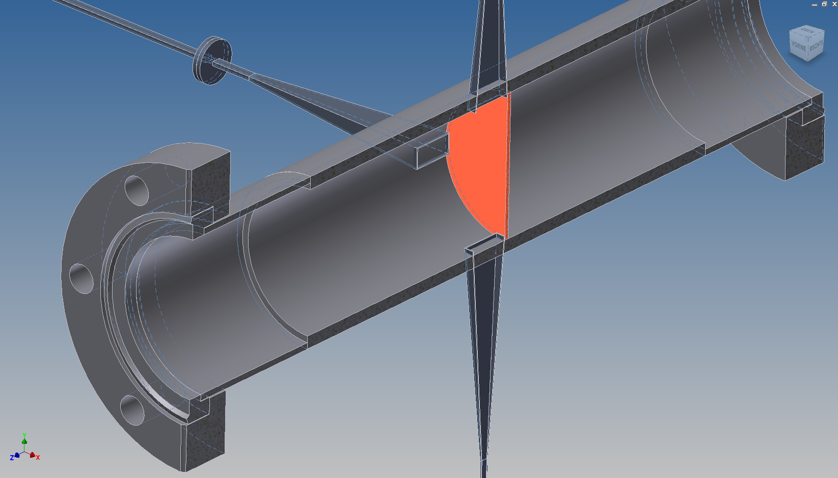
CTR-TCTR Modules
Modules under study and construction
Waveguide-Horn integrated modules to filter out unwanted low frequency signals and also retain far-field estimation.
CTR module
TCTR module

Slide 23
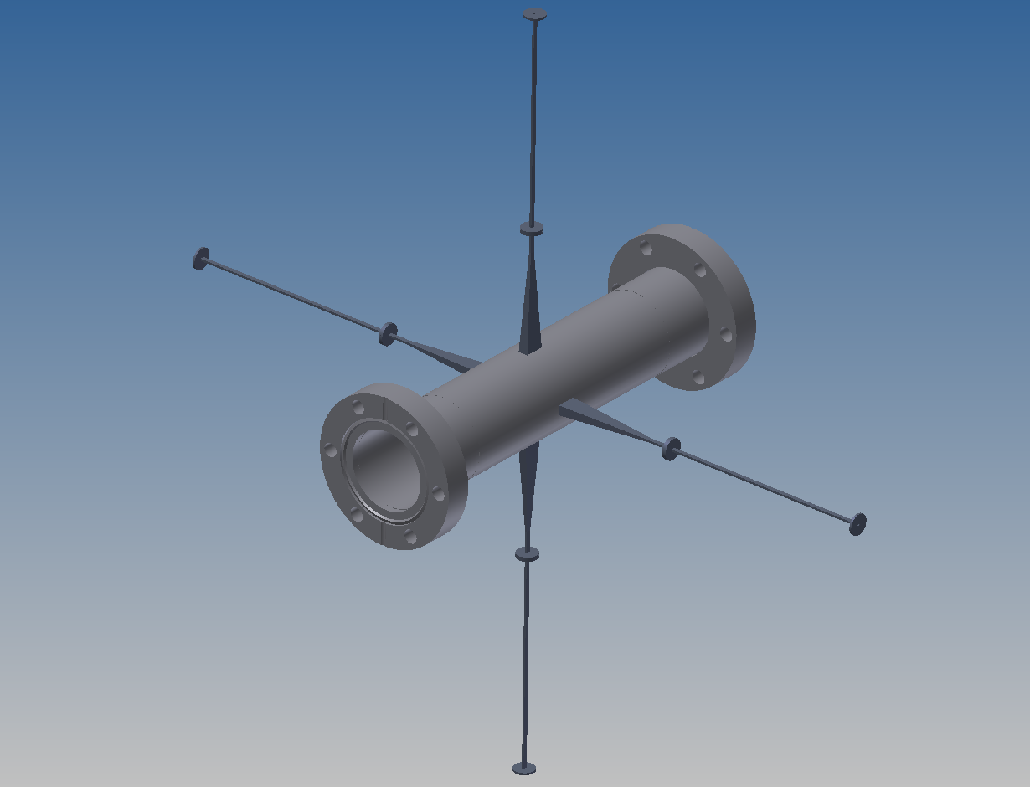
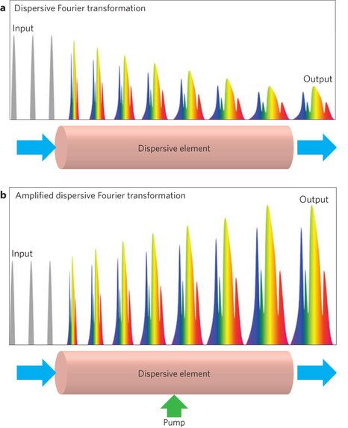
DFT-EOS
Dispersive Fourier Transform (DFT) method
Fast, continuous, Single shot electro optic sampling (EOS) setup using DFT with resolution< 5 GHz in frequency domain. The whole system is fiber based and can be placed as far as is safe from the beamline. (Orange box)
Crystal
beamline
Measurement DFT method
spectrum analyzer
Nature, 2013, Jalali et al
Notes:
using chromatic dispersion
DFT maps the temporal frequency spectrum of a pulse to a temporal waveform whose intensity envelope mimics the spectrum.
This occurs when the pulse propagates inside a dispersive medium with group-velocity dispersion (GVD).
For this to occur, the pulse must propagate sufficiently to satisfy the temporal equivalent of the far-field condition in diffraction.
The temporal waveform is stretched in time (bandwidth compressed) so that it is slow enough to be captured by a photodetector and real-time digitizer. Simultaneously, the waveform can be optically amplified to overcome the thermal noise floor of the high-speed photodiode. Because the time-stretched waveform is sufficiently slow, DFT allows the optical spectrum to be measured directly in the time domain

Slide 24

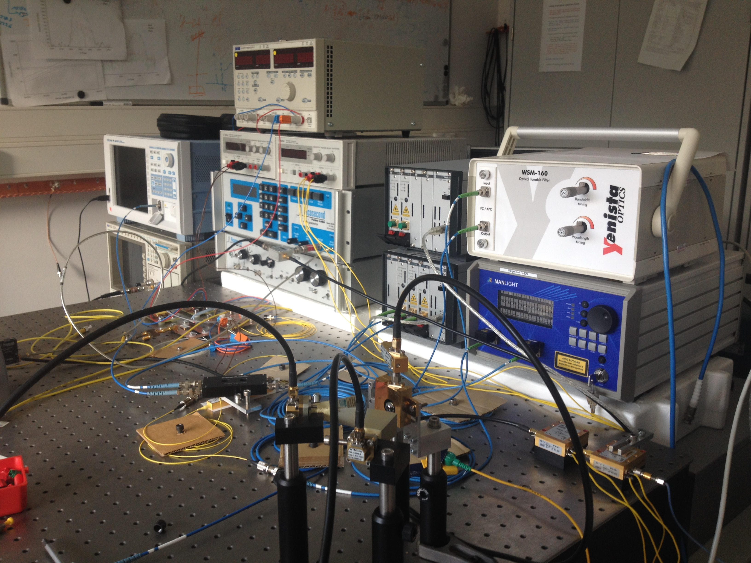
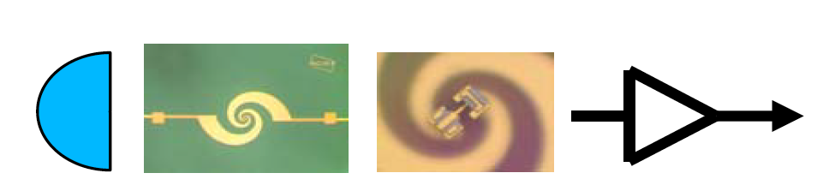
Direct measurement system
Ultra-wide band THz detection based on zero-biased Schottky detector
Laboratory based high frequency generation :
RF generator : 22 GHz
Photo mixing setup : <450 GHz
p⁺
237.5 GHz
Laser 193.2 THz
Bandpass filter
Si-Lens
Antenna
zero-bias
Diode
(0.001- 2 THz)
Pre amplifier
Real-time
Oscilloscope

Slide 25
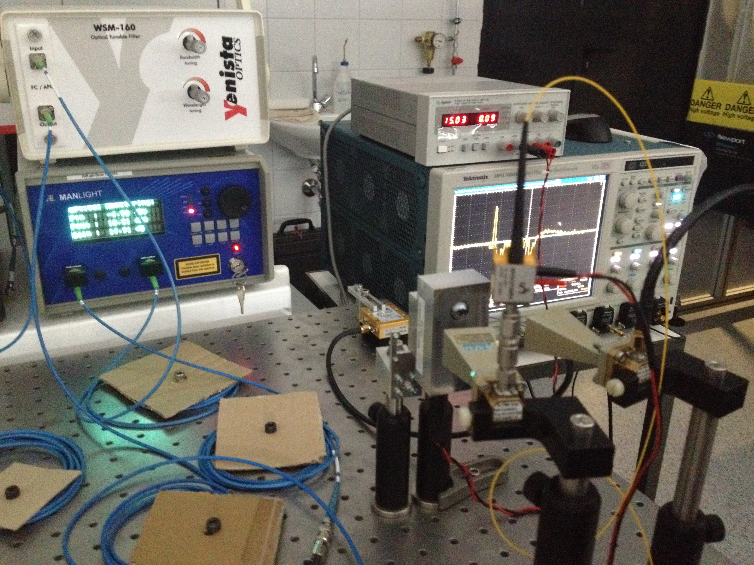
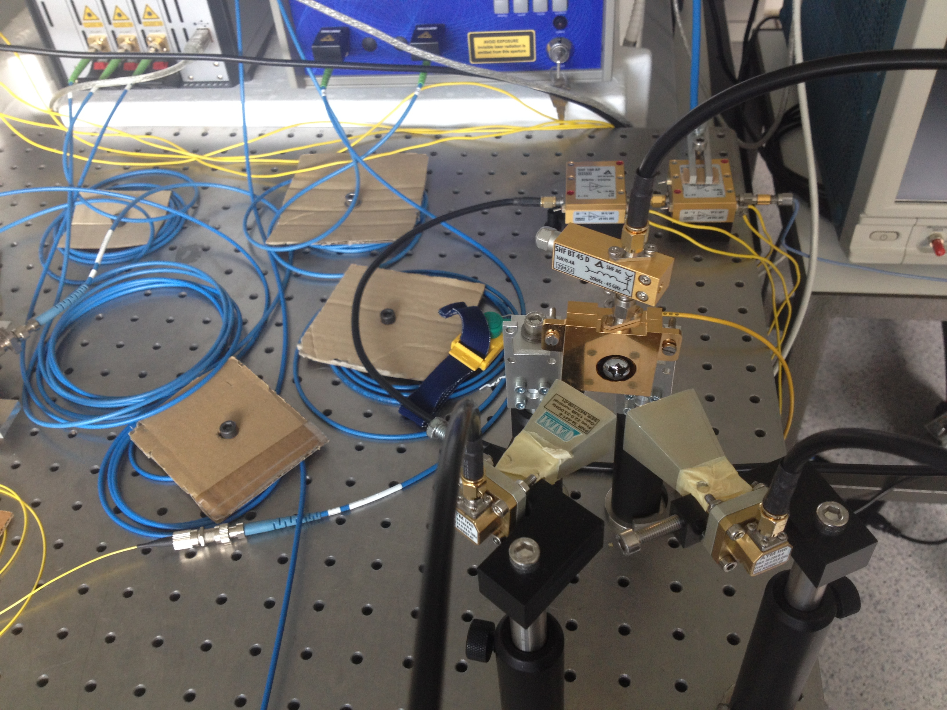
Heterodyne measurement
Layout of the experimental apparatus
p⁺
235 GHz
Horn Antenna
+
Waveguide
~
Real time
oscilloscope
Amp
25 GHz
Filter
Mixer
Oscillator
e.x: 210 GHz

Slide 26
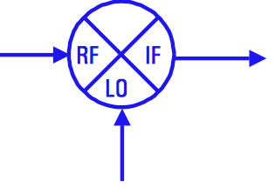
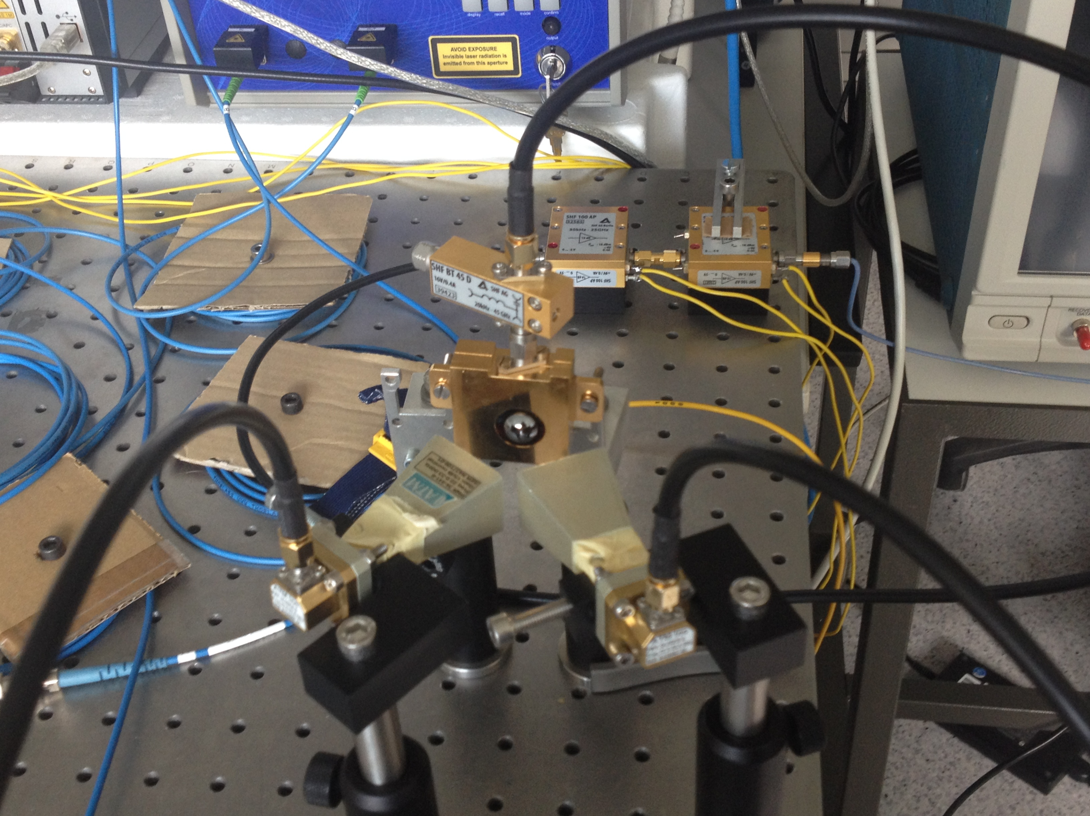
Heterodyne results
RF/Sub THz signal : 26 GHz (Photo-mixing)
LO : 22 GHz (RF generator)
IF : 4 GHz ☺

Slide 27
AWAKE at CERN

Slide 28
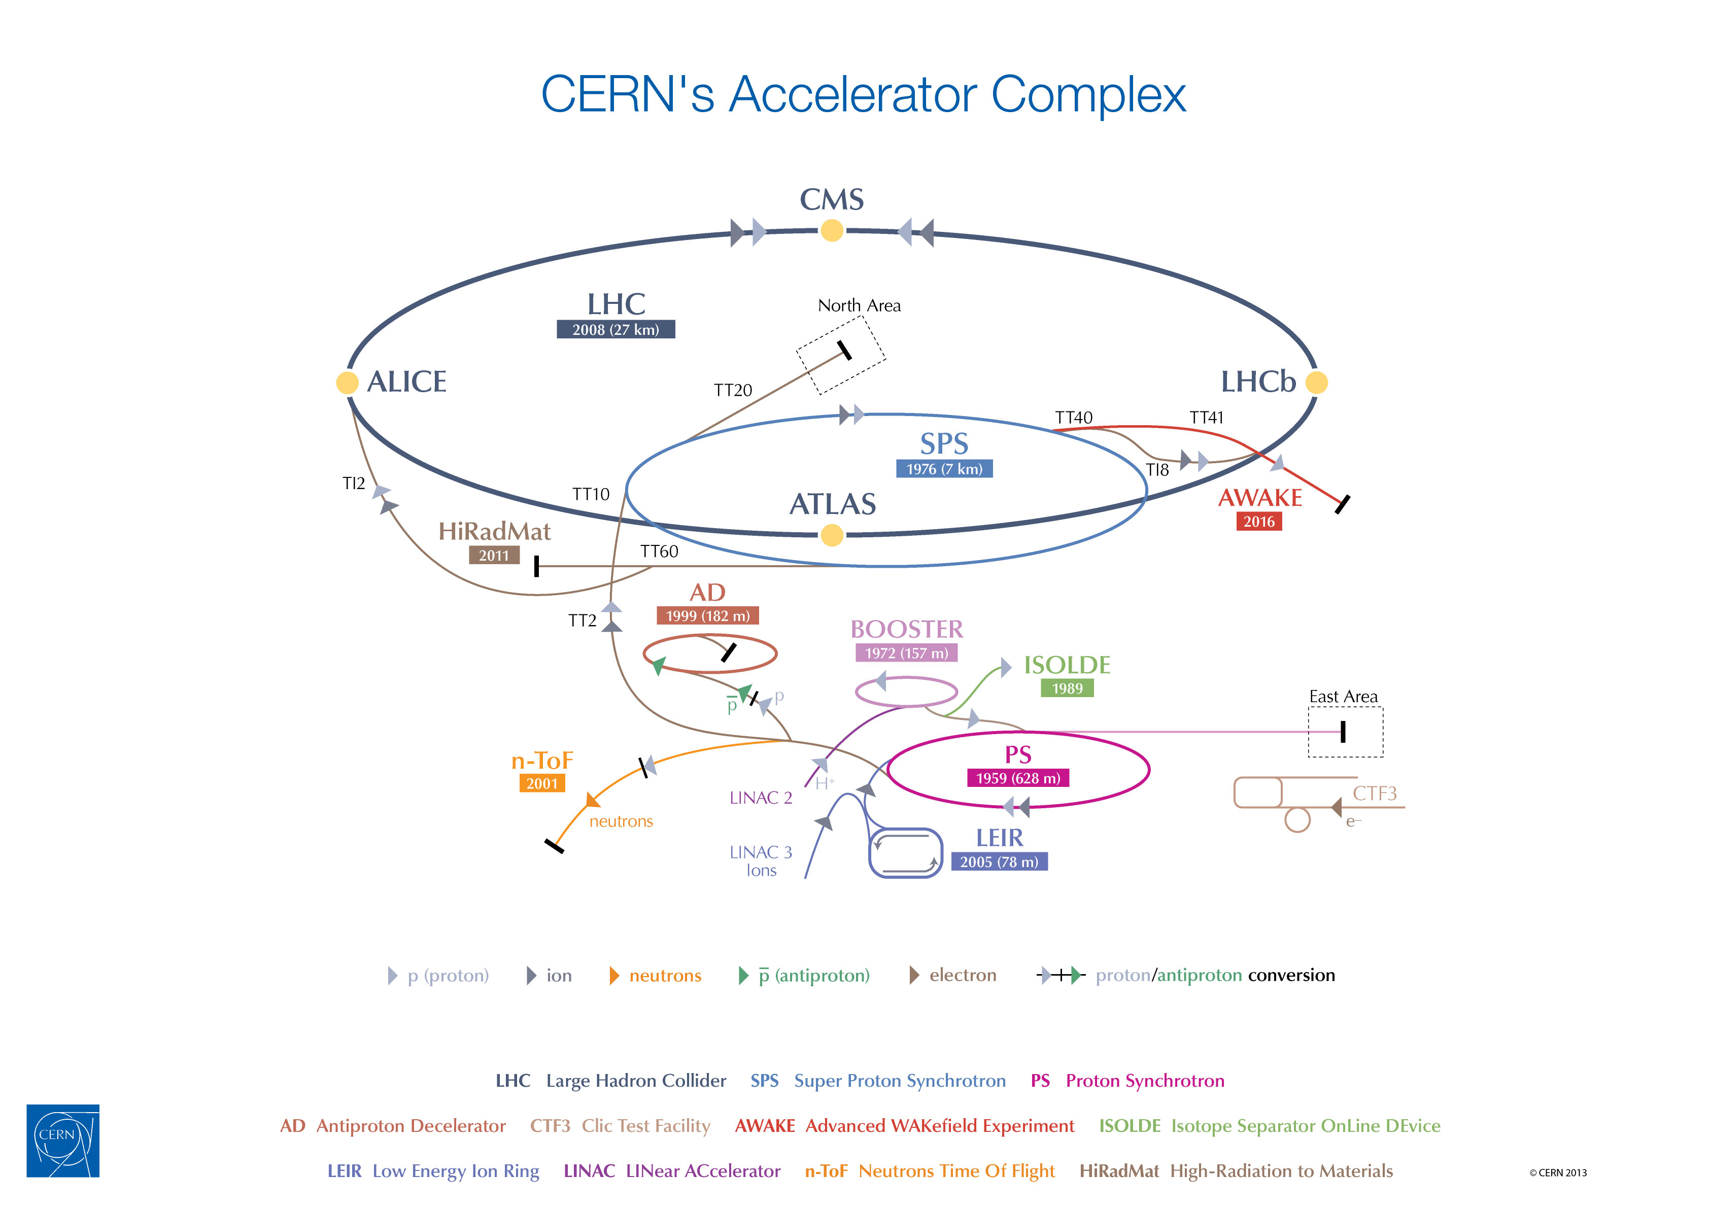
Proton beams at CERN
SPS beam : high energy, available for proof of principle experiment.
Parameter | SPS
E₀ (GeV) | 400
N_{p} (10¹⁰) | 10.5
∆E/E₀ (%) | 0.03
σ_{z} (cm) | 12
ε_{N} (mm-mrad) | 3.6
σ_{r}* (µm) | 200
β* (m) | 5

Slide 29
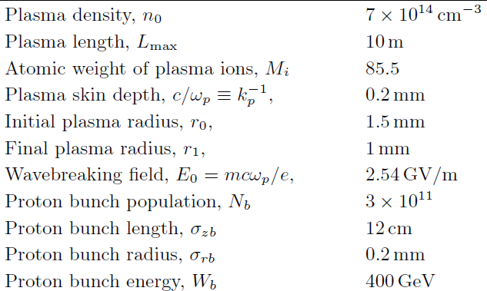
AWAKE experiment at CERN

Slide 30
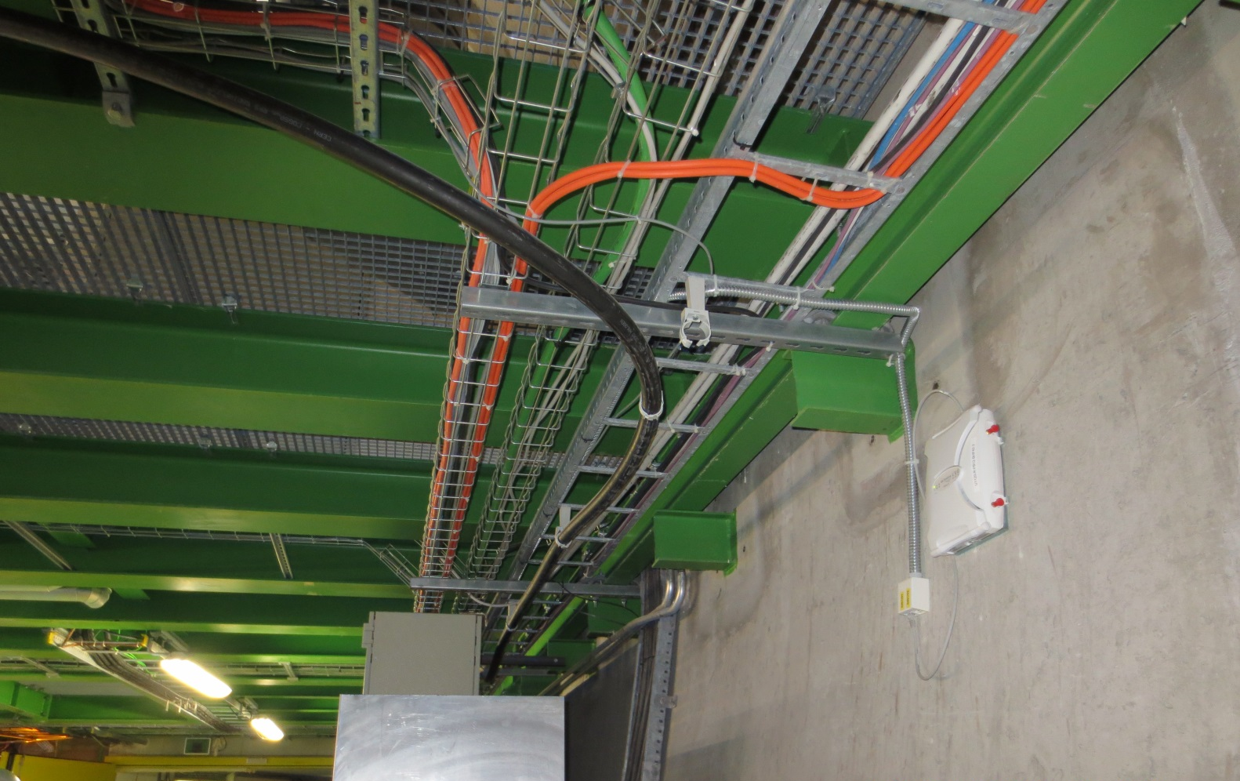
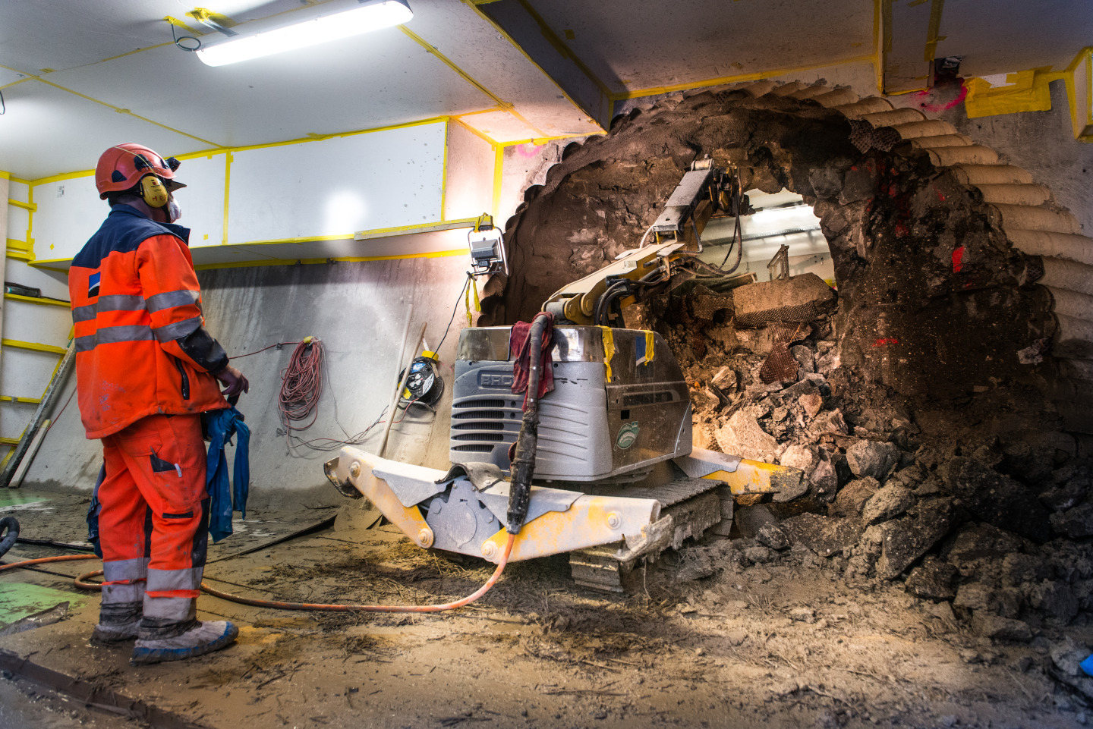
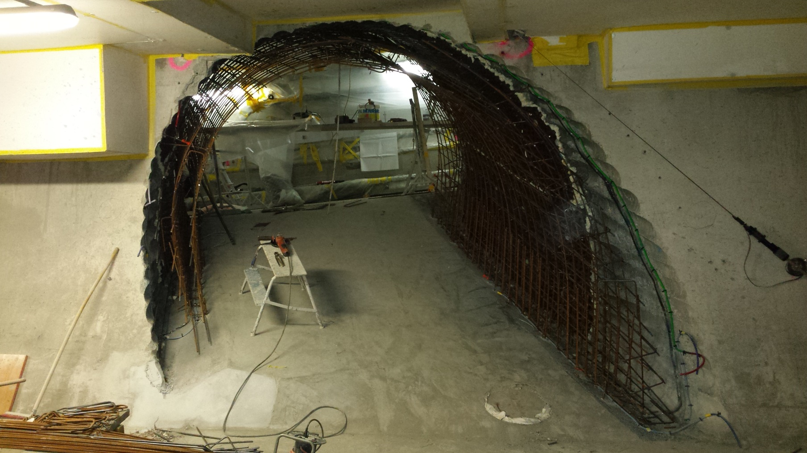
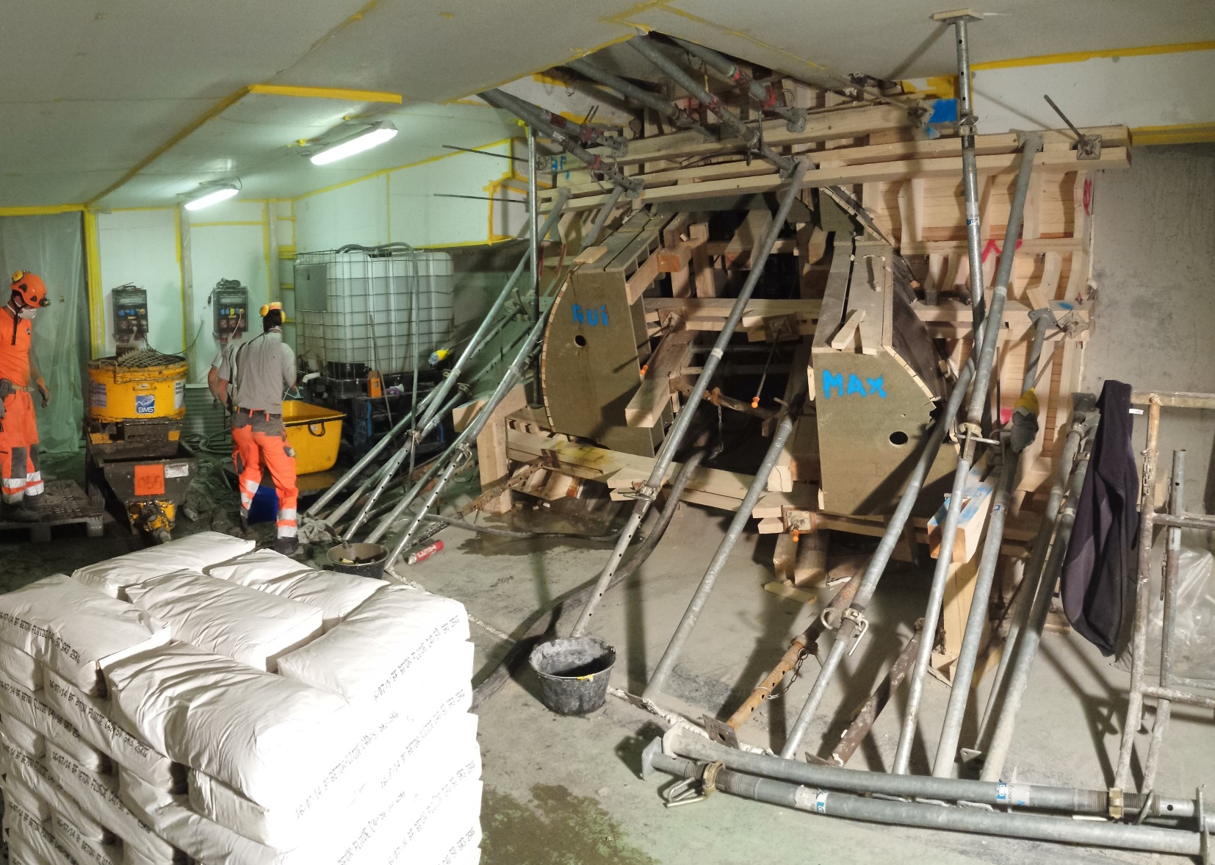
Electron Beam Tunnel Excavation
Notes:
Excavation of vault: more concrete than expected, slower & different team.
Excavation of the invert:
Marls found. Necessity of going deeper close to TT41
Hard sandstone under the marls. Good rock for foundation
It appears that the level of TT41 is 6 centimetres lower than the one that was foreseen. This needs to be confirmed and if necessary adapt the geometry.

Slide 31
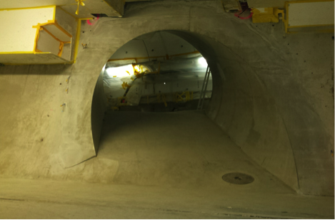
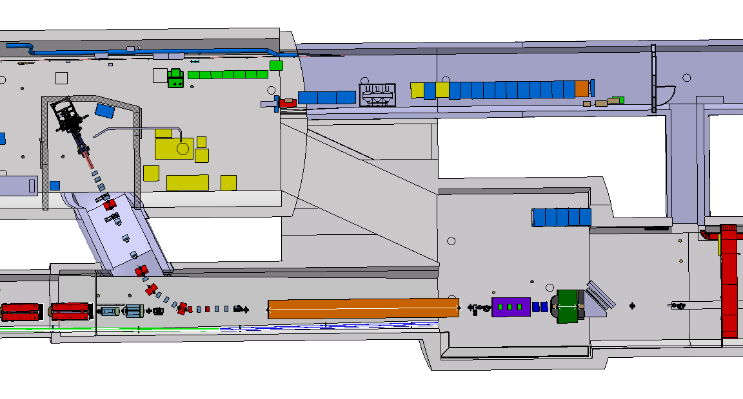
Work at CERN
Electron tunnel is ready!
A. Pardons, CERN

Slide 32
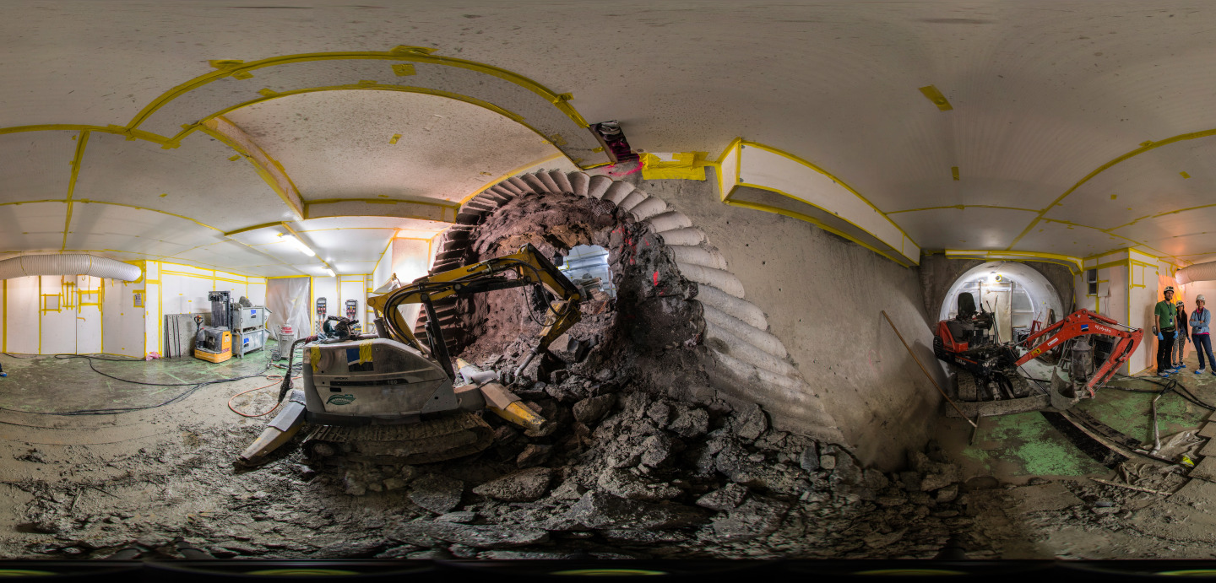
Summary
Construction and development at MPP and CERN is on going.
Laser and plasma source will be sent to CERN by end of 2015.
First diagnostics station will be installed in beamline by Q1-2016.
First p+ beam is planned for Q3-2016.

Slide 33

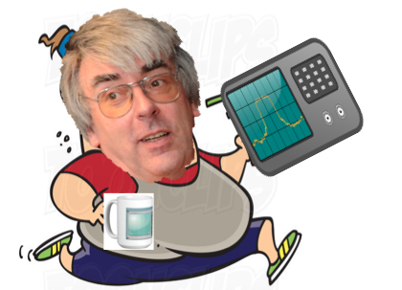

vielen herzlichen Dank!
Frau Traeder, Herr Brandmaier, and their team for their kind help in laser room preparation and installation.
Herr Finenko, Her Haubold and workshop group for all technical designs.
Electronic group for their support and ext(p)ensive equipment, that we have borrowed for a whiiile.
Many others for their support and fruitful discussions.

Slide 34
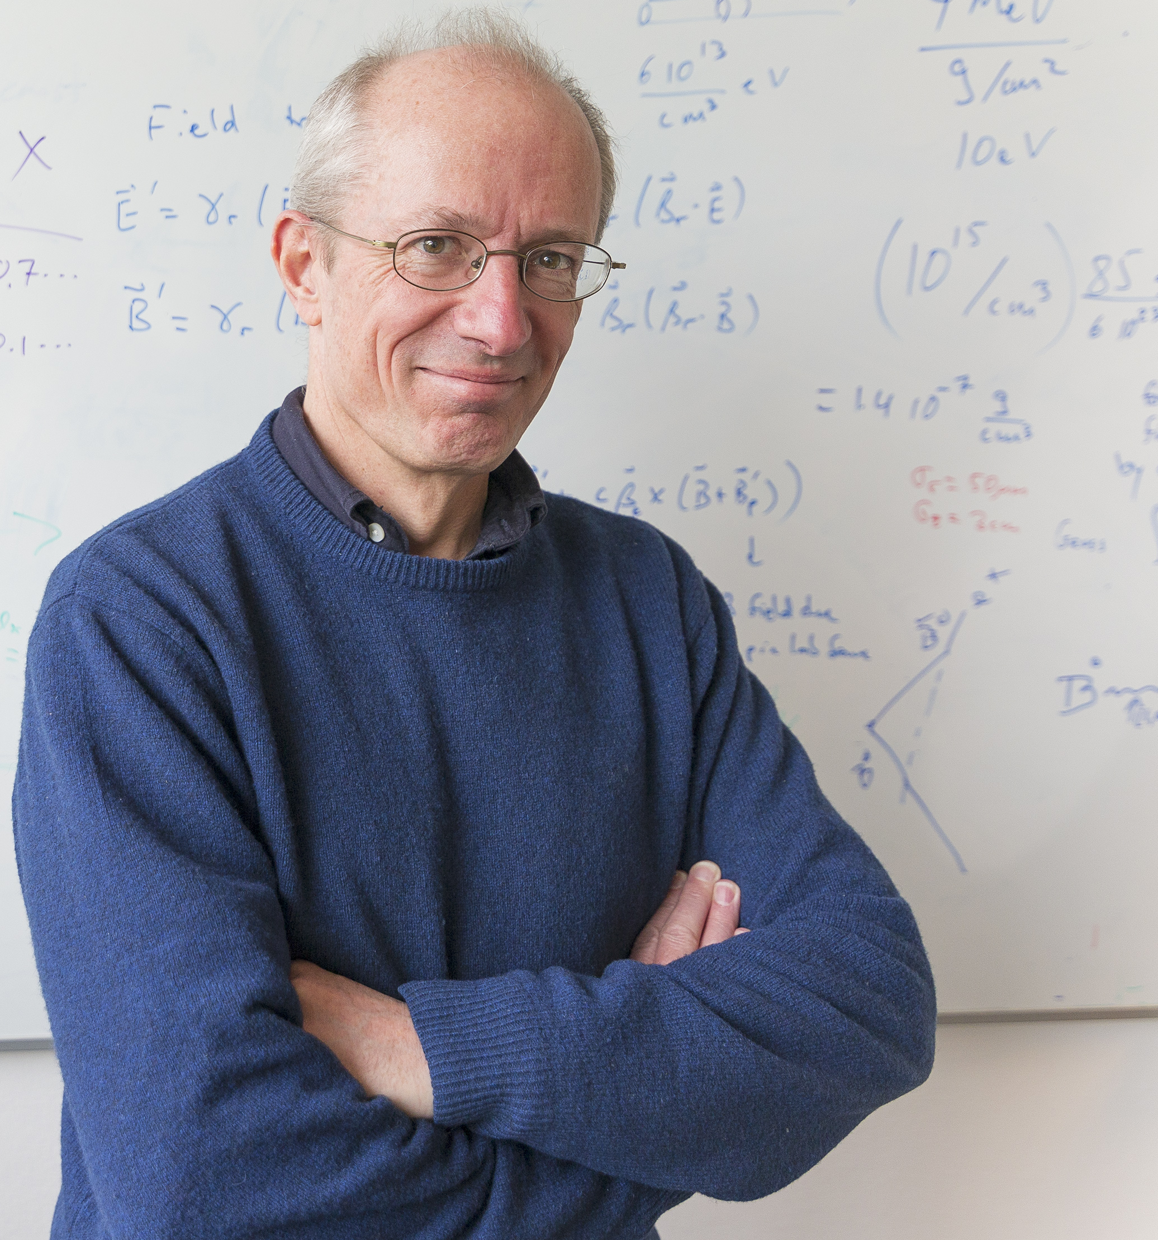



AWAKE people wish you :
Merry Christmas
and
Happy new year! ☺

