Slide 1
EMCMs - Location and Status
Label | Location | Components | Status
P6-1 | HLL | 1 x DHP02 1 x DCDBv2 1 x SWB18v1 | SWB: output signals don´t toggle after accident during probing (bond wires touching) DHP & DCD ok
P6-2 | Bonn | 1 x DHP02 1 x DCDBv2 1 x SWB18v1 | Clear to Source short → not suited for PXD6 matrix SWB, DHP and DCD ok
P4-1 | HLL | 4 x DHP02 4 x DCDBv2 6 x SWB18v1 | SWB: output signals falling edge of the gate signal much too slow after problems with the powering of the SWB (bond wires melted) Only last SWB measured, DHP and DCD ok
W2-4 | HLL | 1 x DHP02 1 x DCDBv2 1 x SWB18v1 PXD6 matrix | SWB: output signals don´t toggle, 1(6) Clear channel is stuck to ClearOn potential, the other 5 show the ClearOff potential, Gate channels 6(6) show the GateOn potential
General Remark:
Do we damage the SWB18v1 when the “nominal” voltages for the DEPFET are used (ClearHigh= 22V as obtained in the optimizations with Hybrid 5.0)?
Recommendation: use only ClearHigh of 13V
Must: List of EMCMs with the components in Database and labeling of the ASICs on the EMCM housing

Slide 2
EMCMs – Open Topics
Open Topics | What is needed | Comment
Stable operation of the 4 high speed links (DHP to DHH) | 4 x DHP0.2 - 1 x DHH(microTCA) | P4-1 can be used for the debugging
Operation of all 1000 DCD channels at 320MHz | 4 x DHPT1.0 and 4 x DCDBv4/DCDPipeline | - with single ended CMOS bit-clock on EMCM-2 modules - with differential LVDS bitclock on EMCM-3
Stable Switcher outputs on a fully assembled EMCM | 1 x DHP02 and 6 x SWB without gated mode | Components which where planned for the EMCM W3-5 can be used
PXD6 operation on the EMCM | 1 x DHP02, 1 x DCDBv2, 1 SWB without gated mode
Gated Mode | 4 x DHPT1.0 and 4 x DCDBv4/DCDPipeline 6 x SWB18v2 (with gated mode) PXD6 and/or additional load caps for the clear | 2 fully assembled modules needed! Only 12 SWB18v2 gated mode available!
Can we assemble DHPT1.0 and DCDPipeline on EMCM2? Test on hybrid level necessary.
Two EMCM2 assemblies should be prepared for the operation with PXD6 matrix.
Gated modes: need fully assembled modules with the latest ASICs
Verification of EMCM Probe Card (Valencia)
1st step: minimum EMCM (1 set of ASICs) without Kapton
2nd step: fully assembled EMCM

Slide 3
back up

Slide 4
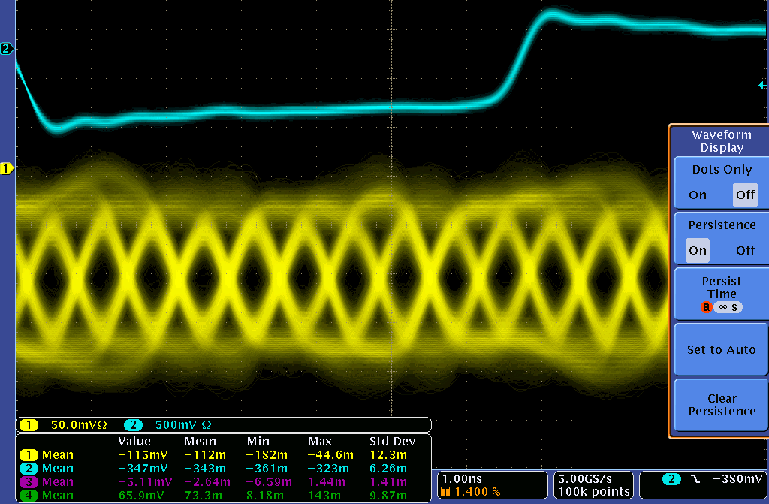
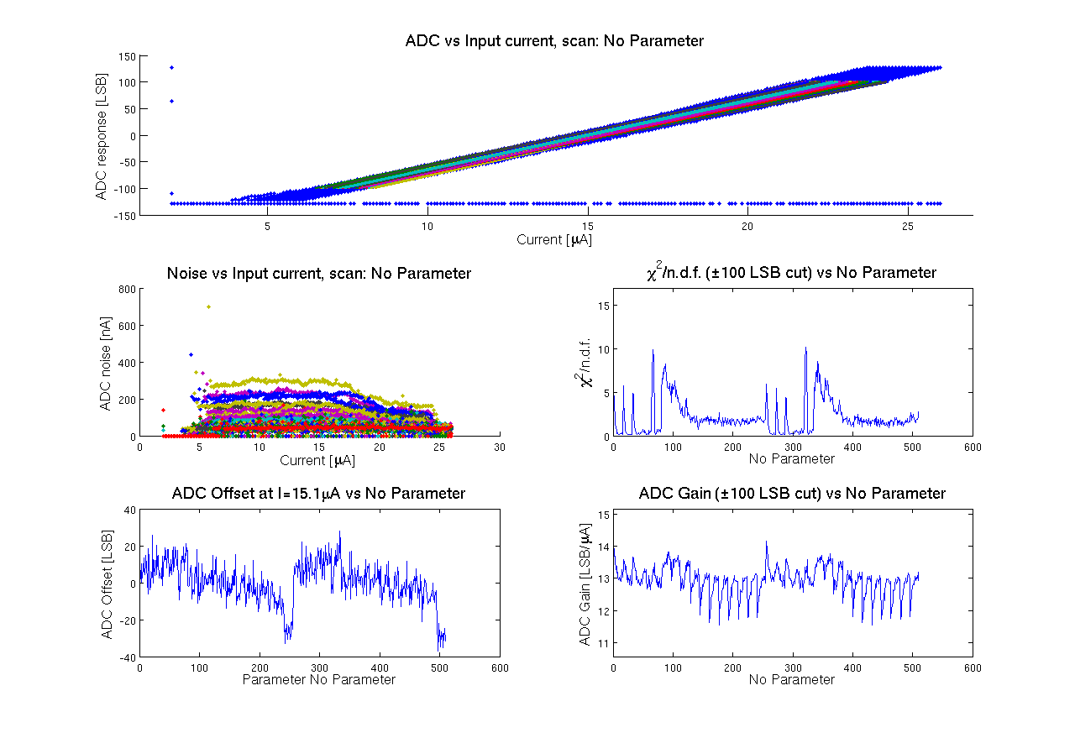
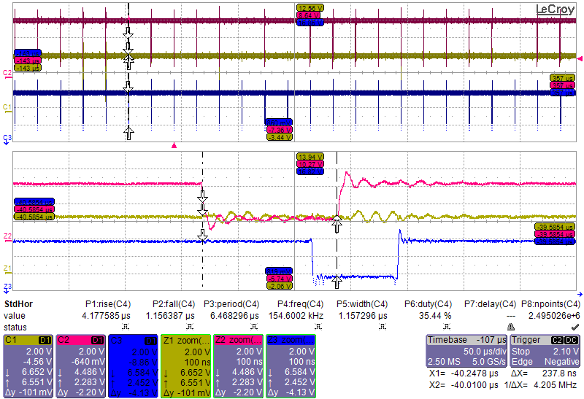
Measurement of SwitcherB, DCD-Bv2 and DHP02
DHP High Speed Link
1.6 Gbps @ 10 m cable
DCDBv2 ADC transfer curve
Some channels show higher noise – connected to long drain line?
Measurements already discussed during DESY meeting Oct. 2013 by F. Lütticke and C. Koffmane.
EMCM P4-1: SwitcherB output
Missing Gate signal at the last SWB

Slide 5
Fully Assembled EMCM (P4-1) – SwitcheB Outputs before accident
Gate1
Gate2
Gate3
Switcher configuration register has to be checked (internal termination resistors must be off)

Slide 6
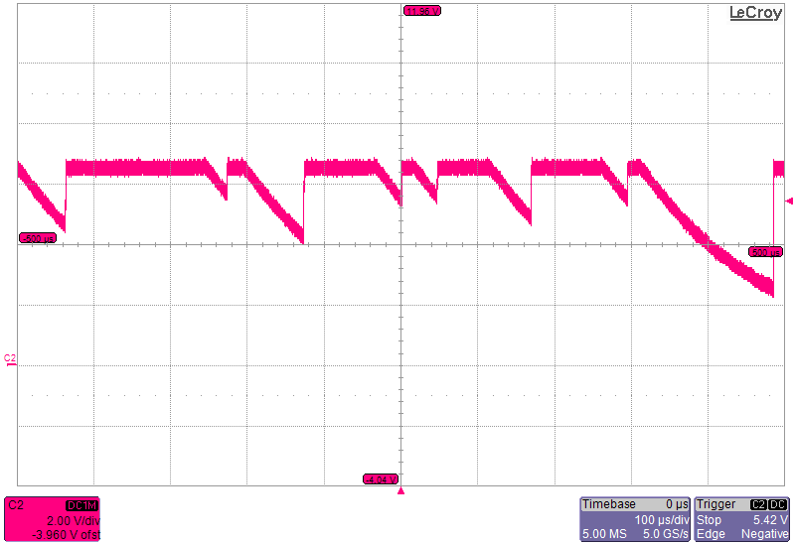
Fully Assembled EMCM (P4-1) – SwitcherB Outputs after accident
Gate1
Falling edge in µs range
Rising edge still fast in ns range

