Slide 1
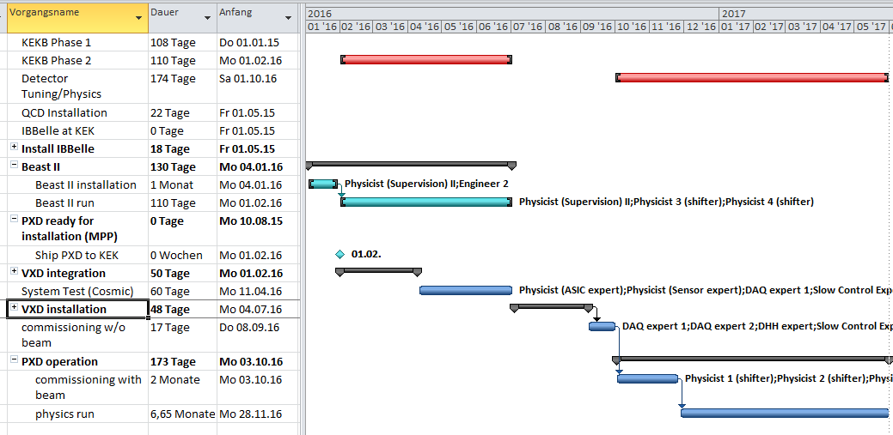
New VXD integration/installation schedule
PXD/SVD integration to VXD: February 2016 (was September 2015)
VXD Installation: summer shutdown 2016 (July-September)

