Slide 1
Measuring DCD characteristics at HLL
PXD meeting via SeeVogh
April 9 2014
Manfred Valentan, MPP

Slide 2
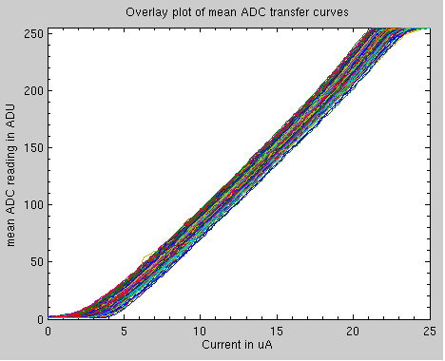
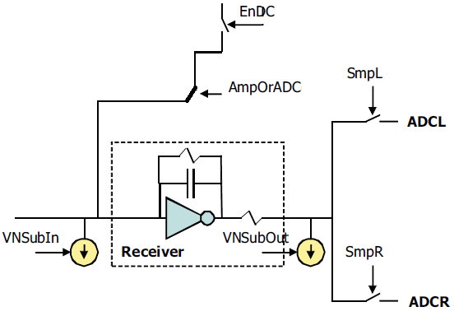
Measurement setup
Keithley 2400 SMU
0 … 25 uA, 0.1 uA steps
5
DCD0, others off
10

Slide 3
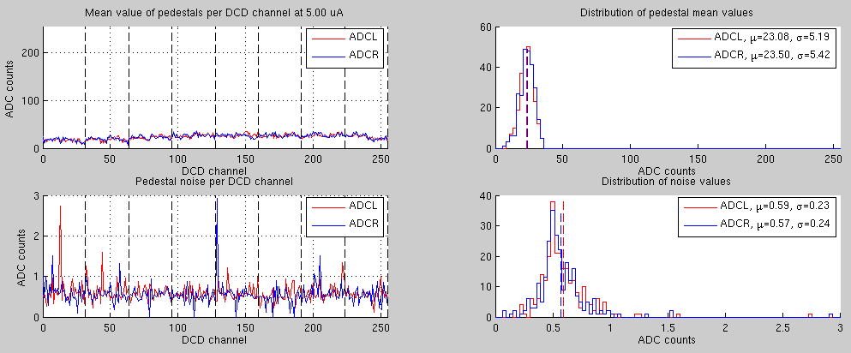
Pedestals, Noise

Slide 4
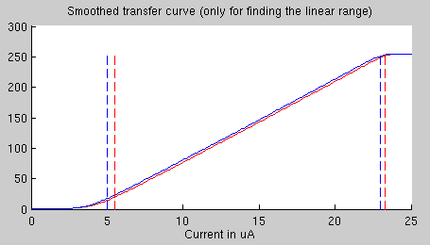
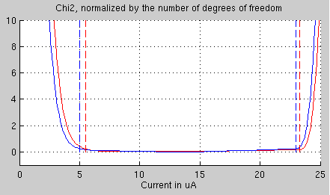
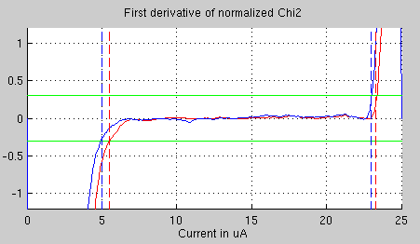
Detailed analysis: Finding the linear region
1) Smoothen the curve: each point is the average of 10 adjacent points
2) Linear fit to upper part of the curve, repeat as function of upper limit.
Calculate sum of square deviation (χ²), divide by number of degrees of freedom (= #points – 2 fit param).
3) Same for lower part of the curve
4) Calculate gradient, arbitrarily define linear region as “gradient < 0.3”

Slide 5
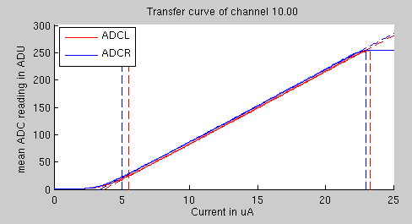
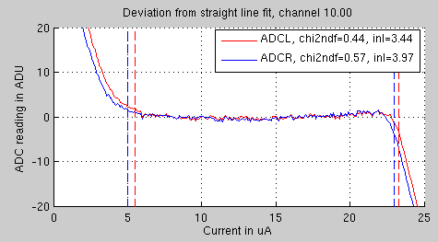
Detailed analysis: Observables calculated for every channel
From transfer curve:
1) Gain: Fit to linear range, find inclination
k = gain
2) Linear region in ADUs
From deviation from fit line:
3) Integral nonlinearity: maximum deviation from fit line (within the linear region)
4) Sum of square deviation from fitline, normalized by the number of degrees of freedom (within the linear region)

Slide 6
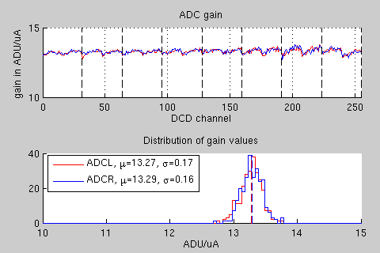
Results: Gain
periodic structure w.r.t. half columns

Slide 7
Results: INL, Chi2

Slide 8
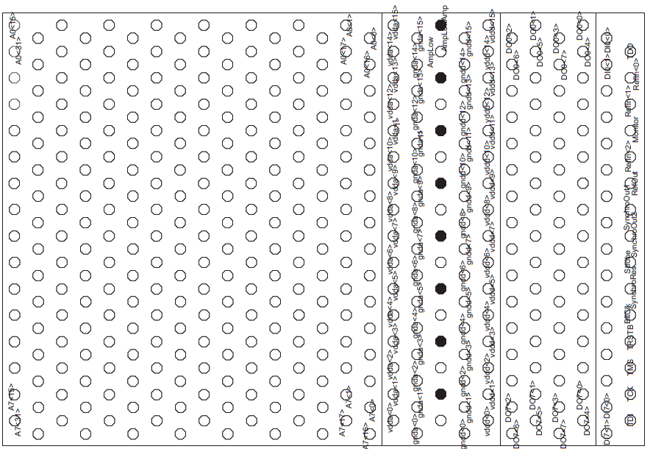
Results: Dynamic range
Channel 5
Channel 203

Slide 9
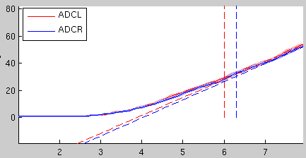
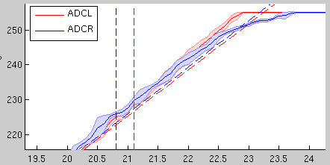
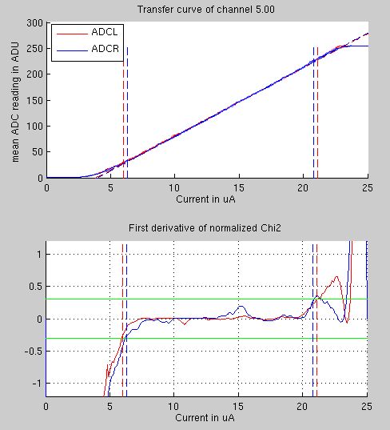
Details of “nonlinear” channel 5
up to 5 ADU
(~2%)
Asymptotic behaviour,
known effect
Small deviation from
fit line, has this been
observed before?
Pronounced effect in
gradient of norm. Chi2!
8σ Deviation, 5 ADU
2% of dynamic range

Slide 10
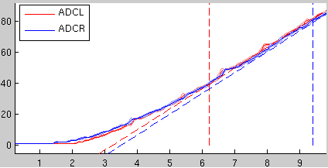
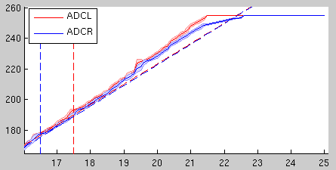
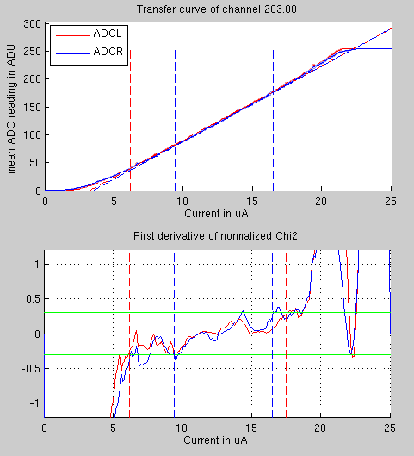
Details of “maximal nonlinear” channel 203
More than 10 ADU deviation
Very unsteady behaviour, investigating…

Slide 11
Summary
Measurement setup at HLL operational
Keithley 2400 SMU, fully populated EMCM, DHH, EPICS
Found ~5 ADU nonlinearity above ~200 ADU
only influences the position measurement for multiple-pixel clusters
charge sharing -> these clusters are unlikely to have high ADU readings
Tried to increase measurement speed
1 DCD, 25 nA steps -> 16 hours
missing some measurement points
most likely timing issue, investigating…

