Slide 1
DCD 2bit DAC
Florian Lütticke
University of Bonn

Slide 2
DCD DACs: what for?
Pedestal Distribution of Hybrid 6
Unirradiated

Slide 3
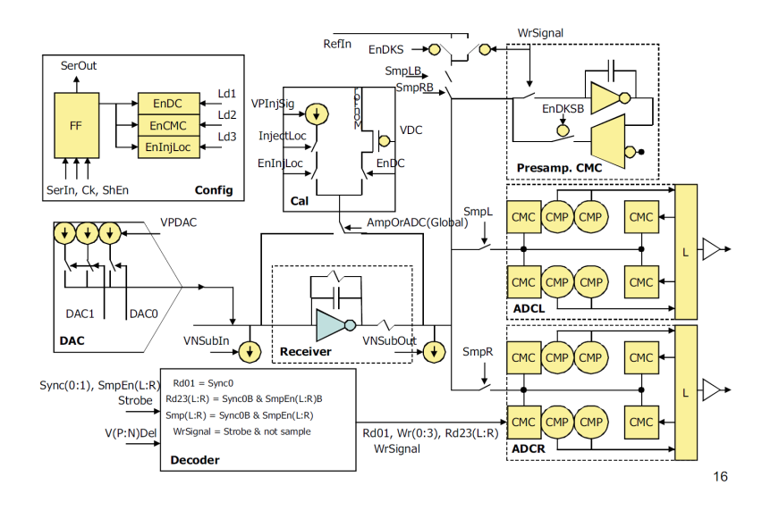
DCD Channel Layout

Slide 4
Issues with Data aquisition
DHP steers 2Bit DAC settings (640 Mbyte/sec)
LSB width steered by one DCD DAC
Design Issues in DHP02:
Steering only works in ACQUISITION mode (not in AQUISITON TO MEM)
Data acquisition in DHP stops synchronously
2 Bit DAC output from DHP stops asynchronously
Last written DAC Data stays on output line when DAC output is switched off

Slide 5
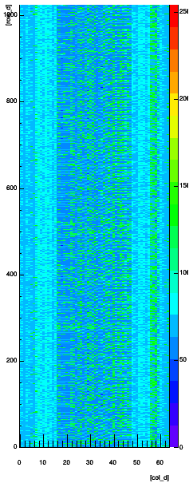
DAC output: DACs switched off

Slide 6
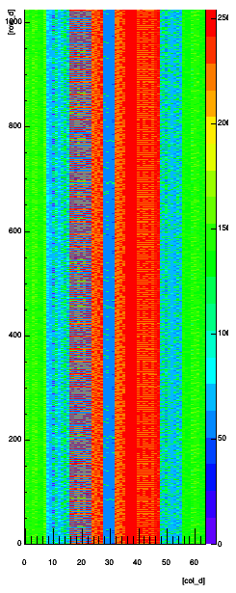
DAC output: DACs switched on – Acquisition to Mem

Slide 7
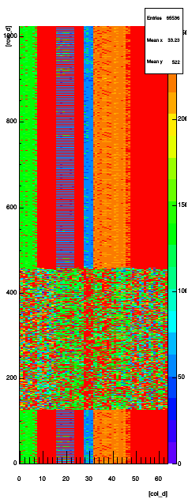
DAC output: Normal acquisition
Leaving acquisition mode: DAC output gets static
Acquisition continues until the specified “last row” from DHP Settings

Slide 8
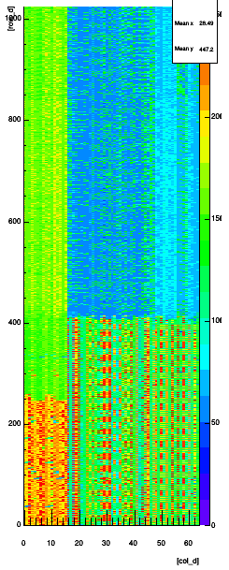
DAC output: programmed Memory
Programmed pattern
Last row set to 0 (not good for normal acquisition)
Data acquisition will work with some tricks:
DHH Memory bigger than matrix - if switching to static occurs after that we don’t have a Problem.
Try often, do intelligent logic to sort out bad events.
Update DAC optimization algorithm
DAC = 0
DAC Value = 2
DAC Value = 3
DAC Pattern

Slide 9
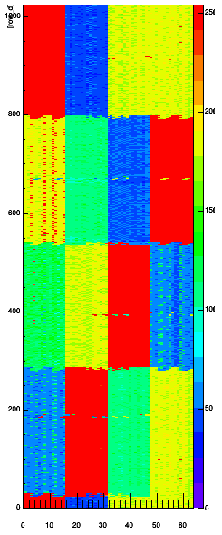
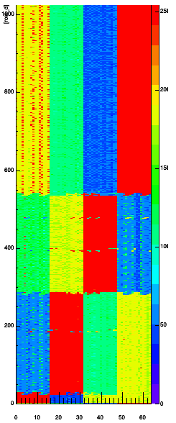
DAC outputs
Acquisition stopped somewhere here
Timing needs to be optimized

