Slide 1
Cooling for Beast & SVX assembly/test
Beast II and SVX integration & test will be in parallel
Both need CO2 for cooling
Need a split and an extra transfer line from platform to B1(from beam position)
Beast II
7/2015

Slide 2
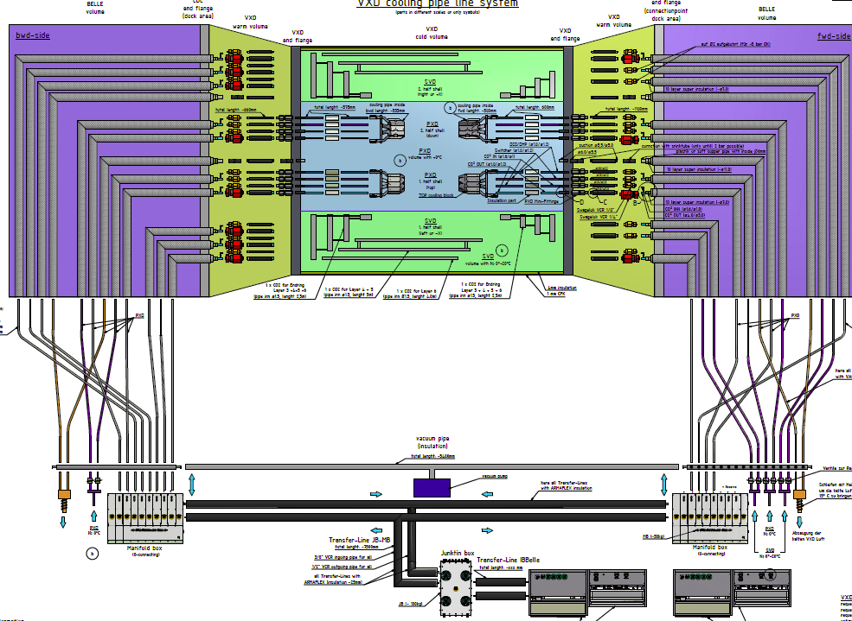
Layout for SVX
Bwd:
2 lines for PXD
6 lines for SVD
Fwd:
2 lines for PXD
2 lines for SVD

Slide 3
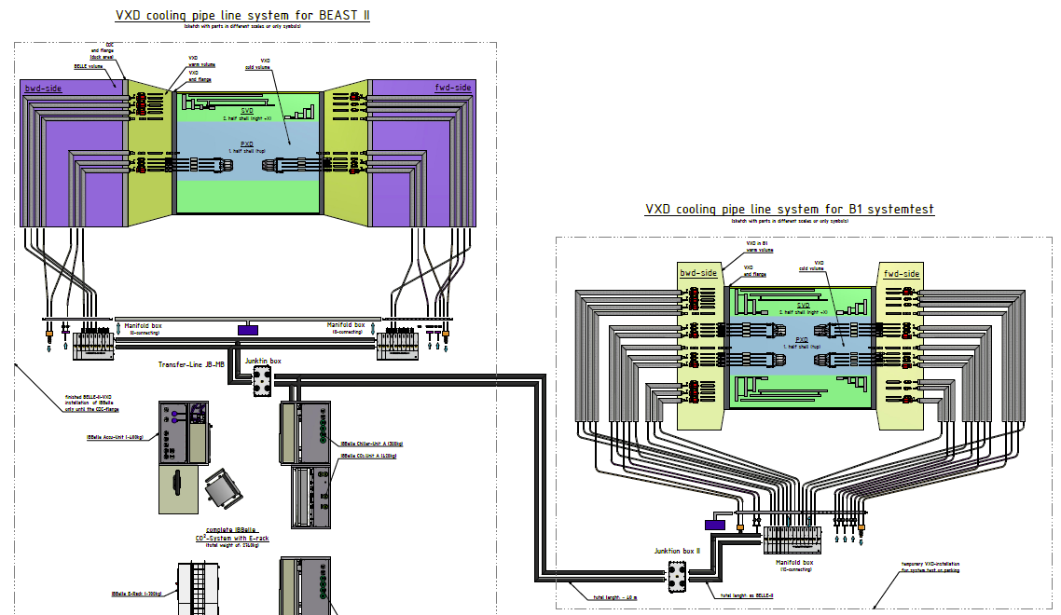
Layout for Beast II and VXD in B1
Transfer line from platform to B2: ~25 m
2nd junction box
In B1: only short CO2 lines needed
=> One (large) manifold (12x)
Bwd:
2 lines for PXD
2 lines for SVD
Fwd:
2 lines for PXD

Slide 4
Options
Avoid large manifold for B1:
Feed PXD fwd supply in Beast II from bwd
Fwd junction box not needed
Can go in B1 (and back during integration of SVD in Belle II)
Need only extra 4x manifold
3rd standard 8x (can be used as spare)
4x to be also used for PXD only integration at MPP
Should decide on cost/effort (600€/channel + 1000€)
2 x 8 + 12 + 4: 23200€
2 x 8 + 4: 15000€
Anyway: we need additional
Junction box
25 m of insulated transfer line (how to route?)
Manifold

