Slide 1
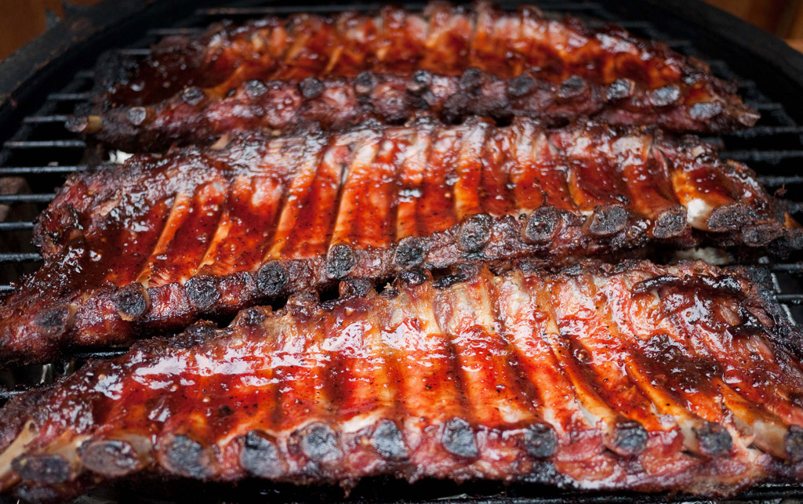
27 May 2014
SVD Ribs and SLM
M.Friedl, F.Buchsteiner, R.Thalmeier (HEPHY Vienna)

Slide 2
Introduction
Thermal Cycling
Sliding FW Endmount
Summary & Outlook

Slide 3
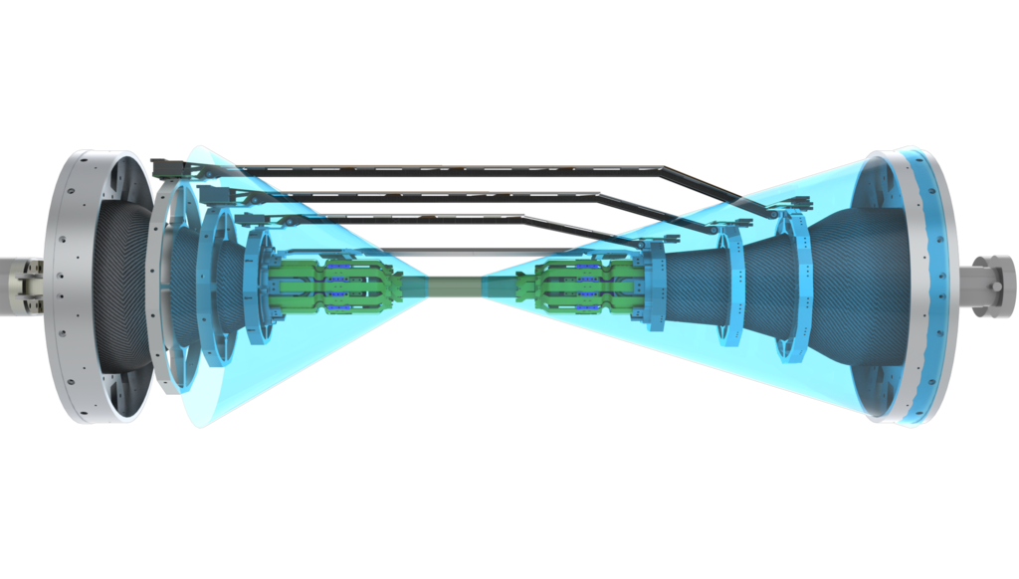
SLM = Slide Lock Mechanism
Ladder mount concept:
Fixed on backward side (Origin)
Sliding on forward side to allow thermal movement

Slide 4
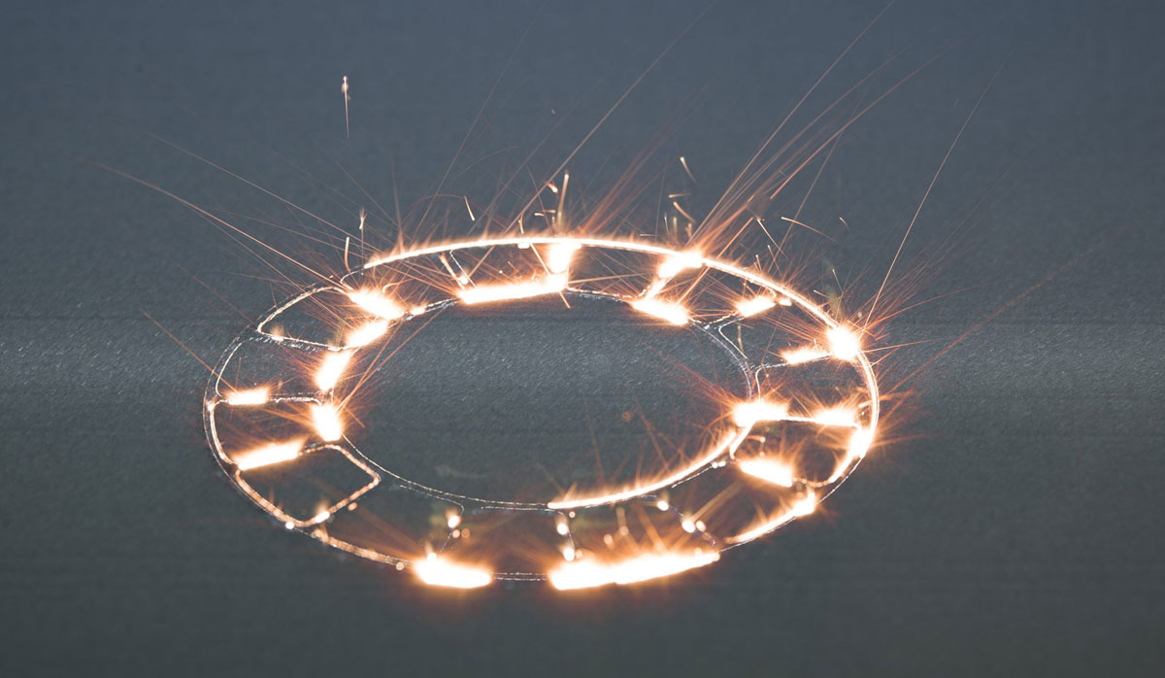
Alternative Meanings
Second Life Magazine
Swiss vitamin drink
Selective Laser Melting

Slide 5
How It Began
Informal discussion after February BPAC
Does SLM really work?
How smooth is the motion?
Decided to perform tests with climate chamber to verify thermal motion due to CTE mismatch
Idea
Mount ribs (with a priori unknown, but presumably low CTE) onto a support with high and known CTE
Thermal cycling between 0 and 40°C
Observe relative motion with gauge and camera

Slide 6
Introduction
Thermal Cycling
Sliding FW Endmount
Summary & Outlook

Slide 7
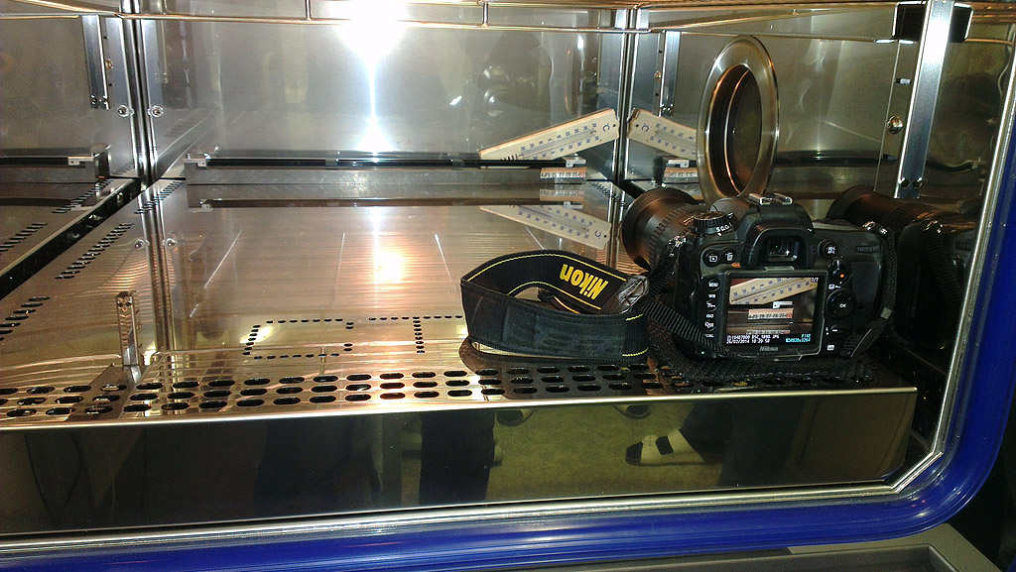
First Measurements with Straight Ribs
Thermometer
Ribs
SLM
Support
Camera

Slide 8
Results
CTE quantification of CF ribs (time-lapse movie)
www.youtube.com/watch?v=71rupQkHZV0
180µm relative motion (negative direction)
240µm is absolute motion of iron support
Remainder (60µm) is CF sandwich ribs: 3 ppm/°C (same as silicon)
Real-time video
www.youtube.com/watch?v=1oRLbkiR7i8
20 min = very boring because nothing happens
No abrupt motion is visible (µm scale)
Perfectly smooth sliding with latest SLM (strong springs)

Slide 9
Mission Accomplished?
Done!
Done?
We were asked to also perform these measurements with slanted ribs
That is where the real problems started…

Slide 10
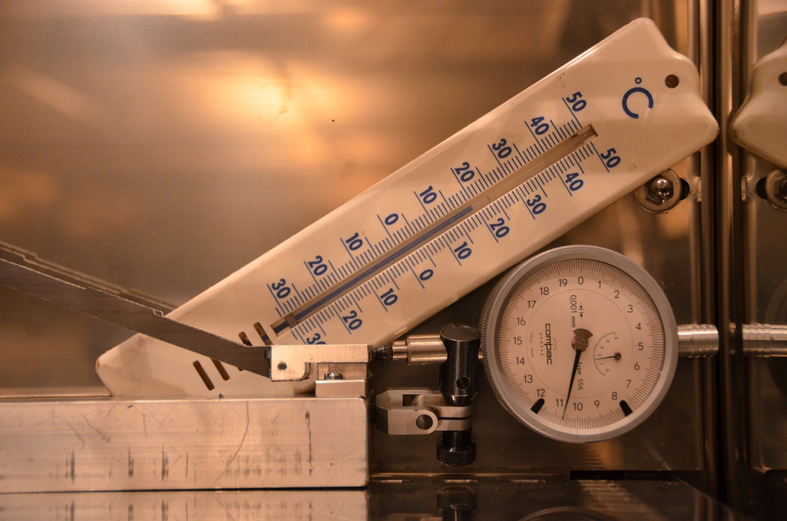
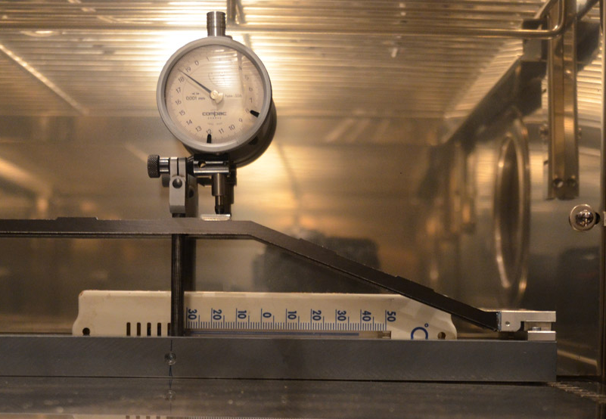
Micrometer Gauge with Slanted Ribs
Vertical displacement
Horizontal displacement

Slide 11
Results
Made several measurements with changing parameters
Always the same problem: more vertical displacement than horizontal motion
Problem: rib is not stiff enough (at the knee)
Need to stiffen rib

Slide 12
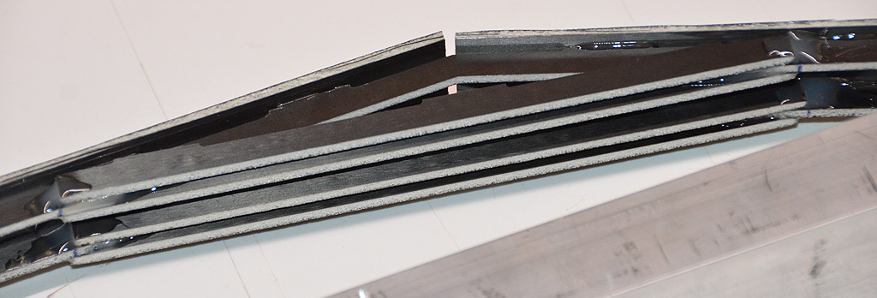
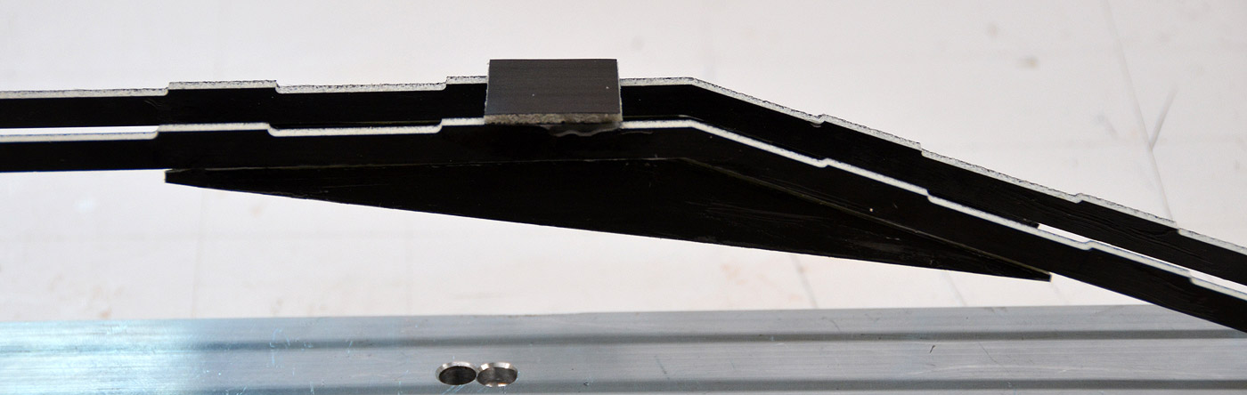
First Attempts
Improved stiffness, but also increase in material budget
Next: truss (skeleton) structure

Slide 13
L6 Optimization Study
Rib | Displacement | Volume [cm³] | D_{max} [mm]
Original |  | 13.80 | 7.44
V0 |  | 31.54 | 1.15
V2 |  | 16.74 | 1.66
V4 |  | 16.17 | 1.79
Same displacement scale (10:1) and color range for all ribs
V0: filling up all available volume
V2, V4: with cutouts

Slide 14
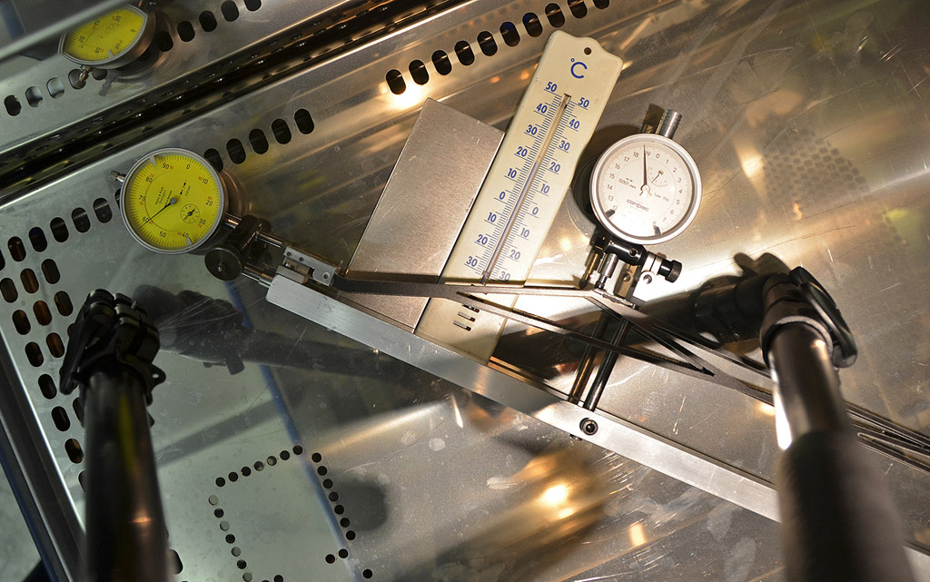
Optimized L6 Prototype Measurement

Slide 15
Results
www.youtube.com/watch?v=qfRq4qdJKP0
Maximum observed displacement: ΔH_{max}=260 µm, ΔL_{max}=383 µm
For the first time: ΔL > ΔH as it should be ☺
Use this design and make similar optimization for L5 and L4

Slide 16
Optimized Ribs
Rib | Displacement | Volume [cm³] | D_{max} [mm]
L6 |  | 16.17 | 1.79
L5 |  | 12.37 | 1.89
L4 |  | 8.21 | 0.63
Significant D_{max} improvement in all cases
Minimal increase of material budget
L5: very limited space towards L4
<1mm clearance to PA1/PA2 in some cases
New ribs ordered, expected back in early July

Slide 17
Introduction
Thermal Cycling
Sliding FW Endmount
Summary & Outlook

Slide 18
Latest Sliding Forward Endmount
Components
End mount with swallow tail
Prism rail (brass)
2 x coil springs (weak and strong variants)
2 x 1.5mm stainless steel balls

Slide 19
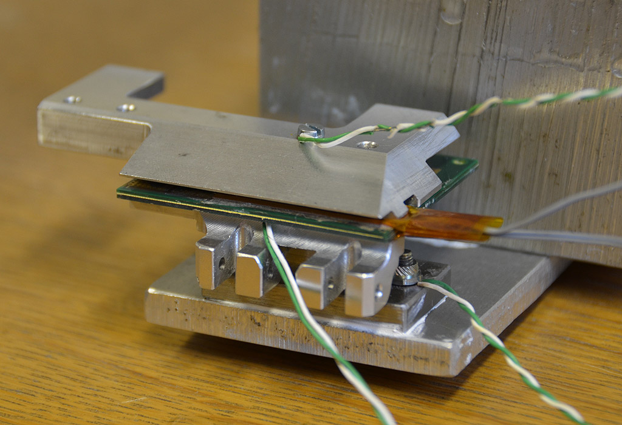
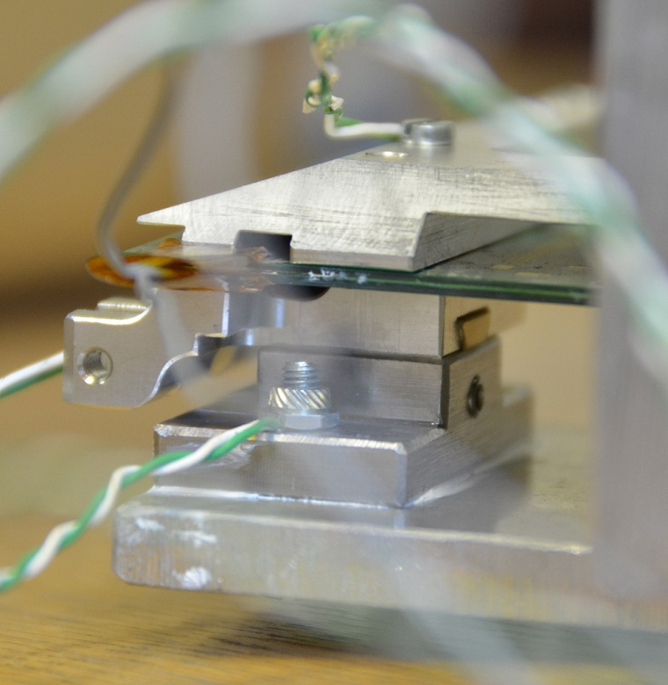
Thermal Conduction Test Setup (1/2)
Dummy end ring with big metal block in water bath
Latest SLM with weak or strong springs
Heater wires simulating APV25 power (4W total)

Slide 20
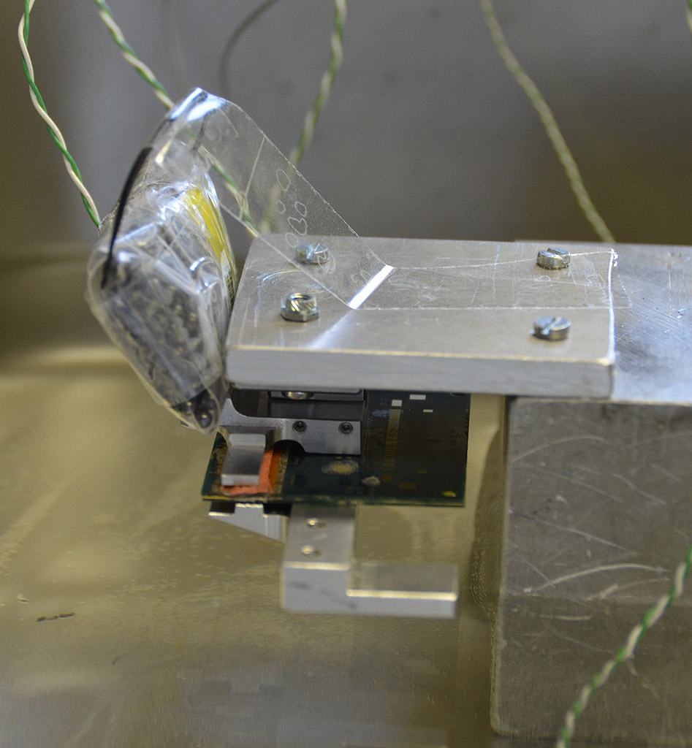
Thermal Conduction Test Setup (2/2)
SLM must also work in upside-down position loaded with the weight of a ladder
Adding 100 g to simulate this condition

Slide 21
Result With Weak Spring
No weight
With 100 g
Larger ΔT with 100 g load → spring too weak

Slide 22
Result With Strong Spring
No weight
With 100 g
ΔT always around 15°C → spring is strong enough

Slide 23
Introduction
Thermal Cycling
Sliding FW Endmount
Summary & Outlook

Slide 24
Summary
Thermal cycling tests of ribs & SLM showed that
Sliding works well (with strong spring)
Original ribs too weak (knee)
Optimized ribs with truss structure
Minimal increase of material budget
Large improvement of stiffness
Heat transfer measurement with latest SLM design (upside down position without and with 100g weight)
Strong spring: always sufficient heat transfer (ΔT~15°C)
Weak spring: worse with 100g weight

Slide 25
Outlook
Ribs
Base material (CF/Airex sandwich panels) ordered
Bad quality delivered → sent back, waiting for reproduction
Water jet cutting for ribs ordered
Expected in early July
Forward SLM
Design and tolerance specifications ready (in SVN)
Production until end of July

