Slide 1
Summary
Highlights
Technical Coordination
TB report
schedule
remarks

Slide 2
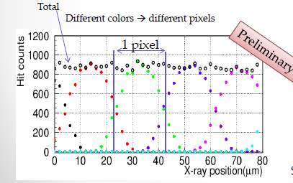
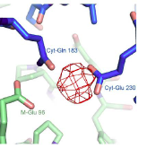
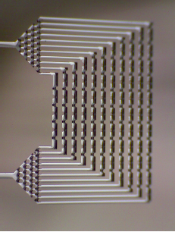
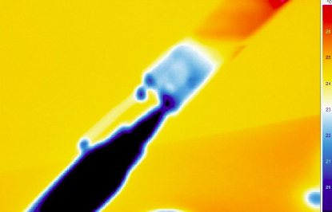
New Applications
X-ray imager for KEK PF
Energy range 2-4 keV
Thin senores
2nd grade Belle II detecotrs
ILC:
nice results on integrated cooling channels
Infinipix for ATHENA
- Gate and douple readout
Electron detector for structural analysis

Slide 3
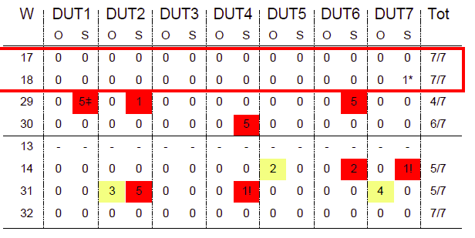
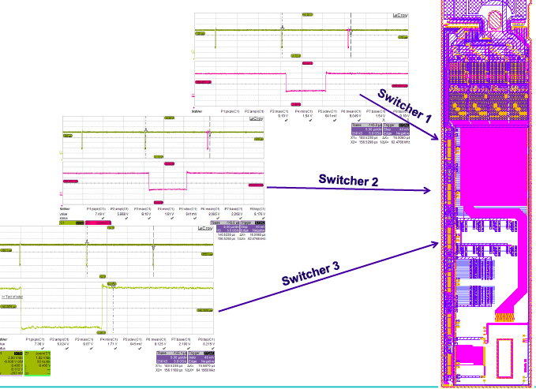
Highlights
Inter-metal insulation process was optimized with EMCM3
EMCM4 with selected technology in work for confirmation
Thanks to the HLL team for their effort congratulations
For the first time all 6 switcher on an EMCM were operated together
Furthermore
Progress using the DAC for pedestal compensation

Slide 4
EMCM Tests
Metal layer processing scheduled for July,
-Optimisation of inter metal insulation technology: ok (excellent job by the HLL team!)
- Electronic tests of EMCM: challenging!
so far: good progress, DCD/DHP works, 6 switcher modules works
however: none of the 6 EMCMs built so far worked completely
DCD/DHP communication does not work at 320 MHz (=> next)
still some problems with Aurora links (don’t get all to work simultaneously)
plagued by hardware (faulty connectors) and software problems
need ASICs! (DHPT already there, DCD & switcher next week)
Gating ?

Slide 5
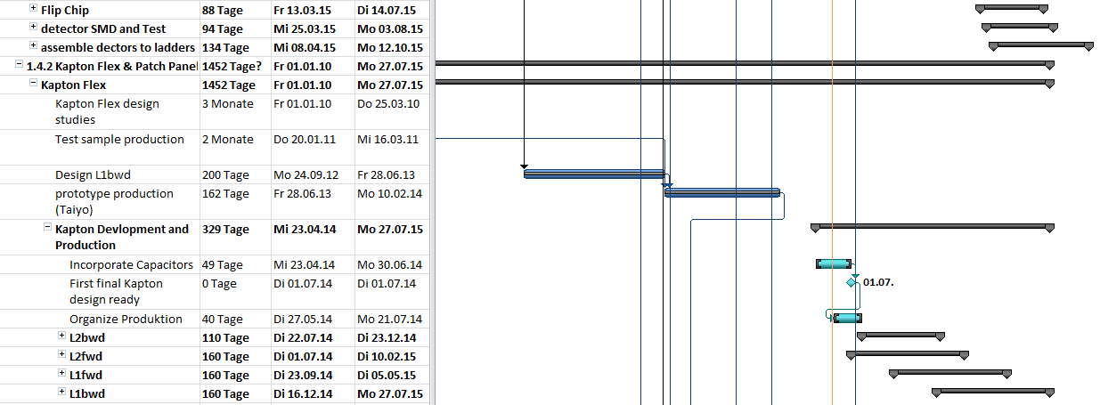
Schedule: Kapton Tapes
Kapton flex design changed: implementation of capacitors
Need to design 4 different Kaptons (fwd, bwd, layer 1 & 2)
Rather long time for design (and manufacturing. Manpower limited)
=> Kapton delivery on critical path: delays ladder assembly!

Slide 6
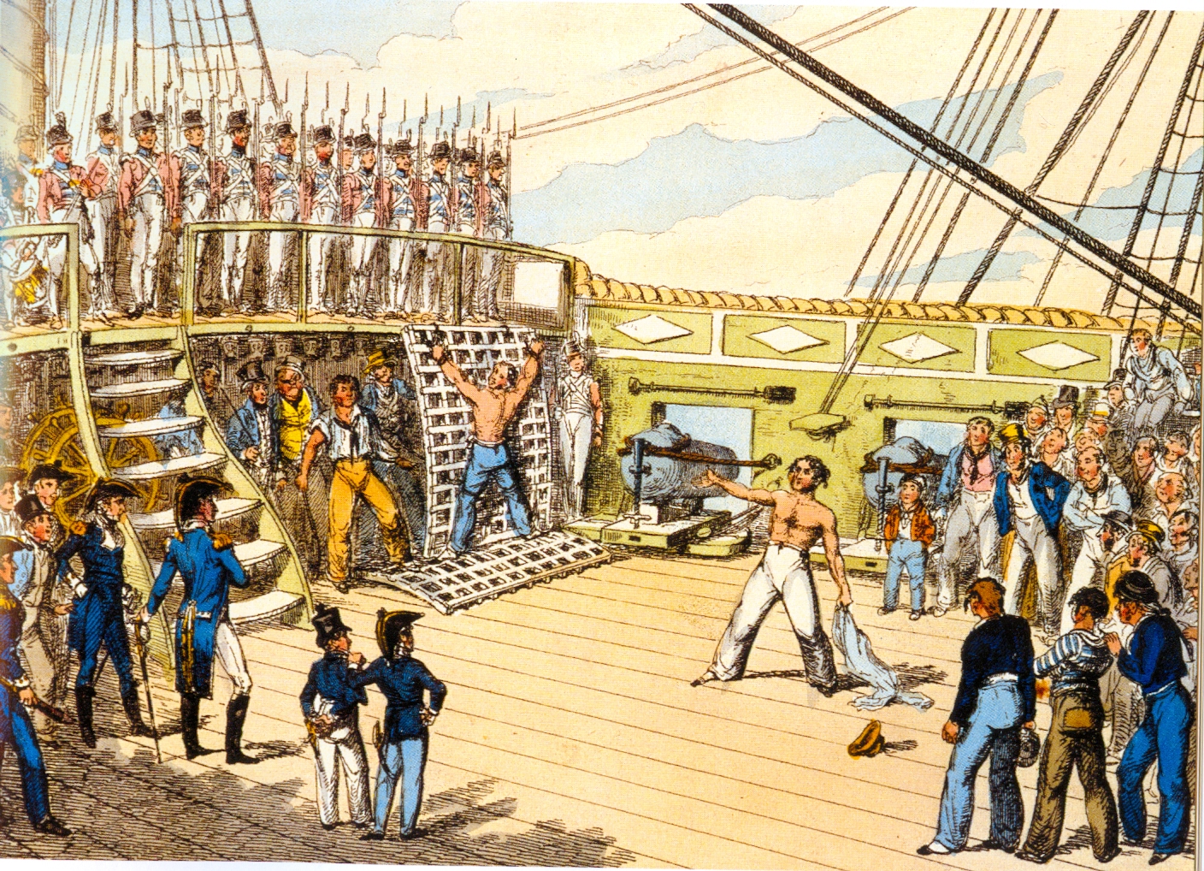
Don’t miss the schedule!

Slide 7
Schedule Changes
shipment of PXD to KEK VXD Installation
Present schedule February 2016 July – September 2016
A2 October 2016 March .- May 2017 +8 months
A3 November 2016 April – June 2017 +9 months
A4 February 2017 July – September 2017 +12 months
C4 February 2017 July – September 2017 +12 months

Slide 8
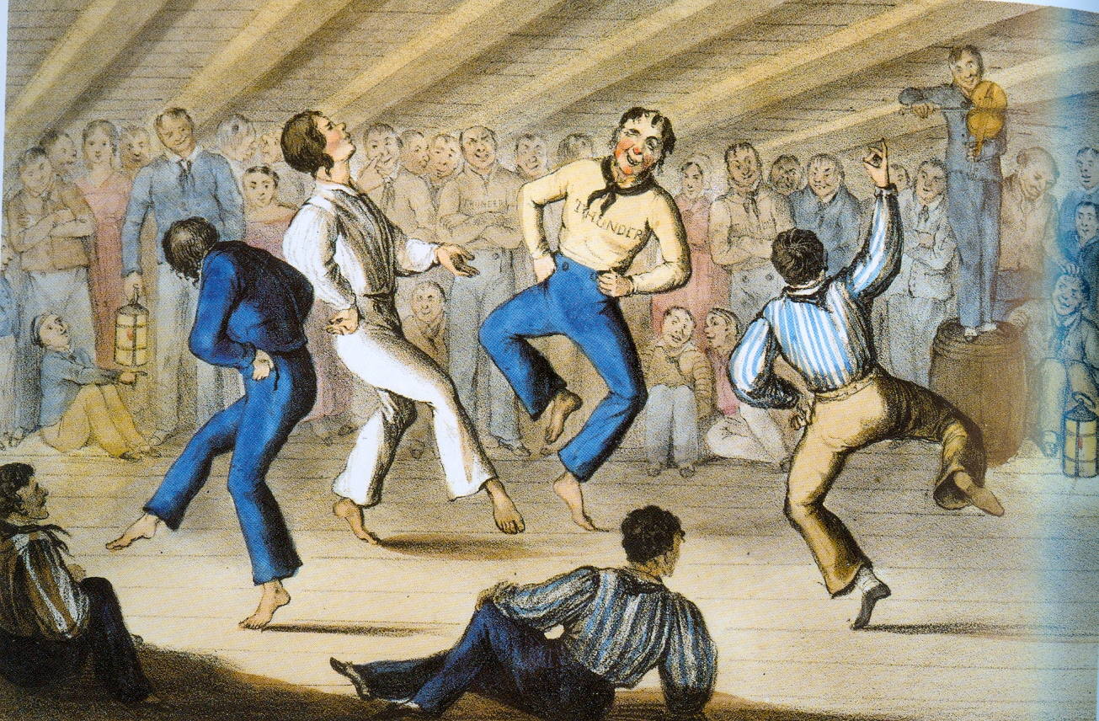
Time for a party?

Slide 9
Consequences
Don’t idle!
EMCM electronic tests have highest priority
Processing in the HLL should not be delayed too much
Kapton tapes (all 4 types) should be ready before module assembly
Moderate changes possible
Recommendations by the TB
Continue PXD6 processing (metal) in October (+ 3 months)
More time for tests of EMCM and ASICs
Reviews of DHPT and DCDpipe in October (and resubmission(s))
Switcher: next slide
Relax IBBelle assembly at MPP (delayed by CERN and clash with ATLAS)
SMD population by NTC: review in ~6 weeks

Slide 10
Switcher bumping
Bonding at PACTEC
They are willing and able (this is what they claim at least..) to bump ~500 SWB on chip level. Technology would be electroless nickel plating for UBM and Sac305 balls per solder jetting.
Swither production via EUROPRACTICE
AMS 18µm HV can be ordered as engineering run at EUROPRACTICE. Wafer level bumping can be done by IZM
We have 3 options for the next swither submission:
Switcher18 by AMS MPW with single chip bumping at PacTec
Switcher18 by EUROPRACTICE engineering run with wafer level bumping by IZM
Switcher33 (with modifications for gating) by AMS MPW with wafer access and waver level bumping by IZM
We discarded 3).
Costs: 1) 30k€ for MPW + 25k€ for bumping (500 chips)
2) 200k€ for eng. Run + ?k€ for bumping
We order test chips at Pactech. If ok, we will go for Pactech (decision in 2 months)
Ivan will get a quotation from IZM for wafer lavel bonding (backup)

Slide 11
Yield
Good ladders
mean
90% C.L
Yield (%)
Toy MC: start with 30 wafers, through a dice to determine good modules
Assuming a certain yield
Join to ladder (smaller number of bwd or fwd module)
Mean and 90% C.L. lower limit

Slide 12
Actual situation so far
Modules | 0 | 1 | 2 | 3 | 4 | 5 | Needed
Inner fwd | 14 | 4 | 2 | 2 | 1 | 6 | 8
Inner bwd | 10 | 8 | 2 | 2 | 1 | 6 | 8
Outer fwd | 31 | 10 | 4 | 2 | 0 | 11 | 12
Outer bwd | 22 | 7 | 9 | 5 | 3 | 12 | 12
Rainer Richter
Take class 0 & 1: 18 fwd and 18 bwd
Yield of metal processing, thinning, copper missing: my guess 85%:
Mean: 14.48 ladder, 90% lower limit: 12 => should be ok
Minimum yield needed: 67.5%
However: flip chip and SMD, kapton assembly, ladder gluing!
Good modules won’t be abundant
Prototyping and tests (thermal cycling, radiaiton) with 2nd grade modules
Need perfect QA (eliminate whatever can go wrong….)
Need of a backup production?

Slide 13
Thanks to Laci & Patricia for organising this workshop

