Slide 1

Infinipix DEPFETs (for the ATHENA project)
Seeon, May 2014
Alexander Bähr
Max-Planck-Institute f. extraterrestr. Physics
Notes:
The HLL develops and produces silicon-base radiation detectors. One of these devices is the DEPFET active pixel sensor.

Slide 2
The ATHENA mission
-next generation x-ray observatory
-designed to observer the hot and energetic universe
payload:
X-IFU (Transition Edge Sensor)
WFI (large area DEPFET sensor)
Notes:
built-in shutter for optical and x-ray applications
with rise time of 100ns

Slide 3
WFI design and key parameters
parameter | characteristic
energy range | 0.1 – 15keV
energy resolution | <150 eV (FWHM) @ 6keV
Field of View | 40‘x40‘ (baseline) 50‘x50‘(goal)
angular resolution | <5 arcsec
array format | central chip: 256x256 outer chips: 4x 448x640 (baseline) 4x 576x768 (goal)
pixel size | central chip: 100x100µm² outer chips: 130x130µm²
detector area | 14.1x14.1cm² (baseline) 17.5x17.5cm²(goal)
fast timing and high count rate capability | window mode: 20µs (baseline) 10µs (goal) 1 Crab>80% throughput<5% pile up
Surpassing all existing x-ray facilities by at least a factor of 2 in field of view, timing and count rate capability
Notes:
built-in shutter for optical and x-ray applications
with rise time of 100ns

Slide 4
DEPFET principle
p-MOSFET build on depleted bulk
charge collected in „internal gate“
causes current modulation
combined sensor and first amplifier
analog charge storage
usable as base cell for Pixel sensor
additional properties possible
  nonlinear signal response
  repetetive readout of charge
  built-in shutter
Notes:
p-channel MOSFET
build on high resistive bulk
deep n implantation underneath gate forms potential minimum for e-
charge removed by applying positive voltage to clearstructure
-sensitivity over the whole bulk thickness
-excellent energy resolution
-geometry adaptable to demands

Slide 5
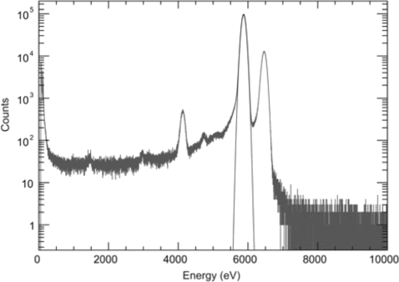
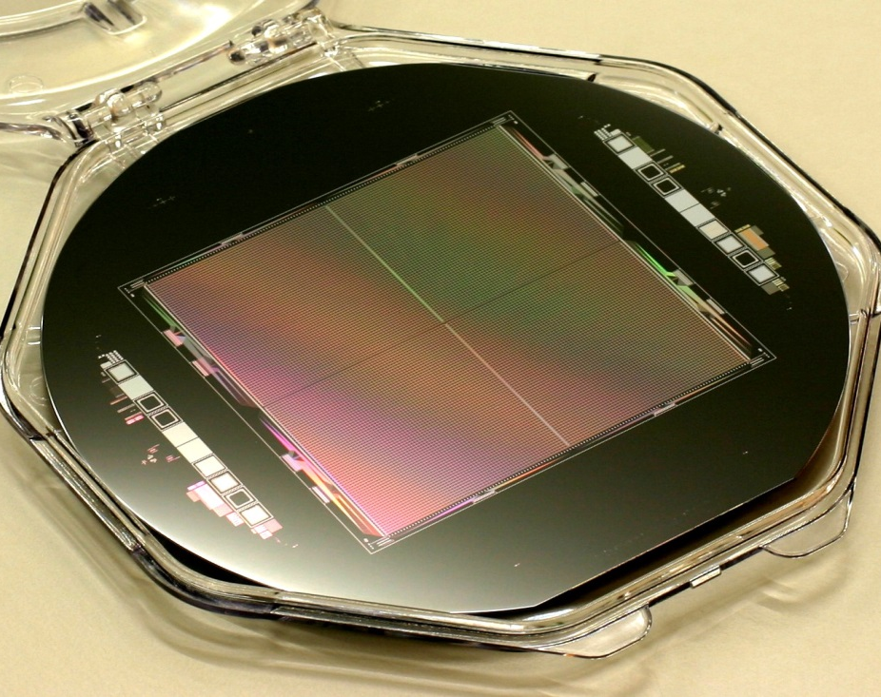
DEPFETs for ATHENA
matrices for spatial resolving spectroscopy:
->read out row wise in parallel by ASTEROID-ASIC
->flexible adressing using SwitcherS
->usually read out in a rolling shutter mode
switching-asics
switching-asics
read-out-asics
typical performance
FWHM< 130eV @5.9keV
P/B ~ 3000

Slide 6
window mode
matrices for spatial resolving spectroscopy:
->read out row wise in parallel by ASTEROID-ASIC
->flexible adressing using SwitcherS
->usually read out in a rolling shutter mode
switching-asics
trapezoidal weighting of DEPFET signal
switching-asics
read-out-asics
->out of time events cause so called misfits
->generates additional „background“
dominant at fast timings

Slide 7
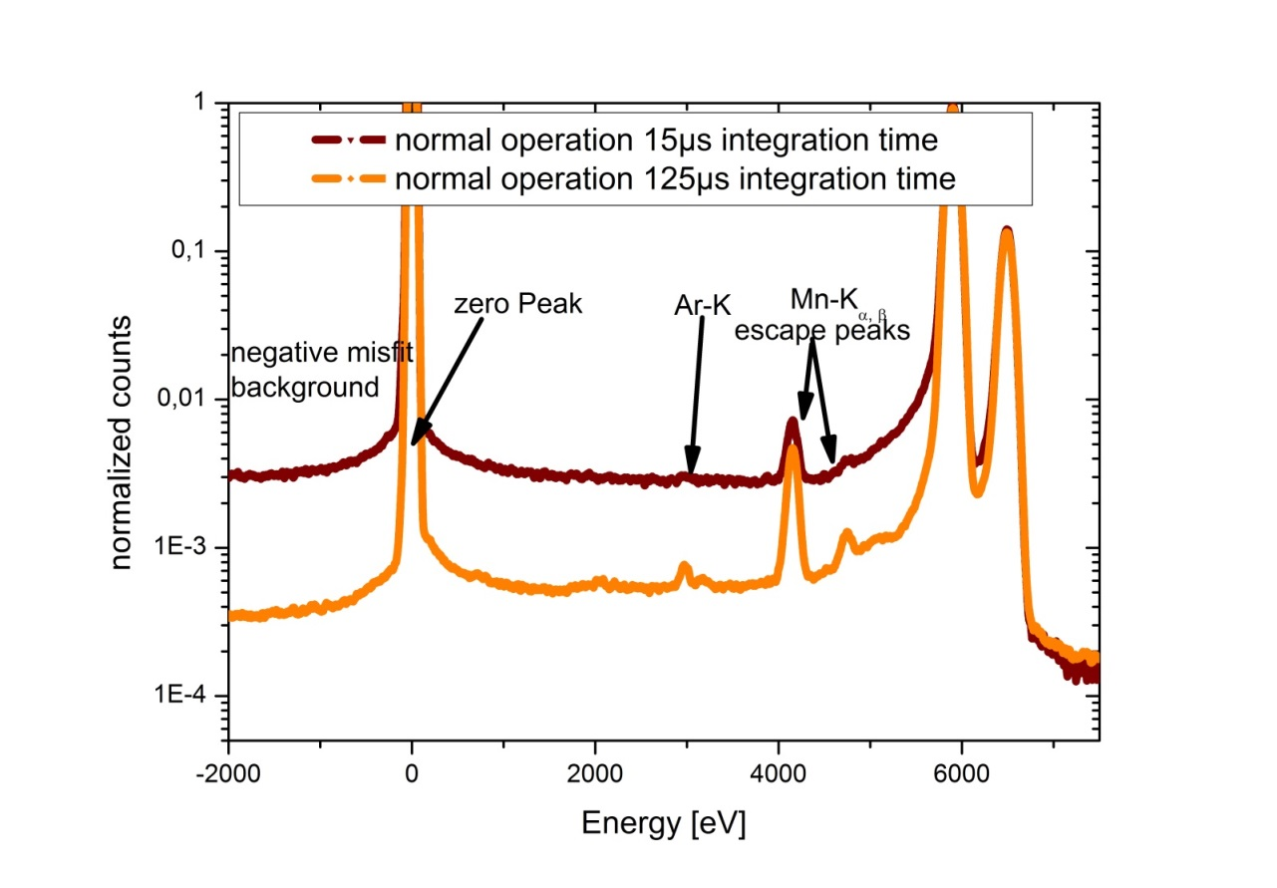

effect of misfits
signal processing of 4.2µs
P/B=280, FWHM=129eV @15µs signal integration
P/B=1600, FWHM=133eV @125µs signal integration
misfitbackground $\sim \frac{t_{read}}{t_{int}}$
->solution:
supression of charge collection during device readout

Slide 8
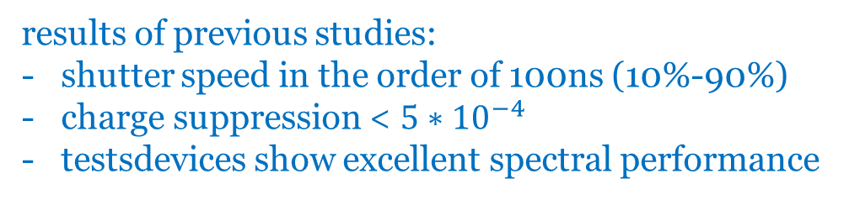
gateable DEPFET
based on circular DEPFET
provides built in shutter by addition of two contacts
results of previous studies:
shutter speed in the order of 100ns (10%-90%)
charge suppression < $5∗{10}^{−4}$
testsdevices show excellent spectral performance

Slide 9
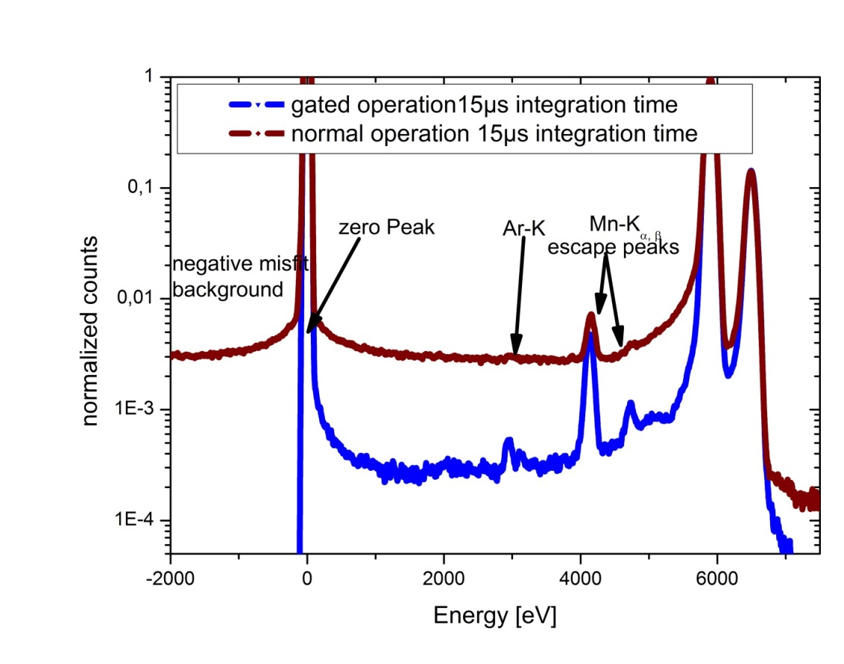
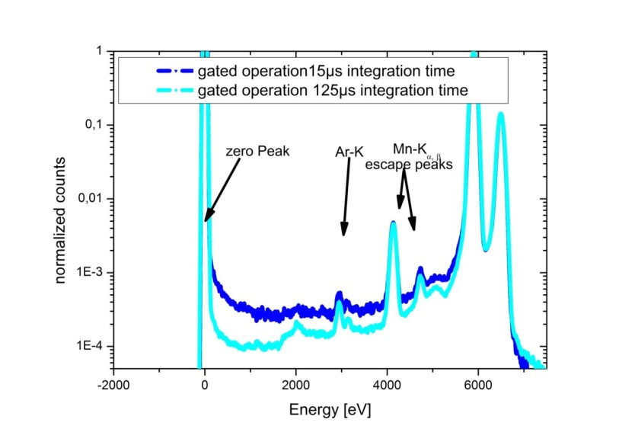

gateable DEPFET
signal processing of 4.2µs
normal operation: P/B=280, FWHM=129eV
gated operation: P/B=3100, FWHM=129eV
signal processing of 4.2µs
15µs signal integration: P/B=3100, FWHM=129eV
125µs signal integration: P/B=11000, FWHM=133eV
misfitbackground $\sim \frac{t_{shutter}}{t_{int}}$
->electrons arriving during readout are lost: ->dead time
->solution:
implement storage

Slide 10
Infinipix
0V
5V
5V
-5V
spacer
gate 1
gate 2
spacer
drift ring
drain 1
source
drain 2
drift ring
-7V
0V
0V
-5V
-7V

Slide 11
Infinipix
0V
5V
5V
-5V
spacer
gate 1
gate 2
spacer
drift ring
drain 1
source
drain 2
drift ring
-7V
0V
0V
-5V
-7V
sensitive
insensitve
insensitve
sensitive

Slide 12
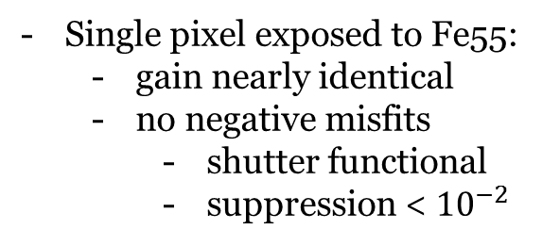
Infinipix: first results
measurement sequence
  DEPFET 1 and 2 are alternating sensitive
  while 1 is collecting arriving charge 2 is read out
  while 2 is collecting arriving charge 1 is read out
Single pixel exposed to Fe55:
  gain nearly identical
  no negative misfits
    shutter functional
    suppression < ${10}^{−2}$

Slide 13

Infinipix: timing
shutter speed<200ns
suppression<$5∙{10}^{−4}$

Slide 14
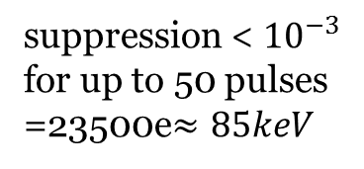
Infinipix: charge handling
single pulse = 470e
suppression < ${10}^{−3}$ for up to 50 pulses
=23500e$≈85keV$

Slide 15
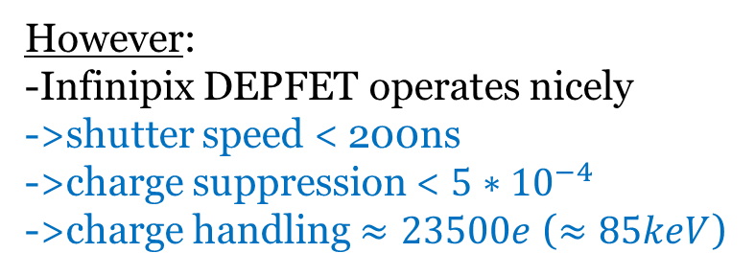
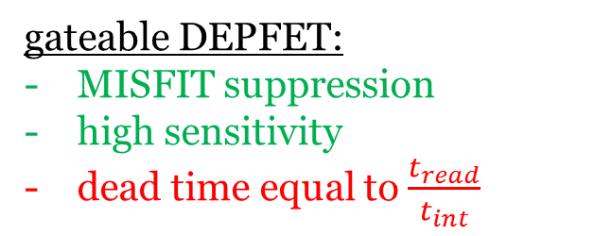
Summary
ATHENA fast sensor requirements:
20µs window mode (aim of 10µs)
single row processed in 2.5µs
INFINIPIX DEPFET:
circular DEPFET, window operation:
high number of MISFIT events
limited sensitivity
(high background)
prototype devices functional:
-technology not optimized:
->limited charge handling capacity
->affects the charge suppression
gateable DEPFET:
MISFIT suppression
high sensitivity
dead time equal to $\frac{t_{read}}{t_{int}}$
However:
-Infinipix DEPFET operates nicely
->shutter speed < 200ns
->charge suppression < $5∗{10}^{−4}$
->charge handling $≈23500e$ ($≈85keV$)

Slide 16

Thanks for your attention

Slide 17
Any Questions?

Slide 18
Outlook
-further measurements
-spectroscopic measurements
->Matrices (32x32 Pixel)
-setup in preparation
->Macropixel (10mm² collection area)
-simulations optimizing
-suppression
-shutter timing
-charge handling
Notes:
Further measurements will cover a deeper investigation of timing performance as well as spectroscopic measurements. Matrices using Blindgate Pixel as base cell to form a 64x64 Pixel detector will be tested.
Further measurements will also be compared to simulations. A study of geometry optimizations is ongoing. New concept.

Slide 19

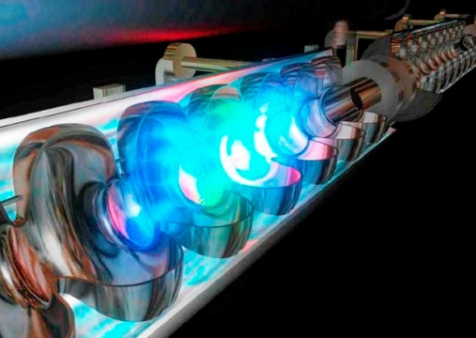
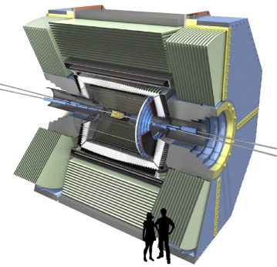
DEPFETs are or will be used in
planetology
free electron laser
particle physics
BepiColombo
XFEL
BELLE II
the MIXS instrument
DSSC sensor
PXD sensor
x-ray astronomy
ATHENA
Wide Field Imager (WFI)
Notes:
built-in shutter for optical and x-ray applications
with rise time of 100ns

Slide 20

gateable DEPFET
sensitive state
surface
potential
p+ source
blind gate
gate
blind
source
drain
FET gate
clear gate
n+ clear
blind gate
p+ drain
Qδ(t)
signal(t)
blind

Slide 21
gateable DEPFET
insensitive state
sensitive state
surface
potential
p+ source
blind gate
gate
blind
source
drain
FET gate
clear gate
n+ clear
blind gate
p+ drain
Qδ(t)
signal(t)
blind

