Slide 1
Hybrid 6 Tests
Florian Lütticke, Carlos Marinas, Norbert Wermes
University of Bonn

Slide 2
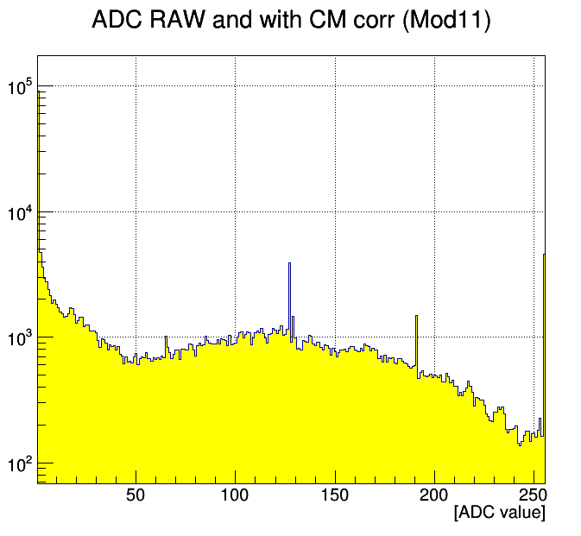
DCD DACs: what for?
Pedestal distribution of Hybrid 6
not irradiated – will get worse
Wider distribution than dynamic range of ADC
Not all pixel “work” at the same time
Known as “bad” from wafer tests + glueing
Pedestal too low,
Reduced dynamic range from DCD ADC <40
Speed problem –
See later slide
Pedestal too high
ADC >254

Slide 3
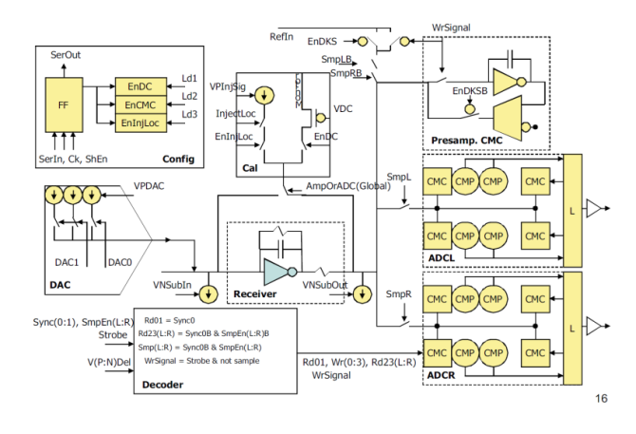
Dynamic DAC compensation
Idea: fold pixels with too low value back into dynamic range
Realized by three switchable current sources. Size of LSB is set by DAC value
Final Task: find best value for
30k Offset DACs
Global DAC
Subtraction DAC
~10¹⁸⁴²⁴ settings
First:
Basic function tests
Find workaround for DHP Issues

Slide 4
Issues with DHP02 data acquisition
DHP steers 2Bit DAC settings (640 Mbyte/sec)
Design Feature in DHP02:
Steering only works in ACQUISITION mode (not in ACQUISITION TO MEM)
Data acquisition is stopped synchronously (after full frame was taken)
2Bit DAC output from DHP stops asynchronously (immediately after command was received)
Last written 2BitDAC Data stays on output line when DAC output is switched off
Not an issue in DHPT 1.0

Slide 5
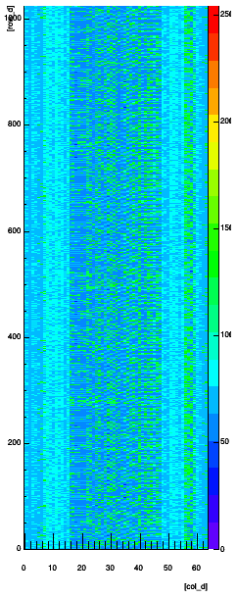
DAC output: DACs switched off

Slide 6
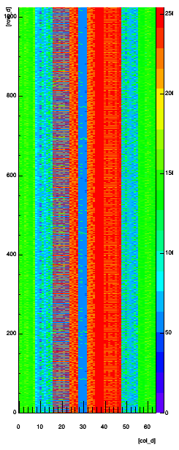
DAC output: DACs switched on – Acquisition to Mem

Slide 7
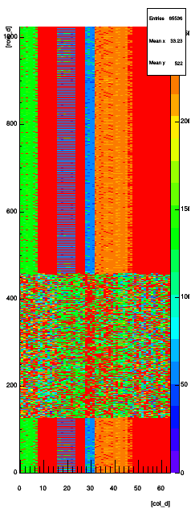
DAC output: Normal acquisition
Leaving acquisition mode: DAC output gets static
Acquisition continues until the specified “last row” from DHP Settings

Slide 8
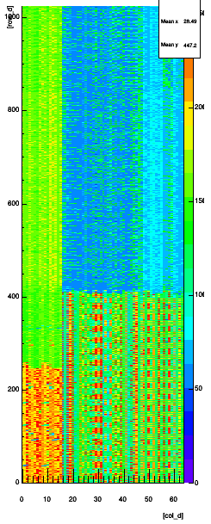
DAC output: programmed Memory
Programmed pattern
“Last Row” set to 0 (not good for normal acquisition)
Data acquisition will work with some tricks
DHP Memory bigger than matrix. If switching to static DACs occurs after that we don’t have a problem
Try often, get lucky and do intelligent sorting of ‘bad data’
Can JTAG be synchronized?
DAC = 0
DAC Value = 2
DAC Value = 3
DAC Pattern

Slide 9
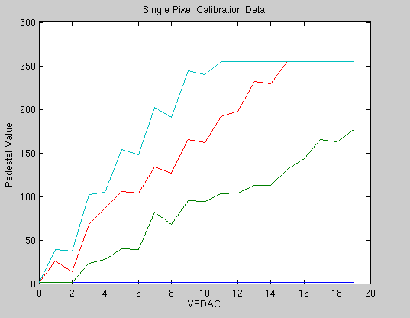
Optimize DAC Settings:
Load constant DAC values into memory
Circumvent DHP limitations
Change VPDAC value
For each VPDAC value:
Optimize DAC Values to be as close as possible to a certain pedestal value
Alternative: try to get pixel to be below certain high threshold while enforce to have them in dynamic range
Find best solution in VPDAC - target pedestal space
Ignore bad Pixel!
Possible 2nd step for finetuning
DAC=3
DAC=2
DAC=1
Target pedestal
DAC=0

Slide 10
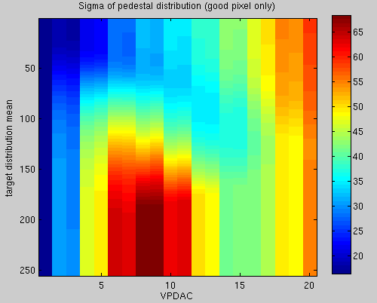
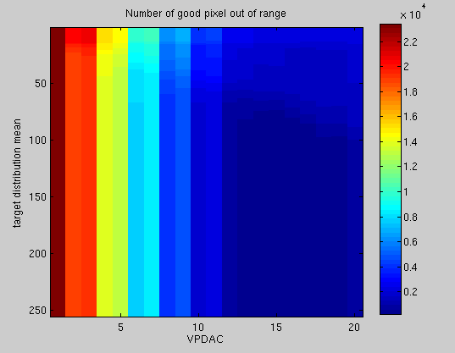
Quality criteria
Criteria:
Distribution width or sigma
Optimization can go wrong. All pixel at max or min value is a nice small distribution. -> additional logic needed.
Number of Pixel out of dynamic range
Not good for final optimization. Very different settings yield the same quality.
Position of 0.05 and 0.95 quantile
Convolution of multiple criteria
Normalized sigma + normalized bad pixel count
Sigma/# good pixel

Slide 11
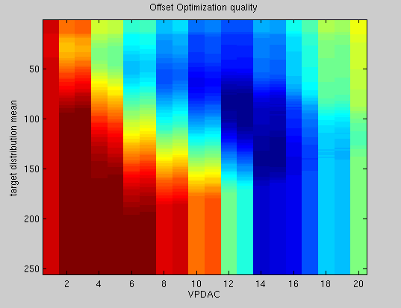
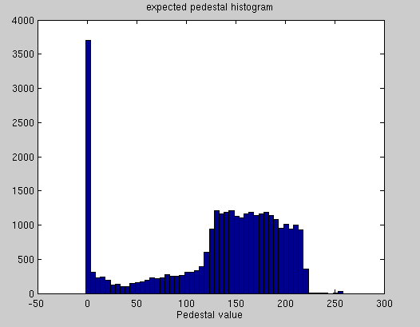
Results
Normalized sigma + normalized bad pixel count
Not optimal yet
Pedestal too low,
Reduced dynamic range from DCD
ADC <40

Slide 12
Limitations
Bad Pixel finder and Out Of Range check works with global threshold. Use local threshold instead
E.g. some ADC Channels start at ADC value 20 instead of ADC Value 1
Does DAC current changes depending on other DAC setting? Settling time?
VPDAC not linear and very strong
128 values.
Value 30 already strong enough to move pixel from below dynamic range to above dynamic range
~20-25 of 128 settings usable
DHP Issues.
No automatic checks possible - do everything by hand

Slide 13
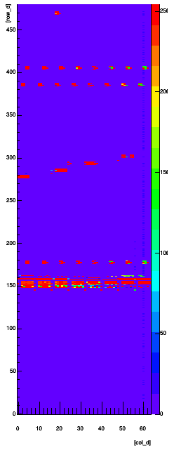
Outlook
Upload of Offset DAC Data
Upload works
Mapping currently work in progress – different timing settings available.
Check if expected Pedestals correspond to real pedestals
Check if DACs influence each other
Compare known expected pedestals with measured ones.
Gradient over Columns
DCD Problem?
Power issues?

Slide 14
Speed Issues
DCDB samples twice, but only one sample is used for comparison with threshold
No problem if signal constant
On rising or falling signal, in some cases signal clips to -65/63, -1/+1, +63/+65
Big matrix – large capacitance – slower signal
Sample as close as possible before clear signal
Best Setting – still artifacts are observed
Is the amplifier of the DCD too slow?
Better Settings?
Voltages?
DCDB4 Pipeline samples once but slower
Needs same time than DCDB2 for both samples

Slide 15
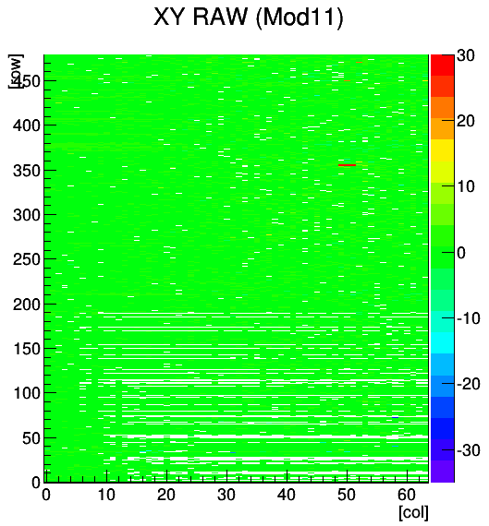
Laser on Hybrid 6
Laser spot on Hybrid 6 visible
Laser focused with microscope
Raw readout

Slide 16
Thank you

