Slide 1

Readiness of the FOS monitor for the thermal mock-up and recent activities.
Kloster Seeon, 16th DEPFET Workshop
E. Currás, D. Moya, I. Vila, A. L. Virto., J.González
Instituto de Física de Cantabria (CSIC-UC)
G. Carrión, M. Frövel.
Instituto Nacional de Técnica Aeronautica (INTA)

Slide 2
Outline
Status and open issues concerning the FOS for the mock-up.
Report on improved thermal calibration and humidity sensitivity.

Slide 3
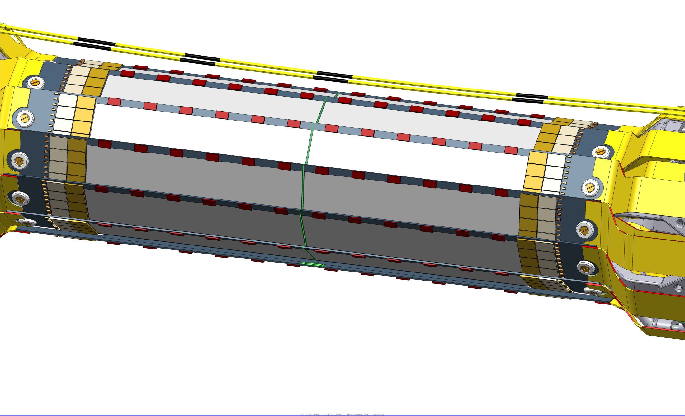
Fiber cables and sensors for the mock-up
Four cables with four sensors
Additional FOS with not specific support (see next table)

Slide 4
FOS at DESY test beam
Fibres for PXD thermal set-up
Fibre Nº | Nº of sensors | position | protection | parameter
51 | 4 | On top of PXD on air | Teflon | Temperature
52 | 4 | On top of PXD on air | Teflon | Temperature
53 | 4 | On top of PXD on air | Teflon | Temperature
37 | 4 | On top of PXD on air | - | Temperature + humidity
38 | 4 | On top of PXD on air | - | Spare
OS-4210 | 1 | To be defined | metal | Temperature
sensor 1 | 1 | To be define | Teflon | Temperature
sensor 2 | 1 | To be define | Teflon | Temperature
Fibre 1 polyimida | 2 | To be define | - | Temperature + humidity
Fibre 2 polyimida | 2 | To be define | - | Temperature + humidity
SN89356/0003 | 1 | To be defined | metal | Temperature
 | New sensors
 | January Test Beam sensors
DAQ integration using January test beam EPICS driver

Slide 5
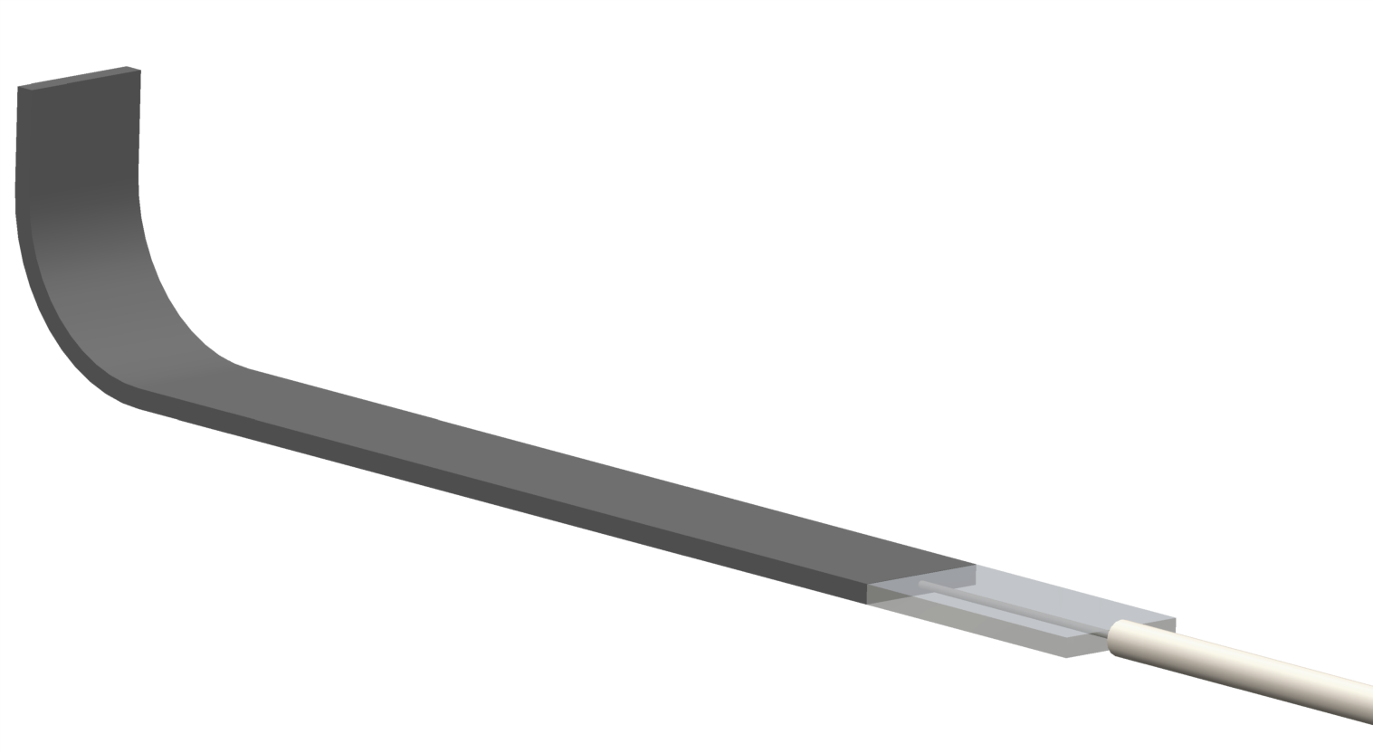
Open issues
Dimensions and fixation of l-shapes.
CFRP L-shape
Fiber egress protection
30 mm
7 mm
3.5 mm

Slide 6
Absolute calibration temperature calibration of fiber sensors
NIST traceable temperature reference sensors.
Measure both long range sensitivity and absolute value.

Slide 7
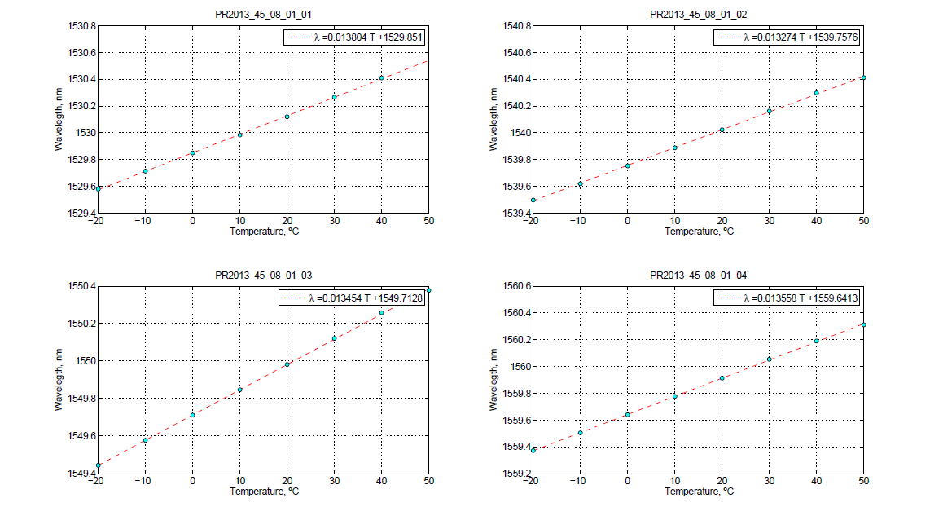
Nist traceable FOS temperature calibration
Four FOS sensors same fiber cable

Slide 8
Questions & Comments ?
Supporting documentation and manual under preparation.
Assuming installation of fibers by mid of July.
Installation of L-shapes in September ?

