Slide 1
Rad damage in direct detection
$$TID\left[rad\right]=\frac{dE}{dx}\left[\frac{MeV cm2}{g}\right]∙Φ[\frac{e^{−}}{{cm}^{2}}]∙1.6∙{10}^{−7}$$
$$\frac{dE}{dx}\left(250keV e^{−} in SiO2\right)=2.1\frac{MeV cm2}{g}$$
(NIST)
Real-space imaging:
1e8 electrons, 100% occup., 4e6 e-/cm², “homogenous” on 25cm² → 0.64 rad/shot
80kHz repetition rate → 51 krad/s (on sensor)
Diffraction imaging:
1e6 electrons in 100(???) pixel, “in-homogenous”, 1 reflex in 4 pixel → 1e4 e/1e-4 cm²
1e8 e-/cm² → 16 rad/shot
1kHz repetition rate → 16 krad/s (local)
TID: Oxide/interface damage → Vth -> more negative → need to compensate

Slide 2
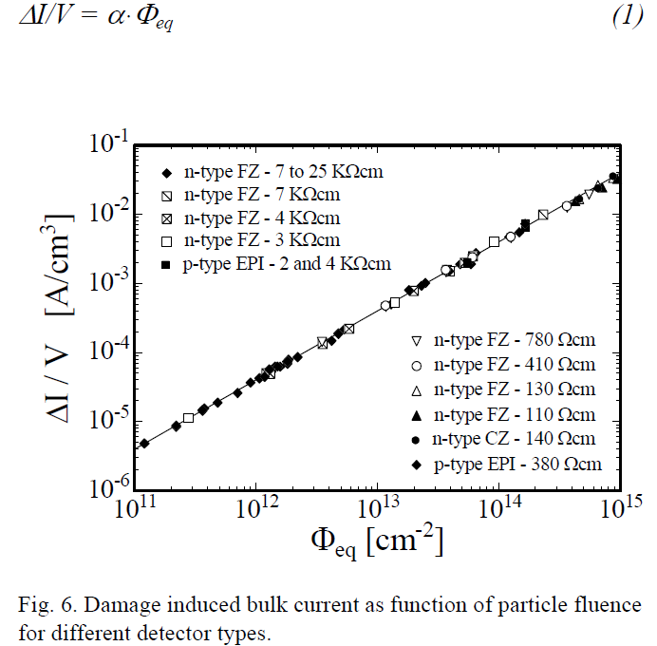
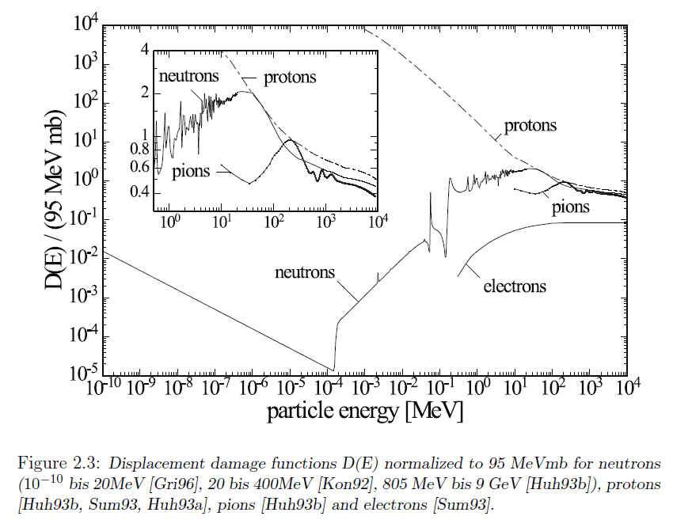
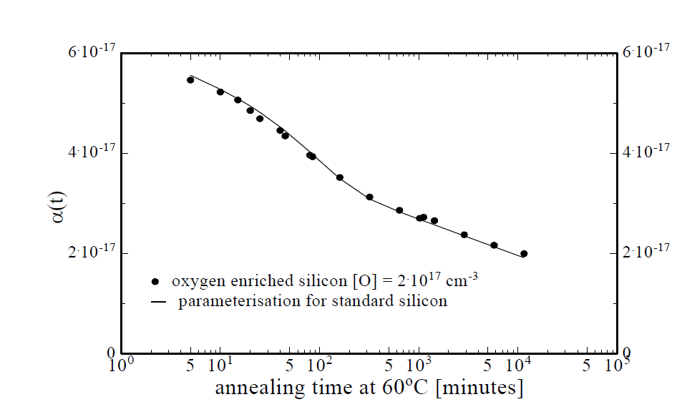
NIEL Damage
:- NIEL → leakage current increase
:- Normalize NIEL Damage to 1MeV Neutrons
:- Andreas Ritter:
Hardness factor for 10 MeV electrons ~1/100
:- ~100 keV even smaller, but non-zero
:- measure!!!

Slide 3
Irradiation plan
:- irradiate with lowE electrons, few 100keV, as a function of fluence
:- first approach
:- MOS caps under bias
:- non-biased PiN diodes
:- 1cm² chips mounted on ceramic carriers
TID and NIEL Damage without uncertainty of conversion to rad and n_{eq}
High-temp annealing studies
:- a nice Master Thesis or so
:- details on irradiation facility at MPSD?
:- space??
:- how to bias?

Slide 4
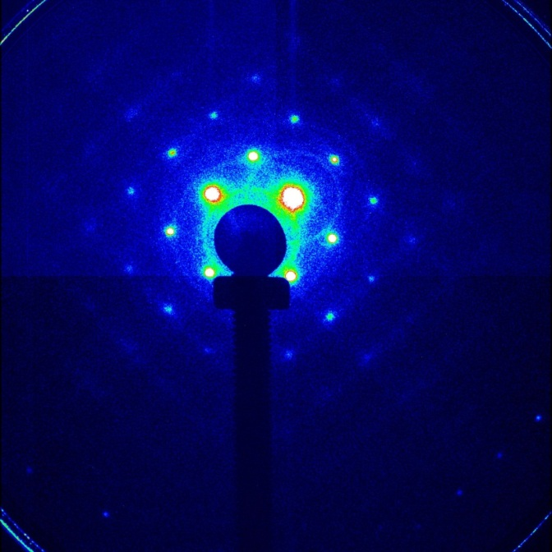
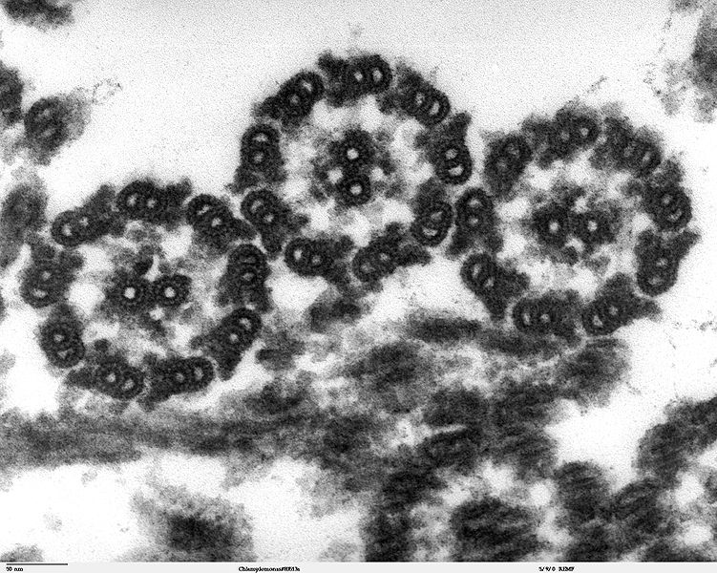
Applications (info from Sascha)
Diffraction imaging
Real-space imaging
1000 Hz +/- full frame rate
10 % of the Pixels are >90 % filled
90 % of the Pixels are <10% filled
Primary electrons 60 -300 KeV and 1-5 MeV
1E5-1E8 electrons within < 1ps, (1000 Hz rep. Rate)
80 kHz +/- full frame rate
100 % of the Pixels are 50 % filled on avarage all values within the dynamic range exist. Normally distributed around 50% .
Primary electrons 100 -300 KeV
1E8 electrons within < 10ns, (80 kHz rep. Rate)

