Slide 1
BPAC Preparation and SVD Schedule
6th Belle II VXD workshop

Slide 2
Meeting Schedule
October
3rd – 4th Oct: Pisa site qualification (class C)
31st Oct. - 1st Nov: IPMU and TIFR site qualification (class C)
Do we really need two days?
November
3rd - 6th Nov: B2GM (KEK)
7th Nov: VXD mechanics meeting (KEK)
7th – 8th Nov: Rehearsal for SVD review (IPMU)
Do we need 2 days?
9th – 10th Nov: SVD readiness review (IPMU)
December / January
Site qualification HEPHY and Melbourne → date tbd

Slide 3
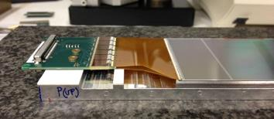
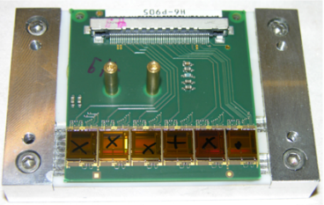
BPAC Milestones: Pisa
Hybrid sandwich production
Procedure and jigs verified
First sandwiches produced
BW sub-assemblies (SBW)
Final jigs available
2 class C for IPMU and TIFR → 4th Oct.
class B for HEPHY → 4th Oct.
FW sub-assemblies (SFW)
Using temporary jigs
Design and productions of final jigs → 15th Oct. ?
class C for IPMU → 10th Oct. / for TIFR → late Oct. → when?
class B for HEPHY → 15th Oct.
Class C Site qualification: 3rd – 4th Oct.
Late October

Slide 4
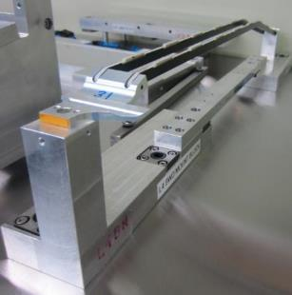
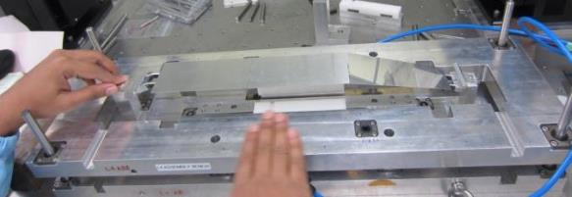
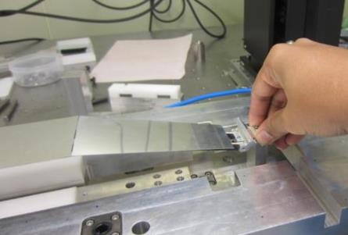
BPAC Milestones: TIFR
Mockup based on rev. 1 built in July
Finishing of design and production of final jigs
more than 90% finished and verified with CMM
To-do: BW & FW pickup jigs
Preparation and programming of gluing robot
Preparation of wire bonding programs
Build 1-DSSD Origami module
Sensor available?
Electrical characterization with APVDAQ
Assembly of Class C ladder → early Jan 2015
Class C FW sub-assembly ready by late Oct.
Site qualification: 31th Oct.
Possible without a class C module?
Shall we postpone to February B2GM?

Slide 5
TIFR: Manpower @ IPMU (Sep-Nov 2014)
Kamesh: 17th Sep - 17th Oct*
Nisar: 17th Sep - 12th Nov
Subhashree: 15th Oct - 26th Nov
Gagan: 26th Oct - 11th Nov
*Kamesh may return to IPMU in November if FW/BW sub-assemblies are made available by 20th Oct.
Long-term travel plan to be presented at BPAC
See backup slides for tentativ schedule

Slide 6
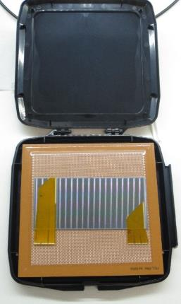
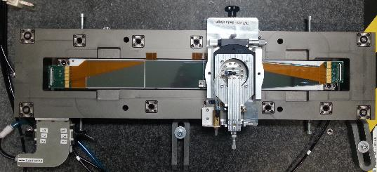
BPAC Milestones: HEPHY
Production of final jigs → almost done
ToDo: BW and FW pick up jigs
Need final drawings of MP jigs
Verification of jigs and procedures → ongoing
Build class C Origami sub-assembly → ongoing
Build class B L5 ladder for beam test
17-24 Nov. @ SPS, CERN
Fully electrically functional
Might not have final mech. precision
Origami flexes from pre-production → no cracks!
Will start next week
Full site qualification in January 2015
19 Jan. 2015?
VXD workshop 21-23 Jan. (tbc)
wire bonded SPA in storage box

Slide 7
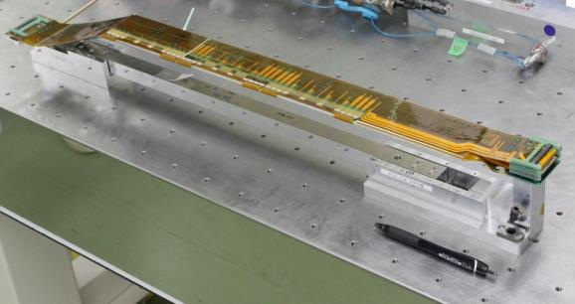
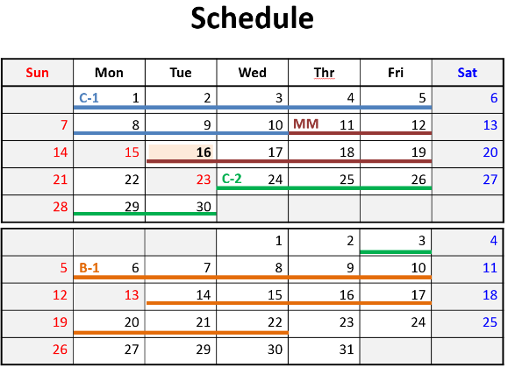
BPAC Milestones: IPMU
Verification and test of final jigs
Build class C ladders
C-1: finished, verify jigs, procedure and wire bonding efficiency
C-2: mech. precision measurement with CMM, cutting method for Airex
MM: partial dummy ladder to study wire bonding of -z
B-1: readable Origami sub-assembly with class C FW and BW sub-assembly?
Do we have enough sensors to be used for partial class B ladders?
Class C site qualification 1st Nov.

Slide 8
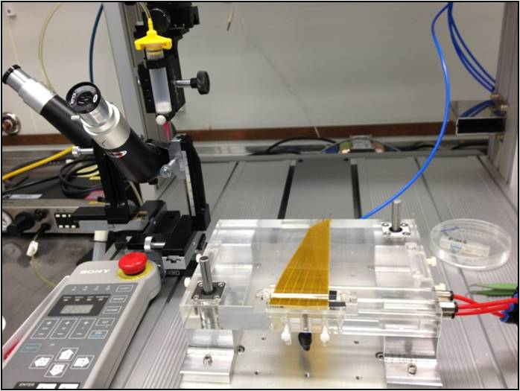
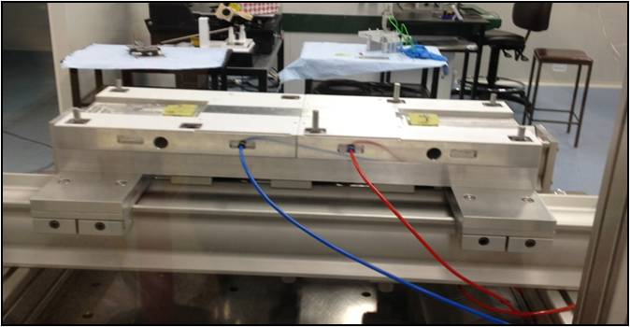
BPAC Milestones: Melbourne
Finishing production of jigs
1 jig remaining
Set up hybrid gluing
Verify assembly procedure
Verify sensor alignment
already done
Finalize wire bonding programs
Assembly class C ladder
Site qualification in Jan. 2015?

Slide 9
Information to be Prepared
Equipment at assembly sites
Clean room, CMM, Bonder, Gluing robot, etc.
TIFR and IPMU:
Plan how commonly used equipment is shared
Access to clean room for TIFR people
Manpower overview
Who is responsible for which task
TIFR:
Organization of assembly teams → Who are the team leaders
How to assure uniform quality of both teams
How is the training of the teams organized
Schedule
Duration of assembly of one ladder / sub-assembly
Duration of full production
TIFR: Long-term travel and stay schedule of teams!

Slide 10
Documents
SVD Twiki
To be reorganized → discussion in IB meeting
Add or complete information on assembly site pages
https://belle2.cc.kek.jp/~twiki/bin/view/Detector/SVD/SiteQualificationPage
Assembly manual
Structured manual
Process flow chart
List up all assembly tasks
Description of each task
Work instructions
Matched with tasks in process flow
Format
Twiki pages → create PDF file(s) for reviewers
Standalone document (PDF) → upload or link it to Twiki page

Slide 11
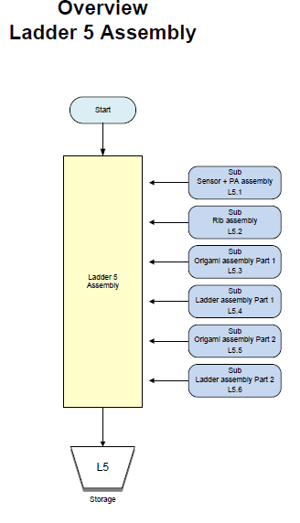
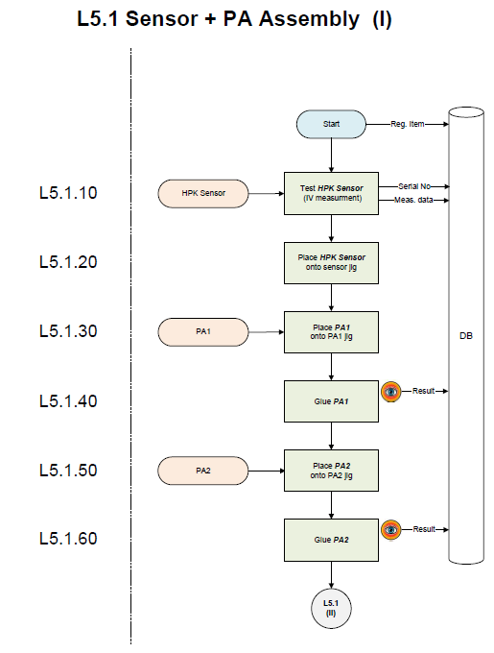
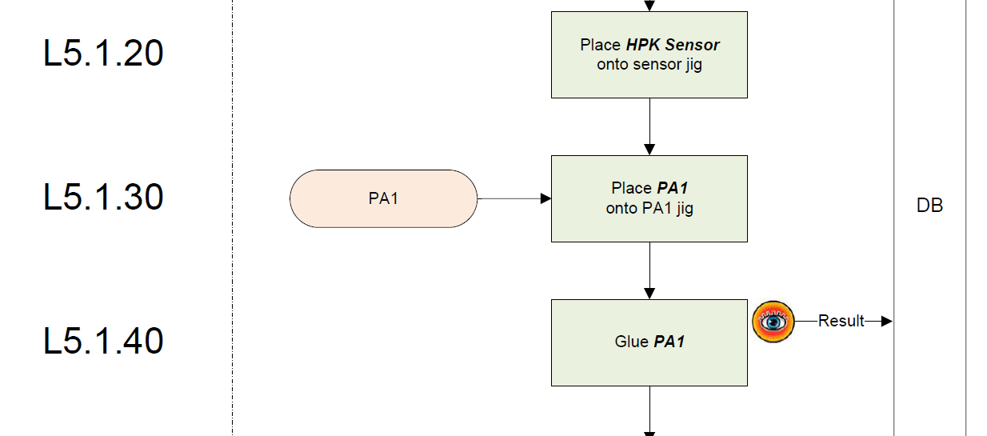
L5 Assembly Process Flow
Main task
Input items
Main task
Assembly steps
Individual Tasks
Described in work instructions
Inspection or
function test
Work instruction for each task
Data to be stored in construction DB
Task number refers to work instruction
L5 process flow

Slide 12
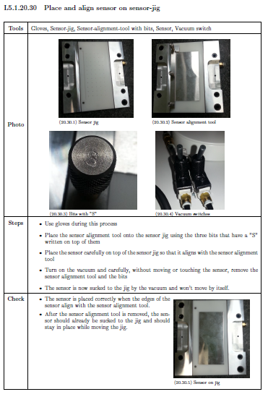
L5 Work Instruction
Task number and name
List of tools and components
Photos of components and / or
assembly steps
L5 assembly manual available on Twiki page
Links to documents on SVN
https://belle2.cc.kek.jp/~twiki/bin/view/Detector/SVD/ViennaPage
Automatically updated
Still in progress
Can be used as template for other layers
Detailed but short description of Task
Things to be verified or considered. Pictures good vs. bad

Slide 13
Tentative BPAC Agenda
Tentative agenda available as Google spread sheet
https://docs.google.com/spreadsheets/d/1FETwDeGazYBz8s9AVe_mUbn52lHJAJvKPDzykLGDkJk/pubhtml
Please also read the column “Content / Remarks”

Slide 14
BPAC Agenda – 1st Day General
General presentations
Physics requirements and performance of the SVD (K. Hara)
SVD group organization and construction schedule (C. Irmler)
SVD mechanics overview (M.Friedl)
Ladder production specific talks
Ladder components production status (K. Hara)
Logistics (M. Friedl)
Overview about parts shipment and (tentative) schedule
QC/QA, internal site readiness review (F. Forti)
QC/QA guidelines and procedures
Construction DB
Site reviews

Slide 15
BPAC Agenda – 1st Afternoon
Ladder assembly
L4-L6 ladder assembly procedure (Y. Onuki)
Description of ladder assembly procedure
Please include FW/BW sub-assemblies from Pisa
Compare with L5 work flow
FW/BW sub-assembly procedure (S. Bettarini)
L3 ladder assembly procdure (G. Taylor)
Assembly site reports
FW/BW, L4, L5, L6, L3
Describe the current status of assembly site
Equipment, Manpower, Schedule, QC procedure
Assembly manual
Open issues
Achieved milestones → highlights (e.g. class C/B ladder)
etc.

Slide 16
BPAC Agenda – 2nd Day Morning
Clean Room Visit
Demonstration of tools
Demonstration of selected assembly steps
E.g. PA bending
Electrical testing
etc.
SVD structure status (S. Tanaka)
Design and production status of cones, end-flanges, outer shell, etc.
Ladder mount procedure (T. Tsuboyama)
Procedure, tools, alignment, etc.

Slide 17
BPAC Agenda – 2nd Day Afternoon
Thermal Mockup Status (tba)
Carsten will provide information → need to assign speaker
Electronics and Grounding (M. Friedl)
Overview, status and schedule of SVD electronics
Electrical performance and test beam results (K. Nakamura)
Results of DESY beam test
Open issues (K. Hara)
List of unsolved issues
Ideas and scenarios how we plan to solve than
Priority of issues
Schedule control and management of unexpected problems (C. Irmler)

Slide 18
BPAC - Timeline
Time
3-4 Oct.: Pisa site qualification
Prepare Indico page with agenda
To be done within next 1-2 weeks
Assembly manuals and presentations
~2 weeks before review
Reviewers need some time to study them
Might be modified afterwards
End of Oct.: working L5 ladder
31 Oct. / 1 Nov.: TIFR and IPMU site qualification
TIFR most likely postponed to Feb. 2015
9-10 Nov. Assembly readiness review
7-8 Nov. rehearsals at IPMU
Jan. 2015: HEPHY and Melbourne site qualification
Full qualification base on class B ladders

Slide 19
SVD Schedule
No significant change since July B2GM
Start of production mainly driven by the PA0 problem
Need to find a solution asap
We can start with FW/BW sub-assemblies
Need to define schedule for shipment of components
VXD integration at the same time as BEAST phase 2
Now starting from Dec. 2016
VXD installation
Summer shutdown 2017 (Jul. – Sept.)
Need to prepare detailed schedule together with PXD group

Slide 20
SVD Schedule
Needs to be shifted due to PA0

Slide 21
Thank you! Let’s start discussion.

Slide 22
Backup

Slide 23
TIFR: tentative visit plan to IPMU (2015)
Kamesh: 10th Jan - 28th Feb
Sukant: 10th Jan - 10th April
Varghese: 10th Jan - 10th April
Gagan: 24th Jan - 14th Feb
Sanjay: 25th Feb - 30th March
Mangesh: 5th April - 5th July
Nisar: 5th April - 5th July
Kamesh: 25th March - 15th May
Sanjay: 10th May - 15th June
Thomas: 28th June - 20th September
Varghese: 28th June - 20th September
Kamesh: 10th June - 10 August
Sanjay: 5th August - 10th September
Subhashree: 15th September - 15th November
Sukant: 15th September - 15th November
Kamesh: 5th September - 15th November

