Slide 1
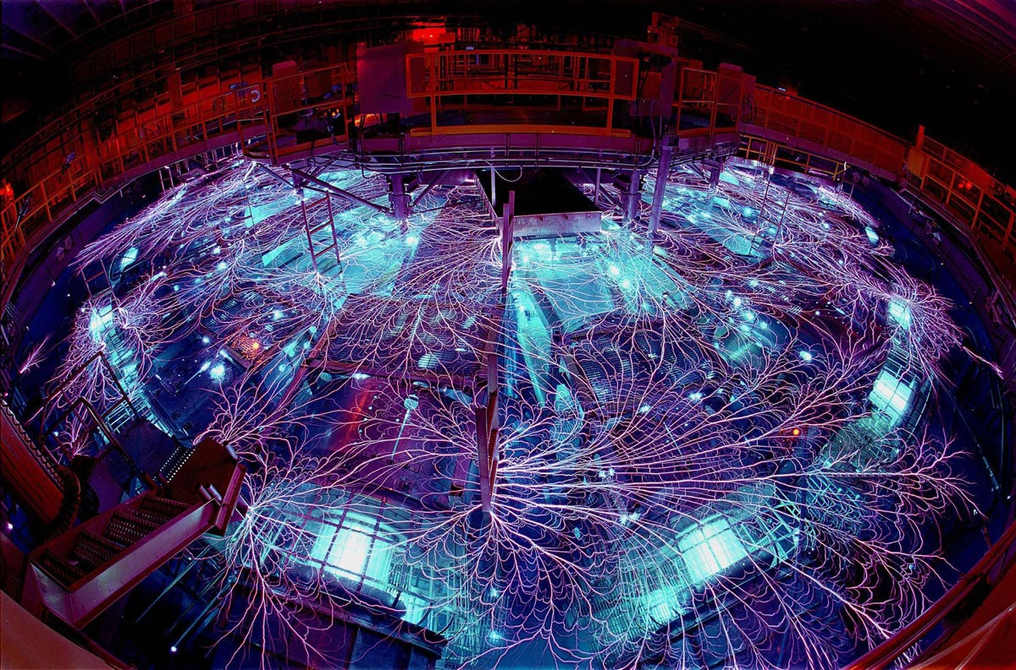
2 October 2014
Electrical Tests
of Modules and Ladders
Markus Friedl (HEPHY Vienna)

Slide 2
Introduction
We already know how to test bare
  Hybrids
  Origamis
See http://kds.kek.jp/getFile.py/access?contribId=3&resId=0&materialId=slides&confId=16355
Now we should think about testing modules (=hybrids with sensor with or without bias)
Purposes:
  Verification of (partial) wire bonding during ladder assembly
  Final tests of completed module

Slide 3
Possible Defects
Affecting full sensor
  No bias connection > no depletion > large noise
  Large common mode noise > could indicate problem with bias
Affecting single strips
  No connection > low noise
  Hot strip > high noise
  Shorted neighbors > half calibration signal (for 2 strips; lower to zero with more to many more)
  Pinhole > low/no calibration signal
Defect may lie with PA and/or sensor
Common mode correction (CMC) can invert low <> high noise
Calibration run (includes noise) needed to find all those defects

Slide 4
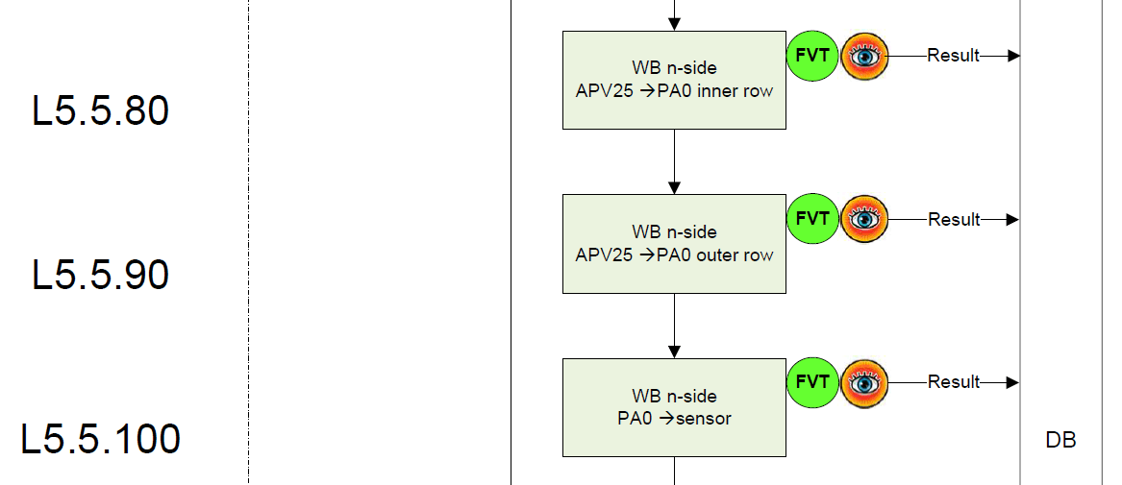
Origami Assembly Flow: n-Side
n-side APV25
Origami
+PA0
DSSD
Excerpt from L5 ladder assembly process flow (Twiki)
Electrical test after each step
n-side bias bonds are made initially

Slide 5
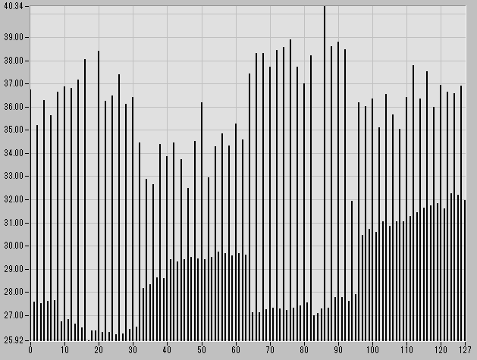
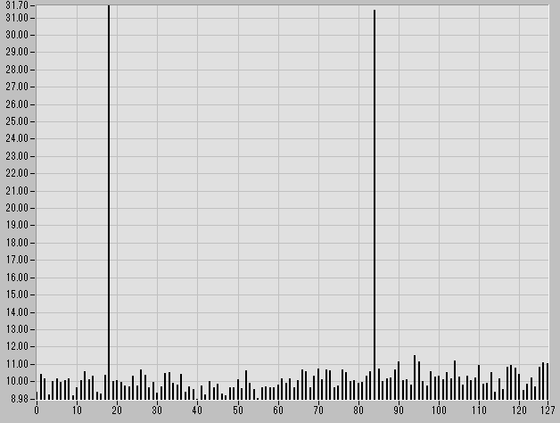
Electrical Tests: n-Side
No bias possible yet
Noise on n-side
  Inner row: higher for even strips (0,2,…)
    Never tried – not clear if really visible
  Full PA0: slightly higher and uniform
  Full DSSD: much higher (no bias)
Screenshots by Sasaki-san
  Upper picture: ½ connections made on both APV and DSSD sides
    Even/odd structure clearly visible
    Con: no way to distinguish PA and DSSD problems
  Lower picture: n-side completed
    Average noise level ~10 ADC

Slide 6
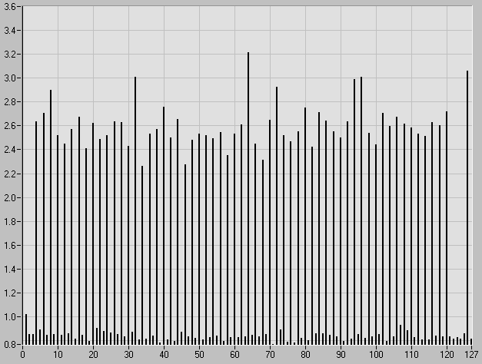
What to Learn Here?
Deviations from ideal pattern indicate problems
Here: most likely bad wire bond to PA > attempt to repair

Slide 7
What We Can and Can’t Do On n-Side
Remember: we have no bias yet
  Would require p-side wire bonds which cannot be placed yet
Without bias, we can find
  No connections
  Shorted strips
We cannot (reliably) find
  Pinholes
  Hot strips
Luckily, pinholes on n-side are harmless
  Only p-side is affected

Slide 8
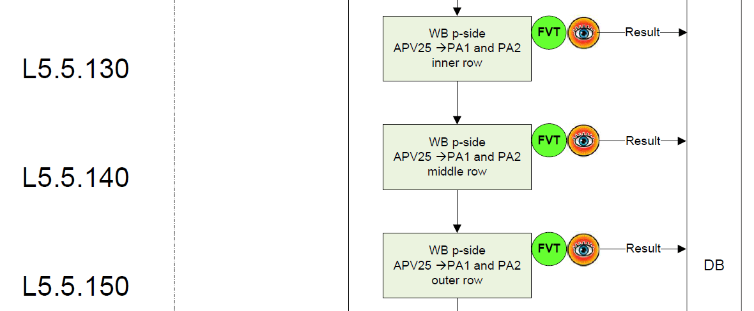
Origami Assembly Flow: p-Side
PA1/PA2
p-side APV25
DSSD
Similar to n-side case
Sensor side is already bonded to PA1/PA2
p-side bias bonds are made initially

Slide 9
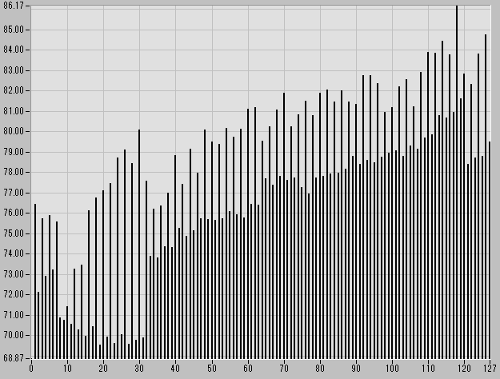
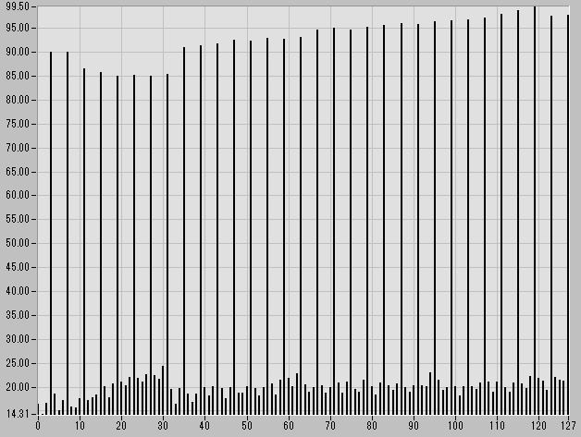
Electrical Tests: p-Side
Bias bonded first
  Start with simple IV measurement
Noise on p-side (no bias)
  Inner row: higher for even strips (0,2,4,…)
  Middle row: higher for all except 3,7,11,…
  Outer row: higher and uniform (no bias),
  somewhat lower (with bias)
Screenshots by Sasaki-san
  Upper picture: inner row bonded
    Even/odd structure clearly visible
  Lower picture: inner+middle rows bonded
    High noise for every 4th strip
    (CMC inverts low <> high noise)
CMC effect

Slide 10
Semi-Final Measurement
Electrical test (with bias) after finishing all bonding reveals
  If biasing works (noise must decrease for both p- and n-sides)
  Pinholes and hot strips
Wires of p-side pinholes & hot strips should be removed (with pull tester)
Reliable pinhole detection using separation voltage between p-bias and local APV ground
  Calibration curve amplitude changes vs. separation voltage
  DAC add-on circuit to be supplied to all ladder assembly sites
  Allows separation voltage to be set by software (automated measurement procedure)

Slide 11
Remedy For Too Many Pinholes
Only current flow INTO APV is problem = p-side only
Remedy: offset voltage between HV bias and APV_GND

Slide 12
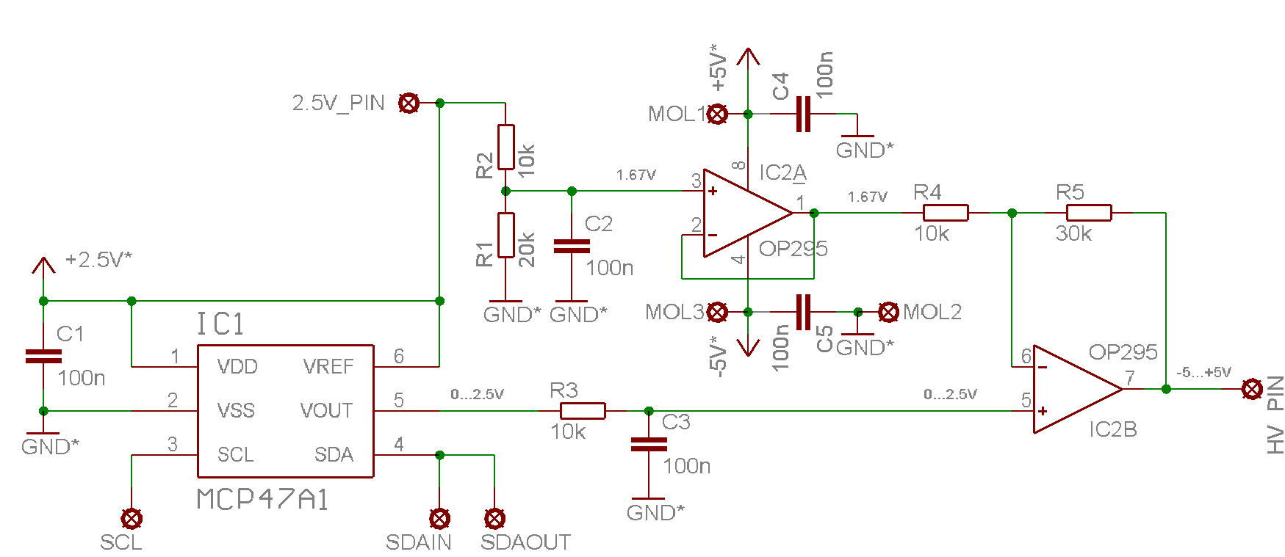
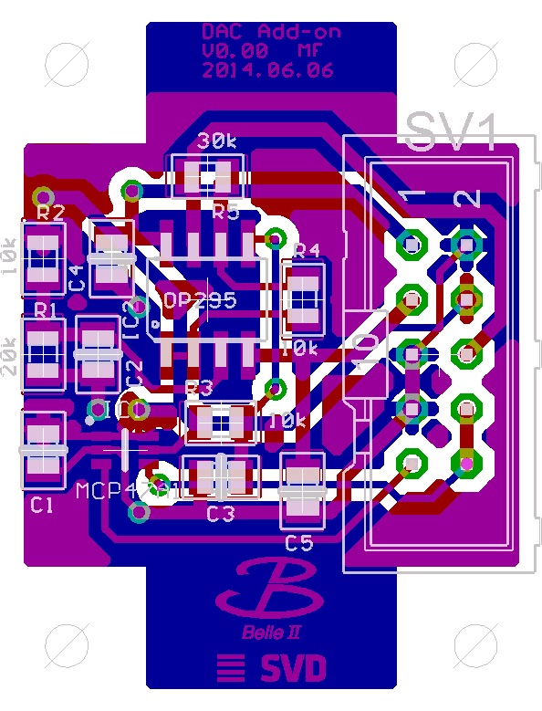
DAC Add-On for APVDAQ Test System
DAC circuit which can create -5…+5V offset to HV
  Tested OK, PCBs (25x33mm²) received but not yet assembled
Connection points to repeater board

Slide 13
Final Measurement
Source or laser scan
Real measurements of sensor signals
Requires
  ⁹⁰Sr source with trigger scintillator+logic
    or
  Pulsed laser with trigger input or output
  (APVDAQ needs NIM input signal for external trigger)
  Movable stage to change position of ladder relative to source or laser
  Software control for movable stage to scan one sensor of the ladder at a time

Slide 14
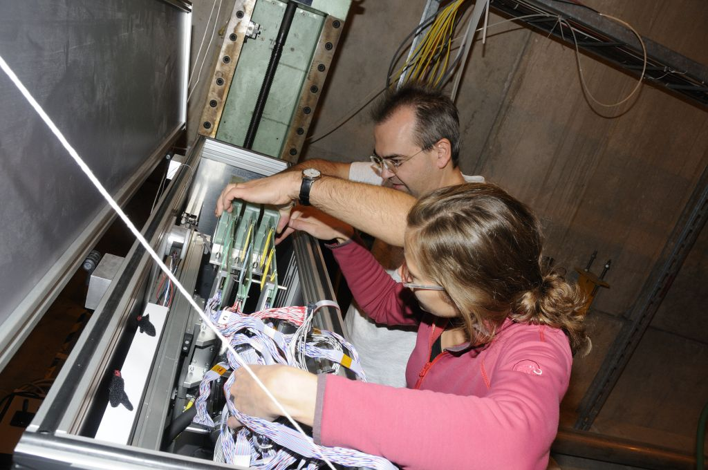
Vienna Solution
Light-proof box with xy control for ladder motion
Source + PM are mounted in the center
So far used in
beam tests
(without source)
Allows CO2
cooling & dry gas
flushing

Slide 15
Additional Information
Twiki: Origami Wire Bonding Order (step-by-step table)
https://belle2.cc.kek.jp/~twiki/bin/view/Detector/SVD/OrigamiWireBondingOrder
Sasaki-san: Origami measurement data
http://hep.phys.s.u-tokyo.ac.jp/~sasaki/sasaki_eqa_document.zip
http://hep.phys.s.u-tokyo.ac.jp/~sasaki/add_eqa_docu.zip
(this is also the source of the wire-bonding sketches)
  Also includes suggestions for good/bad thresholds
  Probably a bit too early to decide about grading

