Slide 1
Status & schedule of ladder parts production
Oct. 2, 2014
Koji Hara (KEK)

Slide 2
Ladder Parts
Ribs (L3-L6)
Airex sheets
L3 mount bridges
BWD End mounts, APV covers, Kokeshi pins
FWD end mounts (incl. SLM), APV covers, Kokeshi pins
L4-L6 Hybrids
L3 Hybrids
Origame CE, -Z, +Z
Pitch adapters
Pipe clamps (already delivered)
Sensors

Slide 3
Ribs (L3): already delivered to Melbourne
Ribs (L4, L5, L6):
re-production of CF sheets ongoing
→ followed by micro-waterjet-cutting
→ Already delivered to assembly sites
Airex sheets (L4, L5, L6):
Already delivered to IPMU

Slide 4
L3 mount bridges and spacers
12 sets have been produced for Melbourne
8 BW, 11 FW are at Melbourne (4 BW, 1 FW are at KEK)
8 sets (BW are mechanical sample) for DESY thermal mockup
→ brought from KEK in this workshop

Slide 5
BW End mounts, APV covers, Kokeshi-pins
75 sets are produced
5 sets are sent to HEPHY for mockup study
70 sets are at IPMU for L4,5,6
Ready to use for mockups
Need to add an additional screw hole for grounding
New position given by Florian in this workshop
Additional 40 sets have been produced for DESY thermal mockup
10 sets brought in this workshop

Slide 6
FW dummy end mounts without SLM for mockup study
30 sets of end mounts and Kokeshi-pins produced
5 sets are sent to HEPHY
10 L6 APV covers available, but no L4-5 APV cover
FW end mounts with SLM
120 sets have been produced including those for thermal mockup
70 sets with L4-5 APV guard
50 sets with L6 APV guard
5 sets brought for HEPHY
5 L4-5 + 5 L6 sets brought for thermal mockup

Slide 7
L3, L4-L6 FR4 Hybrid boards
44% of L4/5/6 hybrids completed
31% of L3 hybrids bonded, 12% tested and shipped

Slide 8
Pitch adapters 1-layer 3-row
All 10 types have been produced
Class B samples also delivered
10 /type/site good samples
Issues :
Short found in “good” samples
Pad widths of P3B1 pieces of sheet 1 is smaller than others
Final production will take 1.5 months + contract delay
Verify the final specification
Start making contract in Oct.-Nov. in the order of
1. PF1,2/PB1,2
2. PA1,2
3. P3F1,2/P3B1,2

Slide 9
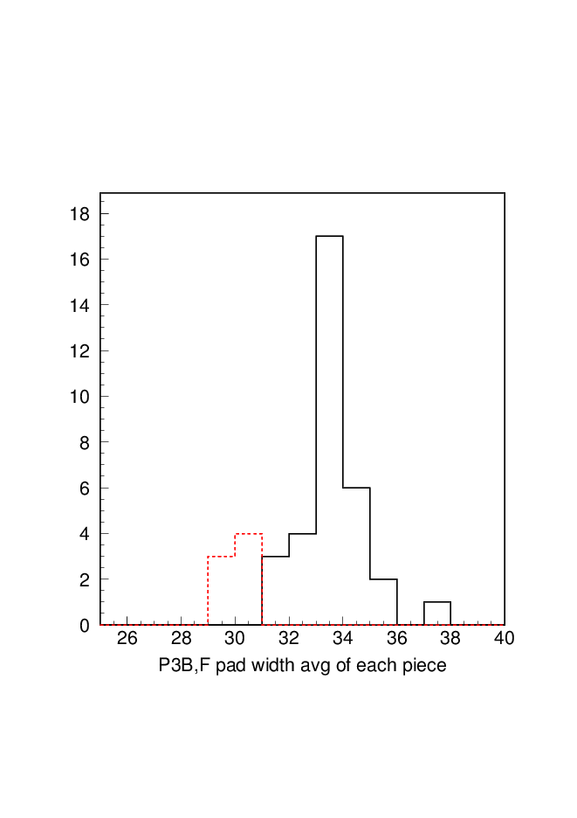
P3B1-3r.03-XX
Other P3F/P3B

Slide 10
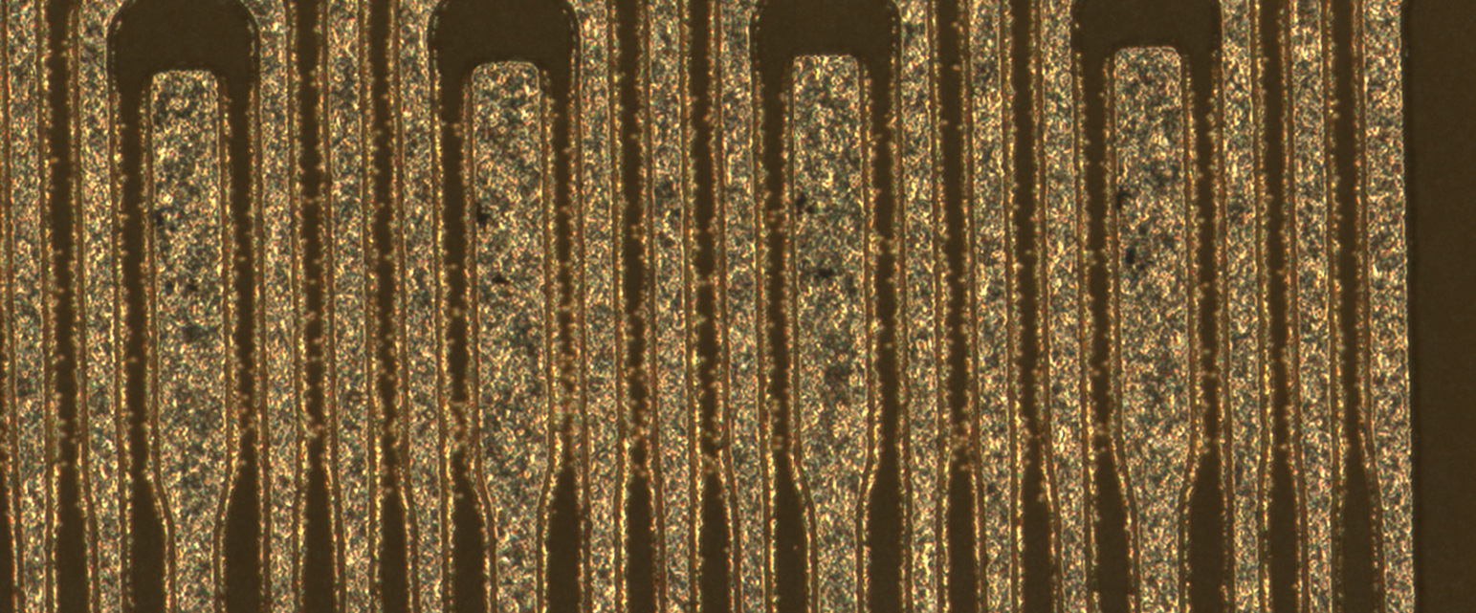
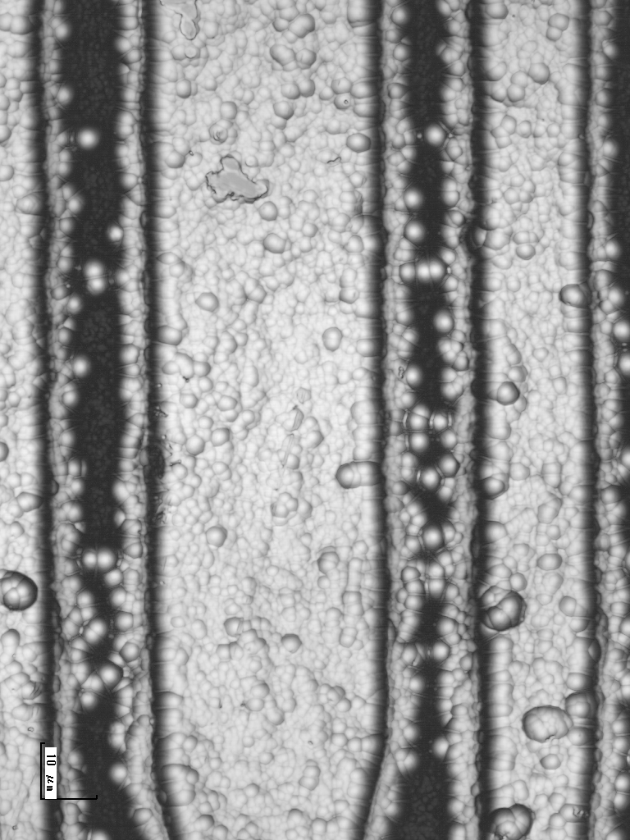
Short on P3F2-3r.05-01
We have also found other suspicious samples

Slide 11
The short in P3F/B samples found last week end.
All P3F1,2 /P3B1,2 good samples have been returned to Tokai Denshi
Answer received in Oct. 2 morning
“it is found short circuit test actually was not performed (!) because of the bad communication between Tokai Denshi and the company performing the test”
In the previous production >1 year ago, it was.
Confirming if it is only P3F/B but also in all others
Also asking possibility to reproduce other 8 types by their responsibility if the test has not been performed

Slide 12
Pitch adapter 2-layer
Samples of the initial production has been delivered
10 / type / site
B-class samples are also delivered
Delivery will be finished by June 23
No plan to produce more

Slide 13
HPK L3 sensors
24 good sensors produced, 21 at KEK
3 have been sent to Torieste and HEPHY for beam test and checks
11 mechanical samples sent to Melbourne
HPK large
167 good sensors produced, 160 at KEK
7 sensors brought to Italy / HEPHY for check
78 61 mechanical samples
20 at HEPHY
1 at Pisa (+ 8 early test production sensors)
57 40 at IPMU/KEK for L4, L6 and spares for L5 and FW/BW

Slide 14
Explanation of the excel file
Tsuboyama-san
Column H: Assignment. Priority is determined with the radiation level. Better DSSDs should go to inner layers.
Proposal
Priority | position | Assignments TIFR/HEPHY/IPMU/Pisa | Cumulative sum
1 | L4 barrel | 12+2/0/0/0 | 14
2 | L4 Backward | 0/0/0/12+2 | 28
3 | L5 Barrel | 0/28+4/0/0 | 60
4 | L6 barrel | 0/0/57+6/0 | 123
5 | L5 backward | 0/0/0/14+2 | 139
6 | L6 backward | 0/0/0/19+2 | 160
 | Total | 14/32/63/51 | 160

Slide 15
Micron Delivery
Thomas
Micron delivered 83 pcs in total
56 sensors (until summer)
3 mechanical samples
24 sensors on 15th of September 2014
Sensors from all but last shipment have been fully tested (59 pcs.) and qualified
Stripscan either by Trieste of Vienna
Longterm stability tests performed on all Micron sensors using Vienna climate chamber

Slide 16
Delivery Status by now
Thomas
Shipment | Delivered to CERN | Number of sensors | Strip scan done by | Current location
1 | 2 Aug 13 | 2 | Micron & Vienna | Vienna (IPR)
2 | 4 Oct 13 | 4 | Micron & Vienna | Vienna (IPR)
3 | 9 Oct 13 | 7 | Trieste | Vienna
4 | 22 Oct 13 | 4 | Trieste | Vienna
5 | 8.1.2014 | 12 | Vienna | Vienna
6 | 31.3.2014 | 14 | Trieste | Vienna
7 | 30.5.2014 | 13 | Vienna | Vienna
8 | 15.9.2014 | 24 (including replacements for rejects) | to be done | Trieste
Sum: |  | 80 (delivered) | (ordered 60) | 13 rejected so far

Slide 17
Quality
Thomas
Sensors have been qualified in three Classes:
Class A: perfectly working: 30 pcs.
Class B: (working with some minor problems):
Class C: not working -> mechanical samples
Summary of available sensors:
Class A: 30 pcs
Class B: 19 pcs (mostly due to scratches caused by testing in Vienna)
Class C: 10 pcs (including 3 mechanical samples delivered by Micron)
Not yet classified: 24 pcs.

Slide 18
L3 parts availability
11 mechanical sensors at Melbourne
Ribs delivered
8 sets of FW/BW bridges + spacers at Melbourne
More 4 sets are at KEK
3-PF1,PF2,PB1,PB2
3-row PAs mechanical samples at Melbourne
“good samples” returned to the company because of short problem
Final mass production to be completed in 2014 JFY
Hybrid
Hybrid samples at Melbourne

Slide 19
FW/BW, L4-6 parts availability
HPK mechanical sensors available at each site
Micron mechanical samples available
Ribs delivered
BW end mounts available
FW end mounts available
Origami
Mechanical samples available (15 / type / site )
100% APV equipped, 70% wire-bonded
Crack problems
PAs
1-layer 3-row PF/PB/PA delivered
“good samples” returned to the company because of short problem
Final mass production to be completed in 2014 JFY
Hybrid delivered
Need to define # of parts for each site

Slide 20
Status of Produced Origami
Assembled Origami :
wire-bonded/APV glued/Produced at Taiyo total (141 ordered) 102/141/151 +Z (27 ordered) 24/27/31 CE(48 ordered) 33/48/51 -Z (66 ordered) 45/66/69
(assembly is suspended now)
crack scan by CMM microscope
So far 22 Origamis checked → cracks found in all of them
Photographs of 512 pads are taken for each Origami PA0
→ damaged pads counted by eye-scan of them for 19 Origamis
Electrical probe test of assembled Origami PA0, PA0 to be produced for repair
Discussing Taiyo
The company used by Tokai Denshi answers us they can do the test of PA0.

Slide 21
PA0 history and crack
Cracks have been overlooked in Taiyo’s check (visual inspection)
We have checked Origami samples we have
Pre-production before 2013 Oct.
No cracks found
Modification of glue between PA0 layers in 2013 oct.
Acrylic glue -> epoxy glue
For radiation tolerance and to reduce curvature around PA0
Accompanying cover sheet under the glue was also changed
Cracks observed
Final production in late 2013
Found cracks in all samples we have checked so far

Slide 22
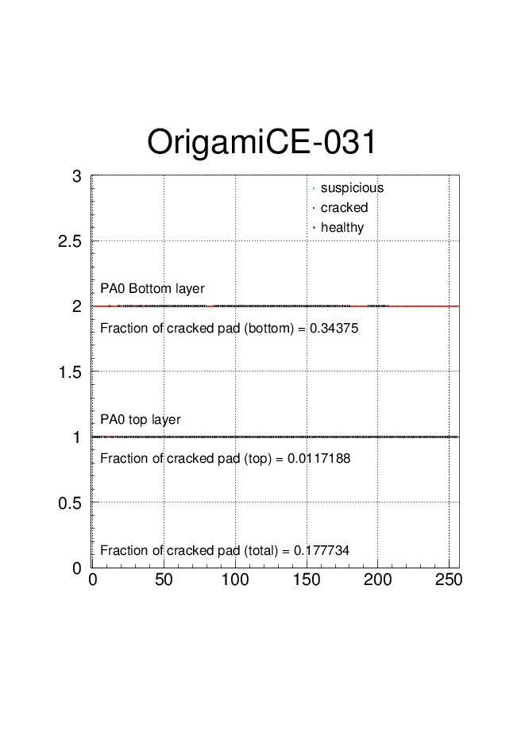
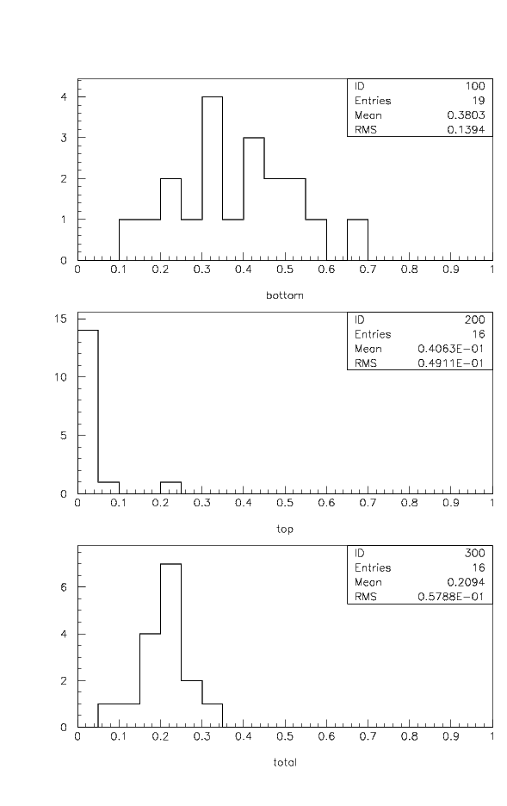
Fraction of pads with crack
(crack on the pad itself excluded)
Pad position

Slide 23
Improved PA0 production
Taiyo is trying to improve the production process
New blanking mold
Different glue between PA0 and Origami
Accompanied with different cover sheet on the glue
Glue between PA0 top and bottom layer is kept same
Taiyo made repaired Origami sample with new PA0 glued on existing PA0
→ Quality checked on Sep. 29 at KEK

Slide 24
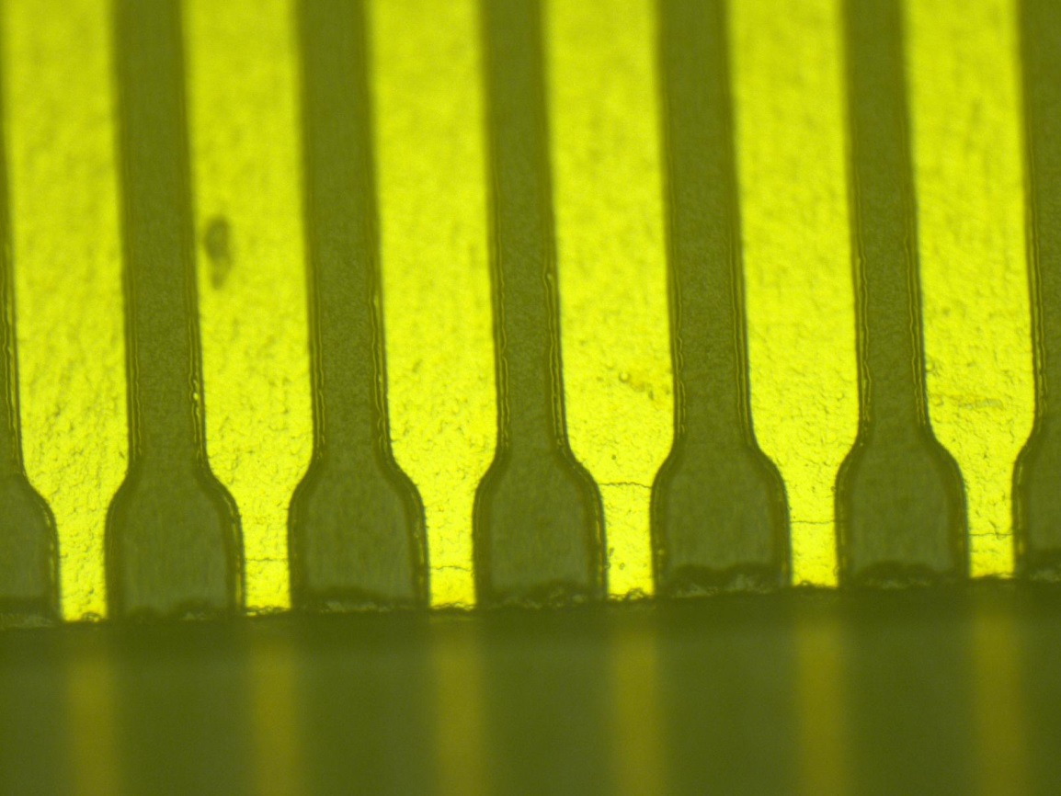
Still find many cracks on both layers
Also in the APV-side

Slide 25
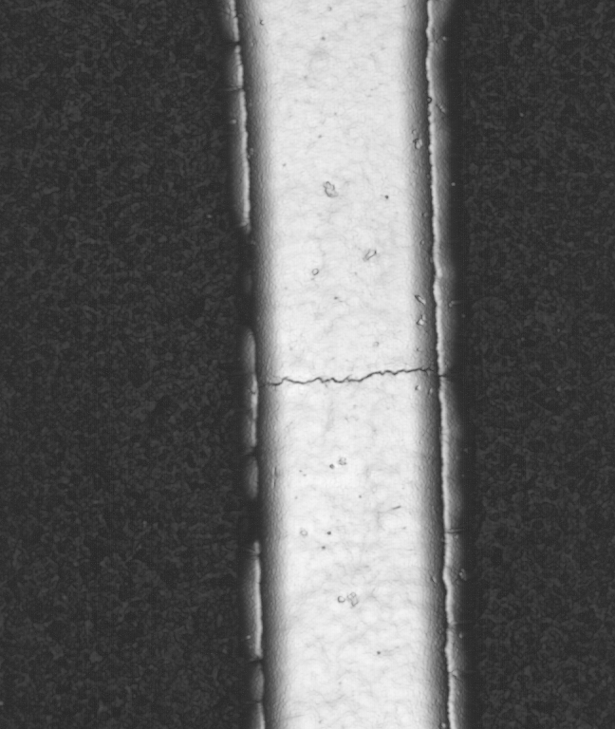
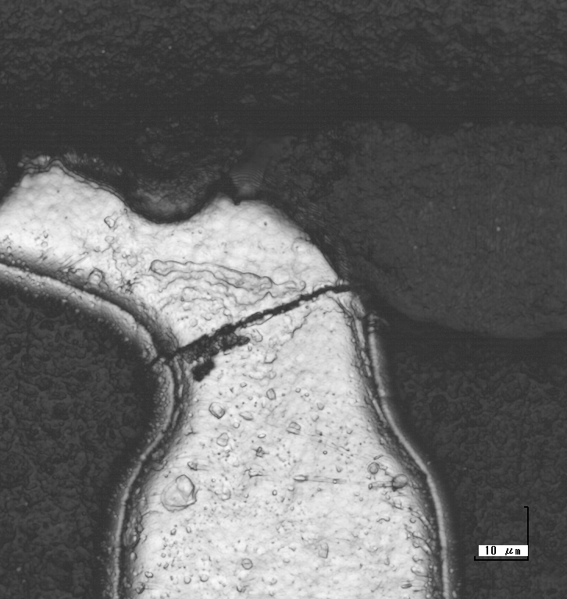
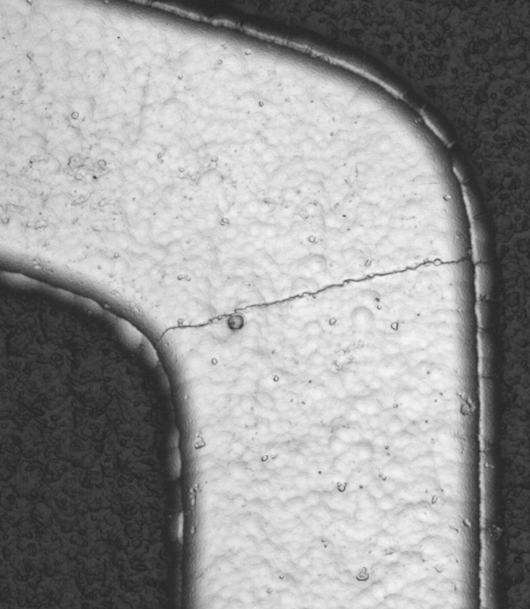
Before
After
The cracks after the modification are small but still there
Sample returned to taiyo
Taiyo is checking
Need more iteration

Slide 26
Solution for PA0 problem
Need to produce crack-free PA0
Must be electrically tested
Two possible (not impossible) ways
a) Gluing new PA0 without cracks on existing Orgami PA0
b) Full reproduction of Origami

Slide 27
Crack-free PA0 production
First trial at Taiyo was not successful
Smaller but many cracks
Taiyo is investigating the sample
Need more iteration
1st trial done in a month
→ another trials → expect to 3 months for 3 trials
2 weeks for the final production
Electrical test
The company used by the tokai denshi can do the test of PA0
Cost is about 550 Yen/piece → ~90,000 JPY @150 pieces
< 2 weeks (machine program and test of 150 pieces)

Slide 28
Gluing option
Gluing on existing PA0
Precise positioning is doable with existing alignment holes
Gluing without bubble is the key issue
Step between top and bottom layer
Selection of glue
Two options
Gluing by Taiyo
Acrylic-type glue sheet, hot pressed by small bars, avoiding touching APV and wires
1 month
Gluing by REPIC
Using araldite, cured in room temperature for one day
REPIC has experience of the similar situation
2 months
Gluing by REPIC is better

Slide 29
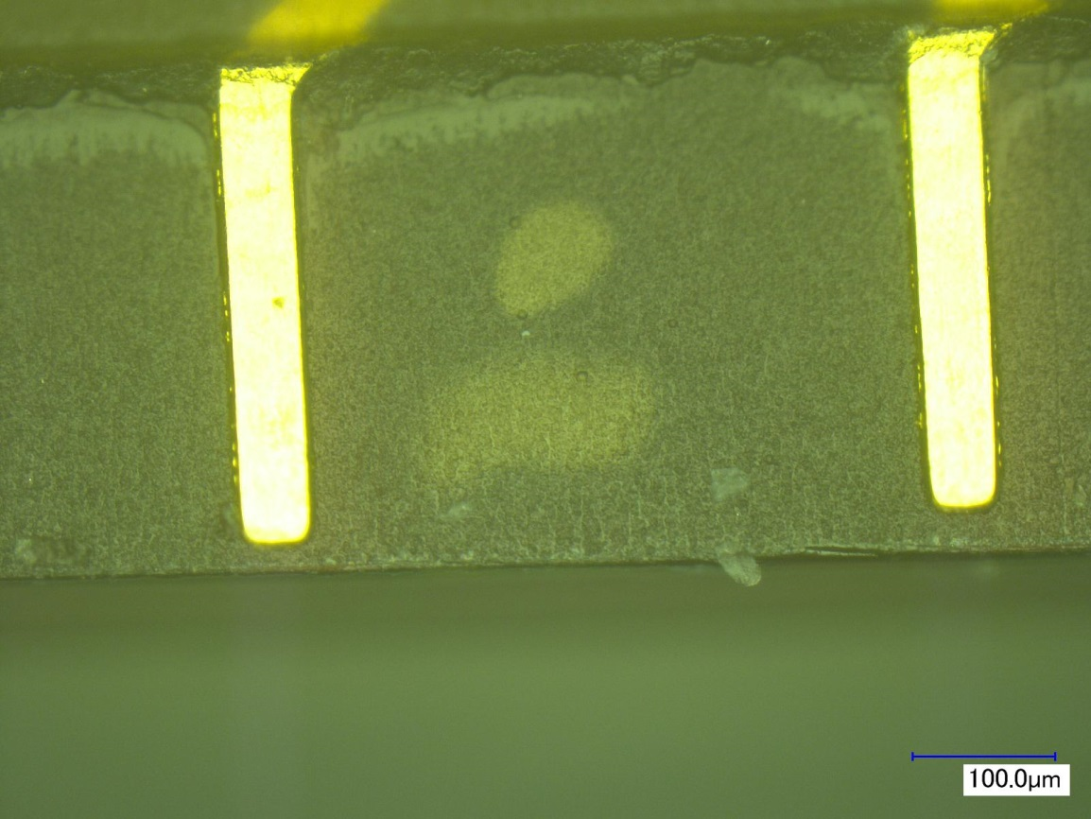
Taiyo glued sample
Bubbles between pads but not under the pads

Slide 30
Full reproduction
Need to procure parts → basically available
APV chips → available at CERN (diced), thinning possible (need to test to get the yield)
Connectors → 500 connectors already bought by HEPHY
Origami + PA0 full production at Taiyo
Reflow soldering, APV gluing, APV wire bonding (control lines) at REPIC

Slide 31
Rough Cost and Delay Estimation
Crack-free PA0 production 4 months
Gluing option : 2 months
Expect Taiyo + REPIC to pay by themselves
Taiyo already showed their will do so, for gluing option at Taiyo
Additional electrical test ~ 90,000 yen → payable
Full reproduction option : 6 months
Origami + PA0 production + assembling parts + bonding
Origami assembly : 25 M JPY
Some of them must be paied by Taiyo + REPIC
APV cost (2500 chips) : 5 M JPY (chip 4.3M, thinning 0.7M)

Slide 34
The quality of DSSD is evaluated
(i) Bias current at 200 V ( for the long-term stability and radiation tolerance)
(ii) Number of AC-coupling and aluminum-trace failures (Preventing the punch-through current flowing into APV25, especially after installation)
(iii) Number of implant errors on the p side (DC measurement) The formula is shown below

Slide 35
The quality of DSSD is evaluated
e) Then I assigned which DSSD goes to each site.
Better DSSDs are assigned in the inner layers because of the higher radiation level.
f) In order to distribute enough numbers of DSSDs to each site, I included the DSSDs diced with saw, not with laser.
g) DSSDs with serial number less than 64 and 80-86 are treated as R&D DSSD.

Slide 36
Explanation of the excel file
Column A-E: Bar code , batch, delivery date.
Column F: The present site where the DSSD is stocked.
Column G: Quality index
Q=(10-Ib(200V))*(60-P_badstrips)*(10-P_couplingerror)(10-Ncouplingerror)
Q>0: The quality is acceptable.
Q==0: The quality is quite poor or the DSSD has been used or lost already.
0>Q>-100 (Calculation: Q=Q-100 for ID<64.)
These DSSDs have been distributed already for tests and R&D.
The DSSDs with 0>Q>-50 are good sensors. though they were produced in the early stage.
Q=-100: quite poor quality or unusable DSSD with ID<64

