Slide 1
Location of
SVD Temperature and Humidity Monitors
L.Vitale & L.Lanceri
INFN & Univ. Trieste
6th VXD Workshop, 02/10/2014
SVD parallel for discussion

Slide 2
Brief reminder on agreed plan

Slide 3
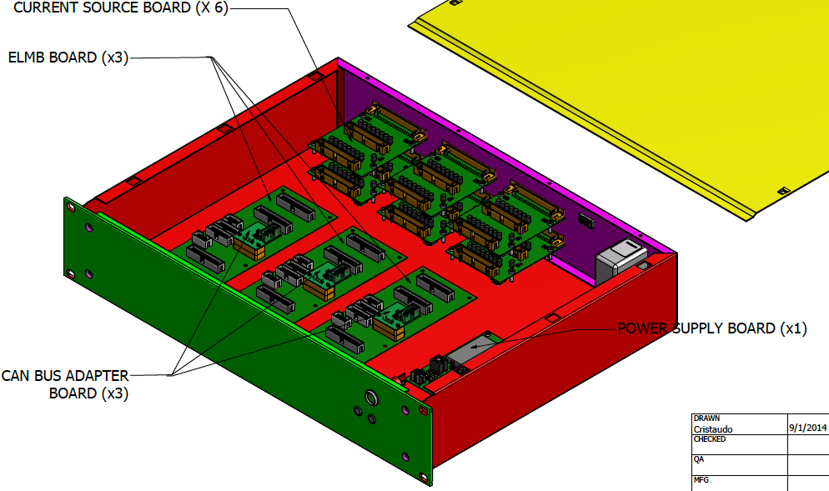
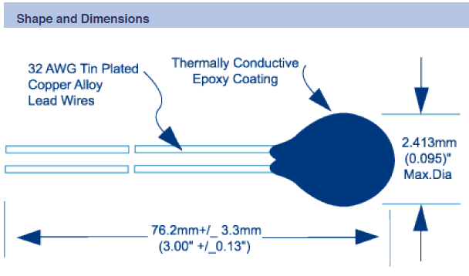
Temperature 1: NTC Thermistors
System now foresees up to 96 thermistors NTC (Betatherm 100kΩ)
  24=12 pairs: 12 half-rings supporting the SVD ladders
  32=16 pairs: inlets and outlets of the CO₂ cooling pipes
  38 still available: a few near FOS fibers for cross-calibration, and possibly at other locations
Readout based on ELMB (Embedded Local Monitor Board)
  1 power supply board, 3 motherboards with ELMB and CANbus adapter, 3 x 2 current source boards, 3 x 2 x 16-channel connectors

Slide 4
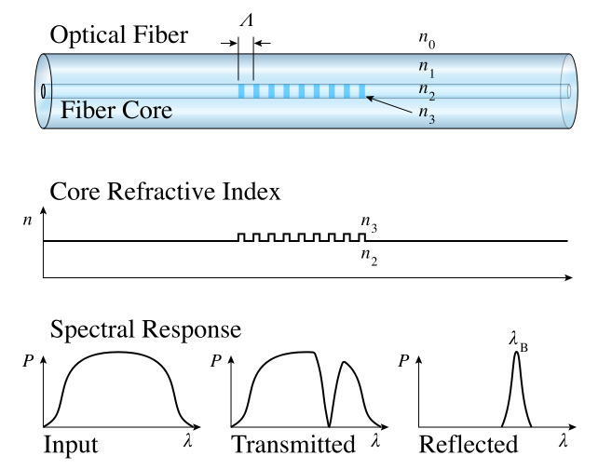
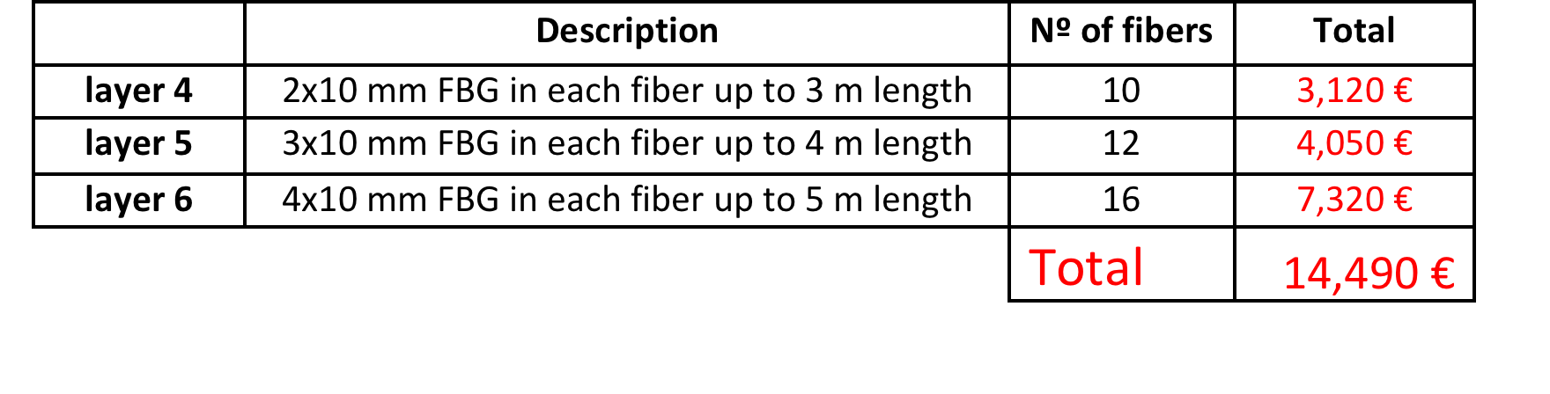
Temperature 2 and Humidity 1 – FOS
FOS R&D completed by the IFIC group for PXD,
successfully tested at the DESY beam test Jan 2014
We adopt a similar approach for SVD:
one fiber per ladder, inserted in the Airex foam,
with several temperature sensing points per fiber
(one per DSSD in layers 4, 5, 6)
Total: 38 fibers and 120 temperature sensing points
Read-out of up to 40 fibers:
One rack-type sm225-800 interrogation unit (16 ch), 0.5Hz
10 (4 x 1) passive couplers.
=> Read-out available for 8-18 additional fibers (with humidity-sensitive coating?)
Model | description | cost | quantity | total
sm225-800 | FBG interrogator | 26,000+VAT | 1 | 31,720
CP-W-P-1X4-1550-250 | 1x4 passive coupler | 180/45+VAT | 10
Moreover, humidity (to avoid condensation issues, from CO₂ cooling at -20ºC): interlock (Dew point < - 30 ºC): sniffing pipes e Chilled Mirror Hygrometers

Slide 5
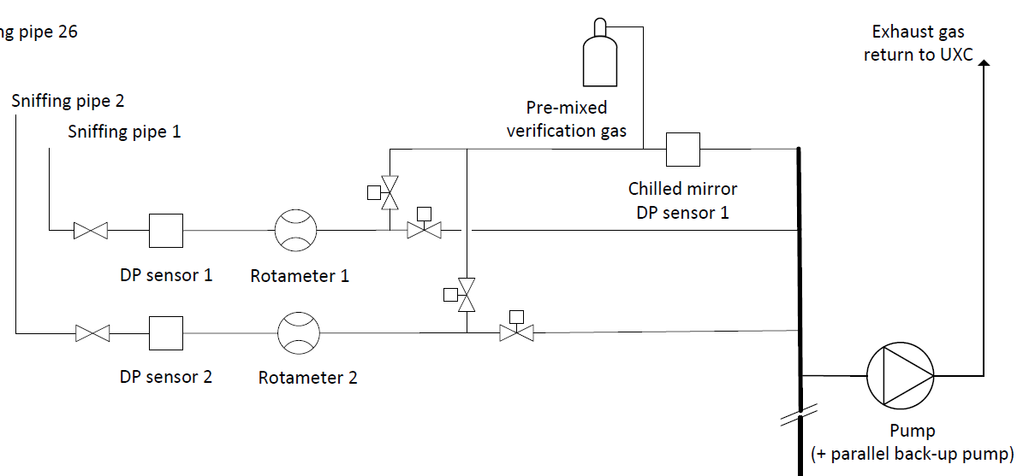
Humidity 2: CMS “sniffer” approach
Vaisala dew point sensors:
  Vaisala DMT242A for the [-80, +20] C dewpoint range
  Vaisala DMT242B for the [-60, +60] C dewpoint range
Chilled mirror:
  Edgetech Dewmaster Chilled Mirror Hygrometer

Slide 6
News, issues and details to be clarified
NTC sensors: total proposed number 24+32+6.
  we already purchased 100 (1000€) Betatherm (Radhard certified by CMS). Are these really too bulky? 2.4mm ⌀
  Final position and mounting on the 12 half-rings (24 sensors)
  Final position and mounting on inlets and outlets of the CO₂ cooling pipes (32 sensors)
  Reference for FOS cross-calibration: we propose 2 sensors per Layer (6 sensors)
FOS: total proposed number, 38 fibers, 158 sensors:
  1 sensor per DSSD both for origami and BW DSSD (inside Airex channel), where exactly?
  1 sensor close to the clamp (outside Airex channel), precise distance?
  Note that test and calibration takes 1 day per 9 sensors in Santander!
  Note that procurements takes >~2 months
  + Humidity with different coating. 2 per layer (?) + 2 outer cylinder (?)

Slide 7
FOS fibers
(4x1)couplers
DOCKs
Layer 6: 16 ladders
16 fibers x 4 (+1) sensors
Layer 6
4 couplers
…
…
Interrogator
…
Layer 5
3 couplers
Layer 5: 12 ladders
12 fibers x 3 (+1) sensors
(16 inputs)
…
…
Layer 4: 10 ladders
10 fibers x 2 (+1) sensors
Layer 4
3 couplers
…
…

Slide 8
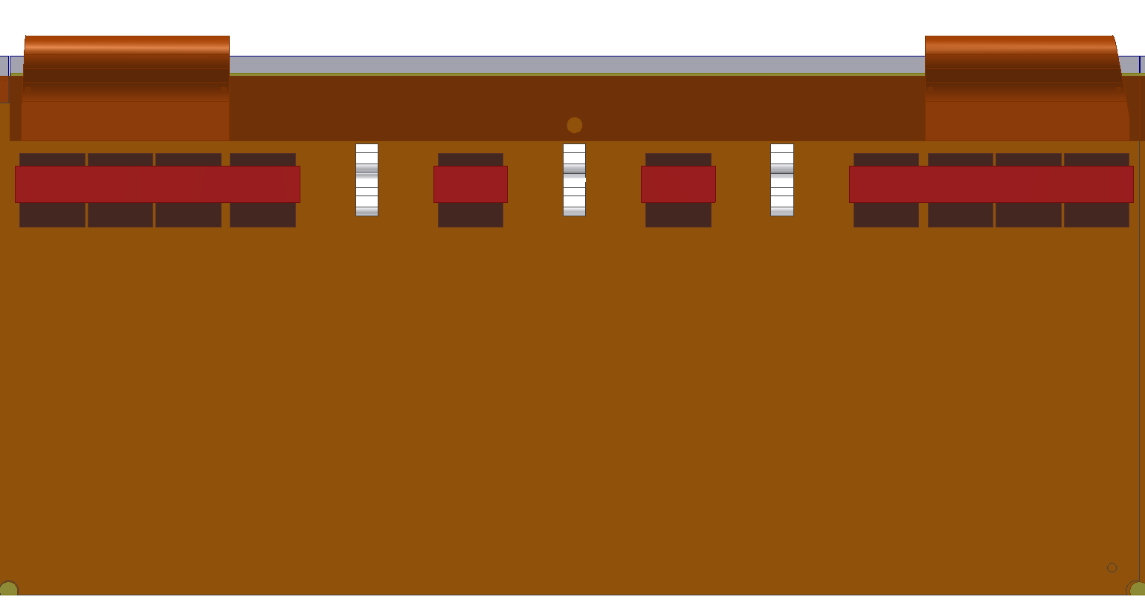
Location of Temperature Sensors on the fibers
Sensor dimension 10mm
Coating: acrylate (almost insensitive to humidity)
Unbuffered (just 250 um ⌀) from clamp to all airex channel
Buffered (~900 um ⌀) from clamp to DOCKs with SC/PC connector?
Airex channel
500 um ⌀
Yellow: buffer tube
Orange: coating
Blue: core

Slide 9
Backup slides

Slide 10
Cabling
NTC sensors connections to docks:
  Stage 1, isolation of sensor leads
  Stage 2, mounting sensor into the probe (mechanics: to be designed!)
  Stage 3, soldering, isolating and labelling the individual twisted-pair cable
    SCEM 04.21.51.405.2 Twisted pairs 9x2
From docks to ELMB box:
  Up to 6 halogen-free, shielded multi-conductor twisted-pairs cables
  Shield connected to ground at docks (?)
  Readily available from CERN catalogue:
    SCEM 04.21.51.410.5 Twisted pairs 21x2
    External diameter: 11 mm

Slide 11
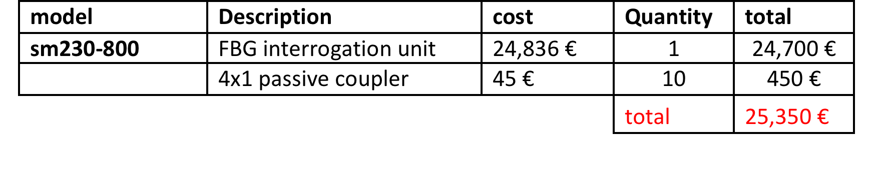
Temperature Monitoring – FOS fibers
PXD FOS R&D completed
successfully tested at the DESY beam test Jan 2014
Same solution can be adopted for SVD:
one fiber per ladder, inserted in the Airex foam,
to measure silicon temperature.
One FBG temperature sensor for each of the SVD strip sensors in layers 4,5,6; 38 fibers and 120 sensors are needed.
One rack-type sm225-800 interrogation unit*, ten passive couplers** 4x1 in order to have 40 channels.
*Interrogation speed 0.5 Hz; Stability 0.1 ºC pm; Repeatability 0.1ºC; Accuracy 0.1ºC (only for the interrogation unit, FBG sensor error must be added);16 input channels
**wide band coupler, 1x4, 1550 nm, insertion loss <7 dB, fibra SMF-28e, pigtail length 1 m tipo 900 micron loose, FC/APC connectors at both ends,(dimensions: cylindrical shape 4x65 mm).

Slide 12
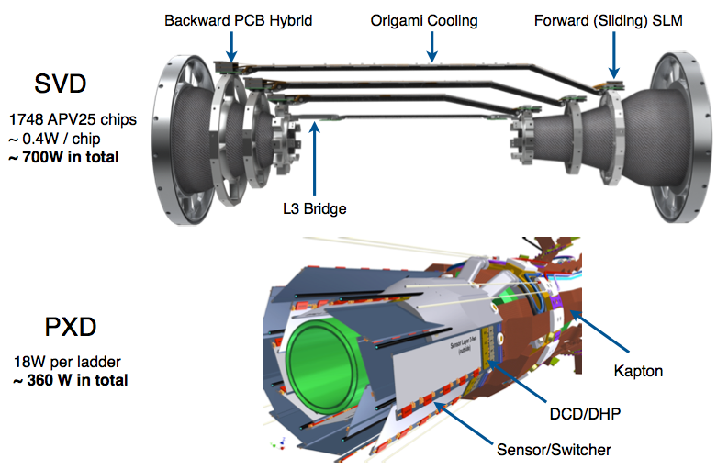
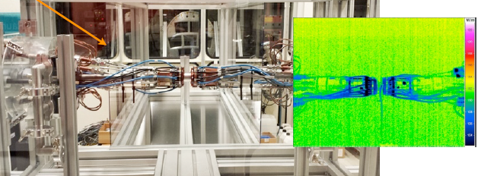
VXD Thermal mock-up (DESY)
PXD+SVD Front End power dissipation: 360+700 W
CO₂ cooling pipes (-20ºC); dry air / nitrogen flow (20ºC)
A crucial moment for understanding several aspects and setting the exact location for the ambient sensors will be the PXD+SVD thermal mock-up in preparation at DESY (Oct. 2014).

