Slide 1
DEPFET IB meeting 2.10.2014
Agenda
Report of the PL.
Application of the Mainz group. Prof. Concettina Sfienti
KEK-PF project
Financial Status of IBBelle
PXD spare production
First thoughts on the procedure for the election of the next PL. (present term ends in June 2015).
A.O.B:
venue for the next PXD/SVD
Other…

Slide 2
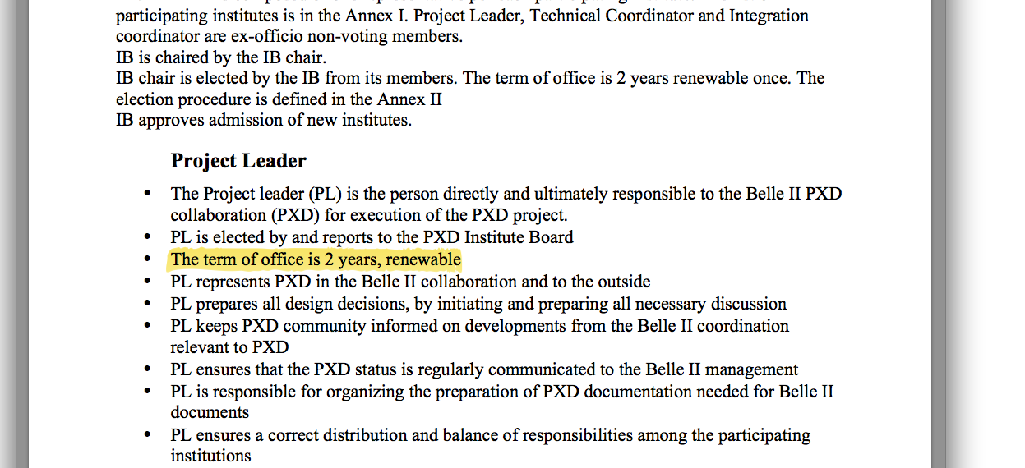
Procedure for the election of the PL

