Slide 1
The new SVD Power Supplies
General requirements
Power supplies structure
Tender process
Test system
F.Forti, INFN and University, Pisa

Slide 2
SVD power system requirements
Voltage/Current requirements
APV chips require 2 positive voltages 1.25V / 60mA and 2.5V / 135mA
2.5W/hybrid in L3 and L456 phi (P) side; 1.65W/hybrid on L456 zed (N) side
Sensor HV is below 100V, with single sensor leakage around 1uA initially, up to 100uA when irradiated (sensor area is between 50 and 75 cm2)
Simmetrical (flexible) biasing w.r.t. main ground
Low Voltage supplies must be floating so they can be referenced to the sensor HV
Additional requirement of a separation voltage to prevent pinholes from injecting current in the preamp input
Noise requirements
Power supply ripple should not add significantly to base detector noise
Granularity requirements
(mainly coming from budget and cable plant considerations)
No requirement to power each hybrid individually
No requirement to power each sensor individually

Slide 3
Numerology
Individual hybrid/sensor powering would imply a significant cable plant and a large number of individual power supplies
Choice of locally reducing and regulating the voltages with DC/DC converters.
Local regulation has the advantage of protecting APV Chips from overvoltages during resets, when current suddenly drops

Slide 4
Readout Chain Overview
Finesse Transmitter
Board (FTB)
FADC+PROC
1748 APV25 chips
2.47m copper cable
Junction box
~12m copper
cable
Unified optical data link (>20m)
Rad-hard DC/DC converters
COPPER
Front-end hybrids
~17m copper
cable
Analog level translation, data sparsification and hit time reconstruction
Unified Belle II DAQ system
LV PS
HVPS
Each sensor in the system is electrically independent
LV (and signals) are level-shifted to HV on each side of detector
Hybrids on the two sides of the detector are electrically independent
Connected only through the sensor HV bias

Slide 5
Junction Box
CERN-made DC/DC converters for front-end powering
6 PCB boards/box
8 hybrids/board (either p or n type)
Max 48 hybrid (24 sensors) per junction box
< 20W in each board
Each group of 4 hybrids has:
2(main) + 2(spares) DC/DC converters (1.25/2.5V)
= 8 DC/DC per board
Grouping criteria
Only p or n side
Positive/negative
Wedge separate from rectangular
Different bias voltages
Only Fwd or Bwd
Location of boxes

Slide 6
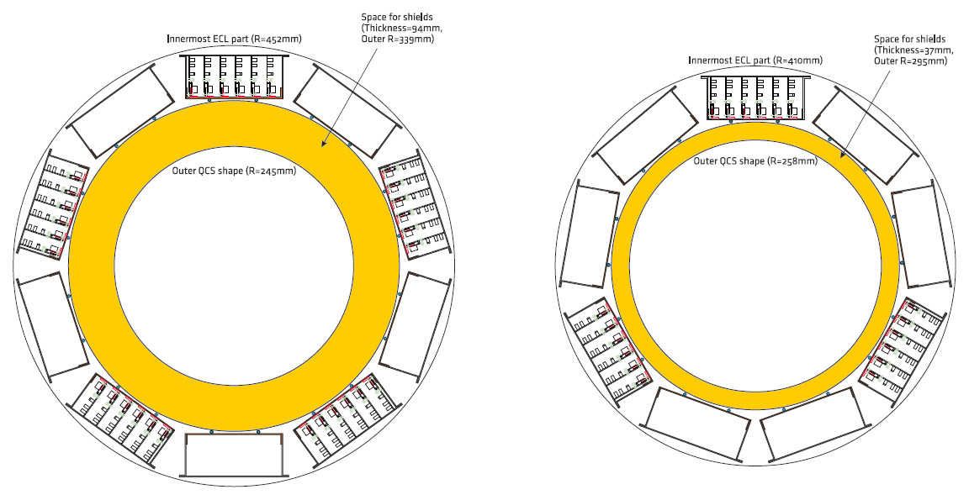
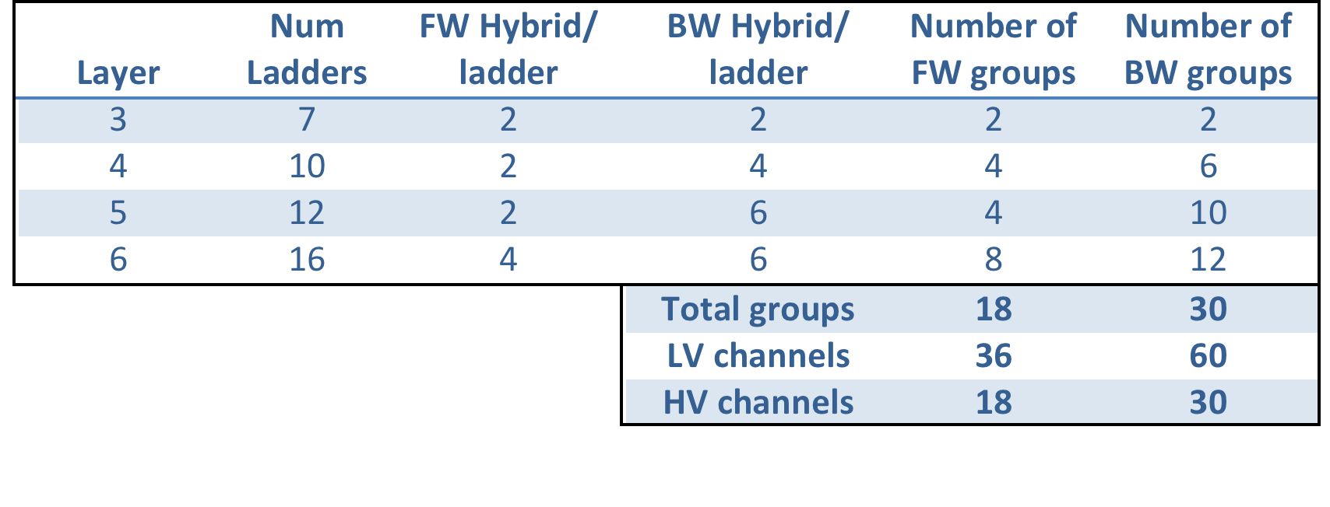
Junction boxes arrangement and grouping
SVD
PXD
Backward
Forward
1 group = max 8 hybrids

Slide 7
Pinhole mitigation
Only current flow INTO APV is problem = p-side only
Remedy: offset voltage between HV bias and APV_GND

Slide 8
Overall schematics

Slide 9
Tender and technical specs
Funding has been approved (115kE) and the tender process has started
Bid required on
Invitation letters went out Friday September 26 to:
CAEN
WIENER
ISEG
TDK-LAMBDA
TEXIO
MATSUSADA
Deadline is October 20
Decision should be on Octber 27/28
Formal approval and contract signing end of november
Delivery time requirement: 12 months → Nov 2015 at KEK.

Slide 10
LV Specs
Low voltage power supply channels (LVPS) have the following electrical specifications:
Fully floating channels with isolation from other channels and ground at least 150V.
Output voltage range: ideally 5 – 12 V, although a smaller range (6-10V) is acceptable.
Output current: at least 2A @ 10V or 4A @ 5V
Output power: >20 W
Remote sensing of voltage for local regulation.
Voltage ripple: <15mV pp
Voltage set resolution and accuracy: 10mV, ±1%
Voltage monitoring resolution and accuracy: 10mV, ±1%
Current set resolution and accuracy: 10mA, ±1%
Current monitoring resolution and accuracy: 10mA, ±1%
Programmable overvoltage and overcurrent protection
Total number of channels: 96

Slide 11
HV Specs
High voltage power supply channels (HVPS) have the following electrical specifications:
Channels must be individually groundable at the detector side.
The polarity of the channels with respect to ground can be, in order of decreasing preference: selectable (i.e. defined by a jumper or a specific connection), or fixed (i.e. defined by the construction of the board).
Output voltage range: 0 - 100 V or more (ideally up to 200V).
Output current: at least 1mA @ 100V
Voltage ripple: <30mV pp
Voltage set resolution and accuracy: 100mV, ±0.5%
Voltage monitoring resolution and accuracy: 100mV, ±0.5%
Current set resolution and accuracy: 100nA, ±2%
Current monitoring resolution and accuracy: 100nA, ±2%
Programmable maximum voltage and overcurrent protection
Programmable ramp-up and ramp-down speed in the range 1-20V/s
Total number of channels: 48 (24 positive and 24 negative if the polarity is fixed).

Slide 12
Separation Voltages Specs
The separation voltage power supply channels have the following electrical specifications:
Fully floating channels with isolation from other channels and ground greater than 150V.
Output voltage range: 0 - 10 V.
Output current: at least 1mA @ 10V
Voltage ripple: <15mVpp
Voltage set resolution and accuracy: 100mV, ±0.5%
Voltage monitoring resolution and accuracy: 100mV, ±0.5%
Current set resolution and accuracy: 10mA, ±1%
Current monitoring resolution and accuracy: 10mA, ±1%
Programmable maximum voltage and overcurrent protection
Total number of channels: 24
Although the separation voltage requires a much smaller current, for reasons of uniformity, it would be advantageous to use the same kind of channels selected for the LVPS.

Slide 13
Other specs
Mechanical and environmental requirements
The power supplies will be installed in an area on top of the Belle-II detector where space is limited. The specifications are the following:
They must be mountable in standard 19” racks
The complete system should occupy no more than four (4) 19” 42U racks.
The operating temperature will be between 10° C and 40° C
Cooling of the power supplies should not require chilled water.
The connectors are not specified in detail, but should be compact enough to allow easy connection to multiwire cables. Both multi-pin connectors and bare wire terminals are possible.
Electrical mains requirements
The AC Power requirements are the following, dictated by the availability of 4 200V/30A sources in the relevant experimental area:
Voltage: 200V; Frequency 50Hz.
Current: maximum of 120A total current absorption, subdivided in at least 4 sources. Maximum 30 A absorption from any single AC power source.
In addition, 2 x 100VAC@30A outlets can be used for independently powered control units, if needed.
Any industry standard plug or bare wire screw terminal is acceptable for the AC power connection.
Interface and control
The system should be fully controllable remotely via a computer interface. The Belle-II SVD detector control system (DCS) is based on EPICS. The requirements are the following:
Control and monitoring of the power supply system should be possible over an Ethernet network connection
The system should have a control software that allows easy configuration, operation and monitoring in standalone mode
EPICS drivers should be available for integration in the Belle-II DCS.
The system should be able to manage channel tripping in an orderly manner, generating alarms, and turning off only the problematic channels
A hardware interlock system should be available to allow an orderly turning off of the channels in case serious accelerator or detector problems. The details of the electrical interface of the interlock are not fully specified, but they should be as simple as possible, ideally a TTL input that enables or disable power.

Slide 14
Test system
A CAEN test system can be available for software development and test of modules, including the test beam.
Includes a smaller crate (but with same software), one LV board. For the HV board we could take and older module from the CERN store
Where should it go ?
Who should take responsibility for it ?

