Slide 1
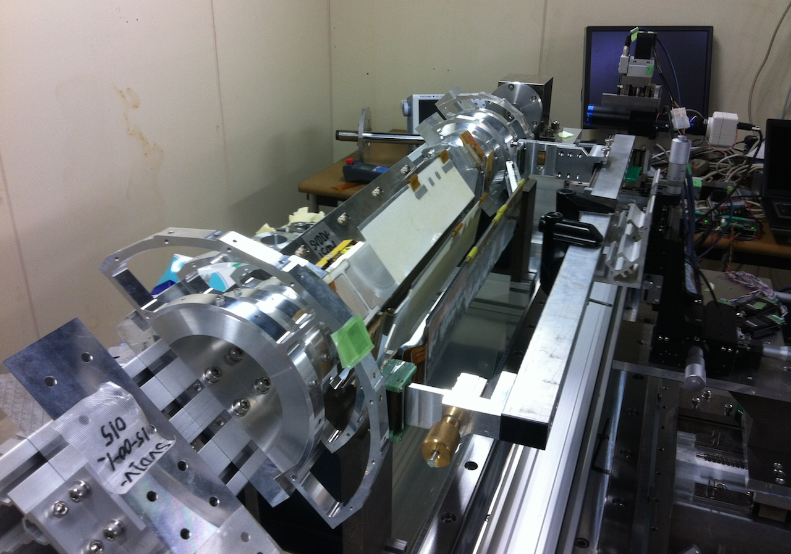
Ladder Mount R&D
T. Tsuboyama (KEK)
2 Oct. 2014

Slide 2
The design concept
The ladder mount table is designed and prepared by KEK engineers who produced the SVD1/SVD2 ladder mount system. A web page is prepared.
http://research.kek.jp/group/svd/mechanics/laddermount/
The SVD support system (end flanges, CFRP cones and end rings) are fixed to a sold bar (∅50mm stainless steel).
The bar is supported by bearing pillow boxes.
The angle of the SVD support is fixed using an index plate.
The ladders are mounted to end rings using a mechanical arm.

Slide 3
The design concept
The SVD structure and ladders will be handled with hands not by motors.
The SVD structure is supported with a bar and rotated by hands and angle is fixed with an index plate.
The ladder mount arm is operated with hands. Ladder mount arm mechanism just keeps the weight of the ladder.
The most dangerous step: pushing Koeshi pins into the end-ring precision holes, will be done carefully.
Sato san is still busy in ladder assembly and we should wait some while.

Slide 4
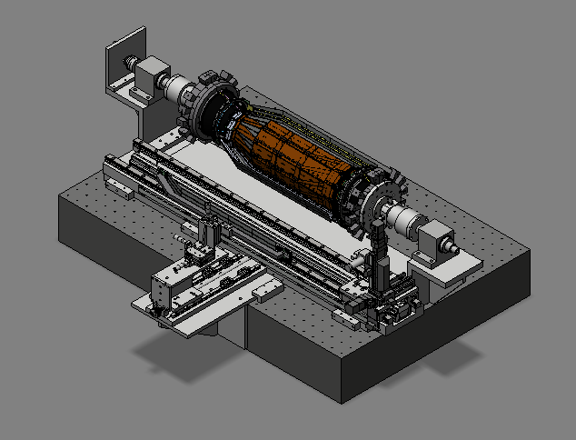
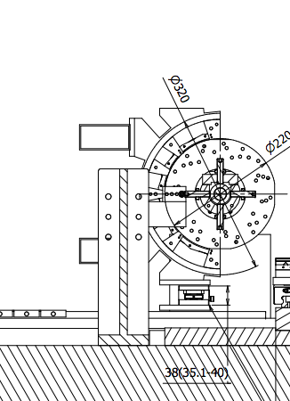
The ladder mount table
Rotary encoder
Bearing
Index plate (hidden in this view)
SVD
Linear rail
Bearing
Microscope
Ladder mount arm
S. Koike

Slide 5
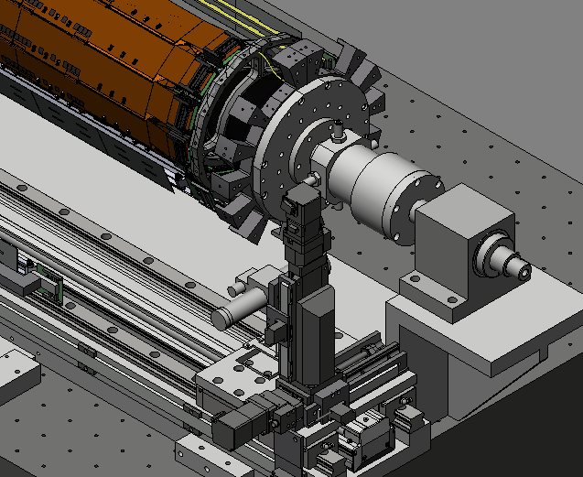
The ladder mount table
CCD camera
Longitudinal movement
Height
Focus

Slide 6
Measurement Functionality
The Belle SVD1 and SVD2 had simpler mechanics and the precision of SVD was guaranteed with the parts machining.
In Belle2 SVD, the dimension is larger and the structure is complex.
We had to compromise the mechanics precision.
Instead we measure the structure shape and the position of DSSD sensors on the ladder mount stage.
A ladder mount table with Measurement Functionality is designed by S. Koike.

Slide 7
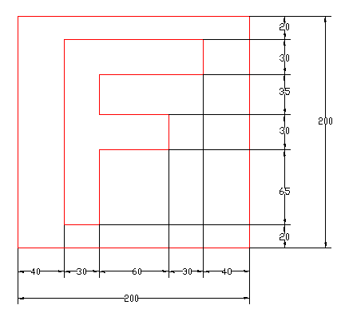
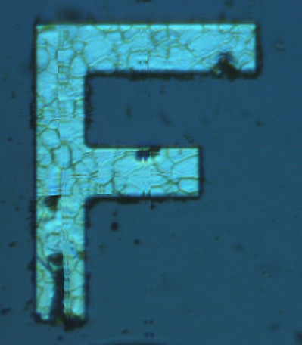
Measurement target
The DSSD sensors HPK and Micron) have four alignment marks on four corners
The ORIGAMI and Airex sheet have apertures to observe the alignment marks directly.

Slide 8
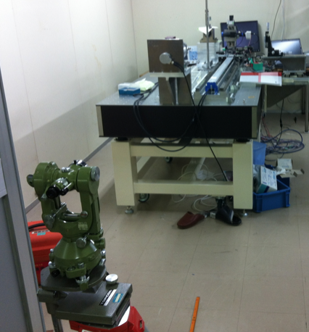
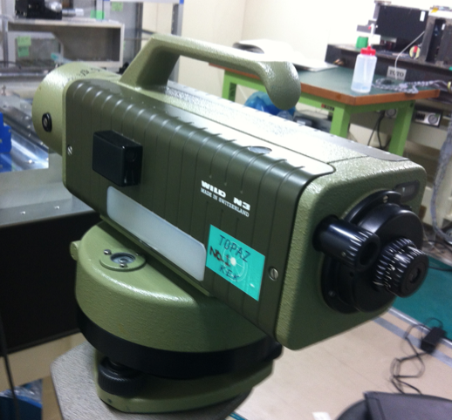
The survey of the linear guide
The straightness of the long rail determines the total precision of this system.
The measurement was done using an auto level and a theodolite.

Slide 9
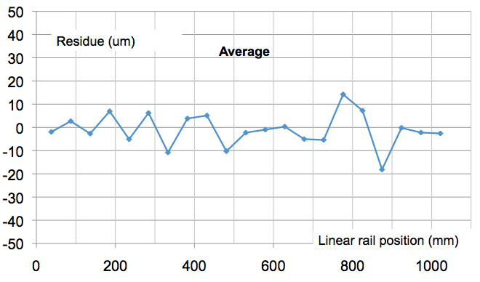
Result
The rail is curved about 100 μm in horizontal at the center. I found it is not easy to correct the shape of rails. The corrections should be applied in the measurement data.
Displacement in the vertical direction
Displacement in the Horizontal direction

Slide 10
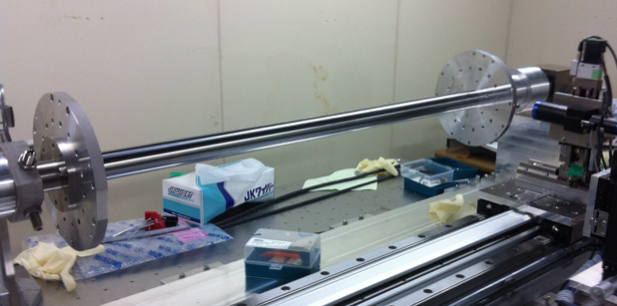
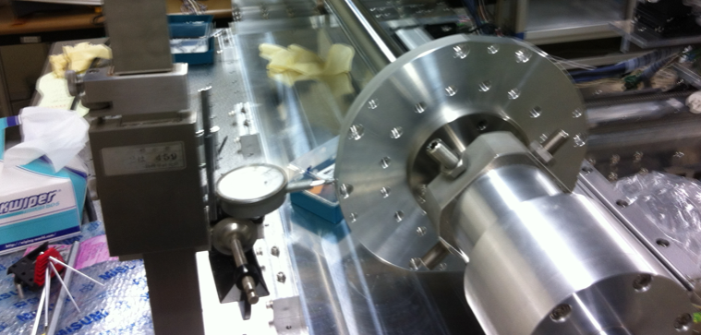
The support bar and the bearing
The SVD support bar should be set to the center of the rotation axis.
The surface was measured using a dial gauge.
Connection bar
The connection ring for the end flanges.
Axis Adjuster screws
Dial Gauge

Slide 11
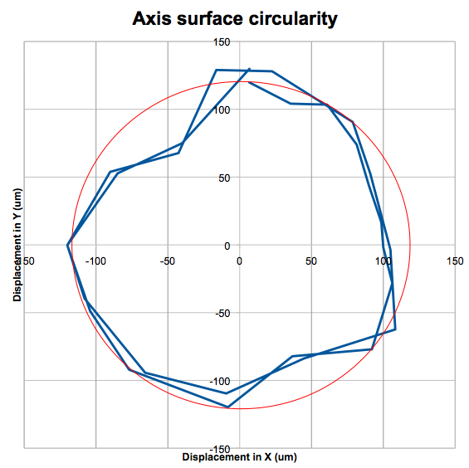
The axis adjustment capability
I found the axis is set well and circularity of ±30 μm is observed.
It means, the axis can be adjusted precisely enough.

Slide 12
Measurement details
Principle:
Stepping motors are only used in the measurement system for fine pitch movement.
Motor drivers
Longitudinal (10um)
Focusing (2um)
Height (1um)
Position measurement
Longitudinal
Focusing
Height
Rotation angle
Focus detection
CCD video camera
Brightness control

Slide 13
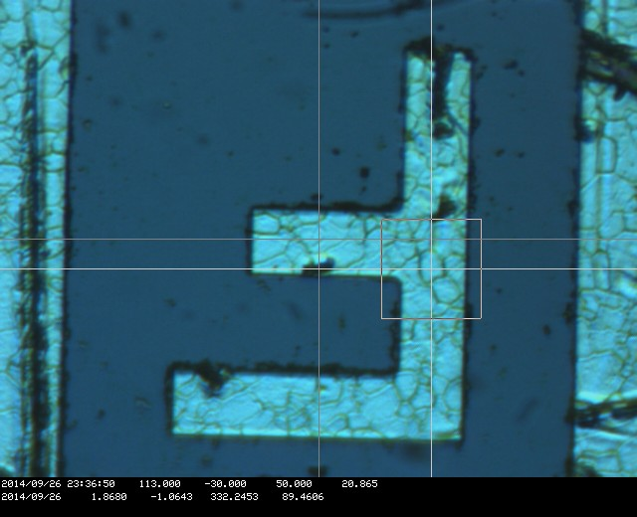
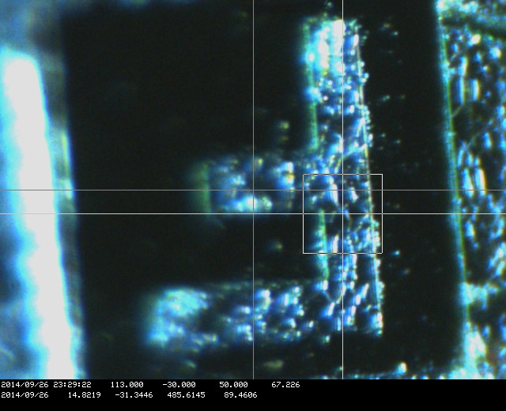
The CCD camera
The camera / lens has a high resolution.
Lighting is done through the object lens.
The same DSSD is seen from different angle.
When the DSSD is tilted, the roughness of the surface is emphasized.
Barrel sensor (camera is normal position) Slant Sensor (camera is in tilted position)

Slide 14
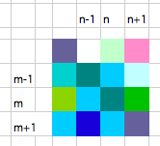
Quantify the focus point
Calculation of roughness.
R is small when the focus is poor: the neighboring pixels have similar brightness.
R is large if focus is sharp: the neighboring pixels have different brightness.

Slide 15
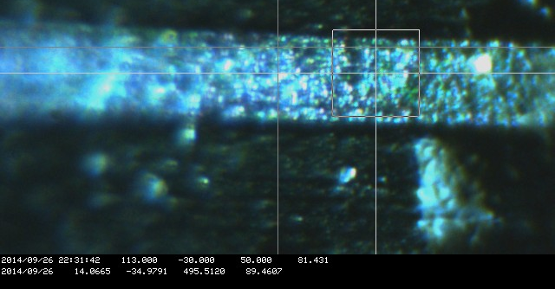
Examples
A part of the slant DSSD is observed.
closer to camera
Focus point
Farther
Date time motor position X, Y , Z
Date readout Height Focus Longi. Angle
Roughness value calculated in the square region

Slide 16
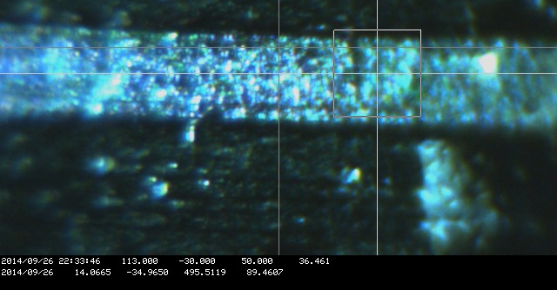
Examples
A part of the slant DSSD is observed.
closer to camera
Focus point
Farther
Date time motor position X, Y , Z
Date readout Height Focus Longi. Angle
Roughness value calculated in the square region

Slide 17
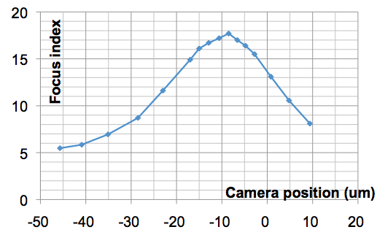
We can tell the position of focus quantitatively to 1-2 μm precision.
Reproducibility: better than our eyes.

Slide 18
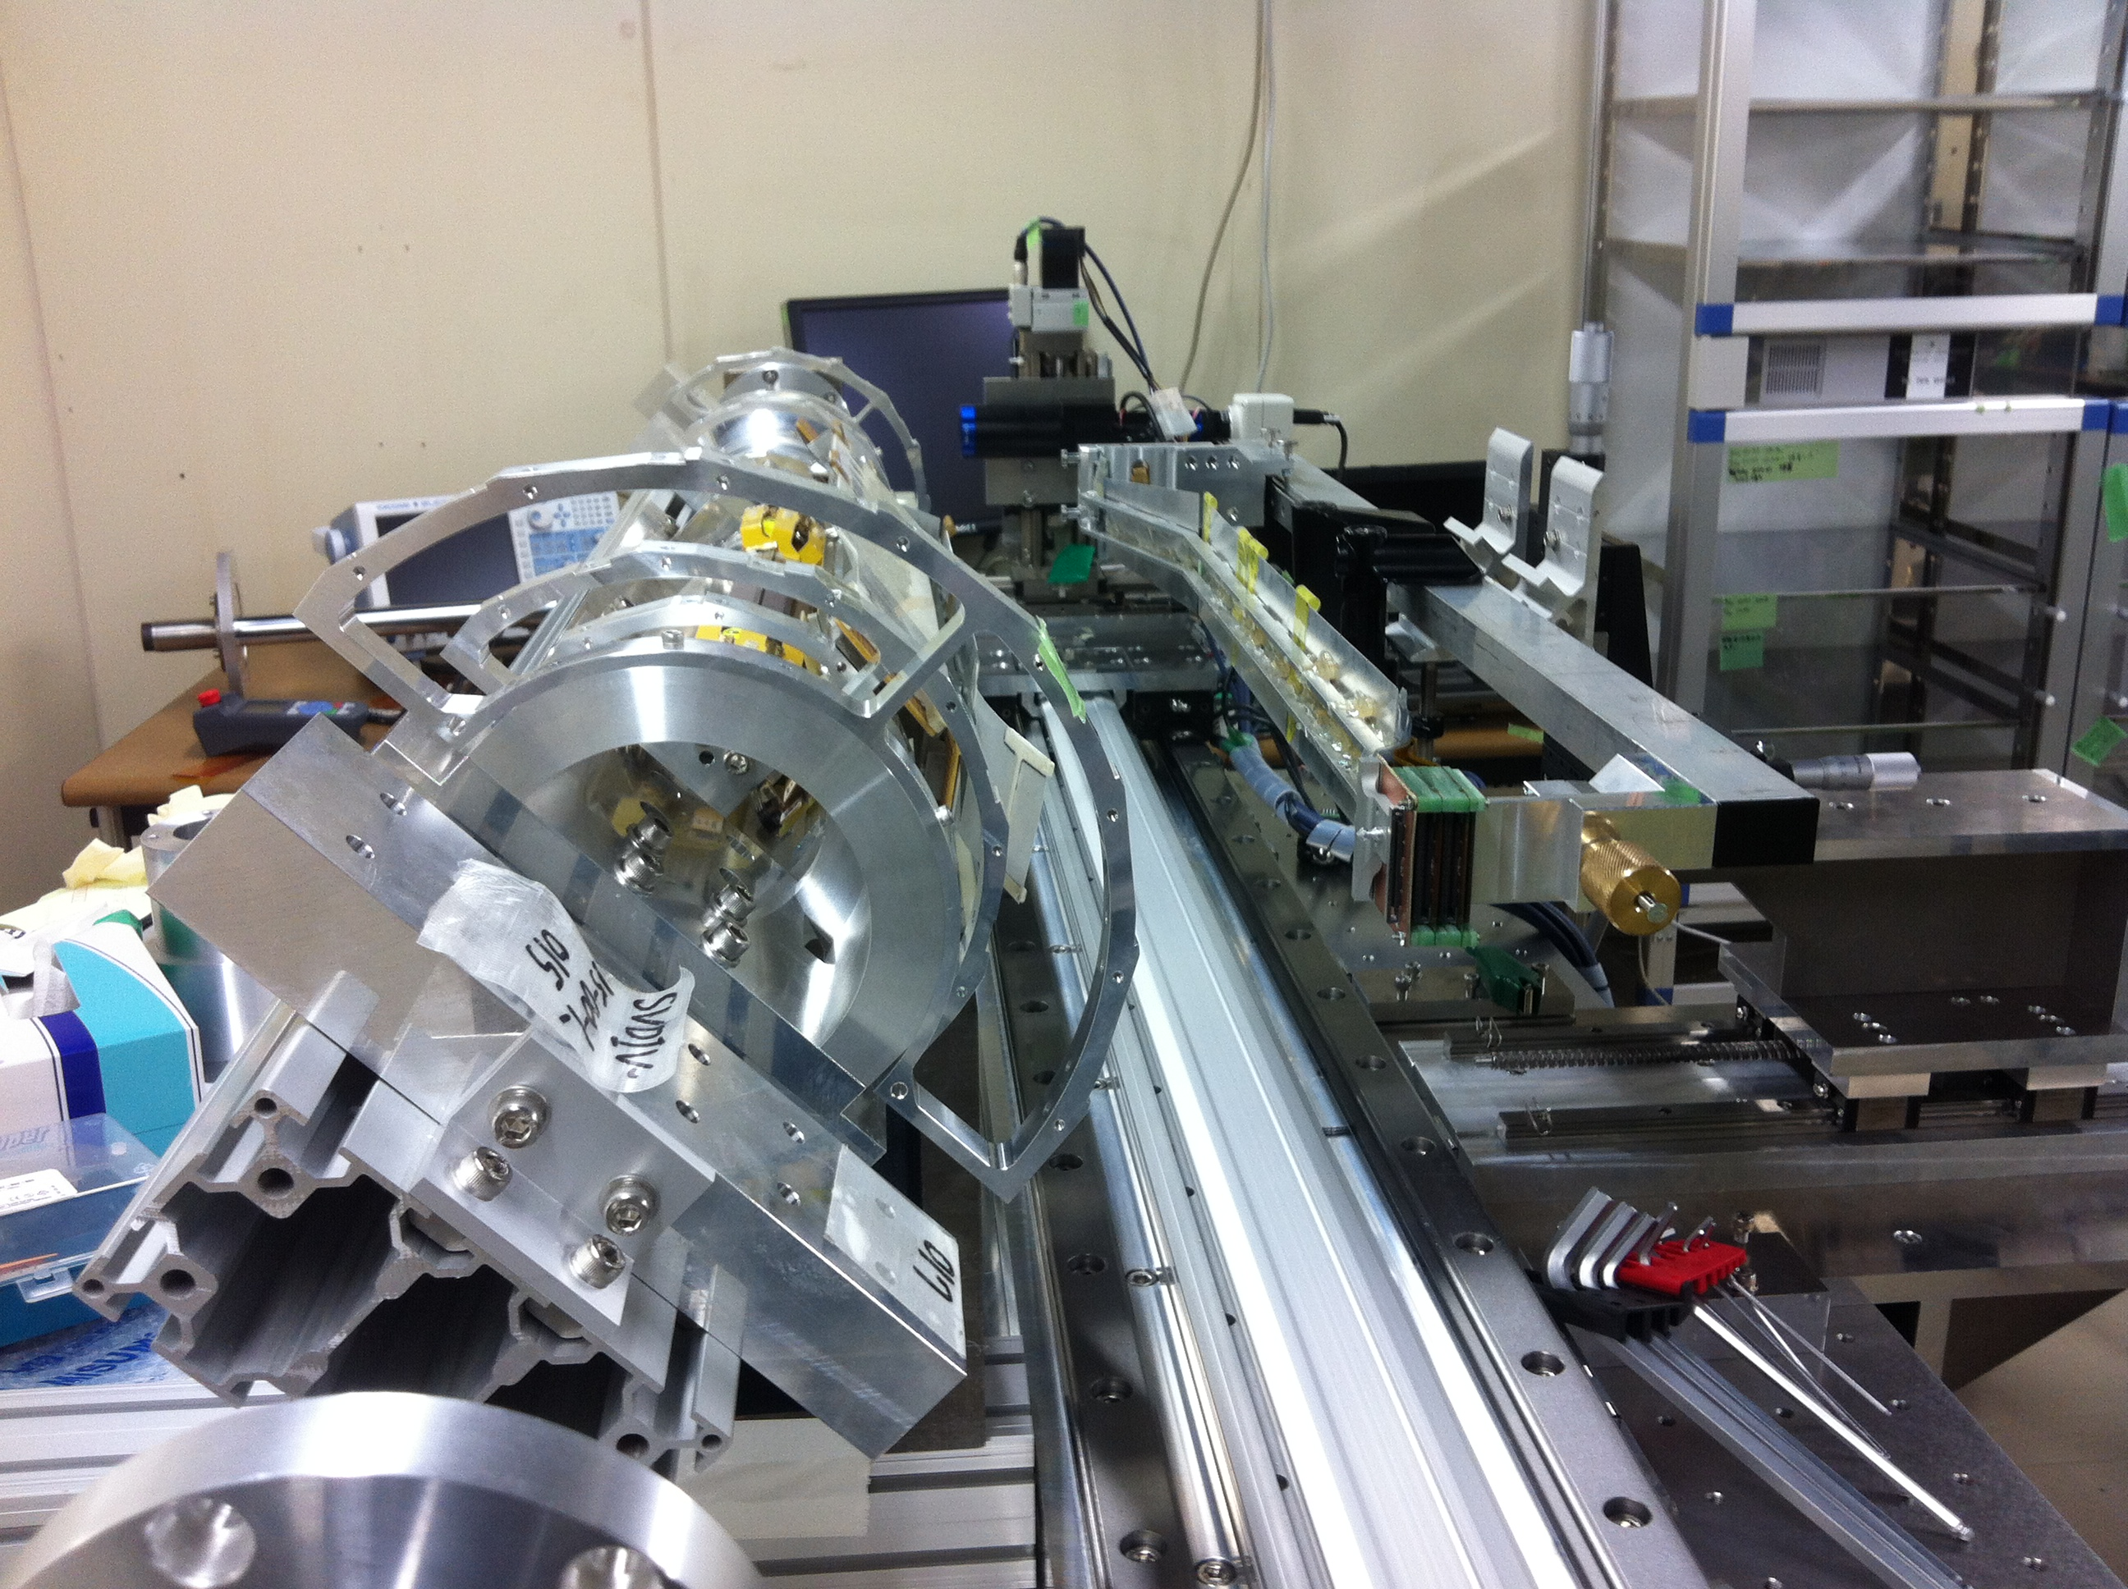
Ladder mount practice
The end ring mock up
Ladder grabbing tool
X-Y-Z adjuster
Ladder mount arm
(linear rail)

Slide 19
Ladder mount practice
We expect Sato san design the ladder mount mechanism, however, he is still busy in the ladder assembly.
The design of the ladder mount arm is not done yet.
I did a ladder mount practice using the ladder grabbing tool made in HEPHY.
The grabbing tool is fixed to the ladder mount arm using clamps.
I first tried mounting a layer 5 ladder. Then tested L4.

Slide 20
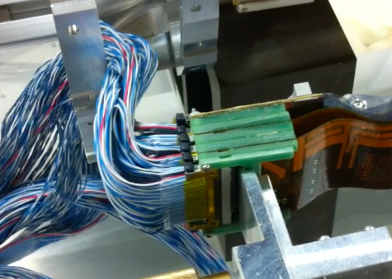
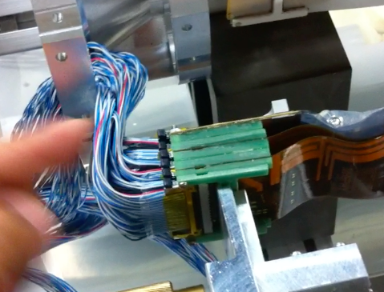
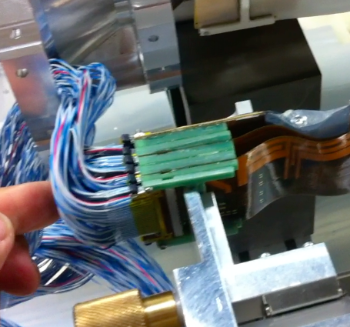
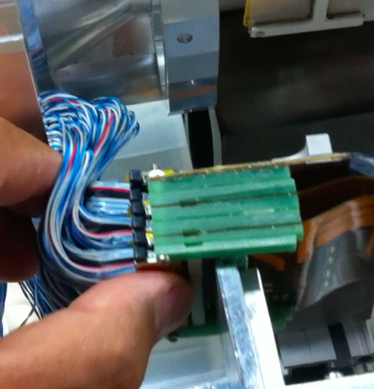
Layer 5
Ladder mount with cables is possible

Slide 21
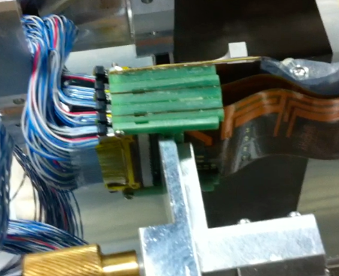
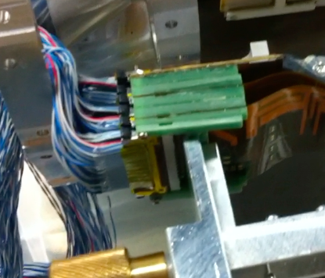
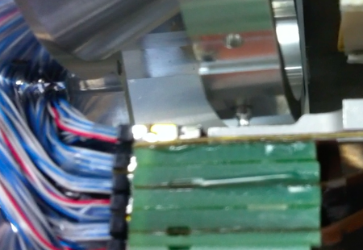
Layer 5
a

Slide 22
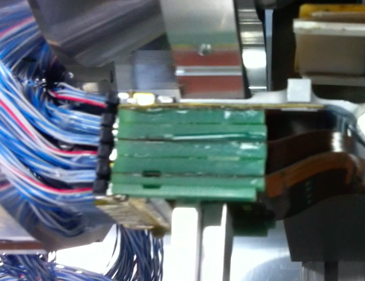
Layer 5
The layer 5 backward connector block at the final position.

Slide 23
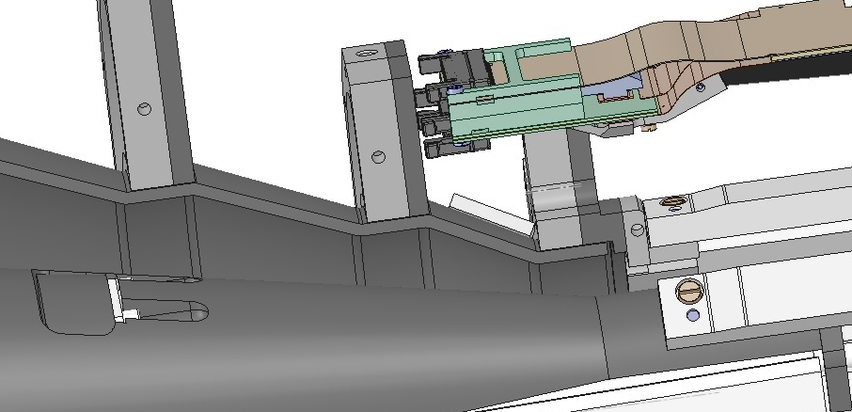
Layer 4
I was told that Layer 5 is trivial and Layer 4 seems to be impossible and I think more about Layer4.
The Layer 4 ladder mounting is difficult because of the tight space for the cable connectors.

Slide 24
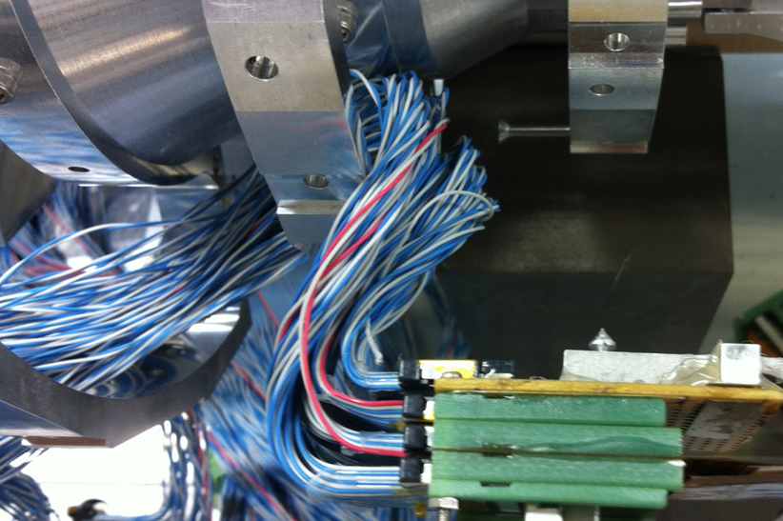
Layer 4
I glued receptacles to the hybrid of Layer 4 modk up ladder and connected the cables.
The hybrid cables interfere with the end ring layer 5.

Slide 25
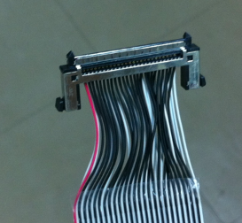
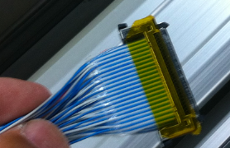
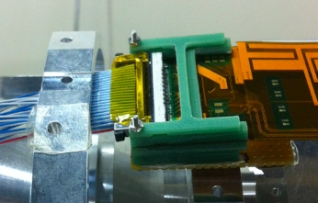
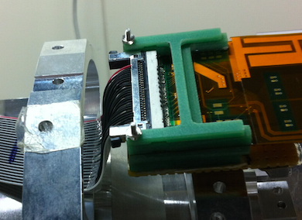
Layer 4
Fortunately, the real situation is better because the picture in the last page was taken with “dummy cables”.
The real hybrid cables are quite flexible.

Slide 26
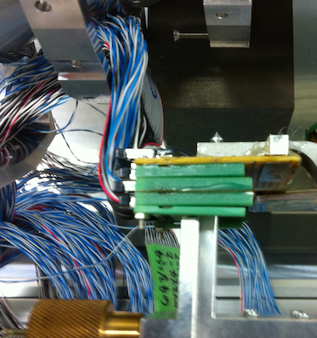
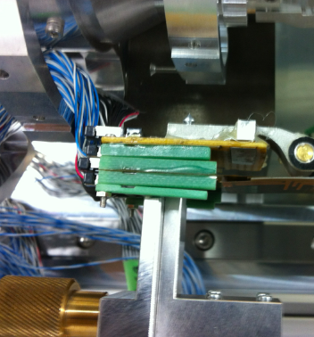
Layer 4
Even four cables are stacked, the test ladder mount with four real hybrid cables was easily done.

Slide 27
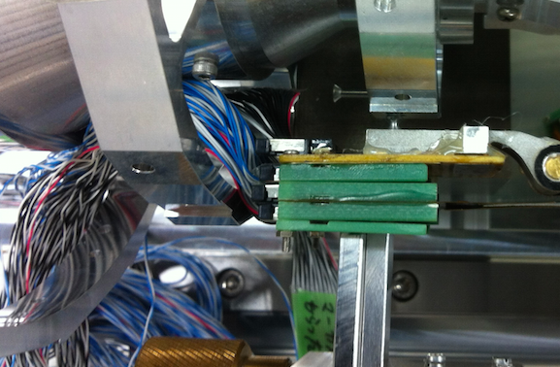
Layer 4
Test ladder mount with four real hybrid cables

Slide 28
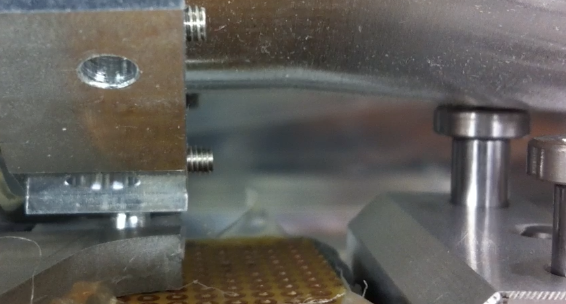
Layer 4
The ladder did not reach to the final position.
The forward ladder grabbing tool hit the Cone (dummy) before the mount blocks are completely pushed to the end ring.

Slide 29
Towards the start of ladder mount
Determination of VXD construction strategy:
Compatibility of the SVD system in with the VXD structure.
Completion of ladder mount tools
ladder mount stage production
Ladder grabbing tool
Related Software and manual
Verification of the functionality
Completion of the support structure.
Procurement of end rings
Gluing end flange, CFRP and end ring and measurement
The methods of assembly are not confirmed. Iteration may be necessary.

Slide 30
Towards the start of ladder mount
Lots of undetermined items should be decided
CO2 tube treatments: Installation to Origami, strain relief…
Electric test and necessary hardware
APVDAQ or FADC
Power supply
FOS fiber verification after mounting
CO2 cooling facility
Resource share with ladder assembly sites
Especially Human resource
…..

Slide 31
Summary
The ladder mount table production is in progress.
Linear rail is measured. There is ~100 μm displacement in horizontal. To be confirmed.
Position measurement can be done down to a few μm.
Ladder arm and grabbing mechanism has not been designed.
Many thanks. The ladder grabbing arm prepared by HEPHY was fixed to the ladder mount arm and test ladder mount is tried. It looks we can connect cables before we start the ladder mount in all layers, thanks to the flexibility of the cable.
Ladder mount in 2015 Summer requires lots of remaining issues solved and completed before 2015 B2GM.

