Slide 1
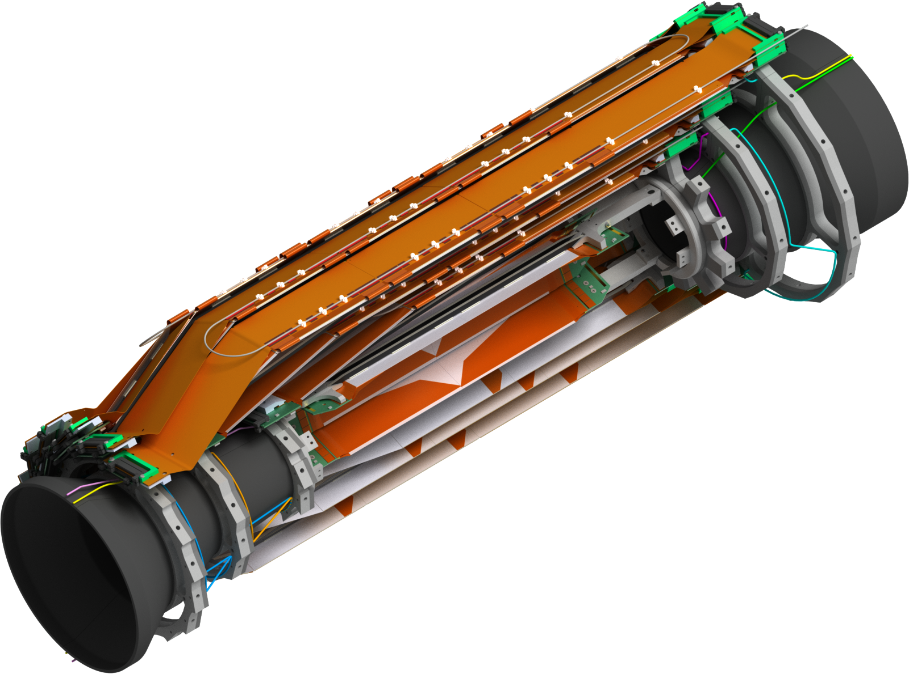
SVD Mechanics Update
6th VXD Workshop PISA

Slide 2
Overview
Kokeshi Pin & new set screw
New cooling pipe routing between the end rings
Origami cooling pipes & clamps
Modification BWD L5 end rings
Clamps for NTC & fiber
Larger surface & position change of Keratherm on the Origamis
Position of the grounding screw BWD shift
Concept for the pipe isolation

Slide 3
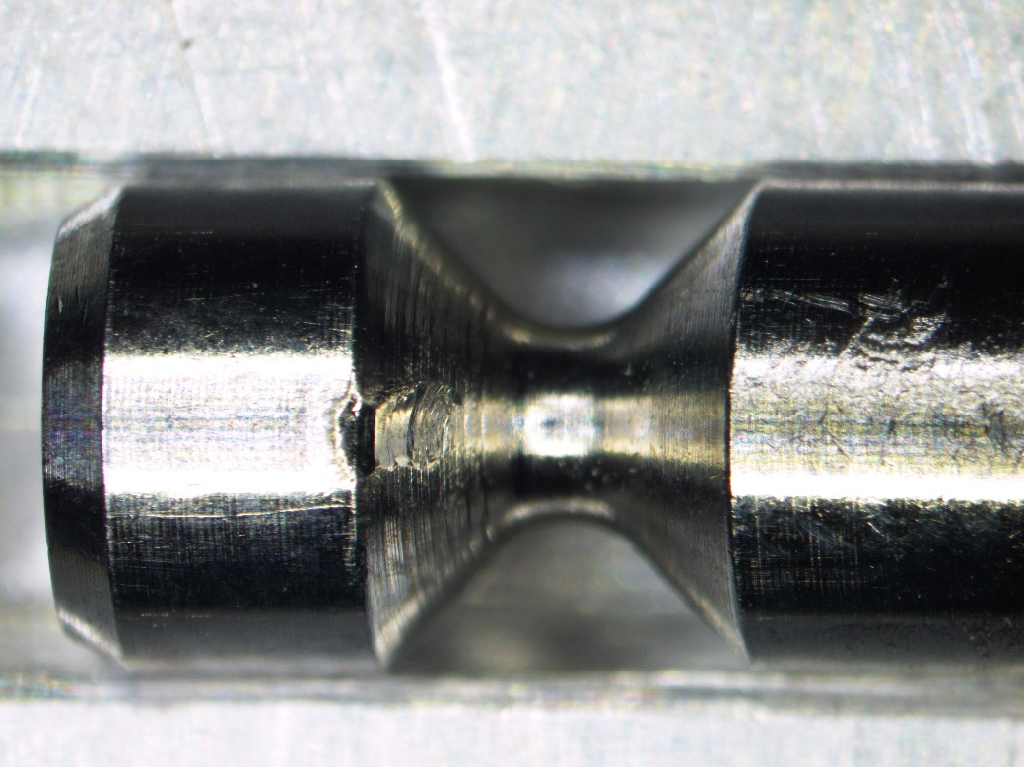
Problem With The Old Set Screw
Old Set Screw (DIN 914 with conical tip)
Impression in the cylindrical part of the Kokeshi Pin (difficult to remove)

Slide 4
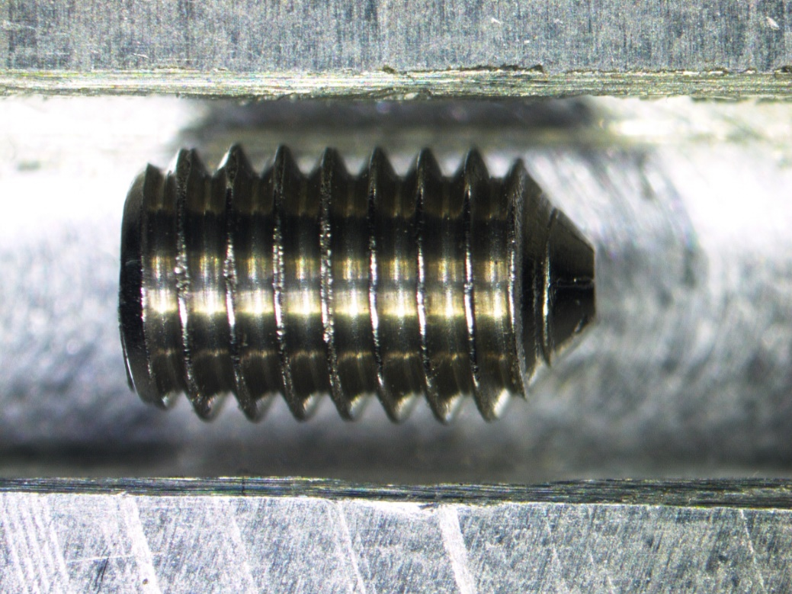
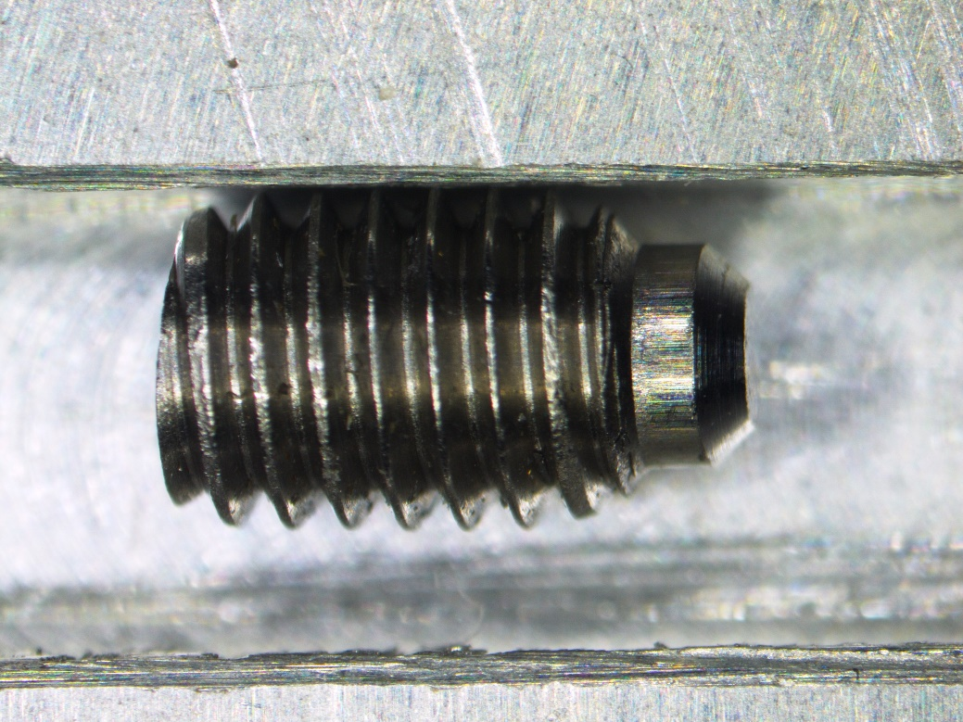
New Set Screw
Old Set Screw M3x5 (DIN914)
Set Screw M3x5 (DIN915)
with a 0.5x45° chamfer
This machining can be done at HEPHY for all screws

Slide 5
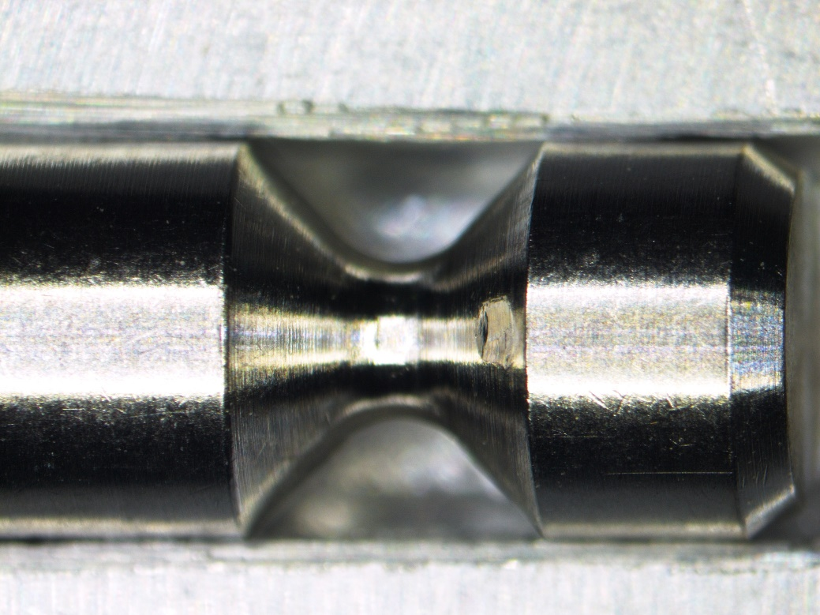
Result With New Set Screw (40Ncm)
Old Set Screw (DIN 914, conical tip)
New Set Screw (DIN 915) with Ø 1.9mm and chamfer
Easy to remove with this constellation (BWD End mount 5, BWD Kokeshi pin 69 and End ring BWD-L5)
We tested all End mounts and Kokeshi pins with different set screws
Easy removal depends on the diameter of the set screw (diameter tolerance: 2.00-1.80mm)

Slide 6
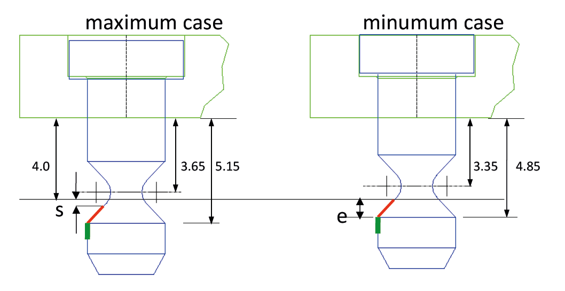
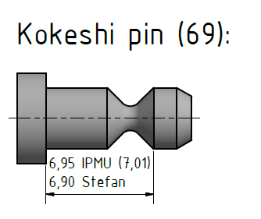
Dimension Of The Kokeshi Pin Set Up (BWD End Mount 5, Kokeshi Pin 69 and End ring BWD-L5)
Toru Tsuboyama
Set up works in the worst case 6.90 - 2.05 = 4.85mm (minimum case)
only if the Ø of the set screw is <=1.9mm

Slide 7
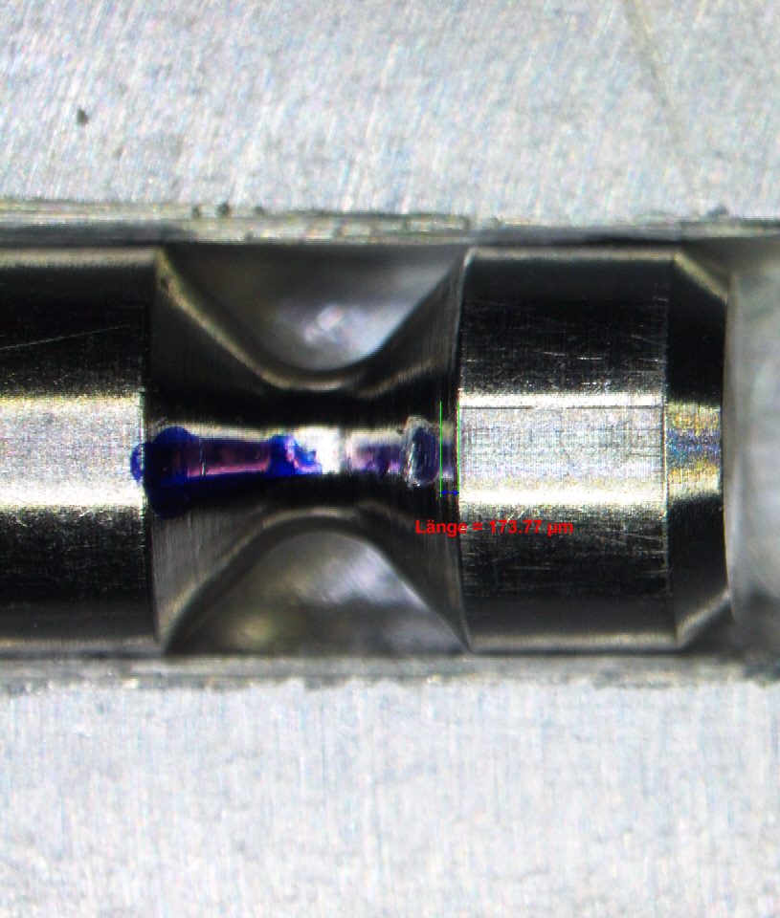
Screw With A Diameter Of About 1.75mm
length = 174µm
diameter = 1.76mm

Slide 8
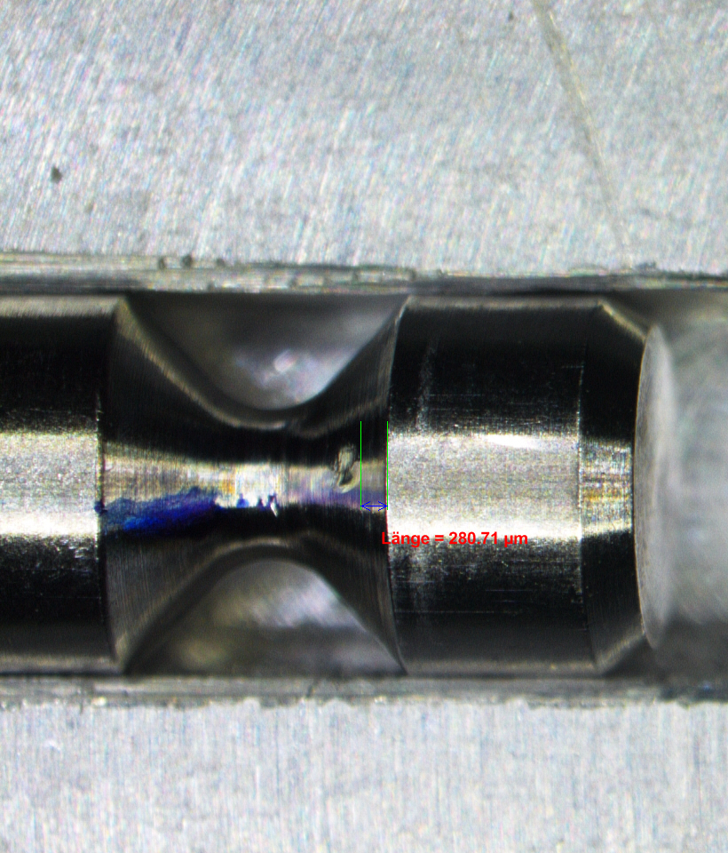
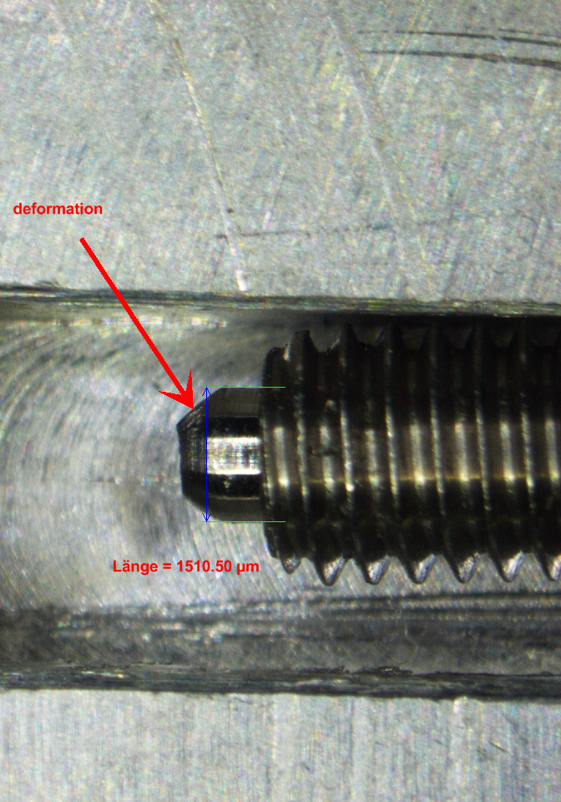
Screw With A Diameter Of About 1.50mm
deformation
length = 281µm
diameter = 1.50mm

Slide 9
Screw With A Diameter Of About 1.60mm
length = 254µm
diameter = 1.60mm
Is our preferred diameter (1.6mm+0.1mm) :
Is small enough to provide sufficient distance to cylindrical part of the Kokeshi pin (even at maximum tolerance 1.7mm)
Under this diameter the screw begins to deform
This machining can be done also at HEPHY for all screws

Slide 10
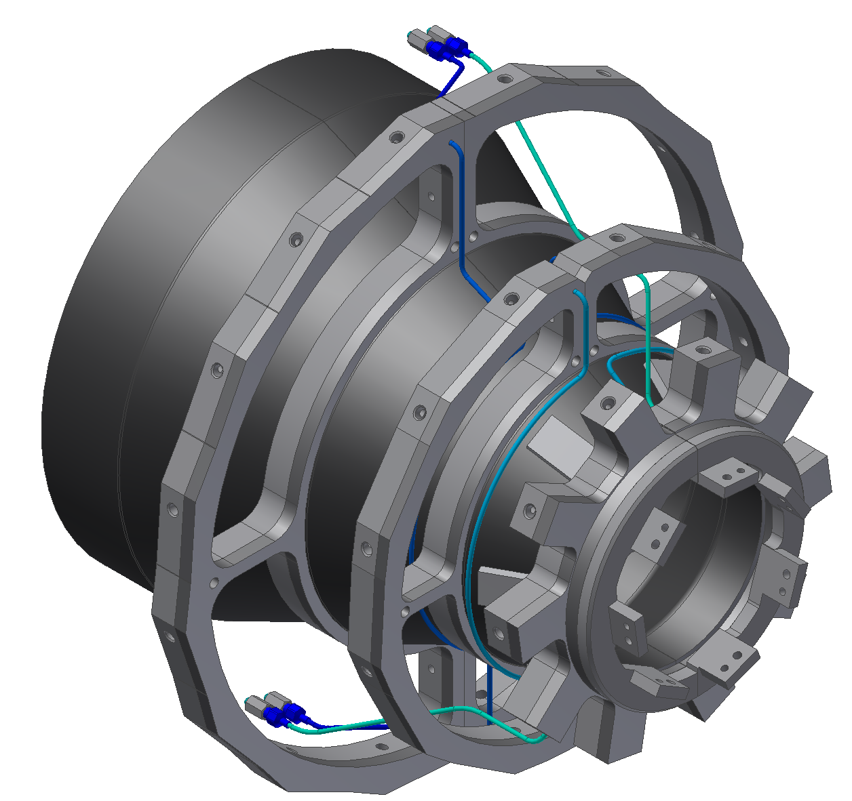
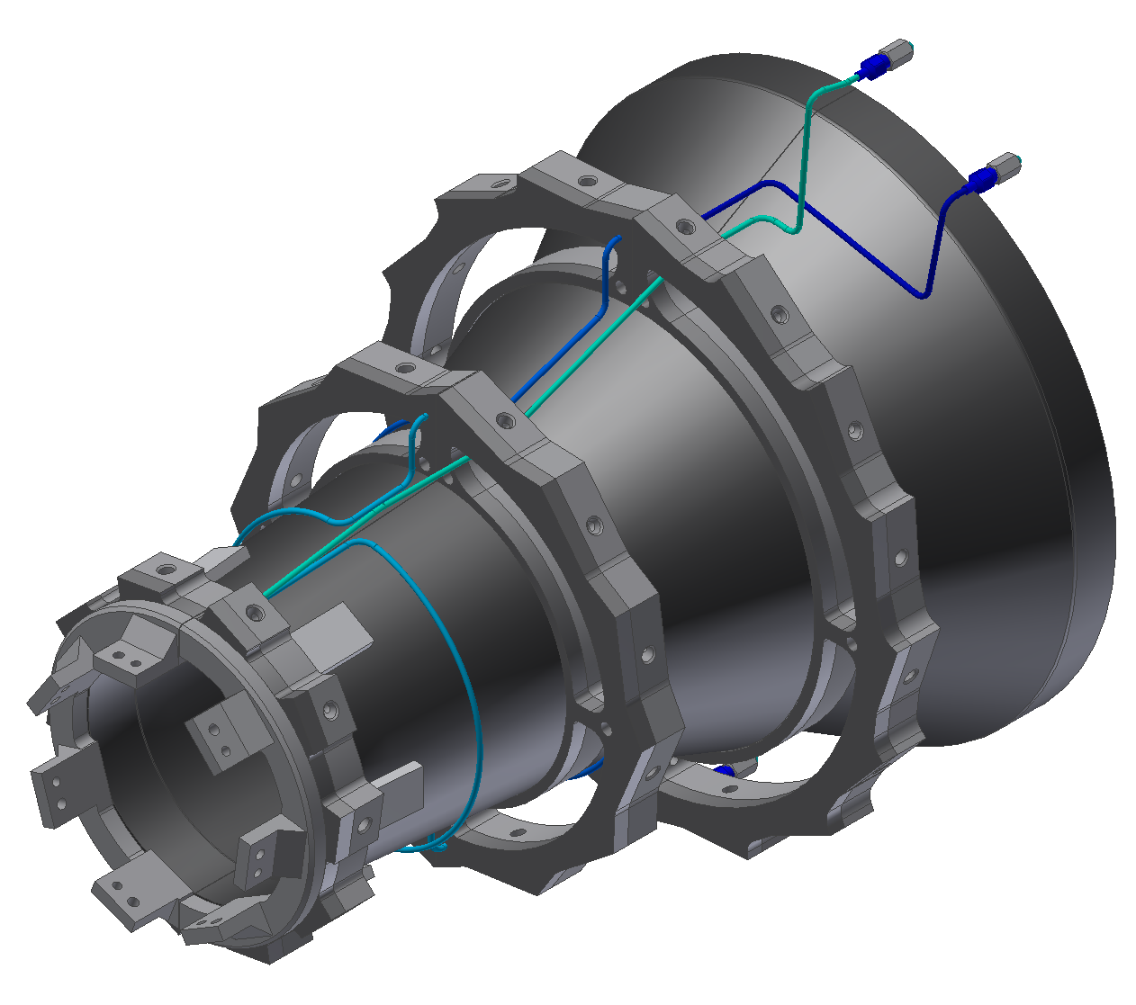
New Cooling Pipe Routing End Rings
Slightly changed from Karsten G. pipe routing because of the diamonds
No extra grounding pipe for L5 end rings (return pipe L4 and L3 is used for grounding the L5 end rings)
Who can bend these pipes? Welcon? (Toru-san)

Slide 11
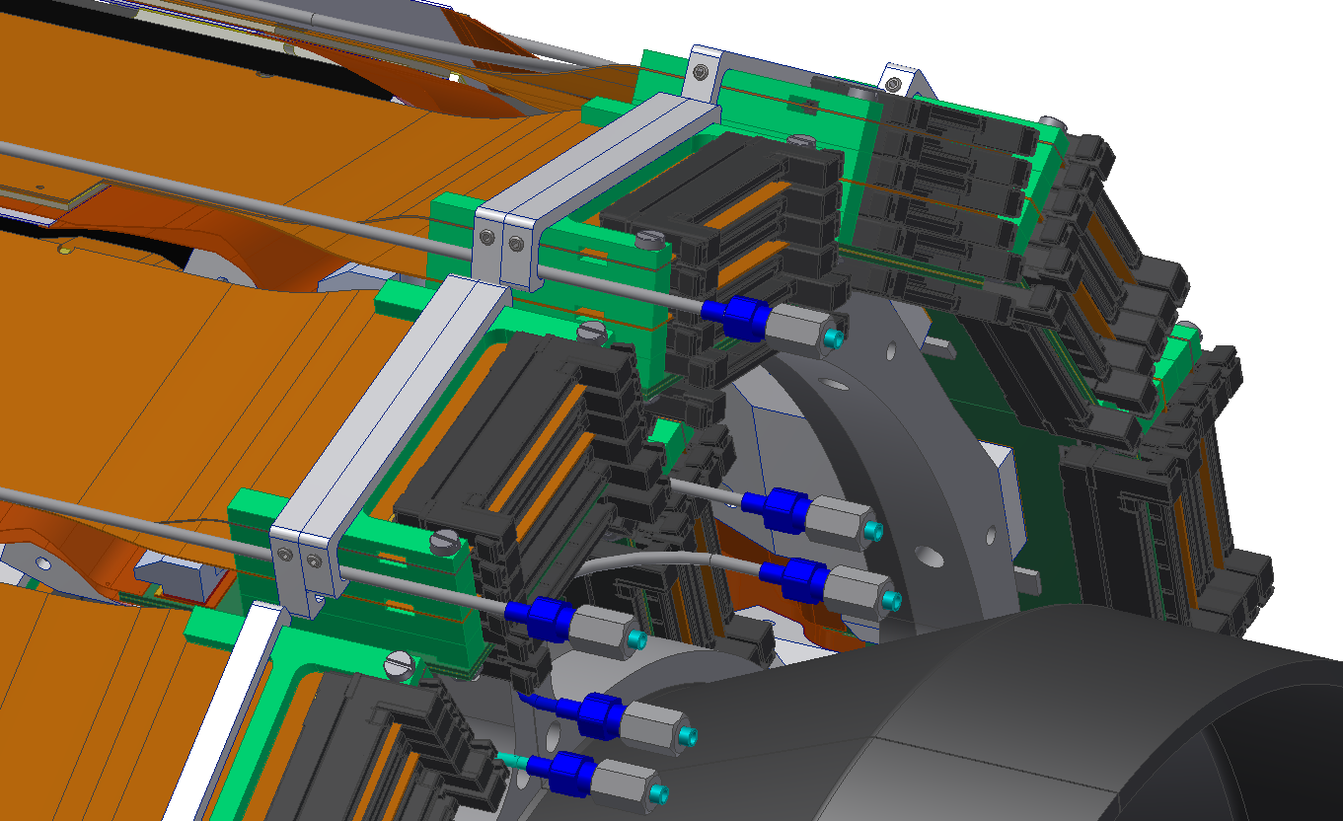
L6 Origami Cooling Pipes & Clamps
L6 Origami pipes
L6 Origami pipe clamps
(pipes are glued on clamps after mounting)

Slide 12
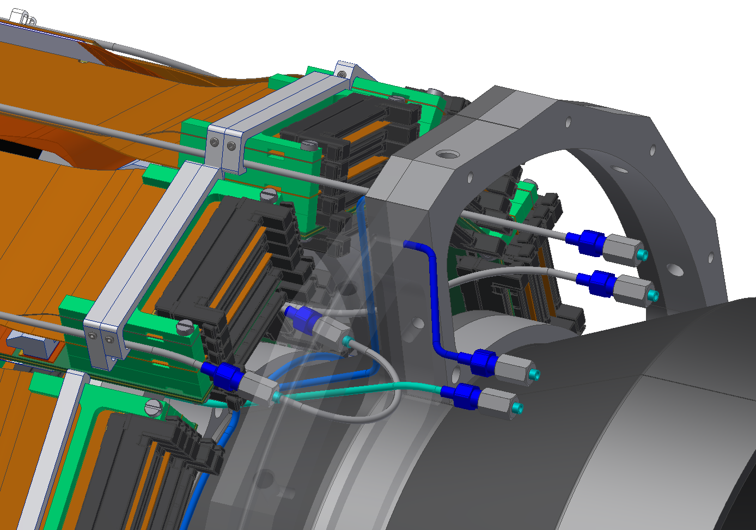
L5 Origami Cooling Pipes & Clamps
L5 Origami pipes
L5 Origami pipe clamps
(pipes are glued on clamps after mounting)
L5 to L4 connection

Slide 13
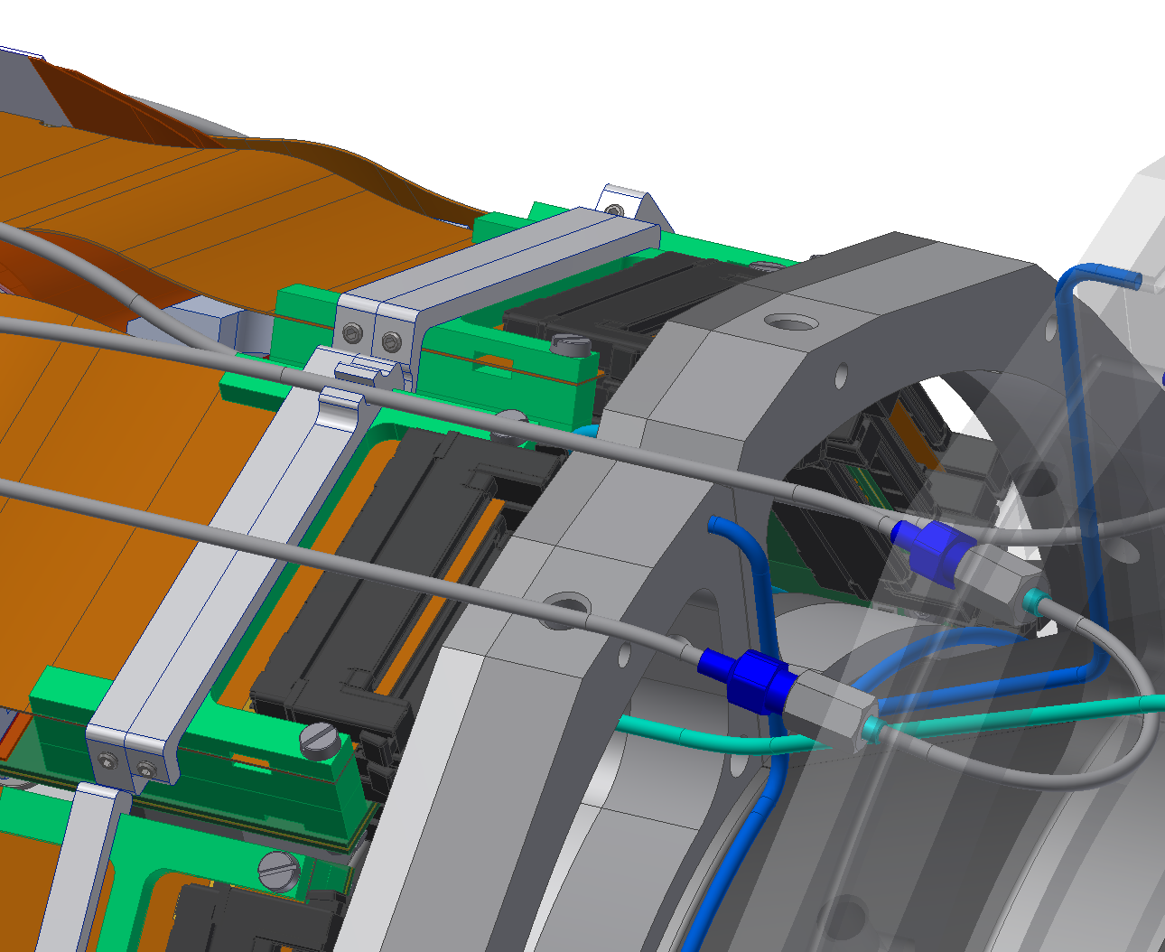
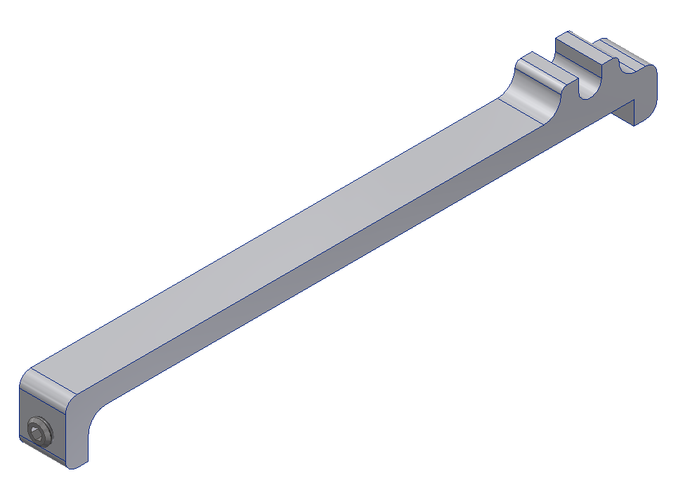
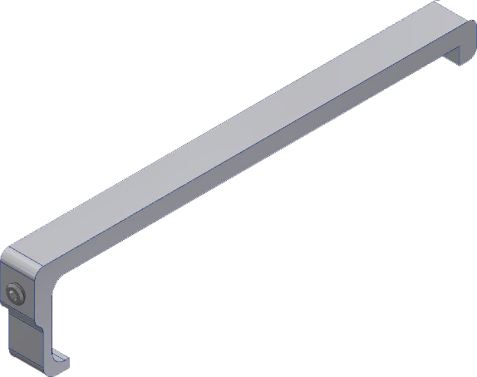
L4 Origami Cooling Pipes & Clamps
L5 Origami pipe
L4 Origami pipes
L4 Origami pipe clamp
(pipes are glued on clamps after mounting)
L5 to L4 connection

Slide 14
Modification BWD L5 End Rings
3mmx45° chamfer (no precision needed)

Slide 15
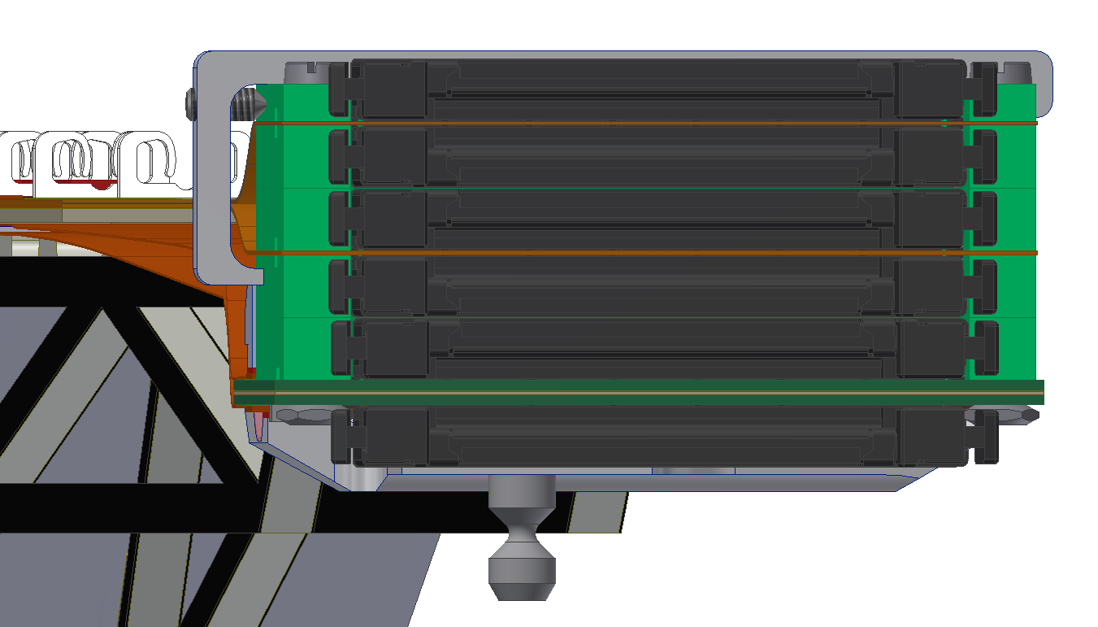
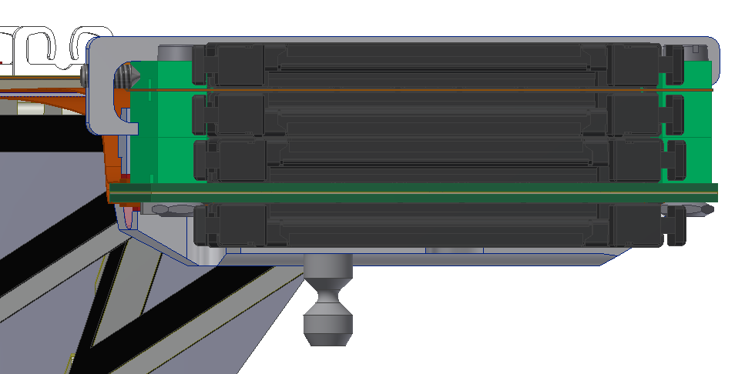
Clamps For NTC & Fiber
L6 and L5 clamps
L4 clamps
Fiber
NTC (more info in next talk)
L6 and L5 clamps
Machining can be done at HEPHY for all clamps
Who glues them? Proposal: during ladder mount

Slide 16
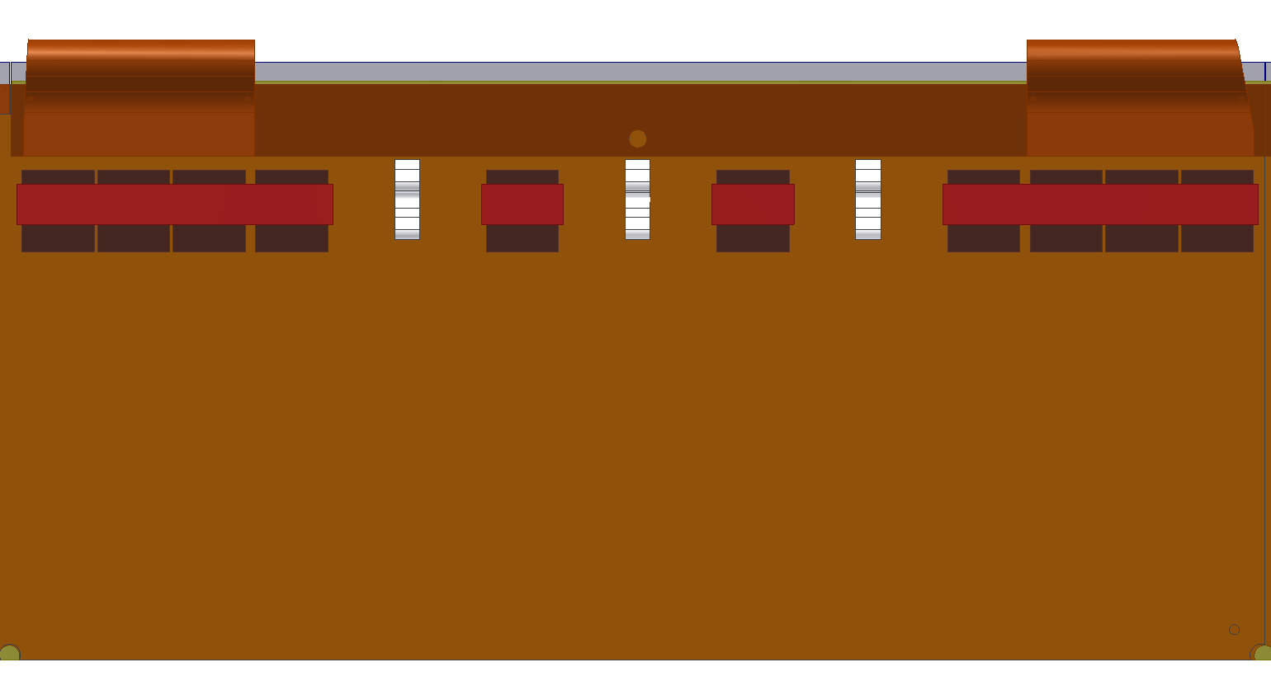
Larger Surface & Position Change Of Keratherm
Keratherm is now 2 mm wider and 0.5 mm on both sides longer
Position of Keratherm shifted 0.5mm closer to PA0 (C. Irmler)

Slide 17
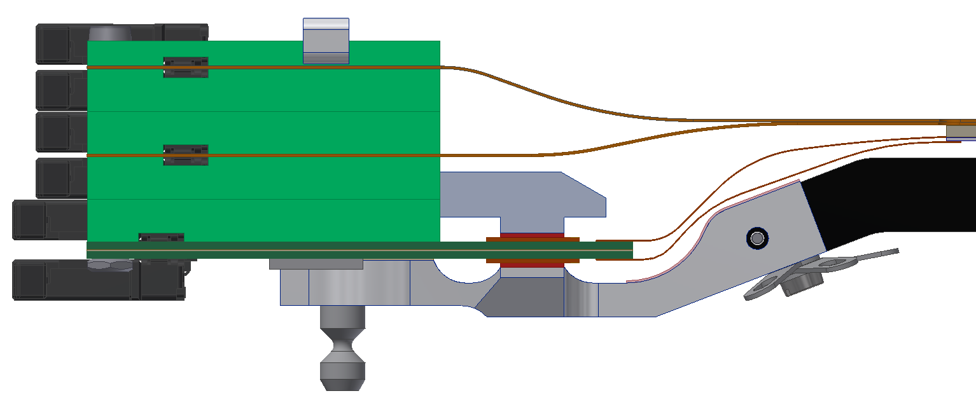
Position Of The Grounding Screw BWD Shift
Grounding screw shifted to the slanted part because of collision with layer 4
No problem because none of the screw holes are drilled yet and the BWD end mounts are already delivered. (Can this be done by KEK machine shop?)

Slide 18
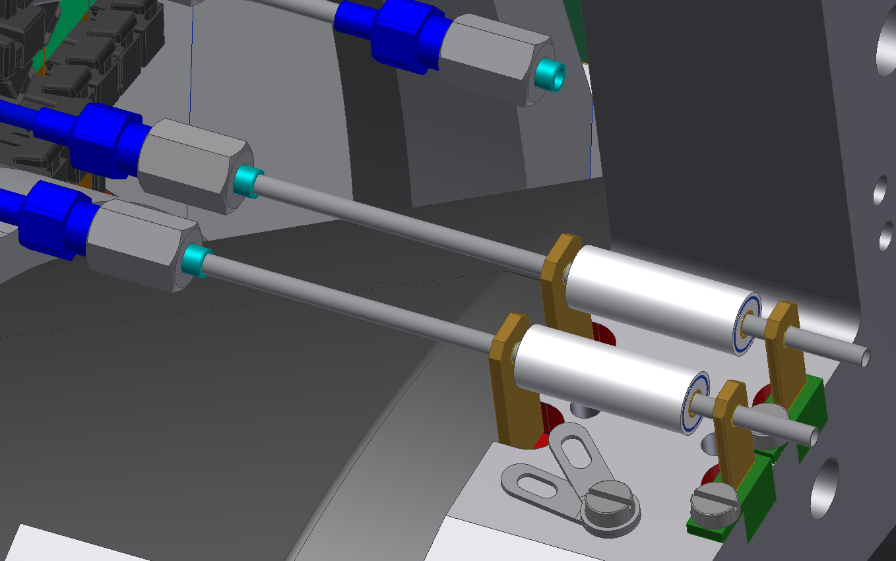
Concept For The Pipe Isolation
Ceramic isolator (Tscharlie)
Brass torque relief (brazed on pipe)
Torque relief isolator
(FR4, like H shapes)
Grounding point for pipes on the end flange
(cable soldered the brass torque relief)

Slide 19
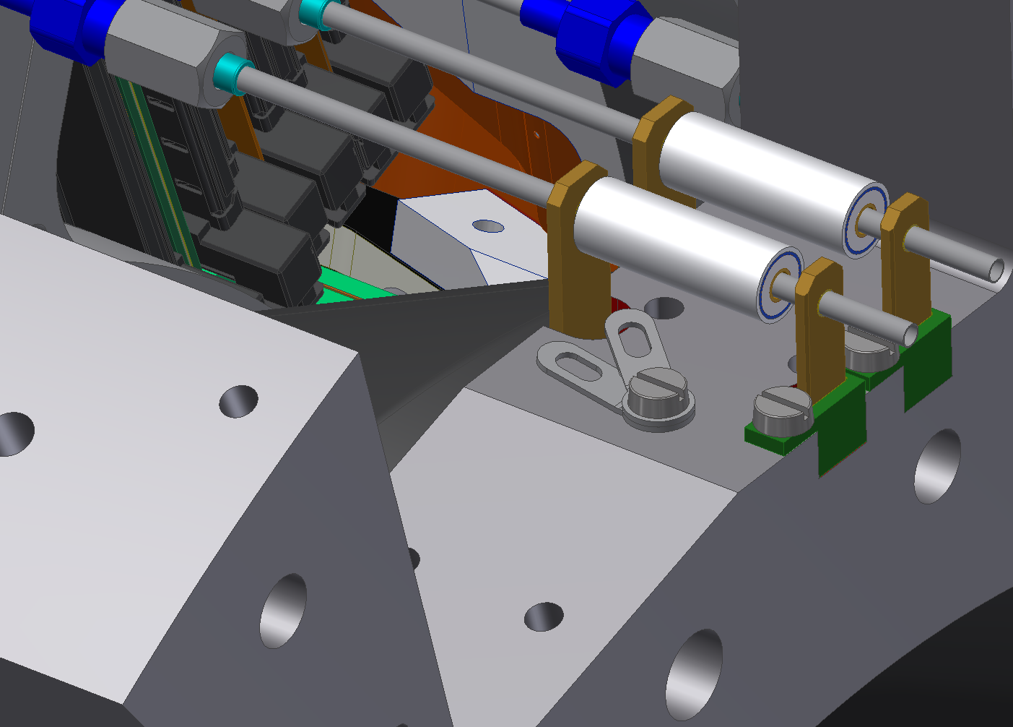
Open Points For This Concept
Is this modification at the end flange possible? (Shuji-san)
Purpose of these drills?
Can we leave them?
Or shift them?
Can Welcon braze the brass plate (torque relief) on the pipe?
If so, which requirement (material thickness and gap between plate and isolator is necessary)? (Toru-san)

Slide 20
Summary & Outlook
We tested the set screw with all the End mounts and Kokeshi pins we have (works from a diameter under 1.9mm)
We would prefer a diameter of 1.6mm+0.1mm
Machining can be done at HEPHY for all set screws (~200 pcs)
New pipe routing between the end rings (can Welcon bend those?)
HEPHY can produce all the clamps for the Origami pipes and for the NTC & fiber clamps (to be glued during ladder mount?)
The L5 BWD end rings are modified (3mmx45° chamfer)
Larger surface & position change of the Keratherm on the Origamis
Position of the grounding screw BWD shift towards the slanted part
Concept for the pipes isolation and torque relief are done
Needs to be verified
Planned release date for the Rev. 2.2 is end of October

