Slide 1
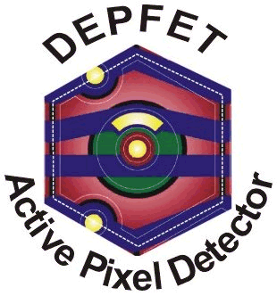
The 6th Belle II PXD/SVD workshop, status of the Belle II SVD and PXD detectors
1-3 October 2014, Pisa (Italy)
F2F Tracking meeting in Pisa, 29.-30.9.2014
Charles University
Prague
Cluster-shape based improvement of spatial resolution for the Belle II DEPFET pixel detector
Peter Kodyš, Charles University in Prague

Slide 2
DEPFET sensors at Belle II
Peter Kodyš, The 6th Belle II PXD/SVD , 1-3 October 2014, Pisa

Slide 3
Using cluster shape to improve of hit position
Full Geant4 simulation in the basf2 (software framework for the Belle II)
There are five basic types of clusters for four different pitch in v direction: single, double and triple pixel clusters, rest of symmetrical and nonsymmetrical clusters.
In Belle II geometry for particles shot of 0.05 – 3.0 GeV electrons and positrons in uniformly distributed directions from the interaction point and in range theta 17 – 150 deg
In Belle II: 25 % form single-pixel clusters, 15 % form 2-pixel clusters along the R-phi coordinate, and 26 % along the z-coordinate. 12 % form non-symmetric "L"-shaped three-pixel clusters, 16 % form larger non-symmetrical clusters, and rest 6 % form symmetrical clusters (like 2x2 clusters).
Peter Kodyš, The 6th Belle II PXD/SVD , 1-3 October 2014, Pisa

Slide 4
Using cluster shape to improve of hit position
For single-pixel clusters, the obvious hit position estimate is the center of the pixel.
For larger clusters, hit position is estimated separately for the u- and v- coordinates, using center-of-gravity estimates for clusters size 2 and the analog head-tail method for size 3 and more. Generally, the average resolution is best for small clusters of size 2 and 3.
For single-pixel clusters, hit position uncertainty is given by the area where a given energy deposition is mostly contained within the single pixel - it therefore depends on pixel charge and clustering threshold.
With particles arriving at different (and unknown) directions, the standard eta-correction algorithms are not usable. Therefore, simple bias-correcting methods for center-of-gravity and head-tail estimates are desirable, that would only use measurable quantities to correct for bias.
Peter Kodyš, The 6th Belle II PXD/SVD , 1-3 October 2014, Pisa

Slide 5
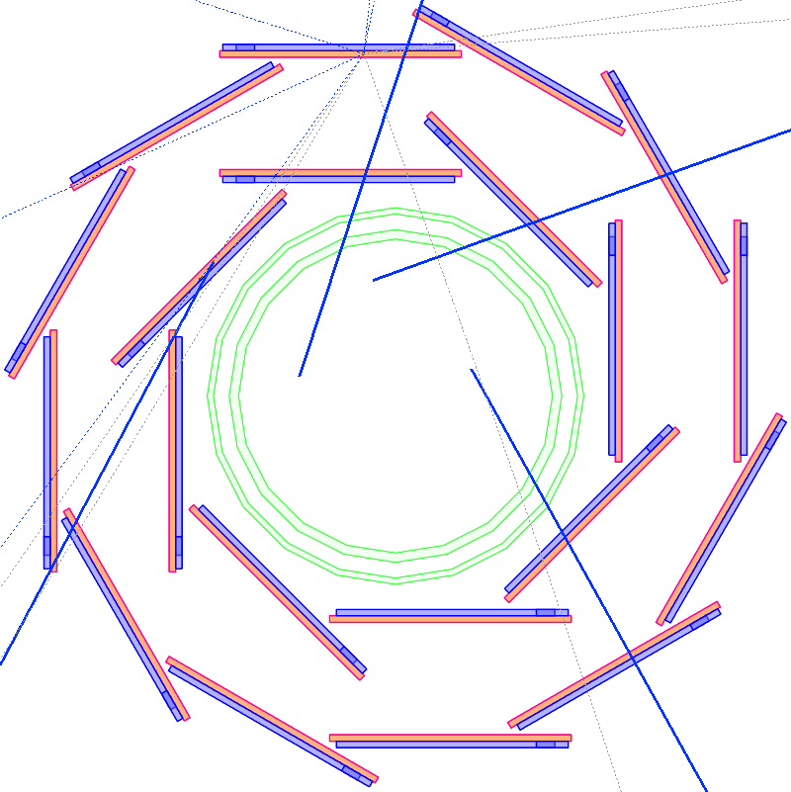
Using cluster shape to improve of hit position
The 3-pixel “L”-shaped clusters are the simplest and most common case where such a bias correction would be desirable.
For these clusters, the center-of-gravity estimate is biased by about 10% of pixel size, comparable to the typical RMS error of the position estimate. Therefore, correction of the bias highly desirable.
We show that adding a fixed (pixel noise dependent) charge to the pixel with zero signal in the 2x2 matrix can significantly improve the center-of-gravity estimate of hit position for such clusters. Adding the fourth pixel with the signal of 1.3 x ENC improved position RMS error from 7.4 microns to 4.7 microns in R-phi, and reduced position from 5 to 2 microns.
Cut of incident angle range in r-phi
Residual plot of “L” shape in one orientation before (left) and after (right) correction
Residual plot of “L” shape in all orientation before (left) and after (right) correction
Peter Kodyš, The 6th Belle II PXD/SVD , 1-3 October 2014, Pisa

Slide 6
Using cluster shape to improve of hit position
Table for hit position bias reconstructed from “L”-shaped clusters before and after correction for different clustering cuts
clustering cuts 3xENC (default)
Fractions of cluster shape types for different clustering cuts.
Table for RMS error reconstructed from “L”-shaped clusters before and after correction for different clustering cuts
Peter Kodyš, The 6th Belle II PXD/SVD , 1-3 October 2014, Pisa

Slide 7
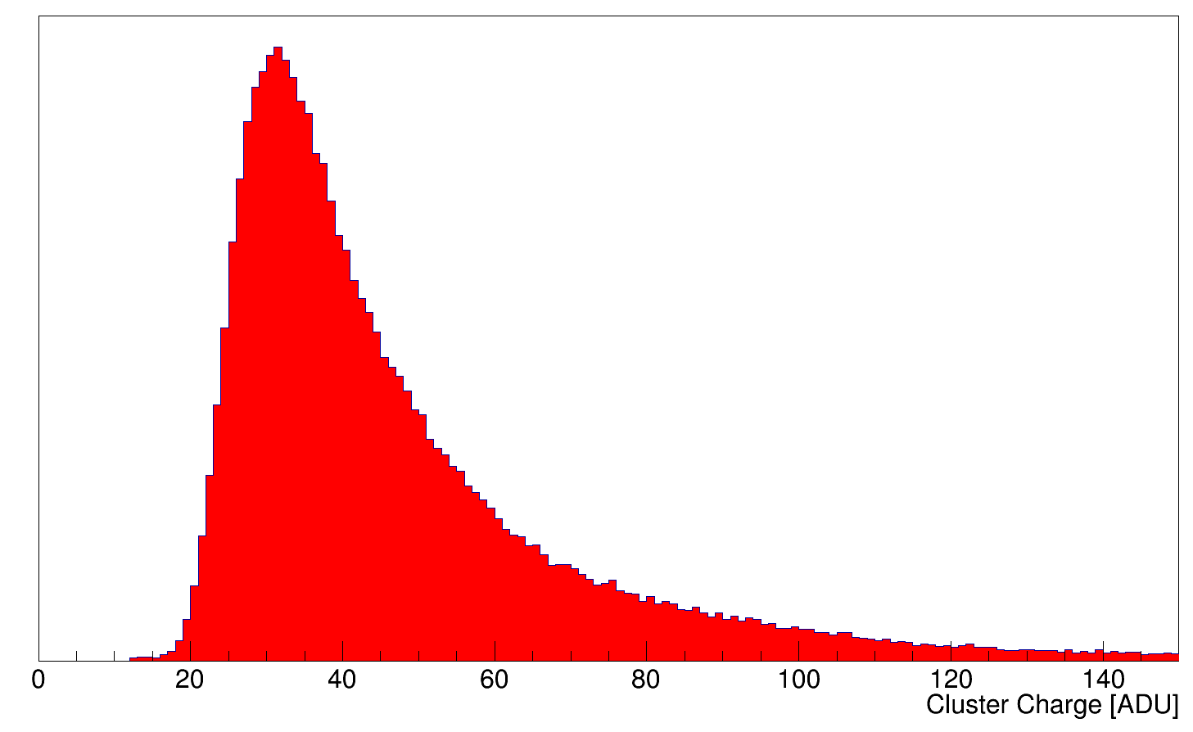
Using cluster correction in detail…
1 ADU = 200 e⁻
r-phi = -10 .. +35 deg, theta 17 – 150 deg
observe big bias
1 ADU = 200 e⁻ | Electrons | ADU
S/N | 300 | 1.5
cluster charge MPV | 6400 | 32
seed cut | 1000 | 5
cluster charge cut | 1600 | 8
cluster shape cut | 600 | 3
adding charge to “L” shape | 1200 | 6
±noise
Example of “L” cluster shape with signals
Typical PXD cluster charge plot in ADU in Belle II
Peter Kodyš, The 6th Belle II PXD/SVD , 1-3 October 2014, Pisa

Slide 8
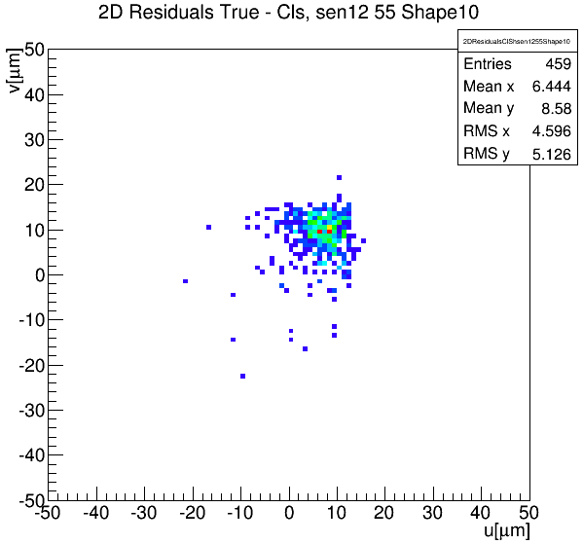
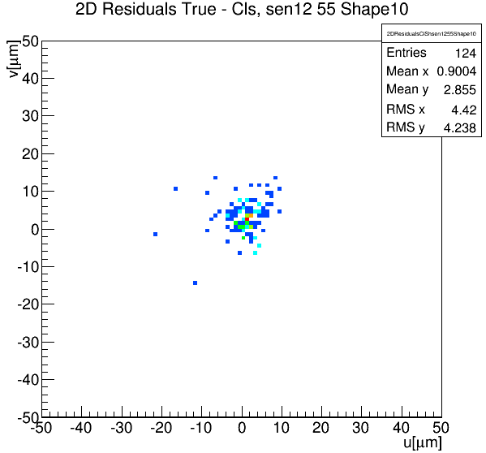
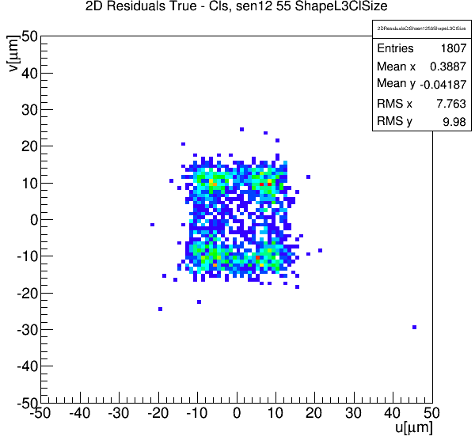
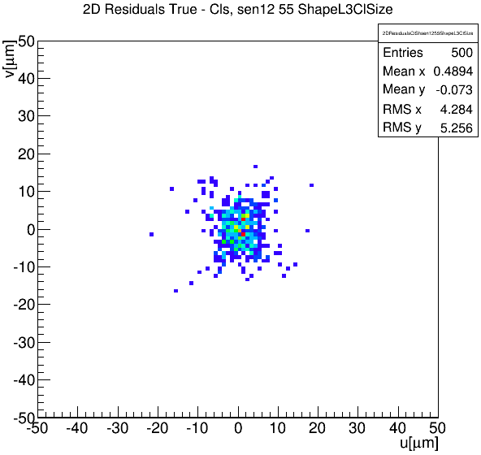
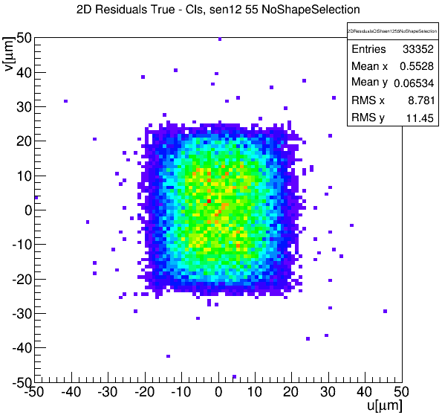
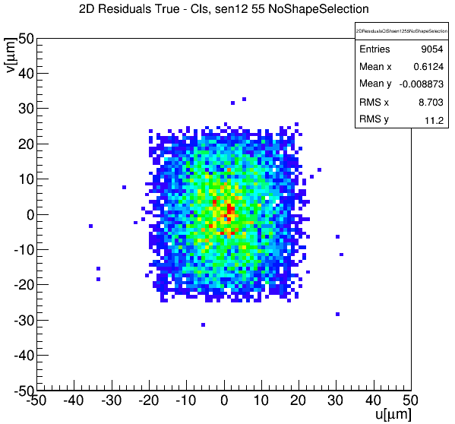
Using cluster correction in detail…
u (r-phi) direction: -10 .. +35 deg
V (theta) change: -10 .. +10 deg
Than bias is on both direction and correction works better
Residual plot of “L” shape in one orientation before (left) and after (right) correction
Cut of incident angle range in r-phi
Residual plot
before (left) and after (right) correction
Residual plot of “L” shape in all orientation before (left) and after (right) correction
Peter Kodyš, The 6th Belle II PXD/SVD , 1-3 October 2014, Pisa

Slide 9
Conclusion & plan
Improvement of hit position reconstruction is important for vertexing performance and new physics searches.
Realistic estimates of hit position uncertainties and correction of reconstruction bias is equally important.
We have shown that the most important reconstruction biases in small “L”-shaped clusters can be easily corrected by adding a constant charge in the missing pixel.
This efficiently corrects for center-of-gravity bias and improves the distribution of residuals.
General algorithm for error estimation and bias corrections for “L” cluster shape independent of Belle II geometry is on process and would be soon
Angle dependent correction and error estimation is under study and would be soon
Improvement of error estimation to more realistic values
In-pixel analysis and validation plots
Peter Kodyš, The 6th Belle II PXD/SVD , 1-3 October 2014, Pisa

Slide 10
Conclusion & plan
Position of source
Peter Kodyš, The 6th Belle II PXD/SVD , 1-3 October 2014, Pisa

Slide 11
Conclusion & plan
0.59
1.10
1.63
Different pixel size vs. angle
2.96
50 x 55 x 75 μm
v: 20.1 / 36.6 / 55.7 deg
Space angle [sr]
50 x 60 x 75 μm
v: 21.8 / 38.7 / 58.0 deg
u 50 μm : 18.4 / 33.7 / 53.1 deg
50 x 70 x 75 μm
v: 25.0 / 43.0 / 61.8 deg
17.5%
9.4%
25.9%
50 x 85 x 75 μm
v: 29.5 / 48.7 / 66.2 deg
47.1%
Peter Kodyš, The 6th Belle II PXD/SVD , 1-3 October 2014, Pisa

Slide 12
Conclusion & plan
Angle vs. in-pixel position
50 x 55 x 75 μm
Thank you for your attention!
Peter Kodyš, The 6th Belle II PXD/SVD , 1-3 October 2014, Pisa

