Slide 1

PXD Summary
DEPFET Sensors production yield
inter-metal insulation
EMCM electronic tests
ASICs
Schedule
I do not have time to mention:
DAQ
Services, Power Supplies
other system aspects
apologies!
H-.G. Moser, 18th B2GM, June 2014

Slide 2
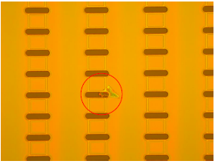
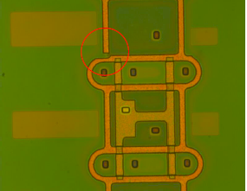
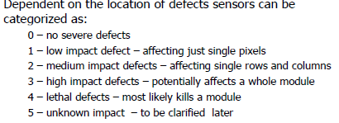
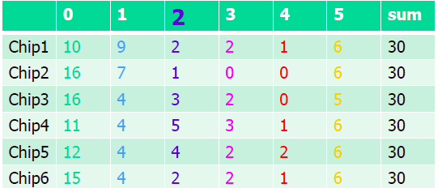
Yield after phase 1
Search for possible defects (optical scan, automatic & manual)
Good (needed)
>19 (8)
> 43 (12)
> 31 (12)
> 19 (8)
Inner bwd
Outer fwd.
Outer bwd
Inner fwd..
So far this is encouraging
Still, more production steps with possible losses ahead
Need perfect QA,
eliminate possible losses,
use grade 2 & 3 for prototyping and tests (irradiations, beast)

Slide 3
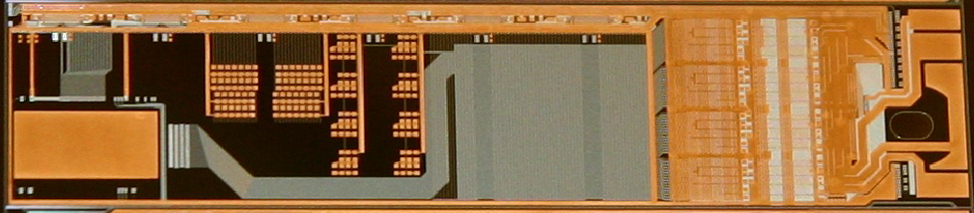
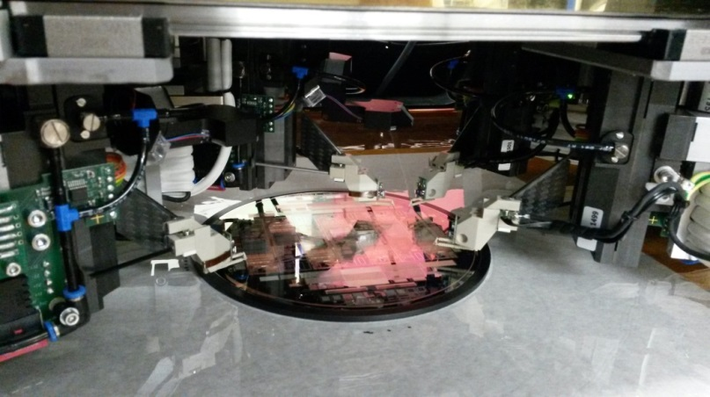

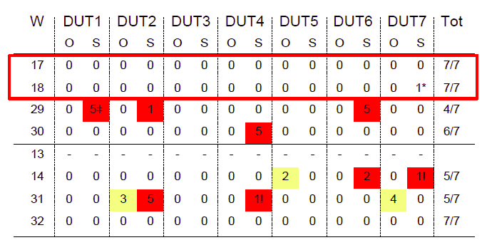
Test of metal system processing with EMCM
Test vehicle to optimize yield of metal system without the time consuming
(and expensive) phase 1
=> EMCM: Electrical Dummy to be tested like a real module
Allows tests of the electrical performance
- routing errors (despite automatic checking tools)
- cross talk, voltage drops, RC delays
EMCM3: several (optimized)
process variations
Wafers 17 and 18 show best results,
Essentially 100% yield
Confirmation batch (EMCM4) processed
Tests started, so far confirm good results of EMCM3

Slide 4
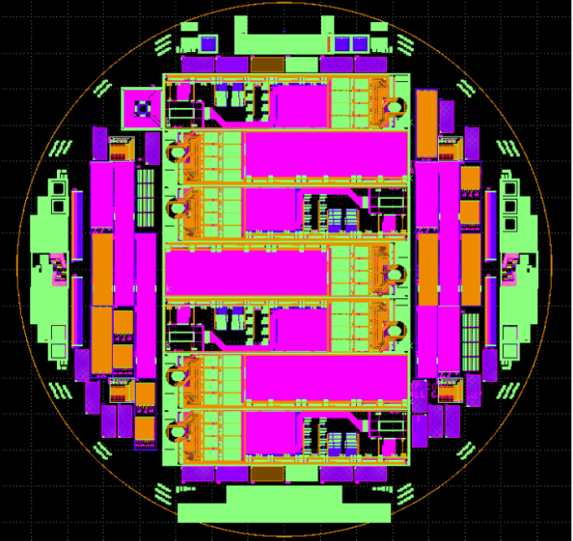
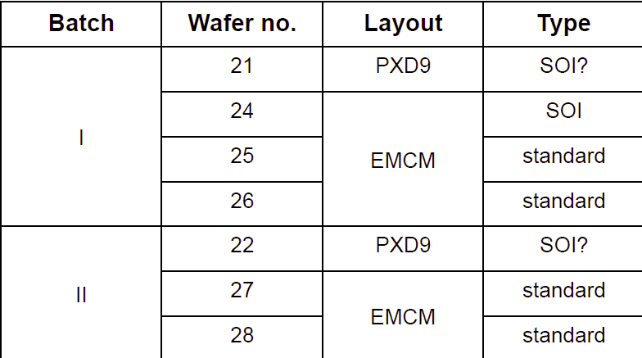
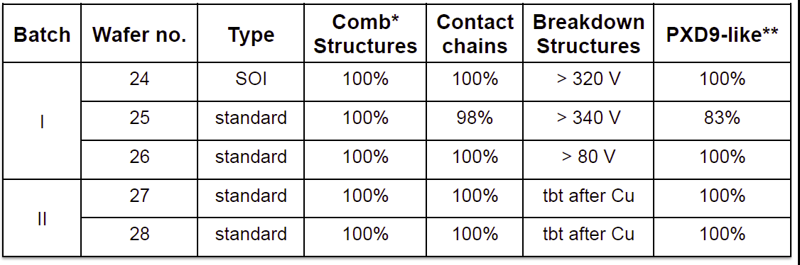
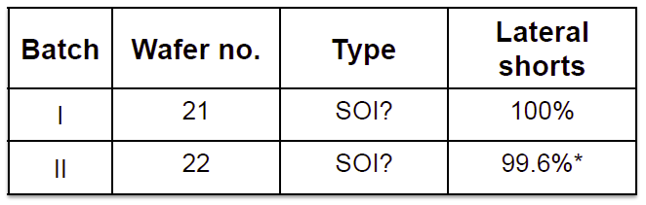
EMCM4
EMCM 4: confirm results of EMCM 3 metal layer yield:
(5 wafers & 2 real PXD9 wafers, incl. SOI wafers))
EMCM
‘PXD9’
EMCM wafer yield (wafer level)
PXD9 wafer yield (wafer level)
EMCM3 results confirmed. Further tests after copper deposition (started).

Slide 5
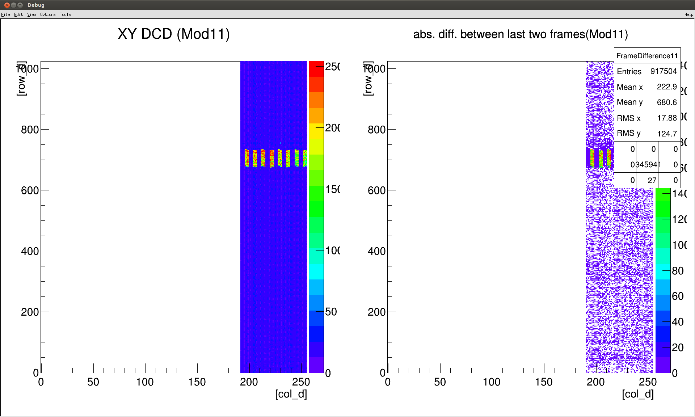
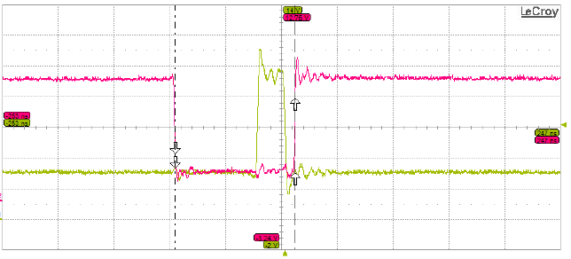
EMCM electronic test results
EMCM2: several modules assembled but only partially successful:
some only partially equipped (1 DCD/DHP, 1 switcher)
some ASICs got damaged
nevertheless: all functions could be successfully tested)
Main limitations:
old AISCs
DCD/DHP communication did not work at full speed
EMCM3: 3 modules assembled
latest ASIC generation (DCDpipe, DHPT, switcher G),
fully populated
differential clock lines (DCD operation at full speed)
larger spacing of termination resistors (facilitates SMD assembly)
gated mode can be tested
Tests very successful (but not yet completed)
Except: High speed link suffers from wrong Kapton layout and DHPT problem
Plan to finish tests till October
start PXD9 phase 2
(metal processing)
W18-3: readout of a small PXD6 matrix (305 MHz)
(mapping wrong, software!)
All switcher work properly at full speed (305 MHz)

Slide 6
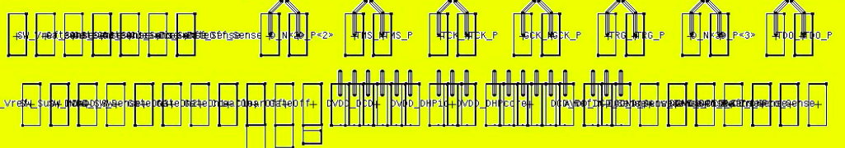
New Kapton/PXD9 footprint
Too high current across some bond wires, non optimal layout of high speed data links
DCD_DCD: 720mA 4 => 6 bonds
DVD_DHP: 220mA 3 => 3 bonds
DVD_DHPcore: 700mA 3 => 6 bonds
DCD_refin: 200mA 1 => 3 bonds
120 mA/bond max
Change possible since 2 differential lines not needed anymore
X
X
DVD_DCD
DVD_DHPcore
DVD_DHP
DCD_refin
DVD_DCD
DVD_DHPcore
DVD_DHP
DCD_refin
In addition: use 30µm bond wire instead of 25µm (x 1.4)

Slide 7
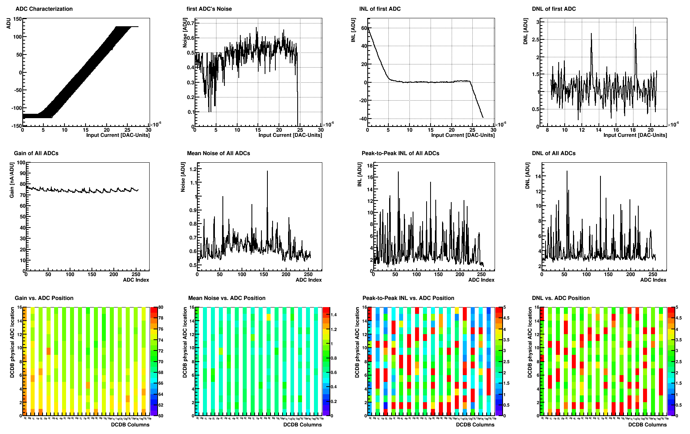
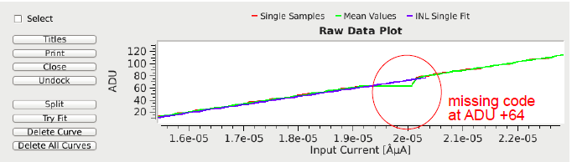
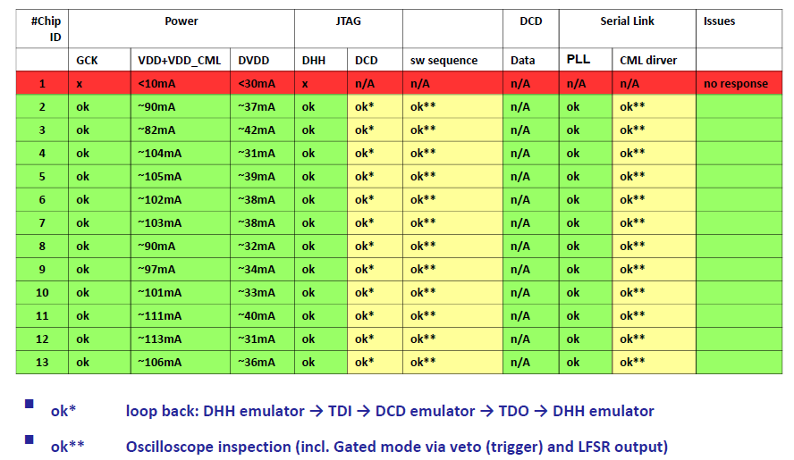
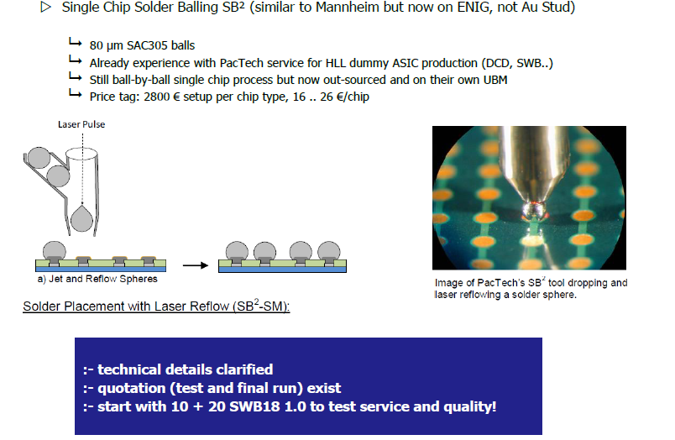
ASICs
DCT pipeline: under test. Performs better than old version, but still some noisy channels.
Reason understood (missing codes due to transistor mismatch). Ok for prototyping
DHPT: under test, performs well (one problem with ‘slow NMOS’ => affects readout speed)
Ok for prototyping, needs re-submission
Switcher: ok (however: gating not yet tested). Final submission with minor improvements.
bumping: can be done on chip level by PacTech.
Plans:
Design review October 27/28
Resubmission in February 2015

Slide 8

DCD Summary
Documentation: Description of new registers
Schematics (updated of DCD manual)
List of known good settings
BSDL file for boundary scan test
Description of digital test pattern
Proposed Tests:
Digital test: write in all registers and read back
Power test: all currents as expected (@ 305 MHz)
JTAG boundary scan ok?
Pedestal control (VNSubIn, VNSubOut,)
Functionality of calibration circuit (internal & external)
  Tuning of optimal settings……
Pedestal spread (rms, peak-to-peak), without sensor
Gain and linearity (with internal or external current source?)
Dynamic range
RMS noise without sensor: @ 305 MHz dependence on
Number of defect channels:
    Large pedestal offset (criteria)
    ( ) Excessive noise (> 2 x rms?)
    Missing codes / excessive non-linearities
Link DCD-DHP: stability @ 305 MHz
Analogue common mode subtraction (with internal current source)
DACs for pedestal correction
Tests should be performed on hybrid 4/5 and on EMCM.
Test with matrix: average noise (increase with respect to measurements without matrix).
LOW STATISTICS!

Slide 9
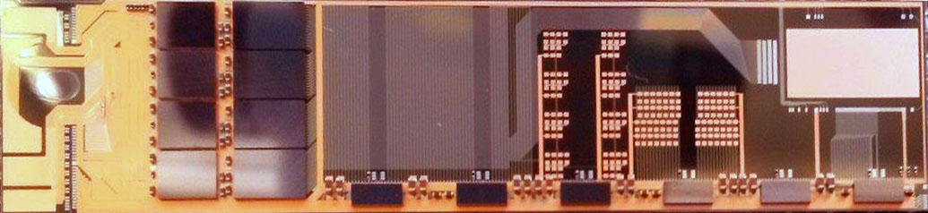
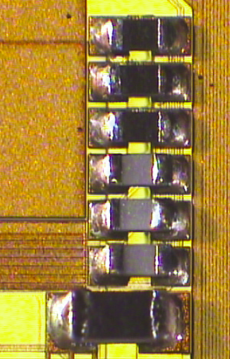
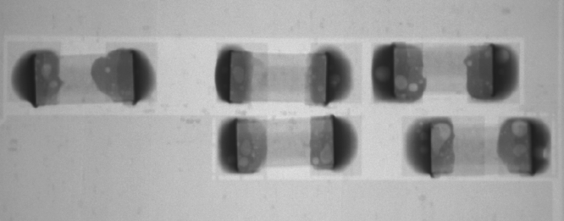
EMCM/Sensor assembly
Flip Chip bonding of ASICs is done by Fraunhofer IZM, Berlin – no issues (chips need to be bumped. Ok for DCD and DHP, switcher =>).
SMD: need to solder ~ 50 small resistors and capacitors (SMD)
Prototyping done by Finetech in Berlin. Ok, but not without problems
Finetech cannot do series production.
Will be done by NTC in Valencia (using a Finetech machine).
NTC is setting up the process, almost completed
Review October 17

Slide 10
How to Continue ?
Sensor: Pilot production starting asap with 2-3 good and 4-3 dummy wafers
dummy: to be used for testing of electronics and kapton
Test of remaining production steps (metalization, thinning, copper)
First information on sensor properties
Possibility to test new ASICs and other system parts with representative test objects
No need to sacrifice hot PXD9 sensors for component tests
Smooth transition of dummy assembly to sensor module assembly
Conclusive tests of gated mode only possible with real sensor
We will get modules for test beam in time
Risk: loss of 2-3 wafers if we still find problems in the metal layout
Question:
when to continue further metal processing?
Immediately
After completion of tests
Clearly the latter would be desirable but conflicts with the schedule

Slide 11
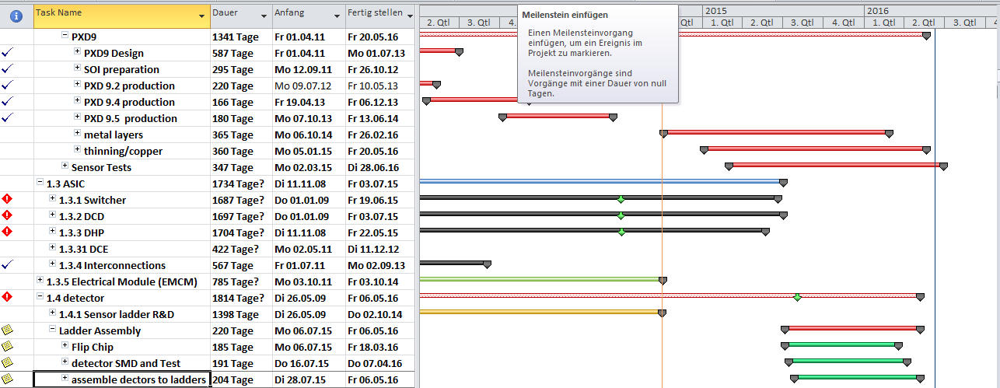
Schedule
 | immeadiate | pilot | pilot with hold
Start test pilot |  | Jul. 15 | Jul. 15
Module production start | Jul. 15 | Sep. 15 | March 16
PXD ready for shipment | April 16 | June 16 | Jan. 17
KEKB schedule ‘C4’: PXD needs to be at KEK for integration before January 2017
Pilot with continuation (eventually wait for copper) is still ok
Pilot with hold will most likely fail to be ready in time

Slide 12
Conclusions
Sensor: Metal processing problemes solved
confirmed with EMCM3 and EMCM4
ready to start production
EMCM electronic tests:
two EMCM3 fully populated (one with a PXD6 matrix)
tests are ongoing
still a lot of work ahead (analogue performance, gating)
ASICs: DCDpipe has known problems (missing codes), tests not complete yet
DHPT: some corrections needed, more tests needed
Switcher: only minor improvements forseen
Review on October 27/28
Submission postponed from November 2014 to February 2015
Sensor processing: will start with a pilot run (few PXD9 wafers & dummies)
test of system components & prototyping
Series production to start September 2015
Delivery to KEK will still be on time

