Slide 1
Switcher bumping at PacTech

Slide 2
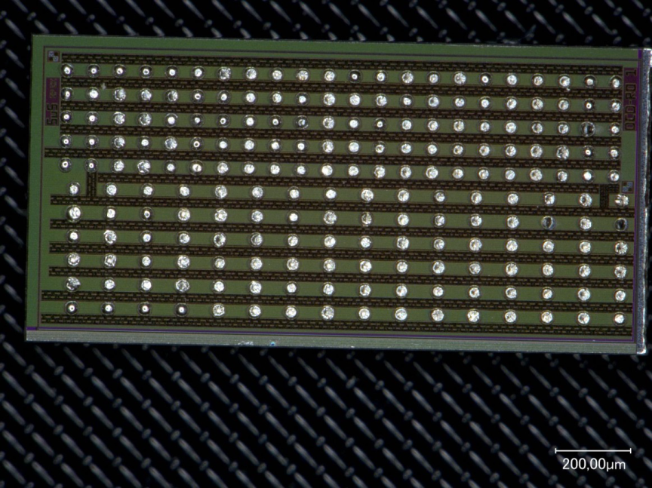
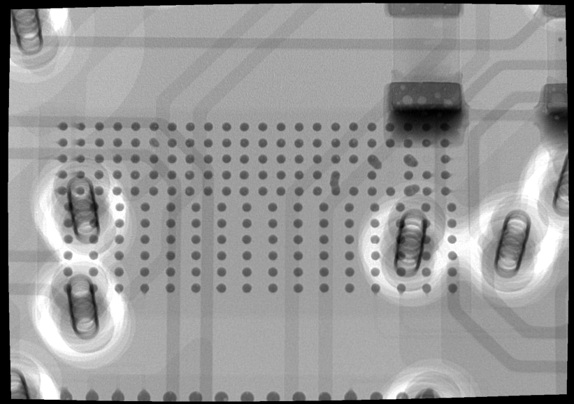
The Motivation
:- SWB bumping so far on chip level in a (semi) manual procedure
:- place gold stud on SWB last metal, jetting of solder on gold stud
:- possible issues and concerns:
:- reproducibility
:- long-term stability of the interconnect (Au-Sn joint)
:- two process steps for each individual bump (on 340 SWBs + spares)
:- Quality control ….
DCDRO – same bumping techno

Slide 3
Possible solutions
SWB engineering run and bumping on wafer level at IZM
:- standard UBM and e-p SAC solder
2. MPW run for SWB and bumping on chip level
:- more tricky, needs to be qualified …
:- PacTech, Germany, close to Berlin, is offering such a service

Slide 4
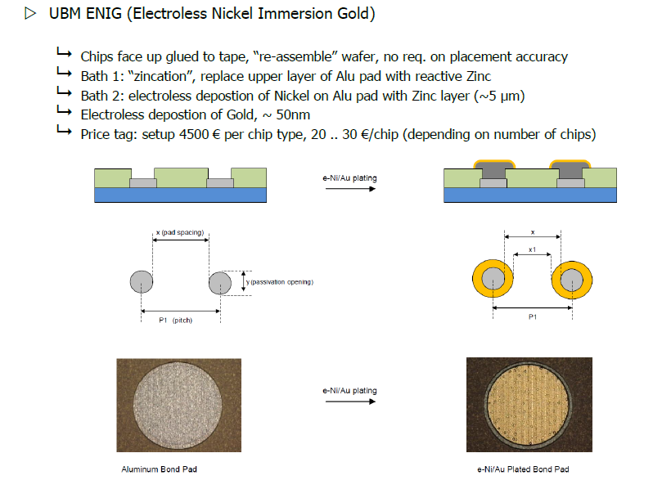
Bumping at PacTech - UBM

Slide 5
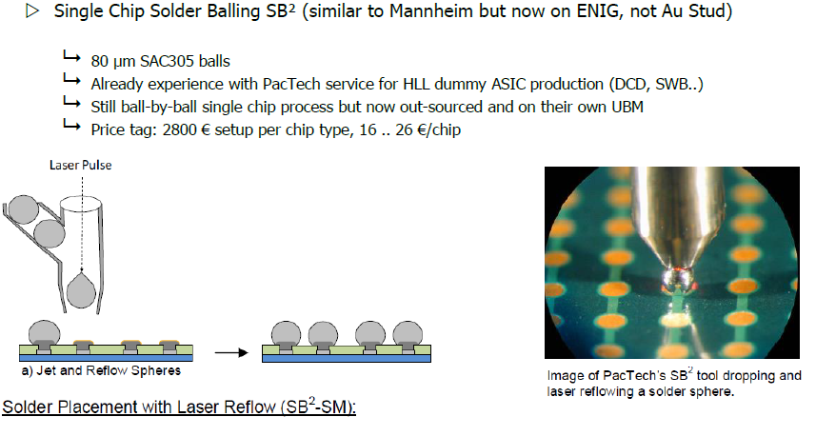
Bumping at PacTech - balling
100 µm

Slide 6
6 June 2014: 20 hot SWB18 1.0 + 10 setup dummies sent to PacTech
:- received warnings because of scratches and probe marks on the pads
:- confirmed that we take the risk
10 July 2014: received 20 bumped hot chips + 6 from setup
→ ~9000 Euro, mostly for setup cost, does not scale with #chips

Slide 7
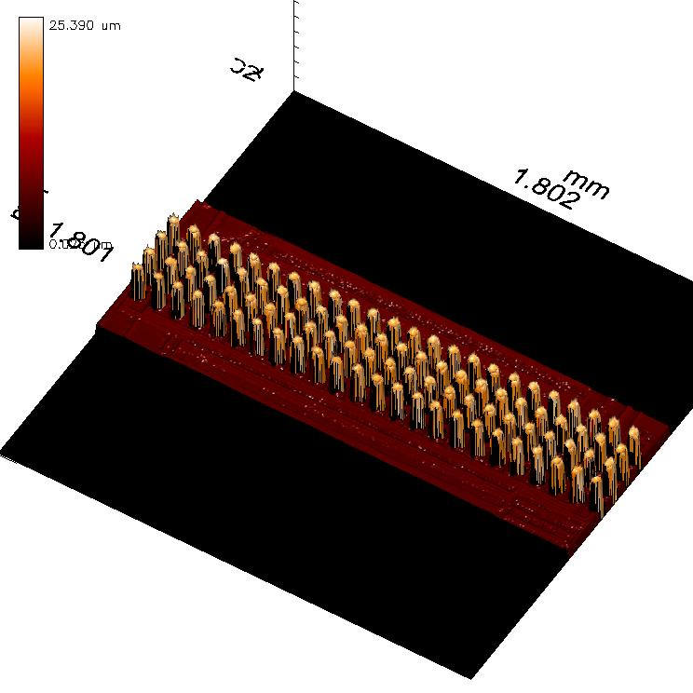
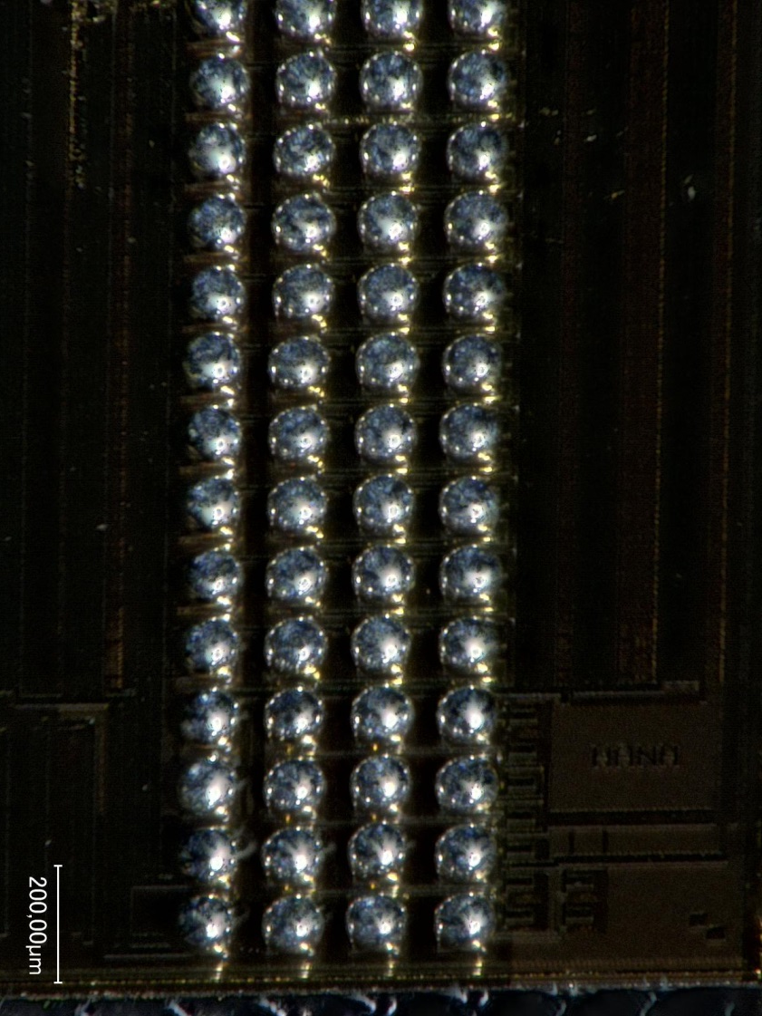
Bump height → very homogeneous

Slide 8
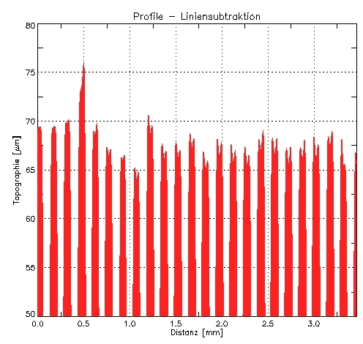
Bump height → very homogeneous
One row of a sample: ~67 µm (-2/+8)

Slide 9
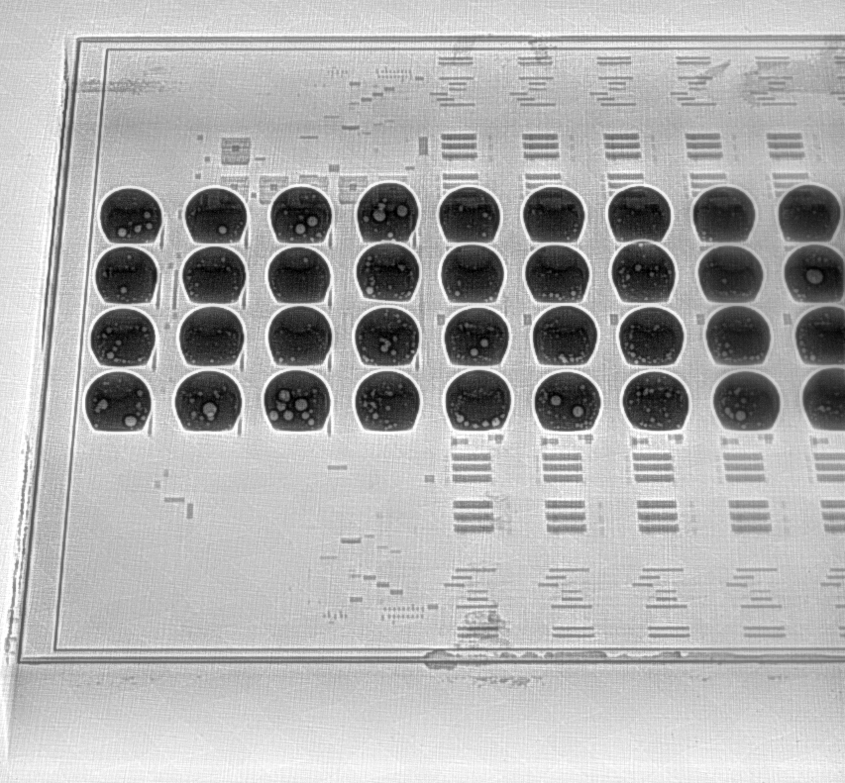
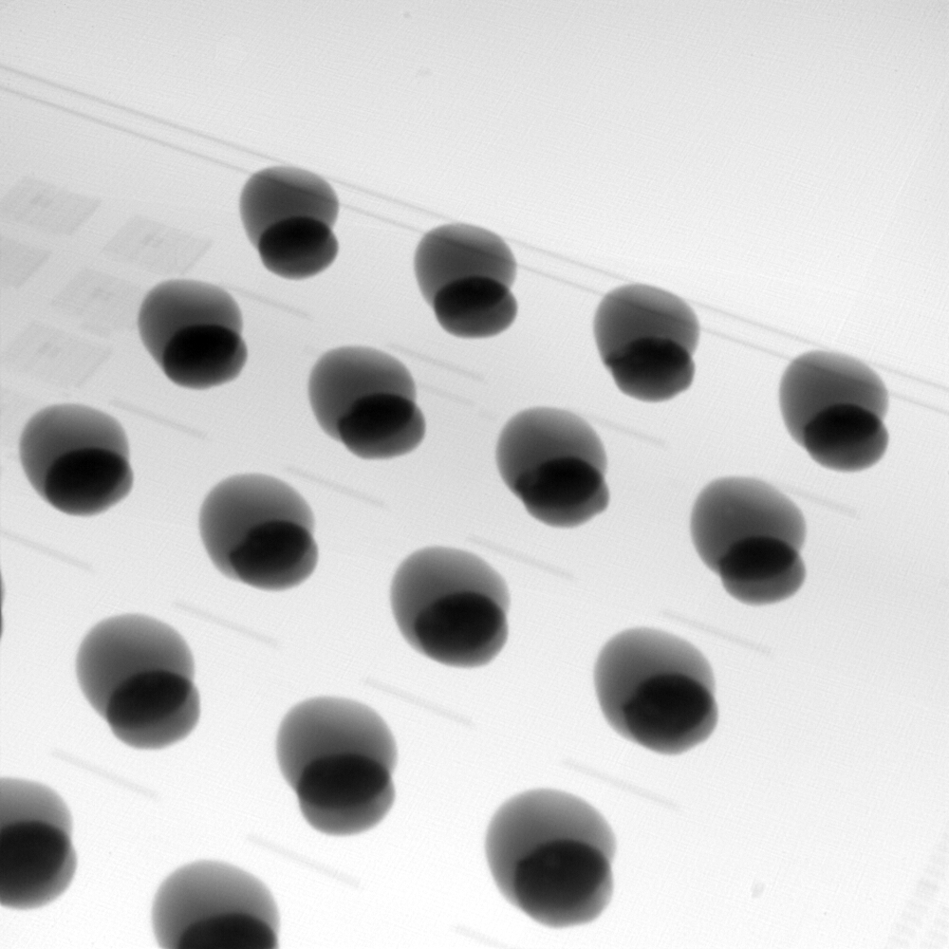
X-ray → some blisters, <20%, acceptable
SAC on Au Stud
PacTech

Slide 10
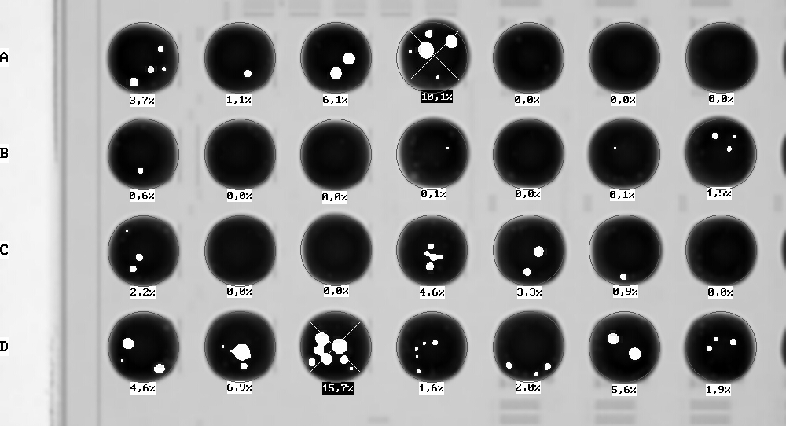
X-ray → some blisters, <20%, acceptable

Slide 11
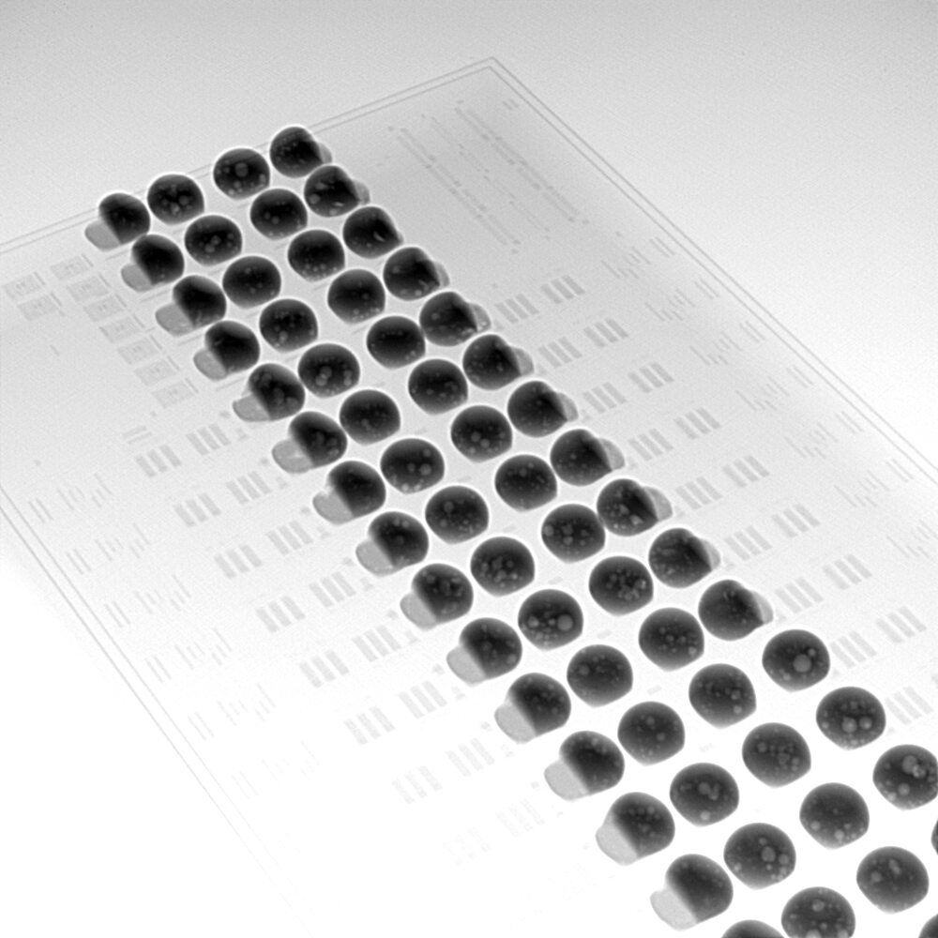
Shear tests

Slide 12
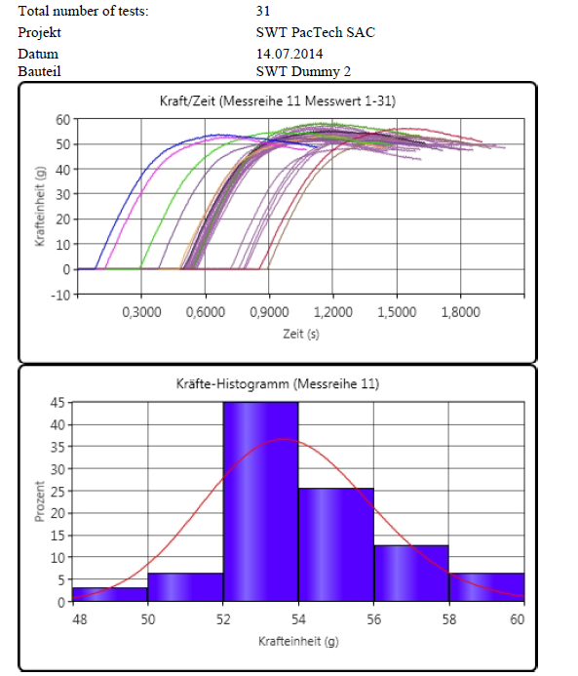
Shear tests

Slide 13
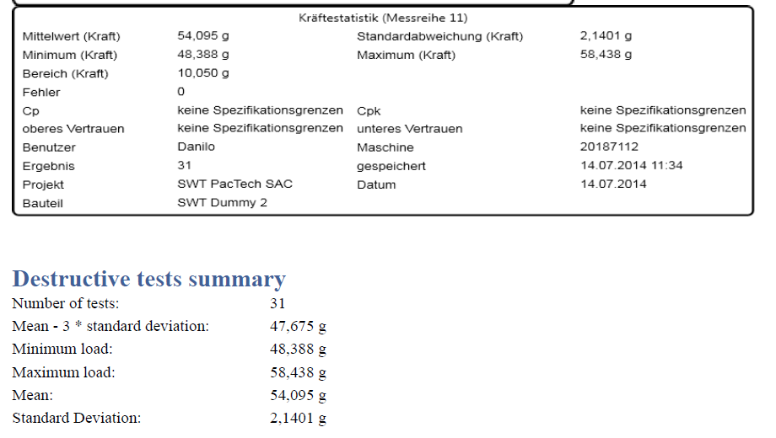
Shear tests
All ball shear, 54g/bump → pass

Slide 14
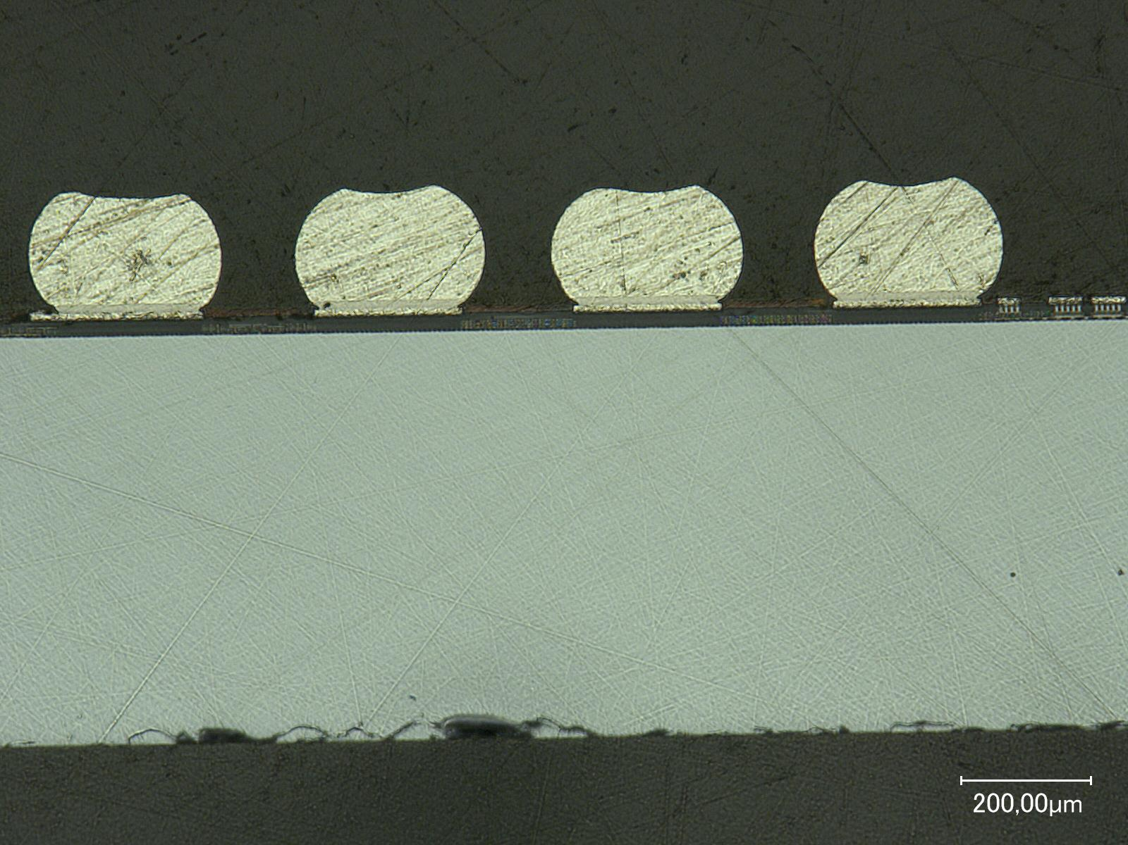
Cross section

Slide 15
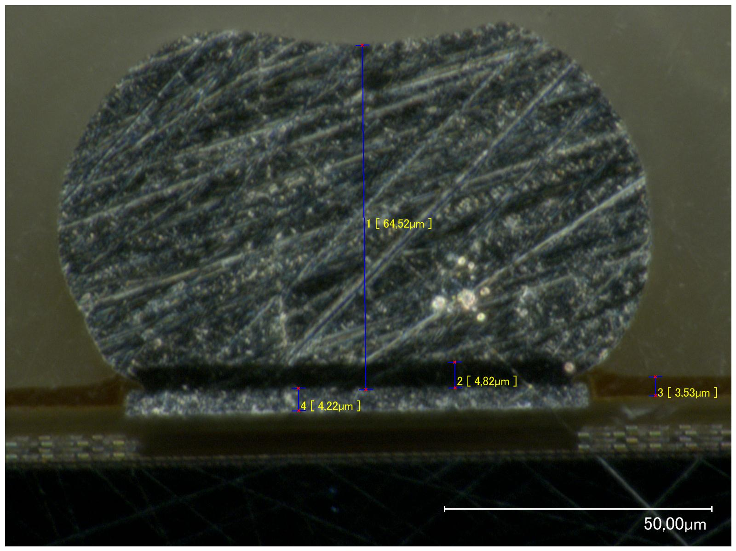
Detail

Slide 16
summary
:- first bumping test of SWB at PacTech so far successful
Next steps:
:- test ASICs on probe station after bumping (have the ASICs here ..)
:- flip chip tests on recently finished bump adapters
:- smaller ball diameter??
:- go for this? Or bumping on wafer level??

Slide 17
