Slide 1
Monitoring hardware for SVD (VXD) L.Lanceri, L.Vitale /INFN Trieste VXD Workshop, 01/10/2014 Slow Controls discussion session
Radiation & beam abort (electronics design just started!)
Temperature by NTC sensors + ELMB readout (existing prototypes)
Temperature (+humidity) by FOS fibers (see PXD)
Humidity (Dew point Vaisala sensors + Chilled Mirror Hygrometer: adopt CMS solution)

Slide 2
1. Radiation monitoring and beam abort Electronics
Reminder: preliminary specifications, design just started
Prototypes to be ready for BEAST phase II
Slow Control (EPICS), via Ethernet interfaces :
Select the current range, set thresholds for beam abort
Set SuperKEKB status register (selecting different preloaded thresholds)
Read out averaged sensor currents at about 1-10 Hz
Read out full buffers (600 ms deep, 100 kHz sampling) for “post mortem” analysis only after a beam abort from Belle II or SuperKEKB

Slide 3
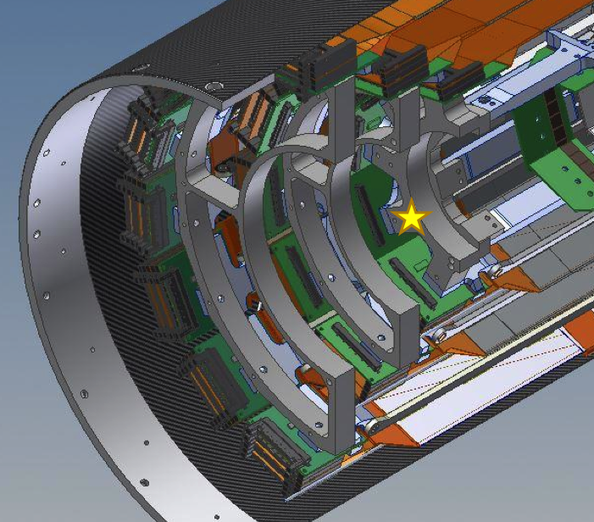
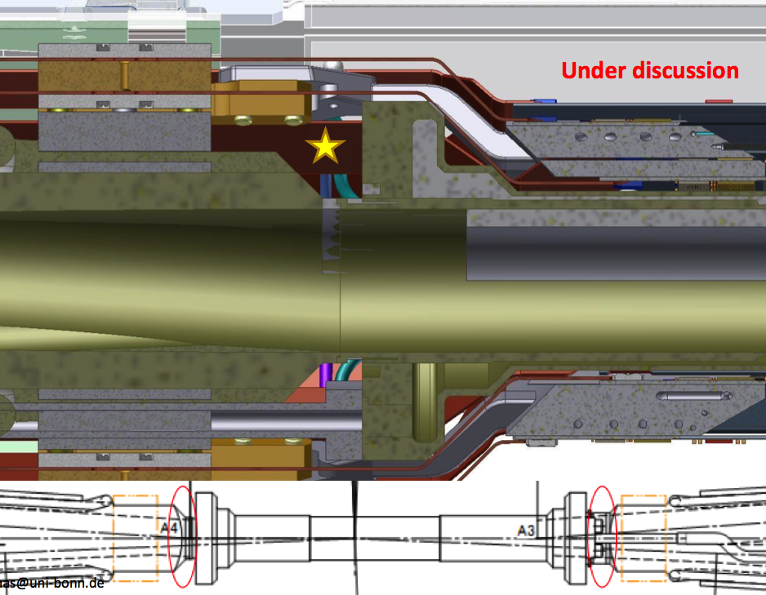
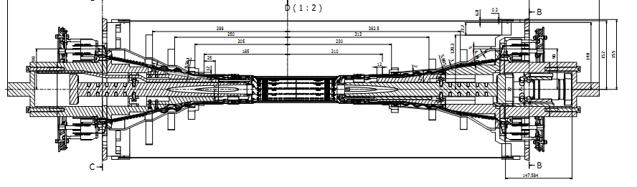
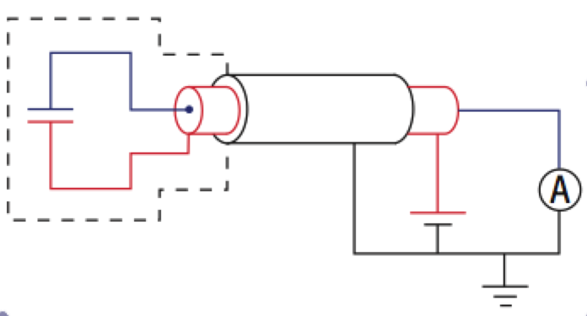
Diamond radiation sensors
4 + 4 sensors
PXD-beam pipe
8 + 8 sensors
close to SVD L3
support rings
Shielded
diamond
sensors
3+15 m (3+40 m) triax cables
Voltage sources (150÷500 V)
picoAmmeters

Slide 4
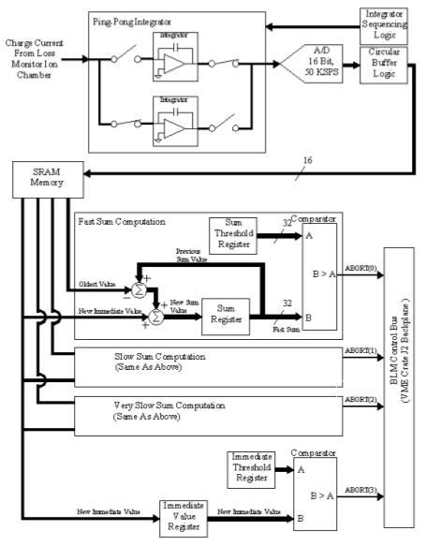
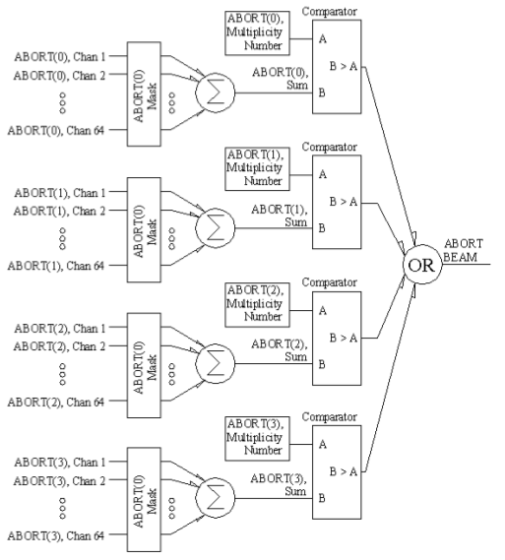
Desired functionality:
similar to Fermilab BLM
BLM Digitizer Card (“logger”):
ADCs, circular buffers, sliding sums
Analog front end + ADC
derived from
Elettra AH510 picoammeter
BLM Abort Card:
masks, majority logic,
thresholds (4 levels)

Slide 5
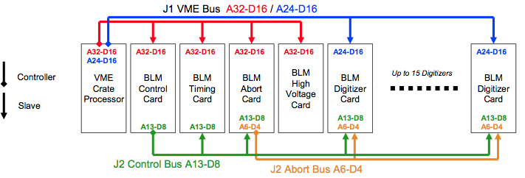
Fermilab BLM example
For each radiation sensor:
3 digital “sliding sums” (and CIC sums), 4 abort levels, 4 circular buffers
N
N
Fermilab system implementation:
BLM VME crate (Digitizers ≈ loggers, Abort, Timing, Control, HV)

Slide 6
VXD electronics: preliminary specs
Modules with 4 input channels, for monitoring and abort
Evolution of AH501 front-end + Altera Cyclone IV FPGA
Functionality similar to the FermiLab BLM system
http://beamdocs.fnal.gov/AD-public/DocDB/ShowDocument?docid=1410
Common logics: features
Sampling synchronized to SuperKEKB revolution period (10 μs)
“SuperKEKB status” register, set via EPICS (for thresholds selection)
Programmable masks and majority logics: abort signal (output)
Circular data buffers, read out upon any abort, internal or external
Circular buffer for timing information, in parallel with data buffers
Ethernet interface(s) for programming and data read-out
“slow” readout of averaged radiation doses for monitoring (typically 1-10 Hz)
Full data buffers readout for post-abort diagnostics (only when an abort occurs)
One of up to three Ethernet ports may be dedicated exclusively to fast readout

Slide 7
VXD rad. modules, preliminary design
From SuperKEKB
100 kHz clock, global abort, …
4 diamond sensors
HV and signal
Ethernet/EPICS
Abort (daisy-chained)
4 diamond sensors
HV and signal
Ethernet/EPICS
Abort
…
(6 modules)
4 diamond sensors
HV and signal
Ethernet/EPICS
Abort(s) to SuperKEKB
(Belle2 box?)

Slide 8
Rad.Mon+Abort, 4-channel module
ADC + 3 Sums
+ 4 Abort Levels
4 Circular
Buffers
(for each
input channel)
Ethernet I/O
From 4 diamond sensors
Timing
Control
Abort
HV
Ext. Clock (100 kHz)
Abort from SuperKEKB
Timing buffer
SuperKEKB status
Thresholds
etc
to SuperKEKB
to 4 sensors

Slide 9
Electronics: preliminary specs
For each of the 4 input channels (diamond sensors):
Individual HV supply
Effective bandwidth: 100 kHz (matched to 1 revolution = 10 μs)
Selectable current range: 0-50 μA or 0-2 mA
16 (24?) - bit ADC; over-sampling possible with frequency > 100 kHz
4 circular data buffers, updated every 10 μs:
“Raw data” + 3 levels of "sliding sums” over programmable numbers of cycles
different digital filtering levels and time responses,
from "immediate" (10 us) to "very slow" (typically 1 s)
4 levels of abort signals
comparison of raw data and sliding sums with programmable thresholds, selected according to the “SuperKEKB Status Register”

Slide 10
2. NTC thermistors with ELMB readout

Slide 11
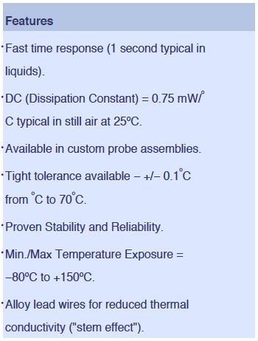
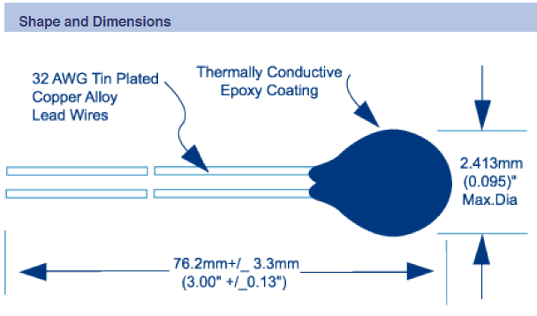
NTC temperature sensors
At least 28 x 2 = 56 NTC thermistors; system design for up to 96
12 sensor pairs attached to the 12 half-rings supporting the SVD ladders
16 sensor pairs on the inlets and outlets of the CO₂ cooling pipes
A few positioned near fibers for cross-calibration, and possibly at other locations
Rad-hard Betatherm 100kΩ NTC thermistors
2 borrowed from CMS, 100 more already procured

Slide 12
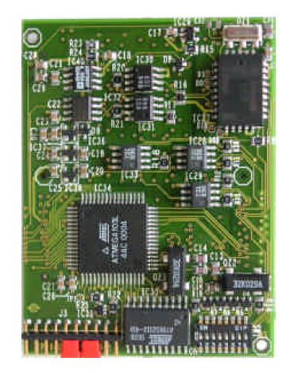
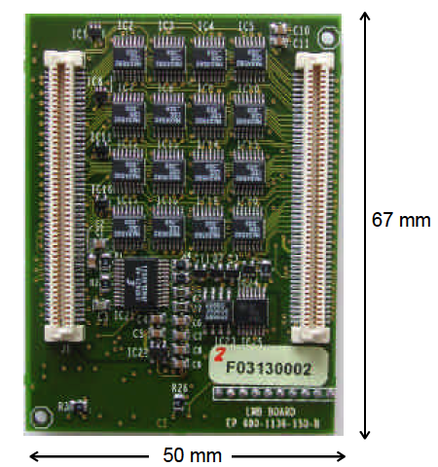
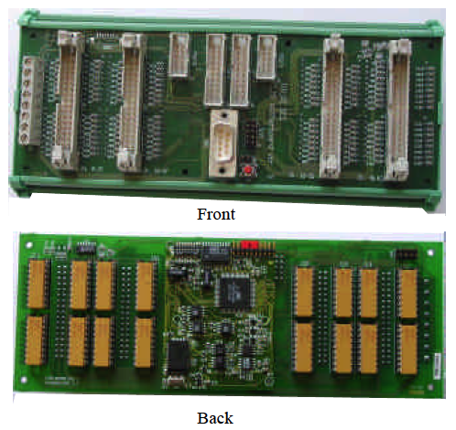
ELMB-based read-out
ELMB boards, widely adopted at CERN
64 chan. MUX, 16 bit ADC; CANbus read-out, CANopen read-out protocol
Present status:
One ELMB board, borrowed from CMS
2 motherboards and 10 adapter mini-cards, fabricated based on public CERN design
Read-out via CANbus interface
Software packages: installed
LabView test programs: developed and running

Slide 13
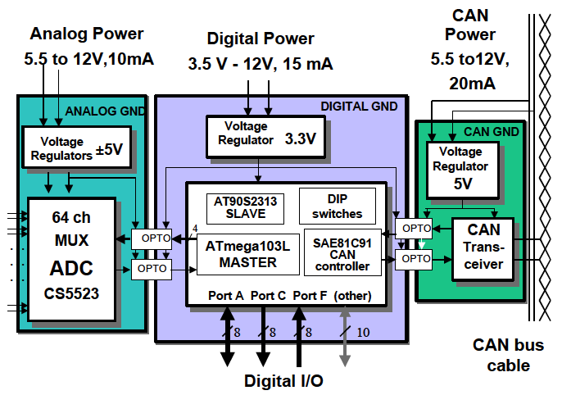
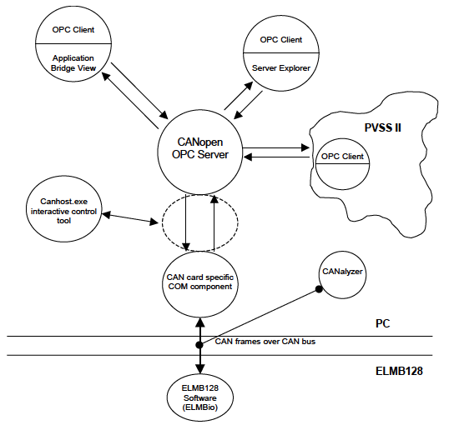
ELMB boards, CAN bus read-out
hardware
software
Embedded Local Monitor Board
CAN node, CANopen protocol
ATmega128 processor
128k flash, 4k SRAM, 4k EEPROM
64 chan. MUX, 16 bit ADC
General purpose motherboard
Interconnections, signal adapters
PC – CAN bus interface
CAN interface drivers
CANopen OPC Server
OPC Clients
Server Explorer
N.I. LabVIEW DSC
(Data Logging & Supervision Control)

Slide 14
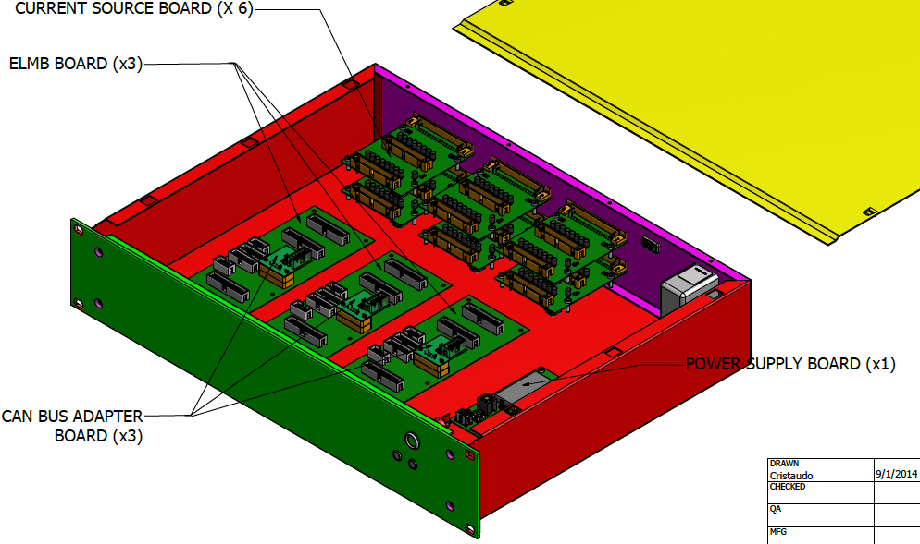
System design for 96 NTCs
In one box, with 3 x 32 NTC channels modularity:
1 power supply board, 3 motherboards with ELMB and CANbus adapter, 3 x 2 current source boards, 3 x 2 x 16-channel connectors

Slide 15
Interconnections
detector
docks
counting room
shielded
twisted
pairs
current
sources
PC
(shield
grounded
at docks)
ELMB
≈ 3÷4 m
single
twisted
pairs
(no shield)
ELMB
CANbus
ELMB
up to
6x16 NTC
sensors
Power supply

Slide 16
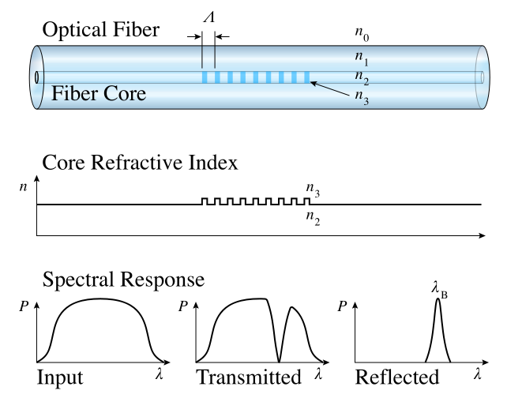
3. Temperature Monitoring – FOS fibers
PXD FOS R&D completed
successfully tested at the DESY beam test Jan 2014
Same solution can be adopted for SVD:
one fiber per ladder, inserted in the Airex foam,
to measure silicon temperature.
One FBG temperature sensor for each of the SVD strip sensors in layers 4,5,6; 38 fibers and 120 sensors are needed.
One rack-type sm225-800 interrogation unit*, ten passive couplers** 4x1 in order to have 40 channels.
*Interrogation speed 0.5 Hz; Stability 0.1 ºC pm; Repeatability 0.1ºC; Accuracy 0.1ºC (only for the interrogation unit, FBG sensor error must be added);16 input channels
**wide band coupler, 1x4, 1550 nm, insertion loss <7 dB, fibra SMF-28e, pigtail length 1 m tipo 900 micron loose, FC/APC connectors at both ends,(dimensions: cylindrical shape 4x65 mm).

Slide 17
FOS fibers
(4x1)couplers
DOCKs
Layer 6: 16 ladders
16 fibers x 4 (+1) sensors
Layer 6
4 couplers
…
…
Interrogator
…
Layer 5
3 couplers
Layer 5: 12 ladders
12 fibers x 3 (+1) sensors
(16 inputs)
…
…
Layer 4: 10 ladders
10 fibers x 2 (+1) sensors
Layer 4
3 couplers
…
…

Slide 18
Approximate schedule
Radiation | 2014 |  |  |  | 2015 |  |  |  | 2016
What | 1 | 2 | 3 | 4 | 1 | 2 | 3 | 4 | 1 | 2
Specifications, sign up
Simulations
Dosimetry, characterization
Diamond sensors choice
Mechanics & cabling design
Electronics specifications
Electronics design & proto.
Overall design, sign up
Components, procurement
"final" prototypes (4 ch.)
BEAST, 1 preliminary tests
BEAST, 2 complete test (4 ch)
electronics production & test
sensors installation & cabling
electronics installation
Temperature & humidity | 2014 |  |  |  | 2015 |  |  |  | 2016
What | 1 | 2 | 3 | 4 | 1 | 2 | 3 | 4 | 1 | 2
T&H Specifications, sign up
Fibers, mechanical layout
Fibers, assembly tests (SVD)
Fibers, multiplexing scheme
Fibers design sign up
Procurement, assembly
installation (PXD & SVD)
Thermistors, lab tests
Mechanics & cabling design
Procurement
assembly, installation

