Slide 1
Readiness of the FOS monitor for the thermal mock-up and recent activities. Pisa, 6th PXD SVD Workshop
E. Currás, D. Moya, I. Vila, A. L. Virto., J.González
Instituto de Física de Cantabria (CSIC-UC)
G. Carrión, M. Frövel.
Instituto Nacional de Técnica Aeronautica (INTA)

Slide 2
Outline
Status and open issues concerning the FOS for the mock-up.
Relative displacement monitoring for the final application at Belle II vertex.

Slide 3
Fiber cables and sensors for the mock-up
Four cables with four sensors
Additional FOS with not specific support (see next table)

Slide 4
FOS at DESY test beam
Fibres for PXD thermal set-up
Fibre Nº | Nº of sensors | position | protection | parameter
51 | 4 | On top of PXD on air | Teflon | Temperature
52 | 4 | On top of PXD on air | Teflon | Temperature
53 | 4 | On top of PXD on air | Teflon | Temperature
37 | 4 | On top of PXD on air | - | Temperature + humidity
38 | 4 | On top of PXD on air | - | Spare
OS-4210 | 1 | To be defined | metal | Temperature
sensor 1 | 1 | To be define | Teflon | Temperature
sensor 2 | 1 | To be define | Teflon | Temperature
Fibre 1 polyimida | 2 | To be define | - | Temperature + humidity
Fibre 2 polyimida | 2 | To be define | - | Temperature + humidity
SN89356/0003 | 1 | To be defined | metal | Temperature
 | New sensors
 | January Test Beam sensors
DAQ integration using January test beam EPICS driver

Slide 5
All the fibers calibrated with temperature at an humidity of 5%
Both teflon protected sensors and not protected sensors calibrated at high and low humidity. The sensitivity for both obtained at low humidity calibration
Teflon protected fibers with more than one sensor are sensitive to humidity with a delay of days. The offset will be obtained from calibrations. Sensor value will be stable 72 hours after humidity reduction in the mock-up cage.
For the not protected sensors ( humidity + temperature) the offset will be determine in the mock-up using a temperature reference sensor. This sensors are not calibrated with humidity.

Slide 6
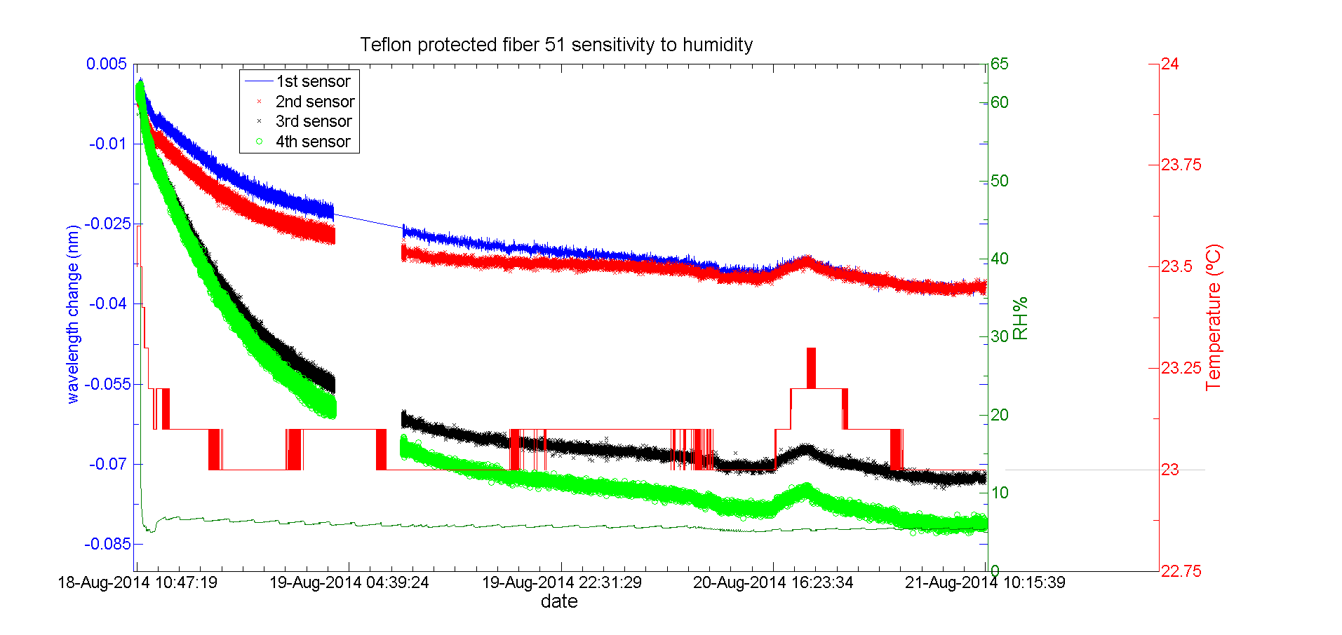
Teflon protected sensor sensitivity to humidity

Slide 7
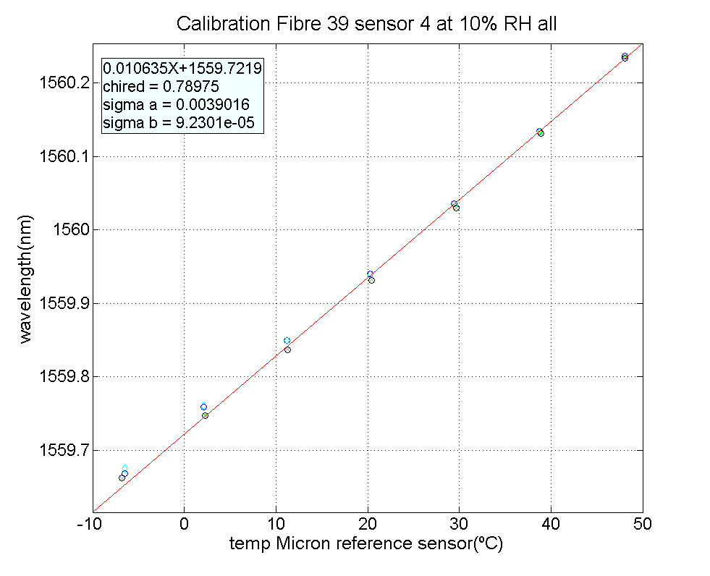
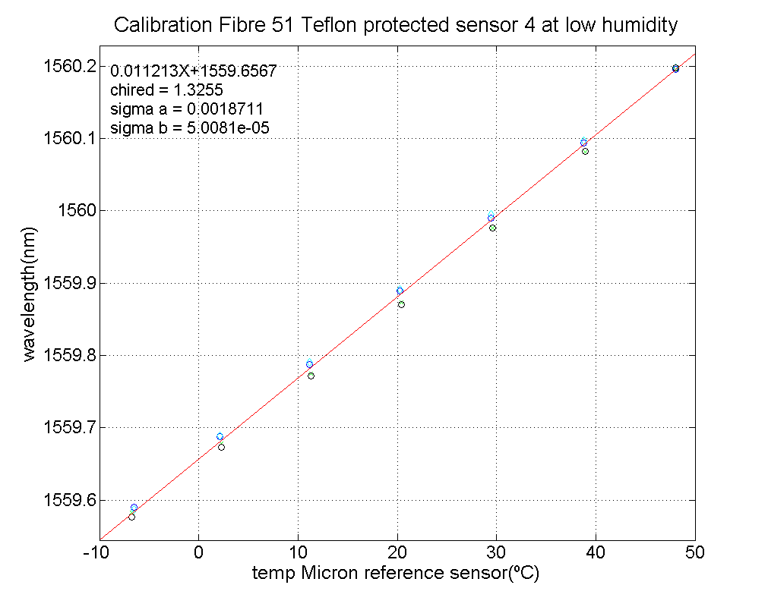
Fibers calibration results

Slide 8
Teflon protected Fibers calibration results
Fibre | sensor | Sensitivity | Offset | X² | Sens. error | residues(pm) | σ residues(pm)
51 | 1 | 0.0103 | 1529.7923 | 1.39 | 0.00004 | -0.18 | 2.11
 | 2 | 0.0099 | 1539.9148 | 1.70 | 0.00004 | 0.17 | 1.95
 | 3 | 0.0108 | 1549.6700 | 1.16 | 0.00006 | 13.74 | 23.70
 | 4 | 0.0112 | 1559.6606 | 1.22 | 0.00004 | -0.94 | 3.59
52 | 1 | 0.0104 | 1529.7363 | 1.43 | 0.00005 | -0.43 | 2.65
 | 2 | 0.0101 | 1539.8858 | 1.52 | 0.00004 | -1.18 | 2.70
 | 3 | 0.0100 | 1549.7553 | 1.37 | 0.00005 | -0.80 | 3.14
 | 4 | 0.0112 | 1559.6606 | 1.22 | 0.00004 | -0.94 | 3.59
53 | 1 | 0.0106 | 1529.7427 | 1.30 | 0.00007 | -0.15 | 3.18
 | 2 | 0.0098 | 1539.9523 | 2.83 | 0.00003 | 1.14 | 1.78
 | 3 | 0.0099 | 1549.7194 | 1.38 | 0.00006 | 0.98 | 2.59
 | 4 | 0.0095 | 1559.7336 | 1.39 | 0.00007 | 0.47 | 2.56

Slide 9
Temperature + humidity sensitive Fibers calibration results
Fibre | sensor | Sensitivity | Offset | X2 | Sens. error | residues (pm) | σ residues(pm)
38 | 1 | 0.0100 | 1529.8123 | 7.00 | 0.00003 | 0.97 | 2.16
 | 2 | 0.0099 | 1539.9481 | 39.69 | 0.00002 | 2.63 | 2.05
 | 3 | 0.0103 | 1549.7135 | 7.50 | 0.00004 | 2.71 | 2.80
 | 4 | 0.0110 | 1559.6983 | 5.67 | 0.00005 | 0.59 | 2.90
39 | 1 | 0.0101 | 1529.8323 | 6.65 | 0.00003 | 1.19 | 2.39
 | 2 | 0.0102 | 1539.9258 | 1.40 | 0.00010 | 0.20 | 4.44
 | 3 | 0.0106 | 1549.7115 | 16.12 | 0.00004 | 3.27 | 2.63
 | 4 | 0.0106 | 1559.7219 | 0.79 | 0.00009 | 2.55 | 3.34

Slide 10
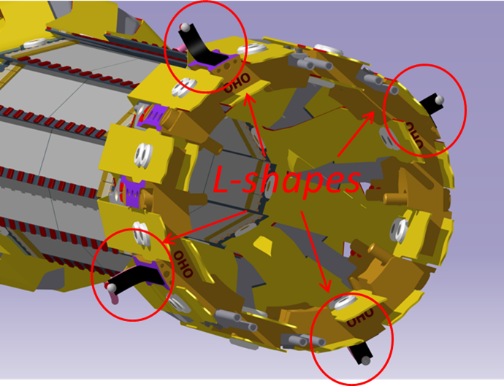
Mock-up displacement monitoring
Use four L-shapes in order to measure relative radial displacement in the mock-ups

Slide 11
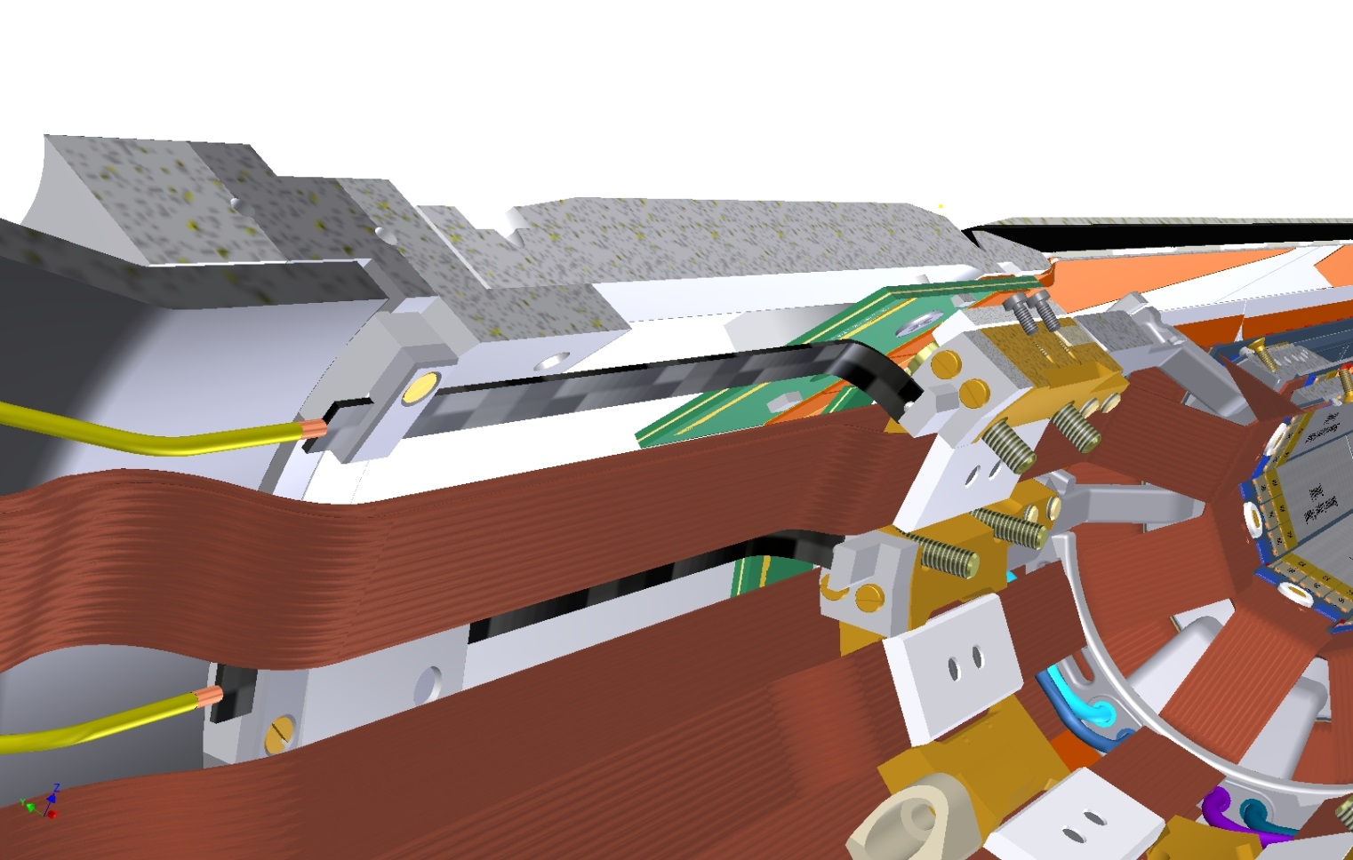
Open issues
Fixation of l-shapes in the mock-up.
A first position and locking proposal.

Slide 12
Open issues for the mock-up
Four L-shapes of four layers for the mock-up in order to measure relative radial displacement.
One of them calibrated ( used for the Test-beam)
The other three must be prepared ( contact sphere must be glued) and calibrated.
Support structures for the L-shapes and temperature humidity sensors must be provided
Define the position of left temperature and humidity sensors.

Slide 13
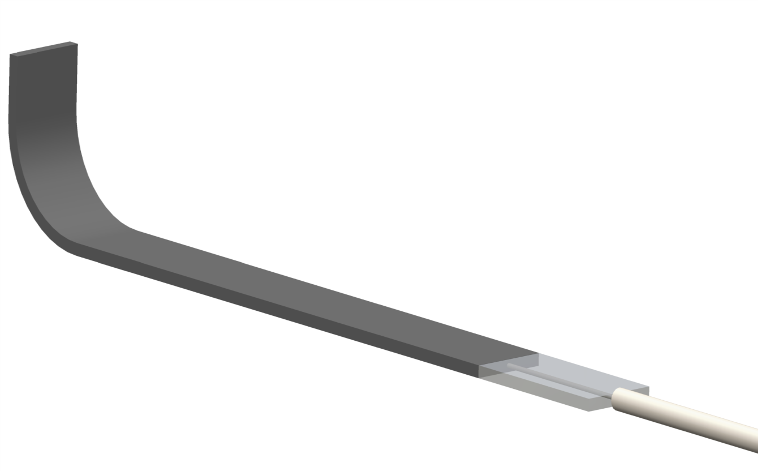
Fo the final application
Define displacement to be measured.
Relative radial displacement
Relative diplacement in Z direction ( the problem must be define ( resolution, range, positioning tolerance..)
CFRP L-shape
Fiber egress protection
NEW DESIGN
OR
30 mm
7 mm
3.5 mm

Slide 14
Questions & Comments ?
Supporting documentation and manual under preparation.
Assuming installation of fibers in the mock-up by end of October.
Installation of L-shapes before december?
L-shape in order to measure relative radial displacement
For the real application
Relative displacement to be measured to be define (Radial or in Z direction). In this last case the problem must be defined (range, resolution and positioning dimensional tolerance)

