Slide 1
Progress of SOI Pixel sensor R&D
T. Tsuboyama (KEK)
1 Ottobre 2014

Slide 2
Monolithic Pixel detector
Necessary for large scale, low-material-budget vertex detectors in the high-energy physics experiments.
  Separating vertices in HL-LHC.
  Identifying b and c particles with high efficiency (ILC/LHC)
  Reduction of hit occupancy.
Comparison with hybrid pixel detectors
  No bumps → higher production yield, cost
  Thinning is easier.
  Cooling is an important issue common to all types of detector.
On going R&Ds: DEPFET, MAPS, SOI, CCD…
  All technologies have pros and cons.
  SOI came later, however, we try to catch up the R&D.

Slide 3

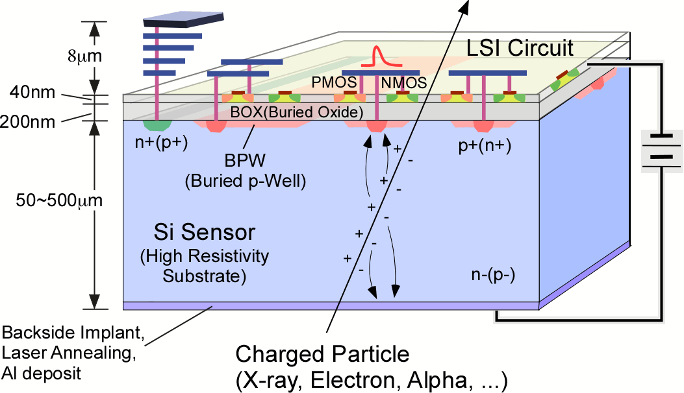
Lapis (Oki) SOI technology
The 0.2 μm CMOS circuit is build above the "sensor grade" Si wafers, separated with 200 nm thick SiO2 layer, called as BOX.
  OKI Semiconductor company was absorbed by Rohm and changed the name as Lapis Semiconductor.
The signal induced in the wafer is read out with the CMOS circuit on the top.
Whole semiconductor process is done in Lapis SOI CMOS commercial process.
The thickness of the sensor part
can be changed from 50
to 700 um depending on
the application.
CMOS
(Low Resistivity)
SiO₂
(BOX)
Sensor
(High Resistivity)

Slide 4
A Grant-in-Aid Project
Please visit "http://www.soipix.jp/index_en.html".
The project contains not only particle physics groups but also groups of astronomy, material science, non-destructive inspection, biology, medical…

Slide 5
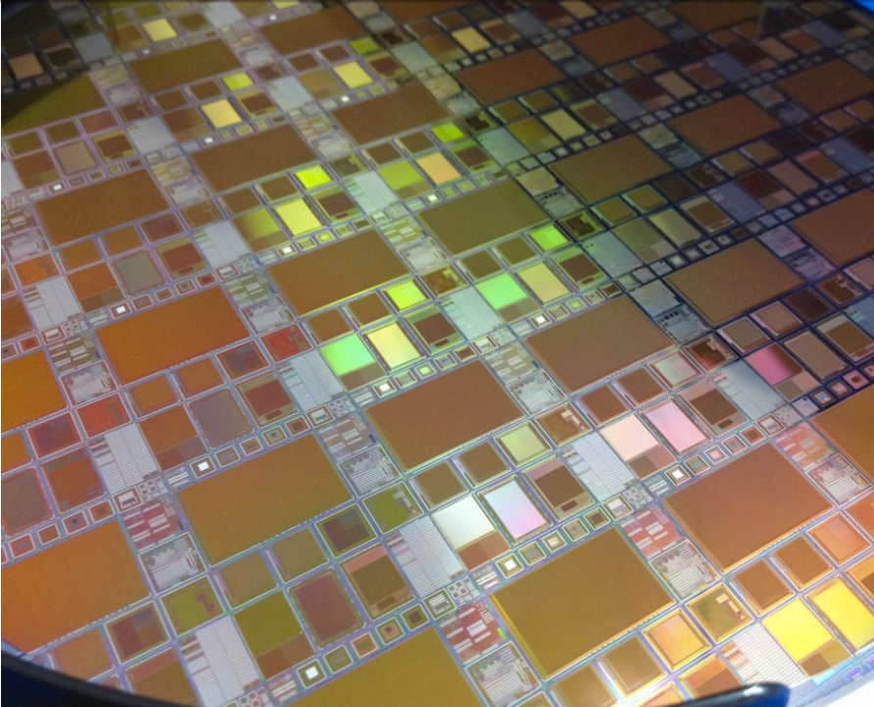
Regular Multi-Project Wafer (MPW) Runs
KEK organizes MPW runs twice a year
Mask is shared to reduce the individual cost
KEK
JAXA
RIKEN
AIST
Osaka U.
Tohoku U.
Kyoto U.
U. Tsukuba
…
Reticule size ; 25 x 30mm
Minimum size: 3 x 3 mm
Lawrence Berkeley Lab. (USA)
Fermi Nat'l Accl. Lab. (USA)
U. of Hawaii (USA)
IFJ & AGH Krakow (Poland)
U. Heidelberg
Louvain-la-Neuve Univ.
Inst. High Energy Physics (China)
Inst. of Microelectronics (China)
Shanghai Advance. Resr. Inst. (China)
Notes:
我々は半導体メーカと協力して、SOI Pixel専用のプロセスを開発してきました。
しかしながら半導体プロセスには多額の費用が必要となる事から、我々はMulti Project Waferラン、という相乗りプロセスを取り入れる事にしました。
このSOI Pixelプロセスは世界で唯一のプロセスであることから、このランには国内を始め海外の研究機関からも参加を得ています。
これにより、個々の研究者は比較的少ない費用で自分専用の検出器を作る事が出来ます。
本領域研究では、A01,A02班が中心となってこのMPWランを運営し、各研究班に試作の機会を提供します。
またこれにより、若手の研究者や公募研究に参加する研究者も容易に開発に携わる事が出来ます。

Slide 6
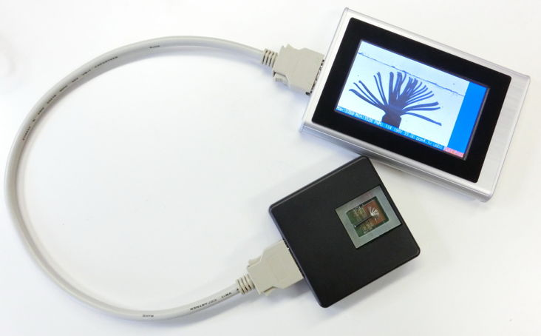
6
SPRiT (SOI Portable Radiation imaging Terminal)
INTPIX4
832 x 512
(17um)²
1st commercial SOI device
http://rd.kek.jp/project/soi/

Slide 7
Issues of the SOIPIX detector
The 0.2 μm CMOS circuit is intrinsically radiation hard.
SOI is almost single-event free because the transistors are isolated from the silicon bulk.
Two sources of TID effect remaining in SOI:
  The BOX is positively charged and changes the transistor characteristics.
  The detector bias applied to the wafer changes the transistor characteristics.
Source
Gate
Drain
SOI transistor
experiments | TID (Gy) | Neutron (n_{eq}/cm²)
LHC pixel | 500 k | 10¹⁵
HL-LHC pixel | 5000 k | 10¹⁶
Belle2 | 10 k | 10¹²
ILC | 1 k | 10¹¹
+ + + + + + + + +
Box
Sensor Silicon
Detector bias

Slide 8
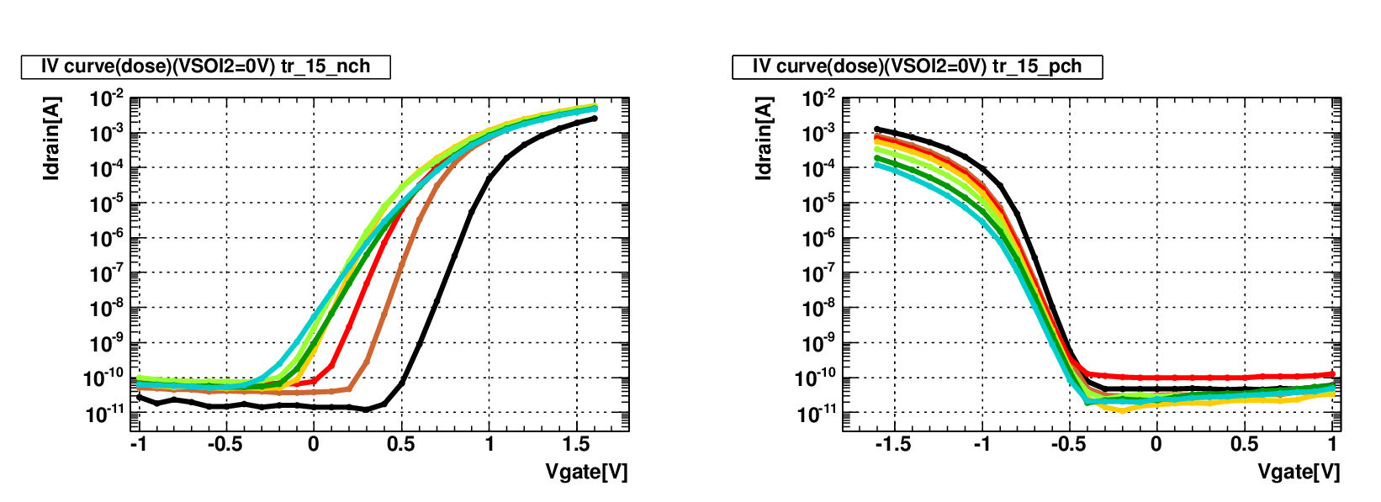
TID effect to the BOX
With accumulating dose, the curves shift negatively for both PMOS and NMOS, influenced by the holes accumulated in the oxide layer.
●preirrad
●3kGy
●10kGy
●20kGy
●50kGy
●100kGy
●200kGy
●preirrad
●3kGy
●10kGy
●20kGy
●50kGy
●100kGy
●200kGy
M. Kochiyama et al., NIM A636(2011)S62

Slide 9
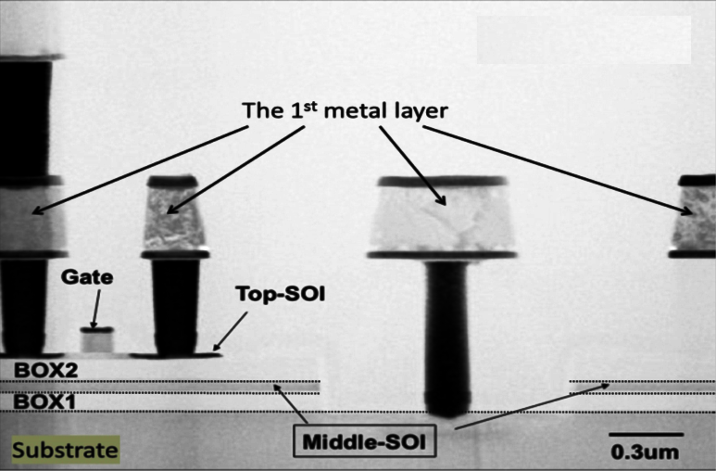
Double SOI
Counter measure for the TID effects in SOI is double SOI.
Two SOI layers are prepared. One layer is used as a shield layer.
By adjusting the control voltage of SOI2, the characteristics of the SOI transistor can be restored.
DSOI wafers are supplied by major SOI wafer company: SOITEC and Shin-etsu.
Source
Gate
Drain
Control voltage
+ + + + + + + + +
Box
SOI2
Box
Sensor Silicon
Detector bias

Slide 10
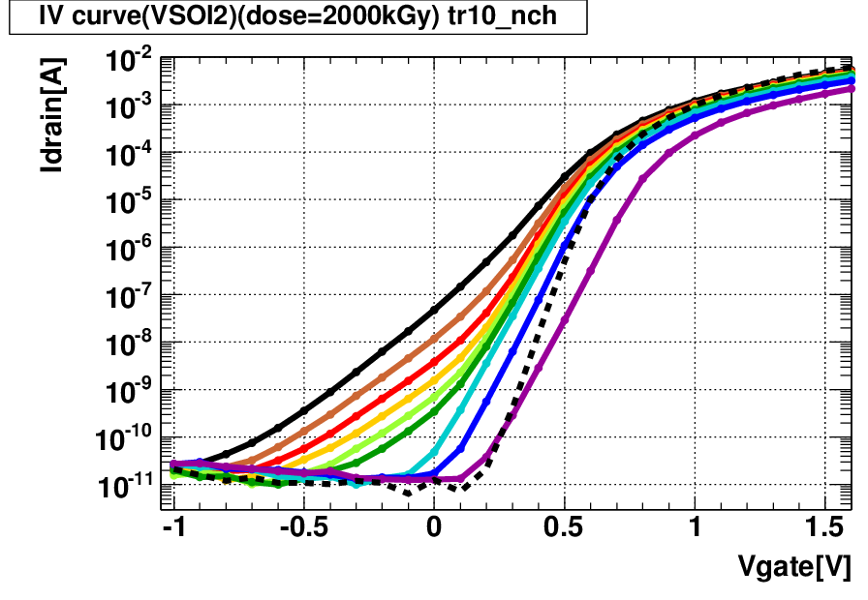
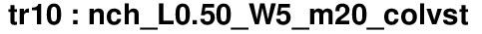
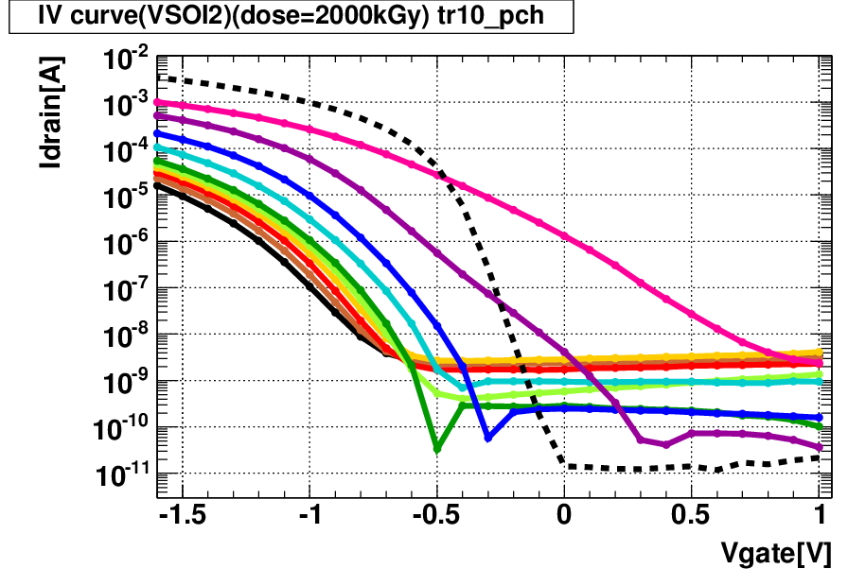
TID effect compensation
The Id-Vg curve for an NMOS and PMOS transistor after 2 MGy (200 Mrad) irradiation.
With V_{SOI2}~ -20 V the transistor characteristics are recovered close to the original ones.
In principle, V_{SOI2} can be changed transistor by transistor.
NMOS
PMOS
- - - pre-irrad
- - - pre-irrad
NMOS
PMOS
2MGy
2MGy
preirrad
Threshold voltage
●VSOI2= 0V
●VSOI2=-1V
●VSOI2=-2V
●VSOI2=-3V
●VSOI2=-4V
●VSOI2=-5V
●VSOI2=-10V
●VSOI2=-15V
●VSOI2=-20V
●VSOI2=-25V
preirrad
Honda (Tsukuba)

Slide 11
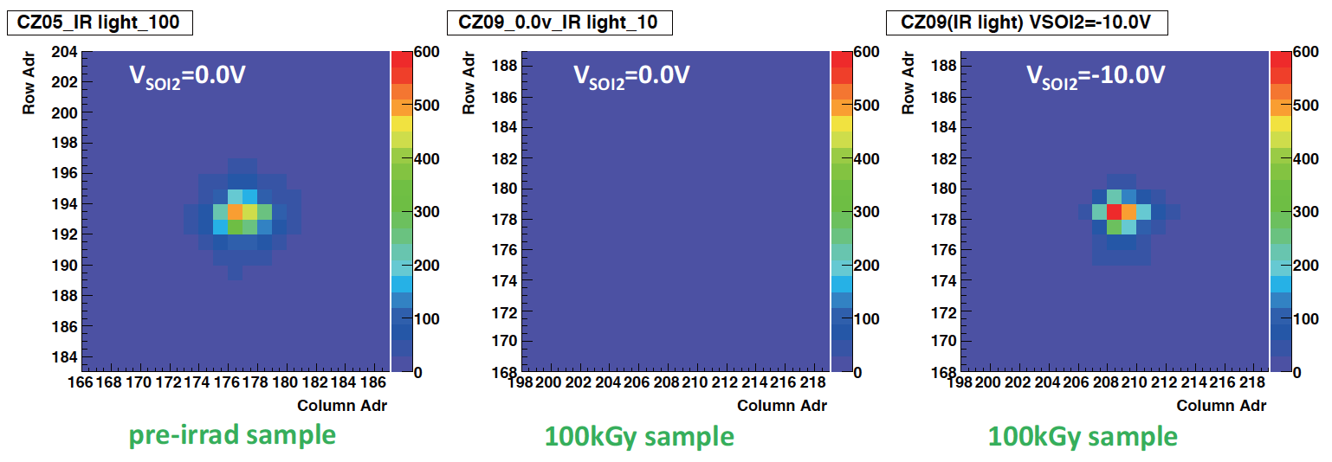
The DSOI pixel sensor
Response to infrared laser
  1064 nm wavelength and 25 ns pulse duration.
100kGy
Pre-irrad
VSOI2=0V
VSOI2=-10V
A 100 um thick n-type Cz (700Ωcm)wafer is used.
Vfd=50V,
Average ADC count vs. the bias voltage.
Linearity and sensitivity after 100kGy (with VSOI2=-10V) are similar to pre-irradiation
M. Asano (Tsukuba)

Slide 12
PIXOR: Application to Belle2
In order to proceed a realistic design, a Belle2 model is prepared: PIXOR
PIXOR type pixel sensor:
Tohoku University is the development center.
  The Pioneering work was made Y. Onuki and S. Ono in 2011.
  The R&D is continued by A. Ishikawa, N. Shinoda, and I. Ushiki in 2014.

Slide 13
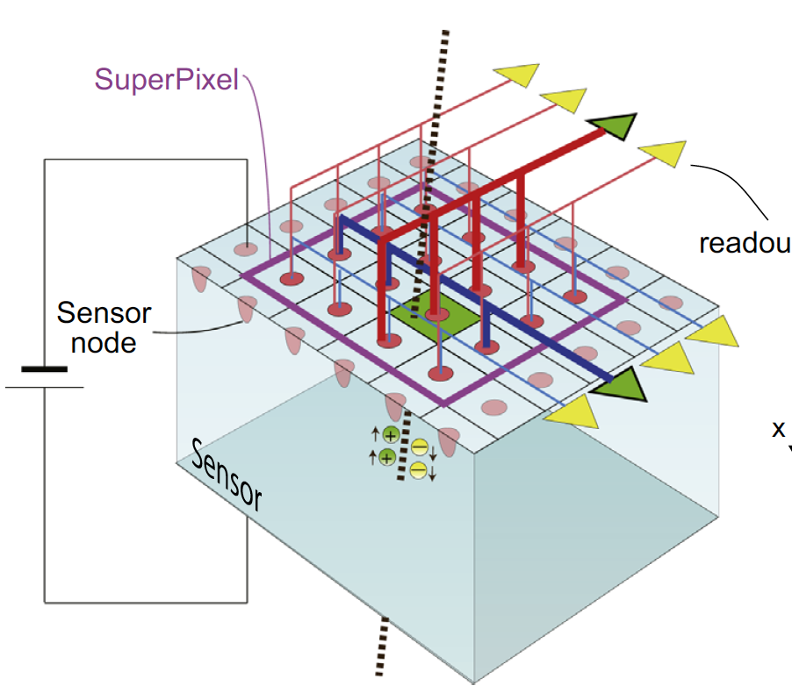
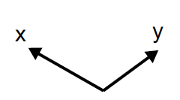
Readout Scheme of PIXOR
Based on NxN pixel matrix called Super Pixel.
We define a NxN pixels as a “Super Pixel” signal from one pixel in a Super Pixel is divided into directions of X and Y.
Analogue OR of each column (row) is processed by a readout circuit and sent to DAQ.
➔PIXOR scheme reduces the number of readout channels from N² to 2N.
We can integrates a complex readout circuit in the given area of a Super Pixel.
The size of Super Pixel is chosen so that the probability of multiple hits in a super pixel is tiny and ghost hits can be negligible.
readout circuit
➔PIXOR could replace the conventional strip detectors and achieve a high position resolution and a low occupancy.
Y. Ono et al., NIMA 731 (2013) 266-269
Notes:
New readout scheme of PIXOR is a signal from one pixel in a Super Pixel which is based on nxn pixel matrix is divided into directions of X and Y.
And then analogue OR of each column (row) is
processed by a readout circuit and sent to DAQ.
Thanks to this scheme, PIXOR reduces the number of readout channels from n² to 2n.
We can have enough space on Super Pixel
area for complex readout circuit.
And the probability of multiple hits in Super Pixel is tiny compared to strip detector and ghost hits can be negligible by
optimizing number of pixels for SuperPixel

Slide 14
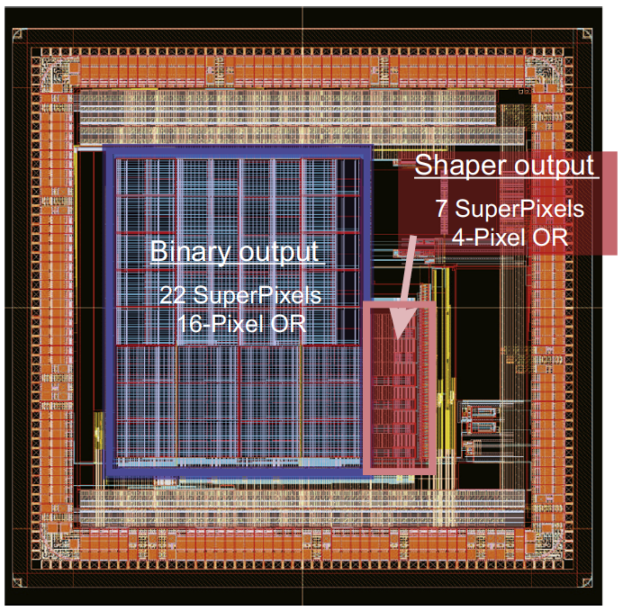
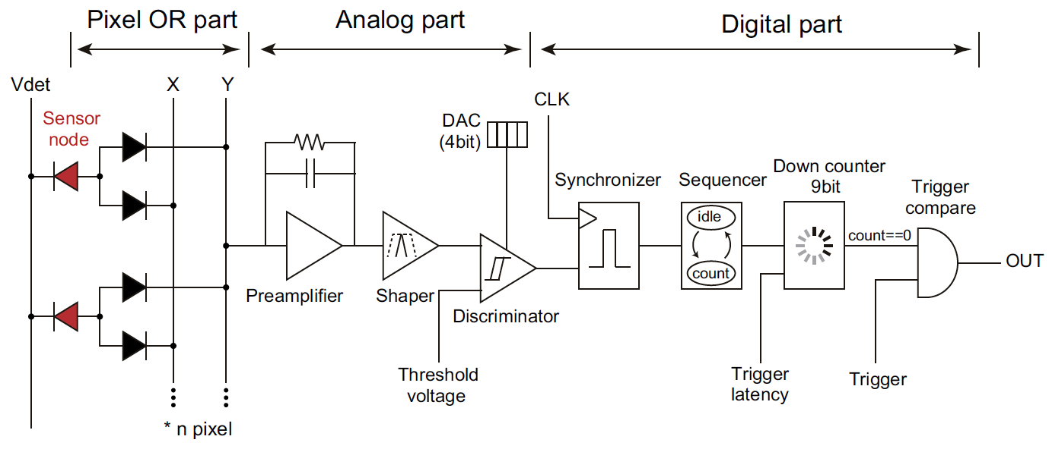
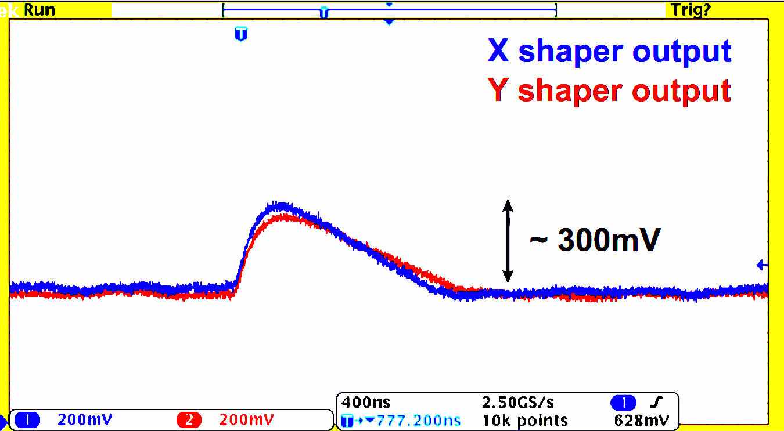
PIXOR: Analog part
First prototype PIXOR1:
The primary goal is to confirm the PIXOR readout scheme.
We developed PIXOR1 chip which has only part of the pixel OR on the sensor (analog and digital circuits are off-sensor).
Test with X ray source
Measured shaper out with ¹⁰⁹Cd X-ray of 22 keV photons.
The signal response is clearly seen for both X and Y directions.
We confirmed OR of several pixels in two directions which are in Super Pixel succeeded .
Shaper output with ¹⁰⁹Cd X-ray
1us
Y. Ono et al., NIMA 731 (2013) 266-269
N. Shinoda, Master thesis, March, 2013

Slide 15
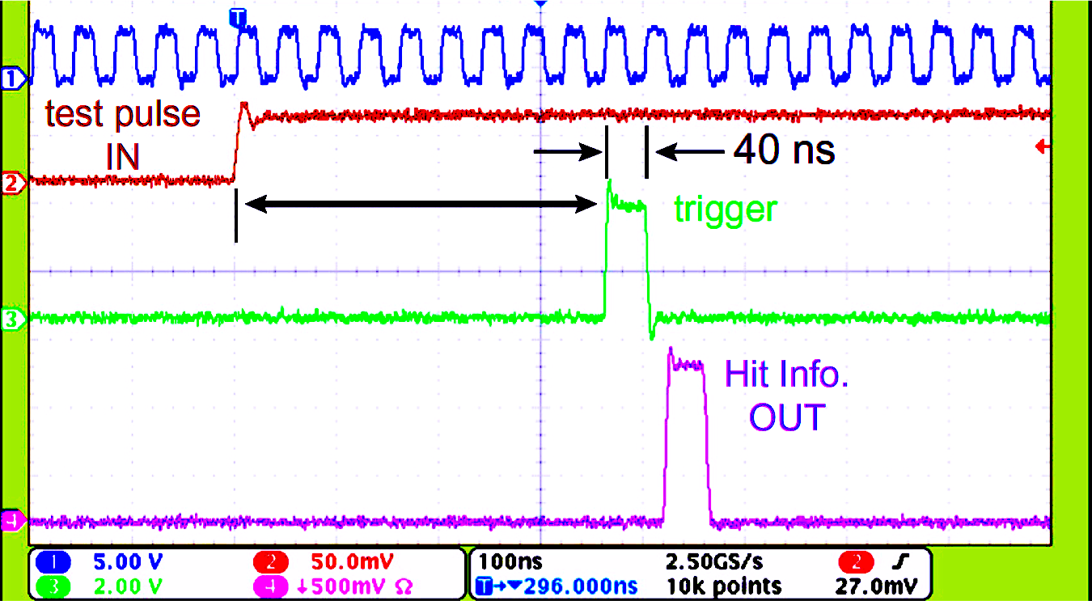
PIXOR
Tohoku Univ.
Digital part
It manages holding of binary data from discriminator and timing comparison of hit and trigger.
Generally a trigger decision takes several micro seconds from the actual event time in high energy experiment (trigger latency).
Evaluated the overall circuit of digital part with a test-pulse.
Clock
Trigger latency
Trigger latency
Digital circuit could store the hit information of the signal during the trigger latency and sent a binary hit information as expected.
Y. Ono et al., NIMA 731 (2013) 266-269
N. Shinoda, Master thesis, March, 2013

Slide 16
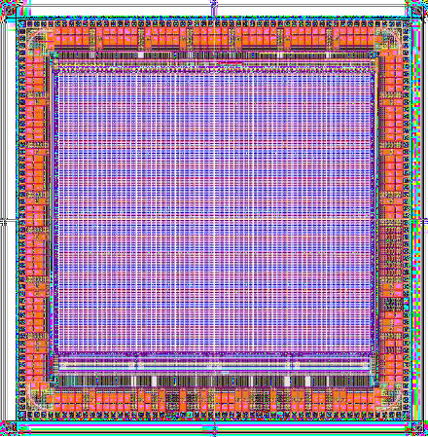
PIXOR R&D plan
With PIXOR3 we would like to prove the PIXOR concept.
A double SOI PIXOR3 is under test in Tohoku.
A beam test is planned within ~1 /2 year.
PIXOR3 design parameters
Item | Spec
Pixel size | 35 um x 70 um
Spatial resolution | 10 x 20 um
Wafer thickness | 50-100 um
Super Pixel size | 16 x 16
Operation clock | 42.4 MHz
Expected occupancy in Belle2 (APV25+DSSD / PIXOR) | From 6.7 % / 0.035 %
Trigger latency | Up to 12 usec.

Slide 17
On-Going SOI Projects
INTPIX: General Purpose Integration Type (KEK)
PIXOR: Belle II Vertex Detector (Tohoku Univ.)
STJPIX: Superconducting Tunnel Junction on SOI (Univ. Tsukuba)
CNTPIX: General Purpose Counting Type (KEK)
SOPHIAS: Large Dynamic Range for XFEL (Riken)
XRPIX: X-ray Astronomy in Satellite (Univ. Kyoto & KEK)
LHDPIX: Nuclear Fusion Plasma X-ray (KEK, NIFS)
TDIPIX: Time Delaying Integration for X-ray Inspection (KEK)
MALPIX: TOF Imaging Mass Spectrometer (KEK, Univ. Osaka)
: A new activity aiming a ILC pixel detector (Univ. Osaka, KEK)
http://rd.kek.jp/project/soi/
http://www.soipic.jp/
Notes:
As I listed here, some projects which are utilizing SOI monolithic pixel detector are ongoing.
Especially I will show recent progress of PIXOR, STJPIX, INTPIX and XRPIX in this talk.
The detail of XRPIX is talked at 3rd day which is session of front end electronics development by Ayaki Takeda.

Slide 18
Summary
SOI is a potential technology for the pixel vertex detectors.
The TID effects can be mitigated with the double SOI technology.
Recently a DSOI pixel detector worked up to 100 kGy irradiation.
PIXOR type detector R&D is in progress. After PIXOR3 is proved with a beam test, a full size detector will be made. This is a preparation of Belle2 SVD upgrade.

Slide 19
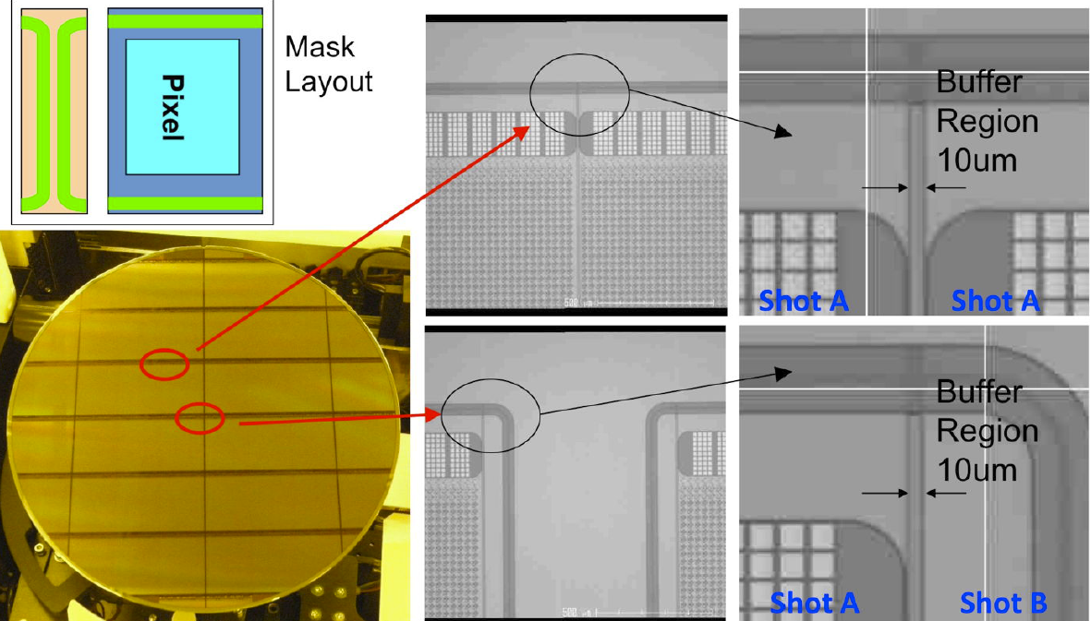
Stitched Large Device
19
19
X-ray image sensor for SACLA XFEL (Riken)
64.8 x 26.7 mm sensing area, 500 um thick
Stitching error <0.025um in X/Y directions
VERTEX2012 T. Hatsui
K. Hara, VERTEX2014, Macha Lake, Czech Sep.16-19

