Slide 1
Introduction and Topics
6th Belle II VXD workshop

Slide 2
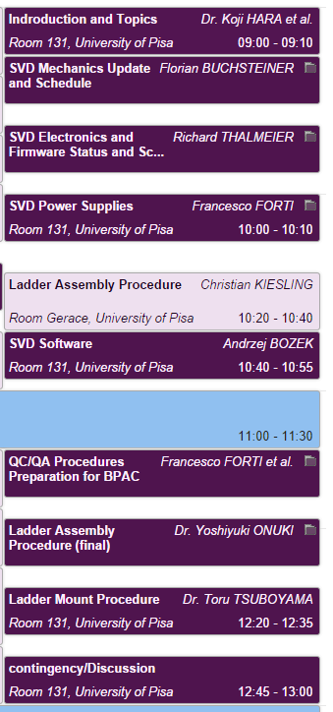
Topics
Very dense agenda
Main topics
Mechanics updates
Software → manpower
QC/QA procedures
PA0 issue
Preparation for BPAC review
Update of assembly procedure
Ladder parts availability
Ladder mount procedure
Logistics
Construction DB
etc.

