Slide 1
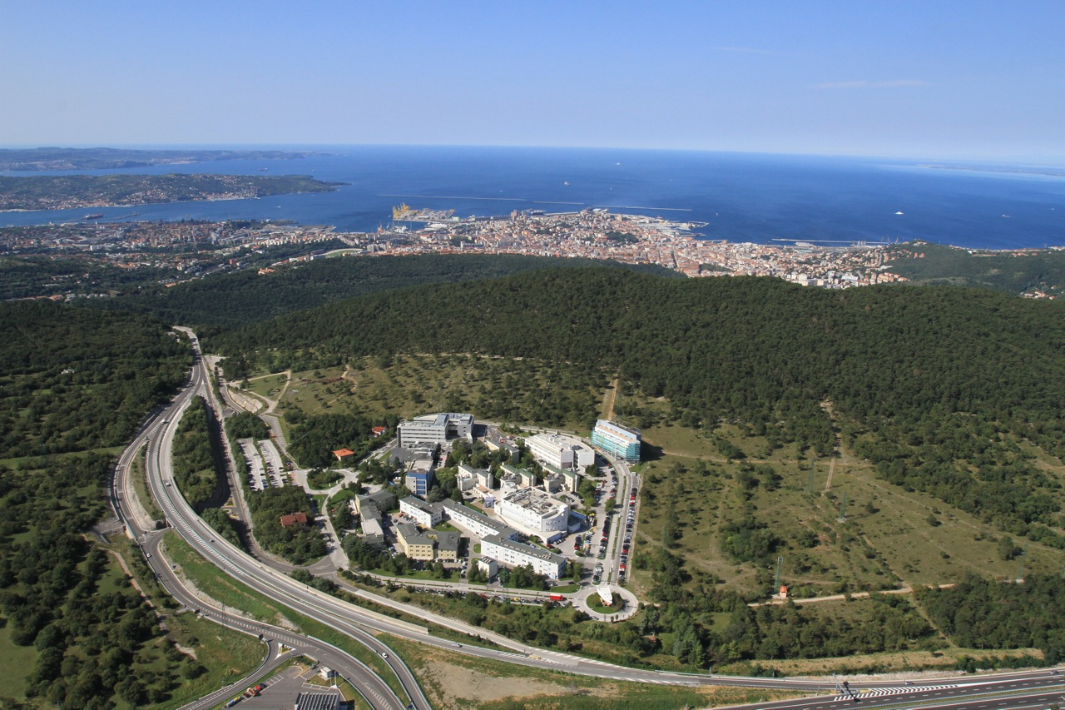
SVD Environmental Monitoring and VXD Radiation Monitoring
L.Lanceri & L.Vitale
INFN and Univ. Trieste

Slide 2
Outline + news since last B2GM
Radiation monitoring:
single crystal diamonds sensors
Temperature monitoring
NTC sensors
FOS Fibers
Plan for humidity
Sniffing pipes plus chilled mirror hygrometer outside
FOS Fibers
Total service space for cables

Slide 3
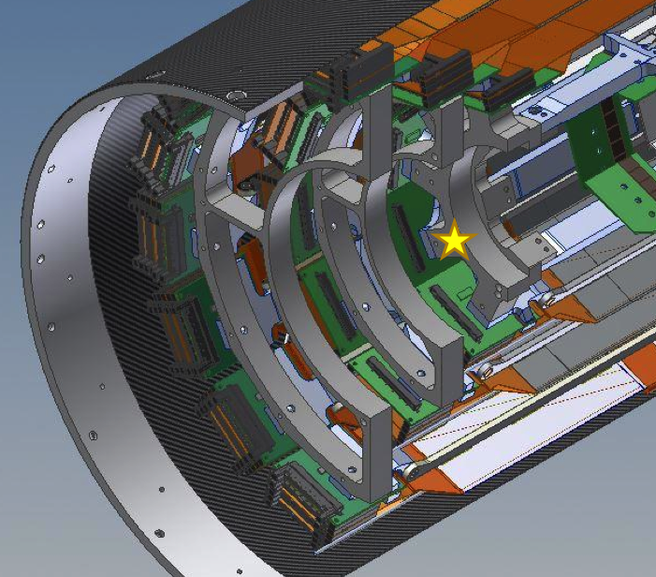
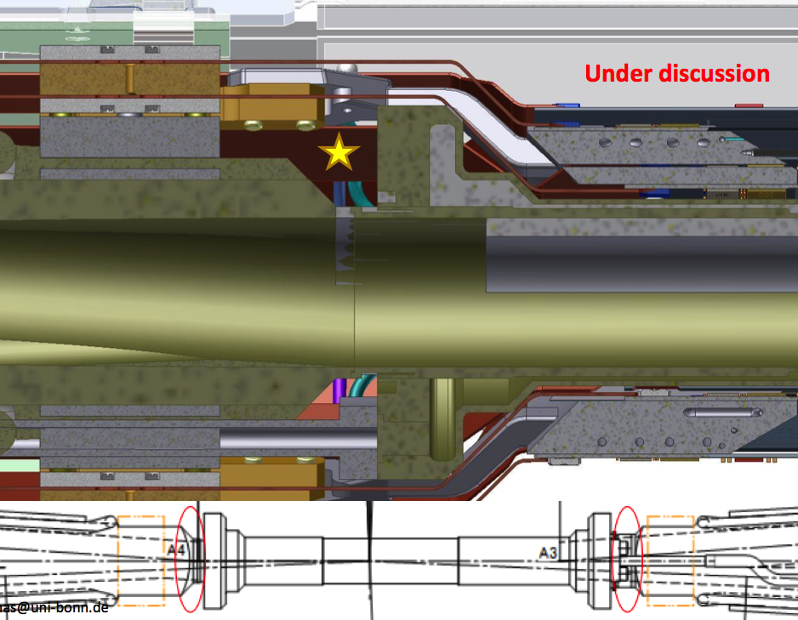
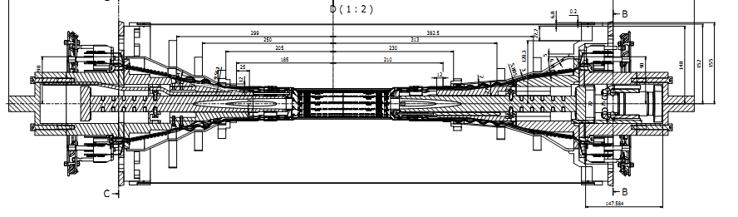
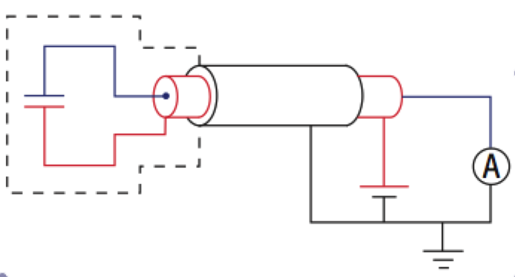
Radiation Monitoring and Beam Abort
6 + 6 sensors (was 8+8)
on SVD support cone
(close to L3 rings)
4 + 4 sensors
PXD-beam pipe
Sensors: scCVD, 4.5x4.5x0.5 mm³
Readout electronics and
Beam Abort Trigger:
In collaboration with
Elettra – Electronics Division
Shielded
diamond
sensors
Voltage sources
(150÷500 V)
picoAmmeters

Slide 4
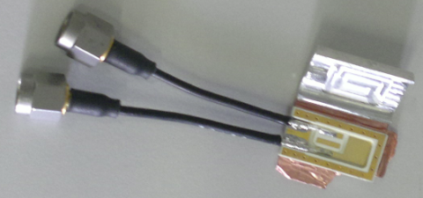
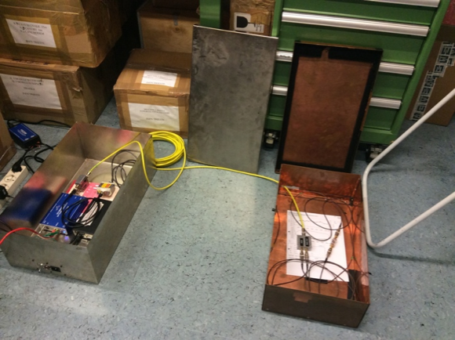
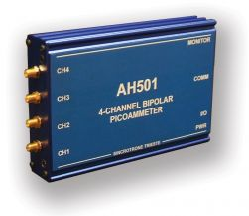
Radiation Monitoring: Mechanics, cabling
Compact packages:
1) 12 x 20 x 3.1 mm³
multi-layer package, Rogers laminate ok for SVD (we already have 28 pc)
2) 12 x 15 x 3.1 mm³
Same material, with perpendicular mounting (for discussion, it can still be modified) we need input from simulation (M. Ritter and C. Marinas working on it).
Cabling
3 m coaxial thin (HS SM47LSFH) from sensors to DOCKs
+ 15 m (or more) HS S_04162-B60, double shield

Slide 5
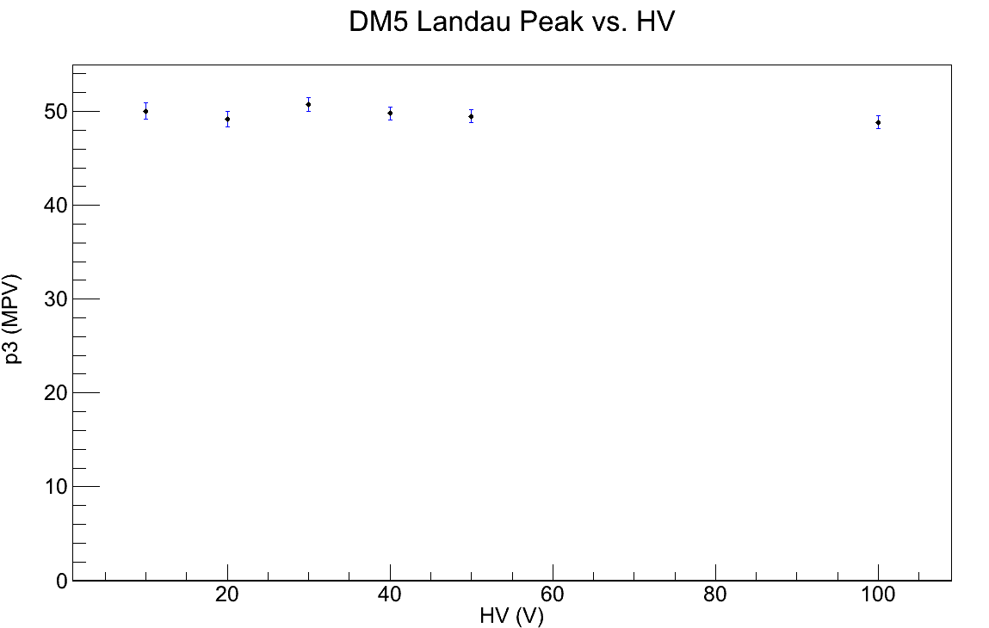
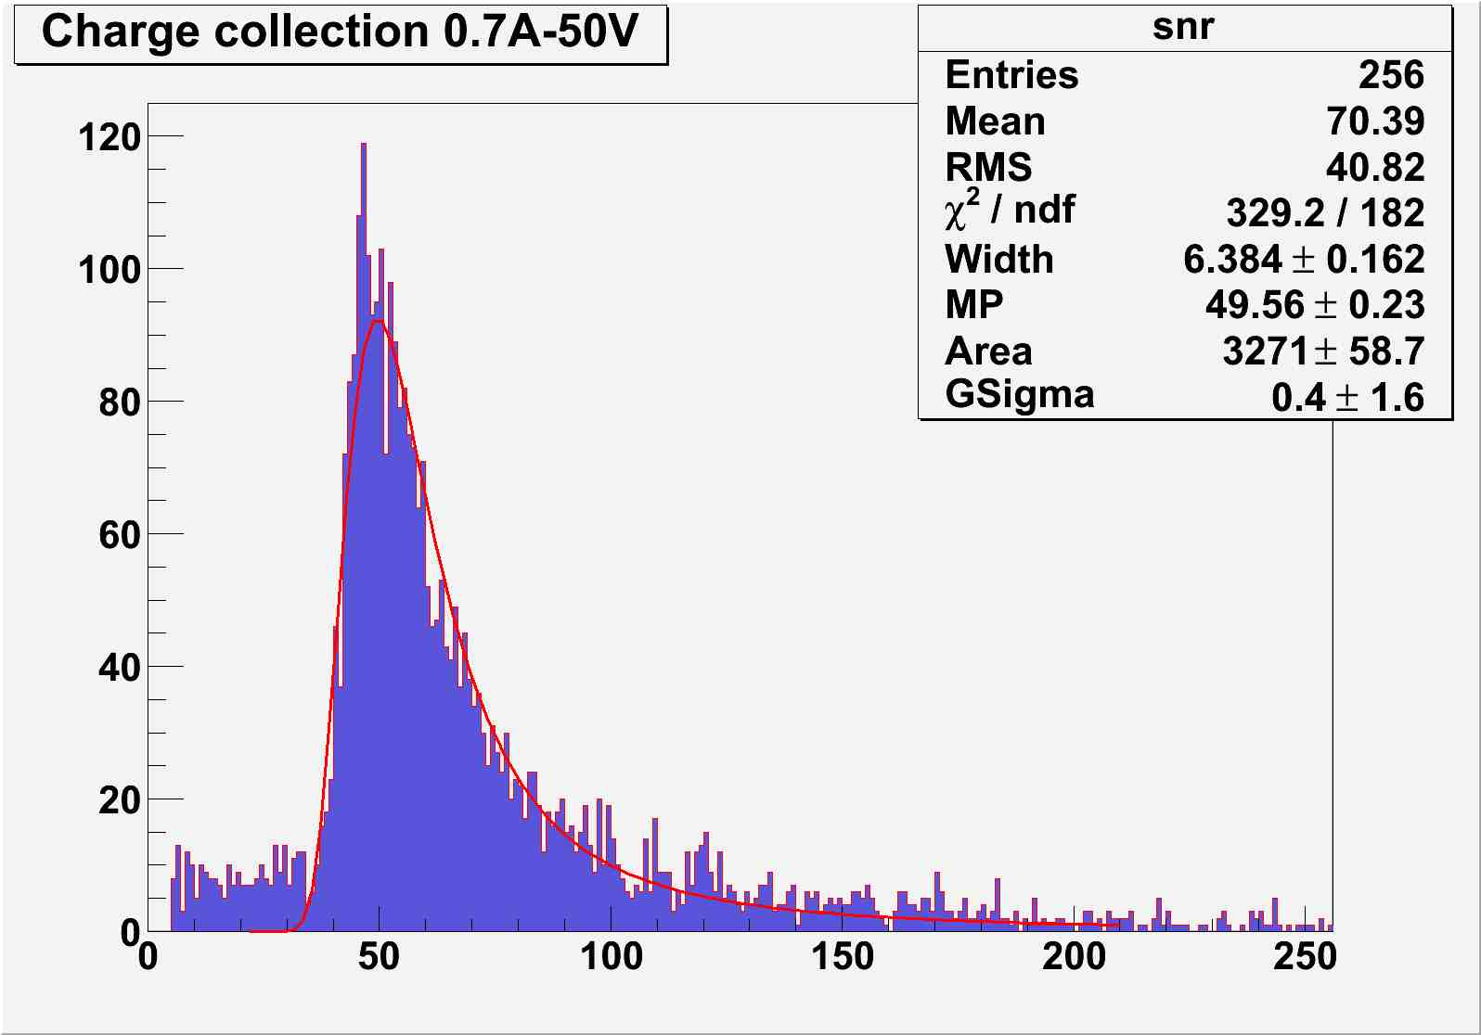
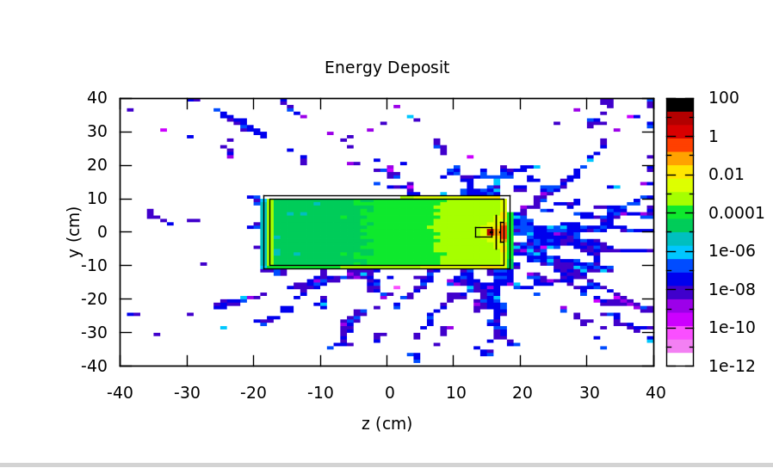
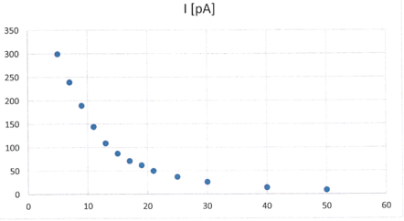
Characterization of scCVD sensors
Single electrons, from Sr90 1-2 MeV (MIP): Landau peak vs HV
MPV vs HV
Current measurements studies with Sr90 point-like source, 3.2 MBq, at different distances, compared to FLUKA simulations, + long term studies for stability and reproducibility
d [mm]

Slide 6
Radiation Monitoring Electronics
For each of the 4 input channels (diamond sensors)
Individual HV supply
Effective bandwidth: 100 kHz (matched to 1 revolution = 10 μs)
Selectable current range: 0-50 μA or 0-2 mA
16 (24?) - bit ADC; over-sampling possible with freq > 100 kHz
4 circular data buffers, updated every 10 μs:
“Raw data” and 3 levels of "sliding sums” over programmable numbers of cycles
digital filtering levels and time responses, from "immediate" (10 us) to "very slow" (typically 1 s)
4 levels of abort signals
from the comparison of raw data and sliding sums with the programmable thresholds, selected according to a “SuperKEKB Status Register”
Approach similar to FermiLab Beam Loss Monitor (BLM) and CERN LHC BLM systems
Specifications discussed within Belle II and with SuperKEKB
In collaboration with G.Cautero, D.Giuressi, and R.H.Menk from Elettra - Sincrotrone Trieste S.C.p.A.
First FPGA based evaluation board implementing the required features for the beam monitoring and abort now in preparation.

Slide 7
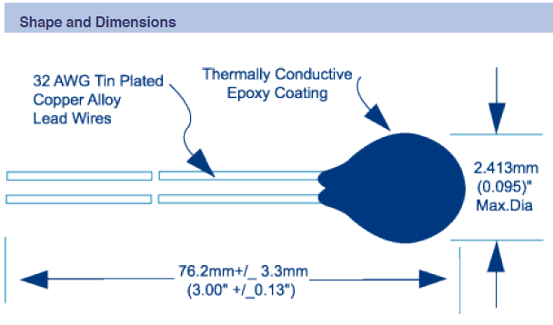
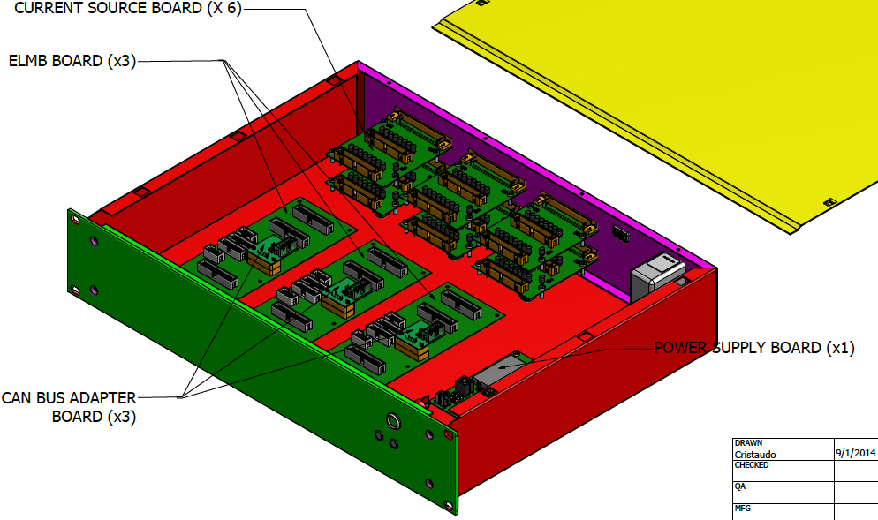
Temperature 1: NTC Thermistors
System now foresees up to 96 NTC thermistors (Betatherm 100kΩ)
24=12 pairs: 12 half-rings supporting the SVD ladders
32=16 pairs: inlets and outlets of the CO₂ cooling pipes
6: near FOS fibers for cross-calibration
34 still available
Readout based on ELMB (Embedded Local Monitor Board)
1 power supply board, 3 motherboards with ELMB and CANbus adapter, 3 x 2 current source boards, 3 x 2 x 16-channel connectors

Slide 8
NTC Interconnections
detector
docks
counting room
shielded
twisted
pairs
current
sources
PC
(shield
grounded
at docks)
ELMB
≈ 3÷4 m
single
twisted
pairs
(no shield)
ELMB
CANbus
ELMB
up to
6x16 NTC
sensors
Power supply

Slide 9
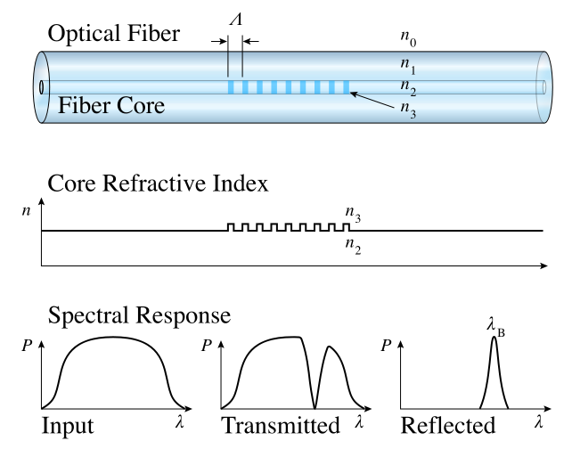
Temperature 2 and Humidity 1 – FOS
FOS R&D completed by the IFIC group for PXD,
successfully tested at the DESY beam test Jan 2014
We adopt a similar approach for SVD:
one fiber per ladder, inserted in the Airex foam,
with several temperature sensing points per fiber
(one per DSSD in layers 4, 5, 6)
Total: 38 fibers and 120 temperature sensing points
Read-out of up to 40 fibers:
One rack-type sm225-800 interrogation unit (16 ch), 0.5Hz
10 (4 x 1) passive couplers.
=> Read-out available for 8-18 additional fibers (with humidity-sensitive coating?)
Model | description | cost | quantity | total
sm225-800 | FBG interrogator | 26,000€+VAT | 1 | 31,720€
CP-W-P-1X4-1550-250 | 1x4 passive coupler | 180/45€+VAT | 10 | ~800€
Moreover, humidity (to avoid condensation issues, from CO₂ cooling at -20ºC): interlock (Dew point < - 30 ºC): sniffing pipes e Chilled Mirror Hygrometers

Slide 10
FOS fibers
(4x1)couplers
DOCKs
Layer 6: 16 ladders
16 fibers x 4 (+1) sensors
Layer 6
4 couplers
…
…
Interrogator
…
Layer 5
3 couplers
Layer 5: 12 ladders
12 fibers x 3 (+1) sensors
(16 inputs)
…
…
Layer 4: 10 ladders
10 fibers x 2 (+1) sensors
Layer 4
3 couplers
…
…

Slide 11
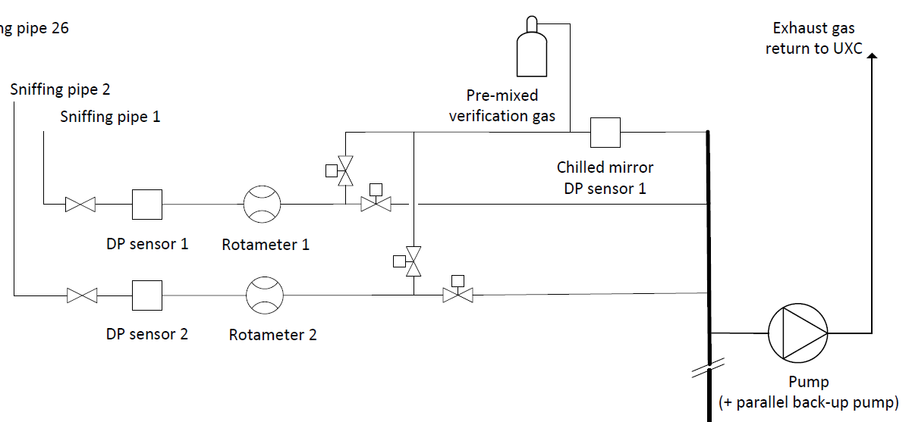
Humidity 2: CMS “sniffer” approach
Vaisala dew point sensors:
Vaisala DMT242A for the [-80, +20] C dewpoint range
Vaisala DMT242B for the [-60, +60] C dewpoint range
Chilled mirror:
Edgetech Dewmaster Chilled Mirror Hygrometer

Slide 12
Cabling space from DOCKs to E-hut
We will have to interconnect (distribution in DOCKs to be optimized!):
a) diamond sensors:
20 coaxial cables (FW) + 20 coaxial cables (BW)
b) NTC sensors:
minimum 4 (maximum 6) multi-conductor cables to individual twisted pairs
(symmetric FW-BW sharing?)
c) FOS fibers
38, all BW + 2? Humidity
Assuming pessimistically a pi/4 filling factor for packed cylindrical cables:
TOTAL (approximately equally shared FW/BW):
from a minimum 1734 mm^2 to a maximum of 1976 mm^2,
corresponding to less than half a 4000 mm^2 slot (one quarter FW, one quarter BW)
Sensors type | #Sensors | #cables | Cable ⌀ mm2 | FW/BW sharing | Total Section mm2
Diamond | 20 | 40 | 5.5 | = | 605+605
NTC | 64-96 | 4-6 | 11 | ~ | 482 to 726
FOS | 38+2(120) | 38+2 | All BW | All BW | 40
Total |  |  |  |  | 1734 to 1976

Slide 13
Conclusions + news since last B2GM
Radiation monitoring:
single crystal diamonds sensors
number of sensors, package for PXD
simulation, current measurements (in progress)
Temperature monitoring
NTC sensors
design of system for readout 96 NTC
location and fixing (in progress)
FOS Fibers
fixing of the fibers
location of the sensors (in progress)
Plan for humidity
Sniffing pipes plus chilled mirror hygrometer outside
FOS Fibers
Total service space for cables
+ Discussions in Slow Control meeting

Slide 14
Back-up

Slide 15
News, issues and details to be clarified
NTC sensors: total proposed number 24+32+6.
we already purchased 100 (1000€) Betatherm (Radhard certified by CMS). Are these really too bulky? 2.4mm ⌀
Final position and mounting on the 12 half-rings (24 sensors)
Final position and mounting on inlets and outlets of the CO₂ cooling pipes (32 sensors)
Reference for FOS cross-calibration: we propose 2 sensors per Layer (6 sensors)
FOS: total proposed number, 38 fibers, 158 sensors:
1 sensor per DSSD both for origami and BW DSSD (inside Airex channel), where exactly?
1 sensor close to the clamp (outside Airex channel), precise distance?
Note that test and calibration takes 1 day per 9 sensors in Santander!
Note that procurements takes >~2 months
+ Humidity with different coating. 2 per layer (?) + 2 outer cylinder (?)

Slide 16
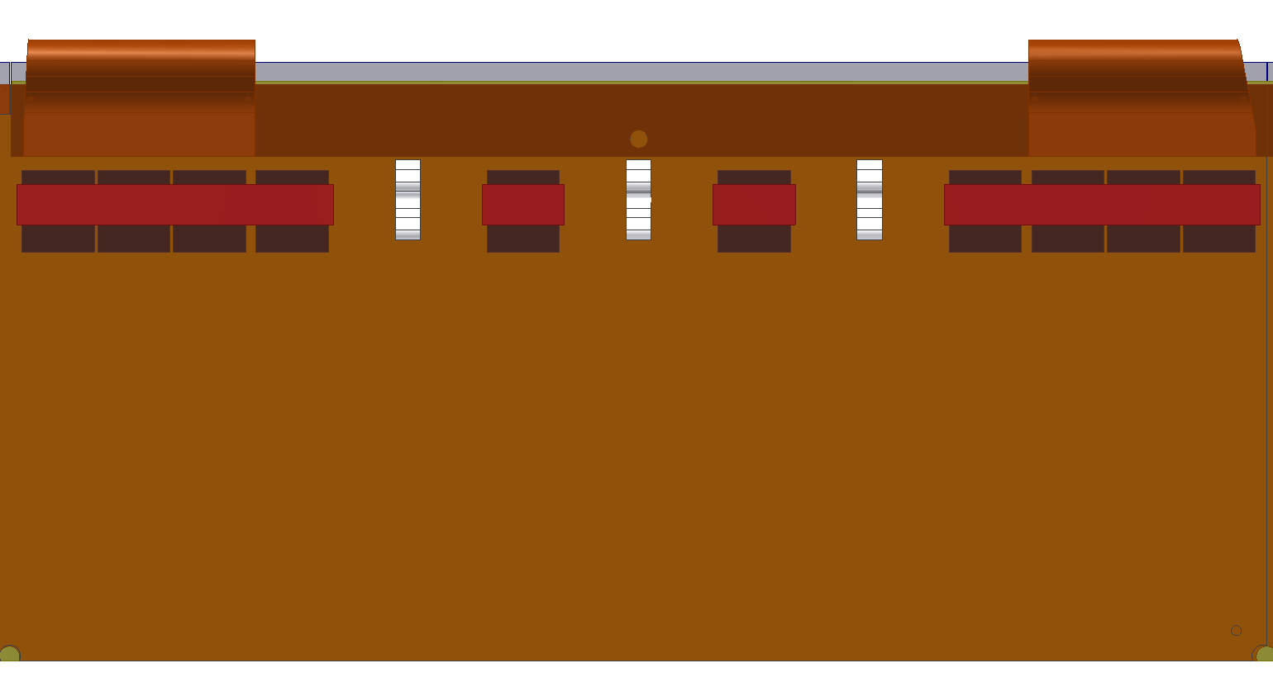
Location of Temperature Sensors on the fibers
Sensor dimension 10mm
Coating: acrylate (almost insensitive to humidity)
Unbuffered (just 250 um ⌀) from clamp to all airex channel
Buffered (~900 um ⌀) from clamp to DOCKs with SC/PC connector?
Airex channel
500 um ⌀
Yellow: buffer tube
Orange: coating
Blue: core

Slide 17
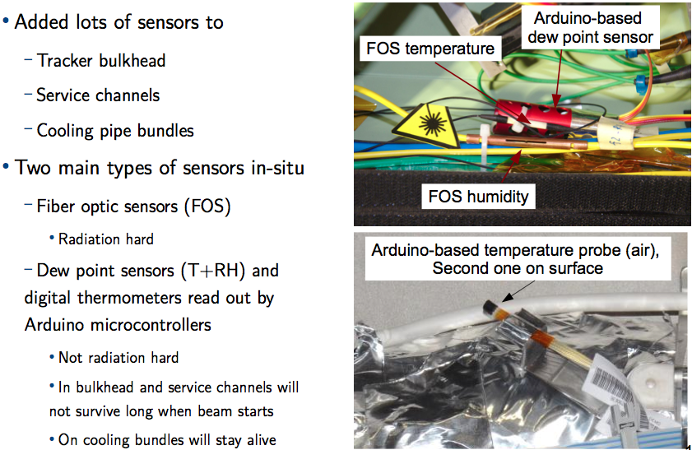
Humidity: CMS approach (reinforced after condensation problems)

Slide 18
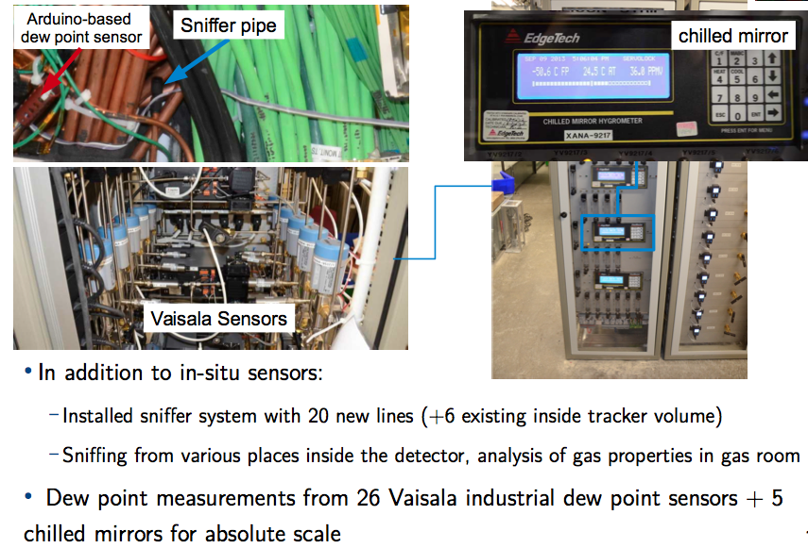
CMS approach (reinforced after condensation problems)

Slide 19
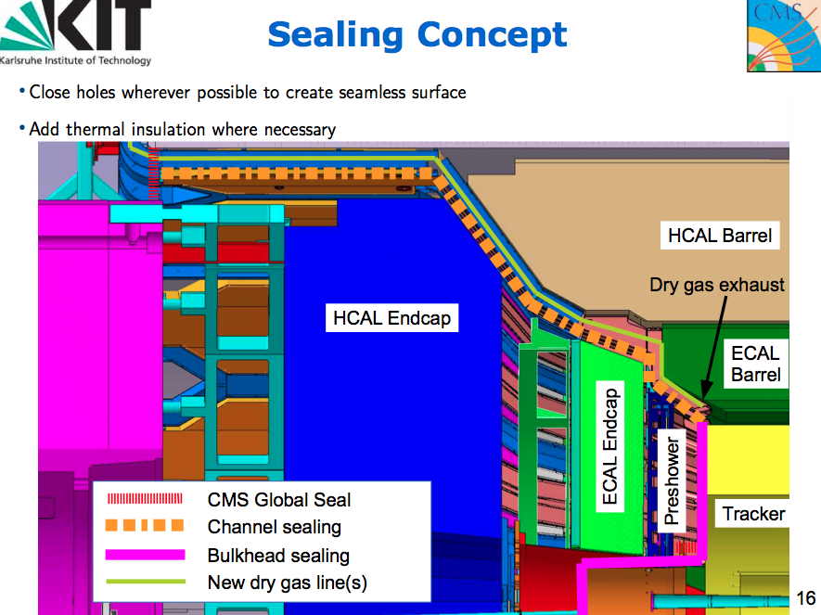
CMS approach (reinforced after condensation problems)

Slide 20
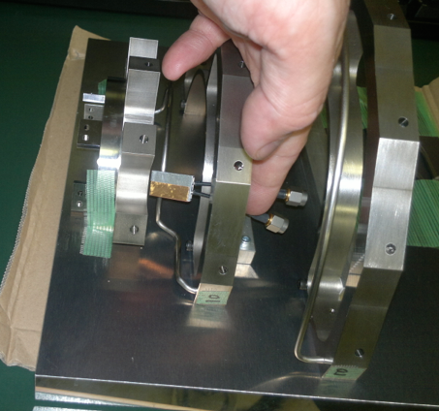
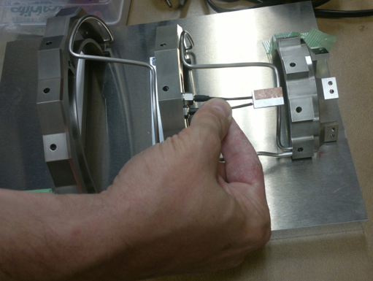
Sensor location test at Gemba
For SVD the package seems already ok (on support cones of L3).
Also first 3m of small (⌀1.6mm) coax cables to DOCKS ok.
Only issue is the path to HUT (under discussion) for standard coax.
For PXD more issues:
this package may be too long (needs to rework it or new one)
The first 3m of coax need grooves along the heavy metal

Slide 21
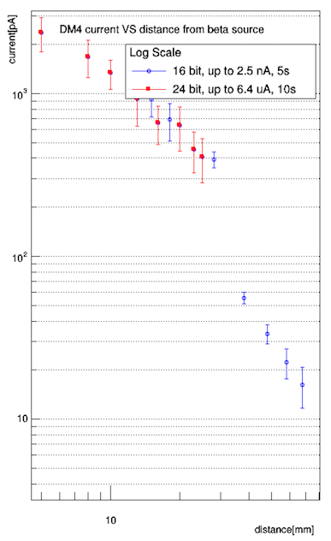
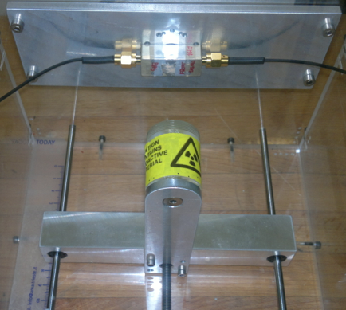
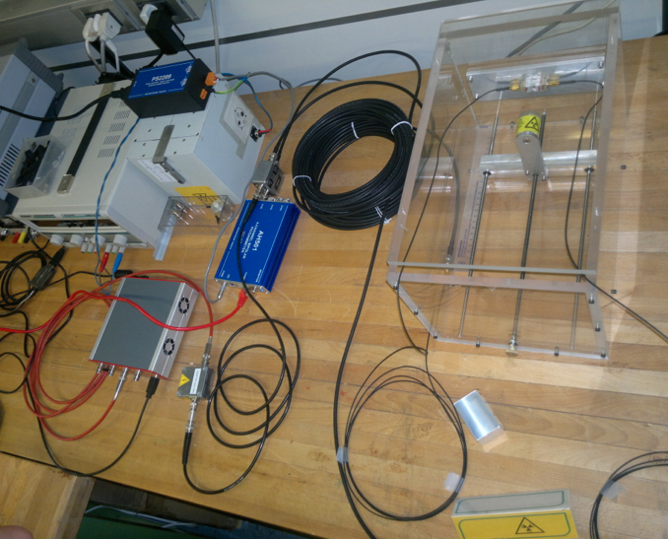
First dosimetry tests with AH501 and ⁹⁰Sr beta source
Point-like ⁹⁰Sr beta source (~2MBq) on a movable stage in front of diamond sensor.
Full setup with AH501 and 3+15m.
Measured current from pA to nA.

Slide 22
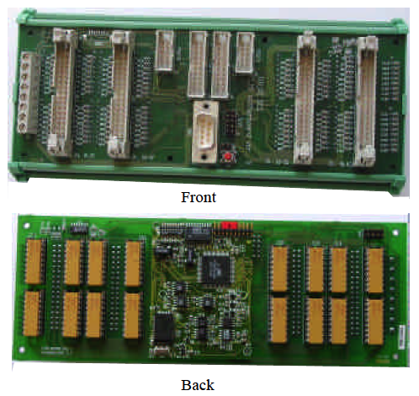
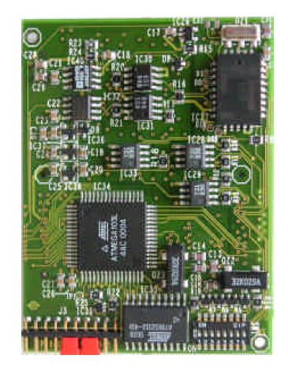
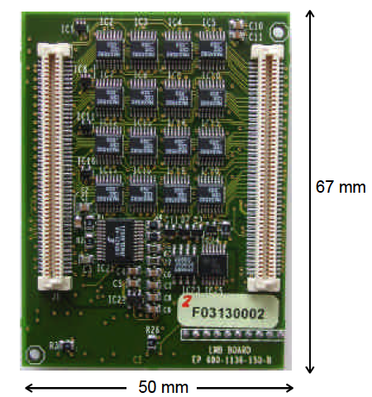
NTC temperature sensors
At least 28 x 2 = 56 NTC thermistors
12 sensor pairs attached to the 12 half-rings supporting the SVD ladders
16 sensor pairs on the inlets and outlets of the CO₂ cooling pipes
A few positioned near fibers for cross-calibration
We adopted rad-hard sensors and readout, largely used by LHC experiments
One ELMB board + 2 Betatherm NTC thermistors: borrowed from CMS
2 motherboards and 10 adapter mini-cards procured (public CERN design)
Read-out via CAN bus interface, implemented
Now purchasing 100 Betatherm thermistors

Slide 23
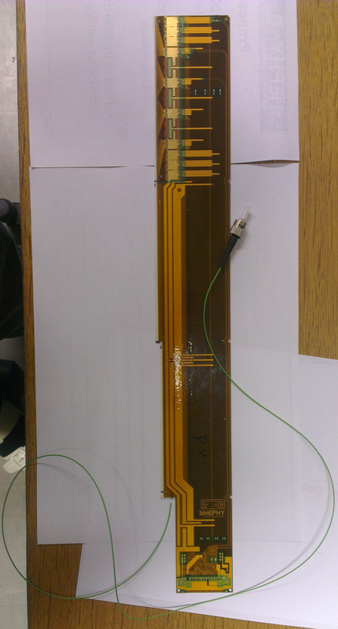
Feasibility test in Vienna
Christian successfully made a mechanical test of this solution in April
a prototype “sandwich” consisting of an Airex sheet with an impressed groove (⌀ ~500µm) and an Origami CE flex;
a commercial optical fiber from which they removed the cover (coating). Section of uncovered fiber ~200µm
A groove impressed on all Airex sheets.
Now a functional test is also needed!
The plan: feed in the fibers after the ladder mount on the end rings.

Slide 24
Cabling space from DOCKs to to E-hut
Numbers for calculatiion of required Cross Sections:
diamond sensors: initially based on (4+8)+(4+8) sensors in total, two coaxial cables per sensor, 24 coaxial cables (FW) + 24 coaxial cables (BW), 5.5 mm diameter each (June written request by Lorenzo)
reduced (after July 21st discussion) to (4+6)+(4+6) sensors:
20 coaxial cables (FW) + 20 coaxial cables (BW), 5.5 mm diameter each
b) NTC sensors: minimum request based on 64 NTC thermistors in total (*)
(= 12x2 NTC on half rings + 16x2 NTC on CO2 inlets and outlets + 8 cross-reference on FOS fibers) from DOCK to E-hut: 4 = (2+2) (**) screened multi-conductor twisted pairs, 11 mm diameter each
(*) The system with 96 channels allows for one full spare ELMB (32 channels) always available
or additional NTC sensors requests (thermal screen, beam pipe, ...) that however would imply to increase the number of cables from 4 to a maximum of 6 in total
(**) The exact location of sensors has to be decided,
as a consequence the FW-BW sharing may not be symmetric
c) FOS fibers
38 fibers (10(L4)+12(L5)+16(L6)), about 1mm diameter each, all BW; (bundled together?)

Slide 25
Approximate schedule
Radiation | 2014 |  |  |  | 2015 |  |  |  | 2016
What | 1 | 2 | 3 | 4 | 1 | 2 | 3 | 4 | 1 | 2
Specifications, sign up
Simulations
Dosimetry, characterization
Diamond sensors choice
Mechanics & cabling design
Electronics specifications
Electronics design & proto.
Overall design, sign up
Components, procurement
"final" prototypes (4 ch.)
BEAST, 1 preliminary tests
BEAST, 2 complete test (4 ch)
electronics production & test
sensors installation & cabling
electronics installation
Temperature & humidity | 2014 |  |  |  | 2015 |  |  |  | 2016
What | 1 | 2 | 3 | 4 | 1 | 2 | 3 | 4 | 1 | 2
T&H Specifications, sign up
Fibers, mechanical layout
Fibers, assembly tests (SVD)
Fibers, multiplexing scheme
Fibers design sign up
Procurement, assembly
installation (PXD & SVD)
Thermistors, lab tests
Mechanics & cabling design
Procurement
assembly, installation

