Slide 1


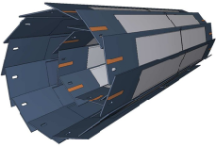
DCD Testing on Hybrid 4.1

Slide 2
Ideal transfer function of 3-bit ADC

Slide 3
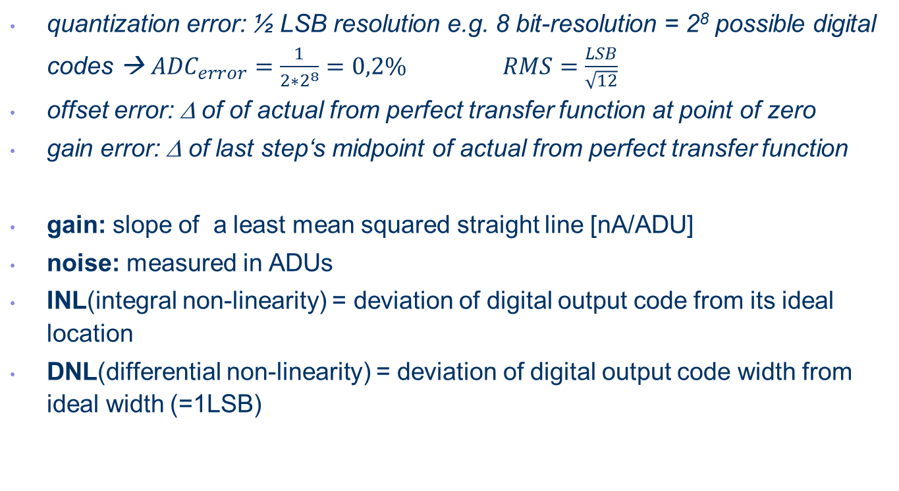
Static ADC Parameters
quantization error: ½ LSB resolution e.g. 8 bit-resolution = 2⁸ possible digital codes → ${ADC}_{error}=\frac{1}{2∗2^{8}}=0,2\%$ $RMS=\frac{LSB}{\sqrt{12}}$
offset error: Δ of of actual from perfect transfer function at point of zero
gain error: Δ of last step‘s midpoint of actual from perfect transfer function
gain: slope of a least mean squared straight line [nA/ADU]
noise: measured in ADUs
INL(integral non-linearity) = deviation of digital output code from its ideal location
DNL(differential non-linearity) = deviation of digital output code width from ideal width (=1LSB)

Slide 4
DNL – differential non-linearity: Precision

Slide 5
DNL – missing code

Slide 6
DNL - monotonicity

Slide 7
INL – integral non-linearity: Curvature

Slide 8
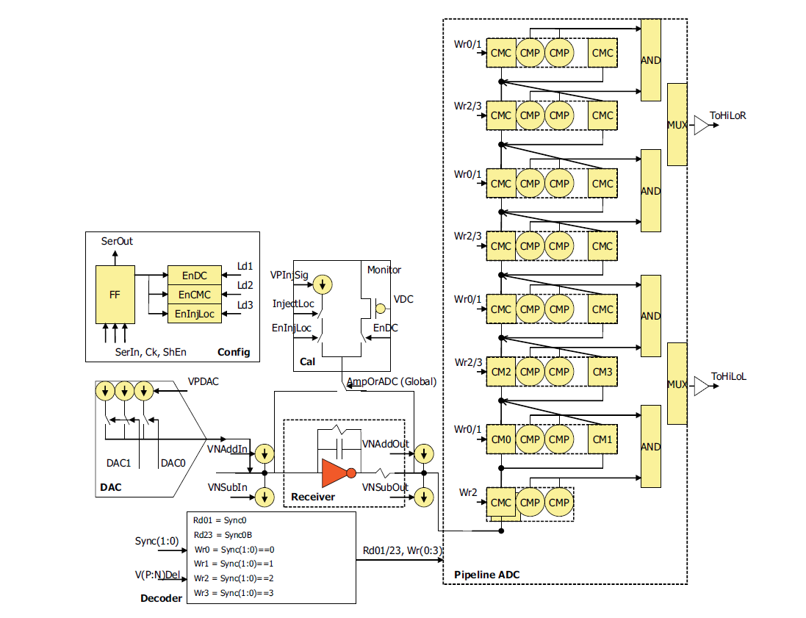
Basic circuit of DCD pipeline analog channel
cascading of 8 converters
buffering input signal (sample&hold)
quantization of differential signals
residue will be gained up and fed into next stage

Slide 9
Testing DCD pipeline – proceeding steps
Setting up target system Scientific Linux 6.0
GPIB connection with external SMU in order to calibrate internal source
Adapting program code
Fine tuning of DCD pipeline-settings
All 8 columns (=256 drain channels) tested („WB_DCD_DCDRO Matrix v1.2“ with copper and aluminium layers)
Results:
      low noise: 1 channel out of 256 σ>1 ADU
      20% of drain lines with high INL/DNL: „ADU +64 bug“ due to large transistor mismatch (ref. to I. Peric “DCDB4_Mismatch” paper March 2014) – can be mitigated by reducing RefIn and increasing IFBPBias at cost of higher noise

Slide 10
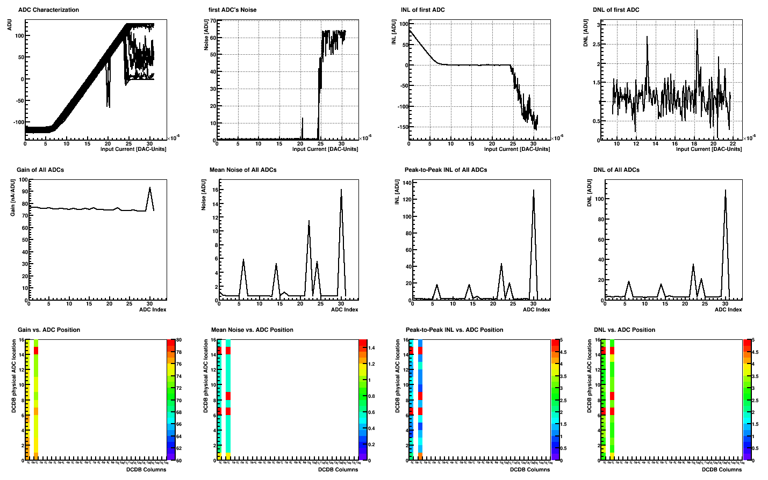
Starting point column 2 internal source

Slide 11
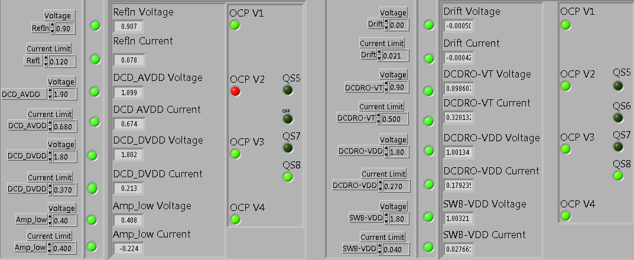
Hybrid 4 power supply settings
All measurements done at 320 MHz

Slide 12
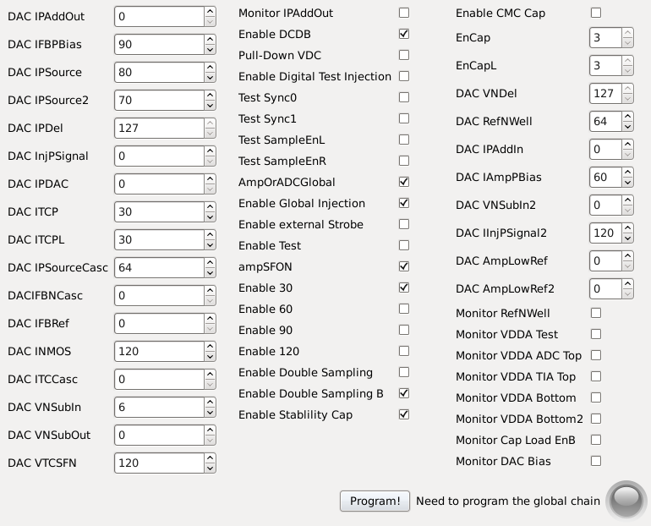
Hybrid 4 DAQ settings

Slide 13
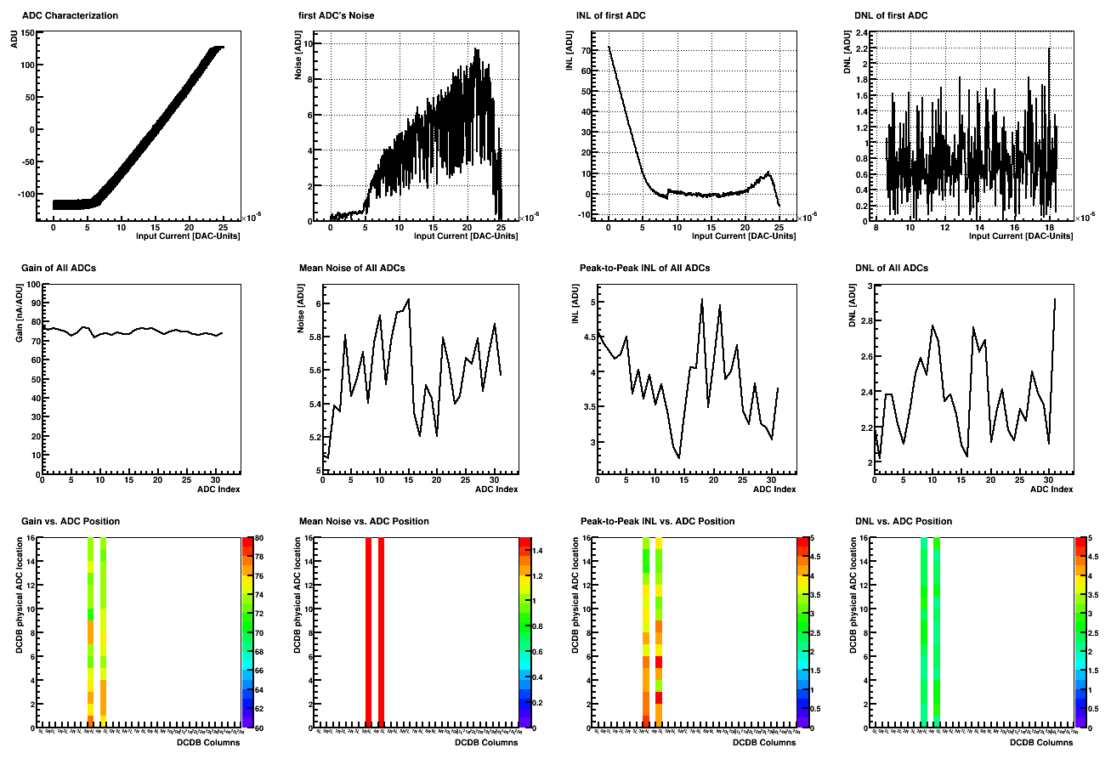
DCD external supply (SMU) column 2

Slide 14

Filter
100kΩ
100nF

Slide 15
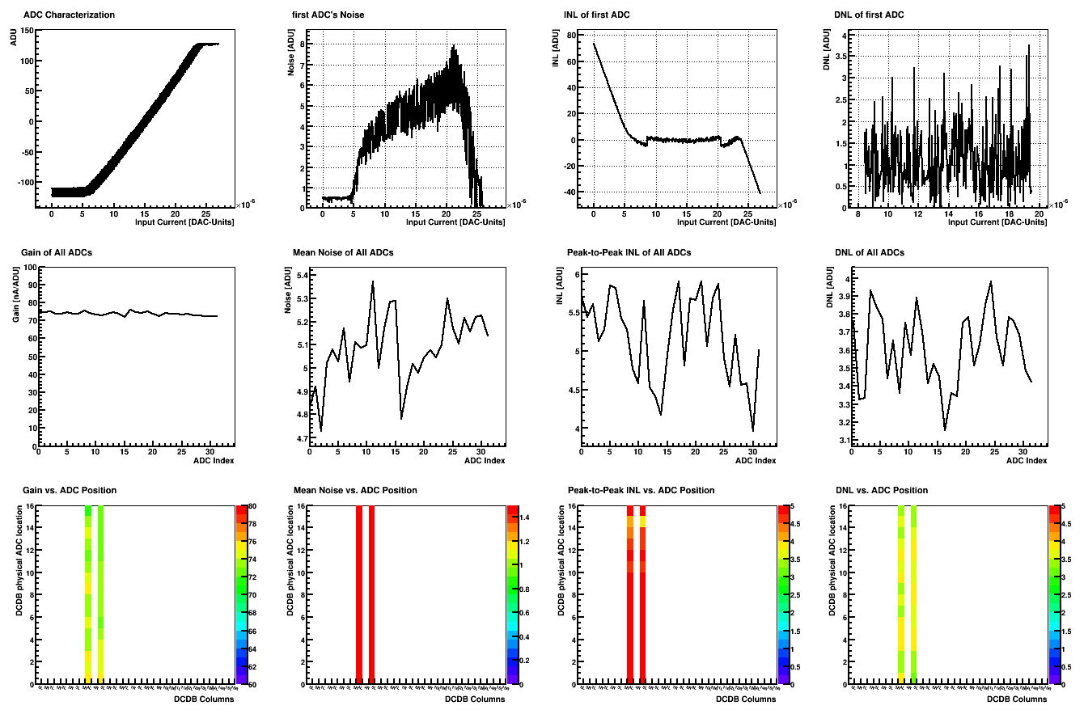
DCD external supply (SMU with filter) column 2

Slide 16
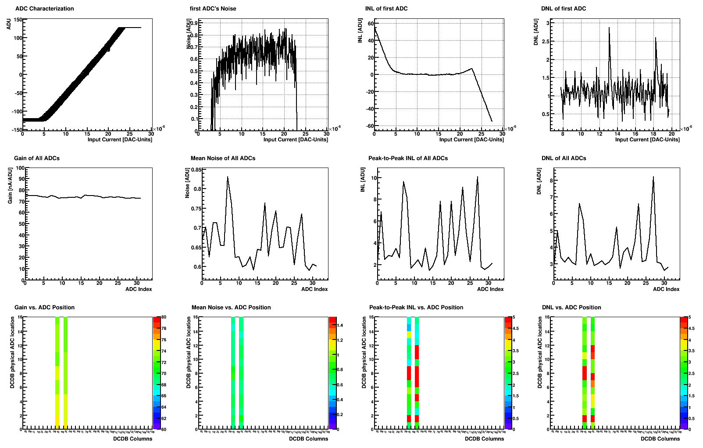
DCD internal source calibrated column 2

Slide 17
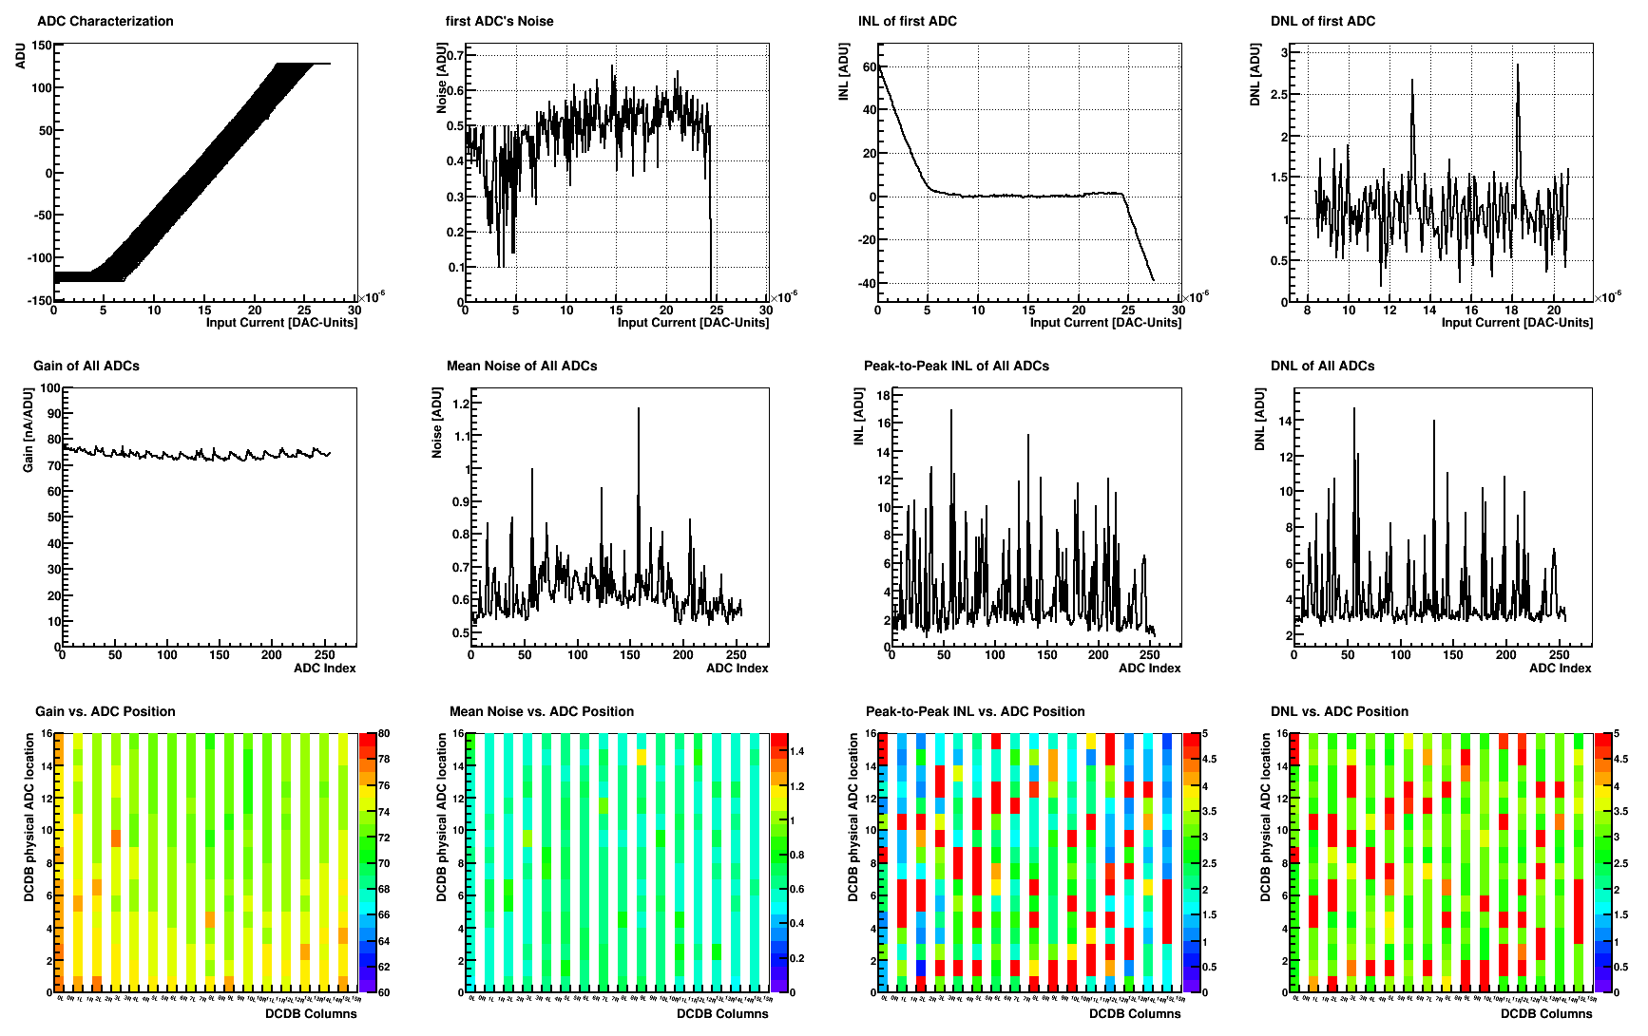
DCD – all channels

Slide 18
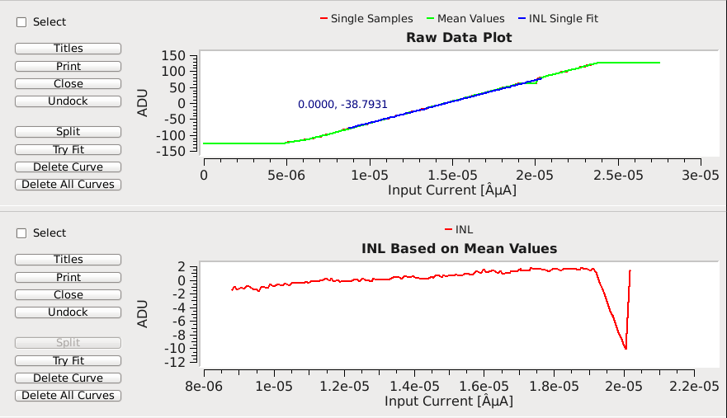
INL column1 pixel 28

Slide 19
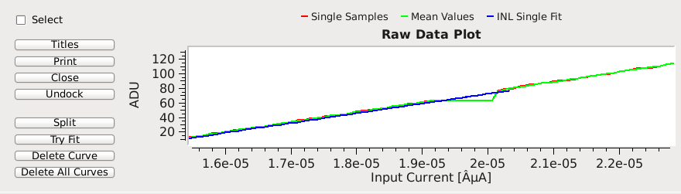
column 1 pixel 28 zooming in
missing code at ADU +64

Slide 20
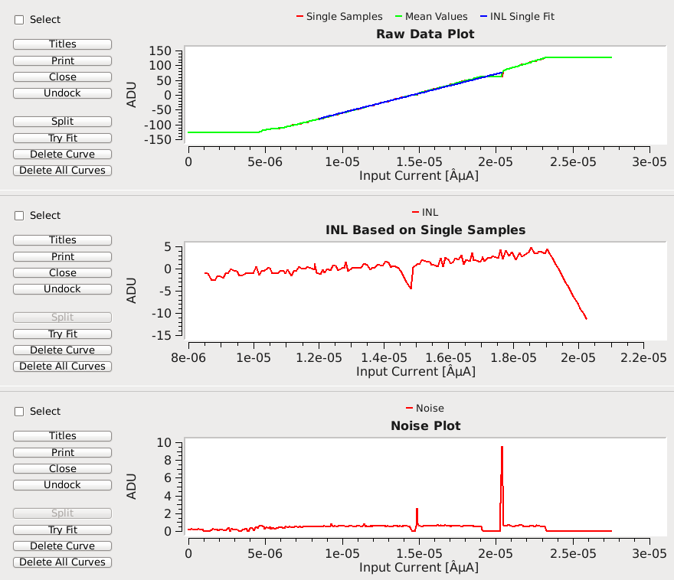
INL & noise column 4 pixel 4
high INL of
ADU+64 also
affecting noise
adversely

Slide 21
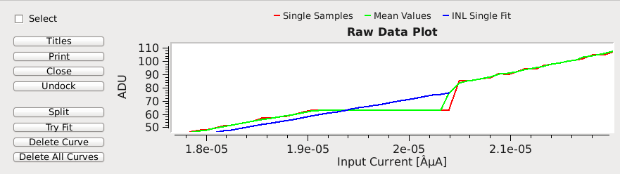
column 4 pixel 4 zooming in

Slide 22

Reason: bad calibration results?

Slide 23
Thank you
for
your attention!

Slide 24
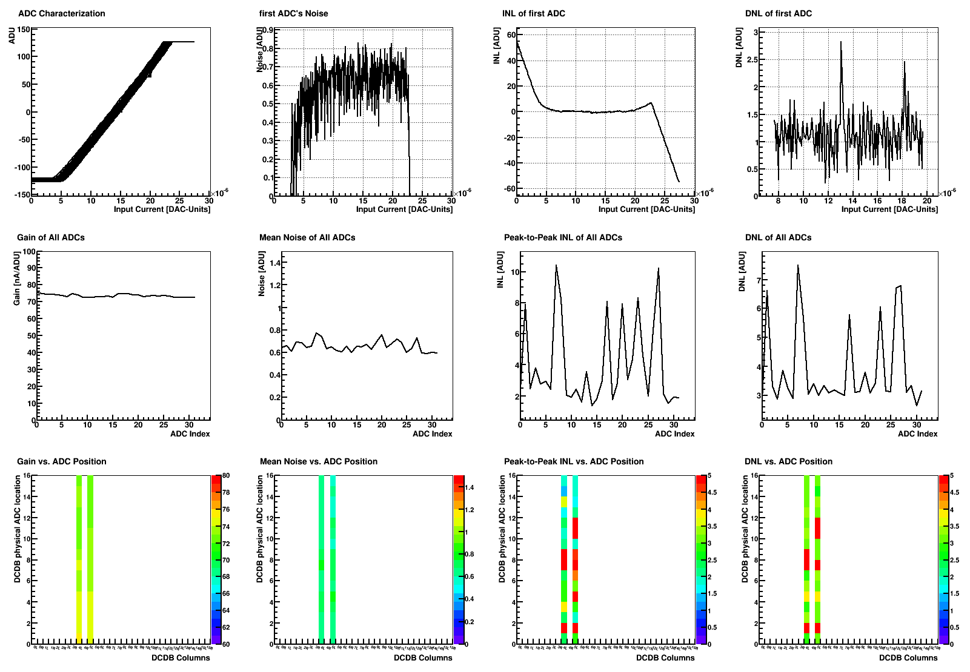
Col2 – IFBPBias+90

Slide 25
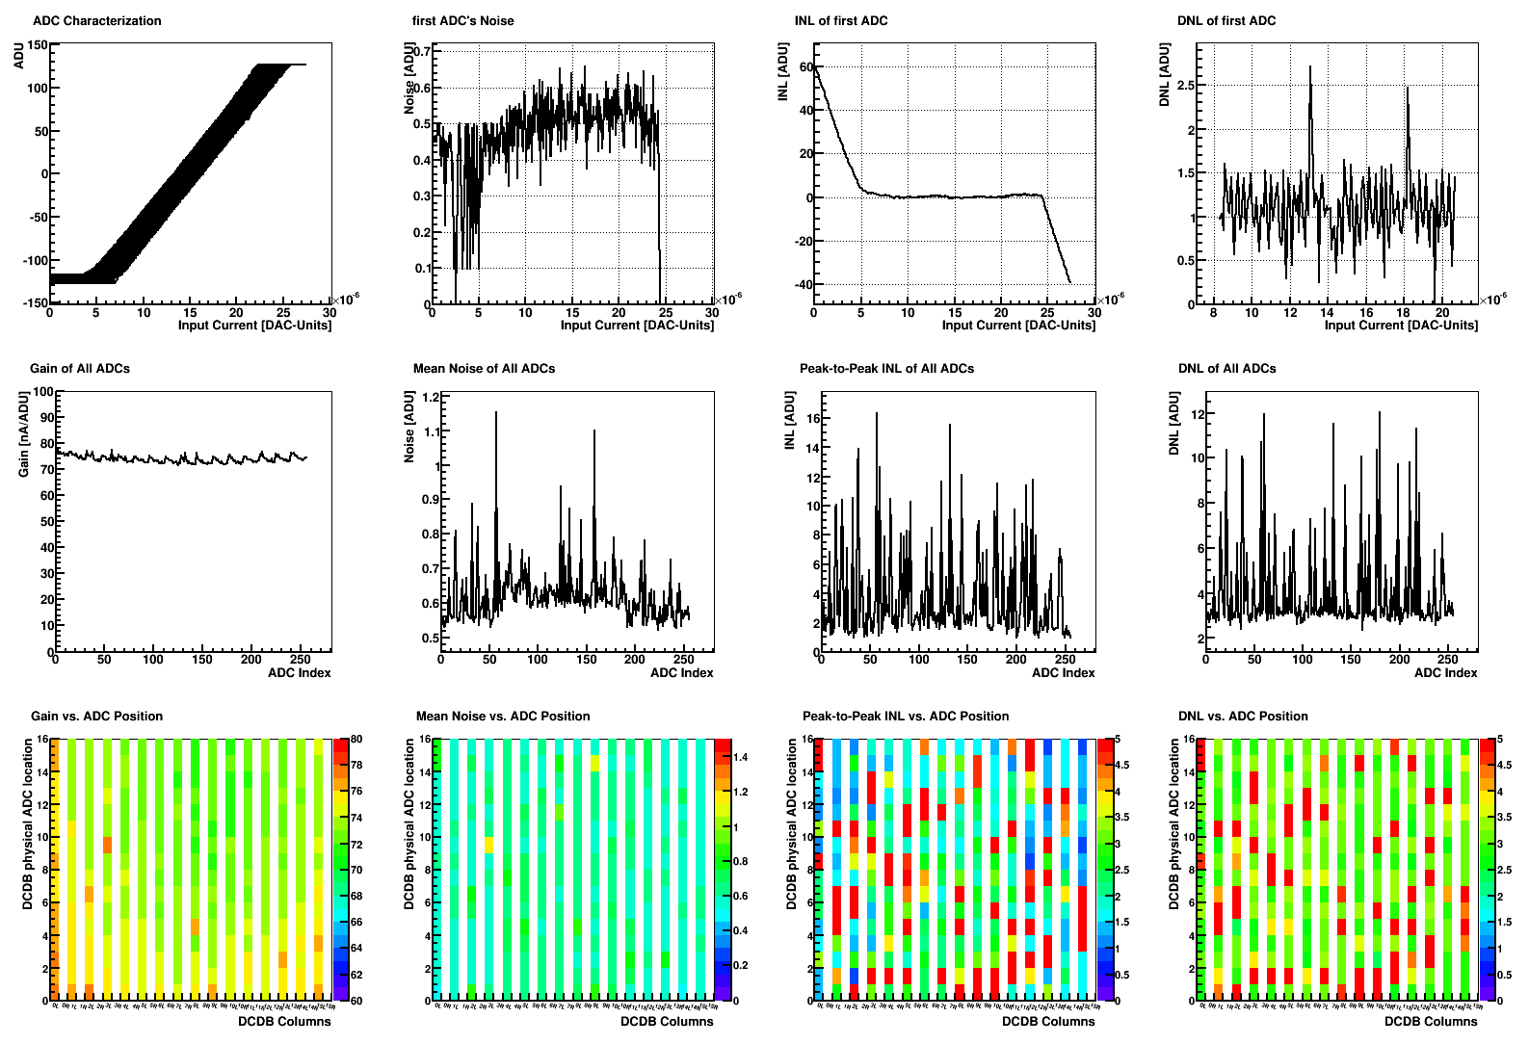
All Channels with IFBPBias+90

Slide 26
INL/DNL example

