Slide 1
Interlock L.Lanceri /INFN Trieste VXD Workshop, Pisa 03/10/2014
Who interlocks whom, when ?
Belle II global, (PXD + SVD) = VXD local
[“Software interlocks” ➔ Slow Control, EPICS ]
Hardware interlock: implementation ?

Slide 2
1. Who interlocks whom, when?
?
?
?

Slide 3
Who ?
Tentative list of (hardware) interlock sources for VXD
VXD/Belle II beam abort
SuperKEKB beam abort (injection?)
VXD Temperature: NTC thermistors
VXD Humidity: sniffers + Vaisala sensors
VXD CO₂ cooling plant
Earthquake sensors ?
Fire detectors in the experimental hall ?
… more? Alarms/signals from nearby subdetectors, SuperKEKB, …?
Software interlocks: EPICS
Full conditions information available, programming flexibility
Not considered here, it is a separate issue
A complete list of interlock sources is needed

Slide 4
Example: NTCs ELMB readout & interlock
detector
docks
Box in Electronics Hut
shielded
Twisted
pairs (16)
to main
interlock
HW Interlock
(shield
grounded
at docks)
ELMB
≈ 3÷4 m
16 twisted
pairs
(no shield)
ELMB
CANbus
current
sources
ELMB
up to
6 x 16 = 96
NTC sensors
PC
Power supply
EPICS
Slow Control

Slide 5
Whom ?
Tentative list of (hardware) interlock recipients in VXD
PXD power supplies: global or by subsections ?
SVD power supplies: global or by subsections ?
… more?
Other recipients of VXD-generated interlocks
Global Belle II interlock system ?
Neighbor subdetectors ?
… others?
A complete list of interlock recipients is needed

Slide 6
When ?
In principle, simple logical OR of different sources
VXD/Belle II beam abort
SuperKEKB beam abort (+ injection?)
VXD Temperature: NTC thermistors, if temperature above threshold
VXD Humidity: sniffers + Vaisala sensors, if Dew Point > -30ºC
VXD CO₂ cooling plant, shut down or failure, CO₂ leaks etc.
… etc
To be implemented in “permit” mode
defective connections or missing conditions generate an interlock
More refined interlock conditions and outputs ?
Ramp down only parts of the PXD or SVD ?
Flexibility/programmability, implementation issues, see below

Slide 7
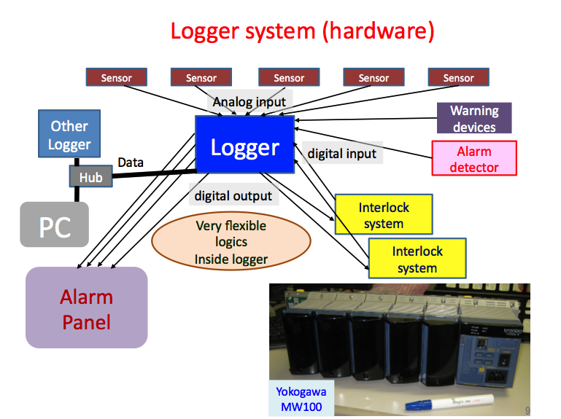
2. Belle II global interlocks and VXD…
Nakayama-san is coordinating the overall Belle II Monitoring and Interlocks
see 16th B2GM report (mainly monitoring discussed up to now)

Slide 8
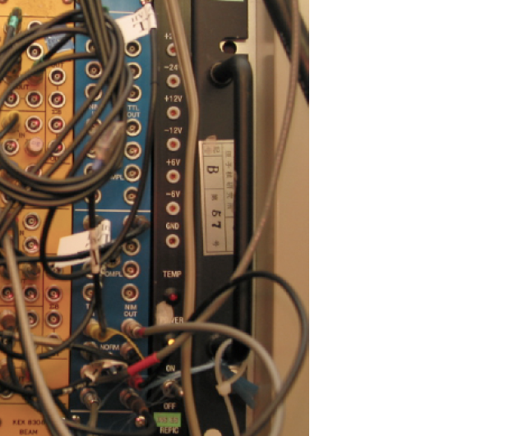
3. VXD Hardware interlock: implementation ?
?
?

Slide 9
VXD Interlock Implementation ?
Requirements, in order of priority:
Reliability, availability of spares, uniformity across Belle II/SuperKEKB
Independence from network & software
Some flexibility/programmability
partial interlocks ?
evolving interlock conditions and requirements ?
Possible implementations, in order of complexity:
Hardwired OR of inputs (standardized across Belle II ?)
Examples: SIAM modules in BaBar, Beam Abort units in SuperKEKB
More complex decision logics (i.e. FPGA-based), custom made or commercial (standardized across Belle II ??)
Industry-standard, commercial Programmable Logic Controllers (PLC)
For instance Siemens PLCs, adopted by some experiments

Slide 10
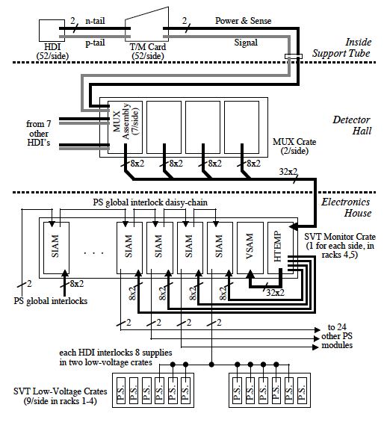
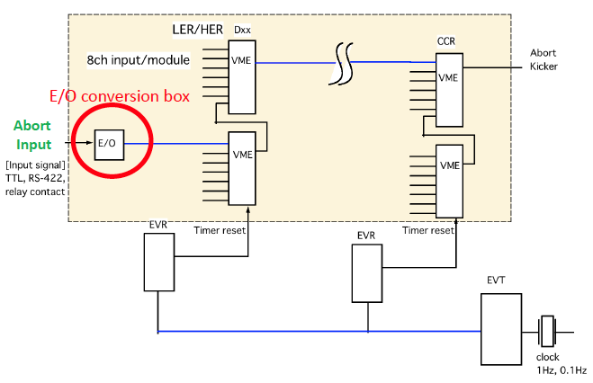
“Low end” implementation examples
BaBar/PEP-II “SIAM” modules
SuperKEKB abort modules
In both cases, essentially
hardwired ORs of inputs

Slide 11
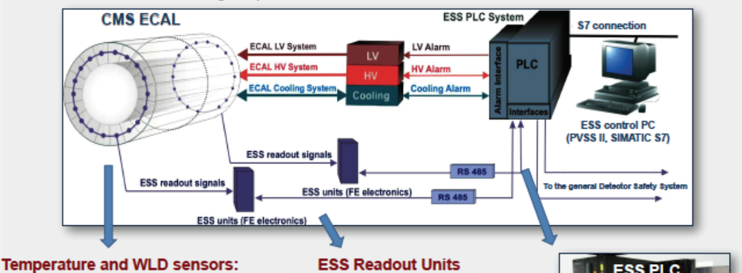
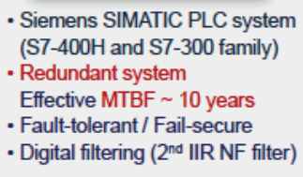
“high end” implementation example
Siemens PLC (Programmable Logic Controller)
in a subdetector at LHC
PLCs (or similar approaches) an overkill?
It depends on the global Belle II decisions

Slide 12
Conclusions, To Do
Who? a complete list of interlock sources is needed
VXD Temperature, humidity, leaks, …; Belle II, SuperKEKB
Whom? a complete list of interlock recipients is needed
PXD, SVD power supplies, (granularity), …; Belle II, SuperKEKB
When? interlocking conditions need to be defined
(thresholds, combined conditions, etc.)
Implementation
Reliability; some flexibility (masks etc.); uniformity across Belle II !

