Slide 1
Online-Cluster-Analysis on FPGAs for recovery of slow pions
Steffen Bähr

Slide 2
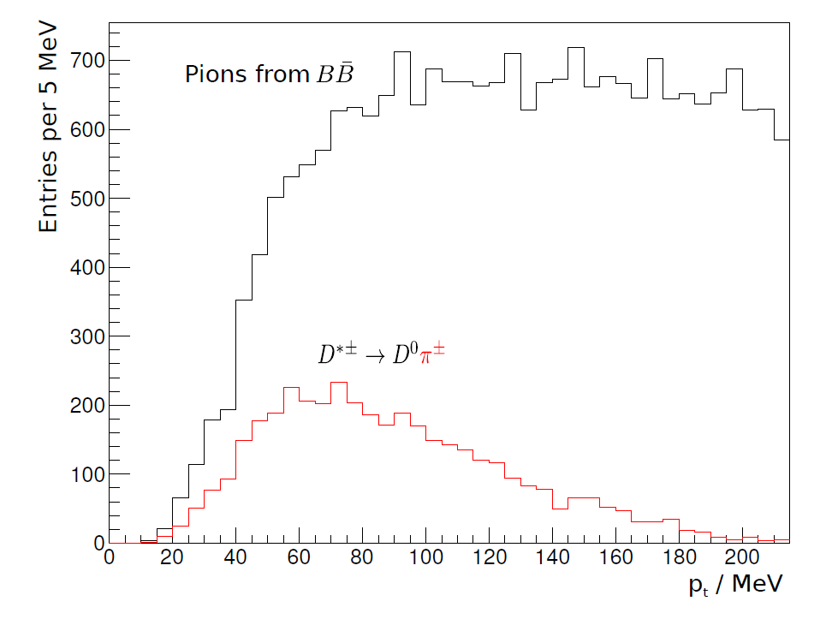
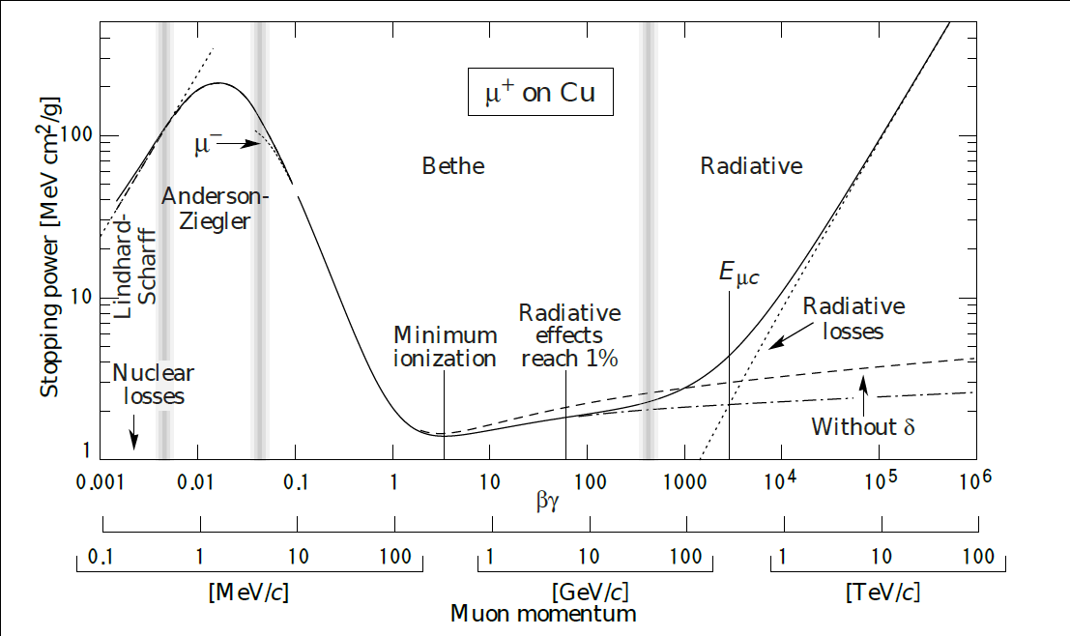
D* Decay in VXD
Particles with low impuls experience high stopping power
D* decays produce pions with low transversal momentum
Below 60 MeV majority of the pions attributed to to this decay

Slide 3
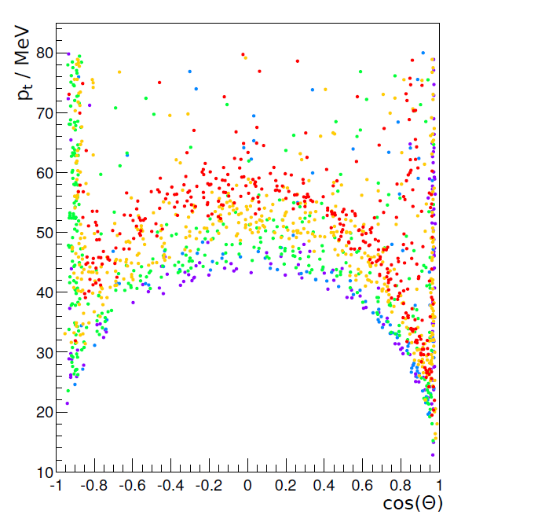
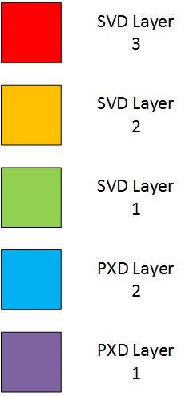
Momentum Distribution of Slow Pions
P_{t} < 60 MeV may already be insufficient to reach all SVD Layers
PXD Hits of slow pions will get lost since no RoI is built
Recovery mechanism necessary

Slide 4
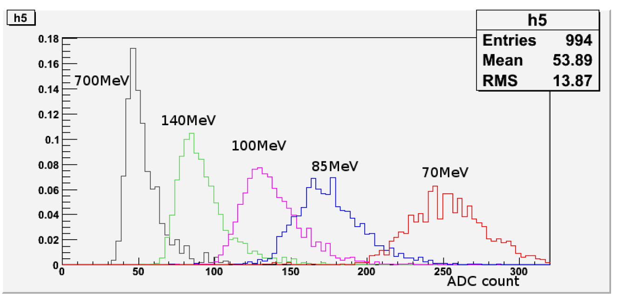
Charge of slow Pions with PXD
Use charge deposit in PXD for different momenta tracks to separate pi from mip
Charge deposit for different momentum

Slide 5
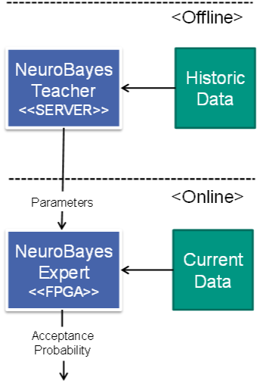
Algorithm for Recovery of slow pions
Usage of the NeuroBayes Algorithm to predict Slow Pions by using cluster features
Training
Usage of Simulated Clusters
Conducted Offline
Prediction
Usage of Detector Data

Slide 6
Cluster Data used for Recovery
Charge deposition of Clusters can be supplemented by additional Information
Additional information about the charge in a cluster
Spreading of clusters in the PXD
Features have different impacts on the result
Cluster Feature | Importance
Total Charge | 1st
Standard Deviation | 8th
Maximum Pixel Charge | 5th
Minimum Pixel Charge | 3rd
Length in Z | 4th
Length in Phi | 6th
Total Length | 2nd
Number of Pixels | 9th
PXD Layer | 7th

Slide 7
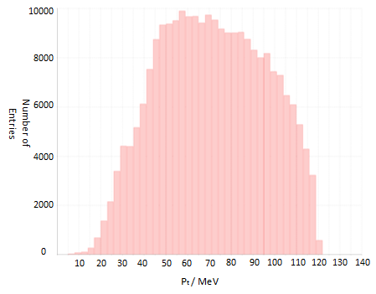
Sample used for NeuroBayes Training
The Pion Sample covers the transversal impuls of pions not reaching the outer Layers
Background includes QED, Touschek and Coulomb

Slide 8
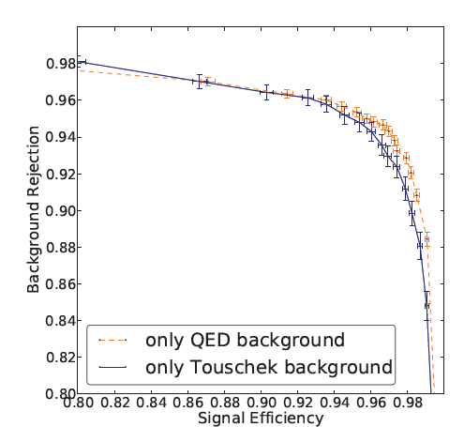
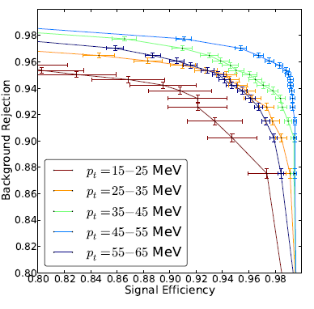
NeuroBayes Performance
NeuroBayes achieves good Signal Efficiency and Background Rejection Ratios for pions with P_{t} < 65 MeV

Slide 9
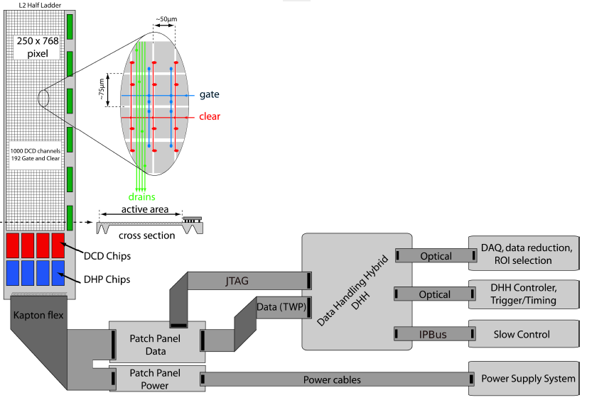
Using the NeuroBayes at the PXD
Algortihm needs to handle the data rates
Usage of FPGAs with guaranteed Throughput
Needs to be placed close to the readout of PXD
FPGAs of DHH has free resources

Slide 10
Challenges for the Implementation on FPGA
Performance
Interface is clocked with 200 MHz
1 Cluster / Clock Cycle has to be able to be achieved
Resources
30 % of the CLBs available
50 % of the DSPs available
Quality
Output of FPGA Implementation cannot differ to much from Software

Slide 11
Cluster Processing Pipeline
Incoming Clusters are passing through a processing pipeline
Protocol Handling for the Interface to the DHH‘s Clustering
Computation of Cluster Features for the NeuroBayes
NeuroBayes Expert makes the decision and passes it to the output interface

Slide 12
Overview of NeuroBayes on FPGA
The NeuroBayes Expert consists of 4 major components
Binning of the Cluster Features
Preprocessing by using CDF
Zero-Iteration done by vector multiplication
Cut on the Ouput

Slide 13
Conversion to Fixpoint
Original NeuroBayes Algorithm uses Floating Point
Usage on FPGA requires more ressources and impacts latencies
Transformation to fixpoint is more efficient, but impacts the quality
Quality of a Fixpoint implementation‘s Output depends on the used bitwidth
Higher Bitwidth equals higher consumption of Ressources, while increasing Quality
DSPs have 25*18 Bit Inputs

Slide 14
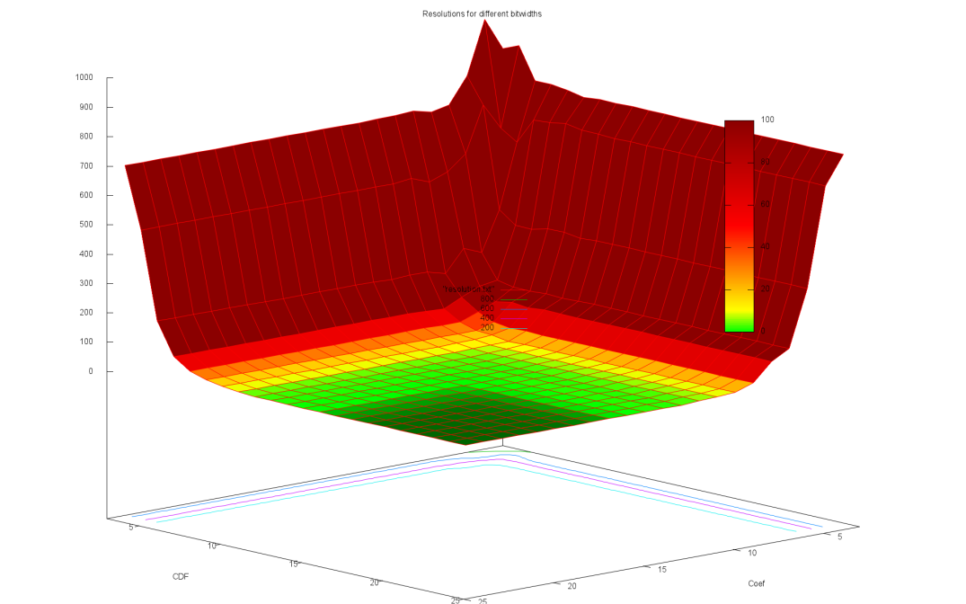
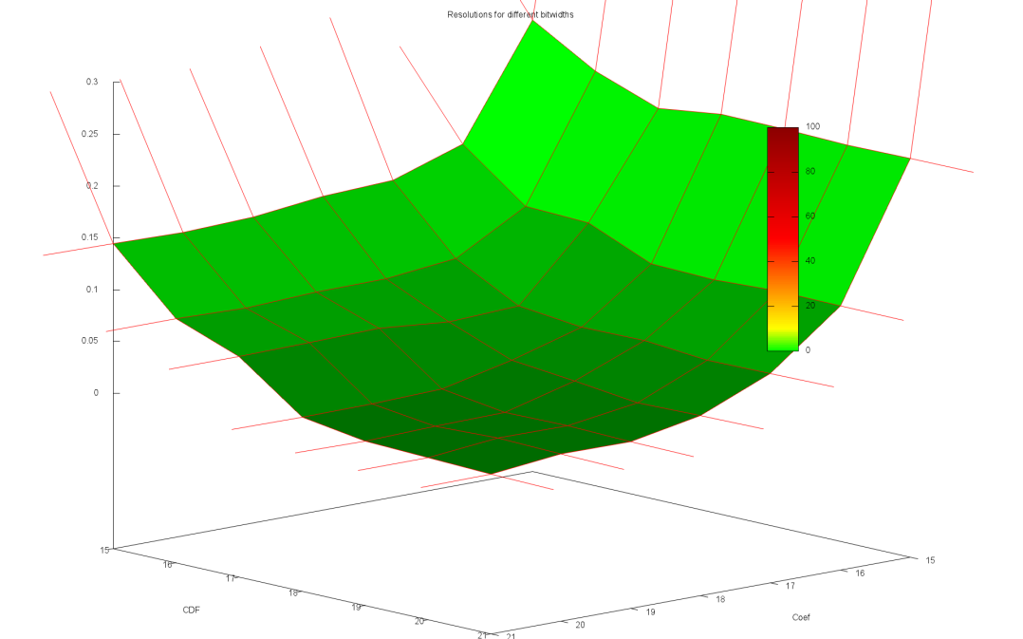
Evaluation of Fixpoint Implementation
Usage of 25*25 Bitwidth results in no difference of output to floating point implemenation
Difference is small for 25*18
Most resource efficient configuration for multiplication
Difference is at 1.5 * 10^-5

Slide 15
Evaluation of Performance
Computation of the Algorithm takes several clock cycles
Performance requirements cannot be met
Usage of Pipelining throughout the implemenation
Fixpoint Vector Multiplication is the critical path
High Frequency through usage of cascading DSPs
Component | Latency | Frequency
Cluster Feature | 1 cycle | 446 MHz
Preprocessing & Binning | 1 cycle | 446 MHz
Vector multiplication | 9 cycles | 350 MHz
Cut | 1 cycle | 446 MHz
Total | 12 cycles | 350 MHz

Slide 16
Ressource Consumption
Critical Path for CLBs in the implemenation is the Binning and Preprocessing
Mostly Usage of Look Up Tables
Usage of DSPs for vector multiplication makes life easier
50 % of DSPs are still available
Each multiplication needs one DSP
Ressource | Demand | Constraint
DSP | 3,125 % | < 50 %
CLB | ~ 2 % | < 30 %

Slide 17
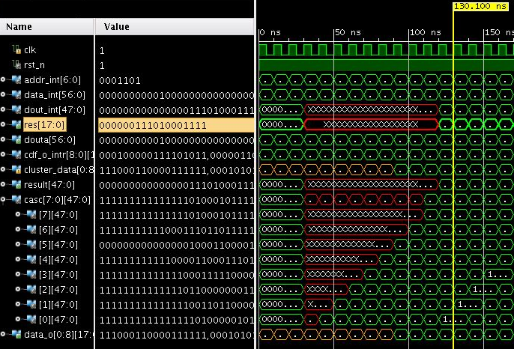
Simulation
Cluster Feature | Value
Total Charge | 425
Standard Deviation | 49
Maximum Pixel Charge | 135
Minimum Pixel Charge | 23
Length in Z | 2
Length in Phi | 2
Total Length | 1
Number of Pixels | 4
PXD Layer | 2
Result of Software is:
0000001110100011110010001 -> slow Pion Cluster
(S)DDD,DDDDDDDDDDDDDD

Slide 18
Summary
Recover slow Pions using FPGAs near PXD
FPGA-Implementation is sufficient
Quality : Difference < 1.5 * 10 ^ -5
Throughput : 350 Mio Cluster per secons
Resources : ~ 2 % CLBs , ~3 % DSPs
Integration into DHH

Slide 19
Demo

